Slide 1


Exploring the Electromagnetic Spectrum and Visible Light
Fundamental Concepts, Properties, and Applications Across Science and Technology

Slide 2
Exploring the Electromagnetic Spectrum and Visible Light
2
Table of Contents
Introduction to the Electromagnetic Spectrum
What is Visible Light?
Properties of Electromagnetic Waves
Types of Electromagnetic Radiation
Applications of Visible Light
Reflection and Refraction
Diffraction and Interference
Optical Instruments
Lasers and Photonics
Biological Effects of Visible Light
Environmental Effects of Visible Light
Conclusion
Summary
04
05
06
07
08
09
10
11
12
13
14
15
16

Slide 3
Exploring the Electromagnetic Spectrum and Visible Light
3
Table of Contents
Key Takeaways
Reflection Questions
Next Steps
Additional Resources
Conclusion and Final Thoughts
17
18
19
20
21

Slide 4

Exploring the Electromagnetic Spectrum and Visible Light
4
Introduction to the Electromagnetic Spectrum
Overview of the Electromagnetic Spectrum
Applications Across Disciplines
Significance of the Spectrum
The electromagnetic spectrum is the range of all possible frequencies of electromagnetic radiation.
It includes radio waves, microwaves, infrared, visible light, ultraviolet, X-rays, and gamma rays.
Understanding the electromagnetic spectrum is essential for various fields, including physics, astronomy, and engineering.
It provides insights into phenomena and technologies that shape our understanding of the universe.
The electromagnetic spectrum serves as a foundation for numerous scientific and technological advancements.
Its study enables breakthroughs in communication, medical imaging, and space exploration.

Slide 5
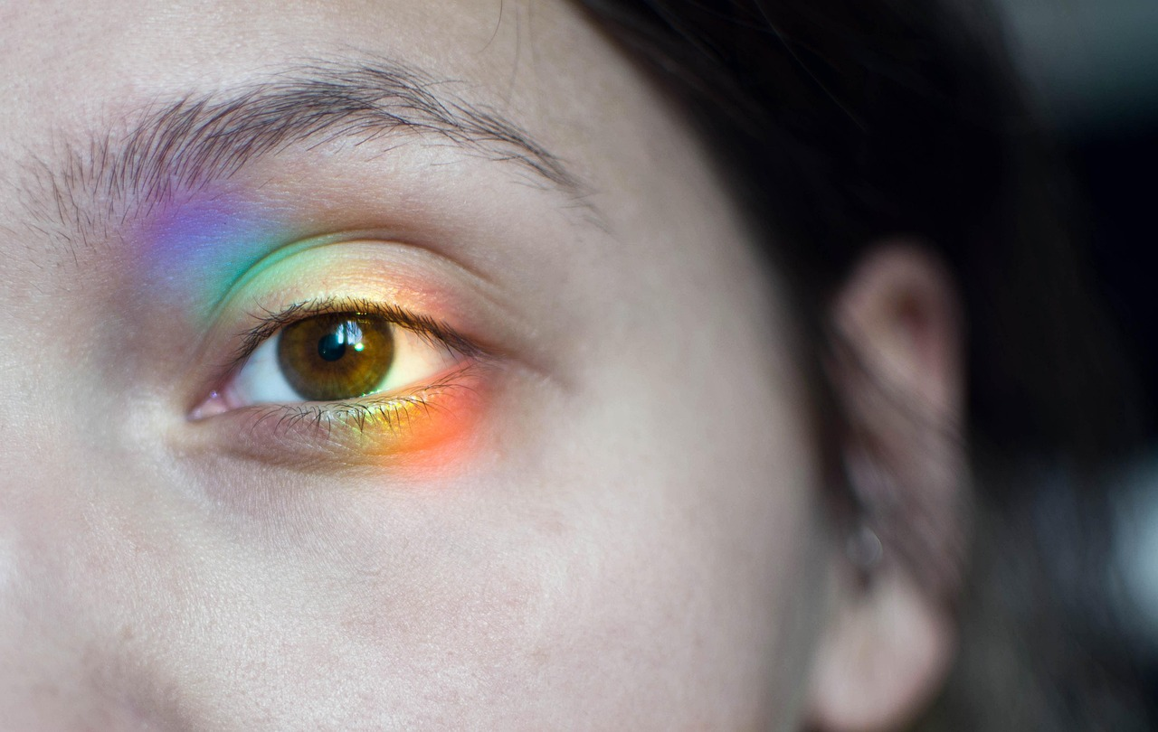
Exploring the Electromagnetic Spectrum and Visible Light
5
What is Visible Light?
Definition of Visible Light
Role in Vision and Communication
Scientific Characteristics
Visible light is a form of electromagnetic radiation that is visible to the human eye.
It has a wavelength between 400-700 nanometers and a frequency between 4-8 x 10^14 Hz.
Visible light is essential for vision, photography, and communication.
It enables humans to perceive the world and facilitates various technologies.
The wavelength of visible light ranges from 400 to 700 nanometers.
Its frequency lies between 4-8 x 10^14 Hz, making it a key part of the electromagnetic spectrum.

Slide 6

Exploring the Electromagnetic Spectrum and Visible Light
6
Properties of Electromagnetic Waves
Electric and Magnetic Components
Travel Through a Vacuum
Electromagnetic waves have both electric and magnetic field components.
These components oscillate perpendicular to each other and to the direction of wave propagation.
Electromagnetic waves can travel through a vacuum without requiring a medium.
This ability allows them to traverse vast distances in space.
Characteristics of Waves
Speed in a Vacuum
Electromagnetic waves are described by their amplitude, frequency, wavelength, and speed.
These properties determine the behavior and energy of the waves.
The speed of electromagnetic waves in a vacuum is approximately 299,792,458 meters per second.
This constant speed is a fundamental property of light and other electromagnetic waves.

Slide 7

Exploring the Electromagnetic Spectrum and Visible Light
7
Types of Electromagnetic Radiation
Radio Waves
Microwaves
Infrared Radiation
Visible Light
Ultraviolet Radiation
Radio waves have long wavelengths and low frequencies.
They are commonly used in communication systems like radios and televisions.
Microwaves possess medium wavelengths and medium frequencies.
They are widely used in cooking and in radar technology.
Infrared radiation has short wavelengths and high frequencies.
It is often associated with heat and is used in remote controls and thermal imaging.
Visible light is the only type of electromagnetic radiation visible to the human eye.
It enables us to see the world in a spectrum of colors.
Ultraviolet radiation has short wavelengths and high frequencies.
It is responsible for causing sunburns and is used in sterilization processes.

Slide 8
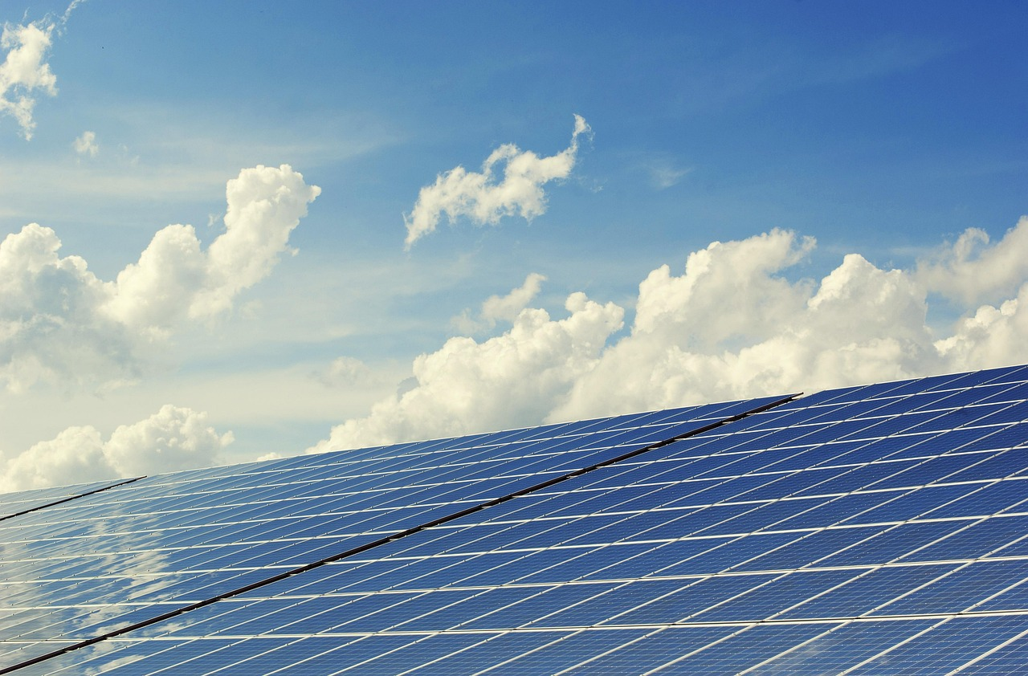
Exploring the Electromagnetic Spectrum and Visible Light
8
Applications of Visible Light
Vision
Photography
Visible light allows us to see the world around us.
It plays a crucial role in our perception of colors and shapes.
Visible light is used to capture images.
Cameras rely on visible light to produce photographs.
Communication
Solar Energy
Visible light is used in fiber optic communication.
It enables high-speed data transmission over long distances.
Visible light is used to generate electricity.
Solar panels convert visible light into usable energy.

Slide 9
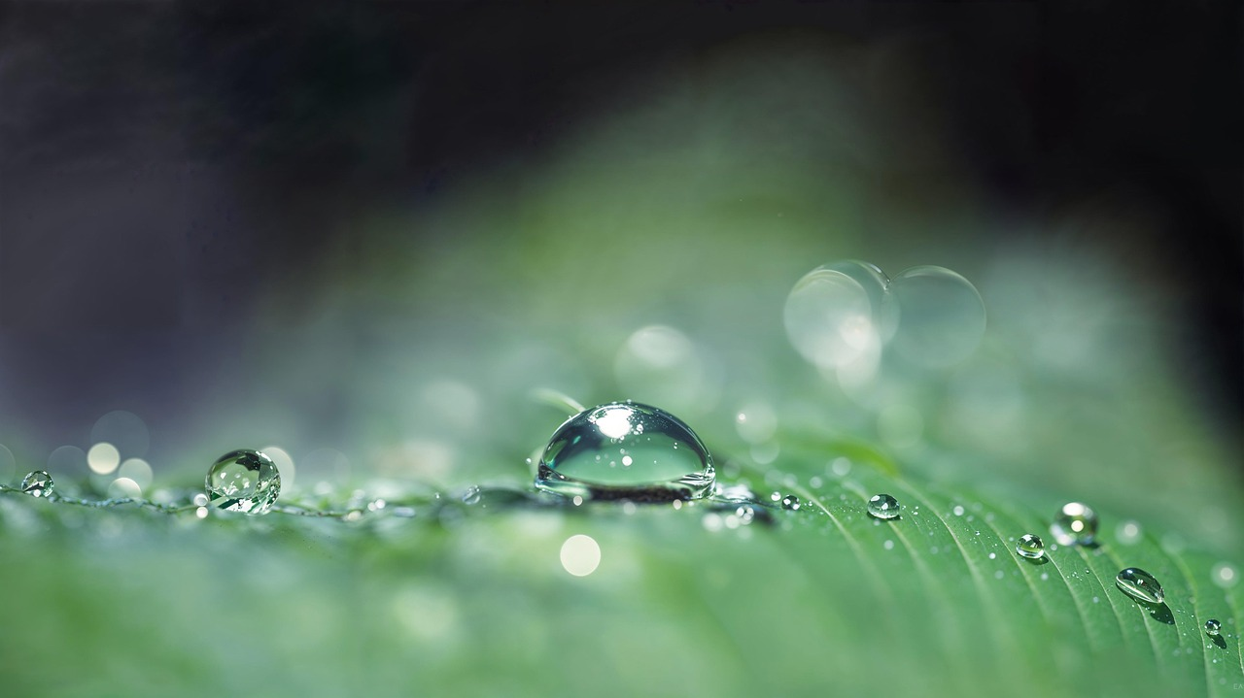
Exploring the Electromagnetic Spectrum and Visible Light
9
Reflection and Refraction
Reflection
Refraction
Total Internal Reflection
Reflection is the change in direction of a wave at a surface.
This phenomenon occurs when the wave bounces back into the original medium.
Refraction refers to the bending of a wave as it passes from one medium to another.
This change in direction is due to the wave's change in speed.
Total internal reflection is the complete reflection of a wave at a surface.
It occurs when the wave cannot pass into the second medium and is instead reflected entirely within the first medium.

Slide 10
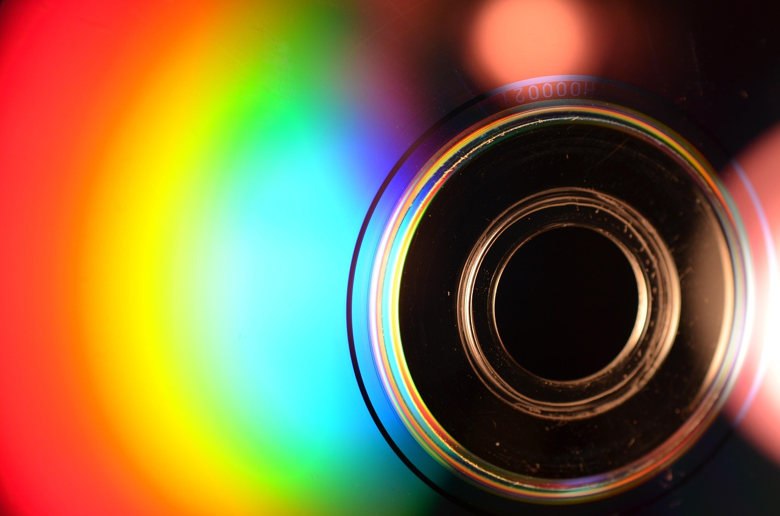
Exploring the Electromagnetic Spectrum and Visible Light
10
Diffraction and Interference
Understanding Diffraction
Diffraction is the bending of a wave around an obstacle or through a small opening.
This phenomenon demonstrates how waves can spread out and change direction when encountering barriers.
Exploring Interference
Interference occurs when two or more waves combine to form a new wave pattern.
This interaction can result in complex wave behaviors depending on the phase and amplitude of the waves.
Constructive and Destructive Interference
The resulting wave pattern from interference can either be reinforced or canceled.
Constructive interference amplifies the wave, while destructive interference diminishes it.

Slide 11
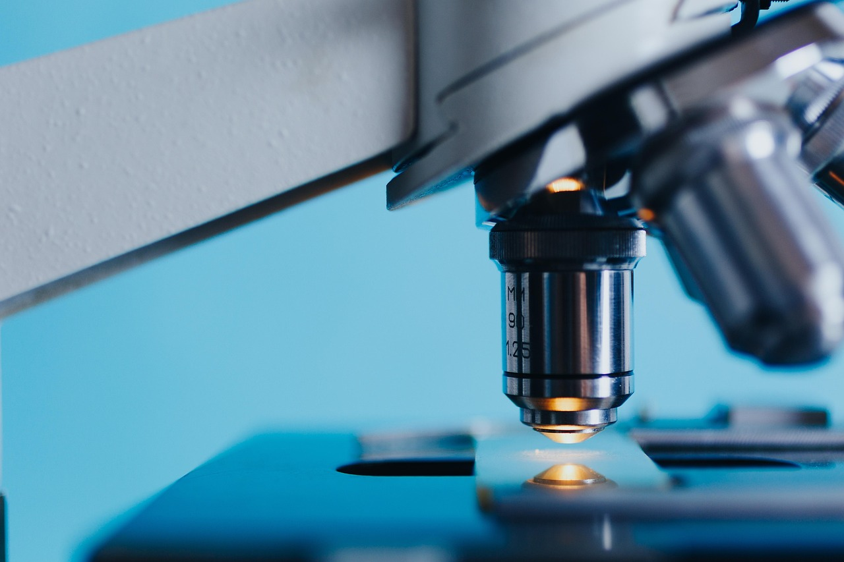
Exploring the Electromagnetic Spectrum and Visible Light
11
Optical Instruments
Telescopes
Microscopes
Spectrometers
Telescopes: use visible light to observe distant objects.
They are essential for astronomical observations and studying celestial bodies.
Microscopes: use visible light to observe small objects.
They are widely used in biology, medicine, and material sciences.
Spectrometers: use visible light to analyze the properties of materials.
They help in identifying chemical compositions and studying material structures.

Slide 12
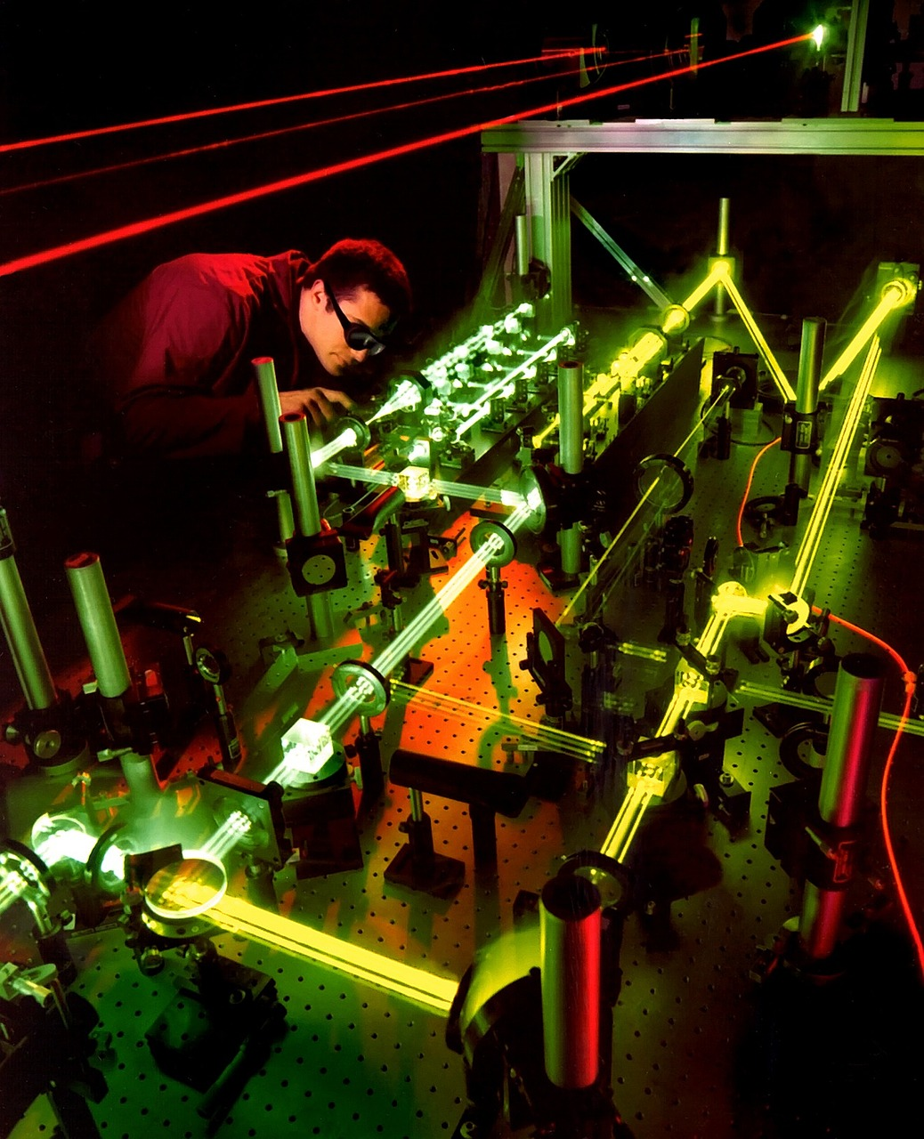
Exploring the Electromagnetic Spectrum and Visible Light
12
Lasers and Photonics
Introduction to Lasers
Exploring Photonics
Applications of Lasers and Photonics
Lasers are devices that produce intense, coherent beams of light.
They are widely used in various fields due to their precision and power.
Photonics is the study of the behavior and manipulation of light.
It plays a crucial role in advancing technologies related to light-based applications.
Lasers and photonics find applications in communication, medicine, and manufacturing.
These technologies are integral to modern advancements in multiple industries.

Slide 13
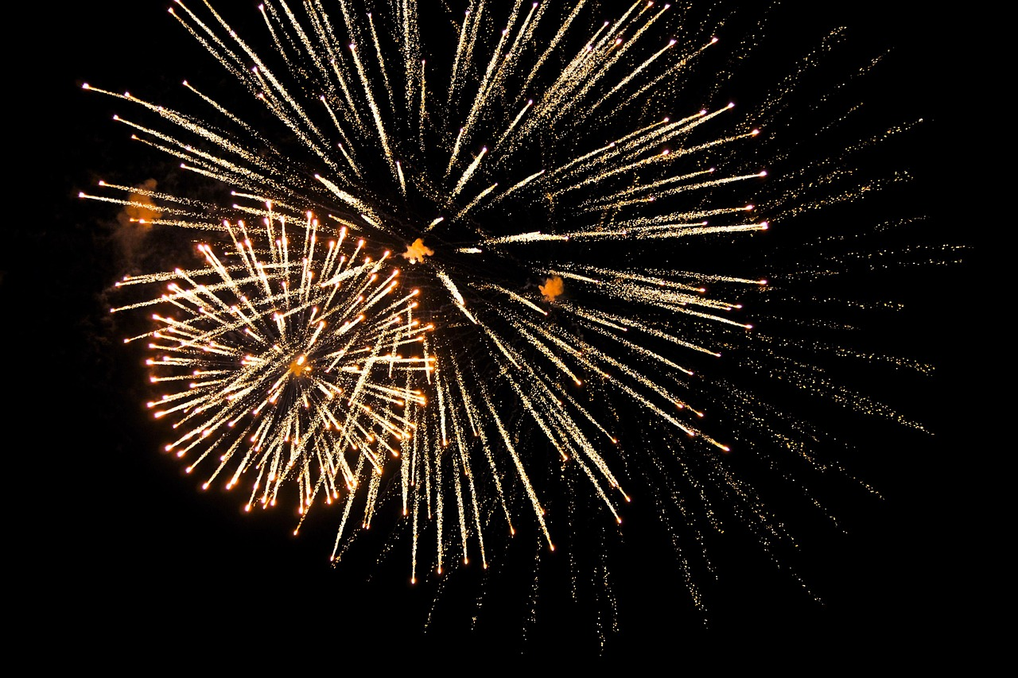
Exploring the Electromagnetic Spectrum and Visible Light
13
Biological Effects of Visible Light
Vision and Perception
Visible light allows us to see the world around us.
It plays a crucial role in how we perceive our environment and interact with it.
Regulation of Circadian Rhythms
Visible light regulates our sleep-wake cycles.
This biological effect ensures synchronization with the natural day-night cycle.
Photosynthesis in Plants
Visible light is used by plants to produce energy.
This process is essential for sustaining life on Earth by generating oxygen and food.

Slide 14
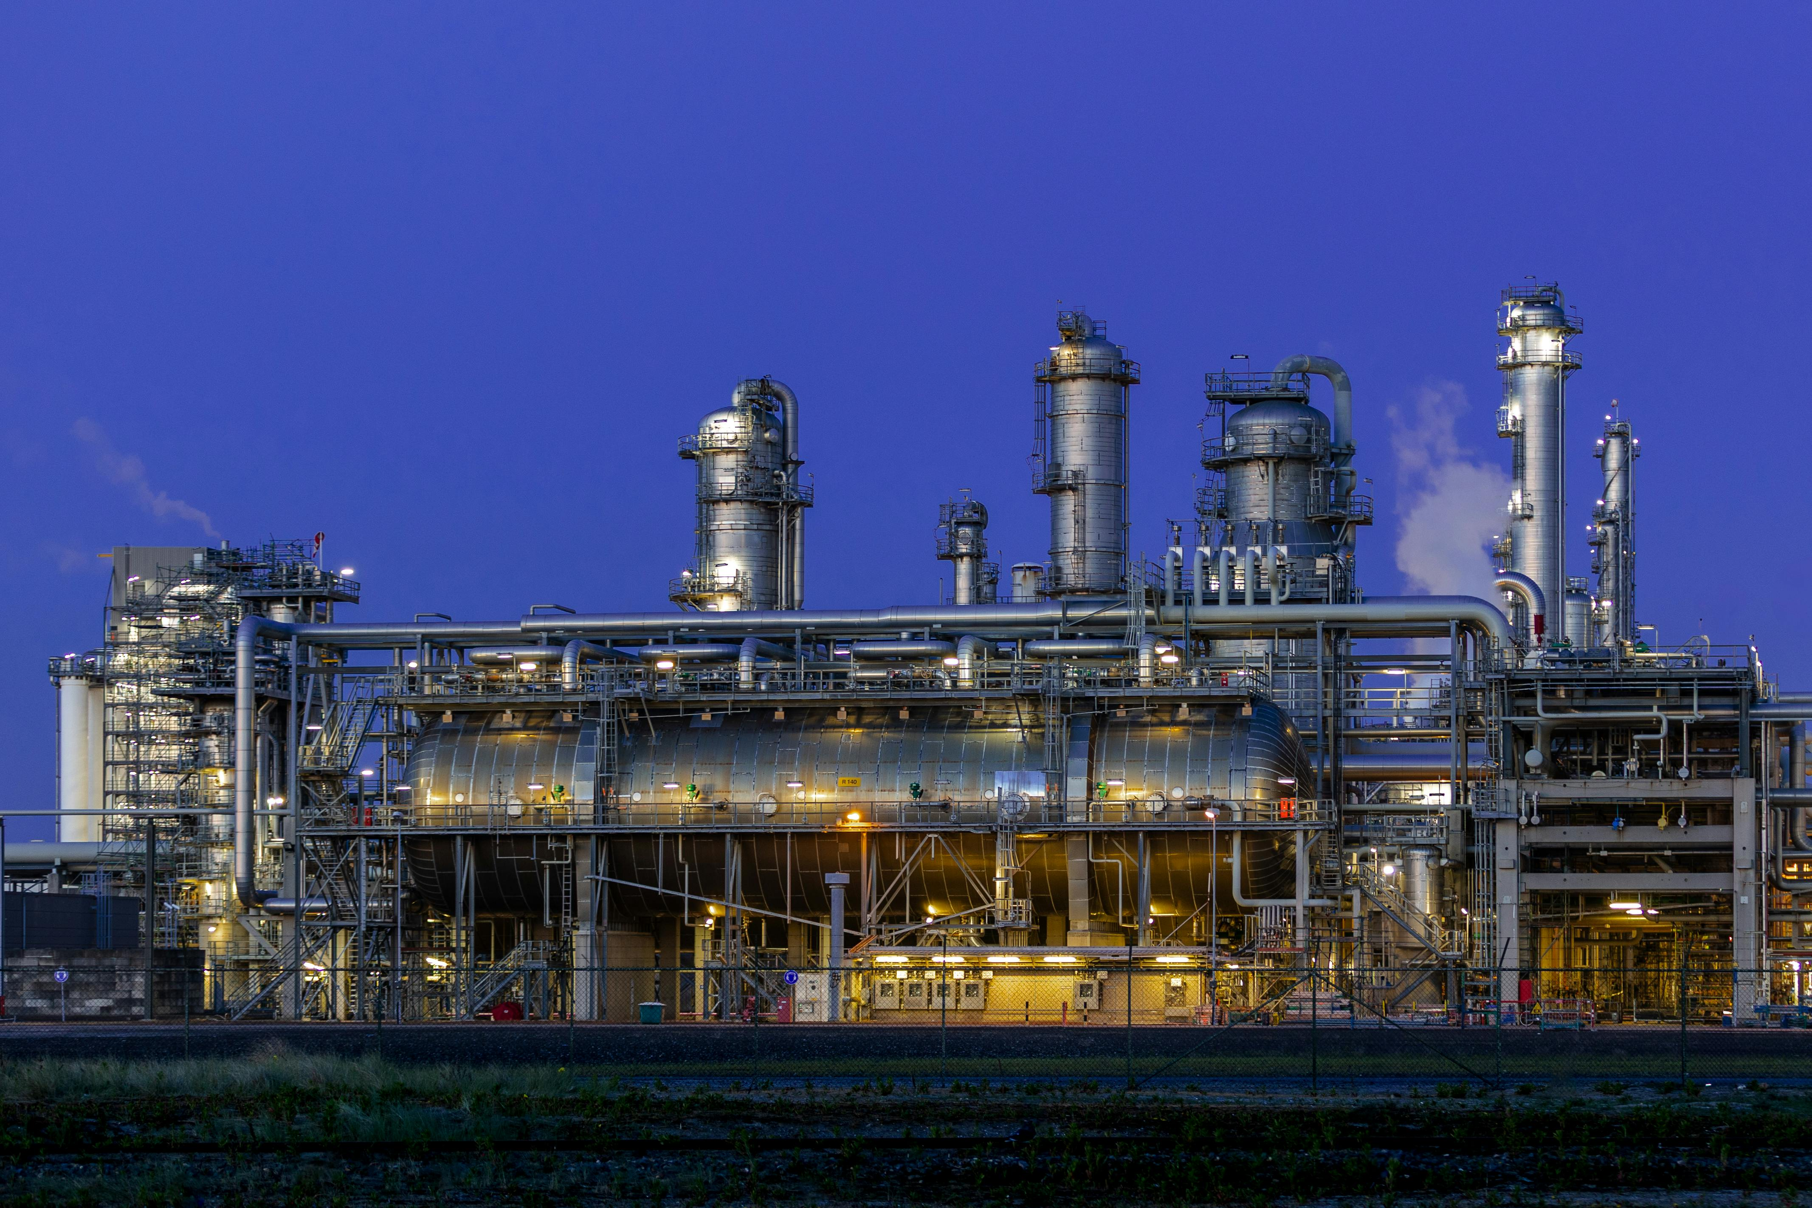
Exploring the Electromagnetic Spectrum and Visible Light
14
Environmental Effects of Visible Light
Light Pollution
Climate Change Impact
Energy Conservation
Light pollution refers to the excessive use of artificial light at night, which disrupts ecosystems and human health.
It can obscure the visibility of stars and interfere with astronomical observations.
Visible light contributes to global warming by increasing energy consumption and heat generation.
This exacerbates climate change and poses challenges for environmental sustainability.
Reducing energy consumption and using energy-efficient lighting are crucial for minimizing environmental impact.
Such measures help conserve resources and reduce greenhouse gas emissions.

Slide 15
Exploring the Electromagnetic Spectrum and Visible Light
15
Conclusion
The Importance of the Electromagnetic Spectrum
Applications of Visible Light
The electromagnetic spectrum is a fundamental concept in physics and astronomy.
It plays a crucial role in understanding the universe and its phenomena.
Understanding visible light is essential for various fields, including physics, astronomy, and engineering.
It enables advancements in technology and scientific exploration.

Slide 16
Exploring the Electromagnetic Spectrum and Visible Light
16
Summary
Components of the Electromagnetic Spectrum
Characteristics of Visible Light
Nature of Electromagnetic Waves
Speed of Electromagnetic Waves
The electromagnetic spectrum includes radio waves, microwaves, infrared, visible light, ultraviolet, X-rays, and gamma rays.
These waves vary in wavelength and frequency, covering a broad range of electromagnetic radiation.
Visible light has a wavelength between 400-700 nanometers and a frequency between 4-8 x 10^14 Hz.
It is the only part of the electromagnetic spectrum visible to the human eye.
Electromagnetic waves have both electric and magnetic field components.
These fields oscillate perpendicular to each other and to the direction of wave propagation.
The speed of electromagnetic waves is approximately 299,792,458 meters per second in a vacuum.
This speed is considered a fundamental constant of nature.

Slide 17
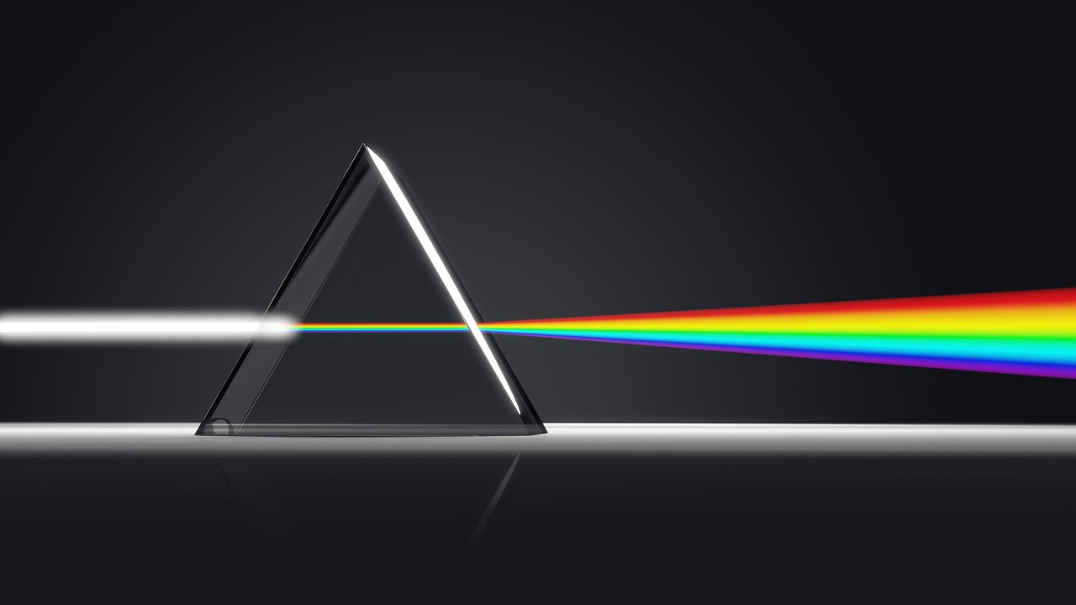
Exploring the Electromagnetic Spectrum and Visible Light
17
Key Takeaways
Understanding the Electromagnetic Spectrum
Visible Light and Human Perception
Applications Across Various Fields
The electromagnetic spectrum encompasses all possible frequencies of electromagnetic radiation.
It is a fundamental concept in physics and other scientific disciplines.
Visible light is a type of electromagnetic radiation detectable by the human eye.
This segment of the spectrum plays a crucial role in everyday human experiences.
Knowledge of the electromagnetic spectrum and visible light is vital for physics, astronomy, and engineering.
These fields rely on this understanding for advancements and practical applications.

Slide 18
Exploring the Electromagnetic Spectrum and Visible Light
18
Reflection Questions
Properties of Visible Light
Properties of Visible Light
Interdisciplinary Connections of the Electromagnetic Spectrum
What is the electromagnetic spectrum, and what types of radiation does it include?
The electromagnetic spectrum encompasses all types of electromagnetic radiation, ranging from gamma rays to radio waves.
What are the properties of visible light, and how is it used in everyday life?
Visible light is a small portion of the electromagnetic spectrum, essential for vision and widely used in technologies like lighting and displays.
How does the electromagnetic spectrum relate to other fields, such as physics, astronomy, and engineering?
The electromagnetic spectrum is integral to advancements in physics, astronomy, and engineering, enabling innovations like telescopes and communication systems.

Slide 19

Exploring the Electromagnetic Spectrum and Visible Light
19
Next Steps
Understanding Electromagnetic Radiation
Applications of Visible Light
Impact on Living Organisms and Environment
Learn more about the properties and applications of electromagnetic radiation.
This knowledge is essential for advancements in science and technology.
Explore the uses of visible light in various fields, such as medicine and communication.
These applications demonstrate the versatility and importance of visible light.
Investigate the effects of electromagnetic radiation on living organisms and the environment.
This research helps in assessing risks and developing protective measures.

Slide 20

Exploring the Electromagnetic Spectrum and Visible Light
20
Additional Resources
Online Resources
Websites, videos, and articles about the electromagnetic spectrum and visible light.
These resources provide accessible and diverse information for learners of all levels.
Books and Textbooks
Comprehensive resources on physics, astronomy, and engineering.
Ideal for in-depth study and understanding of the electromagnetic spectrum.
Experts and Professionals
Consult with experts in the field to learn more about the applications and implications of the electromagnetic spectrum.
Their insights can offer practical and advanced knowledge beyond standard resources.

Slide 21
Exploring the Electromagnetic Spectrum and Visible Light
21
Conclusion and Final Thoughts
Fundamental Concepts in Physics and Astronomy
The electromagnetic spectrum and visible light are fundamental concepts in physics and astronomy.
These concepts form the basis for understanding how energy and matter interact in the universe.
Applications in Everyday Life
Understanding these concepts is essential for various fields and has numerous applications in everyday life.
They play a crucial role in technologies such as communication, medical imaging, and environmental monitoring.

