Slide 1
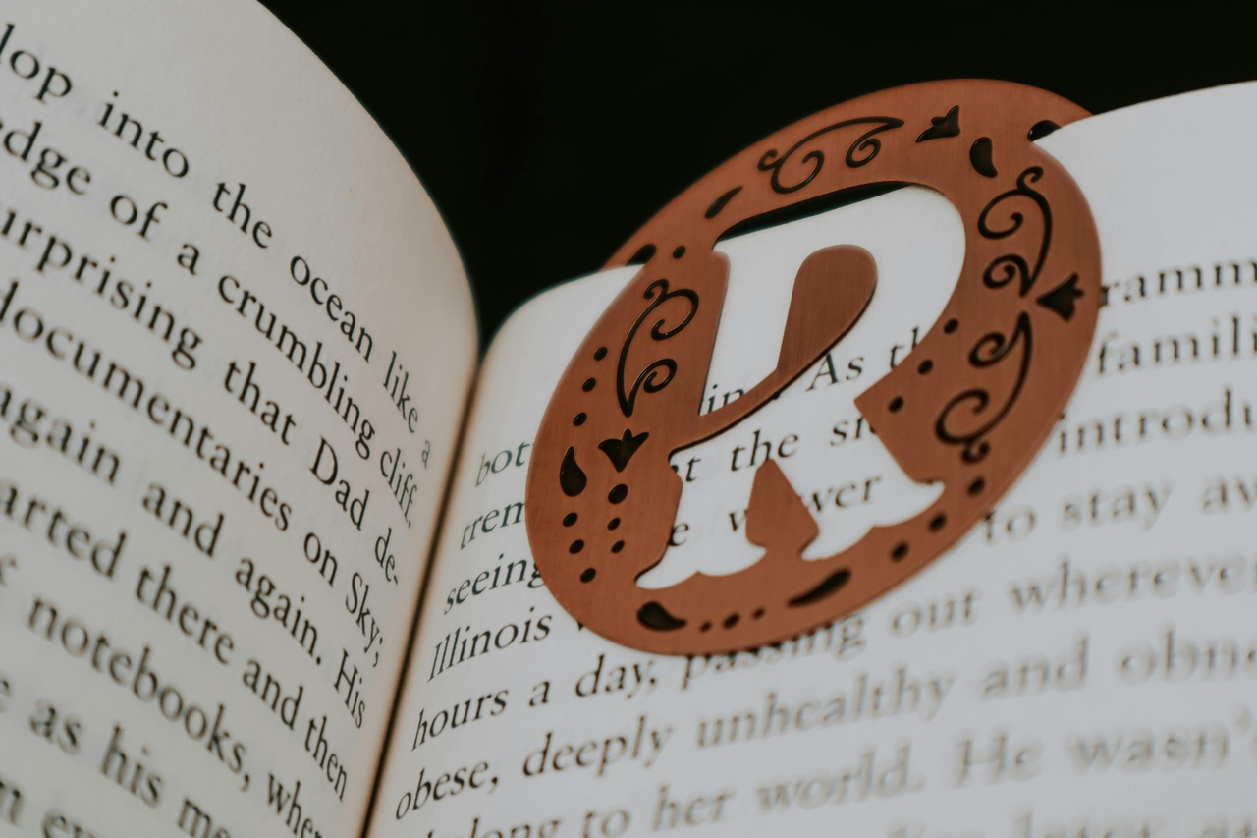



Mastering Punctuation: A Comprehensive Guide
Exploring the Use of Common Punctuation Marks

Slide 2



Table of contents
Lesson Introduction
Subject Knowledge
Punctuation marks
The most common punctuation marks
Period
Comma
Question mark
Exclamation point
Apostrophe
Quotation marks
01
02
03
04
05
06
07
08
09
10

Slide 3

Lesson Introduction
Lesson Introduction
In this engaging lesson, students will embark on a journey to unlock the secrets of proper punctuation.
Punctuation marks are the essential building blocks that help us communicate clearly and effectively in written language.
By the end of this lesson, students will have a firm grasp of the most common punctuation marks and how to use them correctly.
Through a variety of interactive activities and hands-on experiences, they will develop the skills to punctuate their own writing with confidence.
Mastering Punctuation: A Comprehensive Guide

Slide 4


Subject Knowledge
Definition
Common Punctuation Marks
Punctuation marks are the symbols we use to organize and clarify the meaning of written language.
They help to separate words, phrases, and sentences, and indicate the flow of ideas.
Period (.)
Comma (,)
Question mark (?)
Exclamation point (!)
Apostrophe (')
Quotation marks (" ")
Mastering Punctuation: A Comprehensive Guide

Slide 5
Punctuation marks
01
02
03
04
05
Period (.)
Comma (,)
Question Mark (?)
Exclamation Point (!)
Apostrophe (')
Used to indicate the end of a sentence.
Separates items in a list or clauses in a sentence.
Denotes a question or uncertainty.
Shows strong emotion or emphasis.
Indicates possession or contraction.
Mastering Punctuation: A Comprehensive Guide

Slide 6
The most common punctuation marks
Period (.)
Comma (,)
Question Mark (?)
Used to indicate the end of a sentence.
Separates items in a list or clauses in a sentence.
Denotes a question or inquiry.
Exclamation Point (!)
Apostrophe (')
Shows strong emotion or emphasis.
Indicates possession or contraction.
Mastering Punctuation: A Comprehensive Guide

Slide 7
Period
01
02
03
04
05
Definition
Function
Placement
Examples
Importance
The period (.) is a punctuation mark used at the end of a sentence to indicate a full stop or a complete thought.
It signals the reader to pause and helps in separating sentences or indicating abbreviations.
The period is always placed at the end of a sentence, directly after the final word.
"She went to the store."
"Dr. Smith will see you now."
Using periods correctly is crucial for clear and effective communication in writing.
Mastering Punctuation: A Comprehensive Guide

Slide 8
Comma
Introduction to the Comma
Separating Items in a List
Setting Off Introductory Elements
The comma is a versatile punctuation mark that helps to clarify the structure of sentences and improve readability.
Use commas to separate items in a list, such as "apples, oranges, and bananas."
Introductory phrases or clauses should be followed by a comma, like "In the morning, we went for a walk."
Joining Independent Clauses
Parenthetical Elements
When joining two independent clauses with a coordinating conjunction, use a comma before the conjunction, as in "She likes to read, and he enjoys painting."
Commas are used to set off non-essential information within a sentence, like "My brother, who lives in Paris, is visiting next week."
Mastering Punctuation: A Comprehensive Guide

Slide 9
Question mark
01
02
03
04
05
Definition
Usage
Intonation
Clarity
Examples
The question mark (?) is a punctuation mark used at the end of a sentence to indicate a direct question.
It signals to the reader that the sentence is interrogative and prompts a response.
Use a question mark at the end of a sentence that asks a direct question.
For example, "What time is the meeting?" or "Are you coming to the party?"
The question mark also reflects the intonation of a spoken question.
It denotes a rising tone at the end of the sentence, indicating inquiry or uncertainty.
Proper use of the question mark is crucial for clear communication.
It helps to distinguish questions from statements and adds nuance to written dialogue.
"How are you feeling today?"
"Where did you park the car?"
"Have you finished your homework?"
Mastering Punctuation: A Comprehensive Guide

Slide 10
Exclamation point
Conveying Emotions
Adding Emphasis
Avoid Overuse
The exclamation point (!) is used to convey strong emotions such as excitement, surprise, or urgency in writing.
It adds emphasis to a sentence and can change the tone from neutral to enthusiastic or forceful.
Avoid overusing exclamation points as it can diminish their impact and make the writing seem less professional.
Formal Writing
Informal Writing
Use exclamation points sparingly in formal writing, such as academic papers or business correspondence.
In informal writing, like emails or text messages, exclamation points can help convey friendliness and enthusiasm.
Mastering Punctuation: A Comprehensive Guide

Slide 11
Apostrophe
01
02
03
04
05
Definition
Possessive Form
Contractions
Plurals
Common Mistakes
An apostrophe (') is a punctuation mark used to indicate possession or to show that letters have been omitted in a contraction.
Use an apostrophe to show ownership or possession.
Example: The dog's tail wagged happily.
Apostrophes are used in contractions to combine two words into one.
Example: can't (cannot), it's (it is).
Avoid using apostrophes to form plurals, except in rare cases like abbreviations or acronyms.
Example: VIP's (VIPs).
Be mindful of common mistakes such as confusing "its" (possessive) with "it's" (contraction of it is) and using apostrophes with possessive pronouns like hers, ours, yours.
Mastering Punctuation: A Comprehensive Guide

Slide 12
Quotation marks
Definition
Types
Punctuation Placement
Quotation marks, also known as inverted commas, are punctuation marks used to indicate direct speech, a quotation, or to highlight a specific word or phrase.
There are two types of quotation marks: single quotation marks (') and double quotation marks (").
In American English, double quotation marks are more commonly used.
When using quotation marks, always place periods and commas inside the closing quotation mark, while colons and semicolons go outside the closing quotation mark.
Usage
Importance
Quotation marks are also used to denote the titles of short works such as articles, poems, and short stories.
Quotation marks are used to emphasize words or phrases in a sentence.
Remember to use quotation marks accurately to avoid misinterpretation and ensure clarity in your writing.
Mastering Punctuation: A Comprehensive Guide

