Slide 1
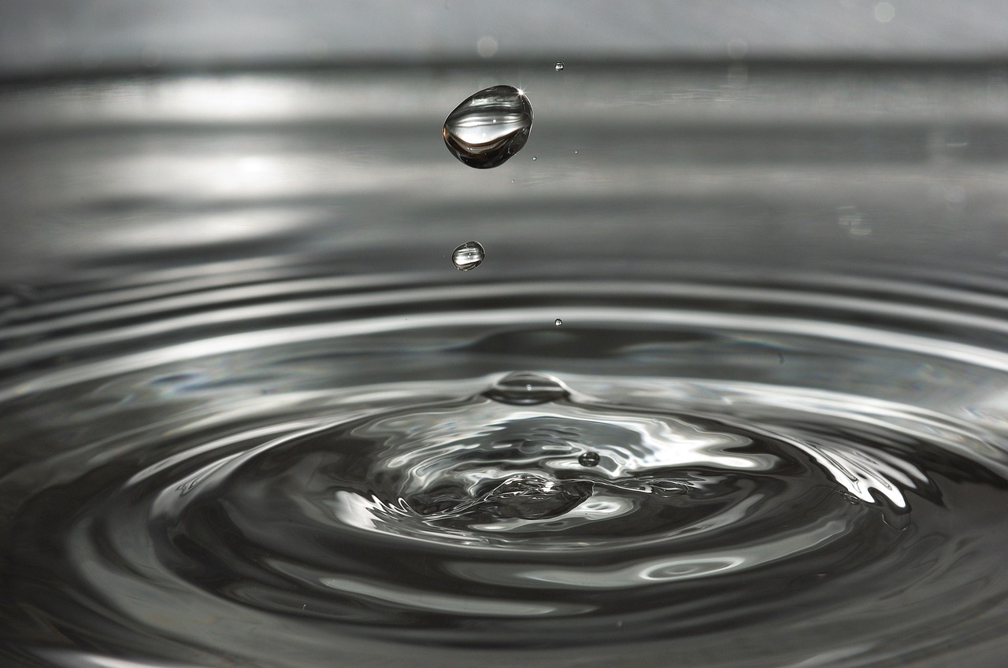
Exploring the Interconnection: The Water Cycle and Project Zero Routines
A Comprehensive Guide to Understanding and Implementing Effective Educational Strategies

Slide 2
Table of Contents
Introduction to Water Cycle and Project Zero Routin…
Understanding the Water Cycle
Introduction to Project Zero Routines
20 Project Zero Routines for Water Cycle Interventi…
Benefits of Project Zero Routines
Challenges and Opportunities in Implementing Projec…
Case Study: Successful Implementation of Project Ze…
Designing and Implementing Project Zero Routines
Group Activities and Discussions
Digital Integration and Resources
Assessment and Evaluation
Conclusion and Next Steps
Reflection Questions
01
02
03
04
05
06
07
08
09
10
11
12
13

Slide 3
Table of Contents
Additional Resources
Final Thoughts and Recommendations
References
14
15
16

Slide 4
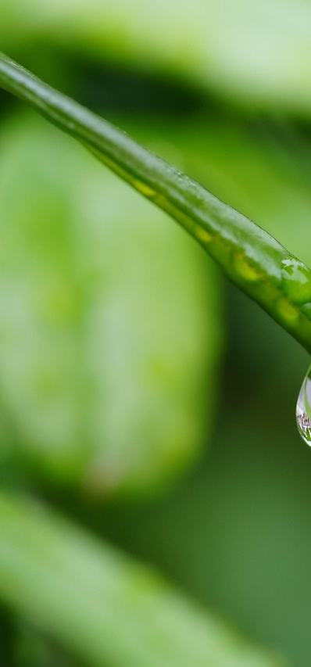
Introduction to Water Cycle and Project Zero Routines
Water Cycle Impact
Project Zero Solutions
20 Intervention Routines
The water cycle impacts water quality and human health.
Understanding it is essential for effective water management.
Project Zero offers a comprehensive approach to water cycle challenges.
It focuses on sustainability and resource management.
This presentation introduces 20 targeted intervention routines from Project Zero.
These routines address specific water cycle issues.
1
Exploring the Interconnection: The Water Cycle and Project Zero Routines

Slide 5

Understanding the Water Cycle
Water Circulation
Influencing Factors
The water cycle is the continuous movement of water between the Earth's surface and atmosphere.
It is essential for life.
Temperature, humidity, and precipitation are key factors that influence the water cycle.
These elements affect the availability of water resources.
Environmental Impact
Project Zero Relevance
The water cycle significantly impacts the environment, human health, and the economy.
Changes in the cycle can lead to droughts and floods.
Understanding the water cycle is vital for Project Zero.
It informs sustainable water management practices.
2
Exploring the Interconnection: The Water Cycle and Project Zero Routines

Slide 6

Introduction to Project Zero Routines
Water Cycle Solutions
Cross-Sector Applications
Sustainable Development Focus
Project Zero routines are a series of steps designed to address water cycle challenges.
These routines provide effective strategies for managing water resources.
These routines can be applied in various fields, including industry, agriculture, and urban development.
They offer tailored solutions that meet the specific needs of each sector.
Project Zero routines aim to promote sustainable development and protect the environment.
By integrating these practices, we can ensure a healthier planet for future generations.
3
Exploring the Interconnection: The Water Cycle and Project Zero Routines

Slide 7

20 Project Zero Routines for Water Cycle Intervention
Water-Energy
Water-Soil
Water-Air
Integrate renewable energy sources with water management systems.
This routine aims to optimize energy use while ensuring water availability.
Enhance soil moisture retention through sustainable practices.
This routine focuses on improving soil health to support vegetation growth.
Monitor air quality and its impact on water resources.
This routine addresses the relationship between water availability and climate change.
Water-Economy
Water-Conservation
Promote water-efficient technologies in various industries.
This routine seeks to balance economic growth with sustainable water use.
Implement strategies for water reuse and recycling.
This routine emphasizes the importance of conserving water for future generations.
4
Exploring the Interconnection: The Water Cycle and Project Zero Routines

Slide 8
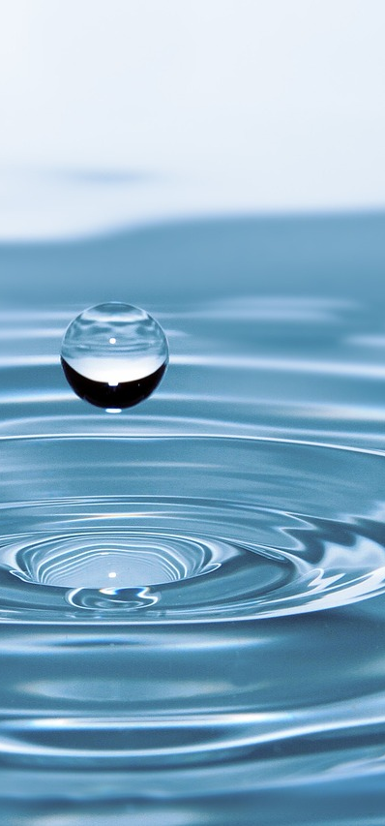
Benefits of Project Zero Routines
Water Quality
Water Efficiency
Project Zero Routines improve water quality.
This results in safer drinking water for all.
These routines enhance water efficiency.
They help in minimizing waste and conserving resources.
Environmental Protection
Cost Savings
Implementing these practices protects our environment.
This is crucial for maintaining biodiversity and natural habitats.
Reduced water treatment costs lead to financial savings.
These savings can be invested in community development projects.
5
Exploring the Interconnection: The Water Cycle and Project Zero Routines

Slide 9

Challenges and Opportunities in Implementing Project Zero Routines
Awareness Gap
Resource Limitations
Many stakeholders are unaware of Project Zero routines.
This knowledge gap limits effective implementation.
Limited resources challenge the execution of these routines.
Without adequate funding, potential benefits may not be realized.
Change Resistance
Innovation Potential
Resistance to change is a common barrier in organizations.
Addressing concerns is crucial for successful adoption.
Project Zero routines offer opportunities for innovation.
Collaboration across teams can lead to improved practices.
6
Exploring the Interconnection: The Water Cycle and Project Zero Routines

Slide 10

Case Study: Successful Implementation of Project Zero Routines
Implementation Overview
Achieved Outcomes
Key Takeaways
Company X embraced Project Zero routines to enhance their operational framework.
This initiative focused on comprehensive staff training and the adoption of innovative technologies.
The implementation led to a remarkable boost in efficiency, with a notable increase in output.
Employee morale saw a significant uplift, contributing to a more collaborative work environment.
Investing in employee development is crucial for the success of new initiatives.
Creating a culture of open communication fosters continuous improvement and adaptability.
7
Exploring the Interconnection: The Water Cycle and Project Zero Routines

Slide 11

Designing and Implementing Project Zero Routines
01
Analyze Challenge
Examine the complexities of the water cycle.
Identify specific obstacles in teaching this concept.
02
Design Routine
Develop a Project Zero routine that captivates students.
Incorporate engaging and interactive elements.
03
Implement Routine
Present the routine with clear and concise instructions.
Encourage active participation from all students.
04
Evaluate Results
Gather feedback to assess student understanding.
Make necessary adjustments to enhance future lessons.
8
Exploring the Interconnection: The Water Cycle and Project Zero Routines

Slide 12

Group Activities and Discussions
Collaborative Design Session
Participants will work together to craft a comprehensive routine.
The focus will be on identifying essential components and steps.
Exploring Implementation Hurdles
Engage in a dialogue about the obstacles encountered during implementation.
Discuss potential opportunities that emerge from addressing these challenges.
Results Presentation and Reflection
Groups will showcase the outcomes of their routine implementations.
Participants will share insights and reflections on their experiences.
9
Exploring the Interconnection: The Water Cycle and Project Zero Routines

Slide 13

Digital Integration and Resources
Collaboration Platforms
Design Tools
Online platforms enhance collaboration among educators.
They foster a community of practice.
Digital tools streamline the design of Project Zero routines.
They provide templates that simplify the process.
Learning Resources
Success Stories
Further learning resources on Project Zero include articles, videos, and online courses.
These materials deepen understanding and support research.
Successful digital integration examples showcase effective Project Zero implementation.
They highlight best practices in various educational settings.
10
Exploring the Interconnection: The Water Cycle and Project Zero Routines

Slide 14
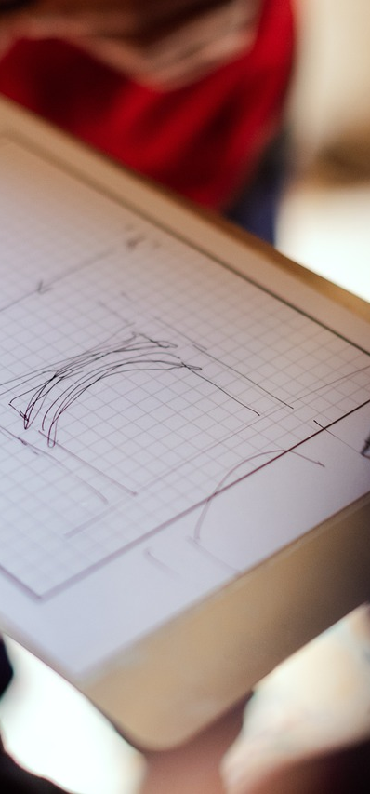
Assessment and Evaluation
Formative Insights
Formative assessment tracks student progress.
It offers continuous feedback to improve learning outcomes.
Summative Review
Summative assessment measures student learning at the conclusion of an instructional unit.
It assesses the effectiveness of teaching methods.
Assessment Tools
Assessment tools like quizzes, tests, and portfolios evaluate student performance.
They provide insights into student learning.
11
Exploring the Interconnection: The Water Cycle and Project Zero Routines

Slide 15

Conclusion and Next Steps
Key Takeaways
Future Directions
Student Engagement
Project Zero routines significantly enhance critical thinking skills.
They promote collaboration and active participation among students.
We plan to expand the implementation of these routines into more subjects.
Future training sessions will equip teachers with the necessary tools for effective integration.
Students are encouraged to utilize Project Zero routines in practical, real-world contexts.
This approach will strengthen their comprehension and retention of the material.
12
Exploring the Interconnection: The Water Cycle and Project Zero Routines

Slide 16

Reflection Questions
Water Cycle Insights
Daily Application
Implementation Challenges
The water cycle involves evaporation, condensation, and precipitation.
This emphasizes the importance of water conservation.
Project Zero routines can be integrated into daily life through reflective thinking.
In my community, these routines foster meaningful discussions about environmental issues.
One challenge in implementing Project Zero routines is resistance to change.
This challenge presents an opportunity to innovate and improve educational methods.
13
Exploring the Interconnection: The Water Cycle and Project Zero Routines

Slide 17

Additional Resources
Recommended Readings
Read texts on Project Zero principles.
Explore literature on inquiry-based education.
Online Learning Platforms
Visit Coursera for courses on Project Zero methodologies.
Check out edX for webinars on innovative teaching practices.
Project Zero Examples
Review case studies of successful Project Zero routine implementations.
Analyze how schools have integrated these strategies into their curricula.
Expert Contacts
Connect with Harvard Project Zero for valuable resources.
Reach out to educators specializing in Project Zero for insights.
14
Exploring the Interconnection: The Water Cycle and Project Zero Routines

Slide 18
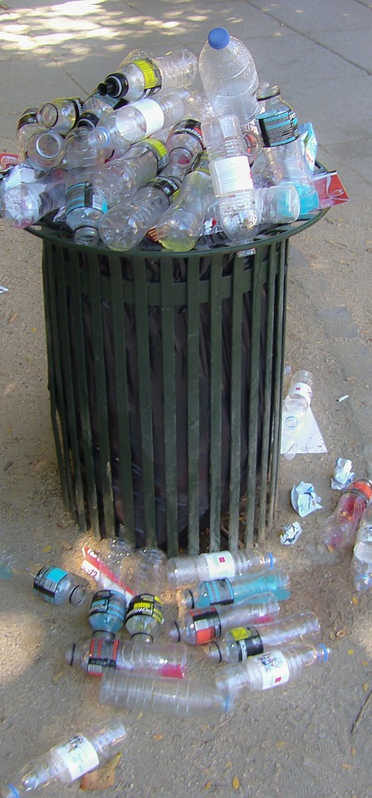
Final Thoughts and Recommendations
Sustainable Development
Project Zero Impact
Lifelong Learning
Sustainable development is essential for ensuring resources are available for future generations.
It promotes environmental protection and responsible resource use.
Project Zero routines effectively manage water scarcity and reduce pollution.
These routines help address challenges in the water cycle, ensuring better water quality.
Continuing education on sustainability is vital for everyone.
Applying Project Zero routines can significantly enhance our environmental impact.
15
Exploring the Interconnection: The Water Cycle and Project Zero Routines

Slide 19

References
Source List
Further Reading
The sources used in this presentation include academic journals, books, and reputable websites.
These references support the information shared.
If you wish to delve deeper into this subject, consider exploring additional articles and studies.
Recommended books and research papers can enhance your understanding of the topic.
16
Exploring the Interconnection: The Water Cycle and Project Zero Routines

