Slide 1
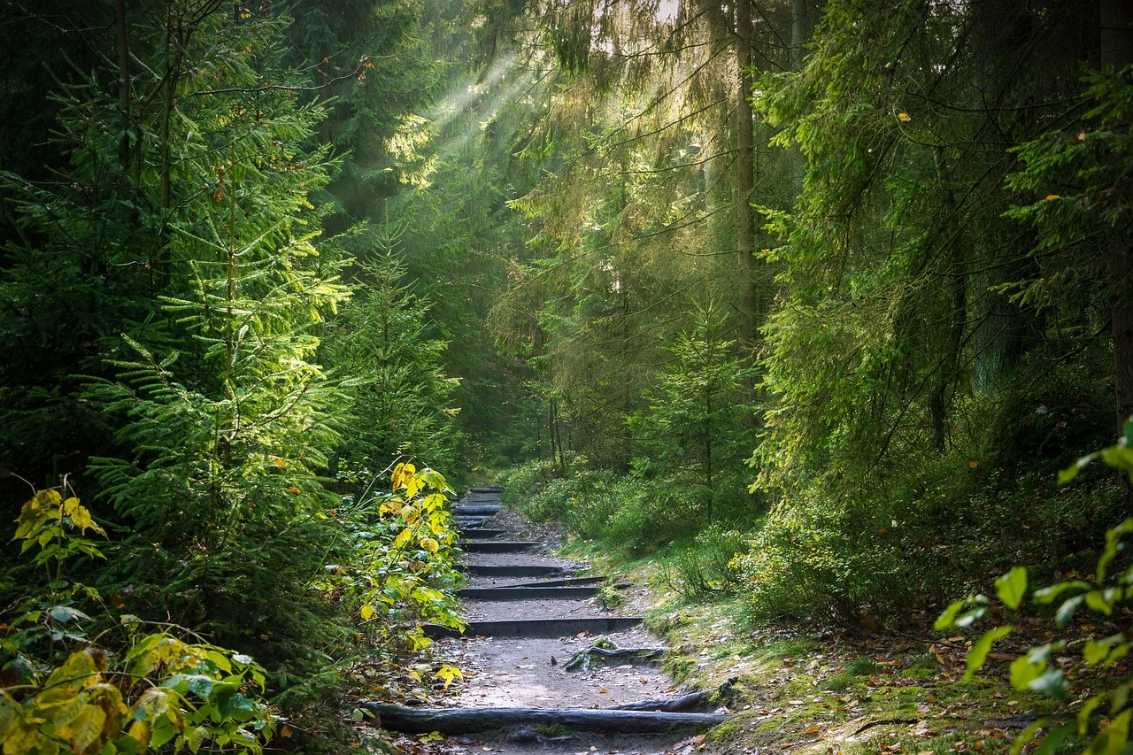
The Enchanted Forest Adventure
Exploring Discovery, Trails, and Uncharted Paths

Slide 2
Table of contents
01
02
03
04
The Enchanted Forest Adventure
Chapter 1: The Discovery
Chapter 2: The Enchanted Trail
Chapter 3: The Uncharted Path

Slide 3
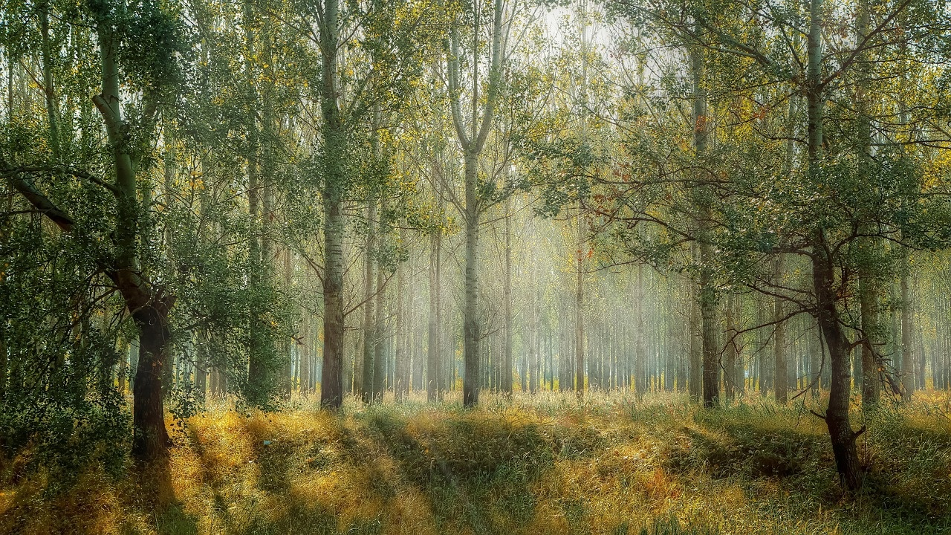
1
The Enchanted Forest Adventure
01
Chapter 1: The Discovery
02
Important Choice
Hj finds an ancient map in an old book in the village of Oakwood.
The map reveals a mysterious forest with winding paths and intriguing landmarks.
Hj decides to embark on an adventure to explore the Enchanted Forest.
Hj faces a decision: take the well-worn path through the forest or venture off the beaten track.
If Hj takes the well-worn path, proceed to Chapter 2: The Enchanted Trail.
If Hj ventures off the beaten track, proceed to Chapter 3: The Uncharted Path.
The Enchanted Forest Adventure

Slide 4
2
Chapter 1: The Discovery
01
02
03
04
05
Setting
Protagonist
Discovery
Map Description
Decision
A bright and sunny day in the small village of Oakwood.
Hj, a curious and adventurous young student.
Stumbled upon an ancient map hidden in the pages of an old book.
Depicted a mysterious forest with winding paths and intriguing landmarks.
Hj had to choose between taking the well-worn path or venturing off the beaten track.
The Enchanted Forest Adventure

Slide 5
3
Chapter 2: The Enchanted Trail
01
Step 1: The Enchanted Signpost
02
Step 2: The Whispering Trees
03
Step 3: The Glowing Mushrooms
Hj encounters a weathered signpost covered in moss, pointing towards three different directions.
As Hj walks deeper into the forest, the trees seem to whisper ancient secrets, guiding Hj along the trail.
Hj stumbles upon a clearing filled with mushrooms emitting a soft, ethereal glow, lighting up the path ahead.
04
Step 4: The Hidden Waterfall
05
Step 5: The Guardian Owl
Following the sound of rushing water, Hj discovers a hidden waterfall cascading into a crystal-clear pool, inviting a moment of rest and reflection.
A majestic owl perched on a branch watches over Hj, its wise eyes seeming to acknowledge Hj's presence on the enchanted trail.
The Enchanted Forest Adventure

Slide 6
4
Chapter 3: The Uncharted Path
01
02
03
04
05
Navigating by the Stars
Encountering Mystical Creatures
Discovering Hidden Ruins
Testing Courage
Unveiling Secrets
Hj relied on the position of the North Star to guide their way through the dense forest.
Along the uncharted path, Hj stumbled upon a friendly sprite named Lumina, who offered guidance.
Amidst the thick foliage, Hj uncovered ancient ruins shrouded in mystery and magic.
Hj faced challenges that tested their bravery and determination as they ventured deeper into the unknown.
Each step on the uncharted path revealed new secrets and wonders waiting to be explored.
The Enchanted Forest Adventure

