Slide 1

Mastering Relative Pronouns: A Comprehensive Grammar Guide
Exploring the Significance and Usage of Relative Pronouns

Slide 2
Table of contents
01
02
03
04
05
06
07
08
09
10
11
Title Slide: Mastering Relative Pronouns: A Grammar Journey
What Are Relative Pronouns?
Why Relative Pronouns Matter
Who Pronoun Explained
Which Pronoun Explained
Where Pronoun Explained
Common Mistakes to Avoid
Interactive Practice Activity
Sentence Construction Challenge
Digital Learning Integration
Assessment Strategies

Slide 3
Table of contents
12
13
14
15
16
17
18
Success Criteria
Homework and Extension
Parent Engagement
Conclusion
Q&A and Resources
Design Recommendations
Notes for PowerPoint Creation

Slide 4

1
Title Slide: Mastering Relative Pronouns: A Grammar Journey
Mastering Relative Pronouns: A Grammar Journey
For A1 Movers ESL Learners (Age 14)
Mastering Relative Pronouns: A Comprehensive Grammar Guide

Slide 5
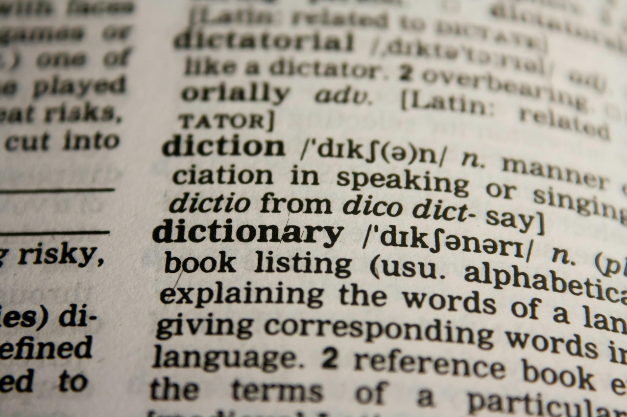
2
What Are Relative Pronouns?
01
Definition
02
Key Pronouns
Linguistic connectors that provide additional information
Who (for people)
Which (for objects/animals)
Where (for locations)
03
Visual
Colorful diagram showing pronoun connections
Mastering Relative Pronouns: A Comprehensive Grammar Guide

Slide 6

3
Why Relative Pronouns Matter
01
Enhance Clarity
02
Add Depth
Relative pronouns help clarify relationships between different parts of a sentence.
They allow for more detailed and descriptive information to be included in sentences.
03
Improve Coherence
04
Enable Complex Structures
Relative pronouns contribute to the overall flow and coherence of written and spoken language.
Using relative pronouns enables the creation of more sophisticated sentence structures.
Mastering Relative Pronouns: A Comprehensive Grammar Guide

Slide 7

4
Who Pronoun Explained
01
"Who" Pronoun Explained
02
Connection to Additional Information
Exclusively for People
Used to refer to individuals or groups of people
Adds information about human subjects
Provides details about the person being discussed
Enhances the description of the subject
03
Examples
04
Interactive Usage
"Maria, who studies mathematics, wants to be an engineer"
"The teacher who inspired me loves science"
Demonstrative graphic showcasing proper usage of "who" pronoun
Mastering Relative Pronouns: A Comprehensive Grammar Guide

Slide 8

5
Which Pronoun Explained
01
Who
02
Which
Used for people
Connects additional information about human subjects
Used for objects and animals
Provides descriptive details
03
Where
Specifies locations and spatial contexts
Connects place-related information
Mastering Relative Pronouns: A Comprehensive Grammar Guide

Slide 9
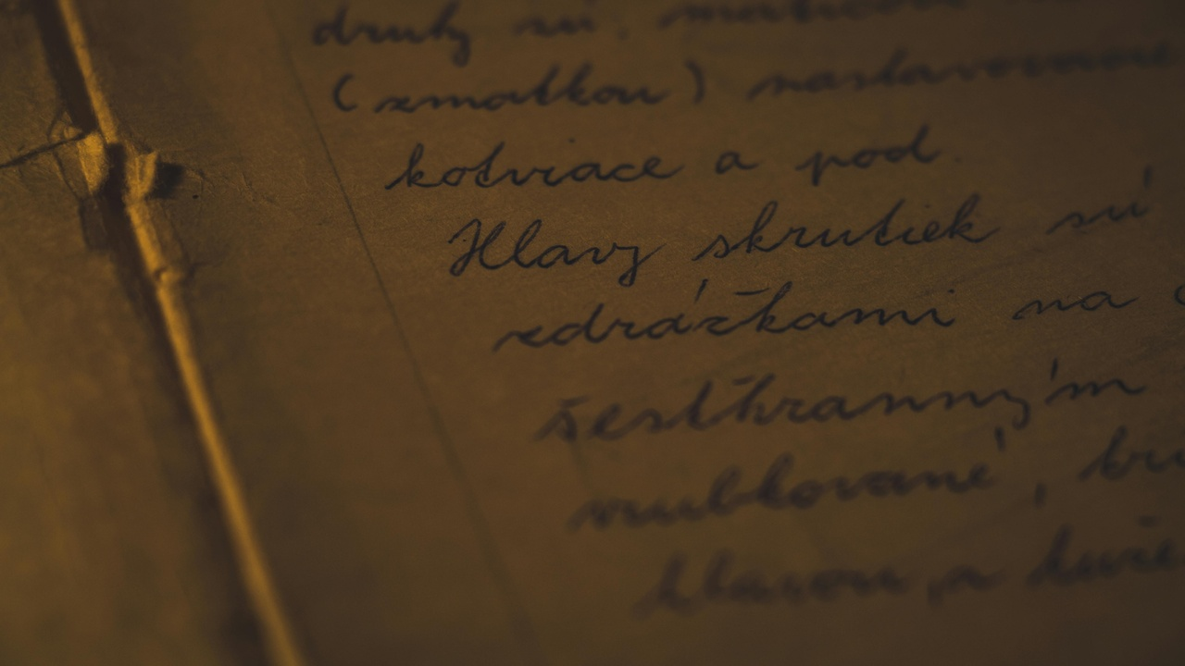
6
Where Pronoun Explained
01
"Where" Pronoun Explained
02
Examples
Specifies locations and spatial contexts
Connects place-related information
The library, where students study quietly, offers resources
Paris, where she met her cousin, was unexpected
Mastering Relative Pronouns: A Comprehensive Grammar Guide

Slide 10

7
Common Mistakes to Avoid
01
Incorrect Pronoun Selection
02
Overcomplicated Sentence Structures
Using "that" instead of "who" for people
Using "who" instead of "which" for objects
Avoiding run-on sentences with multiple relative clauses
Simplifying sentence structures for clarity
03
Grammatical Agreement Challenges
Ensuring pronouns agree in number and gender with their antecedents
Checking for consistency in pronoun usage throughout the sentence
Mastering Relative Pronouns: A Comprehensive Grammar Guide

Slide 11

8
Interactive Practice Activity
01
Interactive Practice Activity
02
Challenge
Pronoun Detective Game
Identify and categorize relative pronouns
03
Group Activity Instructions
04
Scoring System and Rewards
Form groups of 3-4 students
Each group will receive a set of sentences
Identify the relative pronouns in each sentence
Categorize the relative pronouns based on their function in the sentence
Discuss your findings with your group
1 point for each correctly identified relative pronoun
1 point for each correct categorization
Bonus points for group discussion and collaboration
Top 3 groups will receive a reward
Mastering Relative Pronouns: A Comprehensive Grammar Guide

Slide 12
9
Sentence Construction Challenge
01
02
03
Beginner Level
Intermediate Level
Advanced Level
Construct a sentence using the relative pronoun "who".
Example: "The girl who plays the piano is my sister."
Form a sentence incorporating the relative pronoun "which".
Example: "The car which won the race is red."
Create a complex sentence utilizing the relative pronoun "where".
Example: "I visited the park where we used to play as children."
Mastering Relative Pronouns: A Comprehensive Grammar Guide

Slide 13

10
Digital Learning Integration
01
AR Pronoun Hunt
02
Online Interactive Platforms
Utilize Augmented Reality for interactive pronoun exploration.
Engage learners through digital platforms for interactive grammar exercises.
03
Mobile App Challenges
04
QR Code Learning Experiences
Offer mobile applications for on-the-go practice and learning.
Implement QR codes for quick access to grammar resources and exercises.
Mastering Relative Pronouns: A Comprehensive Grammar Guide

Slide 14

11
Assessment Strategies
01
Oral Presentations
02
Written Evaluations
Evaluate students' ability to use relative pronouns in spoken language.
Provide feedback on pronunciation, fluency, and accuracy.
Assess students' understanding of relative pronouns through written exercises.
Review grammar, sentence structure, and coherence in written work.
03
Digital Portfolio Tracking
04
Group Project Assessments
Monitor students' progress in using relative pronouns through online platforms.
Track individual performance and provide personalized feedback.
Collaborative projects to demonstrate application of relative pronouns in context.
Evaluate teamwork, creativity, and effective use of grammar concepts.
Mastering Relative Pronouns: A Comprehensive Grammar Guide

Slide 15

12
Success Criteria
01
Accurately identify relative pronouns
02
Create grammatically correct sentences
Recognize "who," "which," and "where" in sentences
Understand the role of each pronoun in providing additional information
Use relative pronouns appropriately in sentence construction
Ensure pronoun-antecedent agreement for clarity and coherence
03
Apply pronouns in context
04
Demonstrate linguistic flexibility
Demonstrate understanding of when to use "who," "which," and "where"
Incorporate relative pronouns effectively to enhance sentence meaning
Experiment with different sentence structures using relative pronouns
Adapt language usage to convey varying levels of detail and description
Mastering Relative Pronouns: A Comprehensive Grammar Guide

Slide 16

13
Homework and Extension
Homework and Extension
Relative Pronoun Detective Journal
Creative writing challenges
Multilingual comparison project
Digital scavenger hunt
Mastering Relative Pronouns: A Comprehensive Grammar Guide

Slide 17

14
Parent Engagement
01
Workshops and Seminars
02
Take-Home Activities
Organize sessions for parents to understand and support their child's learning of relative pronouns.
Provide interactive exercises and games for parents to engage with their children on relative pronouns at home.
03
Progress Tracking
04
Communication Channels
Share tools and resources for parents to monitor their child's improvement in using relative pronouns.
Establish open lines of communication for parents to discuss any challenges or questions regarding relative pronouns.
Mastering Relative Pronouns: A Comprehensive Grammar Guide

Slide 18

15
Conclusion
01
Recap of Key Learning Points
02
Importance of Mastering Relative Pronouns
Understanding the role of relative pronouns in connecting clauses
Identifying and using common relative pronouns: who, whom, whose, which, that
Distinguishing between defining and non-defining relative clauses
Enhances clarity and precision in communication
Improves writing and speaking skills
Facilitates better comprehension of complex sentences
03
Encouragement for Continued Learning
04
Final Thought
Practice regularly to reinforce knowledge
Engage with diverse language resources
Seek feedback and guidance from proficient speakers
Language mastery is a journey, not a destination.
Mastering Relative Pronouns: A Comprehensive Grammar Guide

Slide 19

16
Q&A and Resources
01
Contact Information
02
Additional Learning Resources
Email: grammarjourney@email.com
Phone: +1-800-123-4567
Online Grammar Guides
Language Learning Apps
03
Recommended Practice Websites
04
Further Reading Suggestions
Grammarly.com
Duolingo.com
"English Grammar in Use" by Raymond Murphy
"The Elements of Style" by William Strunk Jr. and E.B. White
Mastering Relative Pronouns: A Comprehensive Grammar Guide

Slide 20

17
Design Recommendations
01
Consistent Color Scheme
02
Engaging Graphics
Use a harmonious color palette throughout the presentation.
Incorporate visually appealing and age-appropriate images.
03
Readable Fonts
04
Sparingly Use Animations
Choose clear and legible fonts for easy comprehension.
Utilize animations judiciously to enhance content delivery.
Mastering Relative Pronouns: A Comprehensive Grammar Guide

Slide 21
18
Notes for PowerPoint Creation
01
Keep Text Concise
02
Utilize Bullet Points
03
Incorporate High-Quality Visuals
Focus on key points
Avoid unnecessary details to maintain clarity
Organize information in a structured manner
Enhance readability
Use relevant images to support content
Enhance understanding
04
Ensure Color Contrast
05
Create a Cohesive Visual Narrative
Choose colors that are visually appealing
Ensure accessibility
Maintain consistency in design elements
Achieve a professional look
Mastering Relative Pronouns: A Comprehensive Grammar Guide

