Slide 1
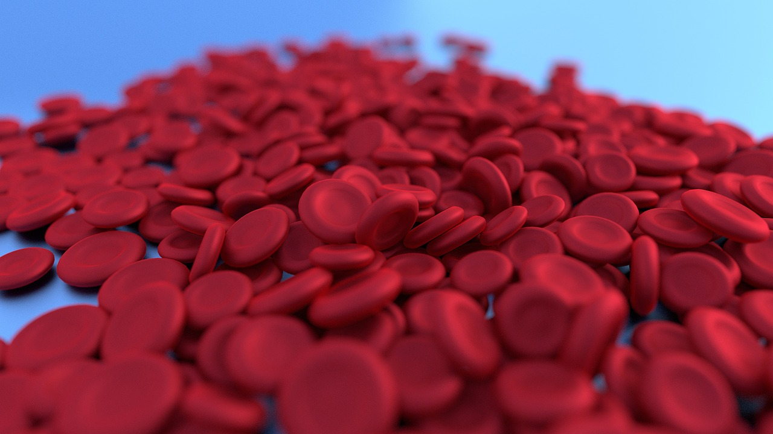
Cell Division: The Foundation of Life and Growth
Understanding the Processes, Importance, and Applications of Cell Division in Biology and Beyond

Slide 2
Cell Division: The Foundation of Life and Growth
2
Table of Contents
Introduction to Cell Division
Why Learn About Cell Division?
Types of Cell Division
Stages of Mitosis
Importance of Cell Division
Cell Division in Real Life
Applications of Cell Division
Common Errors and Misconceptions
Frequently Asked Questions
Key Vocabulary
Teaching Tips
Assessment and Evaluation
Conclusion
04
05
06
07
08
09
10
11
12
13
14
15
16

Slide 3
Cell Division: The Foundation of Life and Growth
3
Table of Contents
Reflection Questions
Next Steps
Additional Resources
Parent Engagement
Safety Considerations
17
18
19
20
21

Slide 4

Cell Division: The Foundation of Life and Growth
4
Introduction to Cell Division
Definition of Cell Division
Importance of Cell Division
Role in Living Organisms
Cell division is the process by which a cell divides into two or more daughter cells.
It is essential for growth, development, and reproduction in living organisms.
Understanding cell division is crucial for understanding biology.
It has implications in medicine, ecology, and agriculture.
Cell division is a fundamental process for the survival of living organisms.
It enables organisms to grow, repair tissues, and reproduce.

Slide 5
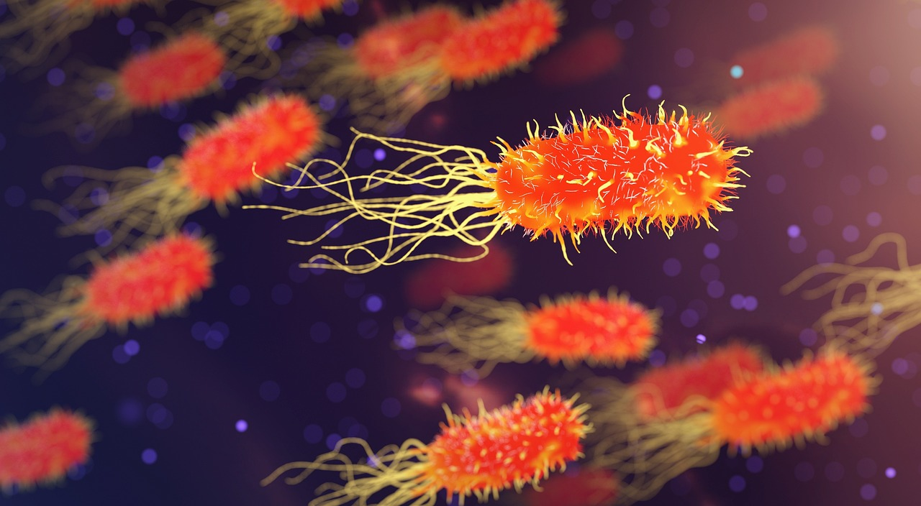
Cell Division: The Foundation of Life and Growth
5
Why Learn About Cell Division?
The Essence of Cell Division
Cell division is a fundamental concept in biology that underlies many biological processes.
Understanding cell division can help us appreciate the complexity and beauty of life.
Applications in Medicine and Beyond
It has practical applications in fields like medicine, biotechnology, and environmental science.
These applications demonstrate the importance of cell division in solving real-world problems.
A Gateway to Biological Understanding
Studying cell division provides insights into the mechanisms of life.
This knowledge forms the foundation for advancements in various scientific disciplines.

Slide 6
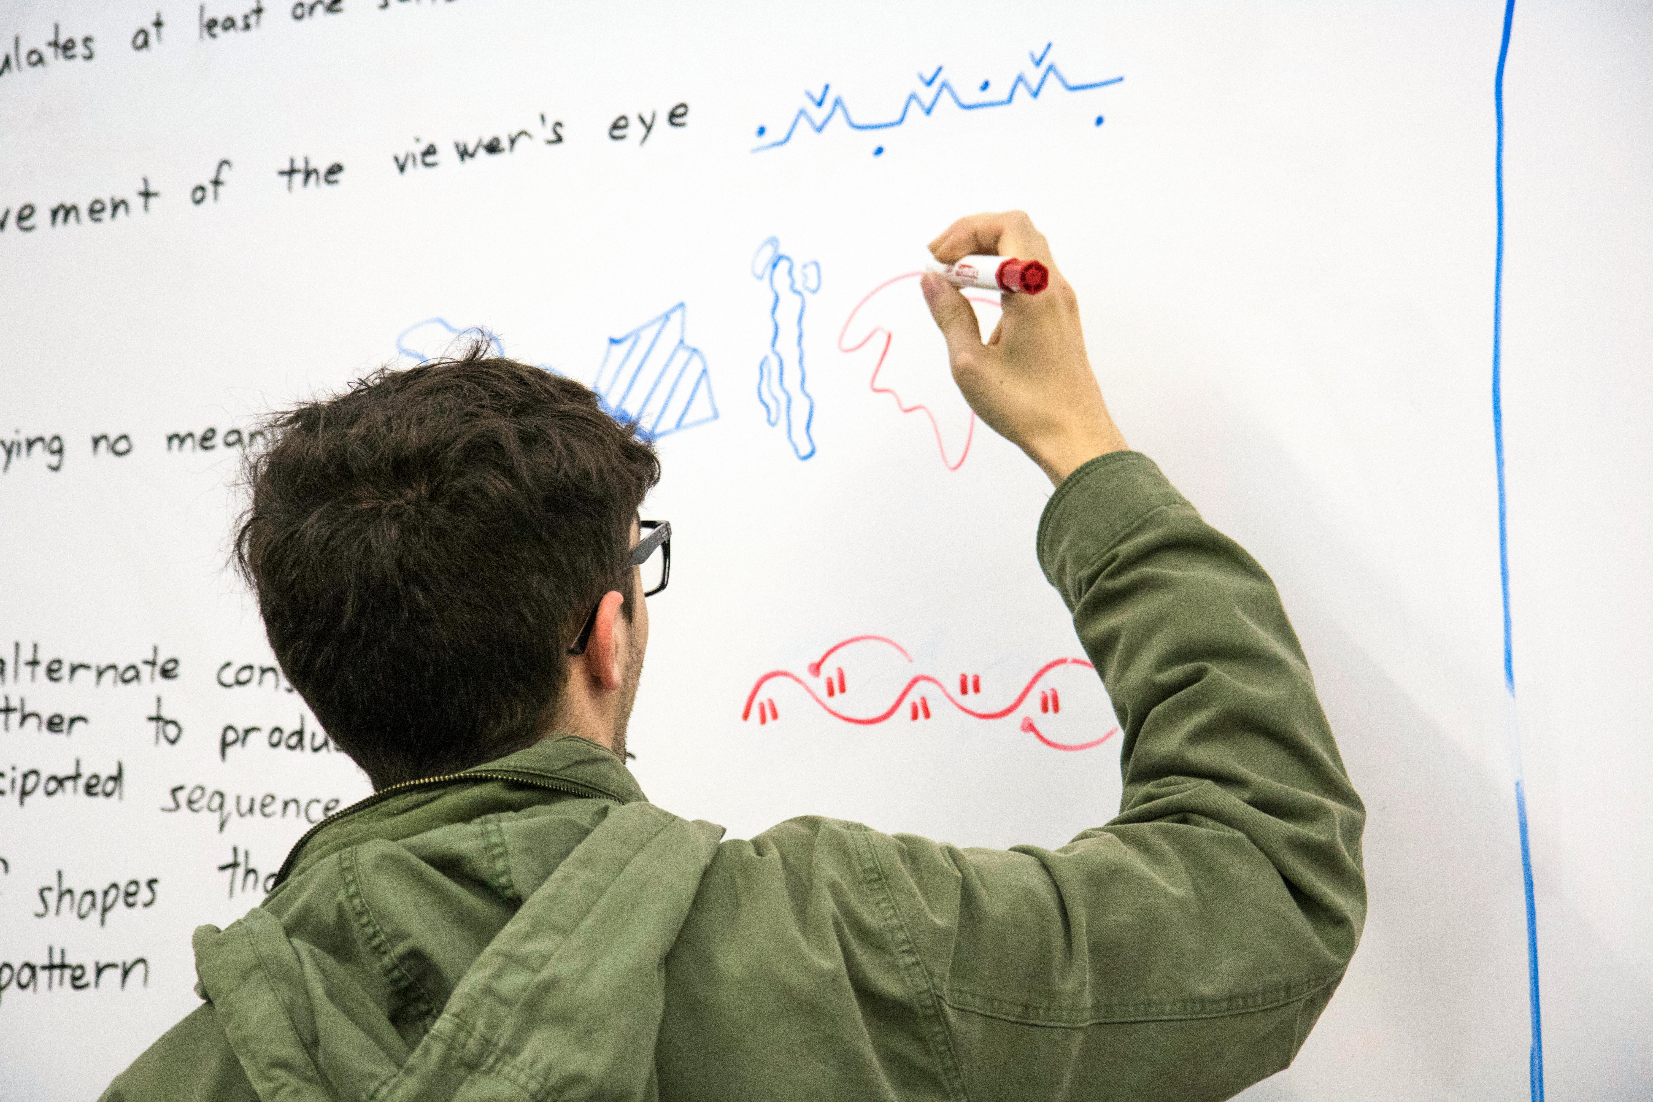
Cell Division: The Foundation of Life and Growth
6
Types of Cell Division
Mitosis
Meiosis
Mitosis: results in two daughter cells genetically identical to the parent cell.
This process is essential for growth, repair, and asexual reproduction in organisms.
Meiosis: results in four daughter cells with unique combinations of chromosomes.
This process is crucial for sexual reproduction and genetic diversity.

Slide 7
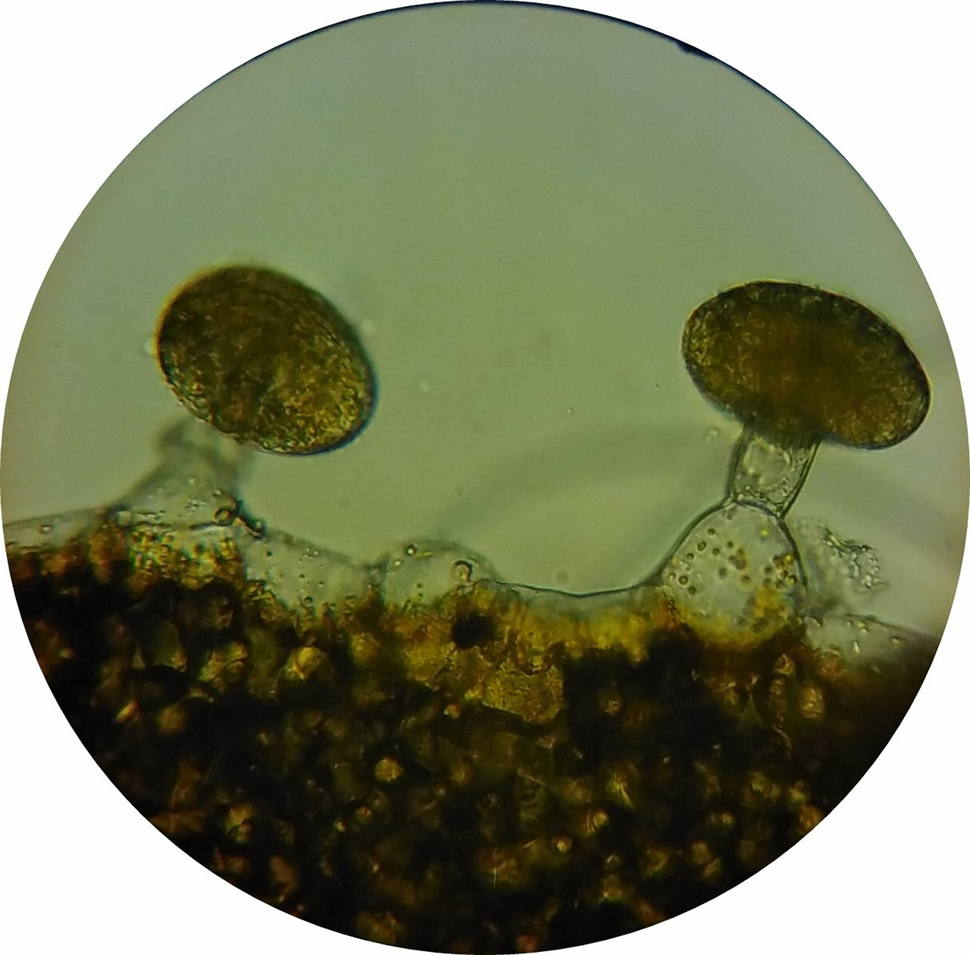
Cell Division: The Foundation of Life and Growth
7
Stages of Mitosis
Prophase
Metaphase
Anaphase
Telophase
Cytokinesis
Chromosomes condense and become visible.
This marks the beginning of mitosis.
Chromosomes align at the center of the cell.
This alignment ensures proper separation later.
Sister chromatids separate and move to opposite poles.
This step is crucial for equal distribution of genetic material.
The nuclear envelope reforms, and chromosomes uncoil.
This prepares the cell for the final division.
The cytoplasm divides, and the cell splits into two daughter cells.
This completes the process of cell division.

Slide 8
Cell Division: The Foundation of Life and Growth
8
Importance of Cell Division
Growth
Repair
Reproduction
Maintenance of Tissue Homeostasis
Cell division allows organisms to grow and increase in size.
This process is fundamental for the development of multicellular organisms.
Cell division helps replace damaged or dead cells with new ones.
This ensures the proper functioning and recovery of tissues.
Cell division is essential for the production of gametes (sperm and egg cells).
It plays a critical role in sexual reproduction and the continuation of species.
Cell division helps maintain the balance of cells within tissues.
This balance is crucial for the stability and health of an organism.

Slide 9
Cell Division: The Foundation of Life and Growth
9
Cell Division in Real Life
Wound Healing
Cancer
Regeneration
Cell division plays a crucial role in repairing damaged tissues.
This process is essential for recovery after injuries.
Uncontrolled cell division can result in the development of cancer.
This highlights the importance of regulation in cellular processes.
Certain organisms utilize cell division to regrow lost body parts.
This ability showcases the remarkable potential of cellular mechanisms.

Slide 10
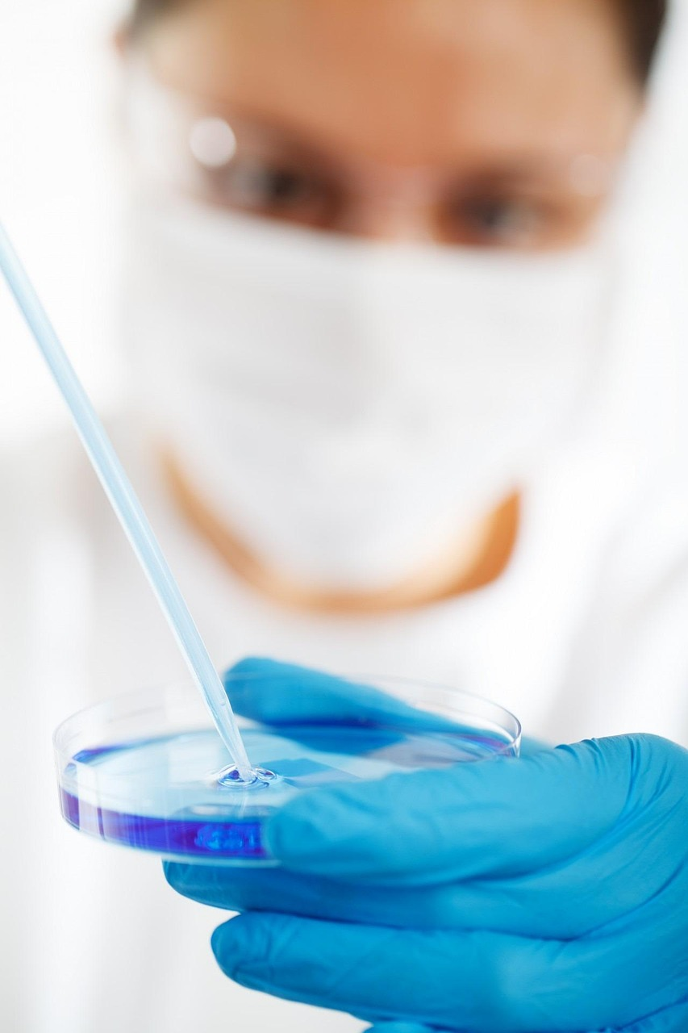
Cell Division: The Foundation of Life and Growth
10
Applications of Cell Division
Medicine
Biotechnology
Agriculture
Understanding cell division can help in the development of treatments for diseases.
Cell division research is crucial for advancements in medical therapies.
Cell division is used in the production of bioproducts and genetically modified organisms.
This process is integral to innovations in biotechnology.
Cell division is essential for plant growth and development.
It plays a key role in improving agricultural productivity.

Slide 11
Cell Division: The Foundation of Life and Growth
11
Common Errors and Misconceptions
01
02
Misconception about Cell Division
Confusion Between Mitosis and Meiosis
Believing that cell division is a random and uncontrolled process.
This misunderstanding can lead to confusion about the mechanisms of growth and repair in organisms.
Confusing mitosis and meiosis, or thinking they are the same process.
This error overlooks the distinct roles these processes play in reproduction and cellular function.

Slide 12
Cell Division: The Foundation of Life and Growth
12
Frequently Asked Questions
Understanding Cell Division
Mitosis: Identical Daughter Cells
Meiosis: Genetic Diversity
Cell division is the process by which a cell divides into two or more daughter cells.
It is a fundamental mechanism for growth, repair, and reproduction in living organisms.
Mitosis results in two genetically identical daughter cells.
This process is crucial for tissue growth and repair in multicellular organisms.
Meiosis results in four daughter cells with unique combinations of chromosomes.
It plays a key role in sexual reproduction and genetic variation.

Slide 13
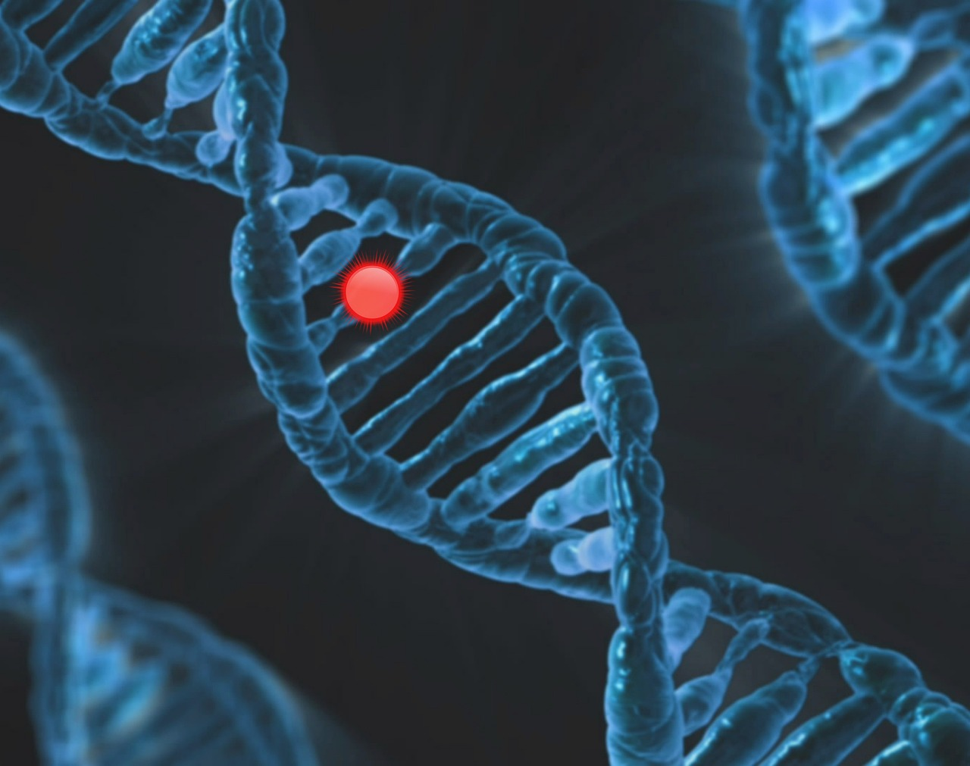
Cell Division: The Foundation of Life and Growth
13
Key Vocabulary
Mitosis
Meiosis
Chromosome
Gene
DNA
The process of cell division resulting in two genetically identical daughter cells.
It ensures that each new cell receives an exact copy of the parent cell's DNA.
The process of cell division resulting in four daughter cells with unique combinations of chromosomes.
This is essential for sexual reproduction and genetic diversity.
A thread-like structure that carries genes in the nucleus of a cell.
Chromosomes ensure the accurate transfer of genetic material during cell division.
A unit of heredity that carries information from one generation to the next.
Genes are segments of DNA that determine specific traits in an organism.
Deoxyribonucleic acid, the molecule that contains genetic instructions for the development and function of an organism.
DNA is structured as a double helix and is the blueprint for all living things.

Slide 14
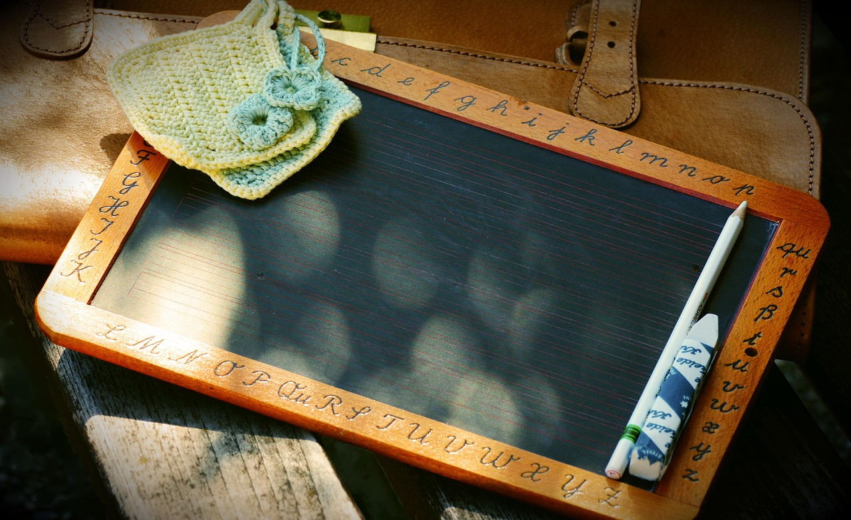
Cell Division: The Foundation of Life and Growth
14
Teaching Tips
Visual Aids for Clarity
Hands-On Engagement
Fostering Critical Thinking
Use visual aids and diagrams to explain complex concepts.
These tools help students grasp abstract ideas effectively.
Incorporate hands-on activities and experiments to engage students.
Such activities make learning interactive and memorable.
Encourage discussion and questioning to promote critical thinking.
This approach helps students develop analytical skills.

Slide 15
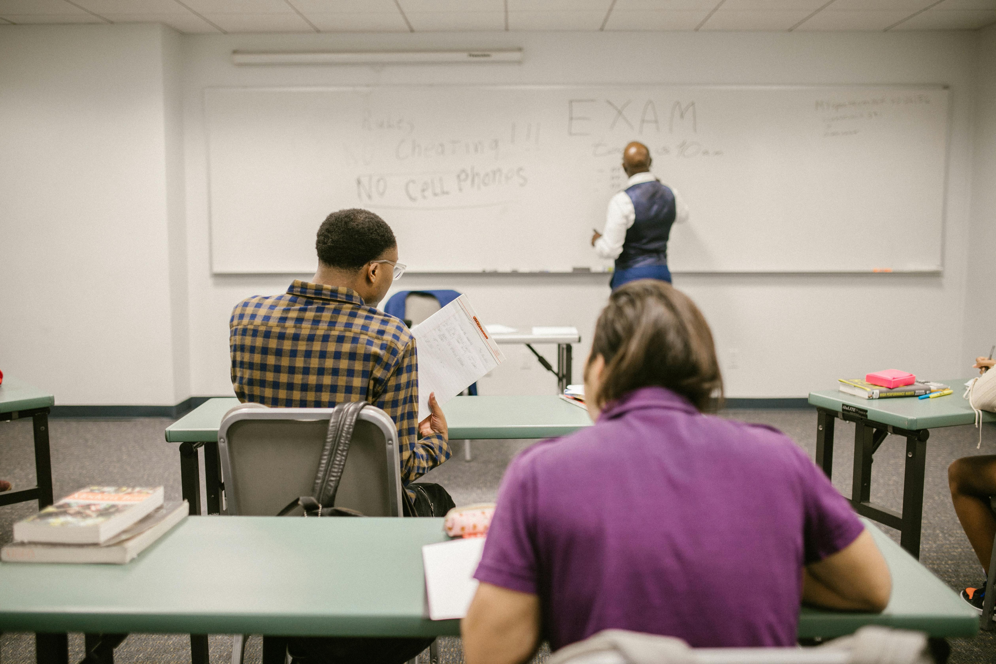
Cell Division: The Foundation of Life and Growth
15
Assessment and Evaluation
Formative Assessments
Summative Assessments
Quizzes, class discussions, and assignments to monitor student progress.
These tools help in identifying areas where students need improvement during the learning process.
Tests, projects, and presentations to evaluate student understanding at the end of the unit.
These methods provide a comprehensive overview of what students have learned.

Slide 16
Cell Division: The Foundation of Life and Growth
16
Conclusion
01
02
The Importance of Cell Division
Practical Applications of Cell Division
Cell division is a fundamental concept in biology that underlies many biological processes.
Understanding cell division is crucial for understanding life and has practical applications in various fields.
Understanding cell division is crucial for understanding life and has practical applications in various fields.
Cell division is a fundamental concept in biology that underlies many biological processes.

Slide 17
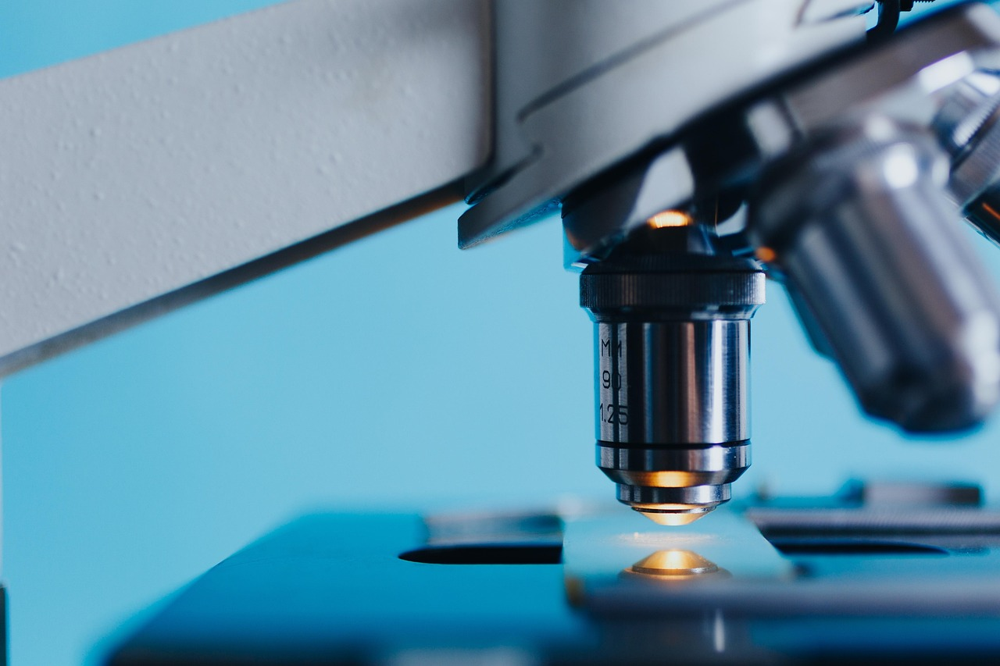
Cell Division: The Foundation of Life and Growth
17
Reflection Questions
Understanding Cell Division
Applications in Medicine
Impact on Agriculture
What did you learn about cell division?
How does cell division relate to real-life scenarios?
What are some potential applications of cell division in medicine?
How does cell division contribute to advancements in biotechnology?
What are some potential applications of cell division in agriculture?
How does cell division influence crop improvement and sustainability?

Slide 18
Cell Division: The Foundation of Life and Growth
18
Next Steps
01
02
Understanding DNA
Gene Expression Insights
Learn about the structure and function of DNA.
Explore the process of gene expression and regulation.
Explore the process of gene expression and regulation.
Learn about the structure and function of DNA.

Slide 19

Cell Division: The Foundation of Life and Growth
19
Additional Resources
Textbooks and Online Resources
Educational Videos and Animations
Textbooks and online resources for further reading.
These materials provide foundational knowledge and in-depth insights.
Educational videos and animations to supplement learning.
These tools make complex concepts easier to understand.

Slide 20

Cell Division: The Foundation of Life and Growth
20
Parent Engagement
Encouraging Conversations
Encourage parents to ask their children about what they learned.
This fosters communication and helps parents stay involved in their child's education.
Learning Together
Provide resources and activities for parents to learn alongside their children.
This creates opportunities for shared experiences and mutual growth.

Slide 21
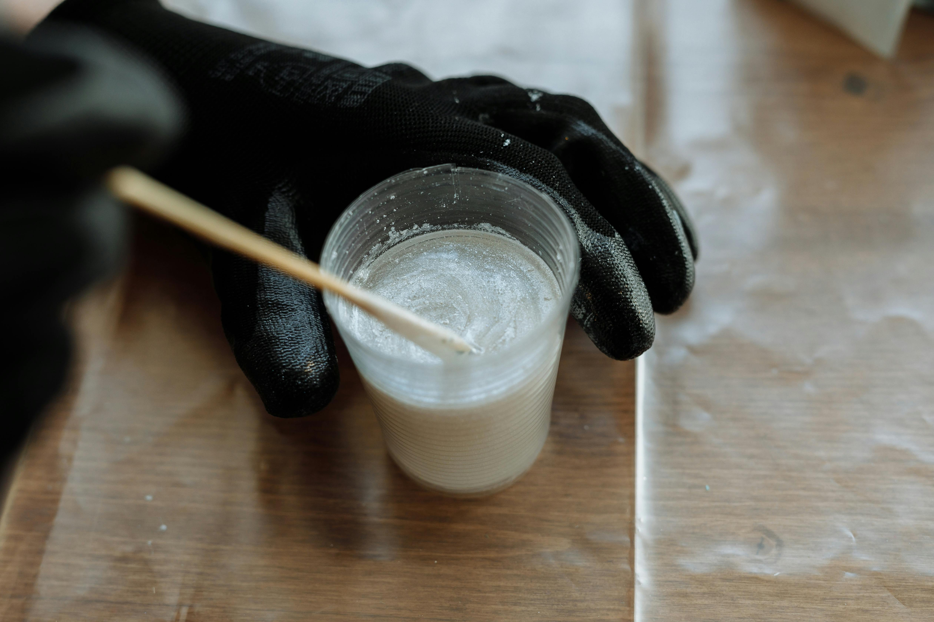
Cell Division: The Foundation of Life and Growth
21
Safety Considerations
Handling Biological Materials
Laboratory Safety Protocols
Handle biological materials and equipment with care.
Follow proper protocols for laboratory experiments and activities.
Handle biological materials and equipment with care.
Follow proper protocols for laboratory experiments and activities.

