Slide 1
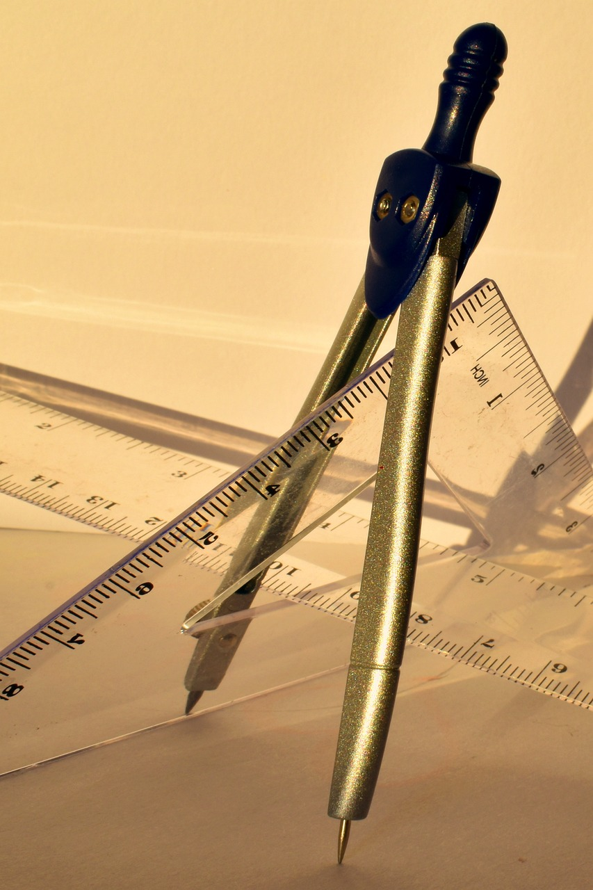
Introduction to Measurement Concepts and Vocabulary
Building foundational measurement skills for young learners through inclusive and engaging activities

Slide 2
Table of Contents
Introduction to Measurement Concepts and Vocab…
Importance of Measurement Concepts
Lesson Objectives
Key Vocabulary
Teaching Strategies
Differentiated Activities
Assessment and Feedback
Parent Engagement
Conclusion
Next Steps
Reflection Questions
Homework Activities
Extension Activities
04
05
06
07
08
09
10
11
12
13
14
15
16

Slide 3
Table of Contents
Key Takeaways
Teaching Tips
Safety Considerations
Formative Assessment
Summative Assessment
17
18
19
20
21

Slide 4

Introduction to Measurement Concepts and Vocabulary
Importance of Measurement Concepts
Lesson Plan Objectives
Inclusive Learning Approach
Introduction to measurement concepts and vocabulary is crucial for 6-year-old students in New Zealand.
This foundational knowledge supports their understanding of the world around them.
This lesson plan aims to introduce basic measurement vocabulary and concepts, such as big, small, longer, and shorter.
These concepts are essential for developing early mathematical skills.
Differentiated activities will cater to mixed-ability groups, including English language learners.
This ensures that all students can engage and benefit from the lesson.
4
Introduction to Measurement Concepts and Vocabulary

Slide 5

Importance of Measurement Concepts
Essential Role in Everyday Problem-Solving
Foundation for Advanced Mathematical Concepts
Enhancing Descriptive Language Skills
Understanding size and measurement is essential for problem-solving in everyday life.
It helps individuals navigate and make decisions in various real-world scenarios.
Measurement concepts lay the foundation for more complex mathematical concepts.
These concepts are crucial for academic and professional growth in STEM fields.
Developing measurement vocabulary enhances students' descriptive language skills.
This improvement supports better communication and understanding in educational settings.
5
Introduction to Measurement Concepts and Vocabulary

Slide 6
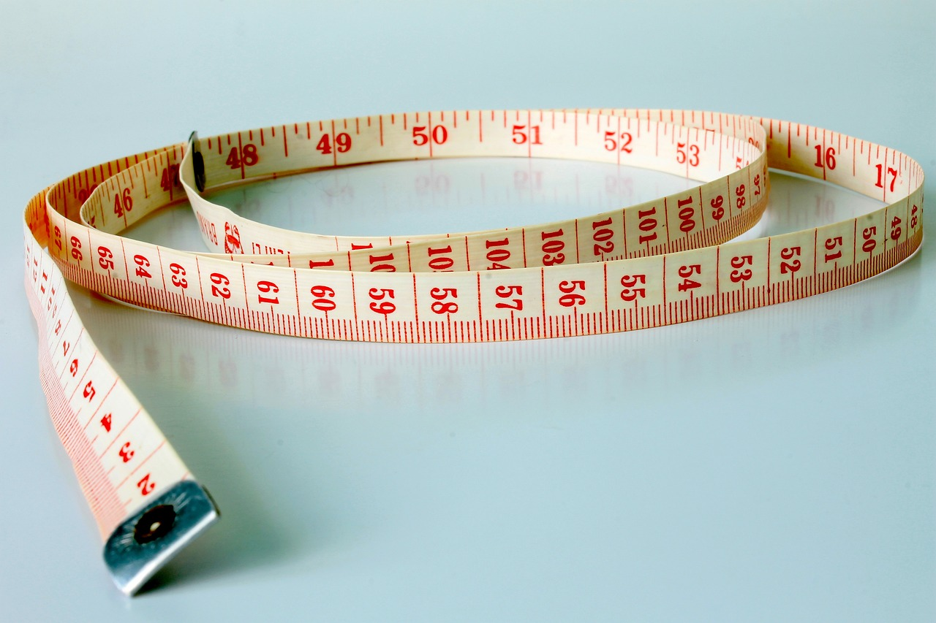
Lesson Objectives
Understanding Measurement Vocabulary
Comparing Objects by Size
Students will recall and define basic measurement vocabulary related to size.
This foundational knowledge is essential for further exploration of measurement concepts.
Students will demonstrate an understanding of comparing objects by size.
This skill helps in distinguishing and categorizing objects effectively.
Ordering Objects Using Measurement Vocabulary
Identifying Patterns in Object Sizes
Students will apply their knowledge of measurement vocabulary to order objects.
This activity reinforces their ability to sequence items based on size.
Students will analyze and identify patterns in the sizes of objects.
Recognizing these patterns aids in developing critical thinking and analytical skills.
6
Introduction to Measurement Concepts and Vocabulary

Slide 7
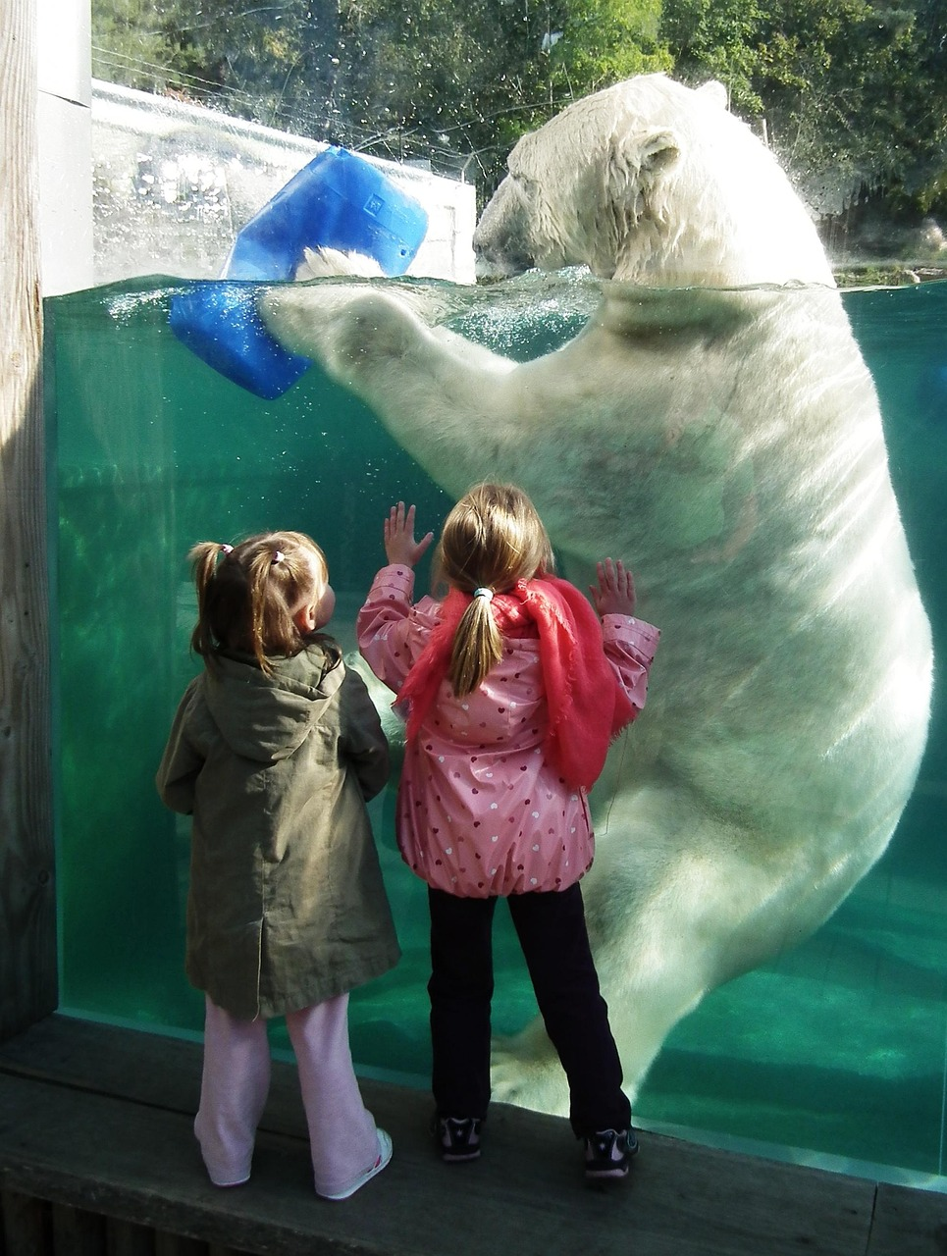
Key Vocabulary
Definition of Big
Definition of Small
Definition of Long
Big: Larger in size than something else.
This term is used to describe objects or entities that are comparatively larger.
Small: Smaller in size than something else.
It refers to objects or entities that are comparatively smaller.
Long: Extending a great distance from one end to the other.
This term is often used to describe objects with significant length.
Definition of Short
Definition of Longer
Short: Not long; extending a short distance from one end to the other.
It is used to describe objects with minimal length.
Longer: Comparative form of long; extending a greater distance than something else.
This term is used to compare the length of two objects or entities.
7
Introduction to Measurement Concepts and Vocabulary

Slide 8

Teaching Strategies
1
Real-Life Examples in Measurement
Use real-life examples to demonstrate measurement concepts.
This approach helps students relate abstract ideas to their everyday experiences.
2
Visual Aids for Vocabulary Retention
Incorporate visual aids to help students understand and remember measurement vocabulary.
Visual tools make abstract terms more tangible and easier to recall.
3
Hands-On Measurement Practice
Provide hands-on activities for students to practice measuring and comparing objects.
Engaging in practical tasks enhances comprehension and skill development.
8
Introduction to Measurement Concepts and Vocabulary

Slide 9

Differentiated Activities
1
Support for English Language Learners
Use simple language, visual aids, and demonstrations to support understanding.
These strategies help ensure comprehension and engagement for students learning English.
2
Guidance for Students Needing Extra Support
Provide additional guidance and modify activities to make them more accessible.
This approach ensures that all students can participate and succeed in the learning process.
3
Challenges for Advanced Students
Offer additional challenges, such as measuring more complex shapes or solving simple measurement problems.
These tasks encourage deeper thinking and skill development for advanced learners.
9
Introduction to Measurement Concepts and Vocabulary

Slide 10
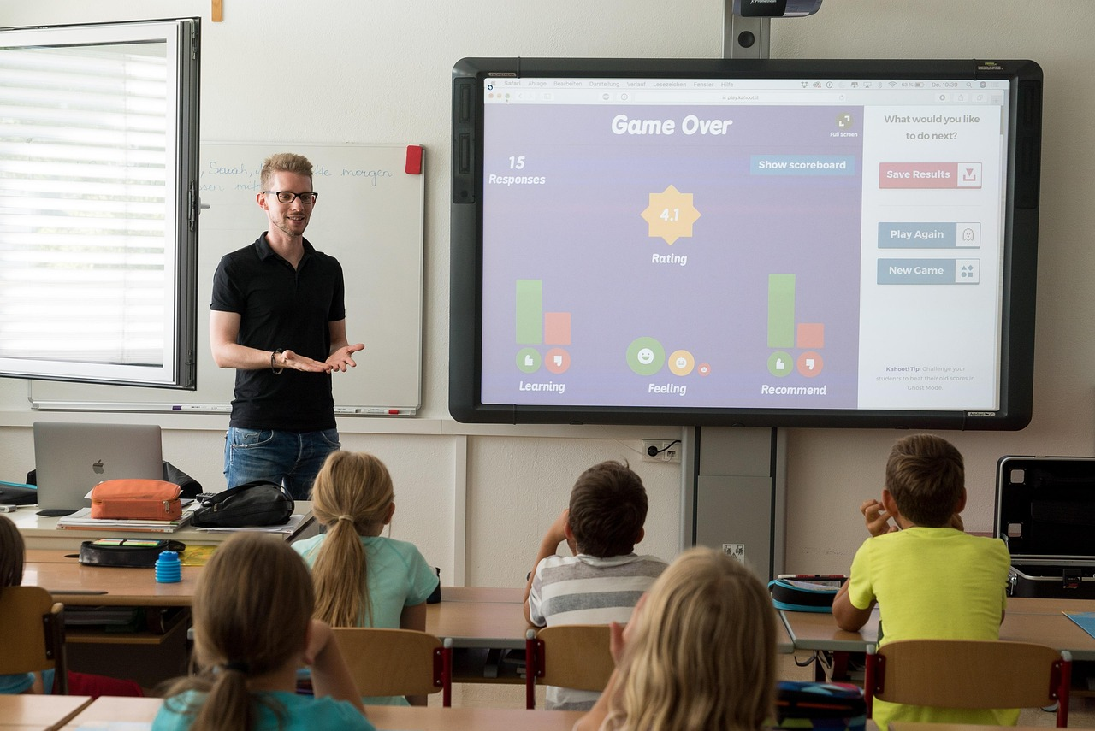
Assessment and Feedback
Regular Assessment Methods
Constructive Feedback
Student Self-Reflection
Regularly assess student understanding through observations, quizzes, and class discussions.
These methods help identify areas where students may need additional support.
Provide constructive feedback that is specific, positive, and actionable.
This approach fosters a supportive learning environment and encourages improvement.
Encourage students to reflect on their own learning and set goals for improvement.
Self-reflection promotes autonomy and helps students take ownership of their progress.
10
Introduction to Measurement Concepts and Vocabulary

Slide 11

Parent Engagement
Regular Progress Updates
Home Measurement Activities
Parent-Child Challenges
Encourage parents to engage with their child's learning through regular progress updates.
This helps parents stay informed and actively involved in their child's educational journey.
Provide parents with simple measurement activities to do with their child at home.
These activities make learning interactive and strengthen the parent-child bond.
Organize parent-child challenges that focus on measurement concepts.
Such challenges promote teamwork and make learning measurement fun and engaging.
11
Introduction to Measurement Concepts and Vocabulary

Slide 12
Conclusion
Importance of Measurement Concepts
Catering to Diverse Needs
Comprehensive Lesson Plan
Introducing measurement concepts and vocabulary is crucial for 6-year-old students.
This foundational knowledge supports their cognitive and academic development.
Differentiated activities cater to the diverse needs of students, including English language learners.
This ensures an inclusive learning environment for all students.
By following this lesson plan, teachers can provide a comprehensive introduction to measurement concepts and vocabulary.
This structured approach enhances the effectiveness of teaching.
12
Introduction to Measurement Concepts and Vocabulary

Slide 13
Next Steps
1
2
3
Numerical Measurements
Understanding Capacity
Time and Duration
Introduce numerical measurements using non-standard and standard units.
This will help students understand the basics of quantifying objects and comparing sizes.
Teach the concept of capacity, comparing the volumes of different containers.
Students will learn to differentiate between larger and smaller volumes effectively.
Introduce time and duration, teaching students to tell time and understand concepts such as morning, afternoon, yesterday, today, and tomorrow.
This will build their ability to organize and sequence daily activities.
13
Introduction to Measurement Concepts and Vocabulary

Slide 14

Reflection Questions
1
2
3
Effective Strategies for Engagement
Differentiated Activities for Mixed-Ability Groups
Connecting Learning to Real-Life and Curriculum
What strategies were most effective in engaging students and promoting their understanding of measurement concepts and vocabulary?
This question encourages reflection on teaching methods that successfully captured students' interest and enhanced their comprehension.
How did the differentiated activities cater to the needs of mixed-ability groups?
This inquiry focuses on evaluating how tailored activities addressed diverse learning needs within the classroom.
In what ways can the learning from this lesson be connected to real-life scenarios or other areas of the curriculum?
This prompts consideration of practical applications and interdisciplinary connections of the lesson's content.
14
Introduction to Measurement Concepts and Vocabulary

Slide 15

Homework Activities
Measurement Scavenger Hunt
Size Sorting Game
Measurement Booklet
Find objects at home that are big, small, long, or short.
Engage in a fun activity to explore and compare different sizes.
Sort pictures or objects of different sizes from smallest to largest or vice versa.
This activity helps in understanding size relationships and order.
Create a booklet with pictures of objects and write or draw something about the size of each object.
A creative way to document and learn about measurements.
15
Introduction to Measurement Concepts and Vocabulary

Slide 16
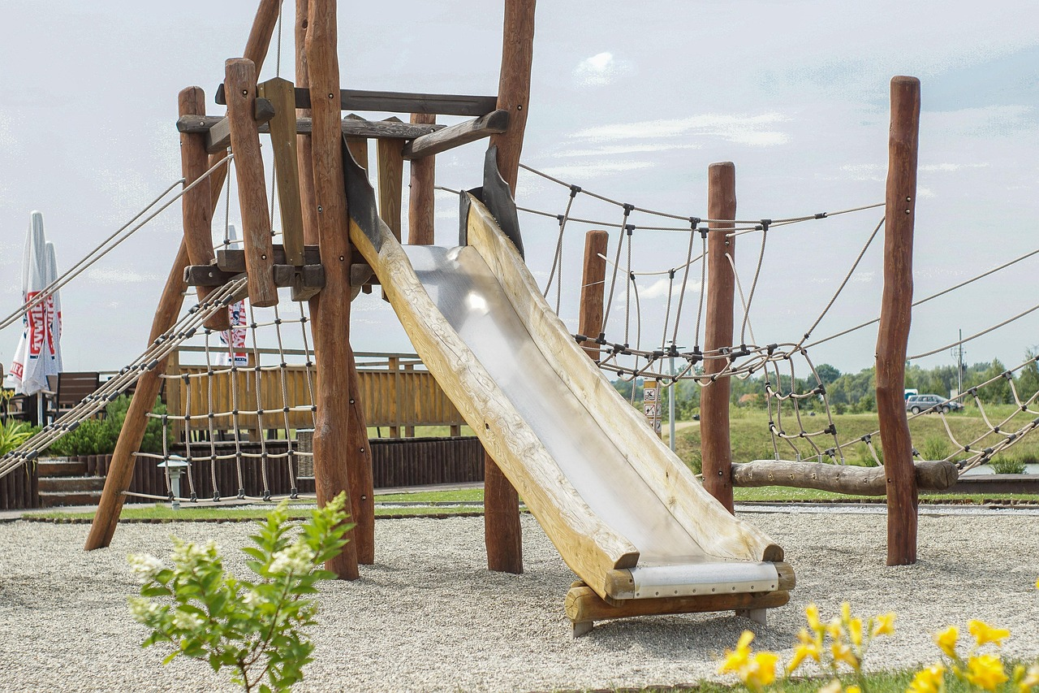
Extension Activities
Measurement Obstacle Course
Design a measurement obstacle course: Incorporate measurement concepts and vocabulary into an obstacle course.
Participants navigate through challenges while applying measurement skills.
Measurement Storybook Creation
Create a measurement storybook: Write and illustrate a story that incorporates measurement concepts and vocabulary.
This activity combines creativity with learning measurement in a narrative format.
Measurement Bingo Game
Measurement bingo: Create bingo cards with pictures or words related to measurement and play a game of bingo.
Engage learners in a fun and interactive way to reinforce measurement concepts.
16
Introduction to Measurement Concepts and Vocabulary

Slide 17

Key Takeaways
Understanding Measurement Vocabulary
Comparing Objects by Size
Ordering Objects by Size
Students will understand and use basic measurement vocabulary.
This foundational knowledge will help them describe and compare objects effectively.
Students will learn to compare objects by size.
This skill is essential for recognizing differences and similarities in dimensions.
Students will be able to order objects from smallest to largest or vice versa.
This ability supports logical thinking and sequencing skills.
17
Introduction to Measurement Concepts and Vocabulary

Slide 18

Teaching Tips
1
Real-Life Examples
Use real-life examples to demonstrate measurement concepts.
This helps students connect theoretical knowledge to practical applications.
2
Visual Aids
Incorporate visual aids to help students understand and remember measurement vocabulary.
Visual tools enhance comprehension and retention of key terms.
3
Hands-On Activities
Provide hands-on activities for students to practice measuring and comparing objects.
Engaging in practical tasks reinforces learning and builds confidence.
18
Introduction to Measurement Concepts and Vocabulary

Slide 19
Safety Considerations
1
Safe Classroom Environment
Ensure the classroom environment is safe and free from hazards.
This includes checking for any potential risks and addressing them promptly.
2
Material Handling Guidance
Provide guidance on handling materials safely and correctly.
This ensures students understand the proper procedures to avoid accidents.
3
Behavioral Rules and Expectations
Establish clear rules and expectations for behavior during the lesson.
This helps maintain order and ensures a focused learning environment.
19
Introduction to Measurement Concepts and Vocabulary

Slide 20

Formative Assessment
1
Observing Student Activities
Observe students during activities to assess their understanding.
This helps in identifying areas where they may need additional support.
2
Encouraging Peer Assessment
Use peer assessment to encourage students to evaluate each other's work.
This fosters collaboration and critical thinking among students.
3
Promoting Self-Reflection
Provide self-assessment checklists for students to reflect on their learning.
This enables students to take ownership of their educational progress.
20
Introduction to Measurement Concepts and Vocabulary

Slide 21

Summative Assessment
1
2
3
Measurement Scavenger Hunt
Size Sorting Activity
Measurement Vocabulary Quiz
Assess students' ability to identify and record objects of different sizes.
Encourage exploration and observation skills through hands-on activities.
Evaluate students' ability to sort objects from smallest to largest or vice versa.
Promote critical thinking and organizational skills in a practical context.
Assess students' understanding of measurement vocabulary.
Test knowledge retention and application of key terms related to measurement.
21
Introduction to Measurement Concepts and Vocabulary

