Slide 1
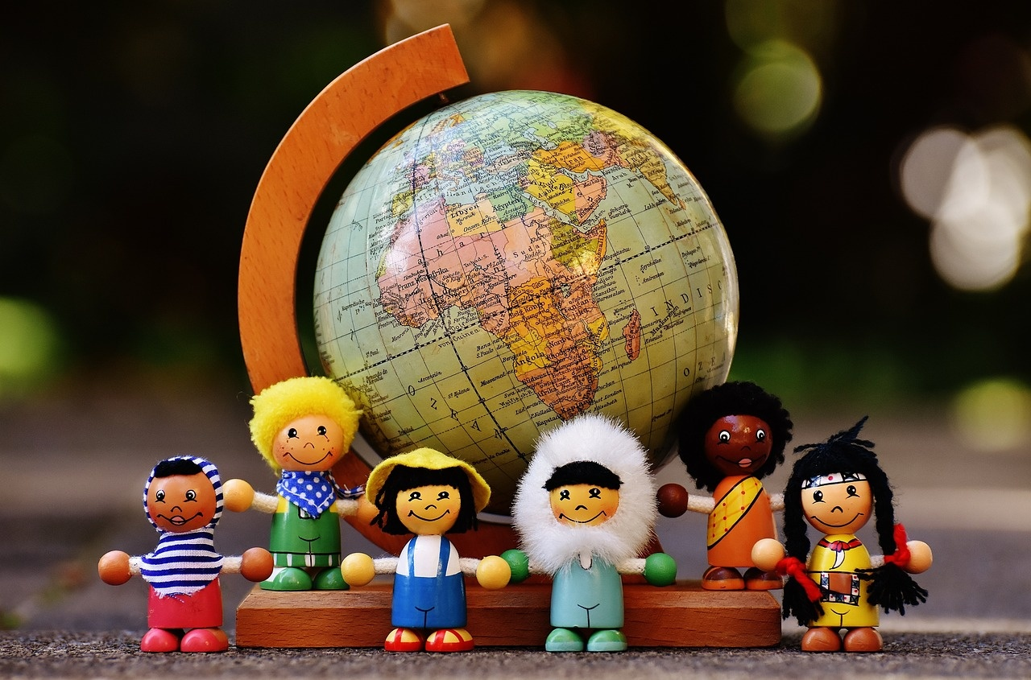
Understanding Global Warming: Challenges and Solutions
Exploring the Impact, Mitigation Strategies, and Community Engagement in the Fight Against Climate Change

Slide 2
Table of contents
Introduction to Global Warming
The Carbon Cycle
Effects on the Great Barrier Reef
Rising Sea Levels and Geological Changes
Mitigation and Adaptation Strategies
Case Study: The Maldives
Group Activity: Carbon Footprint Calculator
Debate: Individual Actions vs. Government Policies
Reflection and Next Steps
Conclusion
01
02
03
04
05
06
07
08
09
10

Slide 3
Table of contents
Additional Resources
Assessment and Evaluation
Extension Activities
Parent Engagement
Safety Considerations
Teaching Tips
11
12
13
14
15
16

Slide 4

Understanding Global Warming: Challenges and Solutions
1
Introduction to Global Warming
Human Impact
Educational Focus
Environmental Effects
Global warming is caused by human activities, particularly the burning of fossil fuels, leading to a rise in Earth's average temperature.
The UK primary school curriculum teaches students about global warming, focusing on its causes and environmental effects.
This presentation will examine how global warming affects the Great Barrier Reef, emphasizing its ecological importance and the risks from rising sea levels.

Slide 5

Understanding Global Warming: Challenges and Solutions
2
The Carbon Cycle
Basic Components
Climate Regulation
The carbon cycle includes the atmosphere, oceans, land, and living organisms.
Carbon is stored as carbon dioxide in the atmosphere and as organic matter in the soil.
The carbon cycle regulates Earth's climate by controlling atmospheric carbon dioxide levels.
Changes in the carbon cycle significantly affect weather and global temperatures.
Human Impact
Reduction Strategies
Human activities, such as burning fossil fuels and deforestation, have altered the natural carbon cycle significantly.
These actions raise carbon dioxide levels, driving global warming and climate change.
To mitigate human impact, strategies like reforestation and carbon capture technologies can be implemented.
Renewable energy reduces carbon emissions and helps restore the carbon cycle.

Slide 6
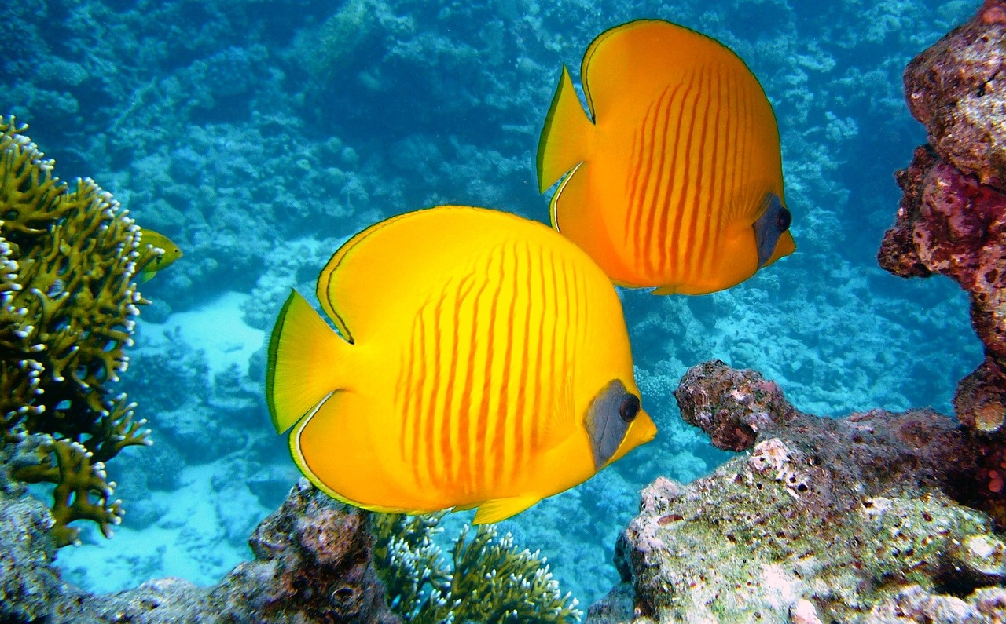
Understanding Global Warming: Challenges and Solutions
3
Effects on the Great Barrier Reef
Coral Bleaching
Rising Sea Temperatures
Conservation Efforts
Coral bleaching occurs when corals expel the algae living in their tissues due to stress from rising temperatures.
This process leads to a loss of color and can result in coral death if conditions do not improve.
Increased sea temperatures disrupt the delicate balance of marine ecosystems, affecting species diversity.
Coral reefs are particularly vulnerable, as even slight temperature increases can lead to widespread bleaching.
Various organizations are working to protect the Great Barrier Reef through restoration and sustainable practices.
Efforts include reducing carbon emissions, improving water quality, and establishing marine protected areas.

Slide 7
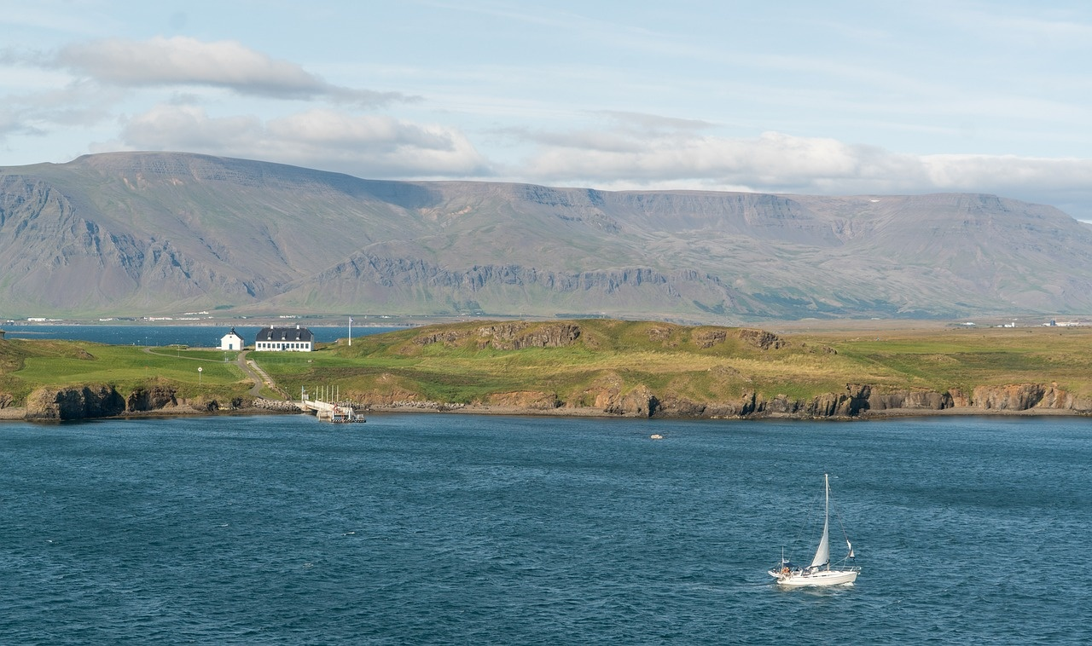
Understanding Global Warming: Challenges and Solutions
4
Rising Sea Levels and Geological Changes
Coastal Impact
Ecosystem Analysis
Rising sea levels pose a significant threat to coastal communities, leading to increased flooding.
Erosion of shorelines results in habitat loss for various marine and terrestrial species.
Ecosystems respond differently to rising sea levels, influencing local biodiversity.
Wetlands and mangroves are especially at risk, diminishing their role as natural barriers.
Food Production Risks
Adaptation Strategies
Changes in land elevation can disrupt agricultural areas, threatening food supply chains.
Saltwater intrusion jeopardizes freshwater sources, essential for irrigation and crop growth.
Sustainable coastal management practices can help mitigate the adverse effects of rising seas.
Developing resilient agricultural methods is crucial for maintaining food security in affected regions.

Slide 8
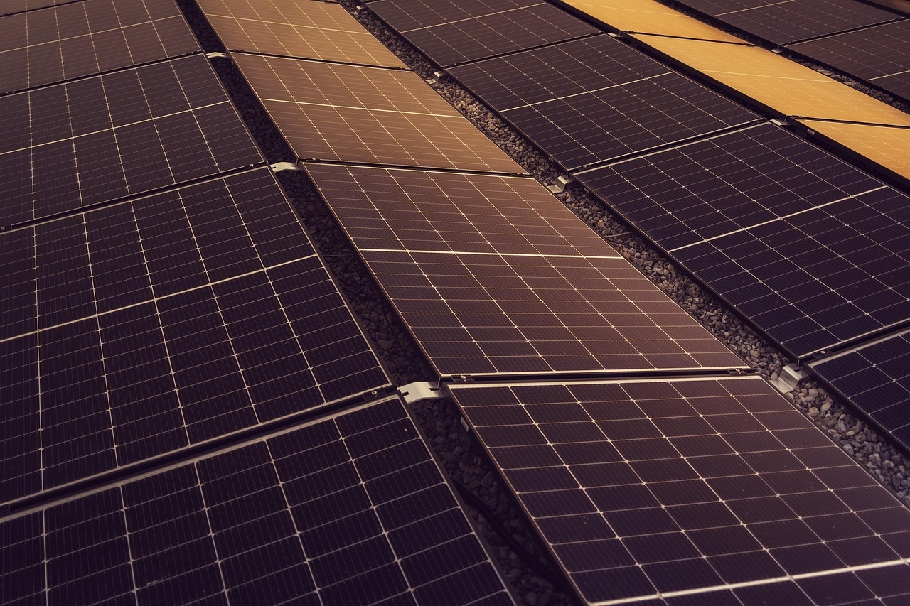
Understanding Global Warming: Challenges and Solutions
5
Mitigation and Adaptation Strategies
Carbon Footprint Reduction
Policy Exploration
Implementing energy-efficient practices at home and in transportation can significantly lower individual carbon footprints.
Encouraging the use of renewable energy sources, such as solar and wind, helps reduce reliance on fossil fuels.
Investigating local and national policies that promote sustainable practices is essential for effective climate action.
Advocating for stricter emissions regulations can lead to significant reductions in greenhouse gas outputs.
International Agreements
Community Project Design
Participating in global agreements like the Paris Accord is crucial for coordinated efforts to combat climate change.
Monitoring compliance with international climate commitments ensures accountability among nations.
Designing community-based initiatives, such as tree planting or recycling programs, fosters local engagement in climate action.
Proposing educational workshops can empower residents to adopt sustainable practices in their daily lives.

Slide 9

Understanding Global Warming: Challenges and Solutions
6
Case Study: The Maldives
Rising Sea Levels
Economic Impact
Adaptation Strategies
Rising sea levels pose a serious threat to the Maldives.
Communities face the risk of losing their homes and livelihoods.
Flooding threatens tourism, a vital part of the economy.
Damage to infrastructure can lead to costly repairs and lost revenue.
Relocating communities to safer areas is crucial.
Enhancing infrastructure to withstand flooding is essential.

Slide 10

Understanding Global Warming: Challenges and Solutions
7
Group Activity: Carbon Footprint Calculator
Calculate Footprint
Sector Analysis
Reduction Strategies
Students will use an online calculator to determine their personal carbon footprint.
This activity encourages awareness of individual contributions to carbon emissions.
Foundation learners will focus on simple calculations related to their daily activities.
Core learners will analyze the impact of transportation, energy, and food sectors on their carbon footprint.
Extension learners will propose actionable strategies to reduce their carbon footprint.
They will create a detailed plan for implementing these strategies in their daily lives.

Slide 11

Understanding Global Warming: Challenges and Solutions
8
Debate: Individual Actions vs. Government Policies
Individual Actions
Government Impact
Global Agreements
Individuals can reduce their carbon footprint by adopting simple habits like using public transport, recycling, and conserving energy.
Every small action contributes to a larger impact on the environment, encouraging others to follow suit.
Government policies play a crucial role in setting regulations that limit emissions and promote sustainable practices.
Effective legislation can drive significant changes in industry standards and public behavior towards climate action.
International agreements, such as the Paris Agreement, aim to unite countries in the fight against climate change.
These agreements establish targets for emissions reductions and foster collaboration among nations to achieve global sustainability.

Slide 12
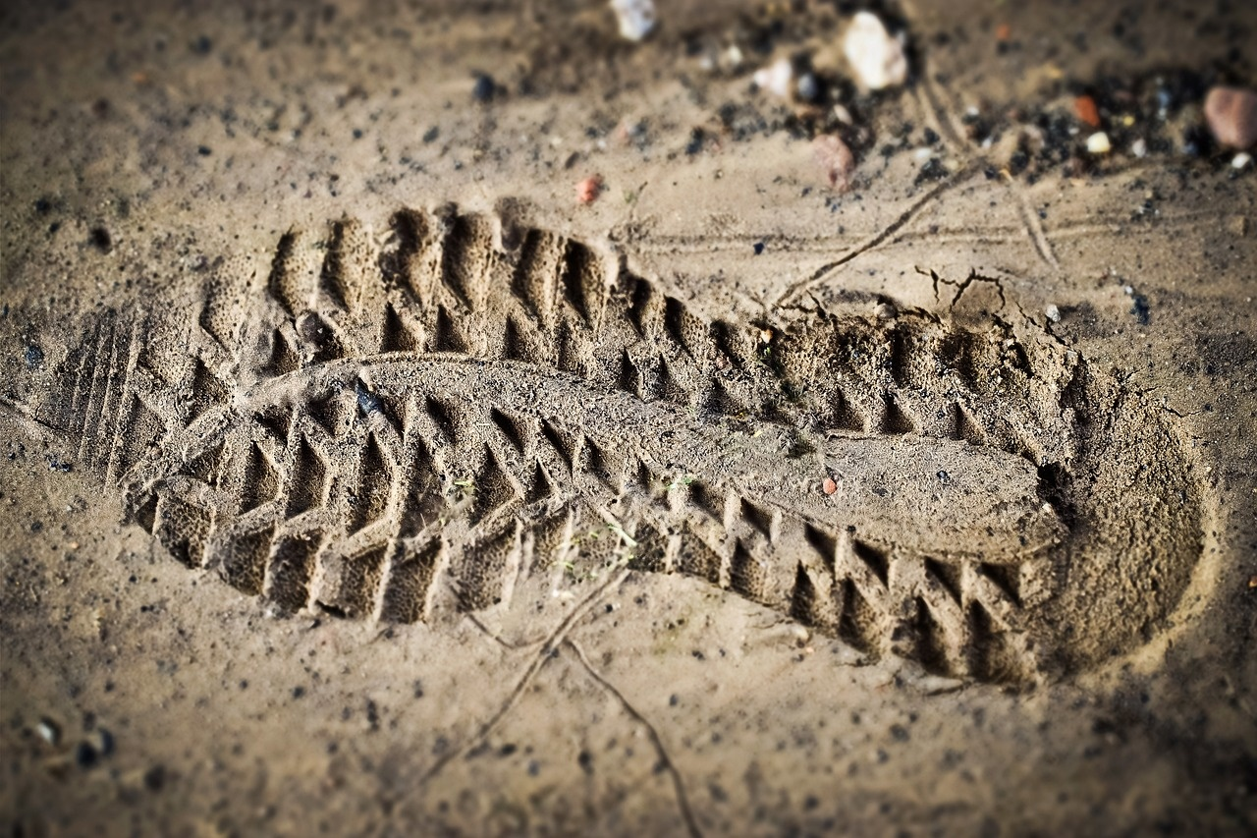
Understanding Global Warming: Challenges and Solutions
9
Reflection and Next Steps
Carbon Footprint Action
Collective Action Importance
Ongoing Learning Plan
Foundation learners can start by reducing single-use plastics in their daily lives.
Simple changes like using reusable bags and bottles can significantly lower individual carbon footprints.
Core learners should understand that collective efforts amplify individual actions in combating global warming.
Working together in communities can lead to larger initiatives that create meaningful change.
Extension learners are encouraged to stay informed about climate issues through workshops and online courses.
Creating a personal action plan can help maintain focus on reducing carbon emissions over time.

Slide 13

Understanding Global Warming: Challenges and Solutions
10
Conclusion
Understanding Global Warming
Taking Action for a Sustainable Future
Global warming is a complex issue that significantly impacts both the environment and human societies.
Recognizing the causes and effects is crucial for addressing this global challenge.
By reducing our carbon footprint, we can mitigate the effects of global warming.
Collective efforts towards sustainability are essential for a healthier planet.

Slide 14
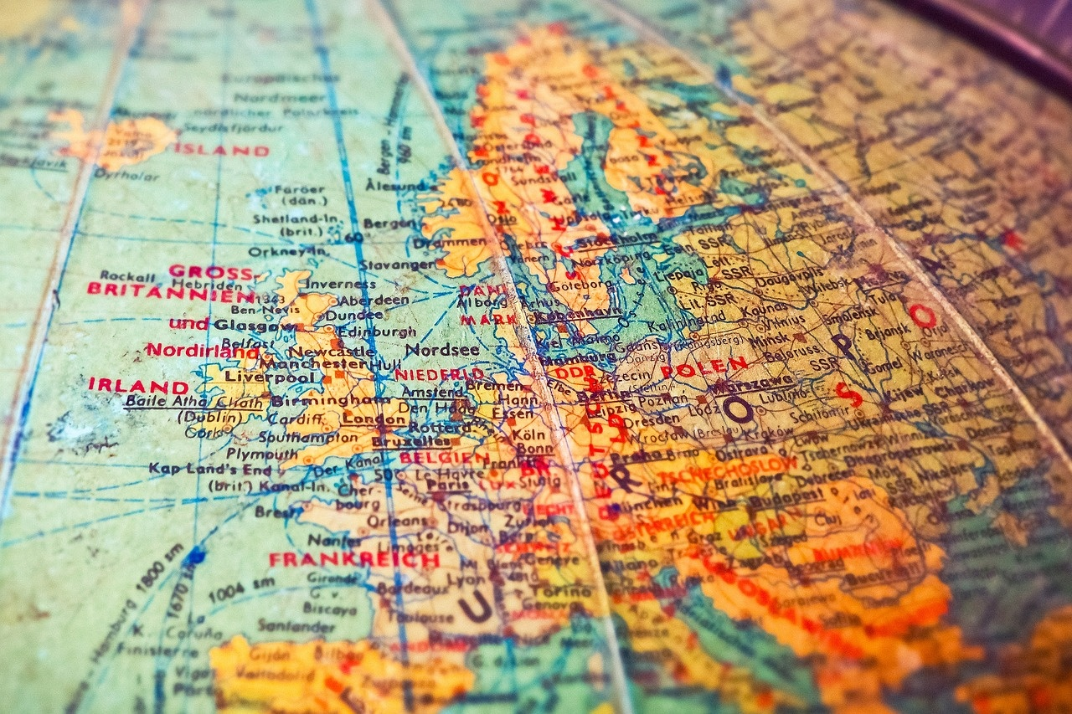
Understanding Global Warming: Challenges and Solutions
11
Additional Resources
Nat Geo Kids
BBC Bitesize
Google Earth
Interactive games like 'Animal Jam' teach kids about wildlife and conservation.
Fun quizzes enhance knowledge of different species and habitats.
Engaging videos simplify Math and Science concepts.
Interactive quizzes help reinforce learning and exam preparation.
Students can track deforestation using satellite images.
Explore urban development through historical maps and city growth.

Slide 15

Understanding Global Warming: Challenges and Solutions
12
Assessment and Evaluation
Formative Monitoring
Summative Evaluation
Continuous Feedback
Formative assessments are conducted regularly to gauge student understanding and progress.
These assessments help identify specific areas where students may require additional support.
Summative assessments take place at the end of a learning period to evaluate overall student knowledge.
They measure the application of concepts learned throughout the course, providing a comprehensive overview of student performance.
Continuous feedback is encouraged from both peers and instructors to enhance the learning experience.
This process promotes self-assessment and reflection, allowing students to take ownership of their learning journey.

Slide 16

Understanding Global Warming: Challenges and Solutions
13
Extension Activities
Sustainable Community Initiative
In-Depth Global Warming Study
Conservation Awareness Campaign
Create a project focused on reducing the impact of climate change.
Organize interactive workshops to involve local residents in sustainability practices.
Examine how global warming affects local wildlife and ecosystems.
Share insights through presentations to raise community awareness.
Develop a creative public service announcement highlighting conservation's importance.
Motivate the public to adopt simple, eco-friendly habits in their daily routines.

Slide 17

Understanding Global Warming: Challenges and Solutions
14
Parent Engagement
Support Learning
Sustainability Workshop
Parents are encouraged to actively support their child's learning journey.
Participation in school activities fosters a strong home-school connection.
A workshop will be held to educate parents about global warming.
Learn practical ways to contribute to sustainability efforts.

Slide 18

Understanding Global Warming: Challenges and Solutions
15
Safety Considerations
Risk Assessment
Clear Instructions
Ensure all experiments and activities are risk-assessed and approved by the school's safety officer.
Regularly review and update risk assessments to reflect any changes in procedures or equipment.
Provide clear instructions and demonstrations before any practical activity.
Supervise students at all times to ensure safety and understanding of the tasks.

Slide 19

Understanding Global Warming: Challenges and Solutions
16
Teaching Tips
Real-Life Examples
Multimedia Engagement
Critical Thinking Activities
Use case studies to demonstrate the impact of global warming on local communities.
Share personal stories or testimonials related to climate change effects.
Engage students with interactive websites that simulate environmental changes.
Show documentaries that highlight real-world climate issues.
Incorporate role-playing scenarios to explore climate-related dilemmas.
Organize group projects that require research and presentation on climate solutions.

