Slide 1
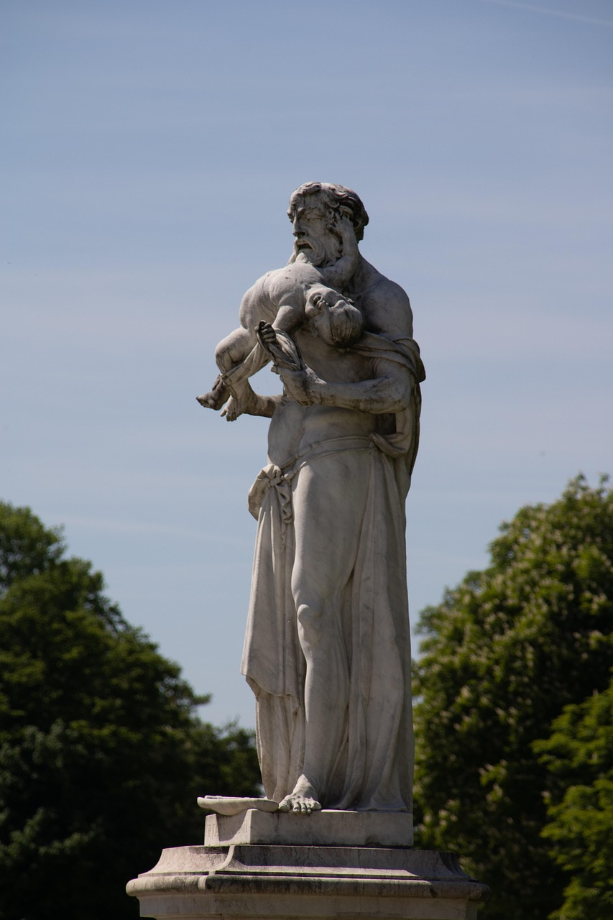
The Prometheus Myth: Exploring Rebellion, Sacrifice, and the Human Condition
An Educational Journey Through Ancient Roots, Cultural Significance, Literary Influence, and Teaching Strategies

Slide 2
Table of Contents
Introduction to the Prometheus Myth
The Origins of the Prometheus Myth
The Cultural Significance of the Prometheus My…
The Literary Influence of the Prometheus Myth
Symbolism and Imagery in the Prometheus Myth
Teaching the Prometheus Myth
Assessment and Evaluation
Extension Activities
Conclusion
Reflection Questions
Next Steps
Key Takeaways
Parent Engagement
04
05
06
07
08
09
10
11
12
13
14
15
16

Slide 3
Table of Contents
Safety Considerations
Teaching Tips
Conclusion and Final Thoughts
Final Reflection
Additional Resources
17
18
19
20
21

Slide 4
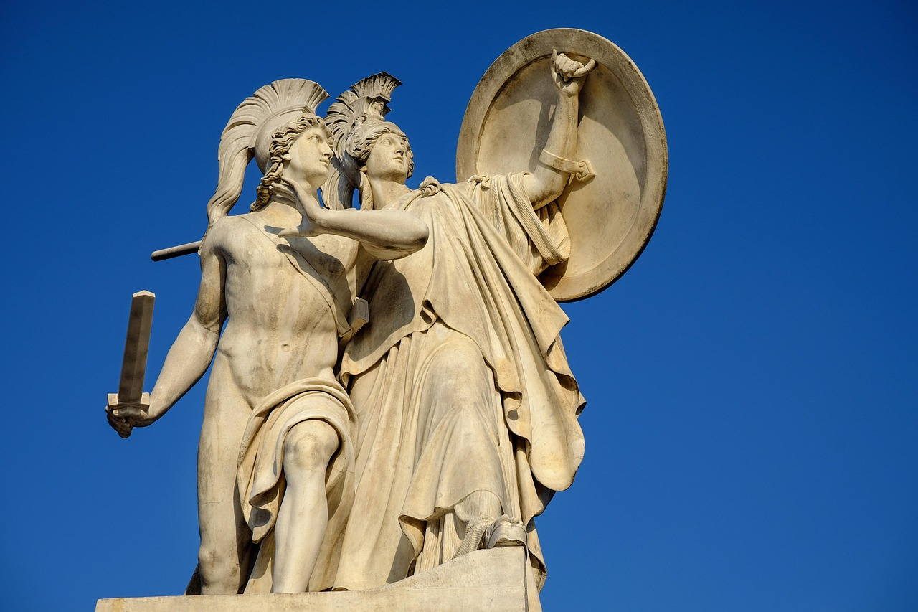
Introduction to the Prometheus Myth
The Core of the Prometheus Myth
Learning Objectives
Target Audience
The Prometheus myth is a cornerstone of Western literature, exploring themes of rebellion, sacrifice, and the human condition.
This lesson plan will introduce 15-year-old students to the myth, its significance, and its lasting impact on literature.
By the end of the lesson, students will be able to analyze the myth's influence on literary works.
They will also develop critical thinking skills through interactive discussions and activities.
This lesson is designed specifically for 15-year-old students.
It aims to make the Prometheus myth accessible and engaging for this age group.
4
The Prometheus Myth: Exploring Rebellion, Sacrifice, and the Human Condition

Slide 5
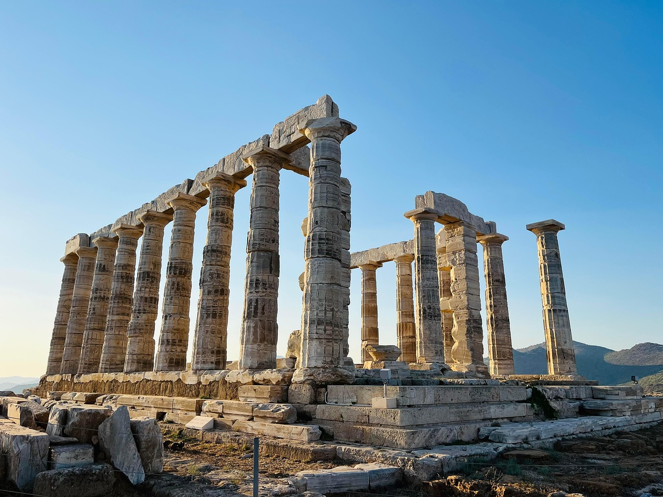
The Origins of the Prometheus Myth
Ancient Roots of the Prometheus Myth
Prometheus: The Titan Who Defied the Gods
The Prometheus myth has its roots in ancient Greek mythology, with the earliest known versions of the story dating back to the 8th century BCE.
The origins of the myth are closely tied to the cultural and historical context of ancient Greece, reflecting the values and beliefs of the time.
The myth tells the story of Prometheus, a titan who defied the gods by stealing fire and gifting it to humanity.
This act of defiance made Prometheus a symbol of rebellion and innovation in Greek mythology.
Evolution of the Prometheus Myth
Cultural Significance of Prometheus
The myth has been retold and reinterpreted over the centuries, with various versions and adaptations emerging in literature, art, and popular culture.
Each retelling reflects the changing perspectives and values of the societies that embraced the myth.
Prometheus represents the enduring human quest for knowledge and progress, as symbolized by the gift of fire.
The myth continues to inspire discussions about the relationship between humanity, technology, and the divine.
5
The Prometheus Myth: Exploring Rebellion, Sacrifice, and the Human Condition

Slide 6
The Cultural Significance of the Prometheus Myth
Reflection of Ancient Greek Values
Influence on Western Literature
Exploration of Human Experience
The Prometheus myth was an important part of ancient Greek culture, reflecting the society's values and beliefs about the natural order and the role of humanity in the world.
The myth's exploration of the complexities of moral decision-making and the nuances of the human condition reflect the ancient Greeks' fascination with the human experience.
The myth's cultural significance can be seen in its continued influence on Western literature and culture.
It has shaped the way authors think about themes such as rebellion and sacrifice.
The Prometheus myth delves into the intricacies of moral choices and the human condition.
This reflects the ancient Greeks' deep interest in understanding the human experience.
6
The Prometheus Myth: Exploring Rebellion, Sacrifice, and the Human Condition

Slide 7
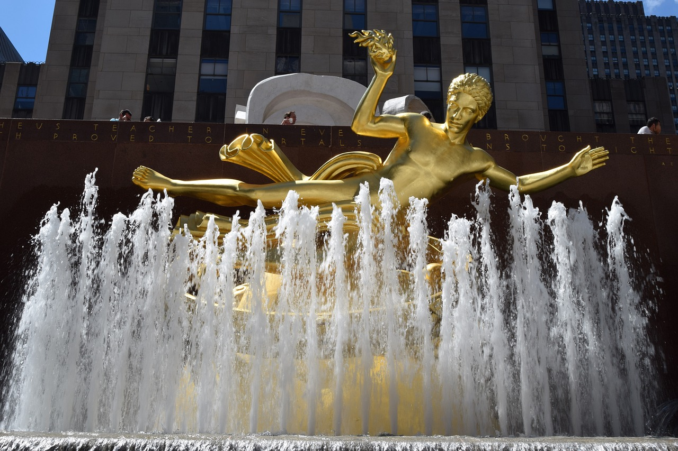
The Literary Influence of the Prometheus Myth
Profound Influence on Literature
Impact on Literary Genres
The Prometheus myth has had a profound influence on literature, shaping the way authors think about themes such as rebellion, sacrifice, and the human condition.
The myth's themes and motifs have been used in various literary works, including classical and modern texts, such as John Milton's Paradise Lost and Mary Shelley's Frankenstein.
The myth's influence can be seen in the development of literary genres, such as science fiction and fantasy.
Its themes and motifs appear in works such as H.G. Wells' The Time Machine and J.R.R. Tolkien's The Lord of the Rings.
Contemporary Relevance
Themes of Rebellion and Sacrifice
The myth's literary influence continues to be felt today.
Authors draw on the story's themes and motifs to explore complex ideas and issues.
The Prometheus myth shapes the way authors think about rebellion and sacrifice.
These themes are central to understanding the human condition in literature.
7
The Prometheus Myth: Exploring Rebellion, Sacrifice, and the Human Condition

Slide 8

Symbolism and Imagery in the Prometheus Myth
Symbolism in the Prometheus Myth
Imagery in the Prometheus Myth
Cultural Interpretations of the Myth
The Prometheus myth is rich in symbolism and imagery, with the story featuring a range of powerful and evocative symbols, such as fire and the titan Prometheus.
The symbolism and imagery of the Prometheus myth have been interpreted in various ways over the centuries, with different cultures and societies assigning different meanings to the story's symbols and images.
The myth's imagery is equally significant, with vivid descriptions of the natural world, the gods, and the titans.
The Prometheus myth is rich in symbolism and imagery, with the story featuring a range of powerful and evocative symbols, such as fire and the titan Prometheus.
The symbolism and imagery of the Prometheus myth have been interpreted in various ways over the centuries, with different cultures and societies assigning different meanings to the story's symbols and images.
The myth's imagery is equally significant, with vivid descriptions of the natural world, the gods, and the titans.
8
The Prometheus Myth: Exploring Rebellion, Sacrifice, and the Human Condition

Slide 9

Teaching the Prometheus Myth
01
Engaging Strategies for Teaching
To teach the Prometheus myth, teachers can use a range of strategies, including group discussions, writing exercises, and multimedia presentations.
Teachers can also use role-playing activities to help students engage with the myth and its characters, such as asking students to take on the roles of Prometheus, Zeus, or other characters from the myth.
02
Developing Critical Thinking Skills
The myth can be used to support the development of critical thinking and analytical skills in students.
This can be achieved by examining the myth's use of symbolism, imagery, and character development.
03
Connecting to Modern Contexts
Teachers can make connections to modern literature and popular culture.
This helps students see the relevance and significance of the Prometheus myth.
04
Interactive Learning Techniques
Role-playing activities allow students to immerse themselves in the myth's narrative.
Such activities encourage deeper engagement with the characters and themes of the story.
9
The Prometheus Myth: Exploring Rebellion, Sacrifice, and the Human Condition

Slide 10

Assessment and Evaluation
Diverse Assessment Strategies
To assess student learning, teachers can use a range of strategies, including literary analysis essays, creative writing exercises, and group discussions.
Teachers can also use multimedia presentations and role-playing activities to assess student understanding of the myth and its themes.
Ongoing and Formative Evaluation
The assessment and evaluation of student learning should be ongoing and formative.
Teachers should provide feedback and support to students throughout the lesson.
Engaging Student Understanding
Role-playing activities and multimedia presentations offer dynamic ways to evaluate comprehension.
These methods help students connect with the themes and content of the myth.
10
The Prometheus Myth: Exploring Rebellion, Sacrifice, and the Human Condition

Slide 11

Extension Activities
01
Creative Learning Activities
To extend student learning, teachers can provide a range of activities, including creative writing exercises, multimedia presentations, and role-playing activities.
These activities encourage students to engage with the material in diverse and imaginative ways.
02
Exploring Prometheus in Culture
Students can research and present on the ways in which the Prometheus myth has been used in art, literature, and popular culture throughout history.
This allows them to understand the myth's influence and relevance across different mediums and eras.
03
Writing Inspired by Prometheus
Teachers can ask students to write their own short story or poem inspired by the Prometheus myth.
Students can then share and discuss their work in a workshop setting to foster collaboration and feedback.
04
Interactive and Analytical Opportunities
The extension activities should be engaging and interactive, providing opportunities for students to develop their critical thinking skills.
These tasks are designed to enhance analytical abilities while keeping students actively involved.
11
The Prometheus Myth: Exploring Rebellion, Sacrifice, and the Human Condition

Slide 12

Conclusion
Timeless Themes of the Prometheus Myth
The myth's themes and motifs, including rebellion, sacrifice, and the human condition, are timeless and universal.
These elements continue to resonate with audiences today.
Prometheus Myth's Global Impact
The Prometheus myth is a powerful and thought-provoking story that continues to inspire and captivate audiences around the world.
Its enduring appeal highlights its relevance across cultures and generations.
Educational Value of the Prometheus Myth
By exploring the Prometheus myth and its influence on literature, students can gain a deeper understanding of the human experience.
This exploration helps develop critical thinking and analytical skills.
12
The Prometheus Myth: Exploring Rebellion, Sacrifice, and the Human Condition

Slide 13

Reflection Questions
01
Engaging Students with the Prometheus Myth
03
Critical Thinking and Analytical Skills
What strategies were most effective in engaging students with the Prometheus myth, and how can these strategies be built upon in future lessons?
How can the Prometheus myth be used to support the development of critical thinking and analytical skills in students, and what opportunities can be provided for students to apply these skills in future lessons?
How can the Prometheus myth be used to support the development of critical thinking and analytical skills in students, and what opportunities can be provided for students to apply these skills in future lessons?
What opportunities can be provided for students to make connections between the Prometheus myth and their own experiences and beliefs, and how can these connections be used to support deeper learning and engagement?
02
Connecting Myth to Personal Experiences
04
Teacher Reflection and Professional Growth
What opportunities can be provided for students to make connections between the Prometheus myth and their own experiences and beliefs, and how can these connections be used to support deeper learning and engagement?
How can teachers reflect on their own practice and identify areas for professional development, to ensure that they are providing the best possible learning experience for their students?
How can teachers reflect on their own practice and identify areas for professional development, to ensure that they are providing the best possible learning experience for their students?
What strategies were most effective in engaging students with the Prometheus myth, and how can these strategies be built upon in future lessons?
13
The Prometheus Myth: Exploring Rebellion, Sacrifice, and the Human Condition

Slide 14

Next Steps
Exploring Prometheus in Modern Literature
Comparative Analysis of Prometheus Myth Versions
Prometheus Myth and Thematic Exploration
The next steps in this learning progression could include a lesson on the influence of the Prometheus myth on modern literature, such as science fiction and dystopian novels.
Students could analyze excerpts from these novels, identifying the ways in which the authors have drawn on the Prometheus myth to convey meaning and themes.
The lesson could also include a comparative analysis of different versions of the myth, including the original Greek myth and later adaptations and interpretations.
This analysis would help students understand the evolution of the myth and its relevance across different historical and cultural contexts.
Students could explore how the Prometheus myth serves as a framework for discussing themes like rebellion, innovation, and consequences.
This thematic exploration would deepen their understanding of the myth's impact on storytelling and societal values.
14
The Prometheus Myth: Exploring Rebellion, Sacrifice, and the Human Condition

Slide 15
Key Takeaways
Prometheus Myth in Western Literature
Timeless and Universal Themes
Impact on Literary Analysis
Enduring Relevance
The Prometheus myth is a cornerstone of Western literature, exploring themes of rebellion, sacrifice, and the human condition.
It has profoundly influenced literature, shaping how authors approach these themes.
The myth's themes and motifs, including rebellion, sacrifice, and the human condition, are timeless and universal.
These themes continue to resonate with audiences today.
By studying the Prometheus myth, students can gain a deeper understanding of the human experience.
This exploration helps develop critical thinking and analytical skills.
The Prometheus myth remains relevant in modern times due to its exploration of universal human themes.
Its influence on literature highlights its enduring significance.
15
The Prometheus Myth: Exploring Rebellion, Sacrifice, and the Human Condition

Slide 16

Parent Engagement
Encouraging Inquiry
Creative Engagement
Collaborative Learning
Parents can support their child's learning by encouraging them to ask questions and seek clarification on the Prometheus myth and its themes.
This approach fosters curiosity and deeper understanding of the material.
Parents can provide opportunities for their child to engage with the myth in a creative and reflective way, such as by writing a short story or poem inspired by the myth.
This allows children to explore the themes of the myth in a personal and imaginative manner.
By working together with teachers, parents can help to provide a comprehensive and engaging learning experience for their child.
This collaboration supports the development of critical thinking and analytical skills.
16
The Prometheus Myth: Exploring Rebellion, Sacrifice, and the Human Condition

Slide 17

Safety Considerations
1
Student Sensitivities
Teachers should be aware of any students who may have sensitivities or triggers related to the myth's themes of rebellion, sacrifice, or punishment.
Providing a safe space for students to share their thoughts and feelings is essential.
2
Support and Guidance
Teachers should be prepared to offer support and guidance as needed.
This ensures students feel comfortable engaging with the material.
3
Inclusive Learning Environment
The lesson should promote a positive and inclusive learning environment.
Opportunities for creative and reflective engagement with the myth should be included.
17
The Prometheus Myth: Exploring Rebellion, Sacrifice, and the Human Condition

Slide 18
Teaching Tips
Utilizing Multimedia Resources
Encouraging Group Discussions
Teachers can use multimedia resources, such as videos and podcasts, to provide students with a range of perspectives and insights on the Prometheus myth.
This approach enriches the learning experience by exposing students to diverse interpretations and ideas.
Teachers can encourage group discussion and debate, to promote critical thinking and analytical skills in students.
These activities foster collaboration and help students articulate their thoughts effectively.
Engaging Through Role-Playing
Connecting Myth to Personal Experiences
Teachers can also use role-playing activities, to help students engage with the myth and its characters in a creative and interactive way.
This method allows students to explore the narrative in a hands-on and imaginative manner.
By providing opportunities for students to make connections between the Prometheus myth and their own experiences and beliefs, teachers can support deeper learning and engagement.
Such connections make the myth more relatable and meaningful to students.
18
The Prometheus Myth: Exploring Rebellion, Sacrifice, and the Human Condition

Slide 19

Conclusion and Final Thoughts
1
The Enduring Power of the Prometheus Myth
The Prometheus myth is a powerful and thought-provoking story that continues to inspire and captivate audiences around the world.
By exploring the Prometheus myth and its influence on literature, students can gain a deeper understanding of the human experience and develop critical thinking and analytical skills.
2
Designing Inclusive Lesson Plans
The lesson plan should be designed to promote a positive and inclusive learning environment.
It should provide opportunities for students to engage with the myth in a creative and reflective way.
3
Fostering Creativity and Reflection
Students should be encouraged to explore the Prometheus myth through creative and reflective activities.
This approach helps them connect with the story on a deeper level and enhances their learning experience.
19
The Prometheus Myth: Exploring Rebellion, Sacrifice, and the Human Condition

Slide 20

Final Reflection
1
2
3
Understanding the Prometheus Myth
Applying Promethean Themes
Engaging Others with Prometheus
What did you learn about the Prometheus myth and its influence on literature?
How can you apply the themes and motifs of the Prometheus myth to your own life and experiences?
How can you apply the themes and motifs of the Prometheus myth to your own life and experiences?
What opportunities can you provide for others to engage with the Prometheus myth and its themes, and how can you support their learning and development?
What opportunities can you provide for others to engage with the Prometheus myth and its themes, and how can you support their learning and development?
What did you learn about the Prometheus myth and its influence on literature?
20
The Prometheus Myth: Exploring Rebellion, Sacrifice, and the Human Condition

Slide 21

Additional Resources
Exploring Online Resources
Literary Works Inspired by Prometheus
For further learning, students can explore online resources such as TED-Ed videos and Crash Course podcasts.
These platforms offer engaging and educational content related to the Prometheus myth and other topics.
Students can read literary works influenced by the Prometheus myth, such as Mary Shelley's Frankenstein and John Milton's Paradise Lost.
These texts provide rich insights into the myth's impact on literature and its thematic relevance.
Prometheus in Art and Popular Culture
Engaging with the Myth in Diverse Contexts
The Prometheus myth can be explored in art and popular culture, with examples including films, plays, and musical compositions.
These creative interpretations showcase the myth's enduring influence across various artistic mediums.
By providing opportunities for students to engage with the Prometheus myth in a range of contexts, teachers can support deeper learning and engagement.
This approach encourages students to connect with the myth on multiple levels, fostering critical thinking and creativity.
21
The Prometheus Myth: Exploring Rebellion, Sacrifice, and the Human Condition

