Slide 1
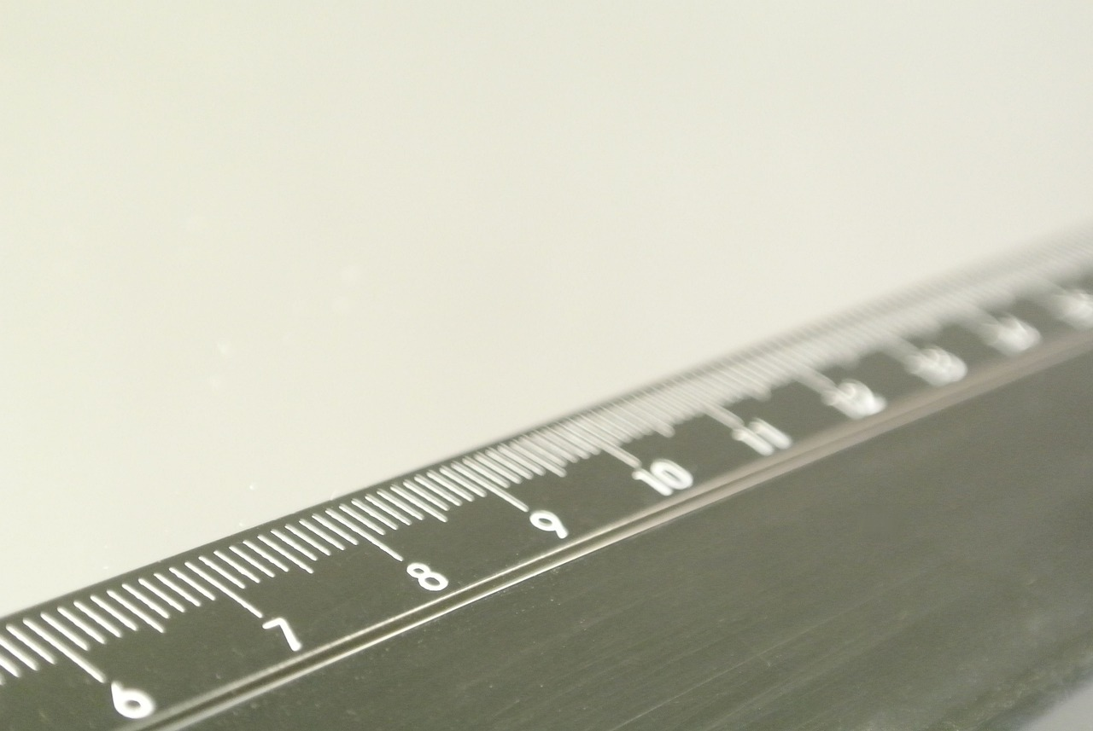
Mastering Measurement: Understanding Length and Its Applications
A Comprehensive Guide to Measurement Fundamentals, Techniques, and Real-World Relevance

Slide 2
Table of Contents
Introduction to Measurement and Units of Length
Why is Measurement Important?
Basic Units of Length
Converting Between Units
Measuring Lengths
Real-World Applications
Practice Time!
Common Errors
FAQs
Objectives
Vocabulary
Resources
Prior Knowledge
04
05
06
07
08
09
10
11
12
13
14
15
16

Slide 3
Table of Contents
Differentiation Strategies
Cross-Curricular Links
Group Activities
Digital Integration
Conclusion
Next Steps
Reflection Questions
Key Takeaways
17
18
19
20
21
22
23
24

Slide 4
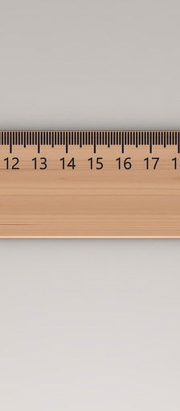
Introduction to Measurement and Units of Length
Basic Length Units
Unit Conversion Techniques
Measuring with Confidence
The basic units of length include meters, centimeters, and millimeters.
Understanding these units is essential for accurate measurement.
We will learn how to convert between different units of length.
This skill will help you solve various measurement problems effectively.
By the end of this lesson, you will be able to measure lengths accurately.
Confidence in measurement is key to applying these concepts in real-life situations.
4
Mastering Measurement: Understanding Length and Its Applications

Slide 5
Why is Measurement Important?
Building Structures
Calculating Distances
Cooking Measurements
Informed Decisions
Measurement is essential for constructing safe and reliable buildings.
It ensures that structures like houses and bridges are designed accurately.
We rely on measurement to determine distances and speeds in various activities.
This is particularly important when traveling or engaging in sports.
Accurate measurement is vital in cooking to achieve the desired flavors and textures.
Following a recipe requires precise measurements of ingredients.
Measurement helps us make informed choices when purchasing materials or comparing prices.
It allows us to evaluate options based on quantitative data.
5
Mastering Measurement: Understanding Length and Its Applications

Slide 6
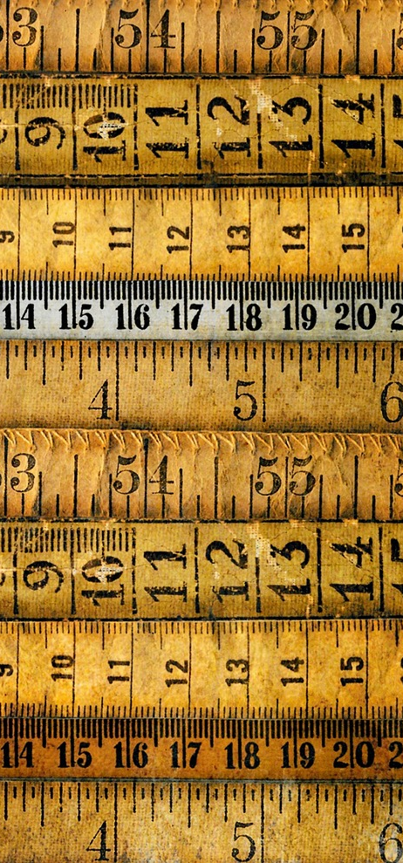
Basic Units of Length
Meter
Centimeter
Millimeter
The meter (m) is the base unit of length in the metric system.
It is used worldwide for most measurements.
The centimeter (cm) is one-hundredth of a meter.
It is commonly used in everyday measurements, such as height.
The millimeter (mm) is one-thousandth of a meter.
It is often used in precision measurements, such as in engineering.
6
Mastering Measurement: Understanding Length and Its Applications

Slide 7
Converting Between Units
01
Meters to Centimeters
To convert meters to centimeters, multiply by 100.
This means that 1 meter equals 100 centimeters.
02
Centimeters to Millimeters
To convert centimeters to millimeters, multiply by 10.
This means that 1 centimeter equals 10 millimeters.
03
Millimeters to Meters
To convert millimeters to meters, divide by 1000.
This means that 1000 millimeters equals 1 meter.
04
Centimeters to Meters
To convert centimeters to meters, divide by 100.
This means that 100 centimeters equals 1 meter.
7
Mastering Measurement: Understanding Length and Its Applications

Slide 8
Measuring Lengths
Measurement Tools
Units of Length
Correct Units Usage
Rulers and meter sticks are essential for measuring lengths accurately.
These tools ensure precision in our everyday measurements.
Lengths can be expressed in various units, including meters and centimeters.
Understanding these units is vital for achieving accurate results.
Using the appropriate unit of measurement is crucial to avoid confusion.
Incorrect units can lead to significant misunderstandings in measurements.
8
Mastering Measurement: Understanding Length and Its Applications

Slide 9
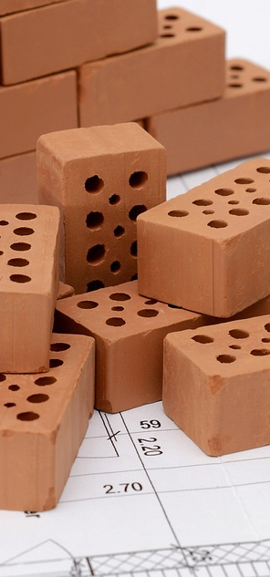
Real-World Applications
Architectural Design
Engineering Solutions
Measurement is crucial for architects to create accurate blueprints.
It ensures that structures are built to specifications and safety standards.
Engineers rely on precise measurements to design machines and systems.
This allows for the creation of efficient and functional products.
Scientific Research
Everyday Problem Solving
Measurements are fundamental in scientific experiments to gather data.
They help in validating hypotheses and advancing knowledge.
People use measurement in daily life to make informed decisions.
From cooking to home improvement, accurate measurements lead to better outcomes.
9
Mastering Measurement: Understanding Length and Its Applications

Slide 10
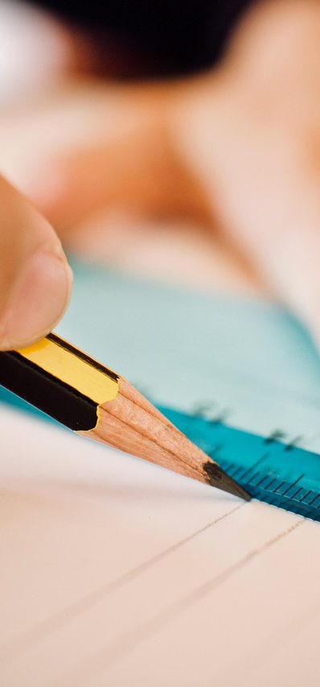
Practice Time!
1
Unit Conversion
Test your skills with unit conversions.
Convert between various units of length.
2
Classroom Measurements
Measure lengths of objects in your classroom or home.
Use a ruler or measuring tape for accuracy.
3
Measurement Problems
Solve measurement problems involving units of length.
Engage with different scenarios to improve your skills.
10
Mastering Measurement: Understanding Length and Its Applications

Slide 11
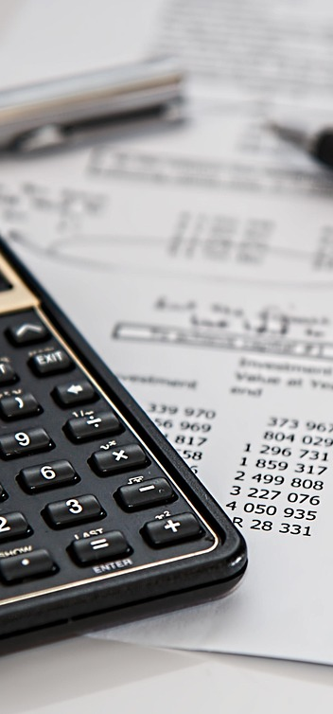
Common Errors
Correct Units
Double-Check Calculations
Use the appropriate unit of measurement to avoid errors.
Be mindful of common mistakes when converting between units.
Verify your results to ensure accuracy in conversions.
This practice helps prevent mistakes that can affect outcomes.
Significant Figures
Accurate Measurement Tools
Record measurements with the correct number of significant figures.
This is crucial for maintaining precision in your data.
Utilize a ruler or meter stick for precise length measurements.
Choosing the right tools reduces the likelihood of errors.
11
Mastering Measurement: Understanding Length and Its Applications

Slide 12
FAQs
Meter vs Centimeter
Unit Conversion
Importance of Measurement
Everyday Applications
A meter is 100 centimeters.
This illustrates the size difference between the two units.
Use conversion factors to convert between units.
This helps maintain measurement accuracy.
Accurate measurements are vital for construction and design.
They also play a key role in problem-solving and decision-making.
Precise measurements in cooking can affect taste.
Accurate dimensions in construction ensure safety.
12
Mastering Measurement: Understanding Length and Its Applications

Slide 13
Objectives
1
Units of Length
2
Unit Conversion
Primary units of length, such as meters, centimeters, and millimeters, are essential in everyday situations. They provide a standard for measuring distances accurately.
Converting various units of length using established conversion factors is crucial for practical applications. Accurate conversions ensure effective communication and understanding in measurements.
3
Accurate Measurement
4
Problem Solving
Utilizing tools like rulers and meter sticks helps ensure precise measurements. Identifying common errors and strategies to prevent them is essential for reliability.
Applying measurement knowledge to real-world problems enables informed decision-making. This skill is vital for interpreting data and making accurate assessments.
13
Mastering Measurement: Understanding Length and Its Applications

Slide 14
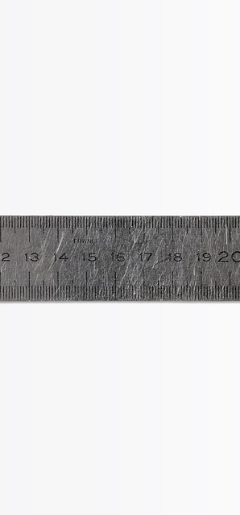
Vocabulary
Meter
Centimeter
The meter (m) is the base unit of length in the metric system.
It is used worldwide for scientific and everyday measurements.
A centimeter (cm) is one-hundredth of a meter.
It is commonly used to measure shorter lengths, such as height.
Millimeter
Conversion
A millimeter (mm) is one-thousandth of a meter.
It is often used in precision measurements, such as in engineering.
Conversion is the process of changing from one unit of measurement to another.
It is essential for comparing different measurements accurately.
14
Mastering Measurement: Understanding Length and Its Applications

Slide 15
Resources
Measuring Tools
Conversion Aids
Rulers and meter sticks are essential tools for measuring lengths.
They provide accurate measurements for various applications.
Conversion charts and factors help in converting between different units of length.
These aids simplify the process of measurement in various contexts.
Online Learning
Practical Examples
Numerous websites and apps offer practice problems related to measurement.
Interactive activities enhance understanding of units of length.
Everyday situations often require measurement, such as cooking or home improvement.
Understanding units of length is crucial for accurate results in these tasks.
15
Mastering Measurement: Understanding Length and Its Applications

Slide 16
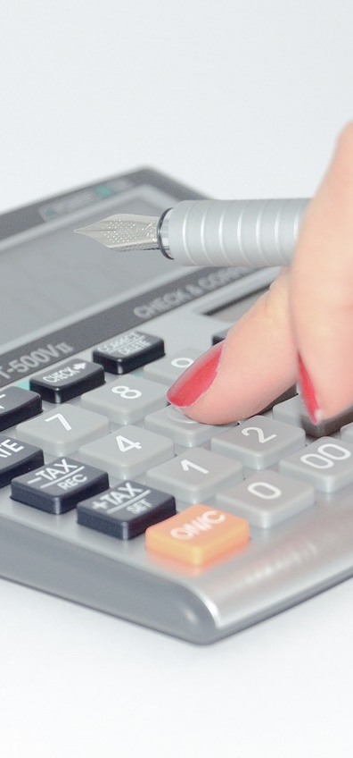
Prior Knowledge
Math Operations
Units & Measurement
Fractions & Decimals
A basic understanding of mathematical operations is essential.
Key operations include addition and subtraction.
Understanding units of measurement is important.
You should be familiar with measuring length, weight, and volume.
Understanding fractions and decimals is essential.
These concepts are used in everyday calculations.
16
Mastering Measurement: Understanding Length and Its Applications

Slide 17
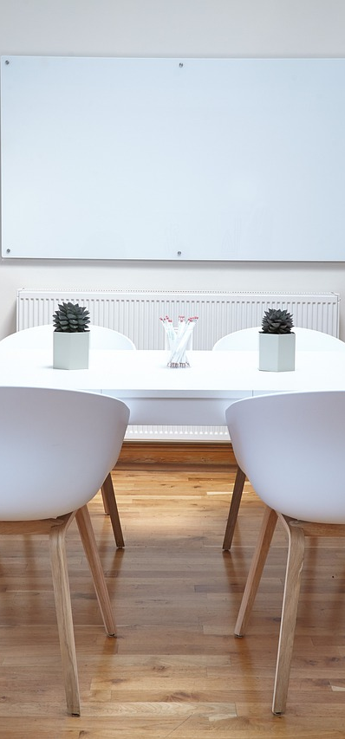
Differentiation Strategies
Learning Centers
Tech Integration
Learning centers provide hands-on activities.
Students can explore and learn at their own pace.
Technology integration uses online resources and apps.
They offer interactive activities and practice problems.
Visual Aids
Peer Teaching
Visual aids include diagrams, charts, and graphs.
They help students visualize complex concepts.
Peer teaching involves students teaching each other.
This method enhances collaboration and understanding.
17
Mastering Measurement: Understanding Length and Its Applications

Slide 18

Cross-Curricular Links
01
Mathematics
Measurement is a fundamental concept in math, encompassing units of length, area, and volume.
It is essential for solving problems and understanding real-world applications.
02
Science
Measurement is vital for conducting experiments and collecting accurate data.
It allows scientists to quantify observations and validate hypotheses.
03
STEM
In STEM fields, measurement is crucial for designing and building structures.
It ensures that projects adhere to specifications and safety standards.
04
Geography
Measurement is used to calculate distances and scales on maps, which is essential for navigation.
It helps in understanding spatial relationships and the layout of geographical features.
18
Mastering Measurement: Understanding Length and Its Applications

Slide 19
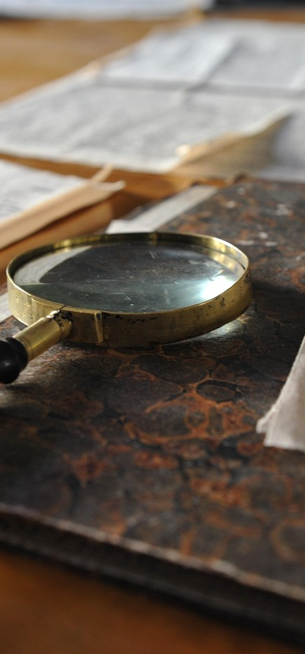
Group Activities
Scavenger Hunt
Unit Conversion Challenge
Room Design Project
Engage in a fun activity to find and measure various objects.
This promotes hands-on learning and measurement skills.
Take on the challenge of converting between different units of length.
This activity sharpens your understanding of measurement relationships.
Utilize measurement skills to design and create a model room.
This project emphasizes accuracy and creativity in measurements.
19
Mastering Measurement: Understanding Length and Its Applications

Slide 20

Digital Integration
Online Measurement Games
Engage students with interactive online measurement games that make learning fun and competitive.
Games like 'Measure It!' help reinforce measurement concepts through hands-on practice.
Virtual Measurement Tools
Utilize online rulers and meter sticks for accurate digital measurements.
These tools allow students to measure objects in real-time during virtual lessons.
Measurement Apps
Incorporate measurement apps to enhance learning with practical applications.
Apps like 'Measure' provide students with tools to apply measurement skills in everyday scenarios.
Interactive Whiteboard Activities
Use interactive whiteboards for collaborative activities that allow students to visualize and manipulate measurements.
Activities can include group challenges where students solve measurement problems together.
20
Mastering Measurement: Understanding Length and Its Applications

Slide 21
Conclusion
1
2
3
Units of Length
Conversion Practice
Real-World Applications
Measurement and units of length, including meters, centimeters, and millimeters, are fundamental concepts in our everyday lives.
We have practiced converting between units of length.
This skill is essential for accurate measurements.
Understanding measurement is crucial for tasks like construction and tailoring.
Precise measurements ensure materials fit correctly in building projects.
21
Mastering Measurement: Understanding Length and Its Applications

Slide 22
Next Steps
Perimeter & Area
Volume & Capacity
Real-World Measurement
In Lesson 2, students dive into the exciting world of perimeter and area.
They will calculate measurements for different shapes.
Lesson 3 introduces the fascinating concepts of volume and capacity.
Students will measure and compare various volumes.
In Lesson 4, students apply measurement skills to real-world scenarios.
They will participate in hands-on activities to enhance their understanding.
22
Mastering Measurement: Understanding Length and Its Applications

Slide 23

Reflection Questions
Measurement Insights
I discovered the significance of measurement in everyday life.
Understanding units of length enhances my ability to make precise calculations.
Real-World Applications
I utilize my measurement skills in various activities, such as baking and home improvement projects.
Applying accurate measurements ensures successful outcomes in my tasks.
Overcoming Challenges
I encountered difficulties with unit conversions, particularly between metric and imperial systems.
To address this, I practiced regularly and consulted resources for clarification.
23
Mastering Measurement: Understanding Length and Its Applications

Slide 24
Key Takeaways
Units of Length
Unit Conversion
Real-World Application
Understanding basic units of length is essential.
Key units include meters, centimeters, and millimeters.
Converting between units of length is straightforward using conversion factors or charts.
Measurement skills are crucial for everyday tasks.
They are important in activities like home improvement and cooking.
24
Mastering Measurement: Understanding Length and Its Applications

