Slide 1

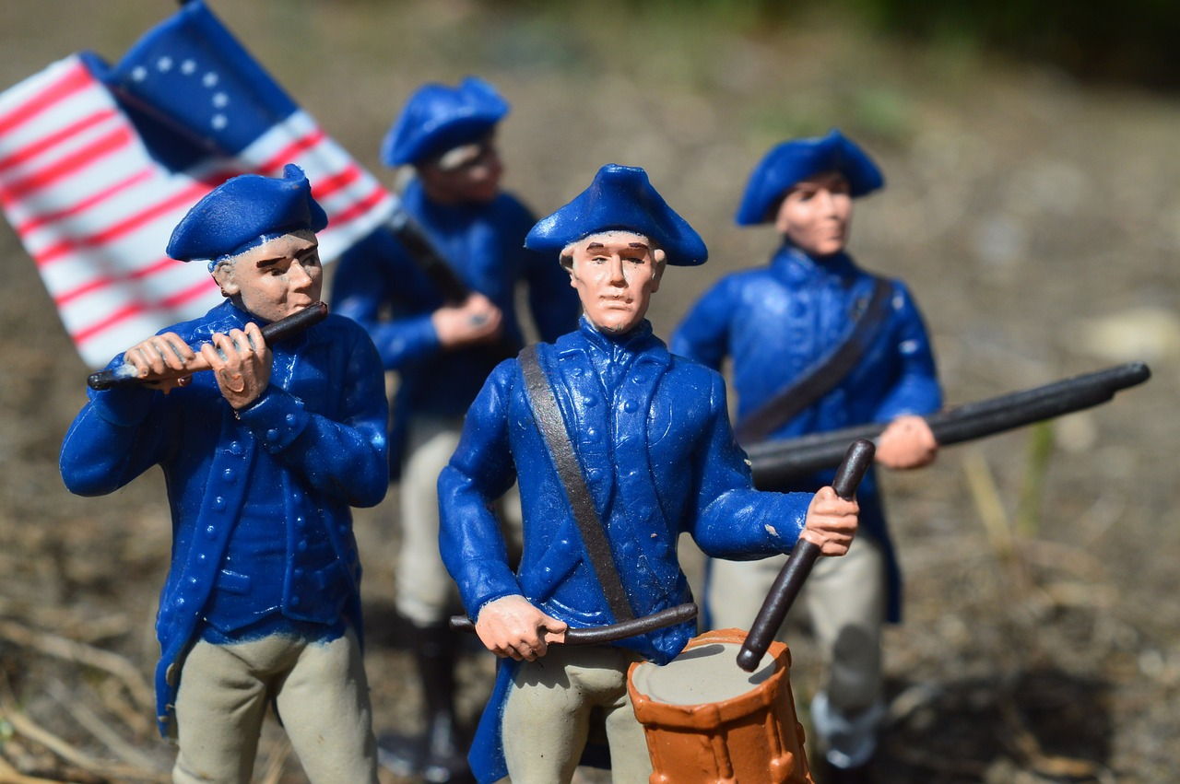
The Colonial Era and the American Revolution: Foundations of American Identity and Democracy
Exploring Key Events, Figures, and Lasting Impacts on Society and Governance

Slide 2
Table of Contents
Introduction to the Colonial Era and the Ameri…
Causes of the American Revolution
Key Figures of the American Revolution
The Declaration of Independence
The American Revolution: A Global Perspective
The Constitution and the Bill of Rights
Impact of the American Revolution on American …
Primary Source Analysis: The Declaration of In…
Group Discussion: The American Revolution
Reflection and Conclusion
Assessment and Evaluation
Extension Activities
Conclusion and Final Thoughts
04
05
06
07
08
09
10
11
12
13
14
15
16

Slide 3
Table of Contents
References and Resources
17

Slide 4

Introduction to the Colonial Era and the American Revolution
Pivotal Moments in American History
Exploring Primary Sources and Discussions
Focus on Lasting Impact
The Colonial Era and the American Revolution are pivotal moments in American history, shaping the country's development and core values.
This lesson plan introduces students to the key events, figures, and ideas that defined this period, with a focus on critical thinking, problem-solving, and effective communication skills.
By exploring primary sources, engaging in discussions, and analyzing historical events, students will develop a deeper understanding of the complexities of the Revolution.
These activities aim to foster critical thinking and provide insights into the lasting impact of the Revolution on American society.
The lesson emphasizes the importance of understanding the Revolution's complexities and its enduring influence.
Students will gain a comprehensive perspective on how this era shaped American values and societal development.
4
The Colonial Era and the American Revolution: Foundations of American Identity and Democracy

Slide 5

Causes of the American Revolution
Taxation Without Representation
Colonial Expansion Restrictions
The British government imposed taxes on the colonies without giving them representation in Parliament.
This fueled resentment and a sense of injustice among the colonists.
The British government restricted the colonies' ability to expand westward, leading to growing tensions.
This limitation stifled the ambitions of settlers and created widespread dissatisfaction.
Enlightenment Ideals
Trade and Commerce Restrictions
The ideas of the Enlightenment, such as liberty and democracy, inspired the colonists to challenge British rule.
These philosophical principles provided a foundation for revolutionary thought.
The British government imposed restrictions on the colonies' trade and commerce, leading to economic hardship and resentment.
These policies disrupted colonial economies and heightened grievances against British authority.
5
The Colonial Era and the American Revolution: Foundations of American Identity and Democracy

Slide 6
Key Figures of the American Revolution
01
02
03
04
05
George Washington
Thomas Jefferson
Benjamin Franklin
Patrick Henry
Abigail Adams
The leader of the Continental Army and the first President of the United States.
He played a pivotal role in securing American independence.
The author of the Declaration of Independence and the third President of the United States.
He was instrumental in shaping the founding principles of the nation.
A leading figure in the Enlightenment and a key diplomat during the Revolution.
His efforts in securing French support were crucial to the American cause.
A vocal advocate for independence and a leader in the Virginia House of Burgesses.
He is famously remembered for his declaration, 'Give me liberty, or give me death!'
A prominent woman who played a key role in the Revolution and advocated for women's rights.
She urged her husband, John Adams, to 'remember the ladies' in the new laws of the land.
6
The Colonial Era and the American Revolution: Foundations of American Identity and Democracy

Slide 7

The Declaration of Independence
Adoption of Independence
Authorship and Purpose
Historical Significance
Adopted on July 4, 1776, the Declaration of Independence declared the 13 colonies' independence from Great Britain.
This marked a pivotal moment in American history, signifying the birth of a new nation.
Written by Thomas Jefferson, the document outlined the colonies' grievances against the British government.
It also asserted their right to self-governance, laying the foundation for democratic principles.
The Declaration of Independence is considered one of the most influential documents in American history.
It has shaped the country's values and principles, serving as a cornerstone of its identity.
7
The Colonial Era and the American Revolution: Foundations of American Identity and Democracy

Slide 8

The American Revolution: A Global Perspective
Influence of Enlightenment Ideals
Impact on Global Revolutionary Movements
The American Revolution was influenced by the Enlightenment and the ideas of liberty and democracy.
These ideals shaped the revolutionary leaders' vision for a new society.
The Revolution had a significant impact on other revolutionary movements around the world, such as the French Revolution and the Haitian Revolution.
It served as a model and inspiration for those seeking freedom and equality.
Legacy in Modern Democracy and Human Rights
Complexity of the American Revolution
The Revolution also had a profound impact on the development of modern democracy and the concept of human rights.
Its principles continue to influence political systems and human rights frameworks globally.
The American Revolution was a complex and multifaceted event, driven by a combination of political, economic, and social factors.
This complexity underscores the diverse motivations and challenges faced by the revolutionaries.
8
The Colonial Era and the American Revolution: Foundations of American Identity and Democracy

Slide 9

The Constitution and the Bill of Rights
01
Framework of Federal Government
The Constitution, adopted in 1787, established the framework of the federal government and the relationship between the government and the citizens.
It laid the foundation for the structure and functioning of the United States government.
02
Guarantee of Individual Rights
The Bill of Rights, adopted in 1791, guaranteed individual rights and liberties, such as freedom of speech and the right to a fair trial.
These amendments were crucial in protecting citizens from government overreach.
03
Impact on American Society
The Constitution and the Bill of Rights have had a profound impact on American politics and society, shaping the country's values and principles.
They continue to influence the nation's legal and cultural framework.
04
Global Influence on Democracy
The documents have also been influential in shaping the development of modern democracy and the concept of human rights.
Their principles have inspired democratic movements worldwide.
9
The Colonial Era and the American Revolution: Foundations of American Identity and Democracy

Slide 10

Impact of the American Revolution on American Society
01
Foundations of a New Government
The Revolution led to the establishment of a new system of government, based on democratic principles and individual rights.
This laid the groundwork for the United States Constitution and the Bill of Rights.
02
Shaping American Identity
The Revolution had a significant impact on the development of American identity and culture.
It fostered a sense of national purpose and unity among the people.
03
Enduring Influence on Politics
The Revolution's emphasis on liberty and democracy continues to influence American politics and society today.
These principles remain central to the nation's political discourse and governance.
04
Cultural and Value Transformation
The American Revolution profoundly shaped the country's values and principles.
It instilled ideals that continue to define the American ethos.
10
The Colonial Era and the American Revolution: Foundations of American Identity and Democracy

Slide 11

Primary Source Analysis: The Declaration of Independence
1
Analyzing Key Themes and Ideas
Read and analyze the Declaration of Independence, identifying key themes and ideas.
Consider the historical context in which the document was written and the significance of its adoption.
2
Historical Context and Significance
Consider the historical context in which the document was written and the significance of its adoption.
Evaluate the impact of the Declaration of Independence on American history and its ongoing relevance today.
3
Impact and Ongoing Relevance
Evaluate the impact of the Declaration of Independence on American history and its ongoing relevance today.
Read and analyze the Declaration of Independence, identifying key themes and ideas.
11
The Colonial Era and the American Revolution: Foundations of American Identity and Democracy

Slide 12

Group Discussion: The American Revolution
01
Causes and Consequences
03
Historical Perspectives
Discuss the causes and consequences of the American Revolution, considering multiple perspectives and factors.
Evaluate the significance of the Revolution in shaping American society and politics.
Discuss the causes and consequences of the American Revolution, considering multiple perspectives and factors.
Evaluate the significance of the Revolution in shaping American society and politics.
02
Contemporary Impact
04
Enduring Ideals
Consider the ongoing impact of the Revolution on contemporary issues, such as individual rights and social justice.
Reflect on the ways in which the Revolution's ideals and principles continue to influence American politics and society today.
Consider the ongoing impact of the Revolution on contemporary issues, such as individual rights and social justice.
Reflect on the ways in which the Revolution's ideals and principles continue to influence American politics and society today.
12
The Colonial Era and the American Revolution: Foundations of American Identity and Democracy

Slide 13
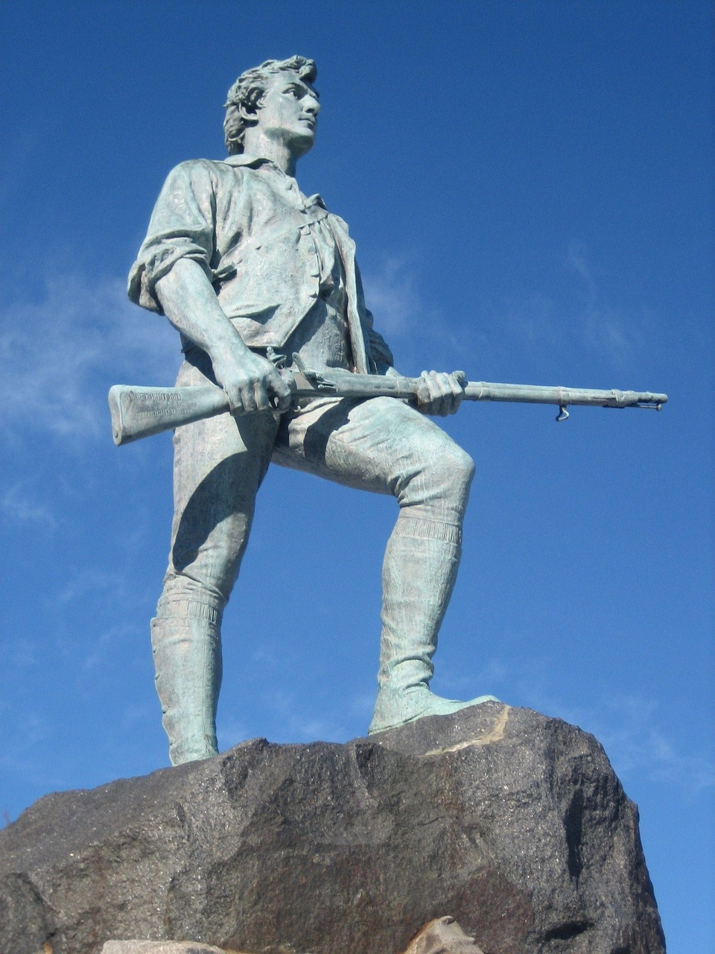
Reflection and Conclusion
1
Learning from the Colonial Era and Revolution
Reflect on what you have learned about the Colonial Era and the American Revolution.
Consider the significance of the Revolution in shaping American society and politics.
2
Significance of the Revolution
Evaluate the ongoing impact of the Revolution on contemporary issues.
Reflect on its relevance to your own life and experiences.
3
Personal Connection to History
Consider the significance of the Revolution in shaping American society and politics.
Reflect on its relevance to your own life and experiences.
13
The Colonial Era and the American Revolution: Foundations of American Identity and Democracy

Slide 14
Assessment and Evaluation
Essay on Causes and Consequences
Group Discussion on Significance
Analysis of Primary Sources
Personal Reflection on Learning
Complete a written essay on the causes and consequences of the American Revolution.
This task encourages critical thinking and a deeper understanding of historical events.
Participate in a group discussion on the significance of the Revolution in shaping American society and politics.
This activity fosters collaboration and diverse perspectives on historical impacts.
Analyze primary sources, such as the Declaration of Independence, to evaluate the impact of the Revolution on American history.
This exercise develops analytical skills and a connection to historical documents.
Reflect on your own learning and understanding of the Colonial Era and the American Revolution.
This reflection helps consolidate knowledge and personal insights on the topic.
14
The Colonial Era and the American Revolution: Foundations of American Identity and Democracy

Slide 15

Extension Activities
Research and Presentation
Historical Fiction Writing
Research and create a presentation on a key figure or event from the Colonial Era and the American Revolution.
This activity encourages deep exploration and understanding of historical significance.
Write a historical fiction story set in the Colonial Era or the American Revolution.
This creative task allows for imaginative engagement with historical contexts.
Museum Exhibit Creation
Debate on American Revolution
Create a museum exhibit on the Colonial Era and the American Revolution, including artifacts and primary sources.
This hands-on project fosters a tangible connection to history.
Participate in a debate on the significance of the American Revolution in shaping American society and politics.
This activity develops critical thinking and public speaking skills.
15
The Colonial Era and the American Revolution: Foundations of American Identity and Democracy

Slide 16

Conclusion and Final Thoughts
1
2
3
Pivotal Moments in American History
Legacy of Liberty and Democracy
Understanding Historical Complexities
The Colonial Era and the American Revolution are pivotal moments in American history, shaping the country's development and core values.
These periods laid the foundation for the nation's identity and principles that endure today.
The Revolution's emphasis on liberty and democracy continues to influence American politics and society today.
These ideals remain central to the nation's governance and cultural ethos.
By exploring the Colonial Era and the American Revolution, we can gain a deeper understanding of the complexities of American history.
This exploration highlights the ongoing impact of the Revolution on contemporary issues.
16
The Colonial Era and the American Revolution: Foundations of American Identity and Democracy

Slide 17

References and Resources
Foundational Documents
Historical Primary Sources
The Declaration of Independence serves as a cornerstone of American history.
The Constitution and the Bill of Rights outline the framework of the nation's government and individual freedoms.
Primary sources from the Colonial Era and the American Revolution provide firsthand accounts of the time.
These documents offer invaluable insights into the lives and struggles of early Americans.
Digital Learning Tools
Exploring the Colonial Era
Online resources offer a wealth of information on the Colonial Era and the American Revolution.
Multimedia presentations enhance understanding through interactive and visual formats.
The Colonial Era is a pivotal period that shaped the foundation of the United States.
Studying this era reveals the challenges and triumphs of early American society.
17
The Colonial Era and the American Revolution: Foundations of American Identity and Democracy

