Slide 1

Exploring the Cosmos: Integrating Science Fiction and Language Learning
A Journey Through Space, Language, and Learning

Slide 2
Table of contents
01
02
03
04
05
06
07
08
09
10
11
Title Slide: Space Odyssey - Bridging Science Fiction and L…
Lesson Overview: Connecting Language Learning with Space Ex…
Why Space Exploration?
Linguistic Learning Objectives: Grammatical Mastery
Differentiation Strategies
Group Activity: Space Mission Narrative
Digital Integration
Cross-Curricular Connections
Vocabulary Exploration
Assessment Strategies
Parent Engagement

Slide 3
Table of contents
12
13
14
15
16
17
18
19
20
21
22
Safety Considerations
Key Takeaways
Reflection and Next Steps
Conclusion
Design Recommendations
Suggested Additional Visual Elements
Export Requirements
List of Key Scientific Terms
Formative and Summative Assessment
Parent Partnership in Language Learning
Safety Measures in Educational Settings

Slide 4

1
Title Slide: Space Odyssey - Bridging Science Fiction and Language Learning
Space Odyssey: Bridging Science Fiction and Language Learning
An Innovative ESL Learning Experience for Year 9 Students
Exploring the Cosmos: Integrating Science Fiction and Language Learning

Slide 5
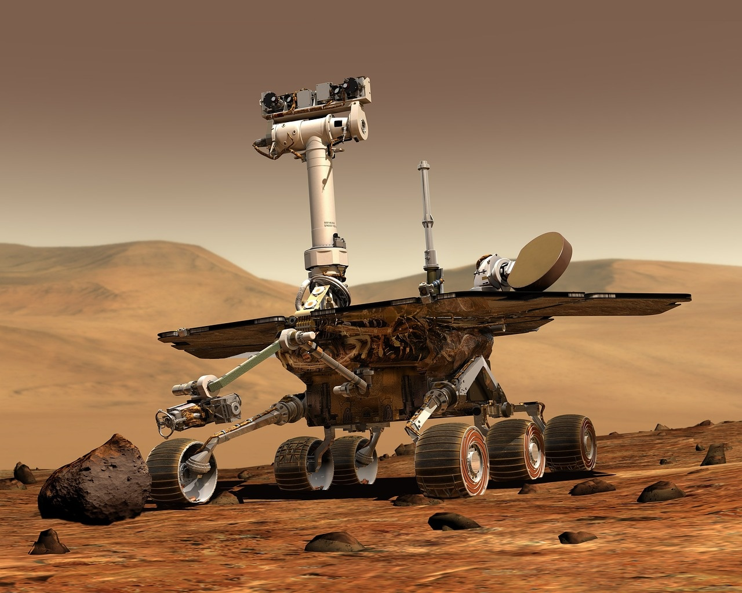
2
Lesson Overview: Connecting Language Learning with Space Exploration
01
Objective
02
Key Learning Goals
Connect Language Learning with Space Exploration
Master present perfect and preterit tenses
Develop advanced time-related expressions
Improve scientific terminology pronunciation
Explore connections between science fiction and reality
Exploring the Cosmos: Integrating Science Fiction and Language Learning

Slide 6

3
Why Space Exploration?
01
Universal Fascination
02
Interdisciplinary Learning Approach
Humans have always been intrigued by the mysteries of the cosmos.
Space exploration offers a glimpse into the unknown and sparks curiosity.
Integrating science, technology, engineering, and language learning.
Encourages critical thinking and problem-solving skills.
03
Linguistic Skill Development
04
Motivational Content Framework
Expanding vocabulary with scientific terminology.
Enhancing communication skills through discussing complex concepts.
Inspires students to engage with language learning.
Provides real-world context for language application and practice.
Exploring the Cosmos: Integrating Science Fiction and Language Learning

Slide 7

4
Linguistic Learning Objectives: Grammatical Mastery
01
Present Perfect Tense
02
Preterit Tense
Understanding usage in relation to past actions with present relevance.
Forming sentences using "have/has" + past participle.
Differentiating between simple past actions and ongoing past actions.
Constructing sentences with regular and irregular verbs in the past tense.
03
Time-Related Expressions
04
Phonetic Pronunciation Challenges
Exploring nuances of time with adverbs like "never," "ever," "already," and "not yet."
Practicing the correct placement of these expressions in sentences.
Identifying and practicing pronunciation of challenging sounds in scientific terminology.
Utilizing phonetic symbols to improve accuracy in pronunciation.
Exploring the Cosmos: Integrating Science Fiction and Language Learning

Slide 8
5
Differentiation Strategies
01
Tiered Learning Materials
02
Flexible Grouping Techniques
03
Multiple Engagement Pathways
Provide varying levels of complexity in learning materials to cater to different student abilities.
Offer different versions of assignments or tasks based on individual learning needs.
Utilize flexible grouping strategies such as small group work, pair work, or whole class activities.
Allow students to work with different peers to enhance collaboration and learning outcomes.
Incorporate diverse learning activities like visual, auditory, kinesthetic, and interactive tasks.
Offer choices in assignments to accommodate different learning preferences and styles.
04
Personalized Learning Contracts
05
Technology-Enhanced Personalization
Develop individualized learning plans based on student interests, strengths, and areas for growth.
Set specific goals and objectives tailored to each student's learning needs and preferences.
Integrate educational technology tools to provide personalized learning experiences.
Use adaptive learning platforms to tailor content and activities to individual student progress and performance.
Exploring the Cosmos: Integrating Science Fiction and Language Learning

Slide 9

6
Group Activity: Space Mission Narrative
01
Collaborative Storytelling
02
Role Assignments
Students work together to create a compelling narrative set in outer space.
Assigning roles such as astronauts, mission control, alien encounters, etc., to enhance engagement.
03
Assessment Criteria
04
Language Focus Areas
Evaluation based on language proficiency, creativity, teamwork, and adherence to the narrative.
Emphasis on using present perfect and preterit tenses accurately within the storyline.
Exploring the Cosmos: Integrating Science Fiction and Language Learning

Slide 10

7
Digital Integration
01
Virtual Space Exploration Tours
02
Online Collaborative Platforms
Immersive experiences through virtual reality technology
Visiting distant planets and galaxies from the comfort of the classroom
Engaging with peers globally to discuss space-related topics
Sharing language learning experiences and insights in real-time
03
Pronunciation Tracking Apps
04
Augmented Reality Language Learning
Utilizing apps to improve pronunciation of scientific terminology
Providing instant feedback and guidance for language accuracy
Overlaying language exercises on space-themed visuals
Enhancing language acquisition through interactive AR experiences
Exploring the Cosmos: Integrating Science Fiction and Language Learning

Slide 11

8
Cross-Curricular Connections
01
Science Integration
02
Historical Technological Development
Exploring astronomical concepts through language learning
Understanding the scientific basis of space exploration in science fiction
Tracing the evolution of space technology and its impact on language
Analyzing historical space missions and their linguistic significance
03
Mathematical Reasoning
04
Media and Communication Studies
Applying mathematical principles in space-related language tasks
Utilizing data analysis skills to interpret scientific language in context
Investigating how space exploration is portrayed in different media forms
Analyzing communication strategies used in science fiction narratives
Exploring the Cosmos: Integrating Science Fiction and Language Learning

Slide 12

9
Vocabulary Exploration
01
Key Scientific Terms
02
Pronunciation Challenges
Extraterrestrial
Propulsion
Gravitational Field
Cosmic Radiation
03
Contextual Usage
Exploring the Cosmos: Integrating Science Fiction and Language Learning

Slide 13

10
Assessment Strategies
01
Formative Assessment
02
Summative Assessment
Real-time Grammatical Monitoring
Phonetic Progression Tracking
Comprehensive Presentation
Written Comparative Analysis
Multimedia Language Portfolio
Exploring the Cosmos: Integrating Science Fiction and Language Learning

Slide 14

11
Parent Engagement
01
Language Learning Partnership
02
Technology and Learning Workshops
Encourage parents to actively participate in language learning activities at home.
Provide resources and guidance for parents to support their child's language development.
Organize workshops for parents to familiarize them with the technology used in language learning.
Offer training sessions on how parents can assist their children with language practice using digital tools.
03
Multimedia Learning Support
04
Home-Based Learning Resources
Share multimedia resources with parents to reinforce language concepts learned in class.
Create a platform for parents to access language learning materials and activities online.
Provide parents with language learning materials that can be used at home.
Offer suggestions for incorporating language practice into daily routines and family activities.
Exploring the Cosmos: Integrating Science Fiction and Language Learning

Slide 15
12
Safety Considerations
01
Digital Resource Management
02
Physical Space Safety
03
Emotional and Psychological Support
Monitor and regulate access to online materials
Implement cybersecurity measures to protect student data
Ensure classrooms are free of hazards and have proper ventilation
Conduct regular safety drills for emergency preparedness
Provide counseling services for students experiencing emotional distress
Educate teachers on recognizing signs of mental health issues
04
Scientific Content Filtering
05
Technology Equipment Guidelines
Review and approve all scientific content for age-appropriateness
Address any controversial or sensitive topics with caution
Establish usage policies for electronic devices in the classroom
Train students on proper handling and care of technology tools
Exploring the Cosmos: Integrating Science Fiction and Language Learning

Slide 16

13
Key Takeaways
01
Enhanced Linguistic Skills
02
Interdisciplinary Engagement
Integrating science fiction narratives into language learning enhances students' proficiency in grammar, vocabulary, and pronunciation.
Connecting space exploration with language acquisition fosters a holistic approach to learning, bridging scientific concepts with linguistic development.
03
Motivational Framework
Using science fiction as a learning tool motivates students by providing engaging content that sparks curiosity and creativity in language acquisition.
Exploring the Cosmos: Integrating Science Fiction and Language Learning

Slide 17

14
Reflection and Next Steps
01
Reflect on Student Engagement
02
Assess Linguistic Development
Evaluate student participation and enthusiasm during space mission narrative activity.
Consider feedback on language learning progress and comprehension of scientific concepts.
Review mastery of present perfect and preterit tenses.
Analyze improvement in pronunciation of scientific terminology and time-related expressions.
03
Identify Future Learning Progressions
Plan for enhanced scientific communication skills development.
Explore innovative technological narratives for language learning advancement.
Organize a global scientific communication workshop to broaden perspectives.
Exploring the Cosmos: Integrating Science Fiction and Language Learning

Slide 18

15
Conclusion
01
Language Proficiency
02
Creativity and Curiosity
Enhanced through engaging space-themed activities
Science fiction integration sparks creativity and curiosity in language learning
03
Interdisciplinary Approach
04
Exploring the Cosmos
Fosters holistic language development
Encouraging students to explore the cosmos through language acquisition
Exploring the Cosmos: Integrating Science Fiction and Language Learning

Slide 19

16
Design Recommendations
01
Color Palette
02
Imagery
Dark blues and purples
Starry backgrounds for a cosmic feel
High-quality space exploration visuals
Astronaut silhouettes and rocket illustrations
03
Typography
04
Visual Elements
Clean, modern fonts for readability
Consistent use of typography styles
Incorporate icons and infographic elements
Include scientific diagram overlays
Exploring the Cosmos: Integrating Science Fiction and Language Learning

Slide 20

17
Suggested Additional Visual Elements
01
Astronaut Silhouettes
02
Rocket and Spacecraft Illustrations
Add visual interest and context to space-related slides.
Use as icons or background elements.
Enhance the theme of space exploration.
Can be used to highlight key points or data.
03
Scientific Diagram Overlays
04
Timeline Graphics
Provide detailed explanations of complex concepts.
Useful for educational and technical presentations.
Showcase the progression of events or milestones.
Ideal for historical or project-based presentations.
Exploring the Cosmos: Integrating Science Fiction and Language Learning

Slide 21
18
Export Requirements
01
Compliance with International Trade Regulations
02
Quality Control Standards
03
Packaging and Labeling Regulations
Understanding of Tariffs and Trade Barriers
Documentation Accuracy
Product Testing and Certification
Consistency in Product Specifications
Language Requirements for Labels
Safety Information Compliance
04
Shipping and Logistics Considerations
05
Market-Specific Requirements
Freight Forwarding Services
Customs Clearance Procedures
Cultural Sensitivity in Marketing Materials
Localization of Product Information
Exploring the Cosmos: Integrating Science Fiction and Language Learning

Slide 22

19
List of Key Scientific Terms
01
Extraterrestrial
02
Propulsion
Relating to or originating from outside the Earth.
The action of driving or pushing forward.
03
Gravitational Field
04
Cosmic Radiation
The region around a mass where another mass experiences a force due to gravity.
High-energy radiation originating from outside the solar system.
Exploring the Cosmos: Integrating Science Fiction and Language Learning

Slide 23

20
Formative and Summative Assessment
01
Formative Assessment
02
Summative Assessment
Real-time Grammatical Monitoring
Phonetic Progression Tracking
Comprehensive Presentation
Written Comparative Analysis
Multimedia Language Portfolio
Exploring the Cosmos: Integrating Science Fiction and Language Learning

Slide 24

21
Parent Partnership in Language Learning
01
Regular Communication Channels
02
Workshops and Training Sessions
Establish open lines of communication through emails, newsletters, and parent-teacher meetings.
Provide updates on language learning progress, upcoming activities, and ways parents can support at home.
Conduct workshops to educate parents on language learning strategies and techniques.
Offer training on how to create a language-rich environment at home to reinforce classroom learning.
03
Interactive Language Activities
04
Feedback and Collaboration
Encourage parents to engage in language activities with their children, such as reading together or practicing vocabulary.
Suggest language learning apps or online resources for additional practice outside of school.
Seek feedback from parents on their child's language learning experience and areas for improvement.
Collaborate with parents to set language learning goals and track progress together.
Exploring the Cosmos: Integrating Science Fiction and Language Learning

Slide 25
22
Safety Measures in Educational Settings
01
Digital Resource Management
02
Physical Space Safety
03
Emotional and Psychological Support
Implement secure access controls for online resources.
Regularly update software and antivirus programs to prevent cyber threats.
Conduct regular safety drills for emergencies like fires and lockdowns.
Ensure classrooms are equipped with first aid kits and emergency contact information.
Provide access to counseling services for students and staff.
Establish protocols for handling mental health crises and emotional distress.
04
Scientific Content Filtering
05
Technology Equipment Guidelines
Monitor and restrict access to inappropriate or misleading scientific content.
Educate students on evaluating the credibility of online sources.
Enforce guidelines for safe and responsible use of technology devices.
Provide training on ergonomic practices to prevent physical strain from prolonged device use.
Exploring the Cosmos: Integrating Science Fiction and Language Learning

