Slide 1

Exploring the Depths of Romantic Poetry
A Comprehensive Journey Through Themes, Symbols, and Key Figures

Slide 2


Table of contents
Introduction to Romantic Poetry
Historical Context of Romantic Poetry
Major Themes in Romantic Poetry
Symbolism in Romantic Poetry
Key Poets and Their Works
Guided Practice: Analyzing Romantic Poetry
Independent Practice: Writing a Romantic Poem
Extension Task: Comparative Analysis
Extension Task: Creative Writing
Assessment and Evaluation
Conclusion
References and Resources
Reflection and Feedback
01
02
03
04
05
06
07
08
09
10
11
12
13

Slide 3

Introduction to Romantic Poetry
Emotional Depth
Nature's Influence
Notable Poets
Romantic poetry emphasizes deep emotional experiences and the importance of individual feelings.
It seeks to express the complexities of human emotions, often exploring themes of love, loss, and nature.
Nature is a central theme in Romantic poetry, symbolizing beauty and inspiration.
Poets often depict nature as a source of solace and a reflection of human emotions.
Key figures include William Wordsworth, known for his love of nature, and Samuel Taylor Coleridge, famous for his imaginative works.
Other significant poets are Lord Byron, Percy Bysshe Shelley, and John Keats, each contributing unique perspectives to the movement.
1
Exploring the Depths of Romantic Poetry

Slide 4
Historical Context of Romantic Poetry
Response to Enlightenment
Influence of Change
Emotion and Nature
Societal Reflection
Romantic poetry emerged in the late 18th century as a reaction against the rationalism of the Enlightenment.
It emphasized emotion and individual experience over reason.
The movement was shaped by the social, political, and economic upheavals of the time.
The Industrial Revolution played a significant role in altering people's relationship with nature.
Romantic poets celebrated the beauty of nature and the depth of human emotion.
They sought to express personal feelings and the sublime aspects of the natural world.
Romantic poetry often reflected the societal and political concerns of the era.
It addressed issues such as social justice, environmental degradation, and the human condition.
2
Exploring the Depths of Romantic Poetry

Slide 5

Major Themes in Romantic Poetry
Nature's Inspiration
Imaginative Exploration
Emotional Core
Nature serves as a profound source of beauty and inspiration for poets.
It offers spiritual renewal and a connection to the divine.
Imagination allows poets to delve into the depths of human experience.
It opens up new realms of thought and creativity.
Emotion is central to the human experience and is vividly expressed in poetry.
Romantic poets emphasize feelings as a way to connect with readers.
Personal Freedom
Awe and Wonder
Romantic poetry champions individualism and personal freedom.
It encourages self-expression and the pursuit of one's own path.
The sublime evokes feelings of awe and wonder in the face of nature's grandeur.
These experiences inspire reflection and a deeper understanding of existence.
3
Exploring the Depths of Romantic Poetry

Slide 6

Symbolism in Romantic Poetry
Nature as a Symbol
Light and Darkness
Nature embodies beauty and the divine, representing the sublime.
It evokes feelings of awe and reverence in the human spirit.
Light symbolizes hope and enlightenment, while darkness signifies despair.
This duality reflects the complexities of the human experience.
Water and Fire
Night and Day
Water represents transformation and renewal, whereas fire embodies passion and destruction.
Together, they illustrate the dynamic nature of existence.
Night symbolizes imagination and dreams, contrasting with the clarity of day.
This contrast shows the tension between reality and fantasy.
4
Exploring the Depths of Romantic Poetry

Slide 7

Key Poets and Their Works
Wordsworth's Nature
Coleridge's Imagination
Byron's Beauty
Celebrated for his deep connection to nature, Wordsworth's poetry often reflects the beauty and tranquility of the natural world.
Notable works include 'I Wandered Lonely as a Cloud' and 'Tintern Abbey', which explore themes of memory and the sublime.
Coleridge is known for his vivid imagination and supernatural themes in poetry.
His famous works, 'The Rime of the Ancient Mariner' and 'Kubla Khan', showcase his unique narrative style and dreamlike imagery.
Lord Byron's poetry often emphasizes beauty and passion, capturing the essence of romanticism.
Works like 'She Walks in Beauty' and 'Don Juan' reflect his exploration of love and human experience.
Shelley's Ambition
Keats' Reflection
Percy Bysshe Shelley is recognized for his radical ideas and ambitious themes in poetry.
His notable pieces, 'Ozymandias' and 'Prometheus Unbound', delve into the concepts of power and rebellion against tyranny.
John Keats is celebrated for his rich imagery and exploration of beauty and mortality.
His masterpieces, 'Ode to a Nightingale' and 'Ode on a Grecian Urn', reflect his deep philosophical reflections on art and life.
5
Exploring the Depths of Romantic Poetry

Slide 8

Guided Practice: Analyzing Romantic Poetry
Poem Analysis
Themes & Symbols
Guiding Questions
Read the selected Romantic poem together as a class.
Discuss the structure, language, and emotional impact of the poem.
Identify key themes present in the poem, such as nature, love, and the sublime.
Explore symbols used in the poem and their significance to the overall message.
What emotions does the poem evoke, and how does the poet achieve this?
How do the themes and symbols enhance the reader's understanding of the poem?
6
Exploring the Depths of Romantic Poetry

Slide 9

Independent Practice: Writing a Romantic Poem
Romantic Inspiration
Sensory Imagery
Nature Connection
Draw from themes of love, beauty, and emotion.
Incorporate symbols that evoke deep feelings.
Utilize vivid descriptions to engage the senses.
Create a strong visual and emotional impact.
Express personal feelings through the lens of nature.
Highlight the relationship between human experiences and the natural world.
7
Exploring the Depths of Romantic Poetry

Slide 10
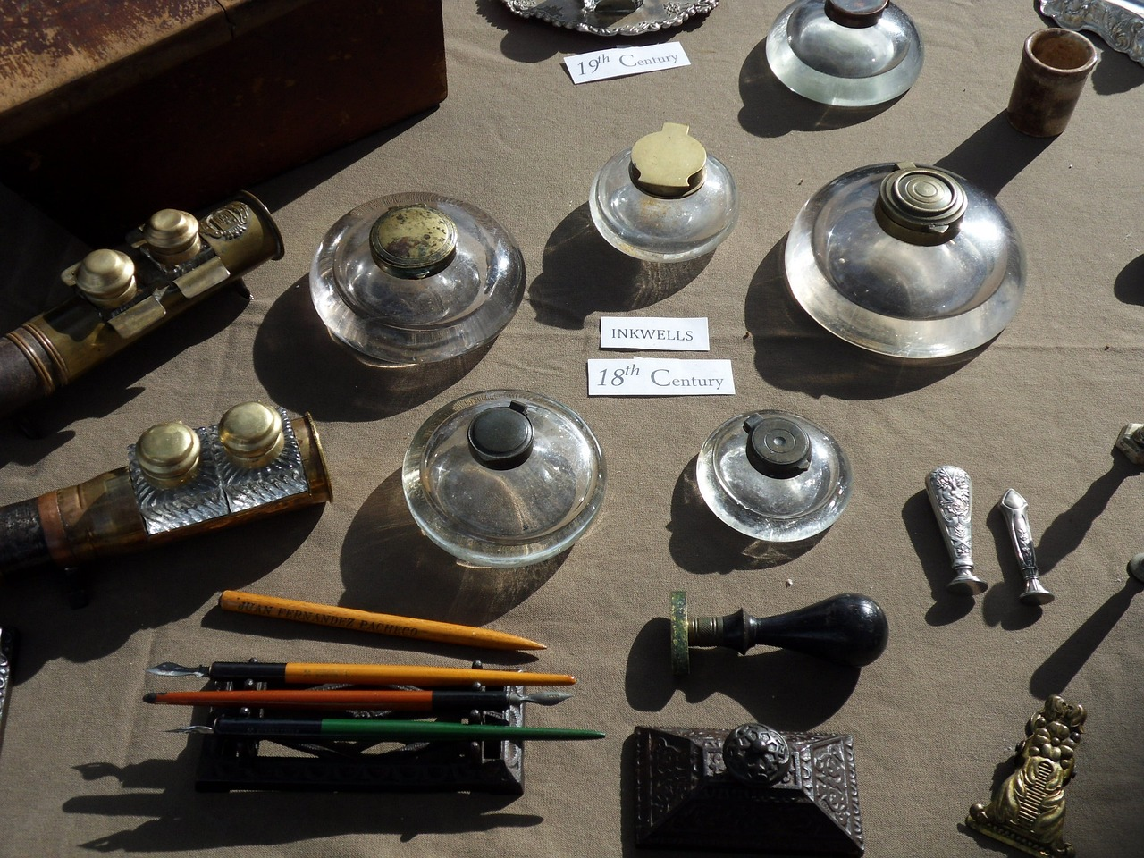
Extension Task: Comparative Analysis
Poet Selection
Theme Exploration
Symbolism Comparison
Analyze the contributions of Wordsworth and Coleridge to the Romantic movement.
Identify and compare the central themes in the poetry of Wordsworth and Coleridge.
Compare the symbols in Wordsworth's and Coleridge's poetry, focusing on daffodils and the mariner.
8
Exploring the Depths of Romantic Poetry

Slide 11

Extension Task: Creative Writing
Romantic Inspiration
Symbolic Themes
Literary Experimentation
Choose a Romantic poem that resonates with you and reflect on its emotional depth.
Consider how its themes can inspire your own writing.
Identify key symbols from the original poem and incorporate them into your work.
Discuss how these symbols enhance your narrative.
Experiment with various literary devices to enrich your writing.
Try different structures and styles to discover your unique voice.
9
Exploring the Depths of Romantic Poetry

Slide 12

Assessment and Evaluation
Class Participation
Written Analyses
Active engagement in discussions is essential.
Students are encouraged to share their thoughts and ask questions.
Quality of written work reflects understanding of the material.
Creative writing pieces should demonstrate originality and insight.
Romantic Poetry Insight
Extension Task Completion
Students should explore themes such as love, nature, and emotion.
Depth of analysis will be assessed through class discussions and assignments.
Advanced learners are expected to complete additional tasks.
These tasks should challenge their understanding and encourage deeper exploration.
10
Exploring the Depths of Romantic Poetry

Slide 13

Conclusion
Summary of Key Points
Final Thoughts
Romantic poetry explores themes of nature and emotion, reflecting a deep connection to the human experience.
Symbolism conveys complex ideas through vivid imagery, with poets like Wordsworth, Coleridge, and Keats shaping the genre.
Understanding Romantic poetry enhances our appreciation of its emotional depth and artistic expression.
Recognizing its themes and symbols allows for a richer engagement with the text.
11
Exploring the Depths of Romantic Poetry

Slide 14
References and Resources
Poetic Works
Study Aids
Online Learning
Explore a thoughtfully selected collection of key Romantic poems that shaped the era.
Familiarize yourself with the influential poets who defined Romanticism.
Delve into vital reading resources that enrich your comprehension of Romantic poetry.
Access curated guides that provide critical insights into the themes and contexts of the works.
Engage with dynamic online platforms offering comprehensive courses on the nuances of Romantic literature.
Participate in virtual discussion groups to deepen your understanding of Romantic poetry.
12
Exploring the Depths of Romantic Poetry

Slide 15

Reflection and Feedback
Learning Insights
Improvement Suggestions
The learning experience highlighted the importance of active participation in discussions.
Understanding different perspectives enriched the overall comprehension of the subject.
Future lessons could benefit from more interactive activities to engage students.
Incorporating real-world examples may enhance the relevance of the material.
13
Exploring the Depths of Romantic Poetry

