Slide 1


Piaget's Play Theory and Cognitive Development
Exploring Play-Based Learning Across Developmental Stages and Diverse Learners

Slide 2
Table of Contents
Introduction to Piaget's Play Theory
Understanding Piaget's Stages
Importance of Play in Cognitive Development
Designing Play-Based Learning Experiences
Image-Based Case Studies
Hands-On Activities
Supporting Learners with LLN Read and Write Di…
Applying Piaget's Theory to Real-Life Scenarios
Technology Integration
Reflection and Feedback
Conclusion
Key Takeaways
Next Steps
04
05
06
07
08
09
10
11
12
13
14
15
16

Slide 3
Table of Contents
Teaching Tips
Reflection Questions
Parent Engagement
Safety Considerations
Conclusion and Final Thoughts
17
18
19
20
21

Slide 4

Introduction to Piaget's Play Theory
Unable to generate content.
We apologise for the inconvenience it seems that the content for this slide failed to generate.
Please try the "Rewrite with AI" editing feature and instruct the AI with the content you'd like to see.
Another alternative would be to regenerate this presentation.
4
Piaget's Play Theory and Cognitive Development
/

Slide 5

Understanding Piaget's Stages
Sensorimotor Stage
Preoperational Stage
The sensorimotor stage spans from 0 to 2 years.
Learning occurs through senses and motor activities.
The preoperational stage spans from 2 to 7 years.
Learning occurs through symbols and language.
Concrete Operational Stage
Formal Operational Stage
The concrete operational stage spans from 7 to 11 years.
Learning occurs through logical thinking and problem-solving.
The formal operational stage begins at 12 years and up.
Learning occurs through abstract thinking and reasoning.
5
Piaget's Play Theory and Cognitive Development

Slide 6

Importance of Play in Cognitive Development
Play and Cognitive Development Stages
Play-Based Learning Benefits
Social and Emotional Growth Through Play
Play facilitates transition between stages of cognitive development.
It acts as a bridge, helping children adapt and grow cognitively.
Play-based learning supports critical thinking, problem-solving, and collaboration.
These skills are crucial for academic and real-world success.
Play is essential for developing social and emotional skills.
It fosters empathy, communication, and resilience in children.
6
Piaget's Play Theory and Cognitive Development

Slide 7

Designing Play-Based Learning Experiences
Enhancing Learning with Visual Aids
Engagement Through Hands-On Activities
Addressing LLN Challenges
Use visual aids and images to support learning.
These tools can make complex concepts more accessible and engaging for learners.
Incorporate hands-on activities and games to promote engagement.
Interactive methods encourage active participation and deeper understanding.
Consider the needs of learners with LLN read and write difficulties.
Tailor activities to ensure inclusivity and support for diverse learning needs.
7
Piaget's Play Theory and Cognitive Development

Slide 8

Image-Based Case Studies
Analyzing Play-Based Learning Environments
Applying Piaget's Theory Through Case Studies
Analyze images of play-based learning environments to understand how they support cognitive development.
Explore the visual elements that contribute to fostering cognitive growth in children.
Use image-based case studies to illustrate the application of Piaget's theory in real-life scenarios.
Demonstrate how these environments align with Piaget's stages of cognitive development.
8
Piaget's Play Theory and Cognitive Development

Slide 9
Hands-On Activities
Sensorimotor Development
Preoperational Development
Concrete Operational Development
Design and create puzzles to support sensorimotor development.
These activities help children enhance their physical coordination and problem-solving skills.
Engage in role-playing activities to support preoperational development.
Role-playing fosters creativity and helps children understand different perspectives.
Participate in games and simulations to support concrete operational development.
These activities encourage logical thinking and teamwork among children.
9
Piaget's Play Theory and Cognitive Development

Slide 10

Supporting Learners with LLN Read and Write Difficulties
1
Utilizing Visual Aids
Use visual aids and images to support learning.
These tools can help learners better understand and retain information.
2
Engaging Activities
Provide hands-on activities and games to promote engagement.
Interactive methods can make learning enjoyable and effective.
3
Personalized Support
Offer one-on-one support and accommodations as needed.
Tailored assistance ensures learners receive the help they require.
10
Piaget's Play Theory and Cognitive Development

Slide 11

Applying Piaget's Theory to Real-Life Scenarios
Designing Play-Based Learning Experiences
Evaluating Play-Based Learning Effectiveness
Design play-based learning experiences for adults with learning difficulties.
Focus on creating engaging and interactive activities tailored to their needs.
Evaluate the effectiveness of play-based learning experiences.
Analyze outcomes to ensure they meet educational goals and improve learning.
11
Piaget's Play Theory and Cognitive Development

Slide 12
Technology Integration
Digital Tools for Play-Based Learning
Designing for Adults with Learning Difficulties
Use digital tools and apps to support play-based learning.
These tools can enhance engagement and creativity in educational activities.
Design digital play-based learning activities to cater to the needs of adults with learning difficulties.
Tailored activities can address specific challenges and foster inclusive learning environments.
12
Piaget's Play Theory and Cognitive Development

Slide 13
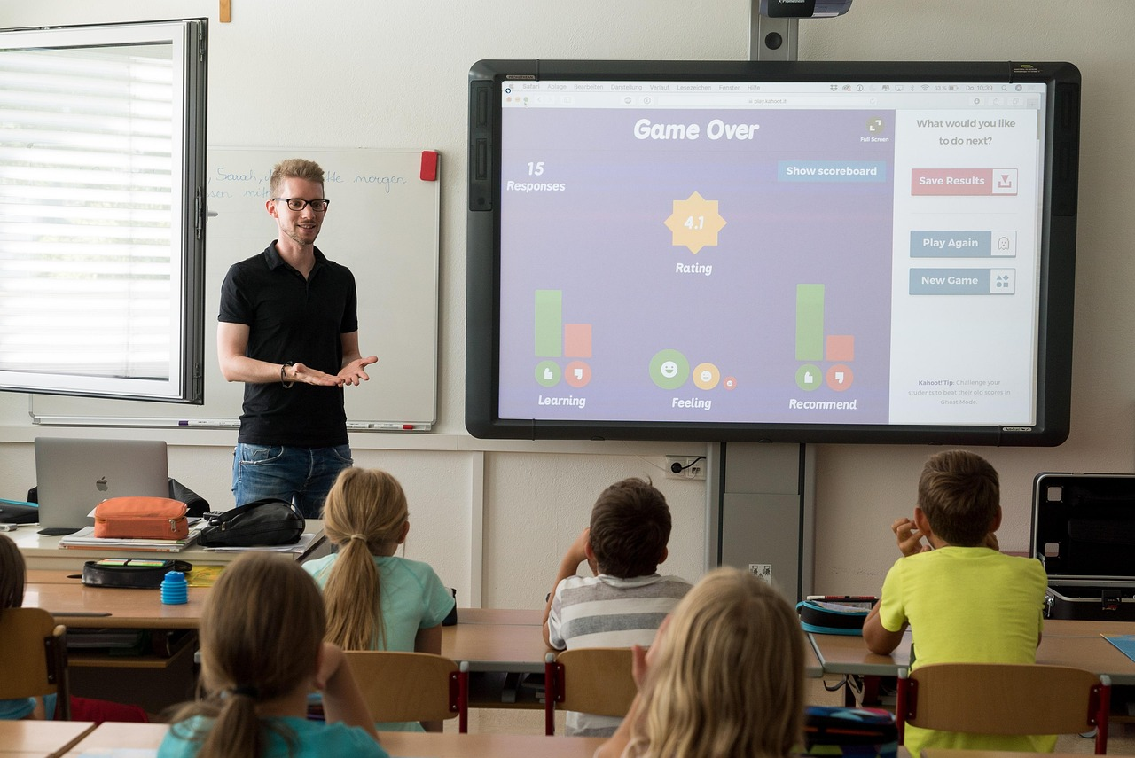
Reflection and Feedback
Opportunities for Reflection
Peer Feedback
Provide regular opportunities for reflection and feedback.
Use self-assessment checklists to support learning.
Use peer feedback to support learning.
Provide regular opportunities for reflection and feedback.
13
Piaget's Play Theory and Cognitive Development

Slide 14

Conclusion
Piaget's Play Theory
Play-Based Learning for Adults
Piaget's play theory provides a framework for understanding cognitive development.
It emphasizes the role of play in learning processes.
Play-based learning can be designed to support cognitive development in adults with LLN read and write difficulties.
This approach tailors activities to address specific learning needs.
14
Piaget's Play Theory and Cognitive Development

Slide 15

Key Takeaways
Stages of Cognitive Development
Role of Play in Development
Applying Piaget's Theory
Understand the four stages of cognitive development.
These stages provide a framework for understanding how children think and learn.
Recognize the importance of play in facilitating transition between stages.
Play acts as a bridge that helps children move from one stage to the next.
Apply Piaget's theory to real-life scenarios.
This application helps in understanding and supporting children's learning processes.
15
Piaget's Play Theory and Cognitive Development

Slide 16
Next Steps
Play-Based Learning Design
Effectiveness Evaluation
Design and implement play-based learning experiences for adults with learning difficulties.
Focus on creating engaging and accessible activities tailored to individual needs.
Evaluate the effectiveness of play-based learning experiences.
Use feedback and measurable outcomes to refine and improve the approach.
16
Piaget's Play Theory and Cognitive Development

Slide 17

Teaching Tips
1
Visual Aids and Images
Use visual aids and images to support learning.
These tools can help clarify complex concepts and make lessons more engaging.
2
Hands-On Activities and Games
Incorporate hands-on activities and games to promote engagement.
Such methods encourage active participation and make learning enjoyable.
3
Individual Support and Accommodations
Provide one-on-one support and accommodations as needed.
This ensures that all learners can succeed regardless of their unique needs.
17
Piaget's Play Theory and Cognitive Development

Slide 18

Reflection Questions
Effective Strategies for LLN Engagement
Designing Lessons for Application and Critical Thinking
What strategies were most effective in engaging learners with LLN read and write difficulties?
This question prompts reflection on the methods that successfully supported learners with literacy and numeracy challenges.
How can future lessons be designed to provide more opportunities for application and critical thinking?
This question encourages consideration of lesson planning to enhance practical skills and deeper analysis.
18
Piaget's Play Theory and Cognitive Development

Slide 19

Parent Engagement
Resources for Play-Based Learning
Engaging in Play-Based Activities
Provide resources and ideas for creating play-based learning opportunities at home.
Encourage parents to explore creative ways to make learning fun and interactive.
Encourage parents to engage in play-based activities with their child.
Highlight the importance of shared playtime in fostering child development.
19
Piaget's Play Theory and Cognitive Development

Slide 20
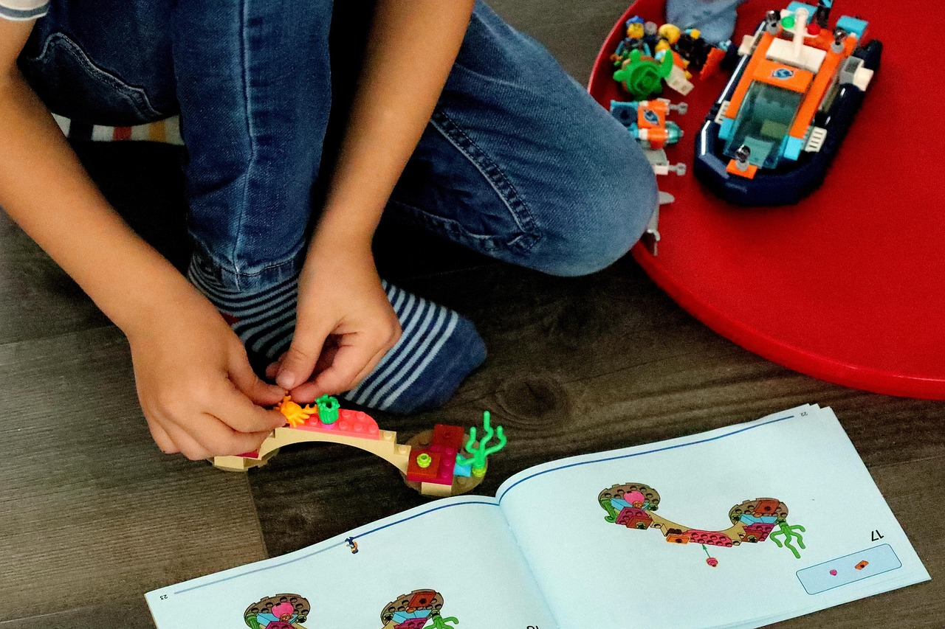
Safety Considerations
Ensuring a Safe Learning Environment
Clear Instructions for Activities
Ensure the learning environment is safe and accessible for all participants.
This includes addressing physical, emotional, and cognitive needs of all individuals.
Provide clear instructions and demonstrations for hands-on activities.
This helps participants understand tasks and reduces the risk of errors or accidents.
20
Piaget's Play Theory and Cognitive Development

Slide 21
Conclusion and Final Thoughts
Conclusion and Final Thoughts
Piaget's play theory provides a framework for understanding cognitive development.
It also aids in designing effective play-based learning experiences.
21
Piaget's Play Theory and Cognitive Development

