Slide 1

Foundations of Computing: Understanding the Essentials
A Comprehensive Guide to Computer Basics, Hardware, Software, and Digital Citizenship

Slide 2


Table of contents
Introduction to Computer Basics
What is Computer Hardware?
What is Computer Software?
Basic Computer Components
Computer Safety and Digital Citizenship
Why is Computer Knowledge Important?
Types of Computers
Computer Peripherals
Computer Software Applications
Computer Networks
Computer Maintenance
Conclusion
Quiz Time!
01
02
03
04
05
06
07
08
09
10
11
12
13

Slide 3
Table of contents
Answer Key
Additional Resources
Final Thoughts
14
15
16

Slide 4

Introduction to Computer Basics
Computer Components
Hardware Overview
Software Basics
Key components of a computer include the CPU, RAM, and storage devices, which collaborate to execute tasks.
Hardware refers to the physical parts of a computer system.
Understanding hardware is crucial for effective troubleshooting and upgrades.
Software consists of instructions that direct hardware operations.
It includes operating systems and applications that enable users to perform tasks.
1
Foundations of Computing: Understanding the Essentials

Slide 5
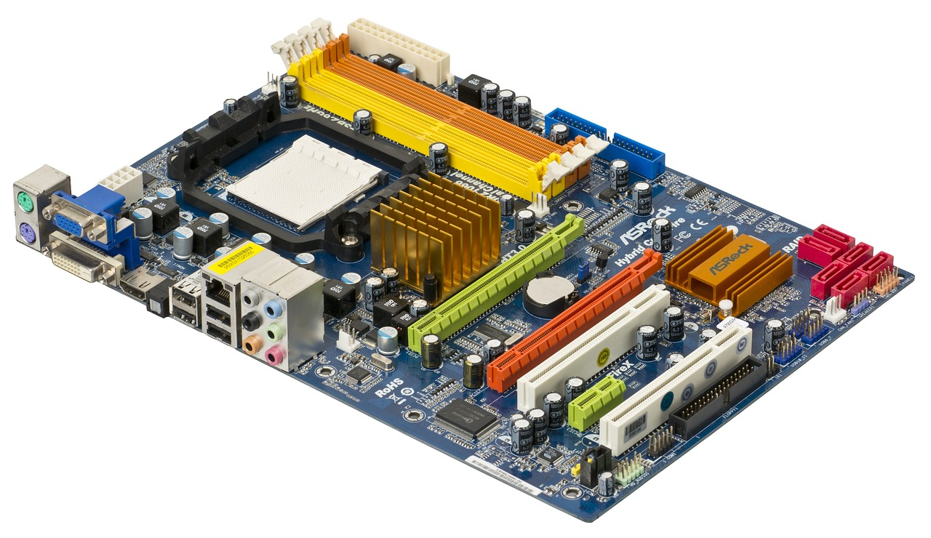
What is Computer Hardware?
Physical Components
Essential Elements
Computer hardware refers to the tangible parts of a computer system.
Examples include the keyboard, mouse, monitor, and CPU.
Hardware is crucial for the computer to operate effectively.
Without hardware, the computer cannot perform any tasks.
Functional Necessity
Task Execution
Each hardware component plays a specific role in the computer's functionality.
The CPU processes instructions, while the monitor displays output.
Hardware enables the execution of software applications.
It provides the necessary interface for user interaction.
2
Foundations of Computing: Understanding the Essentials

Slide 6

What is Computer Software?
Essential Programs
Popular Examples
Computer software is essential for tasks on a computer, including operating systems and applications.
Microsoft Word is widely used for document creation.
Google Chrome enables internet access as a web browser.
Adobe Photoshop is a leading software for image editing.
Task Execution
System Dependency
Software allows computers to perform specific tasks efficiently.
Without software, computers cannot run any applications.
Computers depend on software to function properly.
Without software, a computer cannot operate.
3
Foundations of Computing: Understanding the Essentials

Slide 7
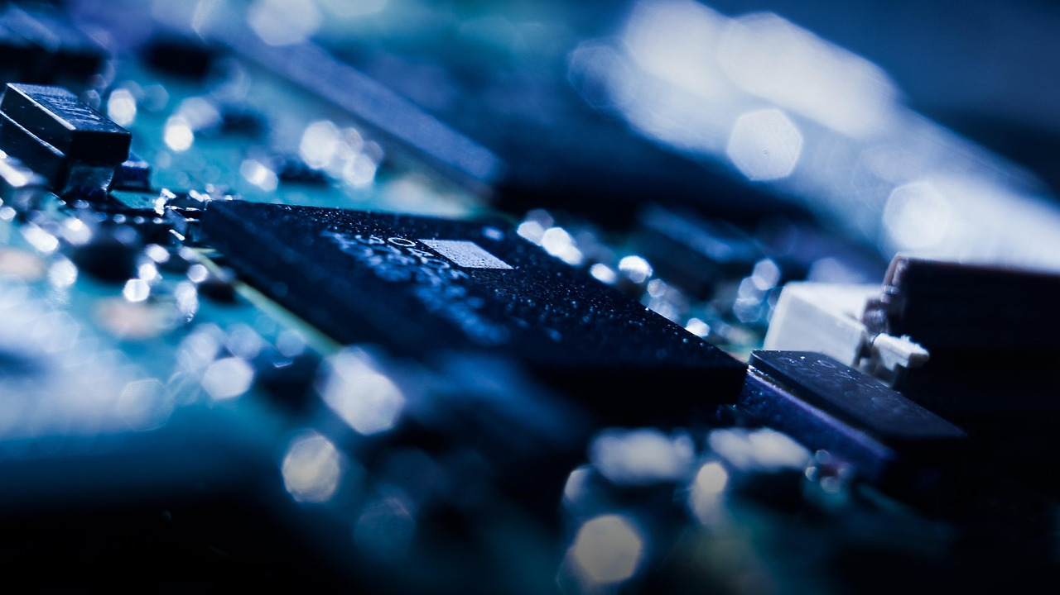
Basic Computer Components
CPU
Keyboard
Mouse
The CPU is the computer's brain, responsible for processing instructions and managing tasks efficiently.
The keyboard is an input device that allows users to enter data and commands easily.
The mouse is used for navigation, enabling users to interact with the computer interface seamlessly.
Monitor
Hard Drive
The monitor displays output, showing visual information generated by the computer.
The hard drive stores data and programs, retaining information even when the computer is powered off.
4
Foundations of Computing: Understanding the Essentials

Slide 8

Computer Safety and Digital Citizenship
Strong Passwords
Cautious Clicking
Utilize complex combinations of letters, numbers, and symbols for your passwords.
Regularly updating your passwords can significantly boost your security.
Verify links before clicking to avoid potential threats.
Be selective when downloading files; only use trusted sources.
Privacy Respect
Safety Guidelines
Be aware of the personal information you disclose online.
Request permission before sharing others' content to maintain respect.
Adhere to your organization's online behavior policies.
Promptly report any suspicious online activities to the relevant authorities.
5
Foundations of Computing: Understanding the Essentials

Slide 9

Why is Computer Knowledge Important?
Job Opportunities
Educational Support
Basic computer skills are essential in today's job market.
Many employers require proficiency in computer applications.
Computers provide access to a wealth of information and resources.
Online learning platforms enhance educational opportunities.
Creativity Boost
Productivity Enhancement
Digital tools enable innovative expression and design.
Computers facilitate the creation of art, music, and multimedia projects.
Computers streamline tasks and improve efficiency.
Software applications help in organizing and managing projects effectively.
6
Foundations of Computing: Understanding the Essentials

Slide 10

Types of Computers
Desktop
Laptop
Stationary computers designed for regular use at a single location.
They typically offer more power and storage than portable devices.
Portable computers that can be easily transported and used in various locations.
They combine the functionality of a desktop with the convenience of mobility.
Tablet
Smartphone
Small, portable computers that are primarily operated via a touchscreen interface.
They are ideal for browsing, reading, and light productivity tasks.
Mobile devices that integrate computing capabilities with communication features.
They allow users to access the internet, run applications, and make calls on the go.
7
Foundations of Computing: Understanding the Essentials

Slide 11
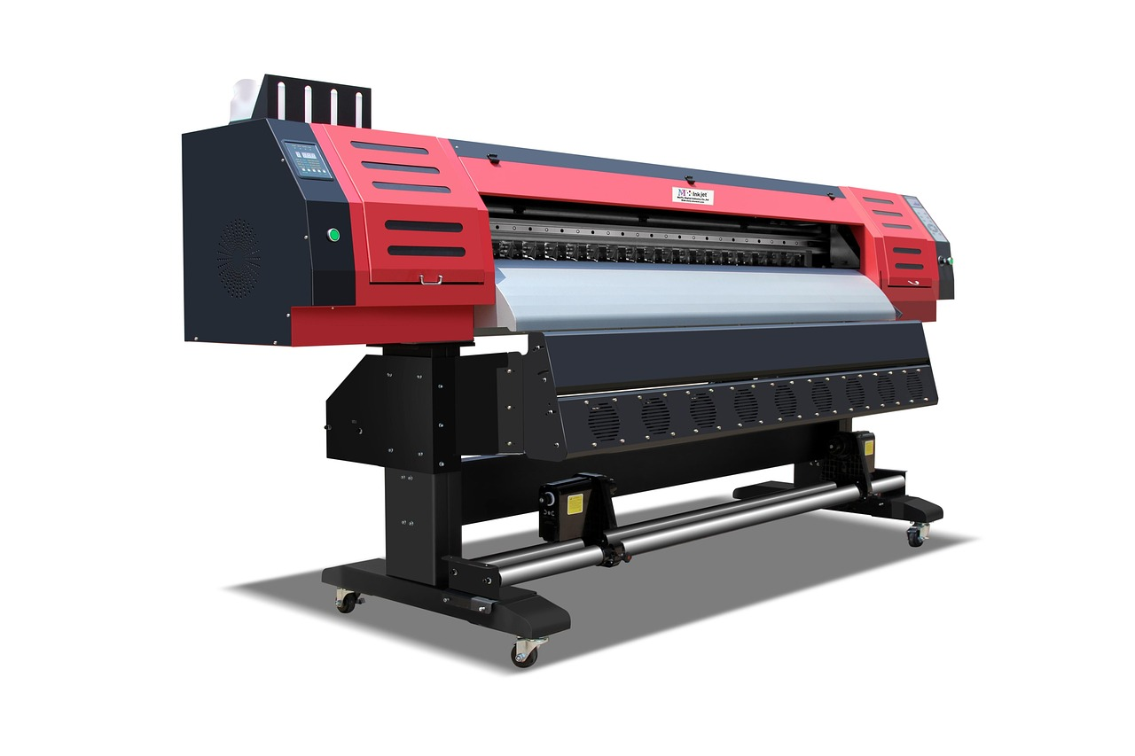
Computer Peripherals
Printer
Scanner
Produces high-quality prints in color or black-and-white.
Ideal for both home and office use.
Transforms physical documents into digital files.
Essential for archiving and sharing information.
Webcam
Speakers
Facilitates real-time video communication.
Perfect for remote work and online classes.
Delivers clear audio for multimedia experiences.
Enhances enjoyment of music, movies, and games.
8
Foundations of Computing: Understanding the Essentials

Slide 12

Computer Software Applications
Word Processor
Web Browser
Microsoft Word is a word processing application. It enables users to create and edit formatted text documents.
Google Chrome is a fast web browser. It features a user-friendly interface and supports numerous extensions.
Image Editor
Spreadsheet Tool
Adobe Photoshop is a leading image editing software. It provides advanced tools for photo manipulation and graphic design.
Microsoft Excel is a robust spreadsheet application. It allows users to analyze data and create visual representations like charts.
9
Foundations of Computing: Understanding the Essentials

Slide 13
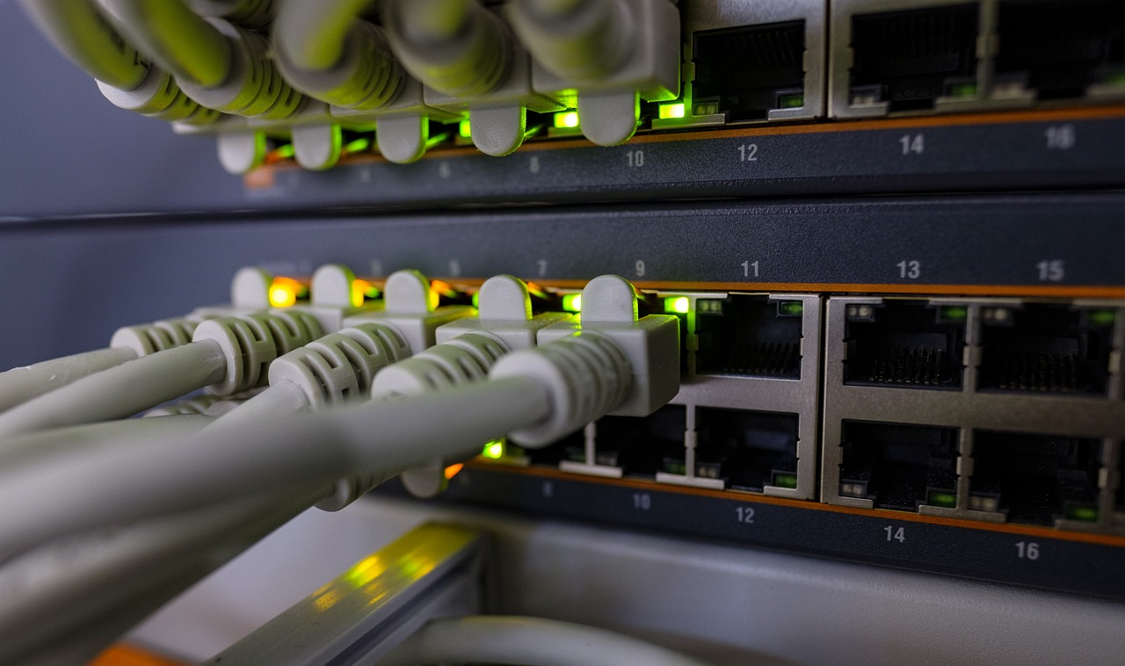
Computer Networks
LAN
WAN
Connects devices in a limited area, such as a home or office.
Typically offers high-speed connections and low latency.
Connects devices over a larger geographical area, such as cities or countries.
Often uses leased telecommunication lines for connectivity.
Internet
Wi-Fi
A global network of interconnected computers and servers.
Facilitates communication and data exchange worldwide.
A wireless network technology that allows devices to connect to the internet.
Provides flexibility and mobility for users within a certain range.
10
Foundations of Computing: Understanding the Essentials

Slide 14

Computer Maintenance
Software Updates
Virus Scans
Regularly update software and operating systems to ensure optimal performance and security. This helps protect against vulnerabilities and enhances functionality.
Run virus scans and malware removal tools regularly. This is essential to detect and eliminate threats that could compromise your system.
Dust Cleaning
Data Backup
Clean dust from computer components to prevent overheating and hardware damage. Regular cleaning can extend the lifespan of your computer.
Back up important data and files to avoid loss in case of system failure. Use external drives or cloud services for reliable storage.
11
Foundations of Computing: Understanding the Essentials

Slide 15

Conclusion
Key Components
Enhancing Literacy
Safety Practices
Computer hardware and software are essential for operation.
Knowing these components helps users operate computers effectively.
Understanding the basics of hardware and software improves computer literacy.
This knowledge helps users use technology better.
Practicing computer safety and digital citizenship is essential.
This protects personal information and ensures responsible technology use.
12
Foundations of Computing: Understanding the Essentials

Slide 16

Quiz Time!
Computer Brain
Input Devices
The brain of the computer is the Central Processing Unit (CPU).
It performs calculations and executes instructions.
Input devices are used to enter data into a computer.
Examples include keyboards, mice, and scanners.
Output Displays
Data Storage
Output displays show the results of computer processes.
Common output devices are monitors and printers.
Data storage refers to the components that hold data and programs.
Hard drives and solid-state drives are typical storage devices.
13
Foundations of Computing: Understanding the Essentials

Slide 17
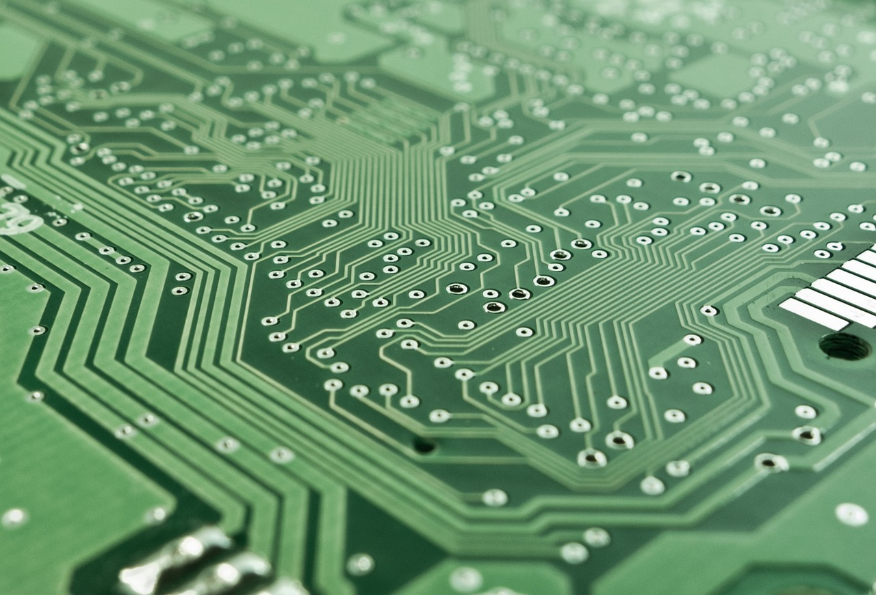
Answer Key
Processor
Input Device
The CPU is the brain of the computer, responsible for executing instructions.
It performs calculations and processes data at high speeds.
The keyboard allows users to input text and commands into the computer.
It is essential for typing documents and navigating software.
Display
Storage
The monitor displays visual output from the computer, allowing users to see their work.
It comes in various sizes and resolutions to suit different needs.
The hard drive stores all data, including the operating system, applications, and files.
It retains information even when the computer is turned off.
14
Foundations of Computing: Understanding the Essentials

Slide 18

Additional Resources
Online Tutorials
Computer Manuals
Access a variety of online tutorials and videos that cover different topics and skill levels.
These resources are often free and can be accessed at your own pace.
Explore comprehensive computer books and manuals that provide in-depth knowledge.
These resources are great for understanding complex concepts and troubleshooting.
Online Communities
Workshops
Join online forums and communities where you can ask questions and share knowledge.
These platforms foster collaboration and support among users.
Participate in computer classes and workshops for hands-on learning experiences.
These sessions often provide direct interaction with instructors and peers.
15
Foundations of Computing: Understanding the Essentials

Slide 19

Final Thoughts
Computer Safety
Continuous Learning
Enjoyment in Tech
Always practice computer safety and digital citizenship.
Be aware of online threats and protect your personal information.
Keep learning and exploring computer hardware and software.
Stay updated with the latest technology trends and advancements.
Have fun and enjoy the world of computers!
Engage in projects that spark your interest and creativity.
16
Foundations of Computing: Understanding the Essentials

