Slide 1

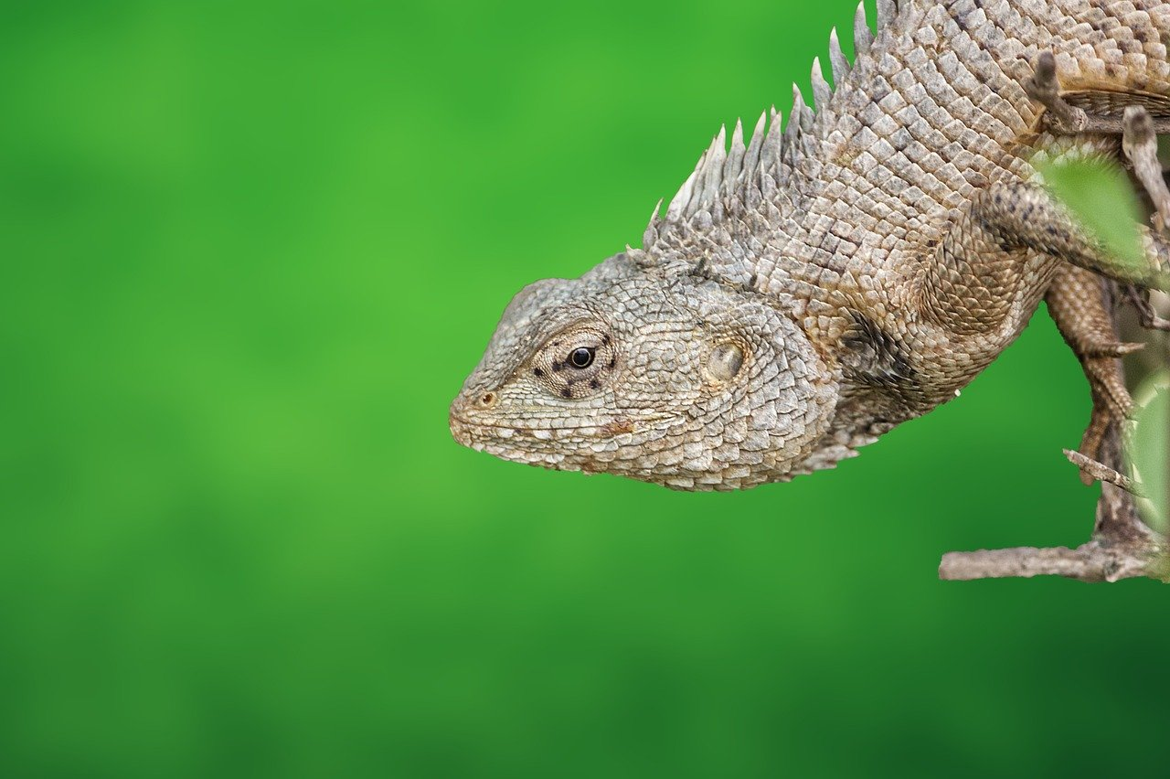
Ecosystems and Biodiversity: Foundations and Conservation
Understanding Interactions, Services, and Human Impact for a Sustainable Future

Slide 2
Table of Contents
Introduction to Ecosystems and Biodiversity
What are Ecosystems?
Importance of Biodiversity
Species Identification and Recording
Ecosystem Services and Human Well-being
Human Impact on Ecosystems
Conservation and Sustainability
Case Study: Coral Reefs
Case Study: Amazon Rainforest
Invasive Species
Species Adaptation
Ecosystem Services
Conclusion
04
05
06
07
08
09
10
11
12
13
14
15
16

Slide 3
Table of Contents
Summary
Reflection Questions
Next Steps
Additional Resources
Assessment and Evaluation
Extension Activities
17
18
19
20
21
22

Slide 4
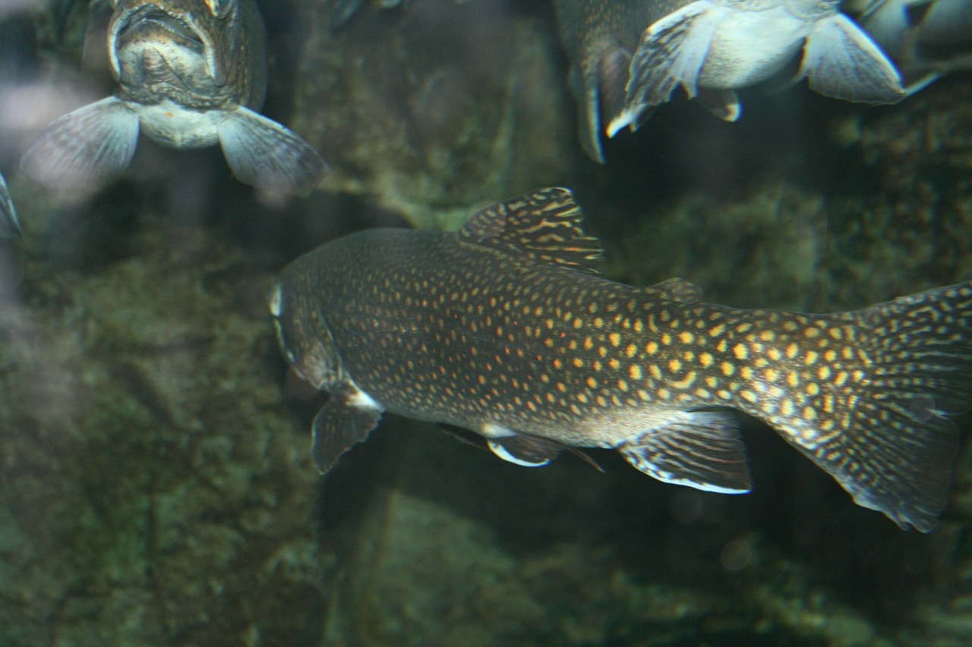
Introduction to Ecosystems and Biodiversity
Definition of Ecosystems
Understanding Biodiversity
Importance of Ecosystems and Biodiversity
Ecosystems are communities of living and non-living things that interact with each other in a specific environment.
They form the foundation for understanding biodiversity and ecological interactions.
Biodiversity refers to the variety of different species that live in an ecosystem.
It plays a key role in maintaining the balance and health of ecosystems.
Understanding ecosystems and biodiversity is crucial for maintaining healthy ecosystems.
This knowledge supports human well-being and the sustainability of our environment.
4
Ecosystems and Biodiversity: Foundations and Conservation

Slide 5
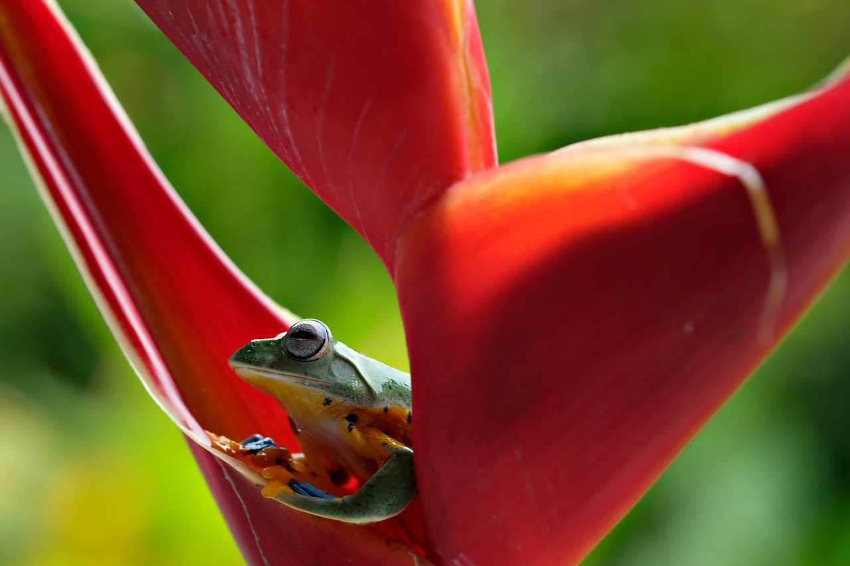
What are Ecosystems?
Definition of Ecosystems
Habitats of Ecosystems
An ecosystem is a complex network of living organisms, including plants, animals, and microorganisms.
The relationships between the species in an ecosystem are critical to its functioning.
Ecosystems can be found in a variety of habitats, including forests, grasslands, deserts, and oceans.
These diverse habitats support unique combinations of species.
Interconnected Species
Impact of Changes
The relationships between species in an ecosystem are vital for maintaining balance.
Changes to one species can have a ripple effect throughout the ecosystem.
Even small changes to one species can disrupt the entire ecosystem.
This interconnectedness highlights the fragility of ecosystems.
5
Ecosystems and Biodiversity: Foundations and Conservation

Slide 6
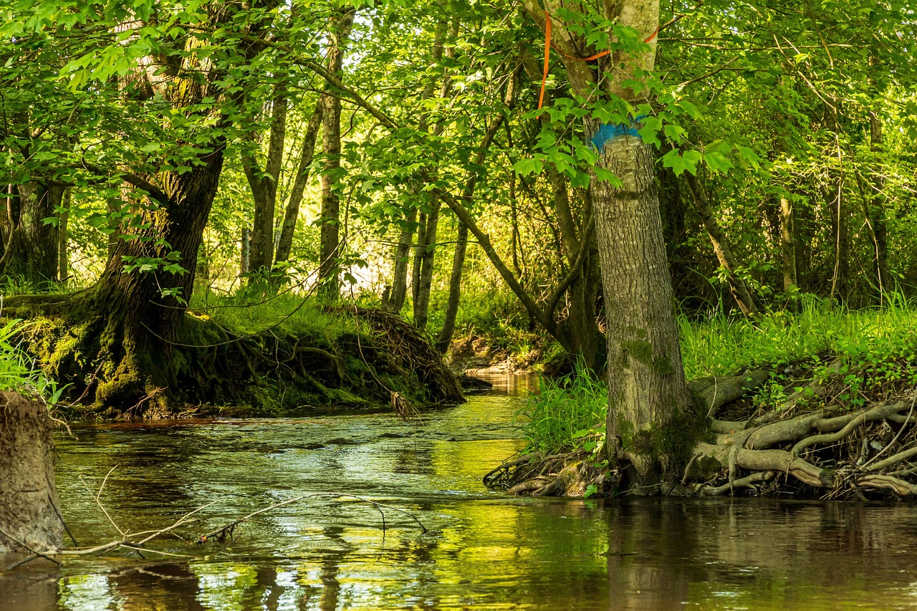
Importance of Biodiversity
Benefits of Biodiversity
Biodiversity and Human Well-being
Threats to Biodiversity
Biodiversity provides a range of benefits, including pollination, pest control, and climate regulation.
It is essential for maintaining the balance of ecosystems and supporting life on Earth.
Biodiversity is essential for human well-being, as it provides a range of ecosystem services, including food, water, and medicine.
These services are critical for sustaining human life and development.
Biodiversity is facing a range of threats, including habitat destruction, climate change, and pollution.
These threats are causing a rapid decline in species and ecosystem health.
6
Ecosystems and Biodiversity: Foundations and Conservation

Slide 7
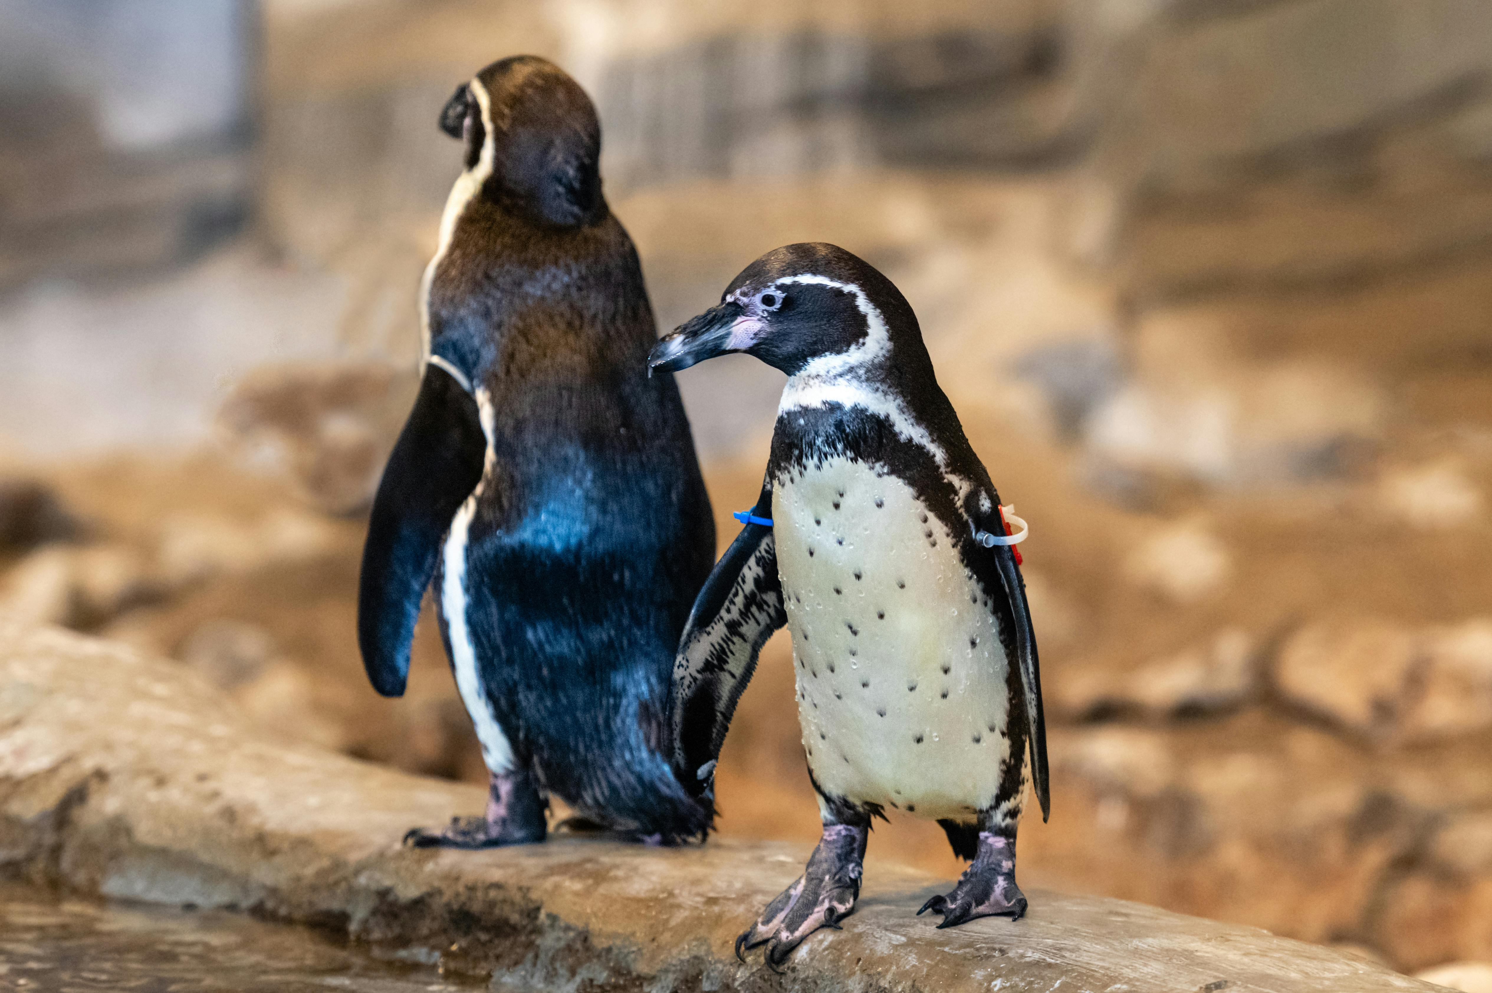
Species Identification and Recording
Importance of Species Identification
Species identification and recording are critical components of ecosystem management and conservation.
By identifying and recording the species that exist in an ecosystem, scientists and conservationists can understand the complex relationships between species and their environments.
Conservation Strategies
This information can be used to develop effective conservation strategies.
It helps in managing natural resources and mitigating the impacts of climate change.
Understanding Ecosystem Dynamics
Recording species provides insights into the interactions between species and their environments.
These insights are essential for maintaining ecological balance and biodiversity.
7
Ecosystems and Biodiversity: Foundations and Conservation

Slide 8

Ecosystem Services and Human Well-being
Essential Ecosystem Services
Ecosystems provide a range of services that are essential for human well-being, including food, water, and medicine.
These services are fundamental to sustaining life and supporting human health.
Cultural and Recreational Benefits
Ecosystems also provide a range of cultural and recreational benefits, including opportunities for tourism, recreation, and spiritual practices.
These benefits enhance the quality of life and foster connections between people and nature.
Threats to Ecosystem Services
Ecosystem services are facing a range of threats, including habitat destruction, climate change, and pollution.
These threats jeopardize the sustainability of ecosystems and the services they provide.
8
Ecosystems and Biodiversity: Foundations and Conservation

Slide 9

Human Impact on Ecosystems
Human Activities and Ecosystem Disruption
Consequences of Ecosystem Damage
Mitigation Strategies for Ecosystem Preservation
Human activities, such as deforestation, pollution, and climate change, can have significant impacts on ecosystems and biodiversity.
These impacts can lead to the degradation of natural habitats and the disruption of ecological balance.
The loss of ecosystem services and the decline of species populations are far-reaching consequences of human impact.
Such damage can affect food security, water quality, and overall environmental health.
Understanding the impacts of human activities on ecosystems is essential for developing effective mitigation strategies.
These strategies aim to reduce harm and promote sustainable practices to protect biodiversity.
9
Ecosystems and Biodiversity: Foundations and Conservation

Slide 10
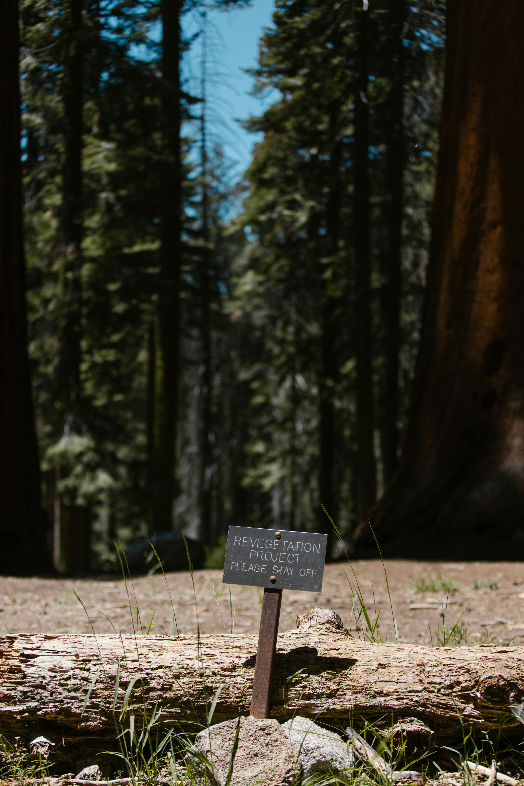
Conservation and Sustainability
Importance of Conservation
Principles of Sustainability
Ecosystem Restoration
Conservation and sustainability are critical for maintaining healthy ecosystems and supporting human well-being.
Conservation efforts, such as habitat preservation and species reintroduction, can help to protect and restore ecosystems.
Sustainability involves managing natural resources in a way that meets the needs of the present.
It ensures that future generations can meet their own needs without compromising resources.
Habitat preservation and species reintroduction are key strategies for ecosystem restoration.
These efforts contribute to the protection and recovery of biodiversity.
10
Ecosystems and Biodiversity: Foundations and Conservation

Slide 11
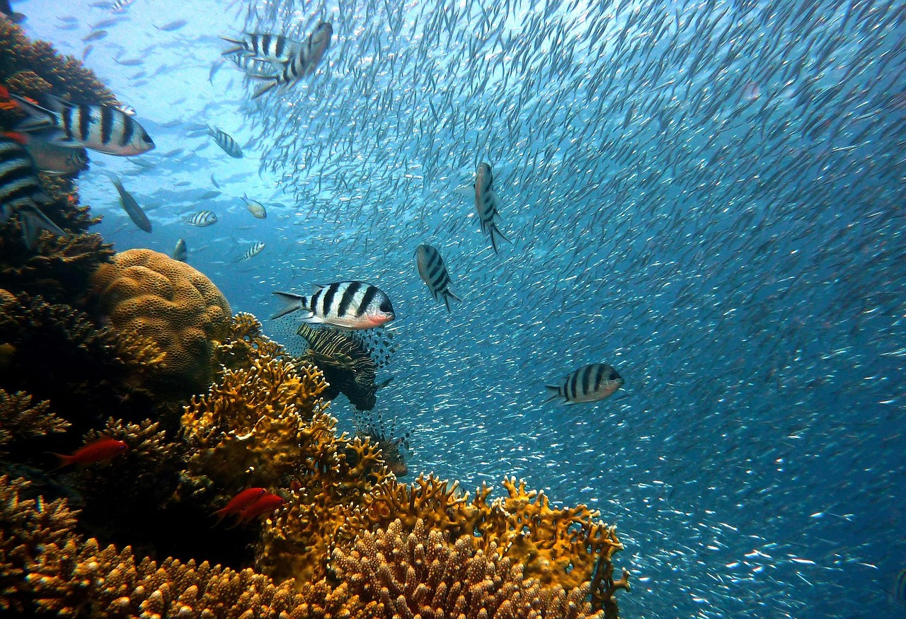
Case Study: Coral Reefs
Diversity and Ecosystem Services
Threats to Coral Reefs
Conservation Efforts
Coral reefs are one of the most diverse ecosystems on the planet.
They provide a range of ecosystem services, including shoreline protection and water filtration.
Coral reefs are facing a range of threats, including climate change, pollution, and overfishing.
These threats are causing significant damage to coral reef ecosystems worldwide.
Conservation efforts, such as marine protected areas and sustainable fishing practices, can help to protect coral reefs.
These measures aim to restore the health and biodiversity of coral reef ecosystems.
11
Ecosystems and Biodiversity: Foundations and Conservation

Slide 12
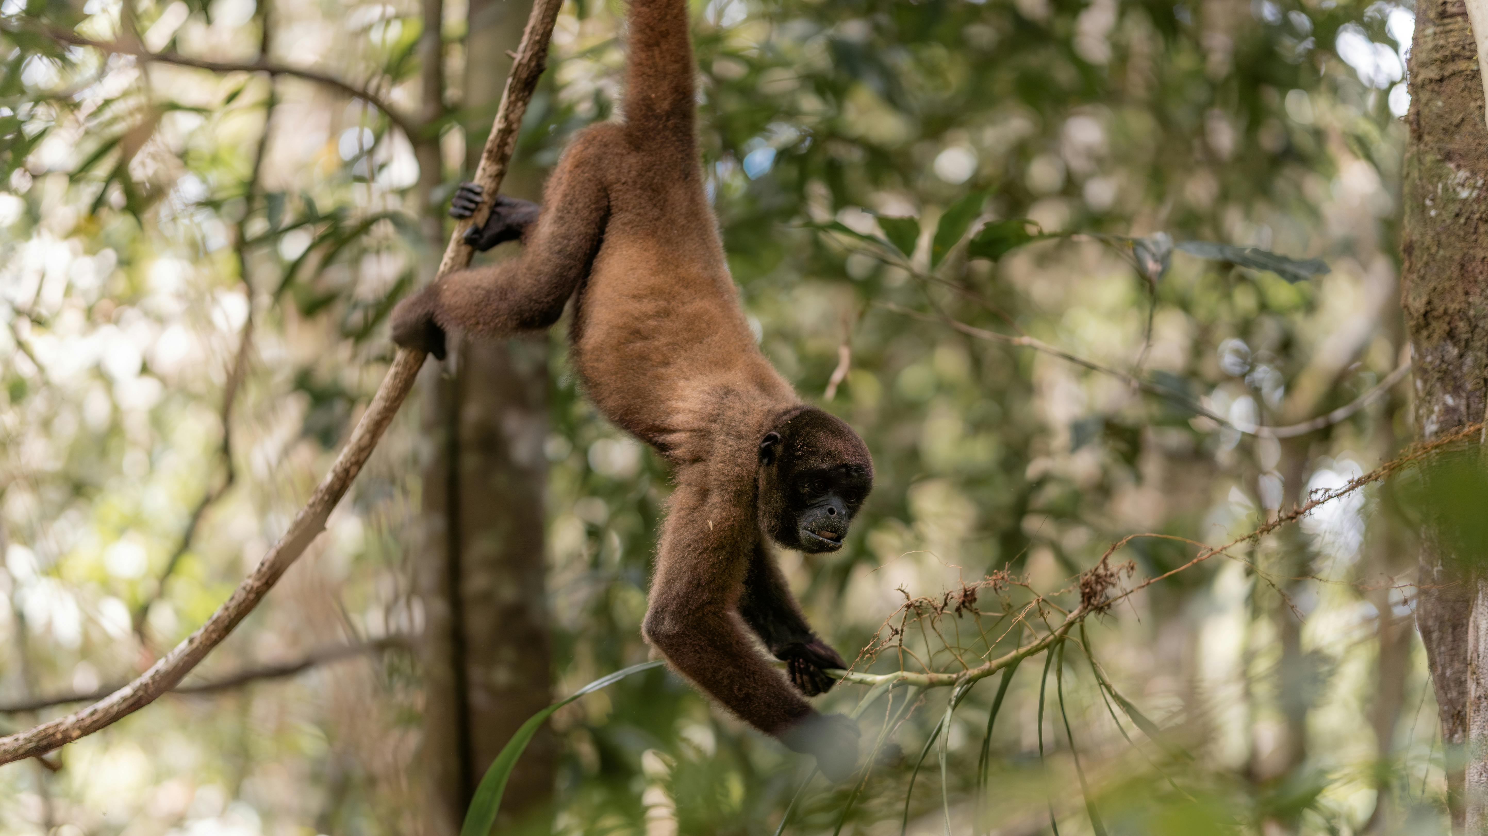
Case Study: Amazon Rainforest
The Amazon's Global Importance
The Amazon rainforest is the largest tropical rainforest in the world, providing a range of ecosystem services, including oxygen production and climate regulation.
Its vast biodiversity and ecological functions are crucial for the health of the planet.
Threats to the Amazon
The Amazon is facing a range of threats, including deforestation, logging, and climate change.
These activities are causing significant harm to its ecosystems and biodiversity.
Conservation Strategies
Conservation efforts, such as protected areas and sustainable land-use practices, can help to protect and restore the Amazon rainforest.
These strategies aim to balance human activity with ecological preservation.
12
Ecosystems and Biodiversity: Foundations and Conservation

Slide 13
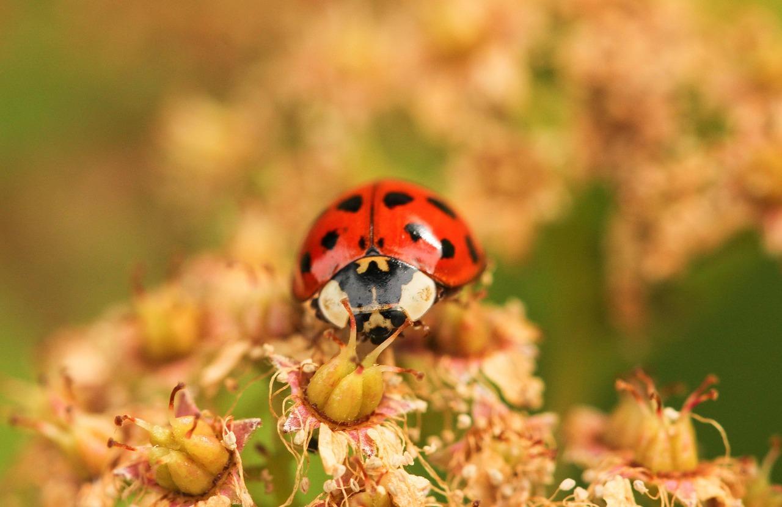
Invasive Species
Definition of Invasive Species
Invasive species are non-native species that are introduced to an ecosystem and can outcompete native species for resources.
They disrupt the balance of ecosystems by dominating resources and habitats.
Impacts on Ecosystems and Biodiversity
Invasive species can have significant impacts on ecosystems and biodiversity, including the loss of ecosystem services.
They contribute to the decline of native species populations and alter ecological dynamics.
Management and Mitigation Strategies
Prevention and early detection are critical for managing invasive species and mitigating their impacts.
Effective strategies include monitoring, public awareness, and rapid response to new invasions.
13
Ecosystems and Biodiversity: Foundations and Conservation

Slide 14
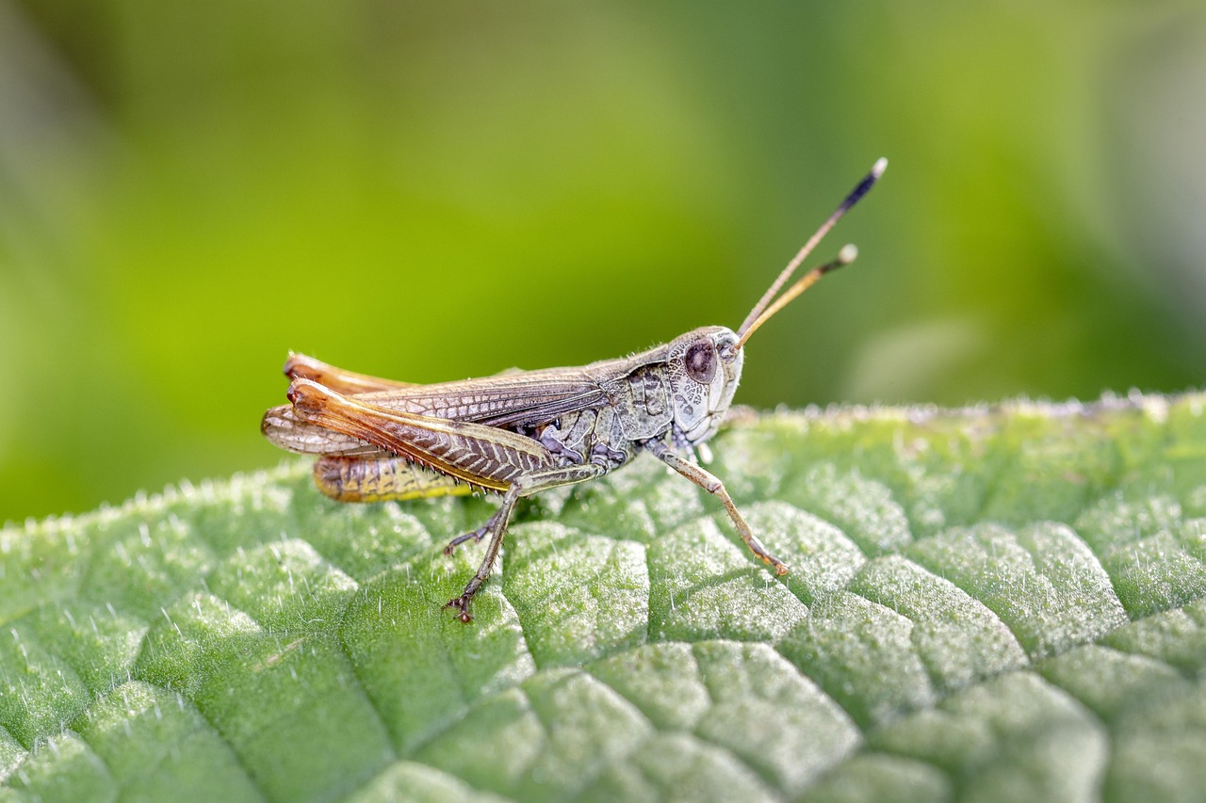
Species Adaptation
Understanding Species Adaptation
Challenges to Adaptation
The Role of Biodiversity
Species adaptation is the process by which species evolve and adapt to their environments.
Adaptation is an important mechanism for maintaining biodiversity, as it allows species to respond to changing environmental conditions.
Adaptation can be limited by the rate of environmental change.
The availability of genetic variation also plays a critical role in determining the success of adaptation.
Biodiversity is maintained through the ability of species to adapt to their environments.
This process ensures resilience against changing environmental conditions.
14
Ecosystems and Biodiversity: Foundations and Conservation

Slide 15
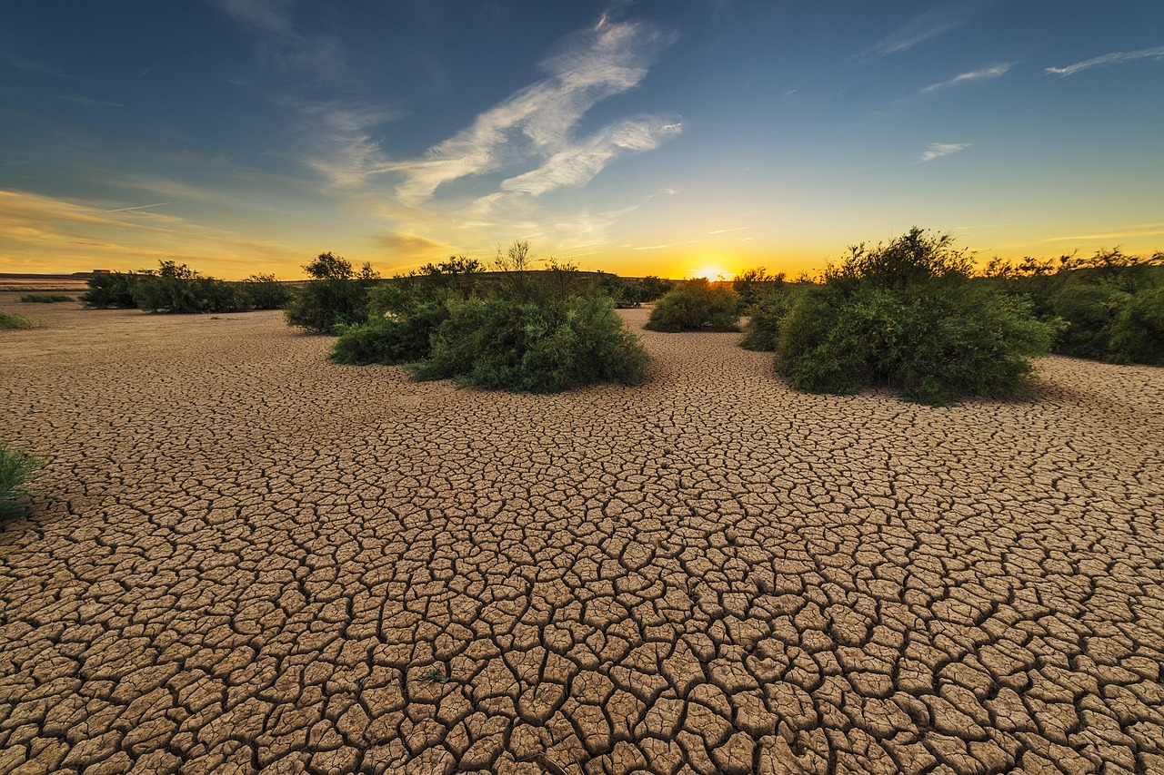
Ecosystem Services
Definition of Ecosystem Services
Examples of Ecosystem Services
Importance of Ecosystem Services
Ecosystem services are the benefits that humans derive from functioning ecosystems.
These services are crucial for maintaining the balance of nature and supporting life on Earth.
Ecosystem services include clean air and water, soil formation, and climate regulation.
These examples highlight the diverse ways ecosystems contribute to human survival and prosperity.
Ecosystem services are essential for human well-being and economic development.
Without these services, societies would struggle to thrive and sustain their populations.
15
Ecosystems and Biodiversity: Foundations and Conservation

Slide 16
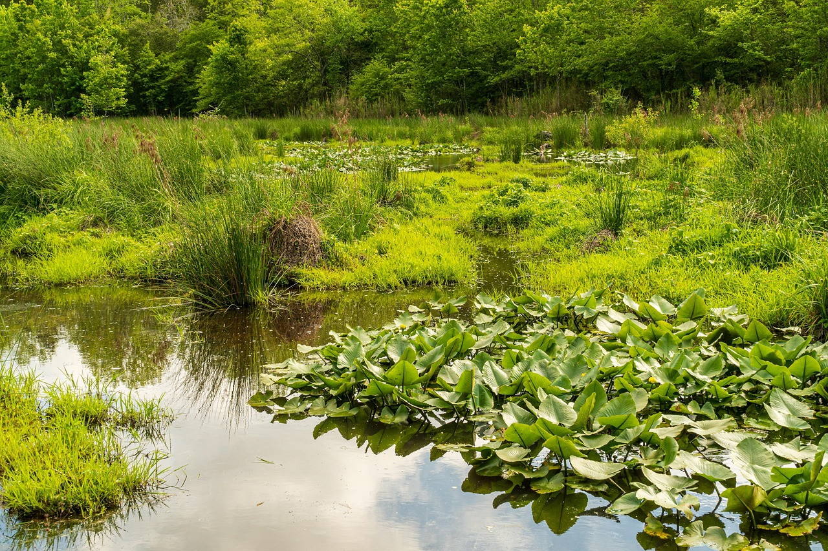
Conclusion
Importance of Ecosystems and Biodiversity
Human Impact on Nature
Need for Conservation and Sustainability
Ecosystems and biodiversity are critical for maintaining healthy ecosystems and supporting human well-being.
They provide essential services such as clean air, water, and food.
Human activities, such as deforestation, pollution, and climate change, can have significant impacts on ecosystems and biodiversity.
These actions disrupt natural processes and threaten the balance of ecosystems.
Conservation and sustainability are essential for maintaining healthy ecosystems and supporting human well-being.
Efforts to protect natural resources ensure a better future for both humans and the environment.
16
Ecosystems and Biodiversity: Foundations and Conservation

Slide 17
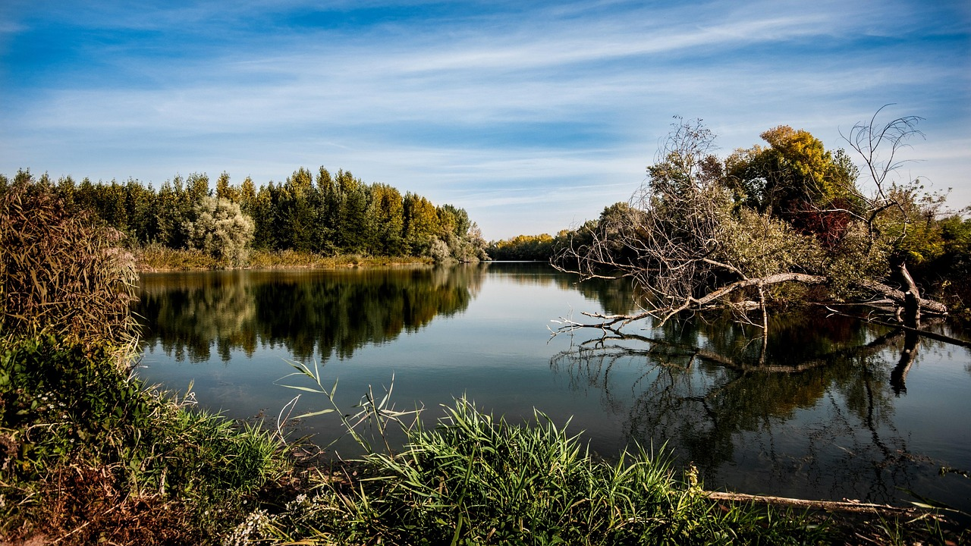
Summary
Understanding Ecosystems
Ecosystems are communities of living and non-living things that interact with each other in a specific environment.
They form the foundation for biodiversity and ecological balance.
Importance of Biodiversity
Biodiversity is essential for human well-being, as it provides a range of ecosystem services.
These services include food, clean water, and climate regulation.
Conservation and Sustainability
Conservation and sustainability are critical for maintaining healthy ecosystems.
They support human well-being by ensuring the long-term health of our environment.
17
Ecosystems and Biodiversity: Foundations and Conservation

Slide 18
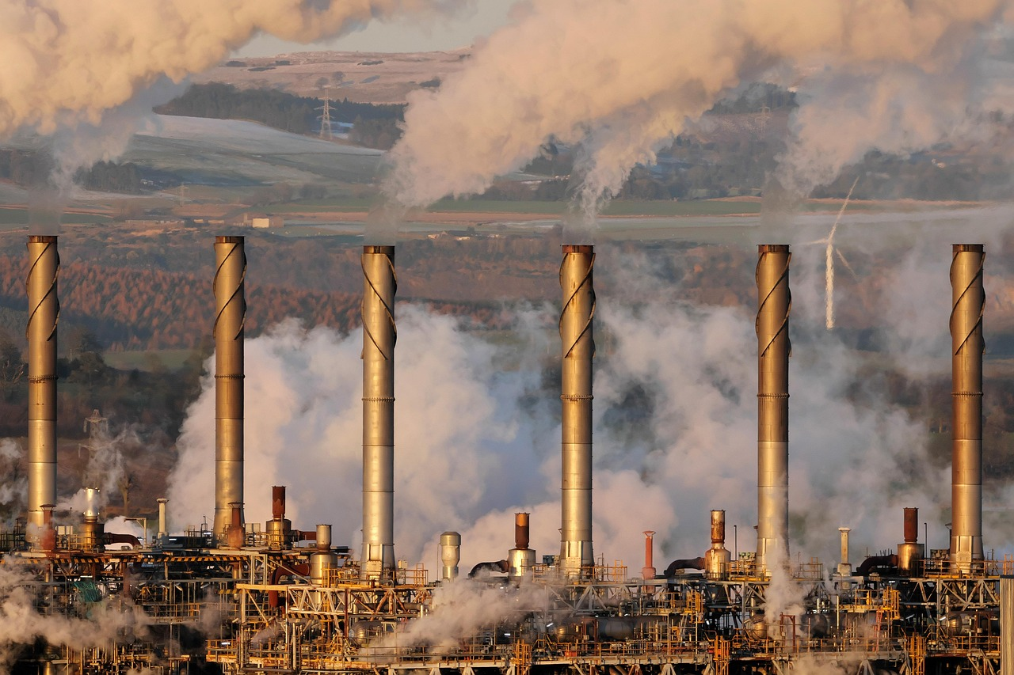
Reflection Questions
Human Activities and Ecosystems
What are some ways that human activities can impact ecosystems and biodiversity?
How can conservation and sustainability help to maintain healthy ecosystems and support human well-being?
Conservation and Sustainability
How can conservation and sustainability help to maintain healthy ecosystems and support human well-being?
What are some ways that individuals can make a positive impact on the environment?
Individual Actions for the Environment
What are some ways that individuals can make a positive impact on the environment?
What are some ways that human activities can impact ecosystems and biodiversity?
18
Ecosystems and Biodiversity: Foundations and Conservation

Slide 19
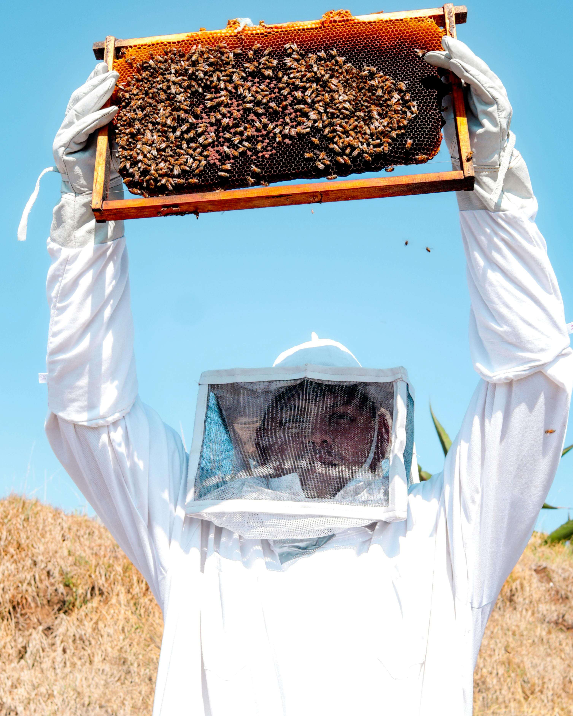
Next Steps
Explore Ecosystems and Biodiversity
Engage in Conservation Efforts
Adopt Sustainable Practices
Learn more about ecosystems and biodiversity through further reading and research.
Deepen your understanding of the natural world and its intricate connections.
Participate in conservation efforts, such as volunteering or donating to organizations that protect and restore ecosystems.
Your actions can directly contribute to preserving the planet's biodiversity.
Make sustainable choices in daily life, such as reducing energy consumption and using public transportation.
Small changes in your habits can lead to significant environmental benefits.
19
Ecosystems and Biodiversity: Foundations and Conservation

Slide 20
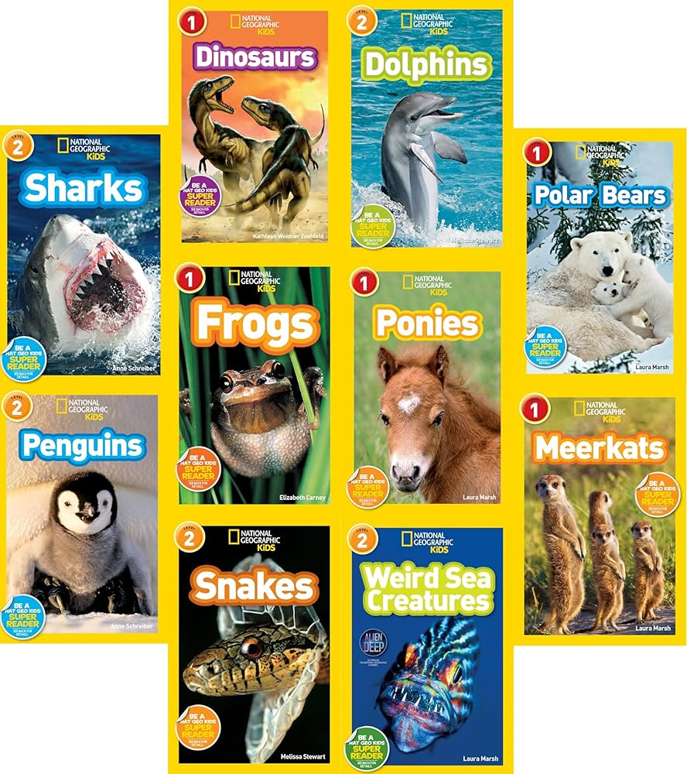
Additional Resources
Interactive Learning with National Geographic Kids
Visualizing Ecosystems with Diagrams
Exploring Species with Identification Guides
National Geographic Kids Website offers interactive games, videos, and articles about ecosystems and biodiversity.
It serves as a digital resource to engage children in learning about the natural world.
Ecosystem Diagrams provide printed or digital illustrations of the components of different ecosystems.
These diagrams help learners understand the relationships and structures within ecosystems.
Species Identification Guides offer printed or digital information and pictures of various species.
These guides are essential tools for learning about biodiversity and recognizing different organisms.
20
Ecosystems and Biodiversity: Foundations and Conservation

Slide 21
Assessment and Evaluation
Written Test
Group Presentation
Species Identification Project
A written test is conducted to assess knowledge of ecosystems and biodiversity.
This evaluates the theoretical understanding of ecological concepts.
Students deliver group presentations to assess understanding of ecosystem services and human impact.
This activity encourages collaboration and critical thinking about environmental issues.
A project is undertaken to assess the ability to identify and record different species.
This hands-on activity promotes practical skills in biodiversity documentation.
21
Ecosystems and Biodiversity: Foundations and Conservation

Slide 22
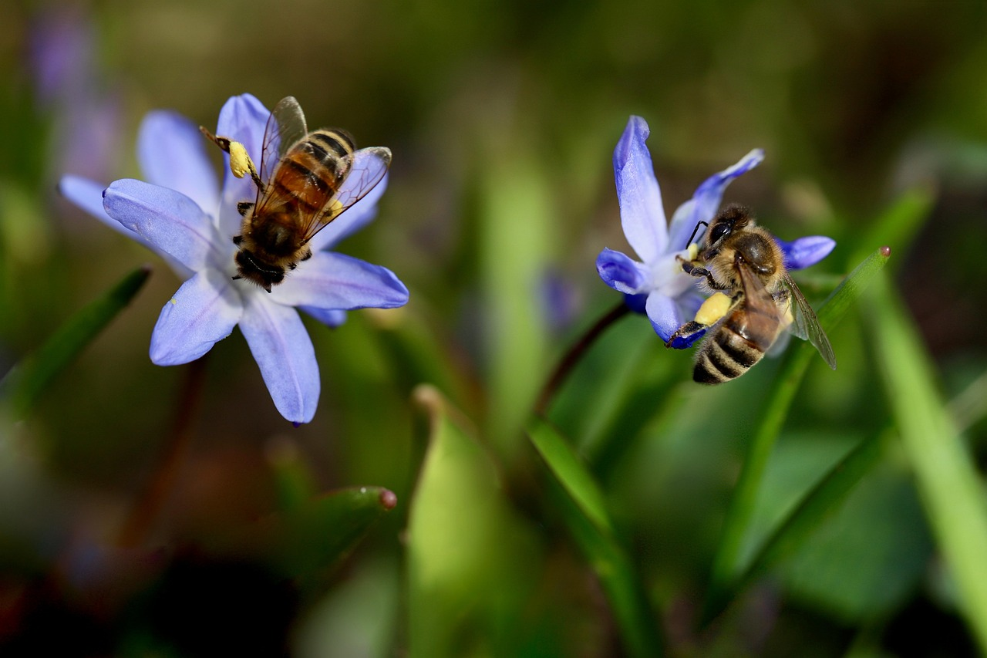
Extension Activities
Ecosystem Diorama
Biodiversity Scavenger Hunt
Ecosystem Model
Create a diorama of a specific ecosystem.
Include different species and their habitats.
Participate in a scavenger hunt to identify different species.
Record findings in a local ecosystem.
Create a model of an ecosystem.
Include components such as producers, consumers, and decomposers.
22
Ecosystems and Biodiversity: Foundations and Conservation

