Slide 1

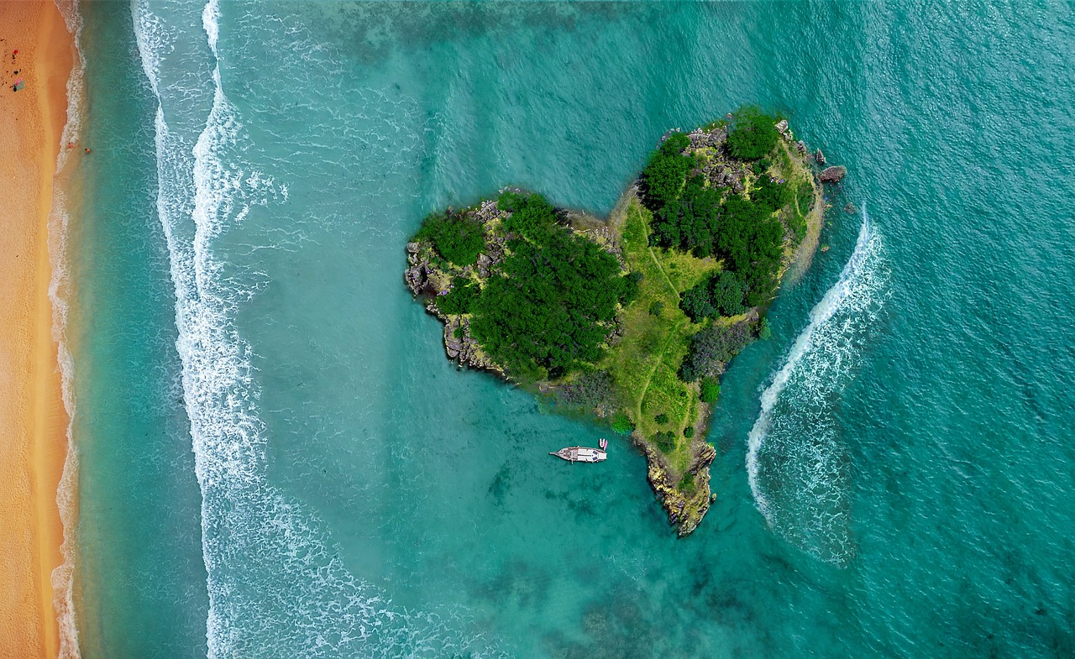
Introduction to the Pacific Islands: Geography, Oceanography, and Geopolitics
Exploring the Diversity, Challenges, and Strategic Importance of the Pacific Island Region

Slide 2
Table of Contents
Introduction to the Pacific Islands
Geography of the Pacific Islands
Oceanography of the Pacific Islands
Maritime Boundaries of Australia
Geopolitics of the Pacific Islands
Mapping the Pacific Islands
Transect of the Islands
Case Study: The Torres Strait Islands
Geopolitical Implications of Maritime Boundari…
Conclusion
Summary
03
04
05
06
07
08
09
10
11
12
13

Slide 3
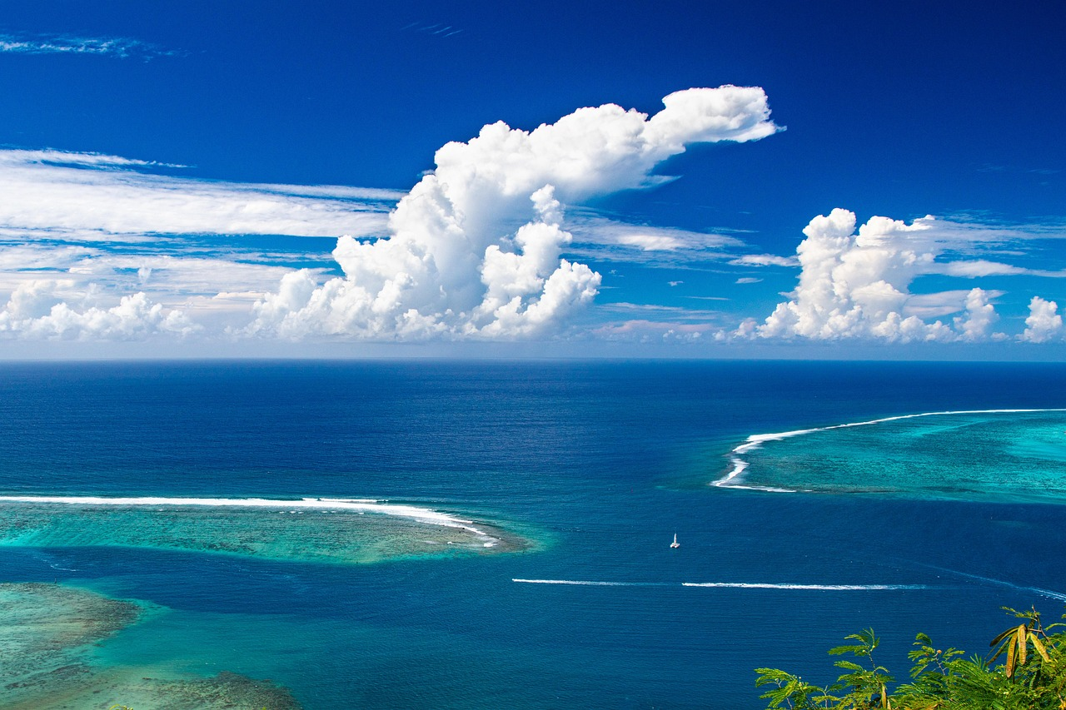
Introduction to the Pacific Islands
Geographical Diversity
Cultural and Economic Significance
The Pacific Islands are a diverse and complex region, characterized by a range of geographical features, including island chains, coral reefs, and volcanic islands.
Understanding the geography of the Pacific Islands is essential for navigating these challenges and developing effective strategies for sustainable development and cooperation in the region.
The region is home to a range of cultures, languages, and economies, and is an important component of Australia's foreign policy and economic strategy.
Understanding the geography of the Pacific Islands is essential for navigating these challenges and developing effective strategies for sustainable development and cooperation in the region.
Environmental Vulnerabilities
Strategic Importance
The Pacific Islands are also vulnerable to a range of environmental and geopolitical challenges, including climate change, overfishing, and territorial disputes.
Understanding the geography of the Pacific Islands is essential for navigating these challenges and developing effective strategies for sustainable development and cooperation in the region.
Understanding the geography of the Pacific Islands is essential for navigating these challenges and developing effective strategies for sustainable development and cooperation in the region.
The region is home to a range of cultures, languages, and economies, and is an important component of Australia's foreign policy and economic strategy.
3
Introduction to the Pacific Islands: Geography, Oceanography, and Geopolitics

Slide 4
Geography of the Pacific Islands
01
02
03
04
05
Diverse Landforms
Rich Ecosystems
Endemic Species
Geological Processes
Climate Challenges
The Pacific Islands are characterized by a diverse range of landforms, including coral atolls, volcanic islands, and continental islands.
These landforms contribute to the region's unique geographical identity.
The region is home to a wide range of ecosystems, including coral reefs, rainforests, and mangrove swamps.
These ecosystems support a variety of life forms and are vital for environmental balance.
The Pacific Islands are also home to a range of unique and endemic species, including birds, fish, and plants.
These species are often found nowhere else in the world, highlighting the region's biodiversity.
The geography of the Pacific Islands is shaped by a range of geological processes, including volcanic activity, erosion, and sedimentation.
These processes have played a significant role in forming the islands over time.
The region is also affected by a range of climate-related factors, including sea-level rise, drought, and extreme weather events.
These challenges pose significant risks to the islands' ecosystems and human populations.
4
Introduction to the Pacific Islands: Geography, Oceanography, and Geopolitics

Slide 5
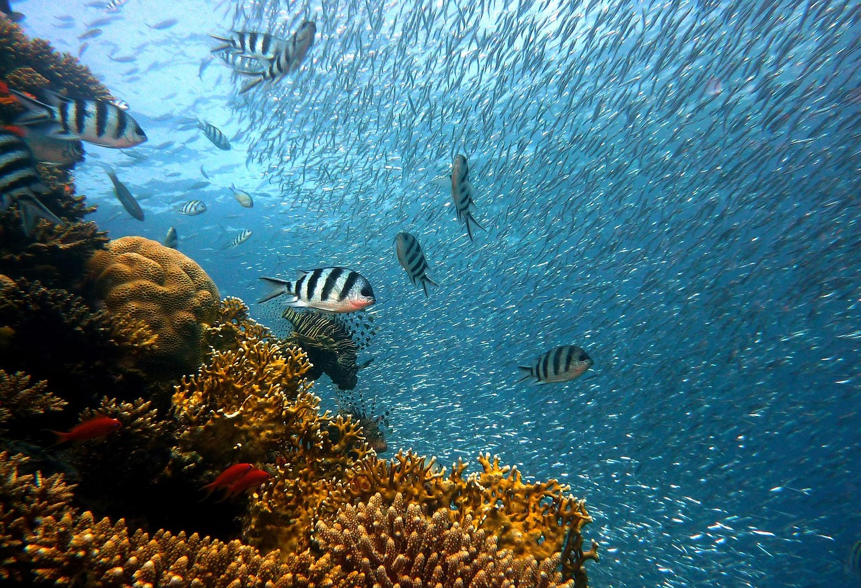
Oceanography of the Pacific Islands
Oceanographic Features
Marine Ecosystems
The Pacific Islands are surrounded by a range of oceanographic features, including coral reefs, ocean currents, and sea mounts.
These features contribute to the unique marine environment of the region.
The region is home to a range of marine ecosystems, including coral reefs, estuaries, and open ocean environments.
These ecosystems support diverse marine life and are vital for ecological balance.
Impact on Climate and Economy
Ocean-Related Challenges
The oceanography of the Pacific Islands plays a critical role in shaping the region's climate, geography, and economy.
It influences weather patterns and provides resources essential for local livelihoods.
The region is also affected by a range of ocean-related challenges, including overfishing, pollution, and climate change.
These issues threaten the sustainability of marine ecosystems and the well-being of island communities.
5
Introduction to the Pacific Islands: Geography, Oceanography, and Geopolitics

Slide 6
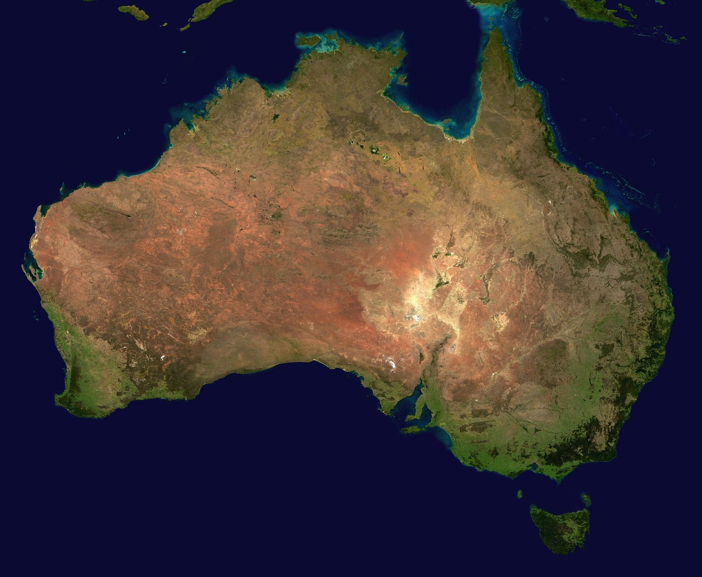
Maritime Boundaries of Australia
01
Significance of Maritime Boundaries
Australia's maritime boundaries are an important component of the country's foreign policy and economic strategy.
They include the exclusive economic zone, the continental shelf, and the territorial sea.
02
Role in International Relations
The maritime boundaries play a critical role in shaping the country's relationships with neighboring nations.
These boundaries help define Australia's interactions and agreements with other countries.
03
Challenges to Maritime Boundaries
The boundaries are subject to a range of challenges, including territorial disputes, overfishing, and environmental degradation.
These issues require careful management and international cooperation.
04
Economic and Environmental Implications
Australia's maritime zones are vital for economic activities such as fishing and resource extraction.
Environmental concerns also necessitate sustainable practices within these boundaries.
6
Introduction to the Pacific Islands: Geography, Oceanography, and Geopolitics

Slide 7
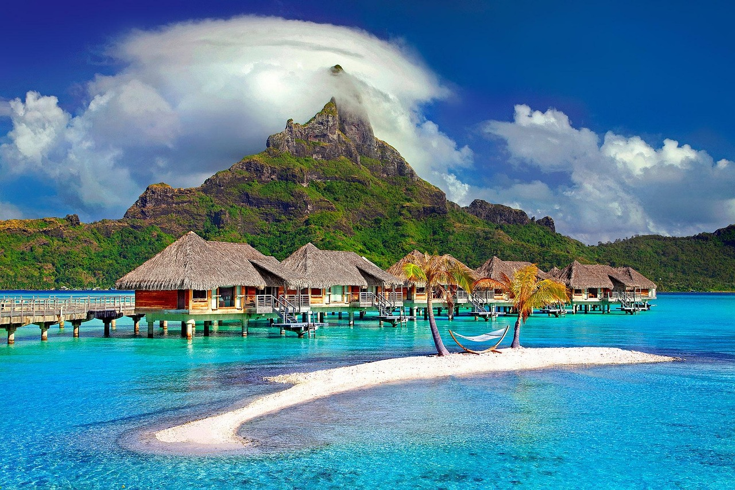
Geopolitics of the Pacific Islands
Strategic Importance of the Pacific Islands
Geopolitical Challenges in the Pacific
The Pacific Islands are a critical component of the Asia-Pacific region, and play a range of important roles in regional geopolitics.
The region is home to a range of strategic locations, including the Torres Strait, the Coral Sea, and the South China Sea.
The Pacific Islands are subject to a range of geopolitical challenges, including territorial disputes, environmental degradation, and climate change.
These challenges complicate regional relationships and demand coordinated international efforts.
Navigating Regional Relationships
Environmental and Strategic Concerns
Understanding the geopolitics of the Pacific Islands is essential for navigating the complexities of regional relationships.
This understanding helps in developing effective strategies for sustainable development and cooperation.
The Pacific Islands face environmental degradation and climate change, which are pressing issues for the region.
These concerns are intertwined with the strategic importance of the area, making them critical to address.
7
Introduction to the Pacific Islands: Geography, Oceanography, and Geopolitics

Slide 8
Mapping the Pacific Islands
Understanding Geography and Oceanography
Analyzing Climate Patterns
Conservation and Sustainable Development
Key Features Identification
Mapping the Pacific Islands is an important tool for understanding the region's geography and oceanography.
Maps can be used to identify and label key features, including island chains, coral reefs, and volcanic islands.
Maps can also be used to analyze the region's climate, including sea-level rise, drought, and extreme weather events.
This analysis is crucial for understanding environmental changes and their impacts on the islands.
Mapping the Pacific Islands can help to identify areas of high conservation value.
It also informs sustainable development strategies to protect the region's natural resources.
Maps are essential for pinpointing significant geographical features.
These include coral reefs, volcanic islands, and island chains that define the Pacific region.
8
Introduction to the Pacific Islands: Geography, Oceanography, and Geopolitics

Slide 9
Transect of the Islands
01
Geographical and Oceanographic Insights
A transect of the Pacific Islands can provide a detailed cross-section of the region's geography and oceanography.
This includes an understanding of the diverse landscapes and marine environments present in the area.
02
Geological Features and Processes
The transect can include information on the region's geology, including volcanic activity, erosion, and sedimentation.
These geological processes shape the islands and influence their long-term stability.
03
Climate and Environmental Challenges
The transect can also include information on the region's climate, including sea-level rise, drought, and extreme weather events.
Understanding these challenges is crucial for developing adaptive strategies.
04
Conservation and Sustainable Development
The transect can help to identify areas of high conservation value and inform sustainable development strategies.
This ensures the protection of biodiversity while supporting the needs of local communities.
9
Introduction to the Pacific Islands: Geography, Oceanography, and Geopolitics

Slide 10
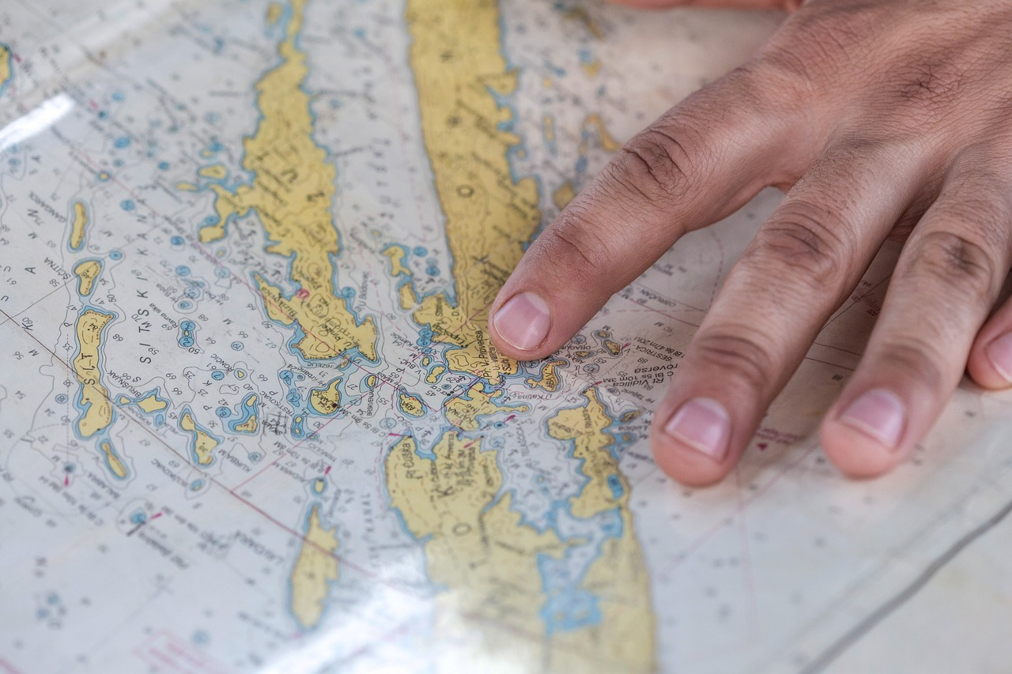
Case Study: The Torres Strait Islands
01
Geographical Location
The Torres Strait Islands are a group of islands located between Australia and Papua New Guinea.
They serve as a natural bridge between the two regions.
02
Biodiversity
The islands are home to a range of unique and endemic species, including birds, fish, and plants.
This biodiversity makes the region ecologically significant.
03
Environmental and Geopolitical Challenges
The islands face challenges such as climate change, overfishing, and territorial disputes.
These issues highlight the vulnerability of the region.
04
Significance in Maritime Boundaries
The Torres Strait Islands exemplify the complexities of maritime boundaries.
They underscore the need for sustainable development strategies.
10
Introduction to the Pacific Islands: Geography, Oceanography, and Geopolitics

Slide 11
Geopolitical Implications of Maritime Boundaries
1
Regional Relationships and Maritime Boundaries
2
Resource Management Challenges
The geopolitical implications of maritime boundaries are critical to understanding the complexities of regional relationships.
These boundaries influence interactions between neighboring nations and their shared interests.
Maritime boundaries can have a significant impact on the management of natural resources, including fisheries and oil and gas.
Effective boundary agreements are essential for equitable resource distribution and utilization.
3
Marine Ecosystem Protection
4
Sustainable Development Strategies
Maritime boundaries can also have a significant impact on the protection of marine ecosystems.
They play a role in establishing conservation zones and mitigating environmental degradation.
Understanding the geopolitical implications of maritime boundaries is essential for developing effective strategies for sustainable development and cooperation.
This knowledge fosters collaboration and long-term regional stability.
11
Introduction to the Pacific Islands: Geography, Oceanography, and Geopolitics

Slide 12
Conclusion
01
02
Geographical Diversity
Cultural and Economic Significance
The Pacific Islands are a diverse and complex region, characterized by a range of geographical features, including island chains, coral reefs, and volcanic islands.
Understanding these features is essential for appreciating the region's unique environmental and cultural landscape.
The region is home to a range of cultures, languages, and economies, and is an important component of Australia's foreign policy and economic strategy.
This diversity underscores the importance of tailored approaches to engagement and cooperation.
03
04
Environmental and Geopolitical Vulnerabilities
Strategic Importance
The Pacific Islands are vulnerable to a range of environmental and geopolitical challenges, including climate change, overfishing, and territorial disputes.
Addressing these issues is critical for ensuring the region's long-term stability and sustainability.
Understanding the geography, oceanography, and geopolitics of the Pacific Islands is essential for developing effective strategies for sustainable development and cooperation in the region.
Such knowledge enables informed decision-making and fosters regional partnerships.
12
Introduction to the Pacific Islands: Geography, Oceanography, and Geopolitics

Slide 13

Summary
Strategic Importance
Environmental Challenges
The Pacific Islands are a critical component of the Asia-Pacific region, and play a range of important roles in regional geopolitics.
The region is home to a range of strategic locations, including the Torres Strait, the Coral Sea, and the South China Sea.
The Pacific Islands are subject to a range of environmental challenges, including climate change and overfishing.
These challenges threaten the sustainability and ecological balance of the region.
Geopolitical Issues
Need for Strategic Understanding
Territorial disputes are a significant geopolitical challenge in the Pacific Islands.
These disputes impact regional stability and international relations.
Understanding the geography, oceanography, and geopolitics of the Pacific Islands is essential.
This knowledge is crucial for developing effective strategies for sustainable development and cooperation in the region.
13
Introduction to the Pacific Islands: Geography, Oceanography, and Geopolitics

