Slide 1

Racial Tension and the Civil Rights Movement in America (1920-1973)
Exploring Historical Context, Key Events, and Social Change Through Primary Sources and Multimedia

Slide 2
Table of Contents
Introduction to Racial Tension in America 1920…
Learning Objectives
Historical Context
Primary Sources
Multimedia Presentations
The Civil Rights Act of 1964
The Role of Media
Key Figures
Group Activities
Assessment
Conclusion
Reflection Questions
Next Steps
04
05
06
07
08
09
10
11
12
13
14
15
16

Slide 3
Table of Contents
Key Takeaways
Teaching Tips
Parent Engagement
Safety Considerations
Extension Activities
Homework
Conclusion and Final Thoughts
17
18
19
20
21
22
23

Slide 4

Introduction to Racial Tension in America 1920-1973
Overview of the Lesson Plan
Engaging with Historical Context
Focus on Civil Rights Movement
This lesson plan introduces 15-year-old students to the complex and sensitive topic of racial tension in America from 1920 to 1973.
Students will gain a deeper understanding of the historical context and events that shaped the civil rights movement.
The lesson will utilize primary sources and multimedia to engage students.
This approach aims to promote critical thinking and a deeper connection to the material.
Students will explore the events that shaped the civil rights movement.
The lesson provides a comprehensive view of racial tension during this period.
4
Racial Tension and the Civil Rights Movement in America (1920-1973)

Slide 5
Learning Objectives
Analyzing Primary Sources
Evaluating Key Events
Creating Multimedia Presentations
Synthesizing Information
Analyze primary sources to identify the causes and consequences of racial tension in America during the period 1920-1973.
This involves examining historical documents to understand the societal impacts of racial issues.
Evaluate the significance of key events, such as the Civil Rights Act of 1964 and the March on Washington.
These events played pivotal roles in shaping the civil rights movement and addressing racial inequality.
Create a multimedia presentation that explores the experiences of different groups during the period 1920-1973.
This task encourages the use of creative tools to highlight diverse perspectives and historical narratives.
Synthesize information from primary sources and multimedia to develop a nuanced understanding of the complex factors that contributed to racial tension in America.
This process involves integrating various forms of evidence to form a comprehensive analysis.
5
Racial Tension and the Civil Rights Movement in America (1920-1973)

Slide 6
Historical Context
The Harlem Renaissance
The Civil Rights Movement
Key Events from 1920 to 1973
The Harlem Renaissance was a cultural and intellectual movement that took place in the African American community in the 1920s and 1930s.
It marked a period of artistic and literary flourishing, celebrating African American heritage and identity.
The Civil Rights Movement was a social movement that aimed to end racial segregation and discrimination in the United States.
It was characterized by widespread activism and landmark legislation promoting equality and justice.
The period 1920-1973 was marked by significant events, including the Montgomery Bus Boycott, the March on Washington, and the Selma to Montgomery marches.
These events played a crucial role in shaping the fight for civil rights and social justice in America.
6
Racial Tension and the Civil Rights Movement in America (1920-1973)

Slide 7

Primary Sources
Understanding Primary Sources
Example of a Primary Source
Analyzing Primary Sources
Primary sources, such as speeches, letters, and newspaper articles, provide firsthand information about historical events.
These sources offer direct insights into the events and perspectives of the time.
The 'I Have a Dream' speech by Martin Luther King Jr. is a powerful example of a primary source that shaped the civil rights movement.
This speech continues to inspire discussions on equality and justice.
Students will analyze primary sources to evaluate the content, tone, and significance of each source.
This process helps in developing critical thinking and understanding historical contexts.
7
Racial Tension and the Civil Rights Movement in America (1920-1973)

Slide 8

Multimedia Presentations
Engaging Students with Multimedia
Exploring Historical Experiences
Components of Multimedia Presentations
Multimedia presentations, such as videos and podcasts, can engage students and provide a visual stimulus.
These tools help in making learning interactive and appealing.
Students will create a multimedia presentation that explores the experiences of different groups during the period 1920-1973.
This activity encourages critical thinking and understanding of diverse perspectives.
Multimedia presentations can include images, music, and narration to convey historical information.
These elements work together to create a comprehensive and immersive learning experience.
8
Racial Tension and the Civil Rights Movement in America (1920-1973)

Slide 9
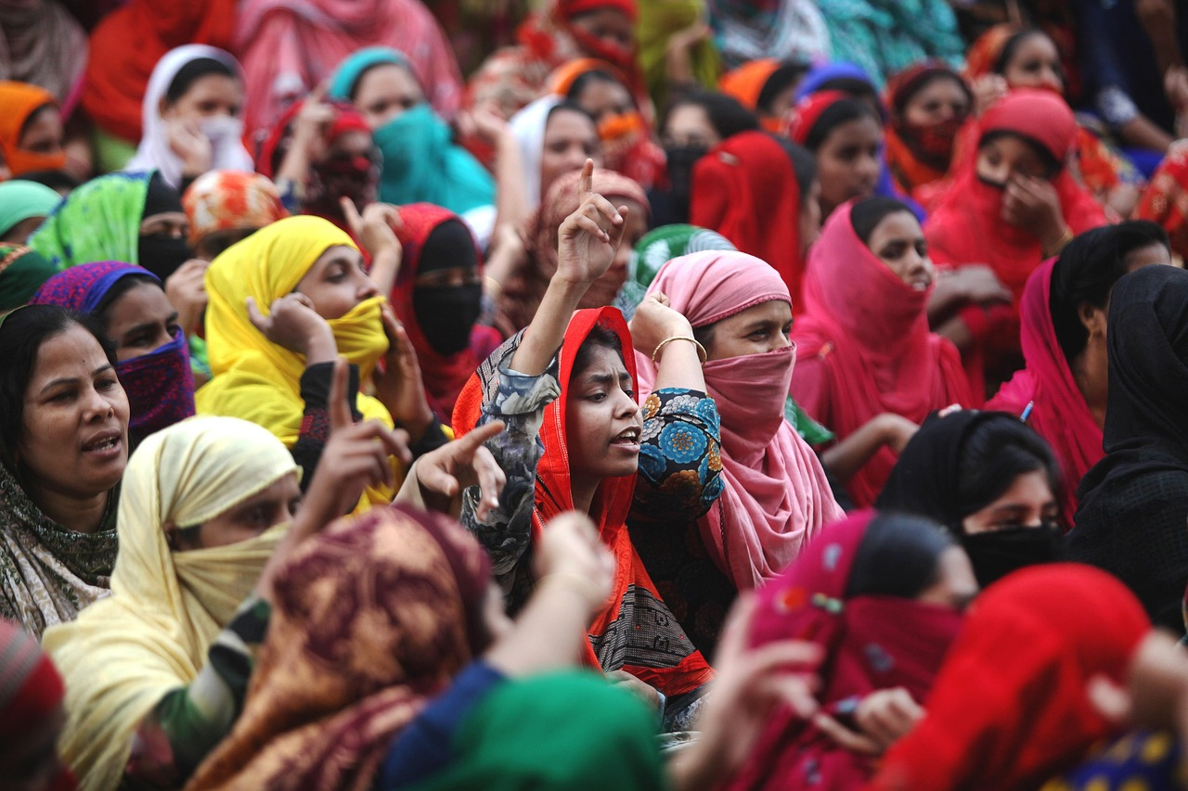
The Civil Rights Act of 1964
Landmark Legislation
Prohibition of Segregation
Impact on Civil Rights Movement
The Civil Rights Act of 1964 was a landmark piece of legislation that outlawed discrimination based on race, color, religion, sex, or national origin.
It marked a turning point in American history by addressing systemic inequalities.
The act prohibited segregation in public facilities, employment, and education.
This ensured equal access and opportunities for all citizens regardless of their background.
The Civil Rights Act of 1964 was a major achievement of the civil rights movement and paved the way for future legislation.
It demonstrated the power of collective action in achieving social justice.
9
Racial Tension and the Civil Rights Movement in America (1920-1973)

Slide 10
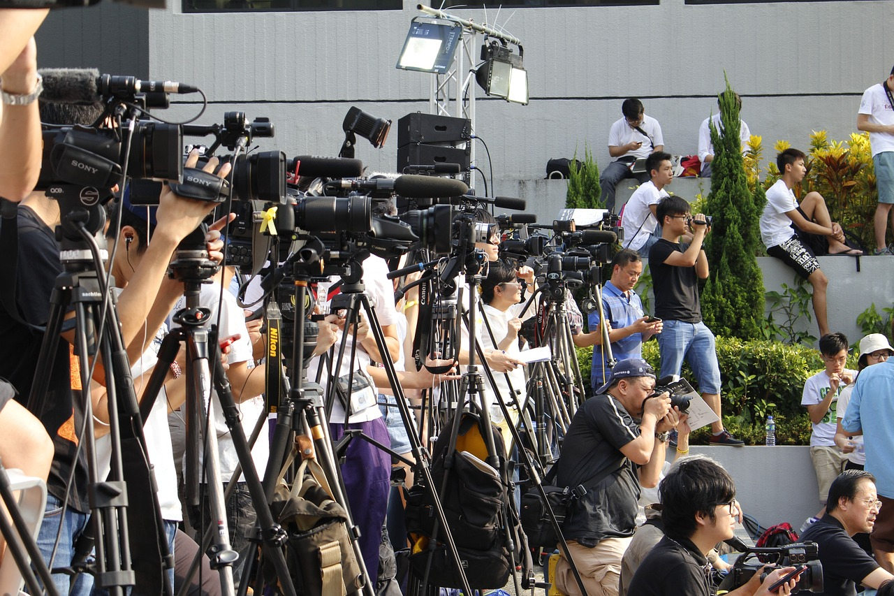
The Role of Media
1
Media's Influence on Public Opinion
The media played a significant role in shaping public opinion during the civil rights movement.
Newspapers, magazines, and television news programs helped to raise awareness of the movement and its goals.
2
Raising Awareness Through Media Channels
Newspapers, magazines, and television news programs helped to raise awareness of the movement and its goals.
The media played a significant role in shaping public opinion during the civil rights movement.
3
Media's Role in Stereotyping
The media also perpetuated racist stereotypes and biases, often portraying African Americans as violent or threatening.
Newspapers, magazines, and television news programs helped to raise awareness of the movement and its goals.
10
Racial Tension and the Civil Rights Movement in America (1920-1973)

Slide 11
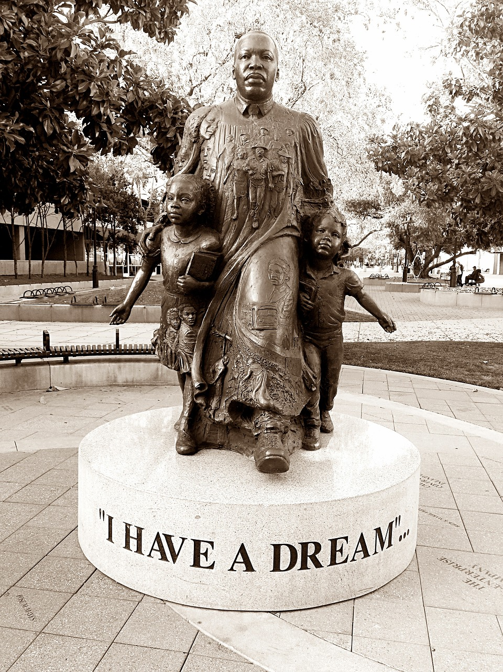
Key Figures
1
Martin Luther King Jr.
Martin Luther King Jr. was a prominent leader of the civil rights movement.
He played a pivotal role in advocating for racial equality through nonviolent resistance.
2
Rosa Parks
Rosa Parks was a key figure in the Montgomery Bus Boycott.
Her act of defiance became a symbol of the fight against racial segregation.
3
Malcolm X
Malcolm X was a prominent figure in the Black Power movement.
He emphasized the importance of self-determination and empowerment for African Americans.
11
Racial Tension and the Civil Rights Movement in America (1920-1973)

Slide 12

Group Activities
Engaging Group Activities
Students will participate in group activities, such as primary source analysis and multimedia presentations.
Group activities will promote collaboration, critical thinking, and effective communication.
Exploring Historical Experiences
Students will work in groups to create a multimedia presentation.
The presentation will explore the experiences of different groups during the period 1920-1973.
Fostering Key Skills
Group activities are designed to enhance collaboration among students.
They also aim to develop critical thinking and effective communication skills.
12
Racial Tension and the Civil Rights Movement in America (1920-1973)

Slide 13

Assessment
Analyzing Primary Sources
Students will be assessed on their ability to analyze primary sources and evaluate historical events.
This involves understanding the context and significance of historical documents and events.
Multimedia Presentation
Students will be assessed on their ability to create a multimedia presentation that explores the experiences of different groups during the period 1920-1973.
The presentation should highlight diverse perspectives and historical narratives.
Synthesizing Information
Students will be assessed on their ability to synthesize information from primary sources and multimedia to develop a nuanced understanding of racial tension in America.
This requires connecting complex factors and drawing insightful conclusions.
13
Racial Tension and the Civil Rights Movement in America (1920-1973)

Slide 14
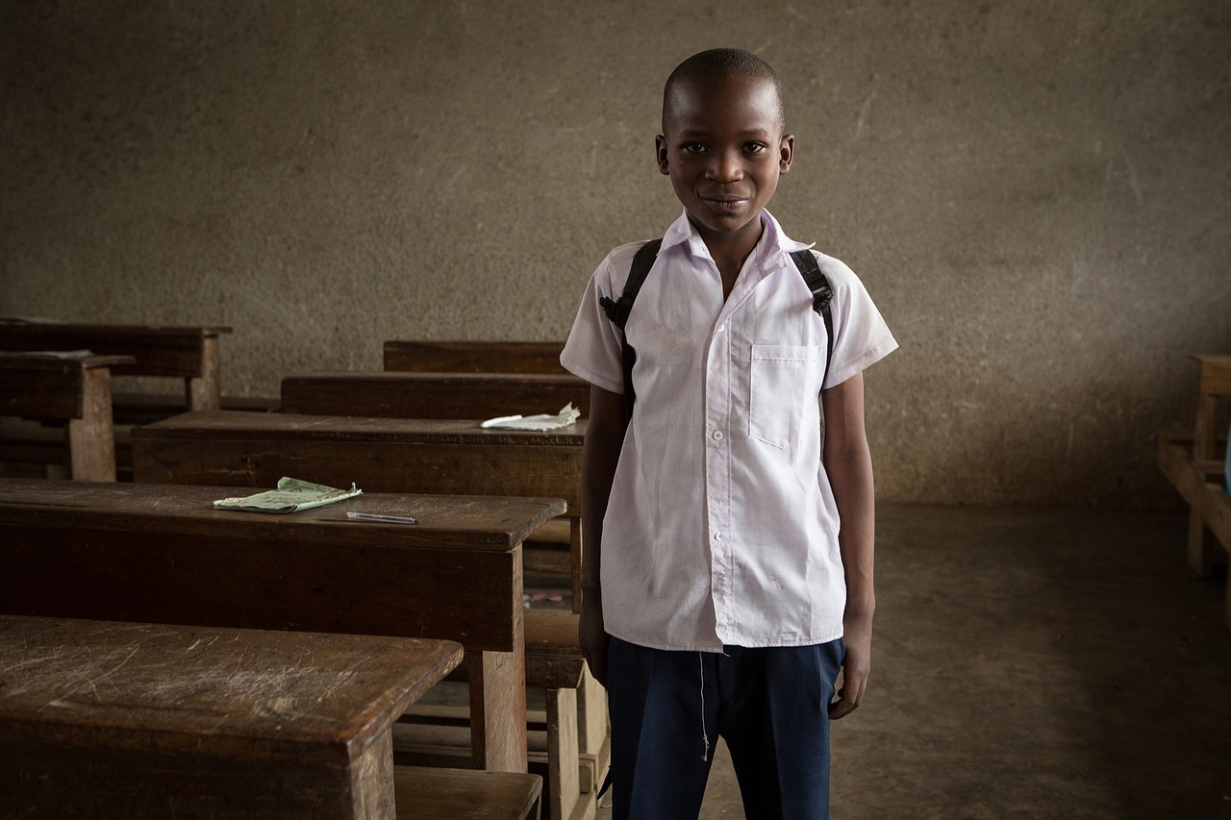
Conclusion
1
2
3
Historical Context of Racial Tension
Engaging Educational Methods
Comprehensive Learning Outcomes
The introduction to racial tension in America from 1920 to 1973 is a complex and sensitive topic.
Students have gained a deeper understanding of the historical context and events that shaped the civil rights movement.
The lesson has utilized primary sources and multimedia to engage students.
These tools have promoted critical thinking and enriched the learning experience.
Students are now better equipped to analyze the civil rights movement.
This understanding is rooted in a thorough exploration of historical events and societal changes.
14
Racial Tension and the Civil Rights Movement in America (1920-1973)

Slide 15

Reflection Questions
Engaging Students Effectively
Developing Critical Thinking
Understanding Historical Context
What strategies were most effective in engaging students with the topic of racial tension in America?
How did students demonstrate an understanding of the historical context and key events of the civil rights movement?
What opportunities were provided for students to develop critical thinking skills?
How did students evaluate the significance of primary sources and multimedia in historical research?
How did students demonstrate an understanding of the historical context and key events of the civil rights movement?
What strategies were most effective in engaging students with the topic of racial tension in America?
15
Racial Tension and the Civil Rights Movement in America (1920-1973)

Slide 16

Next Steps
Exploring Civil Rights Movement
Multimedia Presentation Project
Promoting Social Justice
The next lesson will explore the key events and figures of the civil rights movement in more depth.
Students will gain a deeper understanding of the historical context and its impact on society.
Students will create a multimedia presentation that explores the experiences of different groups during the period 1920-1973.
This project will encourage creative expression and critical analysis of historical narratives.
The lesson will provide opportunities for students to develop strategies and tactics for promoting social justice and equality in their own communities.
Students will engage in discussions and activities aimed at fostering a more equitable society.
16
Racial Tension and the Civil Rights Movement in America (1920-1973)

Slide 17

Key Takeaways
Civil Rights Movement
Understanding History
Understanding History
Racial tension in America during the period 1920-1973 was a complex and multifaceted issue.
It involved various social, political, and economic dimensions that shaped the nation's history.
The civil rights movement was a social movement that aimed to end racial segregation and discrimination in the United States.
It played a pivotal role in advocating for equality and justice for African Americans.
Primary sources and multimedia are essential tools for understanding historical events and social movements.
They provide valuable insights and perspectives that enrich our comprehension of the past.
17
Racial Tension and the Civil Rights Movement in America (1920-1973)

Slide 18

Teaching Tips
Promoting Critical Thinking
Fostering Open-Mindedness
Empowering Social Justice
Use primary sources to promote critical thinking and engagement.
This approach helps students analyze and interpret information directly from the source.
Create a safe and respectful learning environment that encourages open-mindedness and empathy.
Such an environment allows students to express their ideas freely and learn from diverse perspectives.
Provide opportunities for students to develop strategies and tactics for promoting social justice and equality in their own communities.
This empowers students to take actionable steps towards creating a fair and inclusive society.
18
Racial Tension and the Civil Rights Movement in America (1920-1973)

Slide 19

Parent Engagement
Fostering Parent-Child Discussions
Providing Informative Resources
Inviting Classroom Participation
Encourage parents to engage in discussions with their child about the topic.
This helps build a deeper understanding and connection to the subject matter.
Provide parents with resources and information to learn more about the topic.
These materials can empower parents to support their child's learning journey.
Invite parents to participate in classroom activities and events.
This creates opportunities for parents to be actively involved in their child's education.
19
Racial Tension and the Civil Rights Movement in America (1920-1973)

Slide 20
Safety Considerations
1
2
3
Guidelines for Classroom Behavior
Addressing Sensitive Topics
Encouraging Open-Mindedness
Establish clear guidelines for classroom discussion and behavior.
This ensures a structured and respectful environment for all participants.
Be aware of the students' backgrounds and experiences, and be prepared to address any sensitive or triggering topics.
This approach fosters inclusivity and understanding within the classroom.
Provide a safe and respectful learning environment that encourages open-mindedness and empathy.
Such an environment supports meaningful and constructive interactions among students.
20
Racial Tension and the Civil Rights Movement in America (1920-1973)

Slide 21

Extension Activities
1
Researching Civil Rights Figures
Have students research a prominent figure from the civil rights movement.
Create a detailed biography based on their findings.
2
Exploring Historical Experiences
Ask students to create a multimedia presentation.
Focus on the experiences of different groups during the period 1920-1973.
3
Learning from Guest Speakers
Invite a guest speaker to talk to the class about the civil rights movement.
Discuss its ongoing impact on contemporary society.
21
Racial Tension and the Civil Rights Movement in America (1920-1973)

Slide 22

Homework
Primary Source Analysis
Assign students to analyze a primary source and evaluate its content, tone, and significance.
This task encourages critical thinking and a deeper understanding of historical materials.
Multimedia Presentation
Ask students to create a multimedia presentation that explores the experiences of different groups during the period 1920-1973.
This activity fosters creativity and helps students connect with diverse historical perspectives.
Reflective Essay
Have students write a reflective essay on what they learned from the lesson and how they can apply it to their own lives.
This exercise promotes personal growth and the application of historical lessons to modern contexts.
22
Racial Tension and the Civil Rights Movement in America (1920-1973)

Slide 23
Conclusion and Final Thoughts
1
Historical Context of Racial Tension
The introduction to racial tension in America from 1920 to 1973 is a complex and sensitive topic.
Students have gained a deeper understanding of the historical context and events that shaped the civil rights movement.
2
Engagement Through Multimedia
The lesson has utilized primary sources and multimedia to engage students.
This approach has promoted critical thinking and deeper analysis of historical events.
3
Reflection on Civil Rights Movement
Students have explored the events that shaped the civil rights movement.
This has provided them with a comprehensive understanding of the struggles and achievements during this period.
23
Racial Tension and the Civil Rights Movement in America (1920-1973)

