Slide 1

Unraveling Genetic Sex
Exploring Chromosomes, Inheritance, and Future Research

Slide 2
Table of contents
01
02
03
04
05
06
07
08
09
10
11
Title Slide: Decoding Genetic Sex
What Are Sex Chromosomes?
Chromosome Basics
How Sex is Determined
X and Y Chromosome Differences
Genetic Inheritance Patterns
Genetic Variation Beyond Binary
Genetic Inheritance Mechanisms
Common Misconceptions
Scientific Complexity
Future of Genetic Research

Slide 3
Table of contents
12
13
14
15
16
17
18
19
20
21
Conclusion
Q&A and Resources
Design Recommendations
Recommended Slide Transitions
Technical Notes
Slide Layouts
Presentation Structure
Audience Engagement
Visual Design
Scientific Accuracy

Slide 4
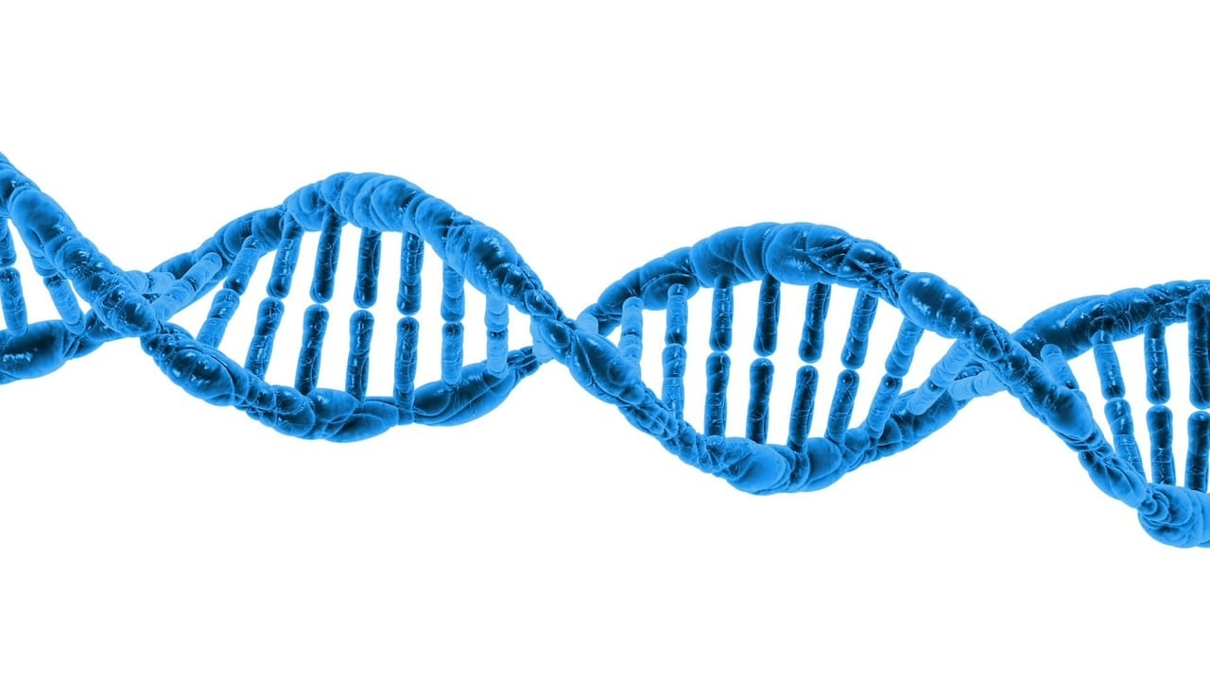
1
Title Slide: Decoding Genetic Sex
Decoding Genetic Sex: Understanding XX and XY Chromosomes
A Journey into Genetic Inheritance and Biological Diversity
Unraveling Genetic Sex

Slide 5
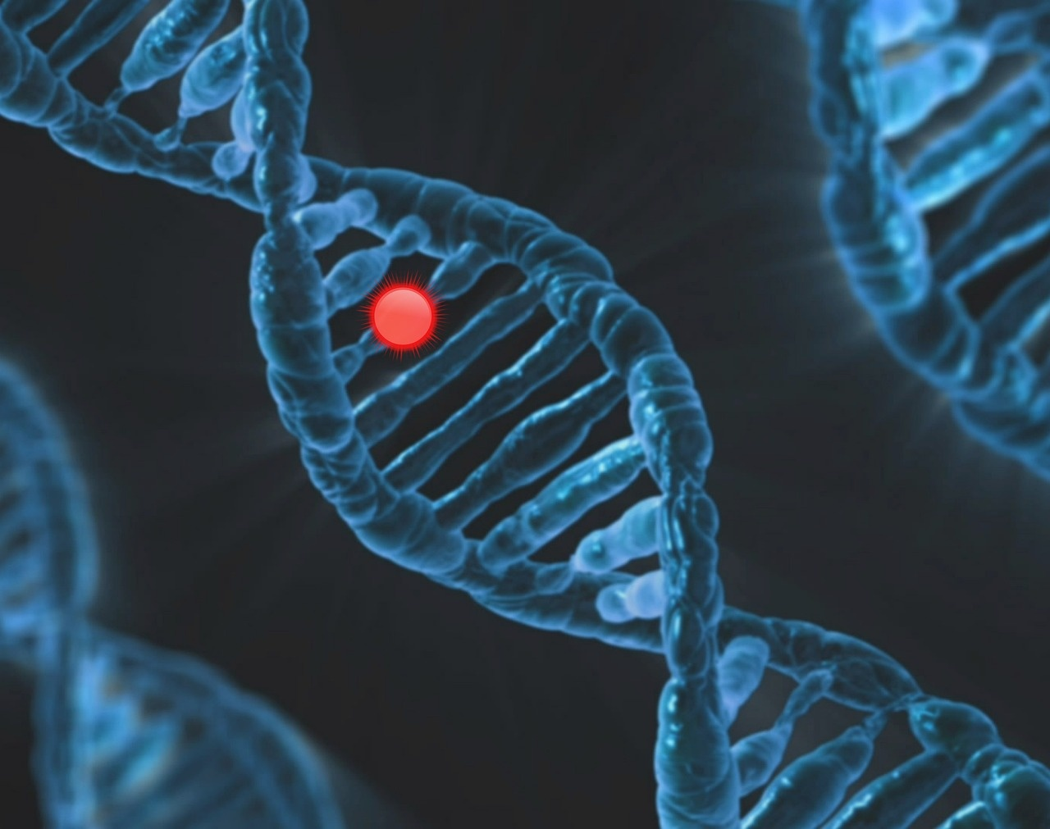
2
What Are Sex Chromosomes?
01
Definition
02
Key Points
Specialized chromosomes determining biological sex
XX typically represents female genetic configuration
XY typically represents male genetic configuration
Fundamental to human genetic inheritance
Unraveling Genetic Sex

Slide 6

3
Chromosome Basics
Human Chromosome Composition
Total chromosomes: 46
22 pairs of autosomes
1 pair of sex chromosomes
Unraveling Genetic Sex

Slide 7

4
How Sex is Determined
01
Fertilization Process
02
Probability Breakdown
Egg always contributes X chromosome
Sperm can contribute X or Y chromosome
X+X = Female
X+Y = Male
Unraveling Genetic Sex

Slide 8
5
X and Y Chromosome Differences
X Chromosome
Y Chromosome
Larger
Carries more genetic information
Inherited from both parents
Smaller
Determines male developmental pathway
Contains SRY gene triggering male characteristics
Unraveling Genetic Sex

Slide 9
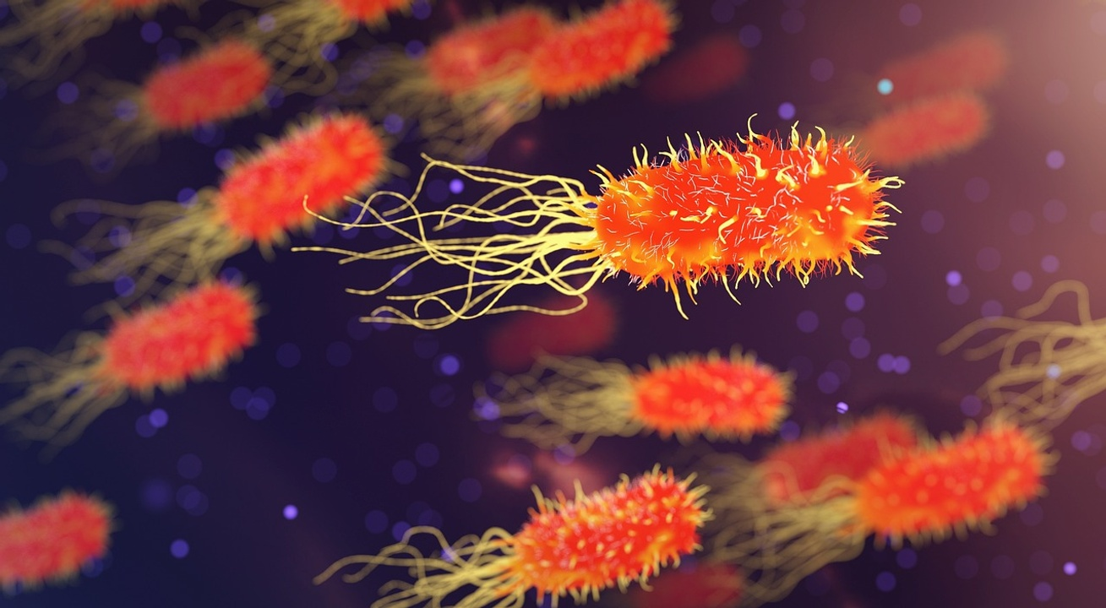
6
Genetic Inheritance Patterns
01
Punnett Square Demonstration
02
Key Concepts
Probability modeling
Potential genetic outcomes
Genetic transmission is probabilistic
Not strictly predetermined
Unraveling Genetic Sex

Slide 10

7
Genetic Variation Beyond Binary
01
Chromosomal Variations
02
Emphasize
XXY (Klinefelter Syndrome)
XYY Configuration
X0 (Turner Syndrome)
Genetic diversity is natural and complex
Unraveling Genetic Sex

Slide 11
8
Genetic Inheritance Mechanisms
01
02
03
Meiosis Process
Epigenetic Influences
Key Points
Genetic recombination during cell division
Creates unique genetic profiles in offspring
Environmental factors impacting gene expression
Influence on genetic traits and characteristics
Meiosis leads to genetic diversity through recombination
Epigenetic factors can modify gene expression and traits
Unraveling Genetic Sex

Slide 12
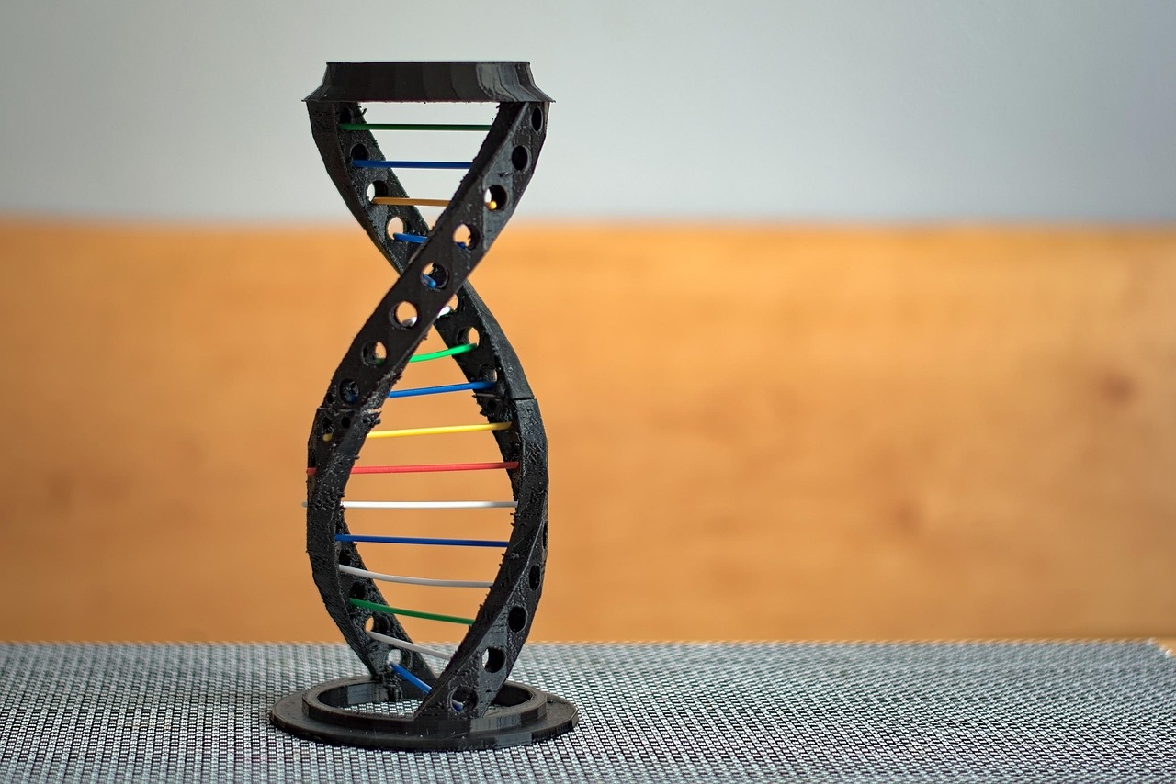
9
Common Misconceptions
01
Myth: Biological sex is strictly binary
02
Myth: Chromosomes only influence sexual characteristics
Reality: Genetic variations can lead to diverse biological sexes
Reality: Chromosomes impact various biological traits beyond sex
03
Myth: Genetic inheritance is completely predictable
Reality: Genetic transmission involves probabilistic outcomes
Unraveling Genetic Sex

Slide 13

10
Scientific Complexity
01
Genetic Interactions
02
Epistasis
Genes interact in complex ways
Influence of multiple genes on traits
One gene's expression influenced by another
Alters expected genetic ratios
03
Polygenic Inheritance
04
Gene Expression Regulation
Traits influenced by multiple genes
Height, skin color, intelligence
Environmental factors impact gene expression
Epigenetic modifications
Unraveling Genetic Sex

Slide 14
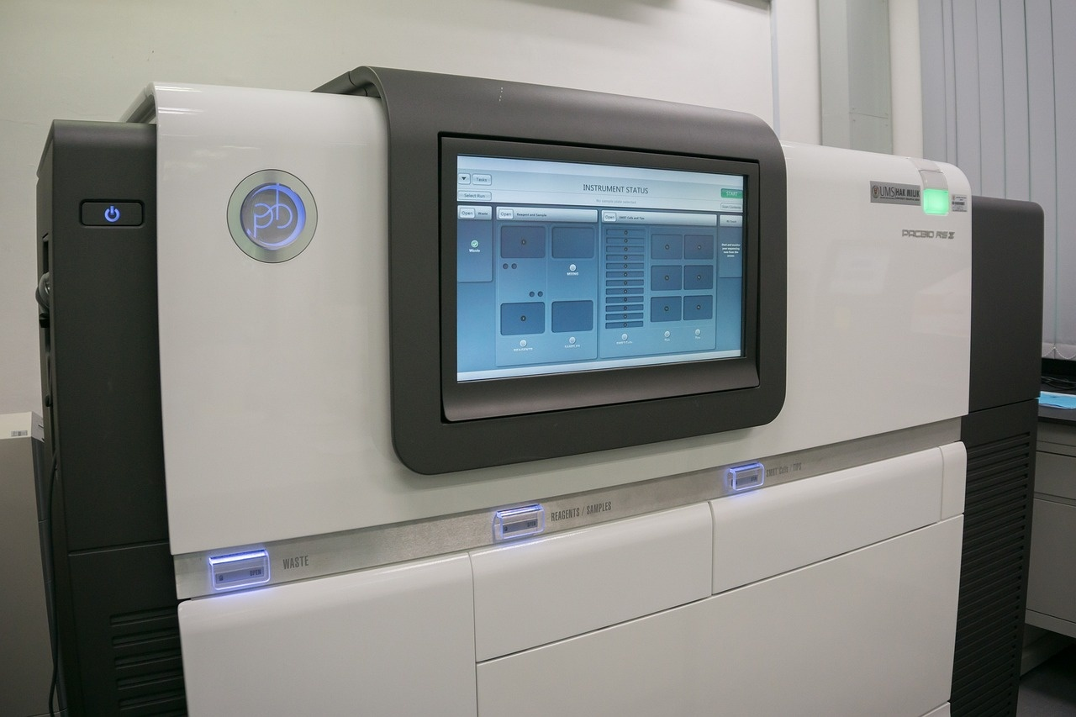
11
Future of Genetic Research
01
Advancements in Genetic Testing
02
Genomic Research Breakthroughs
Improved accuracy and accessibility
Personalized medicine based on genetic profiles
Unraveling complex genetic diseases
Identifying new treatment targets
03
Advanced Chromosome Analysis
04
Ethical Considerations in Genetic Studies
High-resolution techniques for detailed insights
Understanding genetic variations and their implications
Privacy concerns in genetic data sharing
Ensuring informed consent and data protection
Unraveling Genetic Sex

Slide 15
12
Conclusion
Understanding genetic sex
Genetic inheritance
Chromosomes
Involves decoding the complexities of XX and XY chromosomes.
Plays a fundamental role in determining biological sex and diversity.
Are not strictly binary and genetic diversity is a natural and intricate phenomenon.
Scientific exploration
Embracing diversity
Continued research is essential to unraveling the complexities of genetic inheritance.
Celebrates the dynamic and probabilistic nature of human genetic inheritance.
Unraveling Genetic Sex

Slide 16

13
Q&A and Resources
01
Q&A Session
02
Additional Learning Resources
Opportunity for audience questions
Clarification on genetic sex concepts
Online articles and videos
Genetics textbooks and guides
03
Recommended Reading
04
Contact Information
"The Gene: An Intimate History" by Siddhartha Mukherjee
"The Emperor of All Maladies: A Biography of Cancer" by Siddhartha Mukherjee
Email: genetics@scienceedu.com
Website: www.geneticsdecoded.com
Unraveling Genetic Sex

Slide 17
14
Design Recommendations
01
Color Palette
02
Graphics
03
Text
Utilize a clean, scientific color palette
Blues, whites, grays for a professional look
Incorporate high-quality chromosome and genetic graphics
Visual aids enhance understanding
Keep text minimal
Strong visual representations for engagement
04
Consistency
05
Animations
Maintain a consistent, professional design theme
Enhances overall visual appeal
Include subtle animations for chromosome/genetic illustrations
Adds visual interest and engagement
Unraveling Genetic Sex

Slide 18

15
Recommended Slide Transitions
01
Smooth Fade
02
Subtle Slide Movements
Transition smoothly between slides for a seamless flow of information.
Incorporate gentle slide movements to keep the audience engaged without being distracting.
03
Consistent Transitions
Maintain a consistent transition style throughout the presentation for a polished look and feel.
Unraveling Genetic Sex

Slide 19
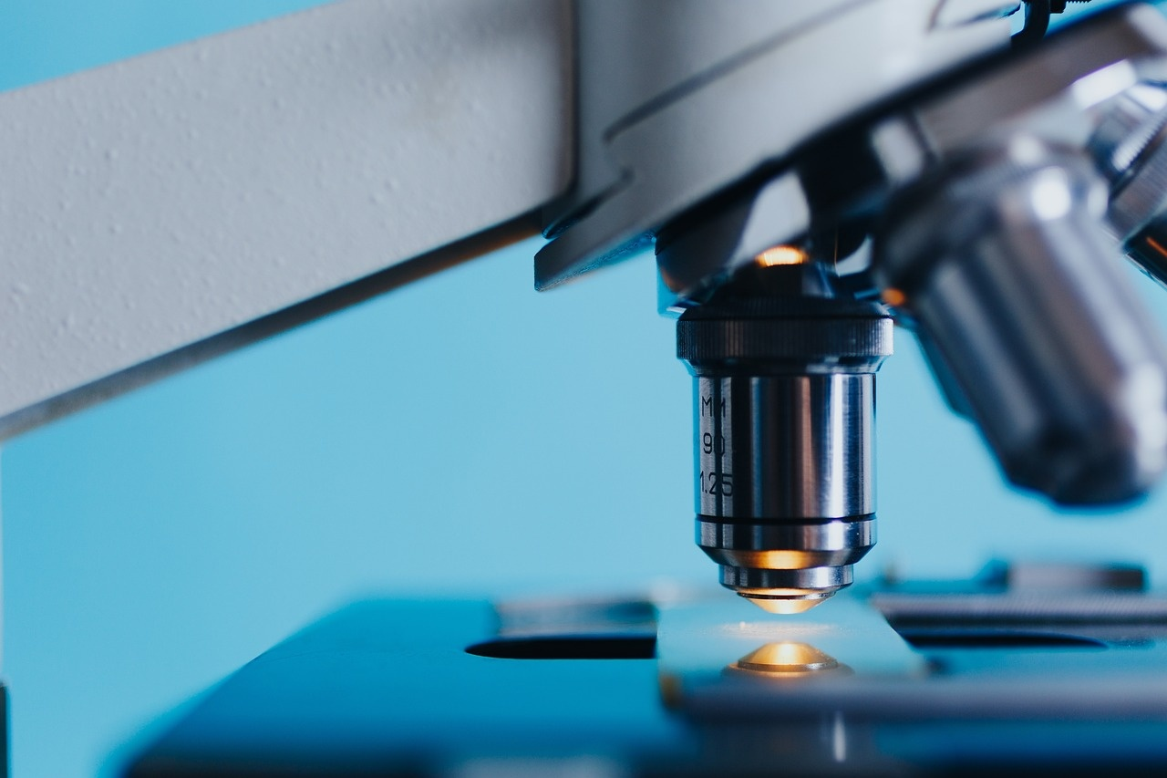
16
Technical Notes
01
Genetic Sequencing Tools
02
Chromosomal Aberrations
Utilize DNA sequencing techniques for accurate analysis.
Next-generation sequencing platforms offer high-throughput capabilities.
Understand common chromosomal abnormalities like trisomy and monosomy.
Explore techniques for detecting chromosomal deletions and duplications.
03
Gene Editing Technologies
CRISPR-Cas9 system for precise genetic modifications.
Consider ethical implications of gene editing in the context of genetic sex determination.
Unraveling Genetic Sex

Slide 20
17
Slide Layouts
01
Title Slide
02
What Are Sex Chromosomes?
03
Chromosome Basics
Title: "Decoding Genetic Sex: Understanding XX and XY Chromosomes"
Subtitle: "A Journey into Genetic Inheritance and Biological Diversity"
Background: Stylized chromosome graphic
Definition: Specialized chromosomes determining biological sex
Key Points:
XX typically represents female genetic configuration
XY typically represents male genetic configuration
Fundamental to human genetic inheritance
Human Chromosome Composition
Total chromosomes: 46
22 pairs of autosomes
1 pair of sex chromosomes
Visual: Chromosome pair diagram
04
How Sex is Determined
05
X and Y Chromosome Differences
Fertilization Process
Egg always contributes X chromosome
Sperm can contribute X or Y chromosome
Probability Breakdown:
X+X = Female
X Chromosome
Larger
More genetic information
Inherited from both parents
Y Chromosome
Unraveling Genetic Sex

Slide 21
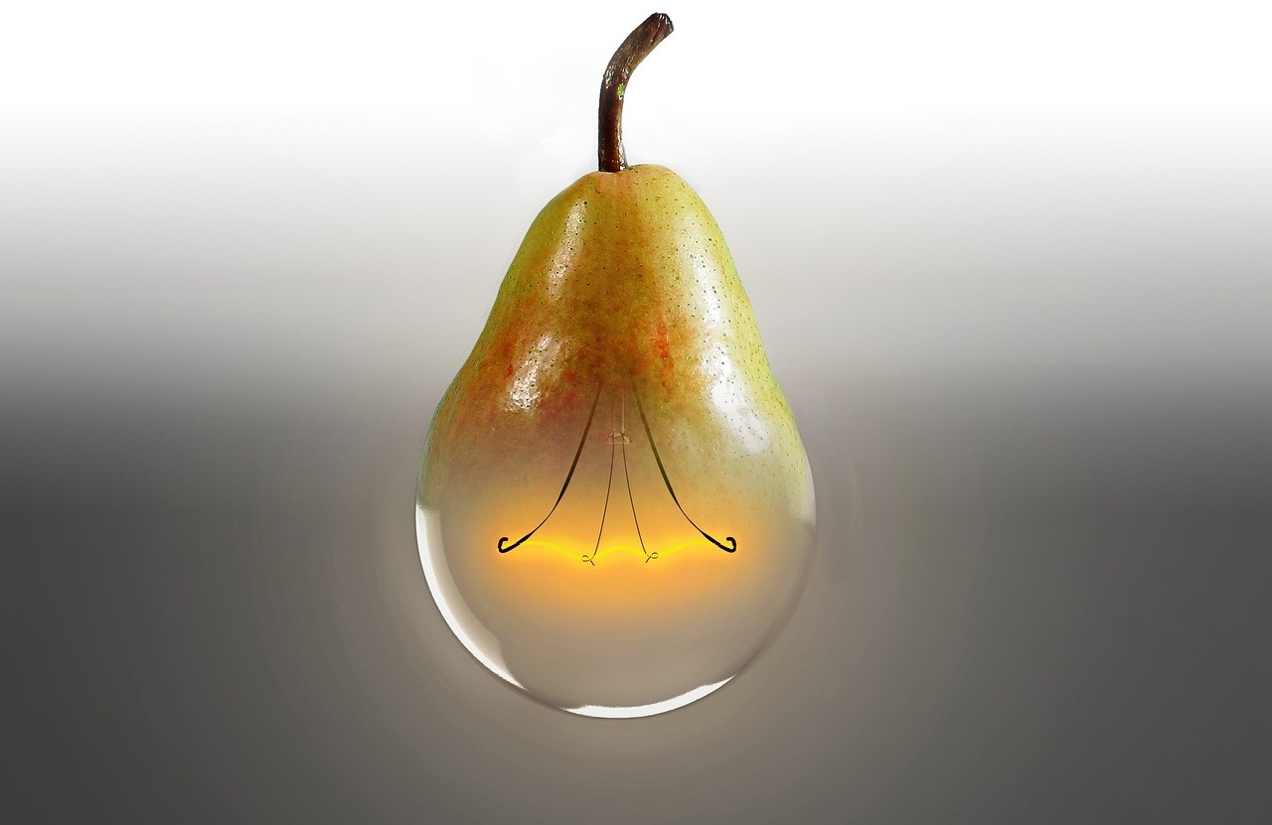
18
Presentation Structure
Introduction to Genetic Sex
Overview of XX and XY Chromosomes
Importance of Genetic Inheritance
Unraveling Genetic Sex

Slide 22
19
Audience Engagement
01
Interactive Polls
02
Q&A Session
03
Case Studies
Engage the audience by conducting live polls to gauge their understanding of genetic sex concepts.
Encourage audience participation by inviting questions and providing clear explanations to enhance learning.
Present real-life scenarios to illustrate the impact of genetic variations on individuals' biological development.
04
Group Activities
05
Visual Quizzes
Foster collaboration among attendees through group discussions or small tasks related to genetic inheritance.
Test audience knowledge with interactive visual quizzes on chromosome structures and inheritance patterns.
Unraveling Genetic Sex

Slide 23

20
Visual Design
Visual Design
Clean and scientific color palette (blues, whites, grays)
High-quality chromosome and genetic graphics
Minimal text with strong visual representations
Consistent, professional design theme
Subtle animations for chromosome/genetic illustrations
Unraveling Genetic Sex

Slide 24
21
Scientific Accuracy
01
Genetic Determinants of Sex
02
Chromosome Specialization
03
Chromosome Pairing
XX chromosomes typically represent the female genetic configuration.
XY chromosomes typically represent the male genetic configuration.
Crucial for human genetic inheritance.
Sex chromosomes: 1 pair out of 23 total pairs.
XX for females, XY for males.
Foundation of biological sex determination.
XX: Female genetic makeup.
XY: Male genetic makeup.
Essential for understanding genetic diversity.
04
Chromosome Functionality
05
Genetic Inheritance
XX: Female genetic characteristics.
XY: Male genetic characteristics.
Key components of genetic inheritance.
XX: Female genetic traits.
XY: Male genetic traits.
Integral to genetic diversity and inheritance.
Unraveling Genetic Sex

