Slide 1












Mastering the Present Simple Tense
A Comprehensive Guide to Understanding and Using Present Simple Tense Effectively

Slide 2

Table of contents
Lesson Introduction
Uses of Present Simple Tense
Forms of Present Simple Tense
Examples of Present Simple Tense
Interactive Exercises
Common Misconceptions
Grasping the Present Simple Tense
Interactions with Different Verb Types
Regular and Irregular Verbs
Confident Usage of Present Simple Tense
01
02
03
04
05
06
07
08
09
10

Slide 3



Lesson Introduction
Lesson Introduction
Importance of Present Simple
Uses of Present Simple
Learning Objectives
Interactive Learning
Welcome to our in-depth exploration of the Present Simple tense! This fundamental aspect of English grammar is crucial for effective communication and forms the backbone of many more complex language structures.
Crucial for effective communication
Forms the backbone of many complex language structures
Express habitual actions
Convey general truths
Schedule events
Understand various uses of Present Simple
Recognize different forms and nuances
Gain confidence in using the tense accurately
Engage in examples and exercises
Address common misconceptions
Explore interactions with different verb types
01
02
03
04
05
Mastering the Present Simple Tense

Slide 4

Uses of Present Simple Tense
Expressing Habitual Actions
Stating General Truths
The Present Simple tense is used to describe actions that are repeated regularly or habits.
For example, "She reads a book every night before bed."
It is used to express facts that are generally true.
For instance, "The sun rises in the east."
Expressing Habitual Actions
Stating General Truths
The Present Simple tense is used to describe actions that are repeated regularly or habits.
For example, "She reads a book every night before bed."
It is used to express facts that are generally true.
For instance, "The sun rises in the east."
Mastering the Present Simple Tense

Slide 5

Forms of Present Simple Tense
Regular Verbs
Irregular Verbs
Most verbs follow a simple pattern when conjugated in the Present Simple tense.
Example: "I play tennis every Saturday."
Some verbs have unique forms in the Present Simple tense that do not follow the regular pattern.
Example: "She goes to the gym after work."
Third Person Singular
Negative Form
Interrogative Form
Verbs used with third-person singular subjects (he, she, it) often require adding an -s or -es at the end.
Example: "He reads books every night."
To form negative sentences in the Present Simple tense, we use the auxiliary verb "do not" (don't) or "does not" (doesn't) before the base form of the main verb.
Example: "They do not like spicy food."
When asking questions in the Present Simple tense, we invert the subject and auxiliary verb "do" or "does."
Example: "Do you speak Spanish fluently?"
Mastering the Present Simple Tense

Slide 6
Examples of Present Simple Tense
STRENGTHS
WEAKNESSES
Clearly indicates habitual actions and routines.
Easy to understand and use in everyday conversations.
Limited to present time reference only.
Can be confusing when used with non-habitual actions.
S
W
OPPORTUNITIES
THREATS
O
T
Provides a foundation for learning more complex tenses.
Enhances clarity in writing and speaking.
Overuse may lead to monotony in language.
Incorrect usage can result in miscommunication.
Mastering the Present Simple Tense

Slide 7
Interactive Exercises
STRENGTHS
WEAKNESSES
Engaging and interactive exercises to reinforce learning
Immediate feedback on responses to enhance understanding
Varied question formats to cater to different learning styles
Limited scope for personalized feedback in group settings
Potential for technical issues with online platforms
Difficulty in assessing subjective aspects of language proficiency
S
W
OPPORTUNITIES
THREATS
O
T
Integration of multimedia elements for enhanced engagement
Collaboration with peers for peer-to-peer learning
Expansion of exercises to cover real-life scenarios for practical application
Student disengagement due to repetitive exercises
Inadequate time allocation for thorough practice
Misinterpretation of exercise instructions leading to incorrect responses
Mastering the Present Simple Tense

Slide 8
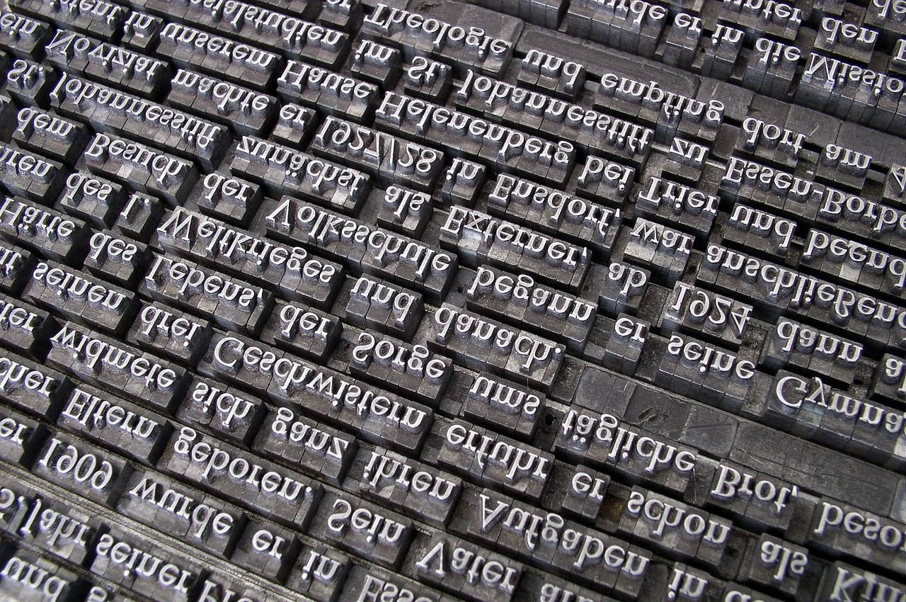
Common Misconceptions
Present Simple is only used for actions happening now
Present Simple is only for the present tense
While the Present Simple can describe actions happening now, it is also used for habitual actions, general truths, and scheduled events.
Despite its name, the Present Simple tense can also be used to talk about future events, especially when they are part of a fixed schedule or timetable.
Every sentence with "always" or "usually" must use Present Simple
Present Simple is only for regular verbs
Present Simple cannot express future plans
While adverbs like "always" and "usually" often accompany the Present Simple tense, they are not exclusive to it and can be used with other tenses as well.
The Present Simple tense is used for both regular and irregular verbs, with slight variations in their conjugation patterns.
In addition to habitual actions and general truths, the Present Simple can also be used to express future plans and scheduled events, especially in formal contexts.
Mastering the Present Simple Tense

Slide 9
Grasping the Present Simple Tense
STRENGTHS
WEAKNESSES
Clear and straightforward usage in expressing habitual actions and general truths.
Forms the foundation for more complex language structures.
Enhances communication skills in both spoken and written English.
Can be challenging for non-native English speakers to grasp initially.
Requires attention to verb forms and subject-verb agreement.
Limited in expressing actions happening at the moment.
S
W
OPPORTUNITIES
THREATS
O
T
Practice and repetition can lead to mastery over time.
Provides a solid base for advancing to other tenses in English grammar.
Widely used in everyday conversations, making it a valuable skill to possess.
Misuse or overuse of the Present Simple tense can lead to misunderstandings.
Lack of variety in tense usage may limit the richness of language expression.
Difficulty in differentiating between Present Simple and other tenses.
Mastering the Present Simple Tense

Slide 10
Interactions with Different Verb Types
Regular Verbs
Irregular Verbs
Regular verbs follow a predictable pattern in the Present Simple tense, where the base form of the verb is used for all persons except for the third person singular, which adds "-s" or "-es" to the base form.
For example, "I play tennis every weekend" or "She watches movies on Fridays."
Irregular verbs do not follow the standard rules for conjugation in the Present Simple tense.
Each irregular verb has its unique forms for different persons.
For instance, "I go to the gym every morning" or "They have breakfast together every day."
Modal Verbs
Phrasal Verbs
Modal verbs, such as "can," "may," "must," etc., do not change their form in the Present Simple tense.
They are always followed by the base form of the main verb.
For example, "She can speak Spanish fluently" or "We must finish the project by Friday."
Phrasal verbs consist of a main verb and one or more particles (prepositions or adverbs).
In the Present Simple tense, phrasal verbs are used similarly to regular verbs, with the particle typically following the main verb.
For instance, "He gets up early every morning" or "They look after their pets carefully."
Mastering the Present Simple Tense

Slide 11
Regular and Irregular Verbs
STRENGTHS
WEAKNESSES
Regular verbs follow a predictable pattern when conjugating in the Present Simple tense.
Irregular verbs add variety and nuance to language usage.
Memorizing irregular verb forms can be challenging for language learners.
Overusing regular verbs may lead to repetitive language usage.
S
W
OPPORTUNITIES
THREATS
O
T
Practice and exposure can help improve mastery of both regular and irregular verbs.
Using a variety of verbs enhances the richness of language expression.
Incorrect verb usage can impact the clarity and accuracy of communication.
Neglecting to differentiate between regular and irregular verbs may hinder language proficiency.
Mastering the Present Simple Tense

Slide 12
Confident Usage of Present Simple Tense
STRENGTHS
WEAKNESSES
Clear and straightforward usage in expressing habits and routines.
Helps convey general truths and facts effectively.
Useful for discussing scheduled events and timetables.
Can be confusing when distinguishing between present simple and present continuous tenses.
Limited in expressing actions happening at the moment of speaking.
Requires attention to subject-verb agreement and third-person singular forms.
S
W
OPPORTUNITIES
THREATS
O
T
Practice through daily conversations and writing exercises.
Utilize online resources and grammar guides for additional support.
Seek feedback from teachers or language partners to improve usage.
Overreliance on present simple tense may lead to repetitive language use.
Misinterpretation of intended meaning due to lack of context.
Difficulty in mastering irregular verb forms and exceptions.
Mastering the Present Simple Tense

