Slide 1


Ancient Egyptian Family Life and Social Hierarchy
Exploring the Structure, Roles, and Cultural Significance of Society

Slide 2
Table of Contents
Introduction to Ancient Egyptian Family Life a…
Importance of Family in Ancient Egyptian Socie…
Social Hierarchy in Ancient Egyptian Society
Roles of Family Members in Ancient Egyptian So…
ELL/ESL Support Strategies
Ancient Egyptian Daily Life
Food and Drink in Ancient Egyptian Society
Clothing and Jewelry in Ancient Egyptian Socie…
Leisure Activities in Ancient Egyptian Society
Conclusion
Assessment and Evaluation
Extension Activities
Parent Engagement
04
05
06
07
08
09
10
11
12
13
14
15
16

Slide 3
Table of Contents
Reflection Questions
Next Steps
17
18

Slide 4

Introduction to Ancient Egyptian Family Life and Social Hierarchy
Complexity of Ancient Egyptian Family Life
Structure of Social Hierarchy
Cultural Significance of Social Organization
Ancient Egyptian family life and social hierarchy were complex and fascinating topics.
Understanding these aspects helps us appreciate the culture and history of this ancient civilization.
The social hierarchy was divided into different classes, with the pharaoh at the top and peasants at the bottom.
This structure defined the roles and responsibilities of individuals in society.
Understanding Ancient Egyptian family life and social hierarchy helps us appreciate the culture and history of this ancient civilization.
It provides insights into the values and traditions of this ancient society.
4
Ancient Egyptian Family Life and Social Hierarchy

Slide 5
Importance of Family in Ancient Egyptian Society
Role of Extended Family
Responsibilities of Parents
Children's Duties and Inheritance
Family was extremely important in Ancient Egyptian society, with the extended family playing a central role.
The extended family provided support and stability within the community.
The father was typically the head of the household, with the mother responsible for managing the home and caring for children.
This division of roles ensured the smooth functioning of the household.
Children were expected to respect and obey their parents, with the eldest son often inheriting the family's property and social status.
This tradition reinforced family hierarchy and continuity.
5
Ancient Egyptian Family Life and Social Hierarchy

Slide 6
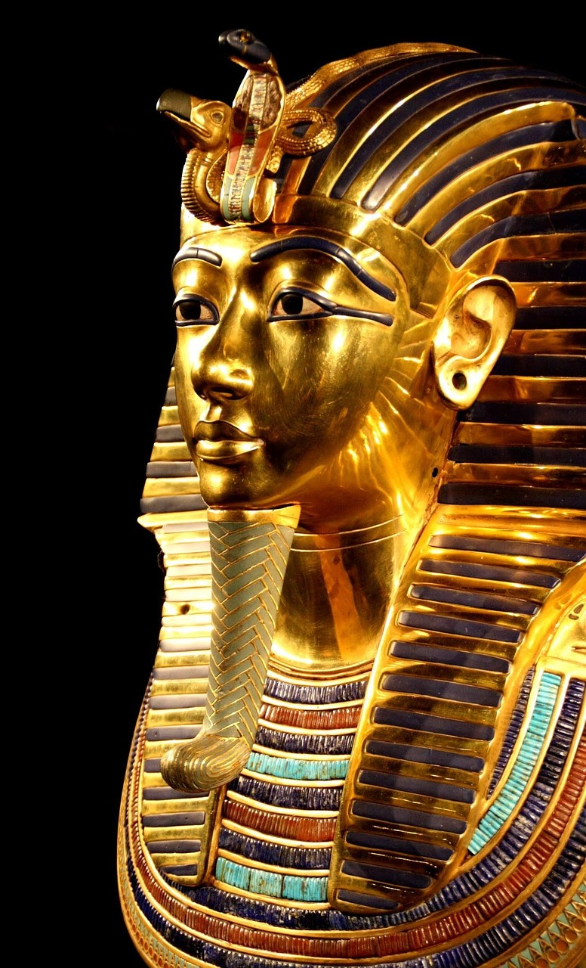
Social Hierarchy in Ancient Egyptian Society
The Structure of Social Classes
Role of the Pharaoh
Social Mobility Constraints
The social hierarchy in Ancient Egyptian society was divided into different classes, including the pharaoh, nobles, priests, and peasants.
Each class had its own roles and responsibilities, with the pharaoh holding absolute power and the peasants making up the majority of the population.
The pharaoh held absolute power and was considered a divine figure in Ancient Egyptian society.
Their authority influenced all aspects of life, including governance, religion, and the economy.
Social mobility was limited in Ancient Egyptian society, with people typically born into their social class.
Individuals generally remained in the same class for life, reinforcing the rigid structure of the hierarchy.
6
Ancient Egyptian Family Life and Social Hierarchy

Slide 7

Roles of Family Members in Ancient Egyptian Society
1
Father's Role in the Family
The father was responsible for providing for the family and protecting them.
He ensured the family's safety and financial stability.
2
Mother's Responsibilities
The mother was responsible for managing the household and caring for children.
She played a central role in maintaining the home and nurturing the family.
3
Children's Contributions
Children were expected to help with household chores and learn a trade or skill.
This prepared them to support themselves and contribute to society in the future.
7
Ancient Egyptian Family Life and Social Hierarchy

Slide 8
ELL/ESL Support Strategies
1
2
3
Visual Aids for Vocabulary and Comprehension
Sentence Frames and Vocabulary Lists
Graphic Organizers for Thought Organization
Provide visual aids, such as diagrams and pictures, to support students who may struggle with vocabulary or comprehension.
These tools can make abstract concepts more tangible and accessible for English language learners.
Offer sentence frames and vocabulary lists to help students participate in class discussions and complete written assignments.
This strategy supports language development and encourages active engagement in classroom activities.
Use graphic organizers to help students organize their thoughts and take notes during the lesson.
These tools provide a structured way for students to process and retain information effectively.
8
Ancient Egyptian Family Life and Social Hierarchy

Slide 9

Ancient Egyptian Daily Life
1
Family and Community Focus
Daily life in Ancient Egypt was centered around the family and community.
People lived in small villages or cities, with most working as farmers or laborers.
2
Role of the Nile River
The Nile River played a crucial role in Ancient Egyptian daily life.
It provided water and fertile soil for crops.
3
Agricultural Lifestyle
Most Ancient Egyptians worked as farmers or laborers.
Their livelihoods depended on the resources provided by the Nile River.
9
Ancient Egyptian Family Life and Social Hierarchy

Slide 10

Food and Drink in Ancient Egyptian Society
1
2
3
Staples of the Egyptian Diet
Fruits and Vegetables
Beverages in Society
The main food staples in Ancient Egyptian society were bread, onions, and garlic.
These items formed the foundation of their daily meals.
Fruits and vegetables were also common, with dates and figs being popular.
These provided essential nutrients and variety to their diet.
Beer was a popular drink, with wine being reserved for special occasions.
This distinction highlighted the social and ceremonial importance of wine.
10
Ancient Egyptian Family Life and Social Hierarchy

Slide 11

Clothing and Jewelry in Ancient Egyptian Society
Simplicity in Clothing
Jewelry as a Popular Adornment
Materials and Craftsmanship
Clothing in Ancient Egyptian society was simple and functional, with men and women wearing loincloths and tunics.
The wealthy wore more elaborate clothing, with the pharaoh and nobles wearing the finest materials and most elaborate designs.
Jewelry was popular, with people wearing necklaces, earrings, and rings made from gold, silver, and precious stones.
The wealthy displayed their status through more elaborate jewelry designs.
Gold, silver, and precious stones were commonly used in jewelry making.
These materials highlighted the craftsmanship and wealth of Ancient Egyptian society.
11
Ancient Egyptian Family Life and Social Hierarchy

Slide 12

Leisure Activities in Ancient Egyptian Society
Ancient Egyptian Games
Music and Dance
Leisure of the Wealthy
Leisure activities in Ancient Egyptian society included playing games, such as senet and mehen.
These games were not only entertaining but also held cultural and spiritual significance.
People also enjoyed music and dance, with the sistrum being a popular instrument.
These activities were integral to both religious ceremonies and social gatherings.
The wealthy enjoyed more elaborate leisure activities, such as hunting and chariot racing.
These pursuits showcased their status and provided thrilling entertainment.
12
Ancient Egyptian Family Life and Social Hierarchy

Slide 13

Conclusion
1
Complexity of Ancient Egyptian Life
Ancient Egyptian family life and social hierarchy were complex and fascinating topics.
Understanding these topics helps us appreciate the culture and history of this ancient civilization.
2
Cultural Appreciation Through Learning
By studying these aspects, we gain deeper insights into the values and traditions of Ancient Egypt.
This understanding fosters a greater appreciation for their contributions to human history.
3
Inclusive Education Strategies
Incorporating ELL/ESL support strategies ensures all students can learn and participate.
These strategies promote equal opportunities for understanding and engagement.
13
Ancient Egyptian Family Life and Social Hierarchy

Slide 14

Assessment and Evaluation
Student Assessment Focus
Evaluation Methods
Inclusive Assessment Strategies
Students will be assessed on their understanding of Ancient Egyptian family life and social hierarchy.
This ensures a comprehensive grasp of the subject matter.
Evaluations will include quizzes, class discussions, and written assignments.
These methods provide diverse opportunities for students to showcase their knowledge.
ELL/ESL support strategies will be incorporated into assessments.
This ensures that all students have the opportunity to demonstrate their knowledge effectively.
14
Ancient Egyptian Family Life and Social Hierarchy

Slide 15

Extension Activities
1
Crafting Ancient Egyptian Models
Create a model of an Ancient Egyptian home or temple.
This activity allows for a hands-on exploration of Ancient Egyptian architecture.
2
Storytelling Ancient Egyptian Life
Write a short story or create a comic strip about daily life in Ancient Egypt.
This encourages creativity while learning about historical daily routines.
3
Exploring Ancient Egyptian Society
Research and create a presentation about a specific aspect of Ancient Egyptian society, such as mummification or hieroglyphics.
This deep dive fosters understanding of cultural and societal practices.
15
Ancient Egyptian Family Life and Social Hierarchy

Slide 16

Parent Engagement
Encouraging Conversations
Parent Participation
Homework Support
Encourage parents to ask their child about what they learned in class.
This helps build a connection between home and school learning.
Provide opportunities for parents to participate in class activities or volunteer in the classroom.
This fosters a sense of community and involvement in their child's education.
Offer resources and support for parents to help their child with homework and projects.
This ensures parents can effectively assist their children in academic tasks.
16
Ancient Egyptian Family Life and Social Hierarchy

Slide 17
Reflection Questions
1
Ancient Egyptian Family Life and Social Hierarchy
What did you learn about Ancient Egyptian family life and social hierarchy?
How did the social hierarchy affect daily life in Ancient Egypt?
2
Impact of Social Hierarchy on Daily Life
How did the social hierarchy affect daily life in Ancient Egypt?
What did you learn about Ancient Egyptian family life and social hierarchy?
3
Lessons from Ancient Egyptian Culture
What can we learn from studying Ancient Egyptian culture and history?
How did the social hierarchy affect daily life in Ancient Egypt?
17
Ancient Egyptian Family Life and Social Hierarchy

Slide 18
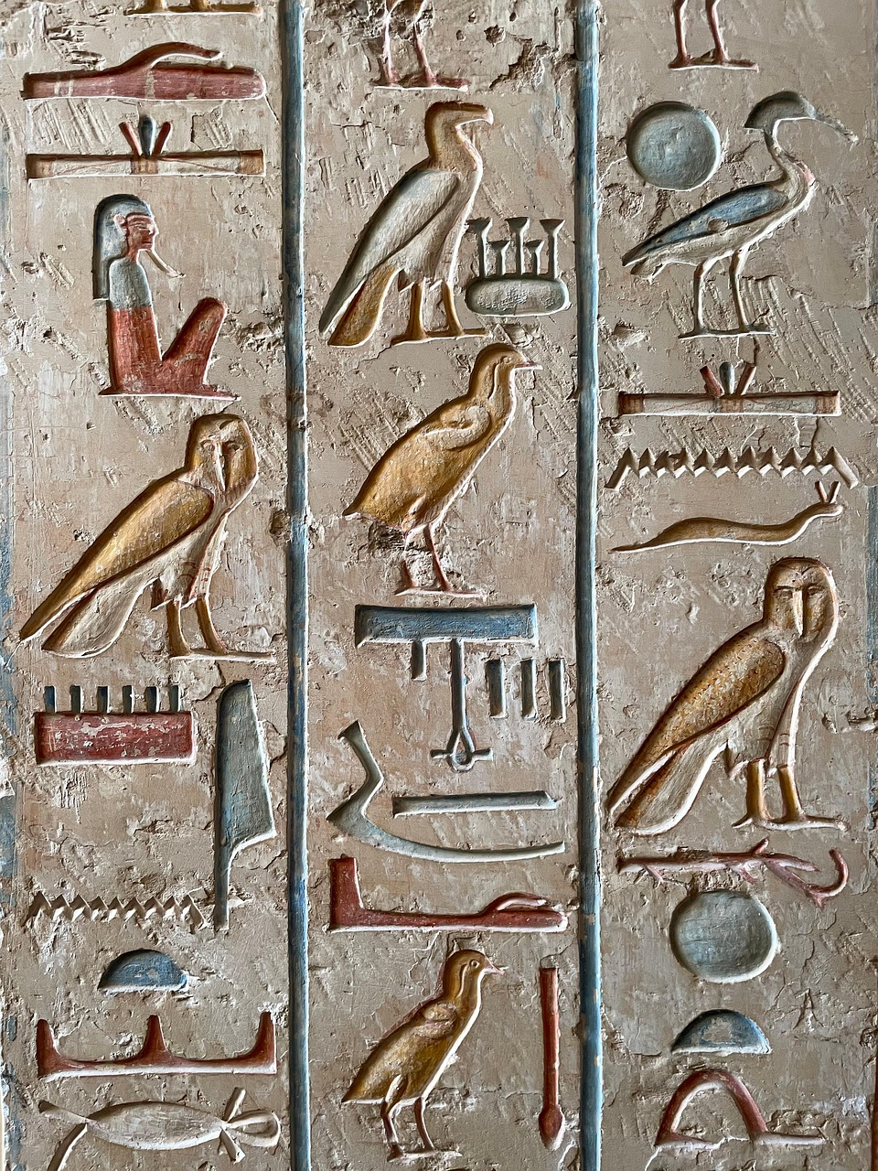
Next Steps
1
2
3
Exploring Ancient Egyptian Culture
Comparative Analysis of Ancient Societies
Enhancing Inclusivity in Education
Continue to explore Ancient Egyptian culture and history.
Dive deeper into the traditions, beliefs, and achievements of this fascinating civilization.
Compare and contrast Ancient Egyptian society with other ancient civilizations.
Identify similarities and differences to gain a broader understanding of historical development.
Incorporate ELL/ESL support strategies into future lessons to ensure that all students have the opportunity to learn and participate.
Adapt teaching methods to meet the diverse needs of learners effectively.
18
Ancient Egyptian Family Life and Social Hierarchy

