Slide 1
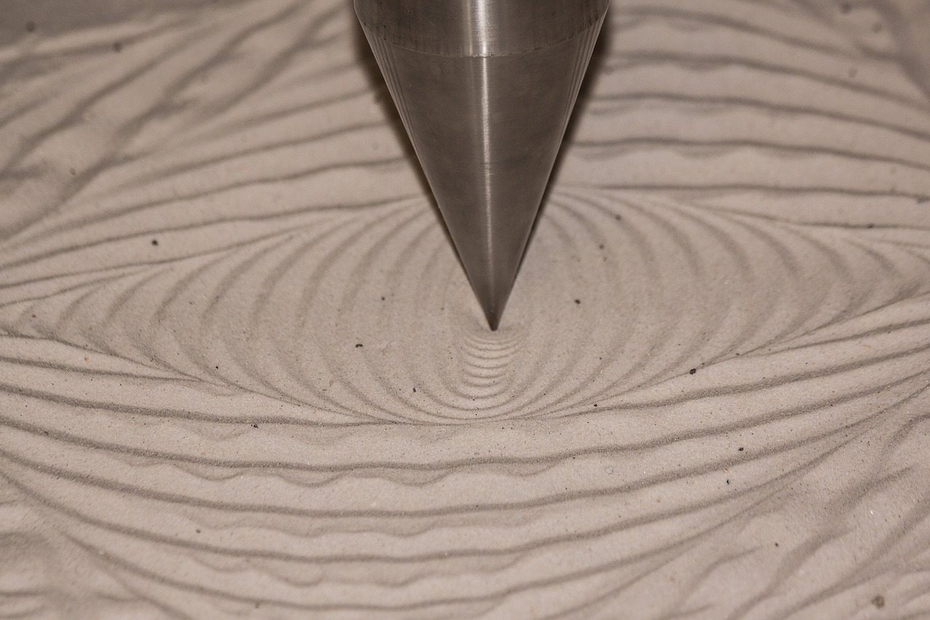
Understanding Newton's First Law of Motion
Exploring Inertia, Force, and Real-World Applications

Slide 2
Table of Contents
Introduction to the First Law of Motion
What is Inertia?
Examples of Inertia
Force and Motion
Real-World Applications
Newton's First Law of Motion
Key Concepts
Common Misconceptions
Interactive Activity
Conclusion
Summary
Review Questions
Extension Activity
04
05
06
07
08
09
10
11
12
13
14
15
16

Slide 3
Table of Contents
Assessment
Resources
Next Steps
Conclusion and Final Thoughts
Final Assessment
17
18
19
20
21

Slide 4

Introduction to the First Law of Motion
Definition of the First Law of Motion
Importance of Understanding the Law
Application in Physics
The First Law of Motion, also known as the Law of Inertia, is a fundamental concept in physics.
It describes the relationship between an object's motion and the forces acting upon it.
Understanding this concept is crucial in understanding how objects move.
It helps explain how objects respond to forces in the natural world.
The First Law of Motion serves as a foundation for analyzing physical phenomena.
It is essential for studying the behavior of objects under various force conditions.
4
Understanding Newton's First Law of Motion

Slide 5
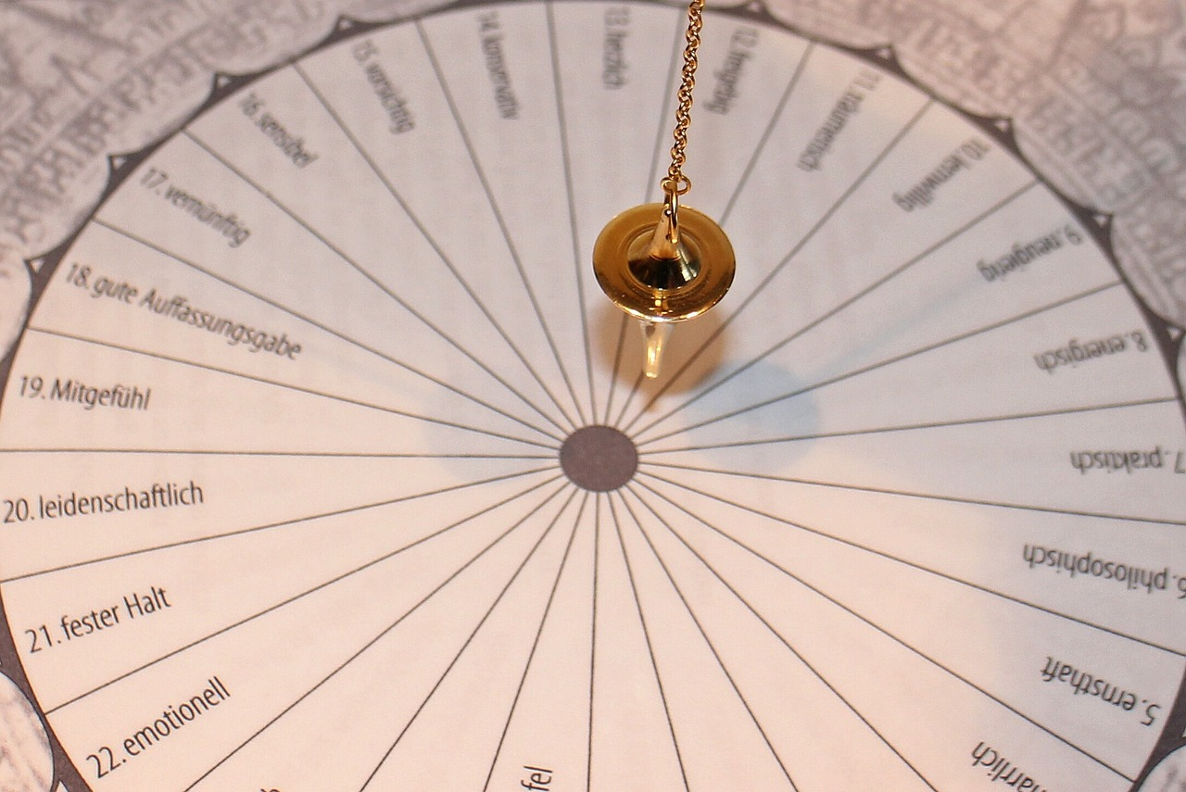
What is Inertia?
Definition of Inertia
Objects at Rest and Motion
Significance of Inertia
Inertia is the tendency of an object to resist changes in its motion.
It is a fundamental property of matter that explains the behavior of objects in various situations.
An object at rest will remain at rest unless acted upon by an external force.
Similarly, an object in motion will continue to move with constant velocity unless influenced by an external force.
Understanding inertia helps us predict and analyze the behavior of objects under different conditions.
It is a key concept in physics that underpins many principles of motion and dynamics.
5
Understanding Newton's First Law of Motion

Slide 6

Examples of Inertia
Inertia in Bowling
Inertia in Automobiles
Inertia in Projectile Motion
A bowling ball will continue to roll down a lane until it is stopped by the pins or the lane's friction.
This demonstrates the principle of inertia, where an object in motion remains in motion unless acted upon by an external force.
A car will continue to move at a constant speed unless the force of friction or air resistance slows it down.
This illustrates how inertia affects vehicles, maintaining their motion until external forces intervene.
A ball thrown upwards will come to a stop and fall back down due to the force of gravity.
This example shows how inertia interacts with gravity, influencing the motion of objects.
6
Understanding Newton's First Law of Motion

Slide 7
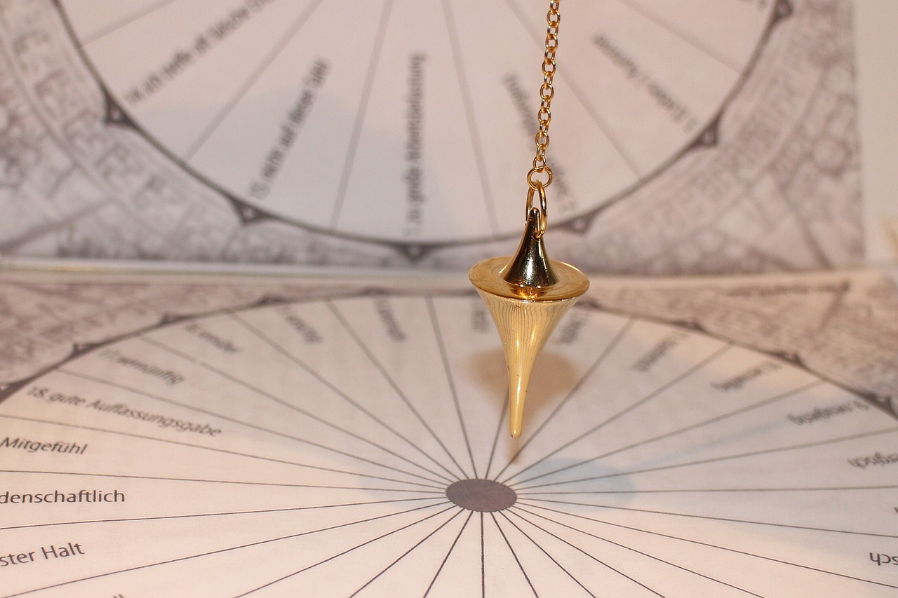
Force and Motion
1
Definition of Force
Force is a push or pull that can cause an object to change its motion.
It is a fundamental concept in physics that explains interactions between objects.
2
Newton's First Law of Motion
The First Law of Motion states that an external force is necessary to change the motion of an object.
This principle highlights the importance of force in altering the state of motion.
3
Applications of Force and Motion
Understanding the relationship between force and motion is essential in various fields, including engineering, transportation, and sports.
These applications demonstrate the practical significance of these concepts in everyday life.
7
Understanding Newton's First Law of Motion

Slide 8

Real-World Applications
1
Automotive Safety Enhancements
The First Law of Motion is applied in the design of safer cars, including airbags and seatbelts.
These innovations aim to protect passengers by mitigating the effects of sudden stops or collisions.
2
Sports Performance and Safety
In sports, the First Law of Motion is utilized to improve performance and reduce the risk of injury.
Athletes and equipment designers use this principle to optimize motion and impact management.
3
Efficient Transportation Systems
The development of high-speed trains and magnetic levitation systems incorporates the First Law of Motion.
This application enhances transportation efficiency and reduces energy consumption.
8
Understanding Newton's First Law of Motion

Slide 9
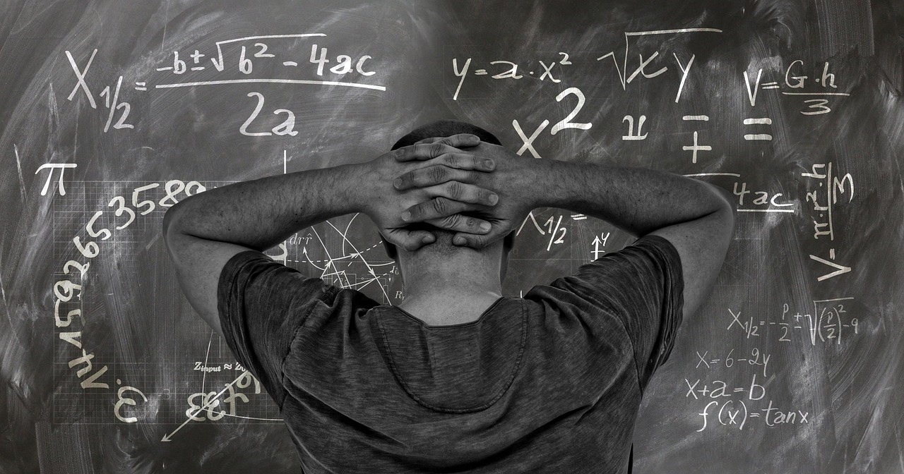
Newton's First Law of Motion
1
2
3
Definition of Newton's First Law
The Law of Inertia
Importance in Physics
Newton's First Law of Motion states that an object at rest will remain at rest, and an object in motion will continue to move with a constant velocity, unless acted upon by an external force.
This principle highlights the behavior of objects in the absence of external influences.
Newton's First Law is often referred to as the Law of Inertia.
It emphasizes the resistance of objects to changes in their state of motion or rest.
Newton's First Law is a fundamental concept in physics that helps us understand how objects move and respond to forces.
It provides a basis for analyzing motion and the effects of external forces on objects.
9
Understanding Newton's First Law of Motion

Slide 10

Key Concepts
Understanding Inertia
Exploring Force
Defining Motion
Inertia is the tendency of an object to resist changes in its motion.
This principle explains why objects at rest stay at rest and objects in motion continue moving unless acted upon by an external force.
Force is defined as a push or pull that can cause an object to change its motion.
It is a fundamental concept in physics that explains interactions between objects.
Motion refers to the change in position of an object over time.
It is a key concept in understanding the dynamics of physical systems.
10
Understanding Newton's First Law of Motion

Slide 11

Common Misconceptions
Force and Motion
Inertia vs. Friction
Understanding Misconceptions
Some people think that force is always necessary for motion, but this is not true.
Motion can occur without the continuous application of force, as explained by the First Law of Motion.
Others think that inertia is the same as friction, but they are different concepts.
Inertia refers to the resistance of an object to changes in its state of motion, while friction is a force that opposes motion.
Understanding these misconceptions can help us better understand the First Law of Motion.
Clarifying these concepts is essential for a deeper grasp of fundamental physics principles.
11
Understanding Newton's First Law of Motion

Slide 12

Interactive Activity
Introduction to the Experiment
Measuring Marble Velocity
Applying External Force
Let's conduct an experiment to demonstrate the First Law of Motion.
This activity will involve observing the behavior of a marble under different conditions.
We will roll a marble down a ramp and measure its velocity.
This step helps us understand the motion of the marble in a controlled environment.
We will then apply an external force to change the motion of the marble.
This demonstrates how external influences affect the state of motion as per the First Law of Motion.
12
Understanding Newton's First Law of Motion

Slide 13

Conclusion
Fundamental Concept in Physics
Importance of Understanding Motion
Applications in Various Fields
The First Law of Motion is a fundamental concept in physics.
It describes the relationship between an object's motion and the forces acting upon it.
Understanding this concept is crucial in understanding how objects move.
It also explains how objects respond to forces in the natural world.
The First Law of Motion has numerous real-world applications.
These include fields such as engineering, transportation, and sports.
13
Understanding Newton's First Law of Motion

Slide 14

Summary
The First Law of Motion
Understanding Inertia
Role of Force
The First Law of Motion states that an object at rest will remain at rest, and an object in motion will continue to move with a constant velocity, unless acted upon by an external force.
This principle highlights the concept of inertia and the conditions under which motion changes.
Inertia is the tendency of an object to resist changes in its motion.
It explains why objects maintain their current state of motion unless influenced by external forces.
Force is a push or pull that can cause an object to change its motion.
This interaction is essential for altering the velocity or direction of an object's movement.
14
Understanding Newton's First Law of Motion

Slide 15

Review Questions
Understanding the First Law of Motion
Exploring the Concept of Inertia
The Role of Force in Motion
The First Law of Motion states that an object will remain at rest or in uniform motion in a straight line unless acted upon by an external force.
This principle highlights the concept of inertia, which is the resistance of any physical object to a change in its state of motion or rest.
Inertia is the property of an object that resists changes to its motion or state of rest.
It is directly related to the mass of the object, with greater mass resulting in greater inertia.
Force is an interaction that, when unopposed, changes the motion of an object.
It can cause an object to accelerate, decelerate, or change direction depending on the magnitude and direction of the force applied.
15
Understanding Newton's First Law of Motion

Slide 16

Extension Activity
Designing a Roller Coaster
Researching Real-World Applications
Creating Motion Simulations
Design a roller coaster that demonstrates the First Law of Motion.
This activity involves understanding how inertia affects the motion of objects in a roller coaster setup.
Research and write about a real-world application of the First Law of Motion.
Explore examples such as seatbelt usage in vehicles to understand the practical implications of inertia.
Create a simulation to model the motion of an object under different forces.
This task helps visualize how varying forces influence an object's motion, adhering to the First Law of Motion.
16
Understanding Newton's First Law of Motion

Slide 17

Assessment
Quiz Activity
Project Task
Presentation Assignment
Understanding the First Law of Motion.
Engage with questions to test comprehension of the concept.
Design a device that demonstrates the First Law of Motion.
Apply creativity and engineering principles to showcase the law.
Explain the First Law of Motion and its real-world applications.
Prepare a detailed presentation to illustrate practical examples.
17
Understanding Newton's First Law of Motion

Slide 18

Resources
Textbook Resource
Online Learning Platform
Simulation Software
The recommended textbook for the course is 'Physics for Scientists and Engineers'.
This book provides comprehensive coverage of fundamental physics concepts and principles.
Khan Academy offers a variety of educational resources for physics topics.
It includes video tutorials, practice exercises, and interactive lessons.
PhET Interactive Simulations provides engaging and interactive physics simulations.
These tools help visualize and understand complex physical phenomena effectively.
18
Understanding Newton's First Law of Motion

Slide 19

Next Steps
Lesson 2: Understanding the Second Law of Motion
Lesson 3: Understanding the Third Law of Motion
Lesson 4: Applying the Laws of Motion to Real-World Problems
This lesson focuses on the relationship between force and acceleration.
It explores how objects respond to applied forces according to Newton's second law.
This lesson examines the principle of action and reaction.
It discusses how forces between two objects are equal and opposite.
This lesson applies Newton's laws to practical scenarios.
It demonstrates how these principles are used to solve everyday challenges.
19
Understanding Newton's First Law of Motion

Slide 20

Conclusion and Final Thoughts
Fundamental Concept in Physics
Understanding Motion and Forces
Real-World Applications
The First Law of Motion is a fundamental concept in physics.
It describes the relationship between an object's motion and the forces acting upon it.
Understanding this concept is crucial in understanding how objects move.
It also explains how objects respond to forces in the natural world.
The First Law of Motion has numerous real-world applications.
These include fields such as engineering, transportation, and sports.
20
Understanding Newton's First Law of Motion

Slide 21

Final Assessment
Final Quiz Overview
Final Project Details
Final Presentation Insights
The final quiz focuses on understanding the First Law of Motion.
Participants will answer questions to demonstrate their comprehension of the concept.
The final project involves designing a device that illustrates the First Law of Motion.
This task encourages creativity and practical application of theoretical knowledge.
The final presentation requires explaining the First Law of Motion and its real-world applications.
Presenters will showcase their understanding and ability to relate the law to everyday phenomena.
21
Understanding Newton's First Law of Motion

