Slide 1
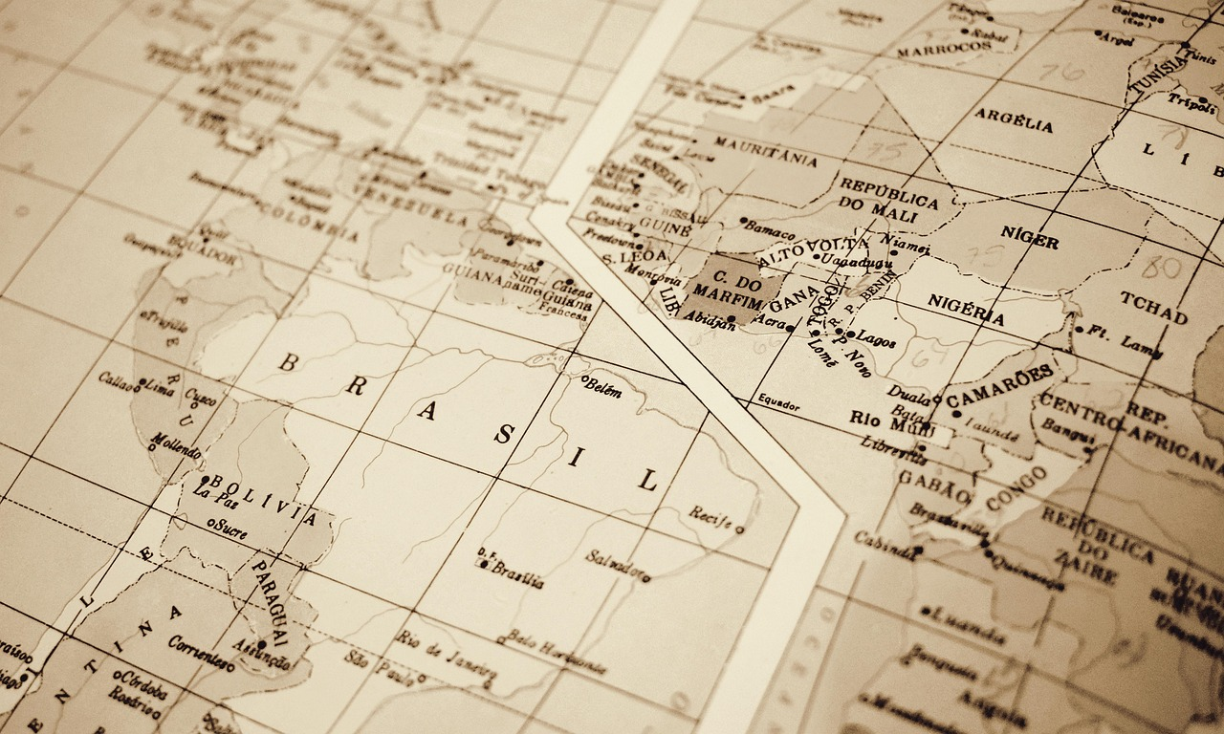

Mastering Geographic Coordinates: Navigating and Understanding Our World
A Comprehensive Guide to Latitude, Longitude, Map Reading, and Real-World Applications

Slide 2
Mastering Geographic Coordinates: Navigating and Understanding Our World
2
Table of Contents
Introduction to Geographic Coordinates
What are Geographic Coordinates?
Importance of Geographic Coordinates
Latitude and Longitude
Reading Maps with Geographic Coordinates
Calculating Distances and Directions
Applications of Geographic Coordinates
Technology in Geographic Coordinates
Practical Activities
Group Project: Mapping Our Community
Conclusion
Assessment and Evaluation
Future Learning
04
05
06
07
08
09
10
11
12
13
14
15
16

Slide 3
Mastering Geographic Coordinates: Navigating and Understanding Our World
3
Table of Contents
Resources
Reflection and Feedback
Final Thoughts
Appendix: Glossary
17
18
19
20

Slide 4
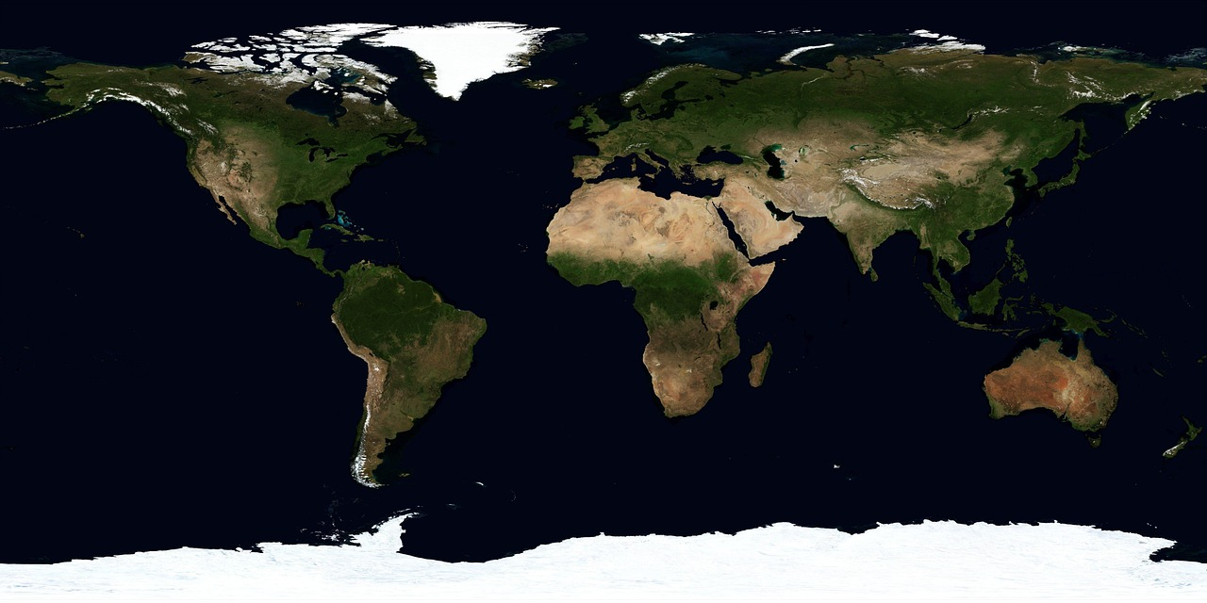
Mastering Geographic Coordinates: Navigating and Understanding Our World
4
Introduction to Geographic Coordinates
Understanding Geographic Coordinates
Mastering Map Reading and Precision
Applying Knowledge in Real-Life Situations
Welcome to the world of geographic coordinates!
In this lesson, we will explore what geographic coordinates are and how they are used to locate places on the Earth's surface.
By the end of this lesson, you will be able to read and use maps with precision.
Calculate distances and directions using geographic coordinates.
Apply this knowledge in real-life situations.
Enhance your ability to navigate and understand the Earth's geography.

Slide 5
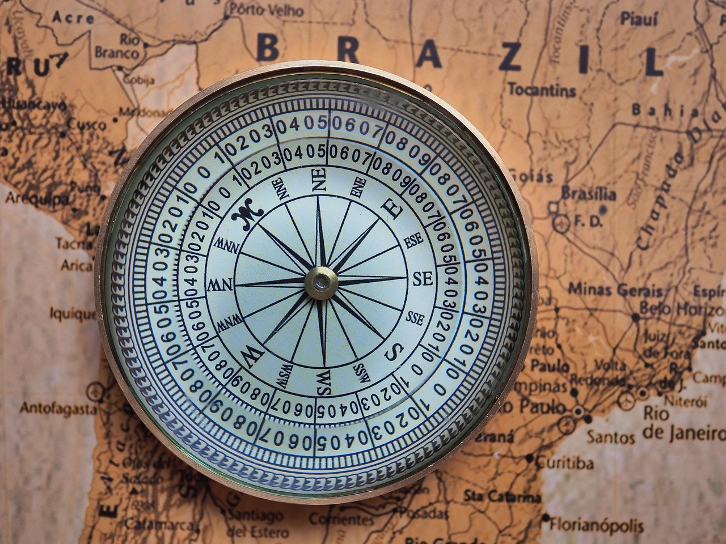
Mastering Geographic Coordinates: Navigating and Understanding Our World
5
What are Geographic Coordinates?
Understanding Geographic Coordinates
Geographic coordinates are a system used to pinpoint locations on Earth's surface.
They rely on latitude and longitude to provide a unique address for any location.
Latitude: Measuring North and South
Latitude measures how far a location is from the equator, either north or south.
It is expressed in degrees, ranging from 0° at the equator to 90° at the poles.
Longitude: Measuring East and West
Longitude determines the distance of a location east or west of the prime meridian.
Like latitude, it is measured in degrees, creating a grid system for precise location mapping.

Slide 6
Mastering Geographic Coordinates: Navigating and Understanding Our World
6
Importance of Geographic Coordinates
Navigation Across Different Mediums
Understanding Earth's Spatial Relationships
Applications in Specialized Fields
Geographic coordinates are essential for navigation, whether it's on land, sea, or air.
They provide precise locations that guide travelers and explorers.
Geographic coordinates help us understand the relationship between different places on the Earth's surface.
They enable the study of spatial patterns and connections globally.
Geographic coordinates are crucial in various fields such as geology, meteorology, and urban planning.
These fields rely on accurate location data for analysis and decision-making.

Slide 7
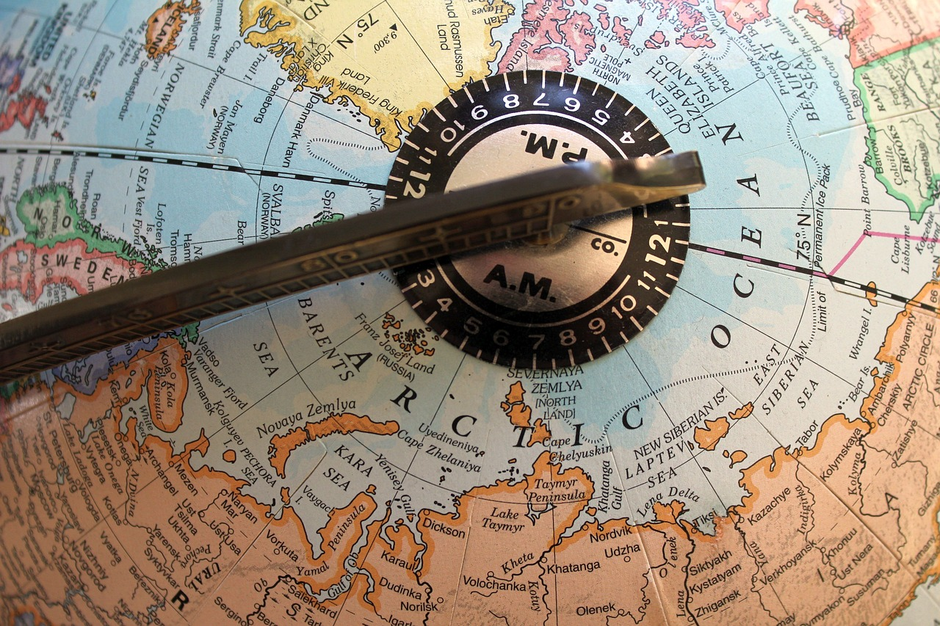
Mastering Geographic Coordinates: Navigating and Understanding Our World
7
Latitude and Longitude
Latitude Basics
Longitude Basics
Importance of Geographic Coordinates
Latitude is measured in degrees, minutes, and seconds, with 0° being the equator.
It increases to 90° at the poles.
Longitude is also measured in degrees, minutes, and seconds, with 0° being the prime meridian.
It increases to 180° east and west.
Understanding latitude and longitude is key to using geographic coordinates effectively.
These coordinates help in pinpointing exact locations on Earth.

Slide 8

Mastering Geographic Coordinates: Navigating and Understanding Our World
8
Reading Maps with Geographic Coordinates
Understanding Map Scale
Deciphering Map Legends
Using the Grid System
The scale helps you determine distances on a map.
It provides a ratio that translates map measurements to real-world distances.
The legend explains the symbols and colors used on the map.
It is essential for interpreting the meaning of various map elements.
The grid system, based on latitude and longitude, allows you to pinpoint exact locations.
It divides the map into coordinates for precise navigation.

Slide 9
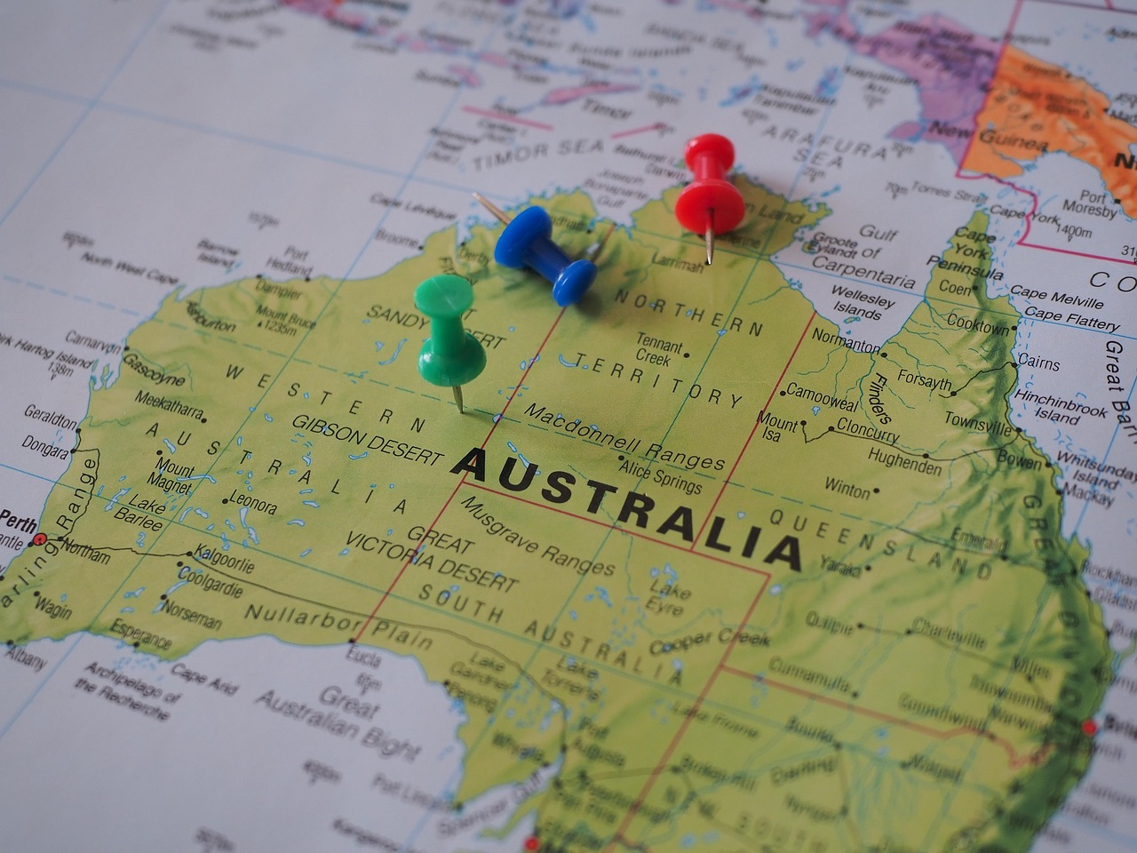
Mastering Geographic Coordinates: Navigating and Understanding Our World
9
Calculating Distances and Directions
Formula for Calculating Distance
Using Tools for Direction
Importance of Distance and Direction
To calculate distances, you can use the formula: distance = speed × time, or use a map scale to estimate distances.
This method is essential for determining how far you need to travel.
For directions, you can use a compass or determine the bearing between two points using their geographic coordinates.
These tools help in identifying the correct path to follow.
Understanding how to calculate distances and directions is vital for navigation and planning routes.
This knowledge ensures efficient and accurate travel planning.

Slide 10

Mastering Geographic Coordinates: Navigating and Understanding Our World
10
Applications of Geographic Coordinates
Navigation and Positioning
Geological Applications
Urban Planning and Development
Geographic coordinates are used in aviation and maritime navigation to chart courses.
They also determine precise positions for safe and efficient travel.
In geology, geographic coordinates help locate mineral deposits and track earthquakes.
They are also essential for studying the Earth's structure.
Urban planners use geographic coordinates to design cities and manage resources.
They also plan infrastructure to meet the needs of growing populations.

Slide 11
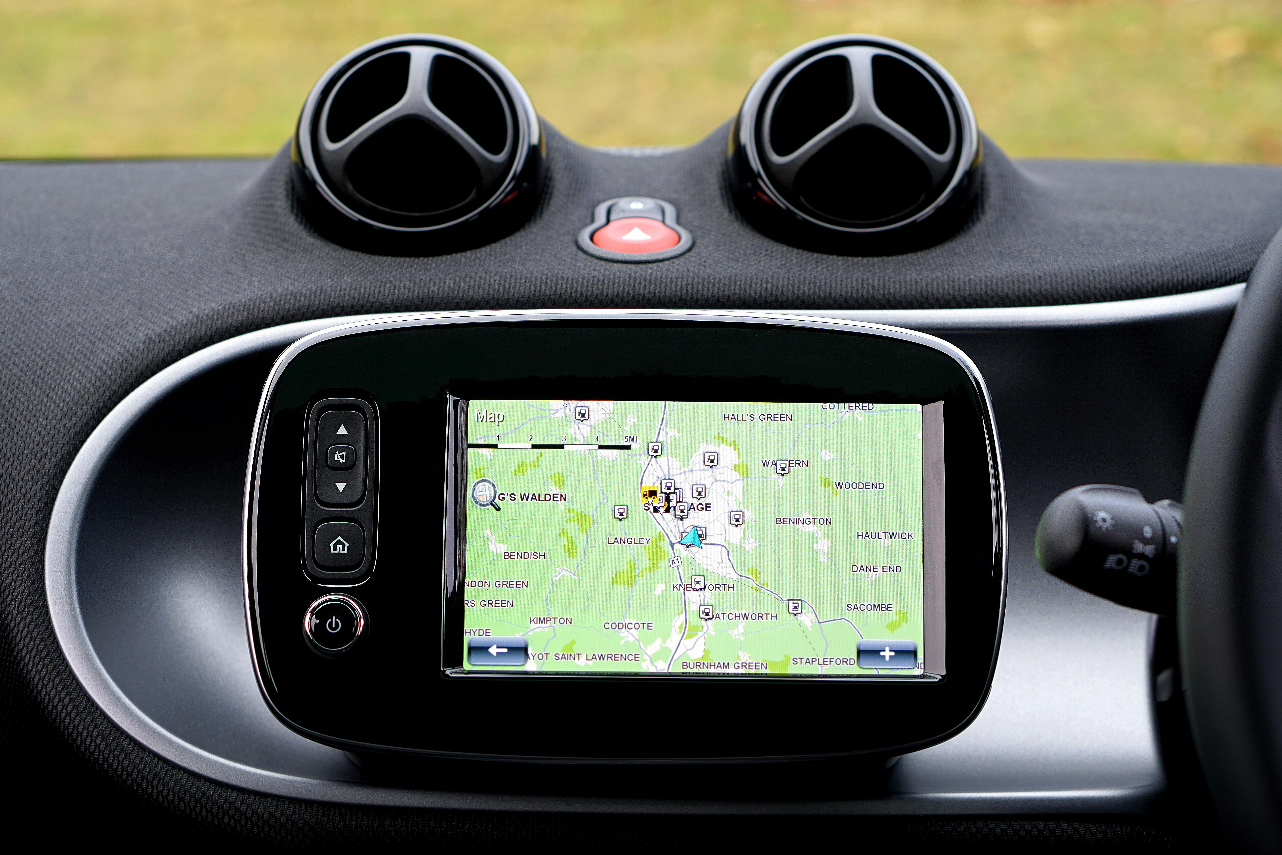
Mastering Geographic Coordinates: Navigating and Understanding Our World
11
Technology in Geographic Coordinates
GPS and Geographic Coordinates
GPS (Global Positioning System) relies on geographic coordinates to provide location information.
It is a widely used technology for navigation and tracking.
GIS and Data Analysis
GIS (Geographic Information System) technology uses geographic coordinates to analyze and present geographically referenced data.
This enables better decision-making and visualization of spatial information.
Online Mapping Services
Online mapping services like Google Maps use geographic coordinates to provide directions and location-based information.
These services are essential for everyday navigation and finding points of interest.

Slide 12
Mastering Geographic Coordinates: Navigating and Understanding Our World
12
Practical Activities
Activity 1: Latitude and Longitude Identification
Activity 2: Distance Calculation
Activity 3: GPS Navigation
Identify and label the latitude and longitude of major cities on a world map.
This activity helps in understanding the geographic positioning of cities globally.
Calculate the distance between two cities using their geographic coordinates.
This task enhances skills in applying mathematical formulas to real-world geography.
Use a GPS device or a mapping app to navigate to a nearby landmark.
This practical activity develops navigation and technology usage skills.

Slide 13

Mastering Geographic Coordinates: Navigating and Understanding Our World
13
Group Project: Mapping Our Community
Group Formation and Area Selection
Mapping Key Locations
Class Presentation and Significance
Divide into groups and choose a local area to map.
This will help you focus on specific community aspects.
Use geographic coordinates to mark important locations such as schools, parks, and shops.
This ensures accuracy and relevance in your community map.
Present your map to the class, explaining the significance of the locations you've chosen.
Highlight why these locations are important to your community.

Slide 14
Mastering Geographic Coordinates: Navigating and Understanding Our World
14
Conclusion
Understanding Geographic Coordinates
The Significance of Latitude and Longitude
Real Places, Real Possibilities
Geographic coordinates are a powerful tool for understanding and navigating our world.
By mastering latitude and longitude, you can unlock a deeper appreciation for geography and its applications.
Latitude and longitude are key to unlocking the mysteries of our planet.
They allow us to pinpoint locations and explore the interconnectedness of places.
Geographic coordinates are not just numbers; they represent real places and possibilities.
They inspire us to explore and connect with the world around us.

Slide 15

Mastering Geographic Coordinates: Navigating and Understanding Our World
15
Assessment and Evaluation
Quiz Evaluation
Project Presentation Assessment
Class Participation Evaluation
Test your understanding of geographic coordinates and their applications.
This activity helps in assessing theoretical knowledge and practical comprehension.
Assess your ability to apply geographic coordinates in a real-world context.
This task evaluates creativity and problem-solving skills in practical scenarios.
Evaluate your engagement and contribution to class discussions and activities.
This measure reflects your collaborative and communicative abilities.

Slide 16
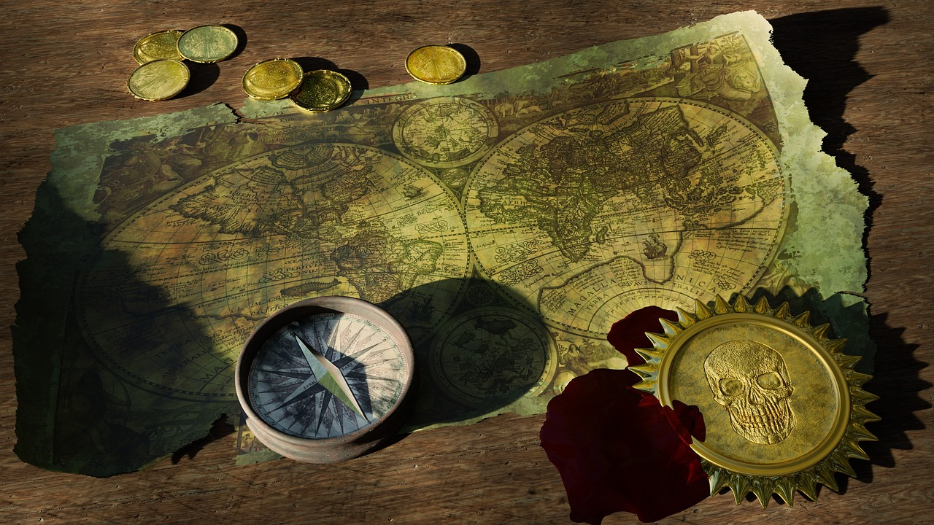
Mastering Geographic Coordinates: Navigating and Understanding Our World
16
Future Learning
Advanced Geographic Information Systems (GIS)
Navigation and Orienteering
Geographic Research Projects
Learn to analyze and interpret geospatial data.
Understand the applications of GIS in various fields.
Apply geographic coordinates in outdoor activities.
Enhance skills in map reading and compass usage.
Investigate and present on topics like climate change, urbanization, or natural resource management.
Develop critical thinking and research skills through geographic studies.

Slide 17
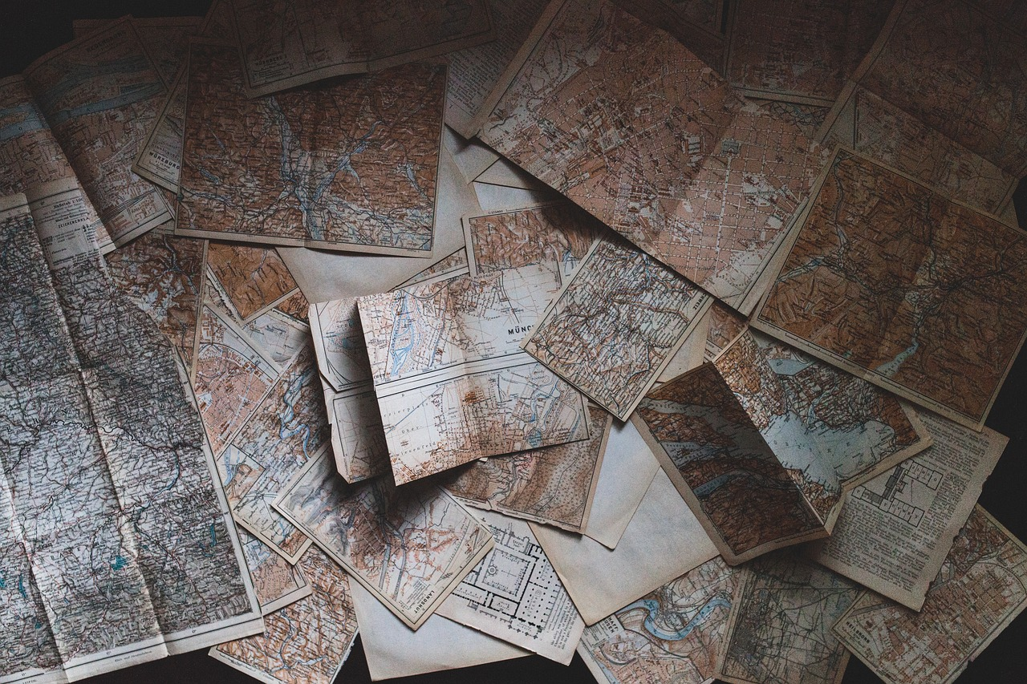
Mastering Geographic Coordinates: Navigating and Understanding Our World
17
Resources
Mapping Tools and Applications
Textbooks and online resources are essential for further learning.
They provide foundational knowledge and advanced insights into geographic concepts.
Real-world Applications of Geographic Coordinates
Explore tools like Google Earth, ArcGIS, and GPS devices.
These tools are instrumental in understanding and visualizing geographic data.
Real-world Applications of Geographic Coordinates
Geographic coordinates are widely used in various professions and industries.
They play a crucial role in navigation, urban planning, and environmental studies.

Slide 18

Mastering Geographic Coordinates: Navigating and Understanding Our World
18
Reflection and Feedback
Reflecting on Learning
Providing Constructive Feedback
Applying Geographic Knowledge
Reflect on what you've learned and how you can apply it.
Consider how geographic coordinates can be used to solve real-world problems and contribute to your community.
Provide feedback on the lesson to help improve future learning experiences.
Reflect on the strengths and areas for improvement in the lesson.
Consider how geographic coordinates can be used to solve real-world problems and contribute to your community.
Think about specific examples where this knowledge can make a positive impact.

Slide 19
Mastering Geographic Coordinates: Navigating and Understanding Our World
19
Final Thoughts
Understanding Geographic Coordinates
The Journey of Continuous Learning
Making a Positive Impact
Geographic coordinates are a fundamental concept in geography, essential for navigation, research, and understanding our world.
They provide a framework for pinpointing locations and exploring the Earth's surface.
Remember that learning is a continuous process; there's always more to discover about geographic coordinates and their applications.
Staying curious and open to new knowledge can deepen your understanding of this vital subject.
Apply what you've learned to make a positive impact and contribute to a better understanding of our planet.
Your knowledge can help address global challenges and foster a sustainable future.

Slide 20
Mastering Geographic Coordinates: Navigating and Understanding Our World
20
Appendix: Glossary
Latitude
Longitude
Geographic Coordinates
The distance north or south of the equator, measured in degrees, minutes, and seconds.
It helps in determining the position of a location on Earth's surface.
The distance east or west of the prime meridian, measured in degrees, minutes, and seconds.
It is essential for pinpointing locations in combination with latitude.
A pair of numbers (latitude and longitude) that uniquely identify a point on the Earth's surface.
These coordinates are used in mapping and navigation systems worldwide.

