Slide 1

Mastering Professional Communication
Strategies for Effective and Impactful Communication in Various Contexts

Slide 2
Table of contents
01
02
03
04
05
06
07
08
09
10
11
Title Slide: Professional Communication Mastery
Lesson Overview: Elevate Communication Strategies
Communication Context Framework: Communication is More Than…
Communication Modalities: Types of Professional Communicati…
Meeting Communication Strategies: Effective Meeting Communi…
Email Communication Masterclass: Email Best Practices
Interdepartmental Communication: Navigating Complex Communi…
Common Communication Errors: Top Communication Mistakes
Technology in Communication: Digital Communication Ecosystem
Emotional Intelligence: Role in Professional Communication
Cross-Cultural Communication: Global Communication Strategi…

Slide 3
Table of contents
12
13
14
15
16
17
18
19
20
Communication Skill Development: Continuous Improvement Fra…
Personal Communication Brand: Building Your Unique Communic…
Action Planning: Personal Communication Development Roadmap
Key Takeaways: Critical Communication Insights
Reflection Questions: Personal Development Prompts
Next Steps: Recommended Follow-Up Learning
Conclusion: Final Message
Q&A and Contact: Open Discussion
Design Recommendations

Slide 4

1
Title Slide: Professional Communication Mastery
Professional Communication Mastery
Strategic Communication Techniques for Mid-Career Professionals
Mastering Professional Communication

Slide 5

2
Lesson Overview: Elevate Communication Strategies
01
Contextual Communication Adaptation
02
Strategic Messaging
Understanding different communication styles based on the context.
Crafting messages with specific goals and outcomes in mind.
03
Interdepartmental Communication
04
Digital Communication Techniques
Enhancing communication between different departments within an organization.
Leveraging technology for effective communication strategies.
Mastering Professional Communication

Slide 6

3
Communication Context Framework: Communication is More Than Information Transfer
01
Psychological Dynamics
02
Organizational Ecosystem
Understanding individual perceptions and emotions
Recognizing cognitive biases in communication
Considering company culture and values
Navigating hierarchies and power dynamics
03
Technological Interfaces
04
Interpersonal Relationships
Utilizing communication tools effectively
Adapting to digital platforms for diverse audiences
Building trust and rapport
Managing conflicts and resolving misunderstandings
Mastering Professional Communication

Slide 7

4
Communication Modalities: Types of Professional Communication
01
Verbal Communication
02
Written Communication
Spoken words, tone, and pitch
Face-to-face conversations, phone calls, and presentations
Emails, reports, memos, and letters
Formal documentation and written records
03
Digital Communication
04
Non-Verbal Communication
Instant messaging, video conferencing, and social media
Virtual meetings and online collaboration platforms
Body language, gestures, and facial expressions
Conveys emotions, attitudes, and intentions
Mastering Professional Communication

Slide 8

5
Meeting Communication Strategies: Effective Meeting Communication Techniques
Effective Meeting Communication Techniques
Active Listening
Strategic Participation
Body Language Awareness
Professional Presentation Skills
Mastering Professional Communication

Slide 9

6
Email Communication Masterclass: Email Best Practices
01
Clear and Concise Language
02
Professional Tone
Use simple and direct language to convey your message effectively.
Maintain a professional and respectful tone in all email communications.
03
Structured Communication
04
Contextual Appropriateness
Organize your emails with clear headings, bullet points, and paragraphs for easy readability.
Tailor your emails to suit the recipient and the purpose of the communication.
Mastering Professional Communication

Slide 10

7
Interdepartmental Communication: Navigating Complex Communication Landscapes
01
Cross-Functional Understanding
02
Collaborative Approach
Foster mutual respect and knowledge sharing between departments.
Encourage team members to learn about other departments' roles and challenges.
Promote teamwork and collective problem-solving.
Implement regular interdepartmental meetings and workshops.
03
Breaking Communication Barriers
04
Strategic Messaging
Identify and address common communication obstacles.
Utilize technology to facilitate better communication channels.
Develop clear and consistent messaging strategies.
Ensure alignment of communication goals with organizational objectives.
Mastering Professional Communication

Slide 11

8
Common Communication Errors: Top Communication Mistakes
01
Over-Formalization
02
Inconsistent Tone
Using overly formal language can create barriers to effective communication.
Fluctuating tones in communication can lead to misunderstandings and confusion.
03
Neglecting Non-Verbal Signals
04
Reactive Communication
Ignoring non-verbal cues such as body language and facial expressions can hinder effective communication.
Responding impulsively without considering the impact of your words can lead to miscommunication and conflict.
Mastering Professional Communication

Slide 12

9
Technology in Communication: Digital Communication Ecosystem
01
Video Conferencing Platforms
02
Collaborative Workspaces
Zoom
Microsoft Teams
Google Meet
Skype
Slack
Microsoft Teams
Trello
Asana
03
AI Communication Analysis Tools
04
Mobile Learning Applications
Grammarly
Hemingway Editor
ProWritingAid
Ginger Software
Duolingo
Coursera
Khan Academy
edX
Mastering Professional Communication

Slide 13
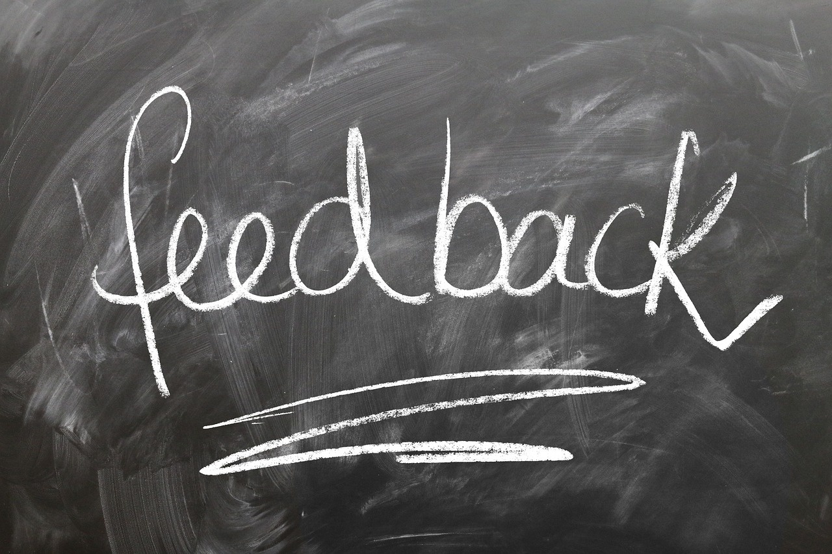
10
Emotional Intelligence: Role in Professional Communication
01
Self-Awareness
02
Empathy
Understanding one's emotions and how they affect communication.
Ability to understand and share the feelings of others, enhancing interpersonal connections.
03
Adaptability
04
Emotional Regulation
Being flexible in communication styles to suit different situations and individuals.
Managing emotions effectively to maintain professionalism and positive interactions.
Mastering Professional Communication

Slide 14

11
Cross-Cultural Communication: Global Communication Strategies
01
Cultural Sensitivity
02
Language Nuances
Understanding and respecting diverse cultural norms and values.
Recognizing linguistic differences and adapting communication accordingly.
03
Adaptive Communication
04
Global Professional Etiquette
Flexibility in adjusting communication styles to suit different cultural contexts.
Awareness of appropriate behaviors and customs in international business settings.
Mastering Professional Communication

Slide 15

12
Communication Skill Development: Continuous Improvement Framework
01
Regular Self-Assessment
02
Peer Feedback
Reflect on communication strengths and areas for growth.
Seek constructive feedback from colleagues for diverse perspectives.
03
Professional Workshops
04
Technology-Enhanced Learning
Attend workshops to enhance specific communication skills.
Utilize online resources and tools for continuous skill development.
Mastering Professional Communication

Slide 16

13
Personal Communication Brand: Building Your Unique Communication Style
01
Authenticity
02
Consistency
Being true to yourself in your communication style.
Maintaining a uniform approach in how you communicate.
03
Professional Values
04
Strategic Adaptation
Incorporating your core values into your communication.
Adapting your communication style to different situations effectively.
Mastering Professional Communication

Slide 17
14
Action Planning: Personal Communication Development Roadmap
01
02
03
04
Self-Assessment
Skill Gap Identification
Learning Strategies
Continuous Refinement
Evaluate current communication skills
Identify strengths and areas for improvement
Pinpoint specific areas where enhancement is needed
Focus on areas such as public speaking or written communication
Research and select appropriate resources
Enroll in courses or workshops to develop targeted communication skills
Implement a plan for ongoing practice
Seek feedback and refine communication abilities continuously
Mastering Professional Communication

Slide 18

15
Key Takeaways: Critical Communication Insights
01
Contextual Adaptability
02
Emotional Intelligence
Understanding the importance of adapting communication style based on the situation.
Recognizing the impact of context on effective communication strategies.
Developing self-awareness and empathy in communication interactions.
Managing emotions to enhance professional relationships and communication outcomes.
03
Continuous Learning
04
Strategic Communication
Embracing a growth mindset to continually improve communication skills.
Seeking feedback and opportunities for skill development to enhance communication effectiveness.
Crafting messages with specific goals and outcomes in mind.
Aligning communication strategies with organizational objectives for maximum impact.
Mastering Professional Communication

Slide 19

16
Reflection Questions: Personal Development Prompts
01
How do I currently adapt my communication?
02
What is my emotional intelligence level?
Reflect on the strategies you use to tailor your communication style to different audiences and situations.
Evaluate your ability to understand and manage emotions, both yours and others', in professional interactions.
03
How can I improve my communication skills?
Identify areas for growth in your communication abilities and develop a plan to enhance them.
Mastering Professional Communication

Slide 20

17
Next Steps: Recommended Follow-Up Learning
01
Advanced Interpersonal Communication
02
Cross-Cultural Communication Workshop
Dive deeper into advanced techniques for effective one-on-one communication.
Enhance your understanding of communicating across diverse cultural backgrounds.
03
Digital Communication Strategies
Explore innovative strategies for leveraging digital platforms in professional communication.
Mastering Professional Communication

Slide 21
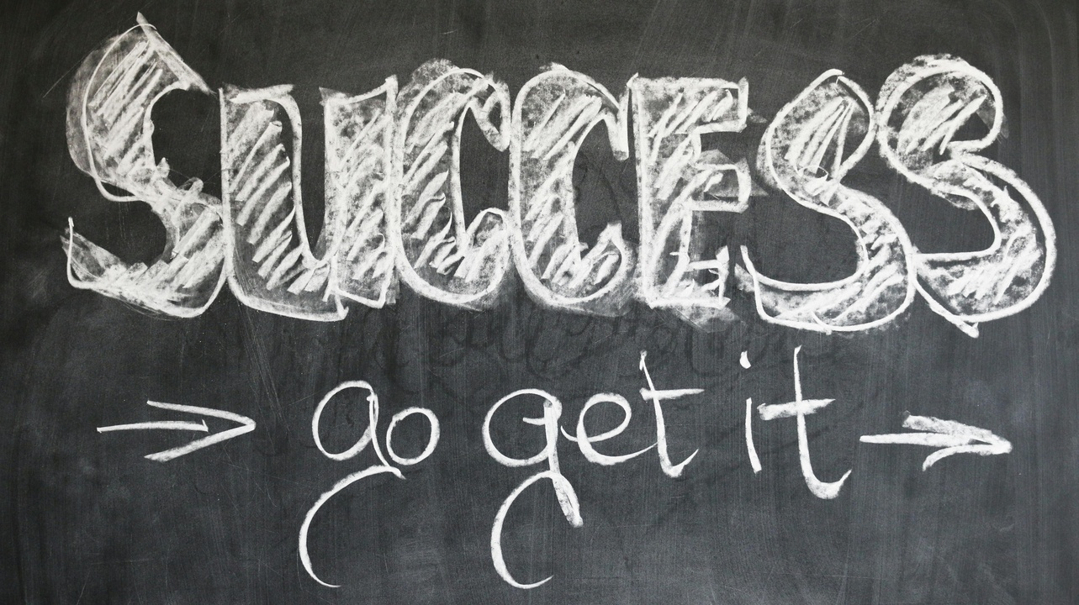
18
Conclusion: Final Message
Conclusion: Final Message
Professional communication is a strategic skill that empowers individuals in their careers.
Mastering Professional Communication

Slide 22

19
Q&A and Contact: Open Discussion
01
Interactive Q&A Session
02
Contact Information
Participants are encouraged to ask questions and share insights.
Facilitator will address queries on communication strategies and techniques.
Email: info@communicationmastery.com
Phone: +1 (555) 123-4567
Website: www.communicationmastery.com
03
Additional Resources
Recommended reading materials for further learning.
Access to online webinars and workshops for ongoing development.
Mastering Professional Communication

Slide 23

20
Design Recommendations
01
Professional Color Palette
02
Clean, Modern Design Elements
Use shades of blue, gray, and white for a sleek look.
Utilize minimalist layouts with ample white space.
03
Icons and Graphics
04
Consistent Typography
Integrate simple, relevant icons for visual interest.
Stick to a cohesive font style and size throughout the presentation.
Mastering Professional Communication

