Slide 1
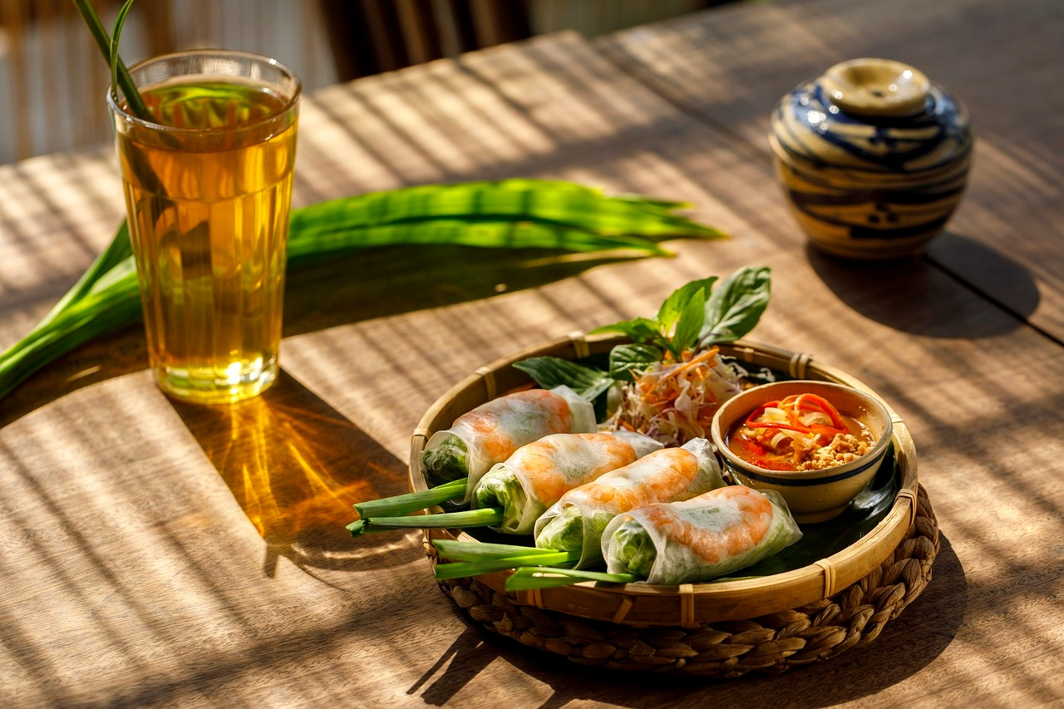
Exploring Culinary Cultures
A Journey Through Food, Identity, and Tradition

Slide 2
Table of contents
01
02
03
04
05
06
07
08
09
10
11
Title Slide: Culinary Cultures Unveiled
Lesson Overview: Key Objectives
What is Culinary Anthropology?
Global Food Systems: Mapping Cultural Food Exchanges
Food as Cultural Preservation: How Recipes Preserve Cultura…
Misconceptions About Cultural Foods: Myth-Busting Infograph…
Culinary Migration Case Studies: Interactive Exploration
Digital Mapping Activity: Technology Integration
Group Activity Guidelines: Cultural Cuisine Mapping Expedit…
Multimedia Research Project: Objectives and Guidelines
Assessment Strategies: Formative and Summative Assessment M…

Slide 3
Table of contents
12
13
14
15
16
17
18
19
20
Key Takeaways: Cultural Identity Through Cuisine
Resources and Further Exploration
Conclusion: Recap of Learning Journey
Credits and References
Design Recommendations
Technical Specifications
Additional Notes
Speaker Notes
Alt Text for Images

Slide 4
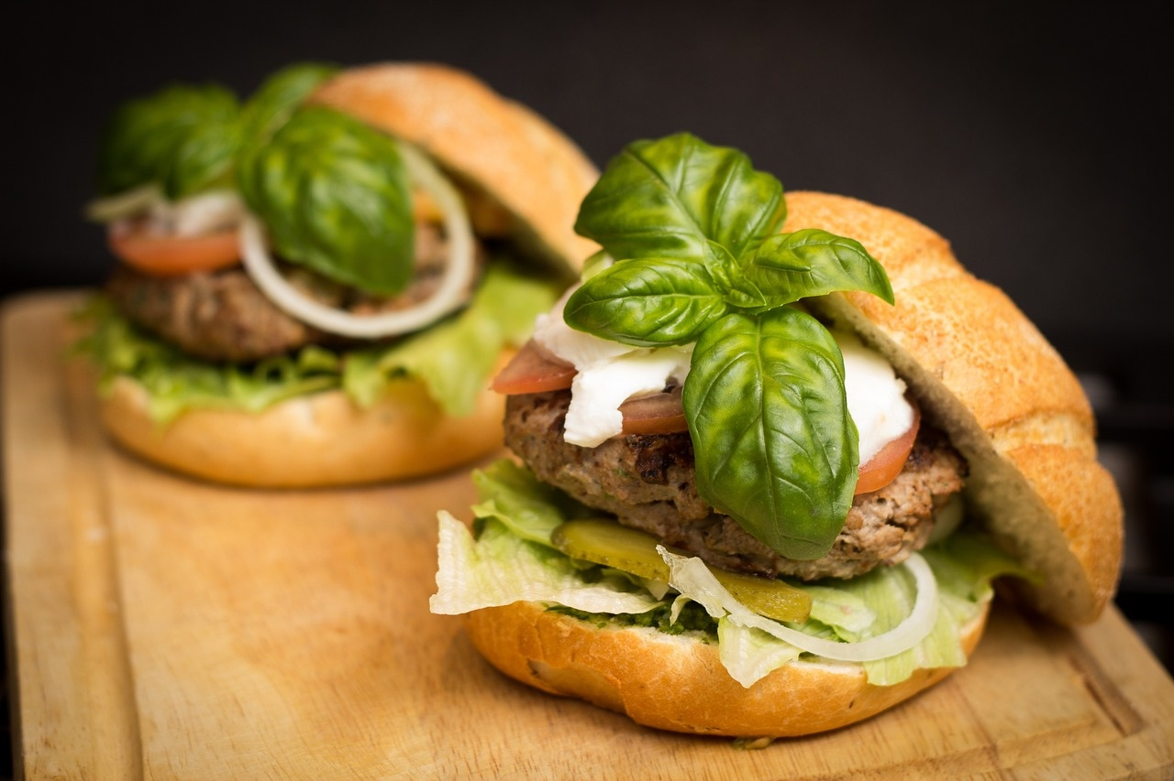
1
Title Slide: Culinary Cultures Unveiled
Culinary Cultures Unveiled
Subtitle: Exploring Global Identity Through Food
Visual: Collage of diverse global cuisines
Recommended Design: High-contrast colors, dyslexia-friendly font
Exploring Culinary Cultures

Slide 5

2
Lesson Overview: Key Objectives
Key Objectives
Analyze relationship between food and cultural identity
Develop critical thinking about global cultural diversity
Understand historical influences on culinary traditions
Exploring Culinary Cultures

Slide 6
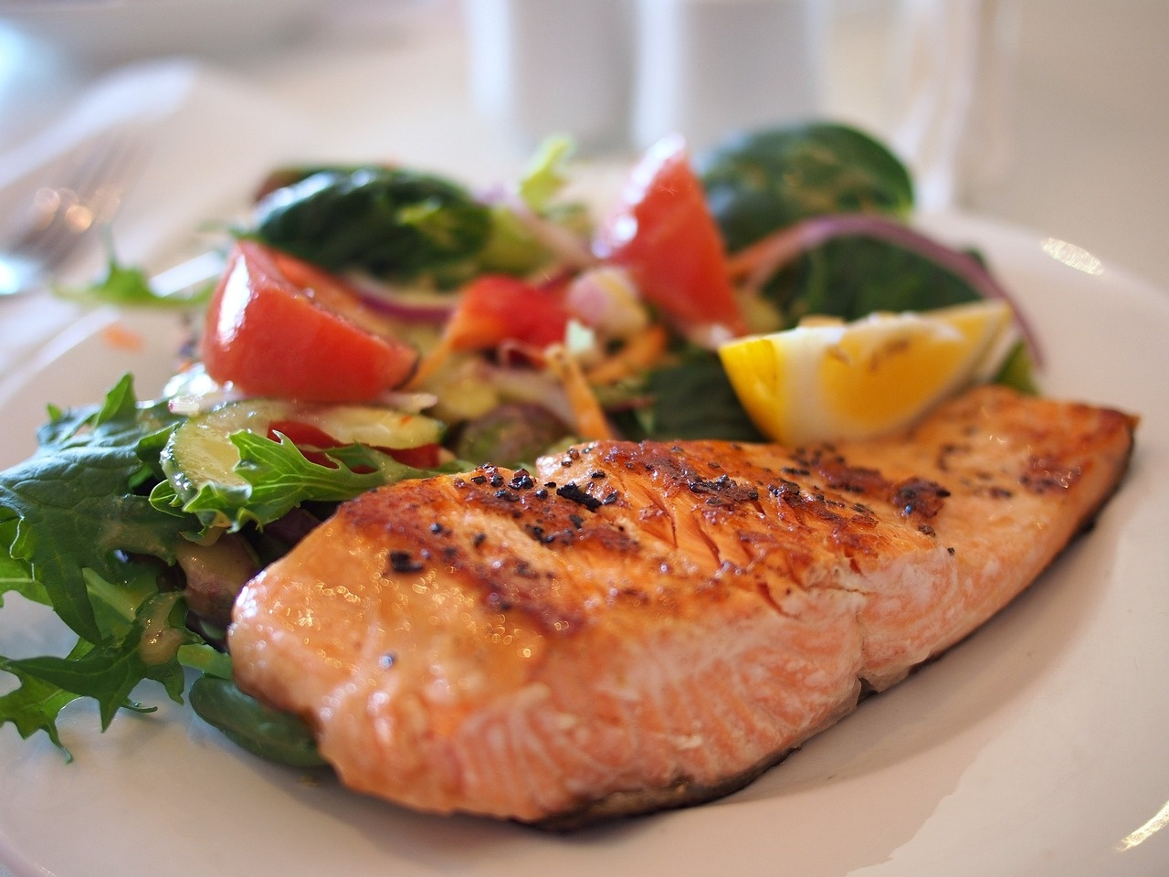
3
What is Culinary Anthropology?
01
Definition
02
Key Concepts
Scientific study of food's cultural significance
Food as a cultural narrative
Reflection of social structures
Historical migration documentation
03
Visual
Infographic showing food's cultural connections
Exploring Culinary Cultures

Slide 7

4
Global Food Systems: Mapping Cultural Food Exchanges
01
Trade routes
02
Colonial influences
Explore how spices, ingredients, and culinary techniques traveled across continents through ancient trade routes.
Understand the impact of colonization on food systems and the exchange of culinary traditions.
03
Cultural hybridization
Witness the fusion of diverse culinary practices leading to the creation of unique global cuisines.
Exploring Culinary Cultures

Slide 8
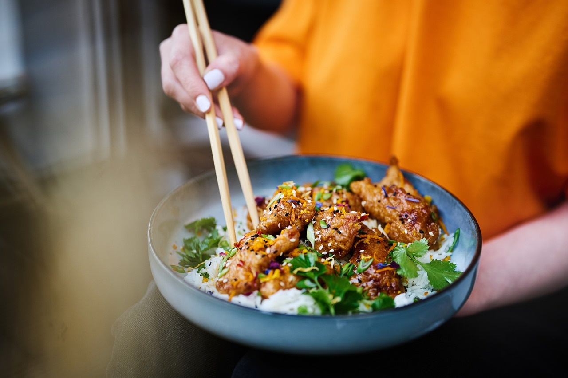
5
Food as Cultural Preservation: How Recipes Preserve Cultural Memory
01
Importance of Food in Cultural Preservation
02
Examples of Cultural Food Traditions
Food as a form of cultural identity
Recipes as a way to pass down traditions
Culinary practices reflecting historical and social contexts
Japanese Tea Ceremonies: Rituals around preparing and serving tea, Symbolism of each step in the ceremony
Mexican Corn Traditions: Importance of corn in Mexican cuisine, Traditional dishes like tamales and pozole
Ethiopian Communal Dining: Injera as a staple food, Sharing meals as a cultural practice
03
Visual Representation
Side-by-side images showcasing the diversity of cultural food traditions
Exploring Culinary Cultures

Slide 9
6
Misconceptions About Cultural Foods: Myth-Busting Infographics
Myth: Food is just nutrition
Myth: Cultural foods are static
Fact: Cultural foods hold deep symbolic meanings beyond mere sustenance.
Fact: Culinary traditions evolve over time, influenced by various factors.
Exploring Culinary Cultures

Slide 10

7
Culinary Migration Case Studies: Interactive Exploration
01
Spice Trade Routes
02
Corn's Global Journey
03
Tea's Cultural Transformation
Exploring Culinary Cultures

Slide 11
8
Digital Mapping Activity: Technology Integration
01
Objective
02
Tools
03
Highlighted Features
Track food origins
Understand cultural exchanges
Google Earth
Custom Mapping Platforms
Interactive mapping
Real-time data visualization
04
Benefits
05
Implementation
Enhances geographical awareness
Facilitates cross-cultural learning
Collaborative mapping projects
Virtual field trips
Exploring Culinary Cultures

Slide 12
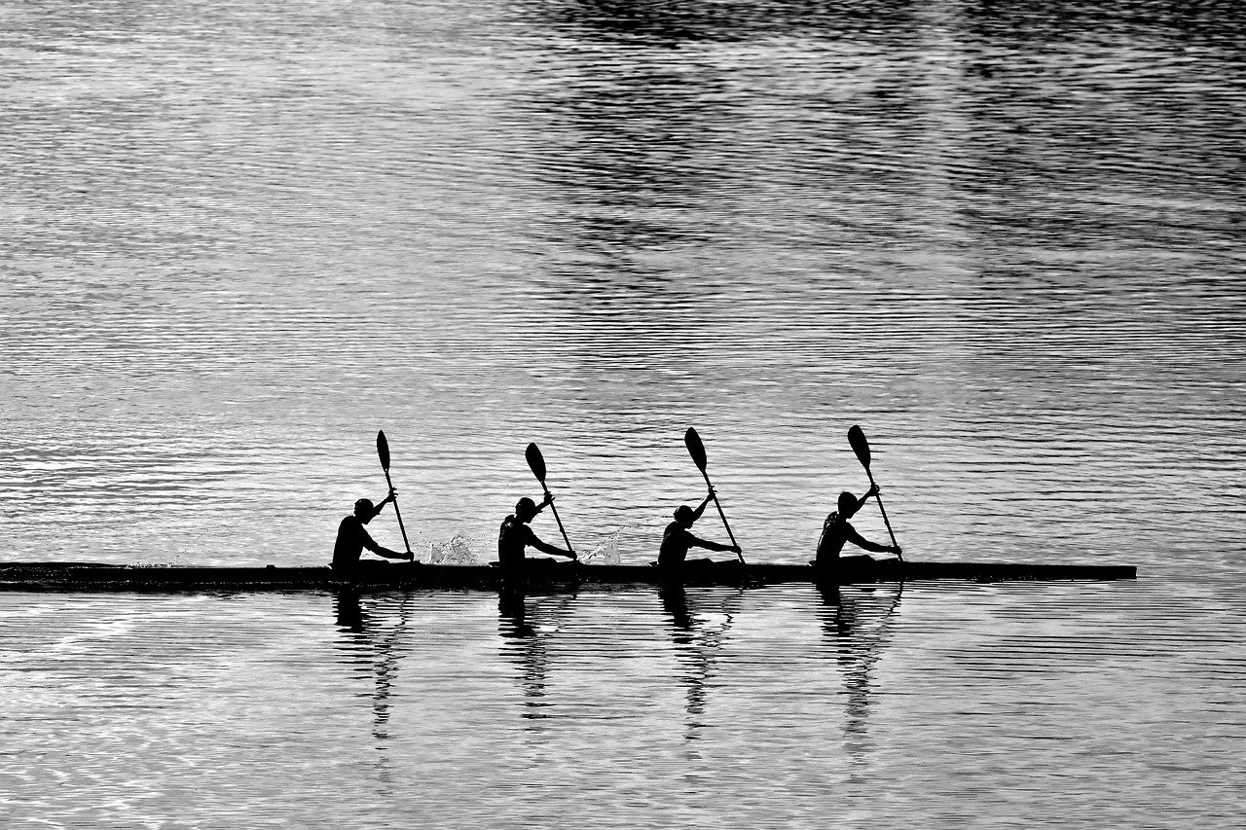
9
Group Activity Guidelines: Cultural Cuisine Mapping Expedition
01
Roles and Responsibilities
02
Assessment Criteria
Team Leader: Coordinates group activities and ensures tasks are completed on time.
Researcher: Conducts in-depth exploration of assigned cultural cuisines and traditions.
Presenter: Compiles findings and presents them to the group and class.
Recorder: Takes notes during discussions and documents key information.
Research Depth: Thorough exploration of cultural cuisines and their significance.
Collaboration: Effective teamwork and communication within the group.
Presentation Quality: Clear and engaging delivery of findings to the class.
Cultural Sensitivity: Respectful representation of diverse culinary traditions.
03
Collaborative Learning Strategies
Brainstorming Sessions: Generate ideas and plan research approach collectively.
Peer Review: Provide feedback on each other's work to enhance quality.
Group Discussions: Share insights and perspectives on cultural cuisine discoveries.
Delegation: Assign tasks based on individual strengths and interests for efficient progress.
Exploring Culinary Cultures

Slide 13

10
Multimedia Research Project: Objectives and Guidelines
01
Objective 1: Research Focus
02
Objective 2: Multimedia Creation
Explore diverse culinary traditions globally
Analyze the cultural significance of food
Develop a video documentary or digital presentation
Create interactive maps showcasing culinary diversity
03
Guidelines for Submission
04
Accessibility Accommodations
Ensure content reflects cultural authenticity
Include references and acknowledgments
Provide alternative formats for accessibility
Consider diverse learning needs in multimedia creation
Exploring Culinary Cultures

Slide 14

11
Assessment Strategies: Formative and Summative Assessment Methods
01
Formative Assessment
02
Summative Assessment
Ongoing feedback during the learning process
Helps identify areas for improvement
Examples: quizzes, peer assessments, class discussions
Evaluation of student learning at the end of a unit or course
Measures overall achievement
Examples: final exams, projects, presentations
Exploring Culinary Cultures

Slide 15
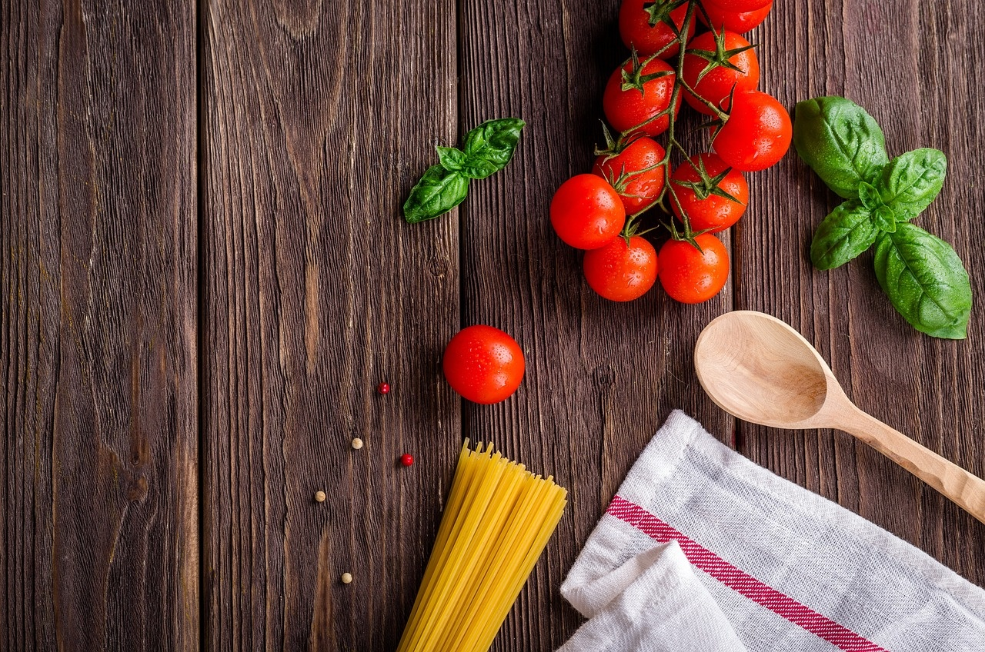
12
Key Takeaways: Cultural Identity Through Cuisine
01
Food as a Reflection of Cultural Identity
02
Interconnectedness of Global Food Systems
Cuisine serves as a powerful expression of cultural heritage.
Diverse flavors and cooking techniques showcase unique cultural identities.
Culinary traditions are influenced by historical exchanges and migrations.
Cultural hybridization leads to the evolution of global cuisines.
03
Preservation of Cultural Memory
04
Challenging Misconceptions
Traditional recipes and food rituals play a vital role in preserving cultural heritage.
Practices like Japanese tea ceremonies and Ethiopian communal dining reflect cultural values.
Cultural foods go beyond mere nutrition, embodying stories and traditions.
Cultures evolve, and culinary practices adapt over time, debunking the notion of static traditions.
Exploring Culinary Cultures

Slide 16

13
Resources and Further Exploration
01
Recommended Platforms
02
Research Databases
Online culinary courses
Food anthropology websites
Virtual cooking classes
Global food history archives
Cultural recipe repositories
Culinary anthropology journals
03
Digital Learning Tools
04
Community Engagement Opportunities
Food mapping apps
Virtual food tours
Cultural cooking blogs
Local food festivals
Cultural cooking workshops
Culinary heritage events
Exploring Culinary Cultures

Slide 17
14
Conclusion: Recap of Learning Journey
01
Explored the intricate relationship between food and cultural identity
02
Analyzed global food systems and cultural exchanges
03
Appreciated the role of recipes in preserving cultural memory
Recognized food as a powerful cultural narrative
Discovered how food reflects social structures and historical influences
Mapped out trade routes and colonial influences
Explored the concept of cultural hybridization through food
Examined examples like Japanese Tea Ceremonies and Ethiopian Communal Dining
Understood how food traditions contribute to cultural preservation
04
Debunked common misconceptions about cultural foods
05
Explored culinary migration through case studies
Clarified that food is more than just nutrition
Highlighted the dynamic nature of cultural foods and the diversity of global culinary practices
Traced the spice trade routes, corn's global journey, and tea's cultural transformation
Visualized the interconnectedness of culinary traditions through animated migration paths
Exploring Culinary Cultures

Slide 18
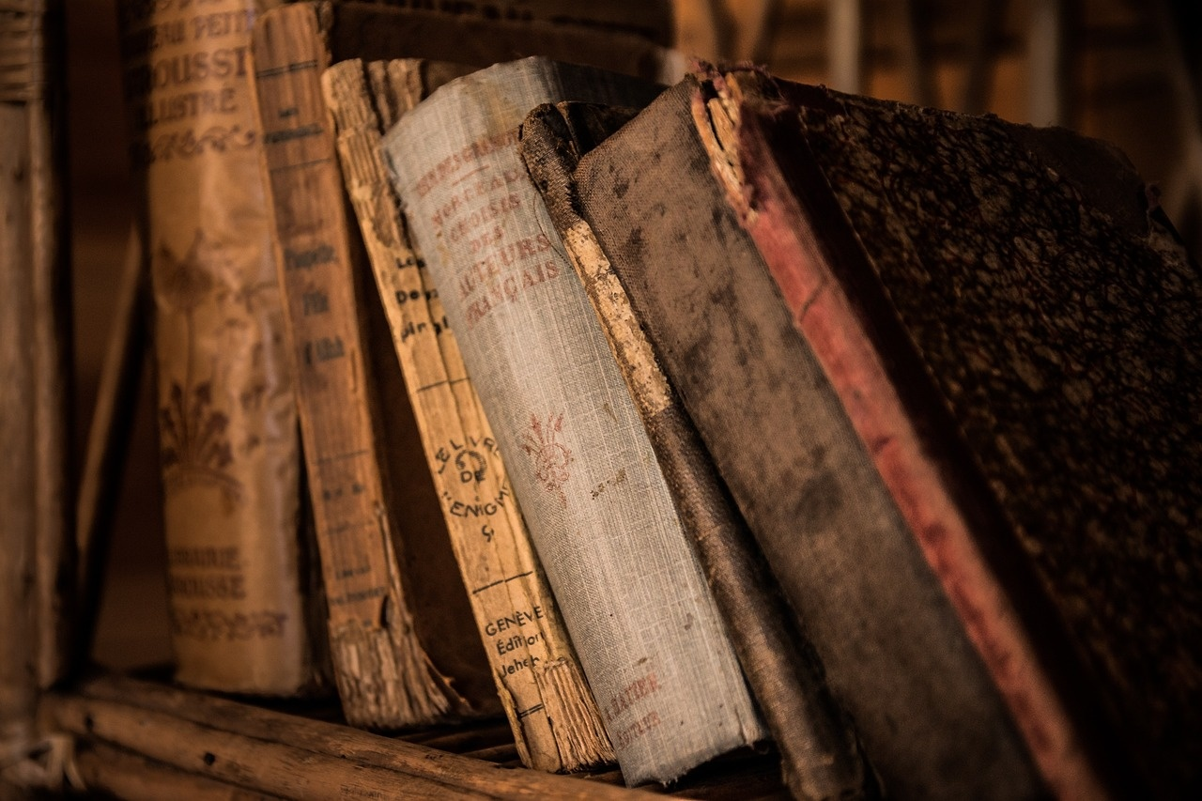
15
Credits and References
01
Acknowledgments
02
Research Sources
Special thanks to [Name], Culinary Anthropologist, for expert insights.
Gratitude to [Name], Food Historian, for valuable contributions.
"Culinary Anthropology: Exploring Food and Culture" by [Author]
"Global Food Systems: A Historical Perspective" by [Author]
03
Image Credits
04
Contact Information
Images sourced from Shutterstock and Unsplash.
Icons used from Flaticon and Freepik.
Email: info@culinaryculturesunveiled.com
Website: www.culinaryculturesunveiled.com
Exploring Culinary Cultures

Slide 19
16
Design Recommendations
01
Font Selection
02
Color Scheme
03
Text Usage
Use OpenDyslexic or Arial fonts for improved readability.
Opt for high-contrast colors to enhance visual appeal and accessibility.
Keep text minimal on each slide to maintain audience engagement.
04
Visual Elements
05
Consistent Design
Incorporate large, clear visuals to support understanding and retention.
Maintain a cohesive design language throughout the presentation for a professional look.
Exploring Culinary Cultures

Slide 20

17
Technical Specifications
Technical Specifications
Software: PowerPoint or Google Slides
Compatibility: Multiple export formats supported
Accessibility Features: Screen reader compatible
Multimedia Integration: Video and audio support
Exploring Culinary Cultures

Slide 21
18
Additional Notes
01
Speaker Notes
02
Alt Text for Images
03
Companion PDF Version
Include key talking points for each slide to guide the presenter.
Alt text should be descriptive and concise to ensure accessibility for visually impaired audiences.
Maintain the same content structure as the PowerPoint presentation for consistency.
04
Facilitator's Guide
05
Multimedia Integration
Provide detailed instructions on how to deliver the presentation effectively.
Ensure that all multimedia elements are integrated seamlessly for a dynamic learning experience.
Exploring Culinary Cultures

Slide 22
19
Speaker Notes
01
Welcome
02
Introduction
03
Food as a Narrative
Welcome everyone to our presentation on 'Exploring Culinary Cultures.'
Today, we will delve into the fascinating world of food and its deep connections to cultural identity.
As we explore various culinary traditions, keep in mind how food serves as a powerful narrative of our shared histories.
04
Journey
05
Engagement
Let's embark on this journey together to uncover the rich tapestry of global cuisines and the stories they tell.
Feel free to ask questions and engage with the material as we navigate through different culinary cultures.
Exploring Culinary Cultures

Slide 23
20
Alt Text for Images
01
Collage of Diverse Global Cuisines
02
Infographic on Cultural Connections of Food
03
Interactive World Map
Showcasing a variety of dishes from different cultures.
Food as a narrative.
Reflection of social structure.
Documentation of historical migration.
Displaying cultural food exchanges through trade routes, colonial influences, and hybridization.
04
Side-by-Side Cultural Food Practices
05
Myth-Busting Infographics
Japanese Tea Ceremonies.
Mexican Corn Traditions.
Ethiopian Communal Dining.
Examples of how recipes preserve cultural memory.
Debunking common misconceptions about cultural foods.
Clear, color-coded explanations.
Exploring Culinary Cultures

