Slide 1


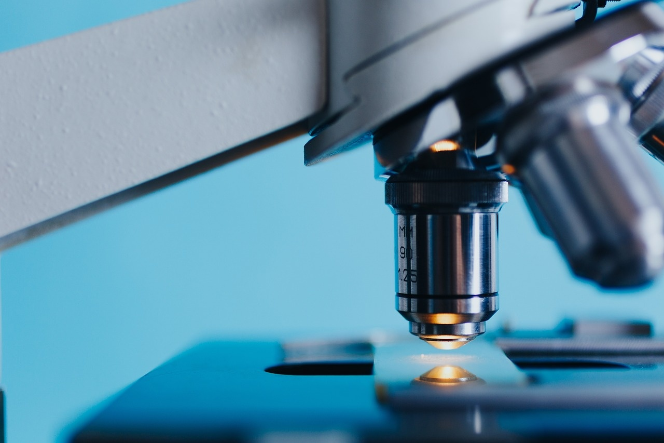
Exploring Science: A Comprehensive Curriculum
Unveiling the Wonders of Scientific Inquiry and Investigation

Slide 2
TABLE OF
CONTENTS
Curriculum Overview
Vision and Framework
Curriculum Strands and Global Contexts
Scientific Inquiry and Investigation
Scientific Processes and Skills
Unit Breakdown
Unit 1: Introduction to Scientific Methodology
Unit 2: Living Systems
Duration: 8 weeks
Essential Questions
Learning Objectives
Global Context
Key Concepts
Fundamental Skills
Observation
01
02
03
04
05
06
07
08
09
10
11
12
13
14
15

Slide 3
TABLE OF
CONTENTS
Data collection
Experimental design
Critical analysis
Systems
Models
Interactions
Introduction to Scientific Methodology
How do scientists investigate the natural world?
What makes a valid scientific investigation
Develop basic laboratory skills
Understand scientific method
Create and interpret scientific models
16
17
18
19
20
21
22
23
24
25
26
27

Slide 4
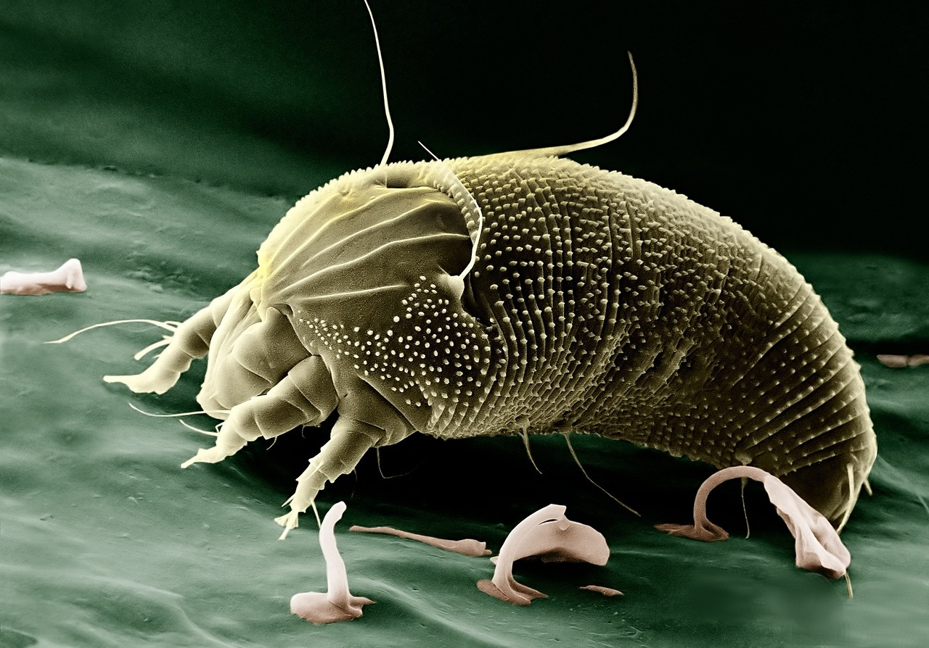
Exploring Science: A Comprehensive Curriculum
Curriculum Overview
Scientific Inquiry and Investigation
Scientific Processes and Skills
Global Context: Orientation in Space and Time
Key Concepts: Systems, Models, Interactions
Fundamental Skills: Observation, Data collection, Experimental design, Critical analysis

Slide 5

Exploring Science: A Comprehensive Curriculum
Vision and Framework
Vision and Framework
Curriculum Strands and Global Contexts
Scientific Processes and Skills
Curriculum Model: International Baccalaureate Middle Years Programme (IB MYP)
Grade Level: MYP Year 1
Disciplinary Focus: Integrated Science Approach
Scientific Inquiry and Investigation
Global Context: Orientation in Space and Time
Key Concepts: Systems, Models, Interactions
Fundamental Skills: Observation, Data collection, Experimental design, Critical analysis

Slide 6
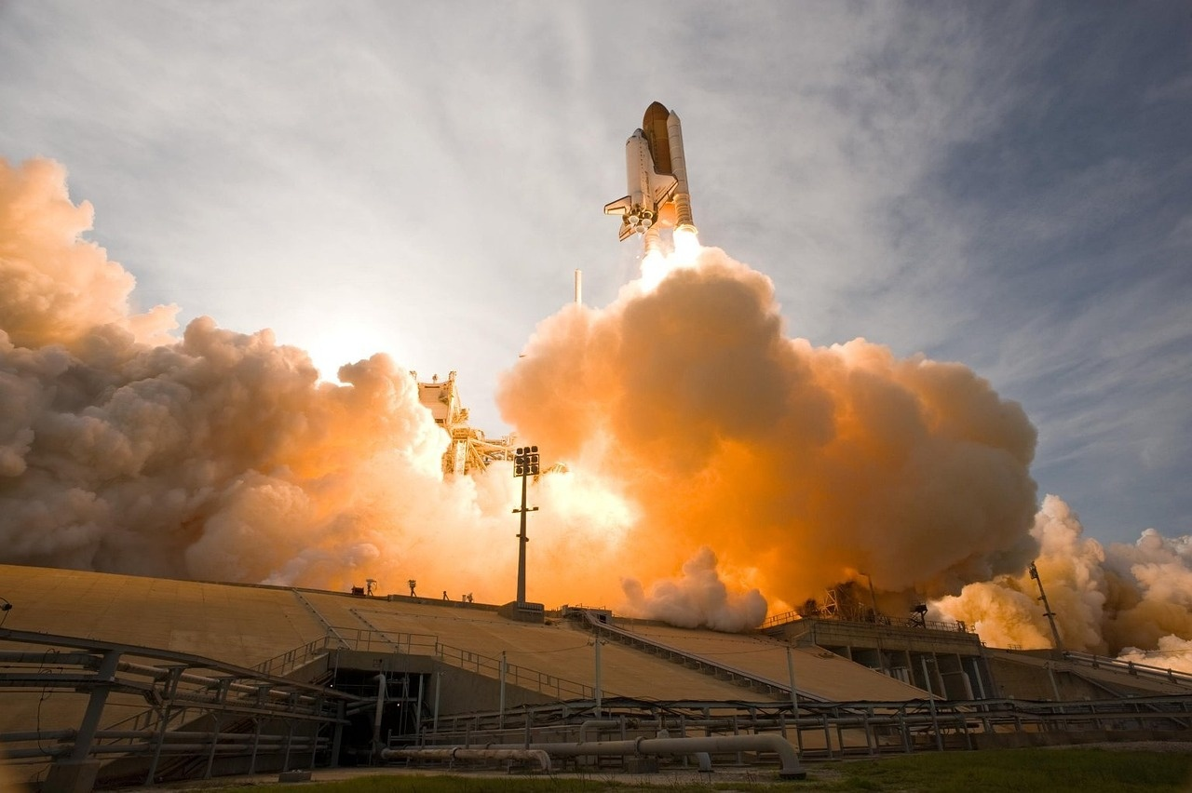
Exploring Science: A Comprehensive Curriculum
Curriculum Strands and Global Contexts
Scientific Inquiry and Investigation
Scientific Processes and Skills
Global Context: Orientation in Space and Time
Key Concepts: Systems, Models, Interactions
Fundamental Skills: Observation, Data collection, Experimental design, Critical analysis

Slide 7

Exploring Science: A Comprehensive Curriculum
Scientific Inquiry and Investigation
Global Context
Orientation in Space and Time
Key Concepts
Systems
Models
Interactions

Slide 8




Exploring Science: A Comprehensive Curriculum
Scientific Processes and Skills
Observation
Data collection
Experimental design
Critical analysis
The act of noting and recording phenomena as they occur in nature.
Involves using the senses or instruments to gather information.
Systematic gathering of information for analysis.
Can be qualitative or quantitative.
Planning experiments to test hypotheses.
Includes selecting variables, controls, and methods.
Evaluating data and results to draw conclusions.
Involves statistical analysis and logical reasoning.

Slide 9


Exploring Science: A Comprehensive Curriculum
Unit Breakdown
Unit 1: Introduction to Scientific Methodology
Duration: 8 weeks
Essential Questions: How do scientists investigate the natural world? What makes a valid scientific investigation?
Learning Objectives: Develop basic laboratory skills, Understand scientific method, Create and interpret scientific models

Slide 10
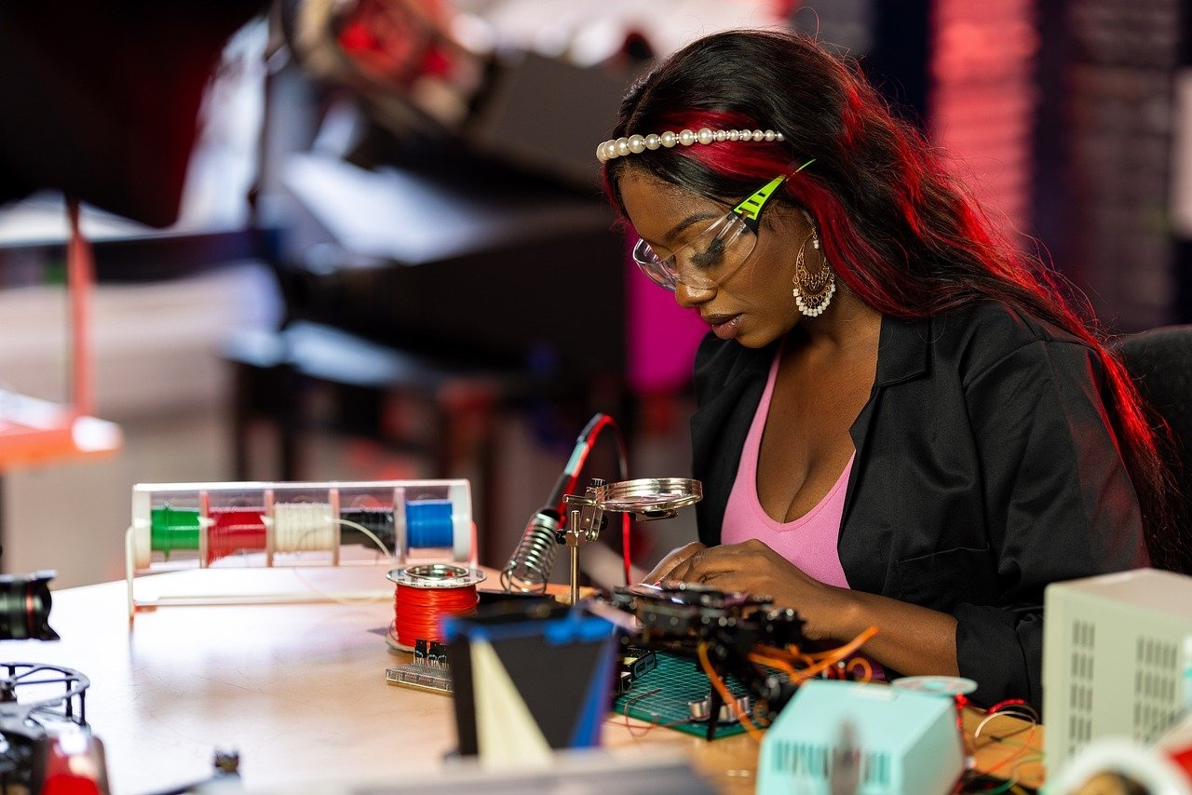
Exploring Science: A Comprehensive Curriculum
Unit 1: Introduction to Scientific Methodology
Unit 1: Introduction to Scientific Methodology
Essential Questions
Learning Objectives
Duration: 8 weeks
How do scientists investigate the natural world?
What makes a valid scientific investigation?
Develop basic laboratory skills
Understand scientific method
Create and interpret scientific models

Slide 11
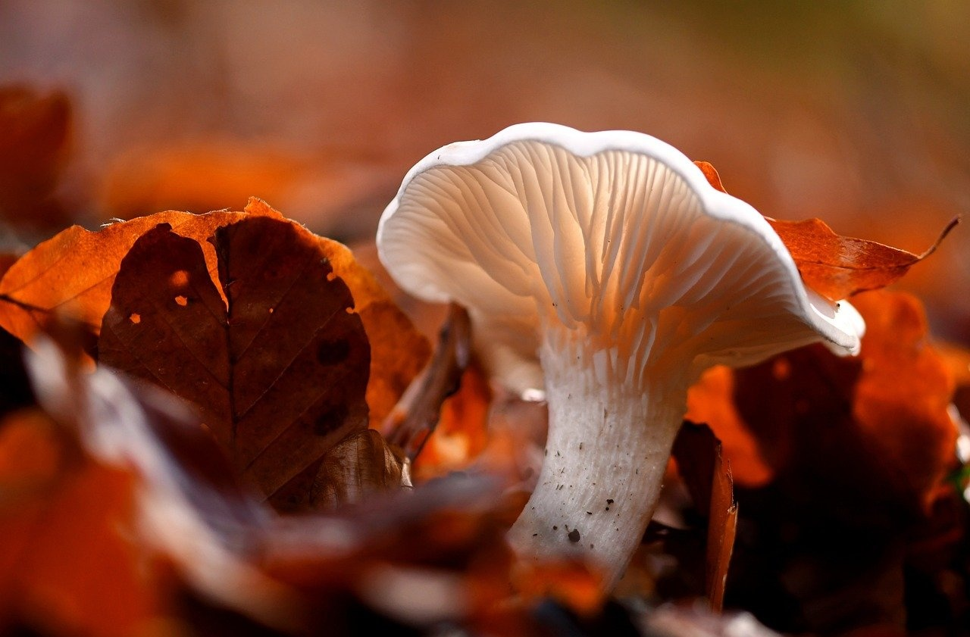
Exploring Science: A Comprehensive Curriculum
Unit 2: Living Systems
Unit Focus
Duration
Explore the characteristics and functions of living organisms
Investigate the interactions within ecosystems
10 weeks
Essential Questions
Learning Objectives
How do living systems maintain balance and adapt to changes?
What are the interdependencies within ecosystems?
Identify the components of living systems
Analyze the roles of organisms within ecosystems
Understand the impact of human activities on living systems

Slide 12
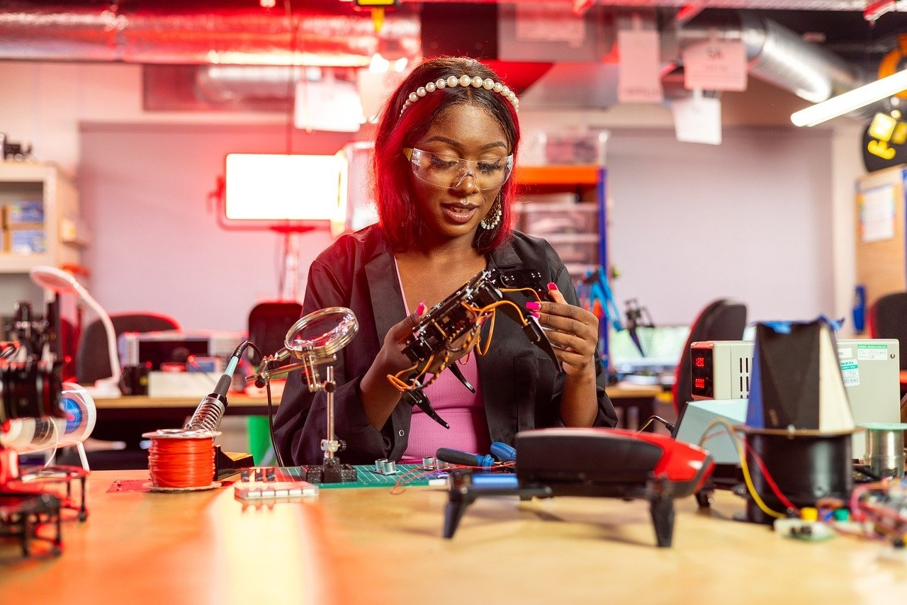
Exploring Science: A Comprehensive Curriculum
Duration: 8 weeks
Unit 1: Introduction to Scientific Methodology
Essential Questions: How do scientists investigate the natural world? What makes a valid scientific investigation?
Learning Objectives: Develop basic laboratory skills, Understand scientific method, Create and interpret scientific models

Slide 13
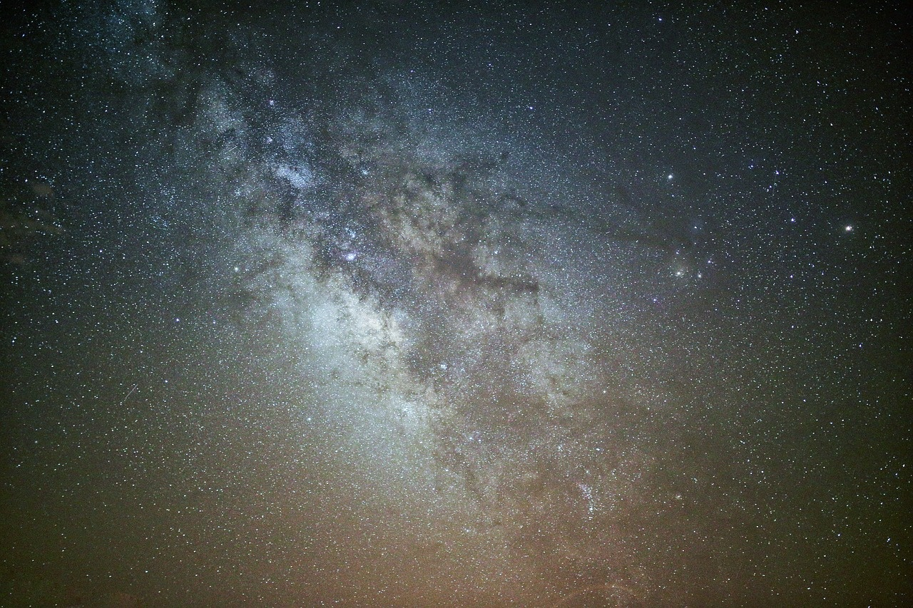
Exploring Science: A Comprehensive Curriculum
Essential Questions
Investigating the Natural World
Valid Scientific Investigation
Observation: Scientists use their senses to gather information about the natural world.
Hypothesis: They propose explanations based on observations.
Experimentation: Conduct experiments to test hypotheses.
Data Collection: Gather and analyze data from experiments.
Conclusion: Draw conclusions based on data analysis.
Testable Hypothesis: The hypothesis must be testable and falsifiable.
Controlled Variables: Control variables to ensure accurate results.
Repeatability: Experiments should be repeatable by other scientists.
Peer Review: Results should be reviewed by the scientific community.
Evidence-Based: Conclusions must be based on empirical evidence.

Slide 14
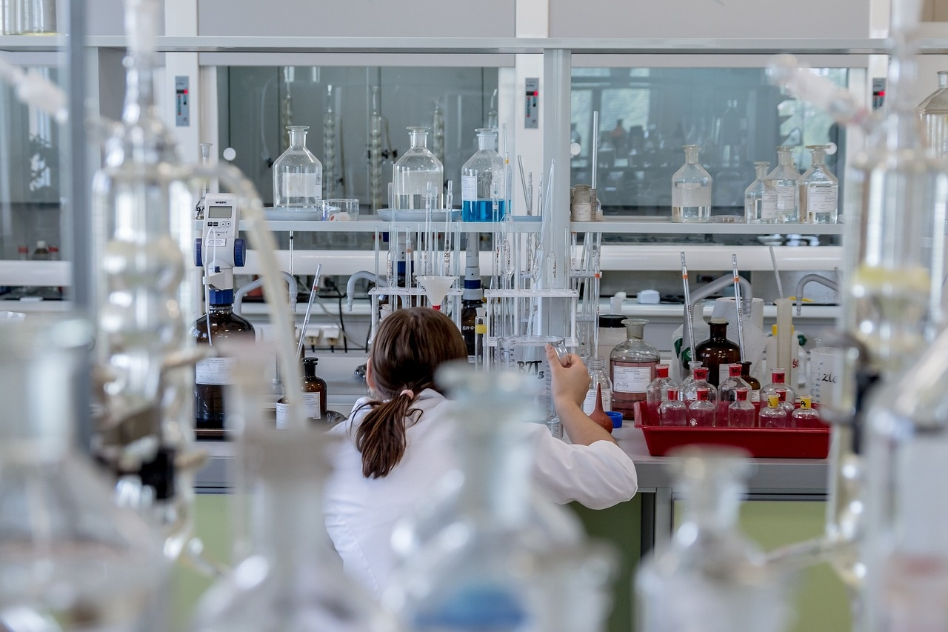
Exploring Science: A Comprehensive Curriculum
Learning Objectives
Develop basic laboratory skills
Understand scientific method
Create and interpret scientific models
Learn proper lab safety protocols
Understand how to use lab equipment
Practice accurate measurement techniques
Formulate hypotheses
Design and conduct experiments
Analyze and interpret data
Develop theoretical models
Use models to make predictions
Compare models with experimental data

Slide 15

Exploring Science: A Comprehensive Curriculum
Global Context
Orientation in Space and Time
Understanding the interconnectedness of systems
Exploring models to represent scientific phenomena
Analyzing interactions within different environments
Relevance to Real-World Applications
Applying scientific inquiry to historical events
Investigating how scientific processes shape our understanding of the universe
Recognizing the impact of scientific discoveries on society
Cultural Perspectives
Examining how different cultures approach scientific inquiry
Considering the influence of cultural beliefs on scientific practices
Exploring the role of diversity in shaping scientific knowledge

Slide 16

Exploring Science: A Comprehensive Curriculum
Key Concepts
Systems
Models
Interactions
A set of interacting or interdependent components forming an integrated whole.
Examples include ecosystems, computer systems, and social systems.
Simplified representations of reality used to understand, explain, or predict complex phenomena.
Examples include mathematical models, physical models, and conceptual models.
The ways in which the components of a system influence one another.
Examples include predator-prey relationships, user interactions with software, and economic transactions.

Slide 17
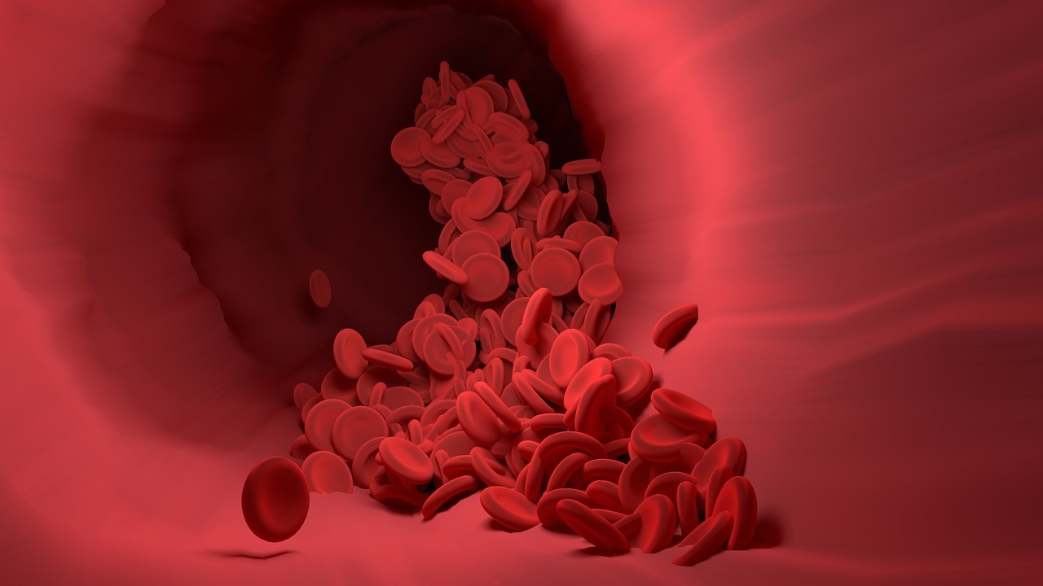
Exploring Science: A Comprehensive Curriculum
Fundamental Skills
Observation
Data collection
Experimental design
Critical analysis

Slide 18

Exploring Science: A Comprehensive Curriculum
Observation
Observation in Science
Purpose of Observation
Types of Observations
Importance of Accurate Observation
Developing Observation Skills
Observation is a fundamental skill in scientific inquiry.
To gather data and information about the natural world.
Qualitative observations: Descriptions without numerical data.
Quantitative observations: Measurements and numerical data.
Accurate observations are crucial for forming hypotheses and conducting experiments.
Practice and training can enhance observation skills over time.

Slide 19
Exploring Science: A Comprehensive Curriculum
Data collection
Observation
Data Collection
Experimental Design
Critical Analysis
Description: The act of carefully watching and noting details in order to gather information.
Importance: Forms the foundation for further scientific inquiry and investigation.
Definition: The process of gathering and recording information or evidence for analysis.
Methods: Utilizing tools such as sensors, surveys, and experiments to collect data accurately.
Purpose: Structuring experiments to ensure reliable and valid results.
Components: Variables, controls, and procedures play a crucial role in experimental design.
Definition: Evaluating data and information to draw meaningful conclusions.
Skills: Developing the ability to assess the validity and reliability of collected data.

Slide 20
Exploring Science: A Comprehensive Curriculum
Experimental design
Identifying Variables
Controlled Variables
Hypothesis Development
Experimental Procedure
Data Analysis
Independent variable: The factor that is intentionally changed in an experiment.
Dependent variable: The factor that is measured or observed as a result of the changes made to the independent variable.
Factors that are kept constant throughout the experiment to ensure that the only thing affecting the dependent variable is the independent variable.
A testable prediction about the relationship between the independent and dependent variables based on prior knowledge or research.
Step-by-step instructions outlining how the experiment will be conducted, including materials needed, data collection methods, and safety precautions.
Organizing and interpreting the data collected during the experiment to draw conclusions about the hypothesis.

Slide 21
Exploring Science: A Comprehensive Curriculum
Critical analysis
Observation
Data Collection
Experimental Design
Critical Analysis
Students will learn to make detailed observations during experiments.
Emphasis will be placed on accurate data collection techniques to ensure reliable results.
Understanding how to design experiments effectively to test hypotheses.
Developing the ability to critically analyze experimental results and draw meaningful conclusions.

Slide 22

Exploring Science: A Comprehensive Curriculum
Systems
Definition
A system is a set of interconnected components working together to achieve a specific function or goal.
Characteristics
Interdependence: Components rely on each other.
Boundaries: Systems have defined borders separating them from their environment.
Feedback: Systems receive and respond to input.
Types of Systems
Open Systems: Exchange matter and energy with the environment.
Closed Systems: Do not exchange matter with the environment but can exchange energy.
Isolated Systems: Do not exchange matter or energy with the environment.
Examples
Ecosystems: Interconnected relationships between living organisms and their environment.
Circulatory System: Organs and vessels working together to transport blood throughout the body.
Solar System: Sun, planets, and other celestial bodies orbiting around the sun.
Note
Understanding systems is crucial in science as it helps analyze complex interactions and phenomena.

Slide 23
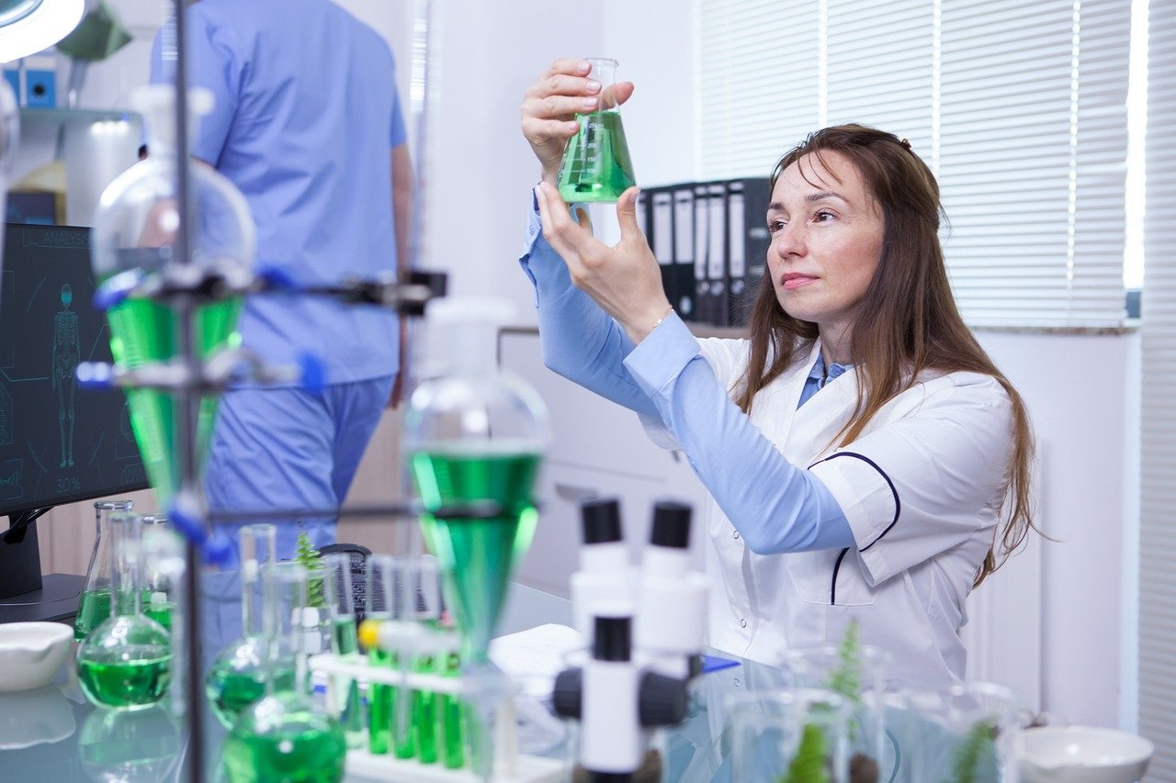
Exploring Science: A Comprehensive Curriculum
Models
Scientific Models
Types of Models
Representations of real-world phenomena
Used to explain, predict, and understand natural processes
Physical models: tangible representations
Conceptual models: theoretical frameworks
Mathematical models: equations and formulas
Importance of Models
Examples of Scientific Models
Aid in visualization and conceptualization
Facilitate communication and collaboration in science
Solar system model for planetary motion
DNA double helix model for genetic structure

Slide 24
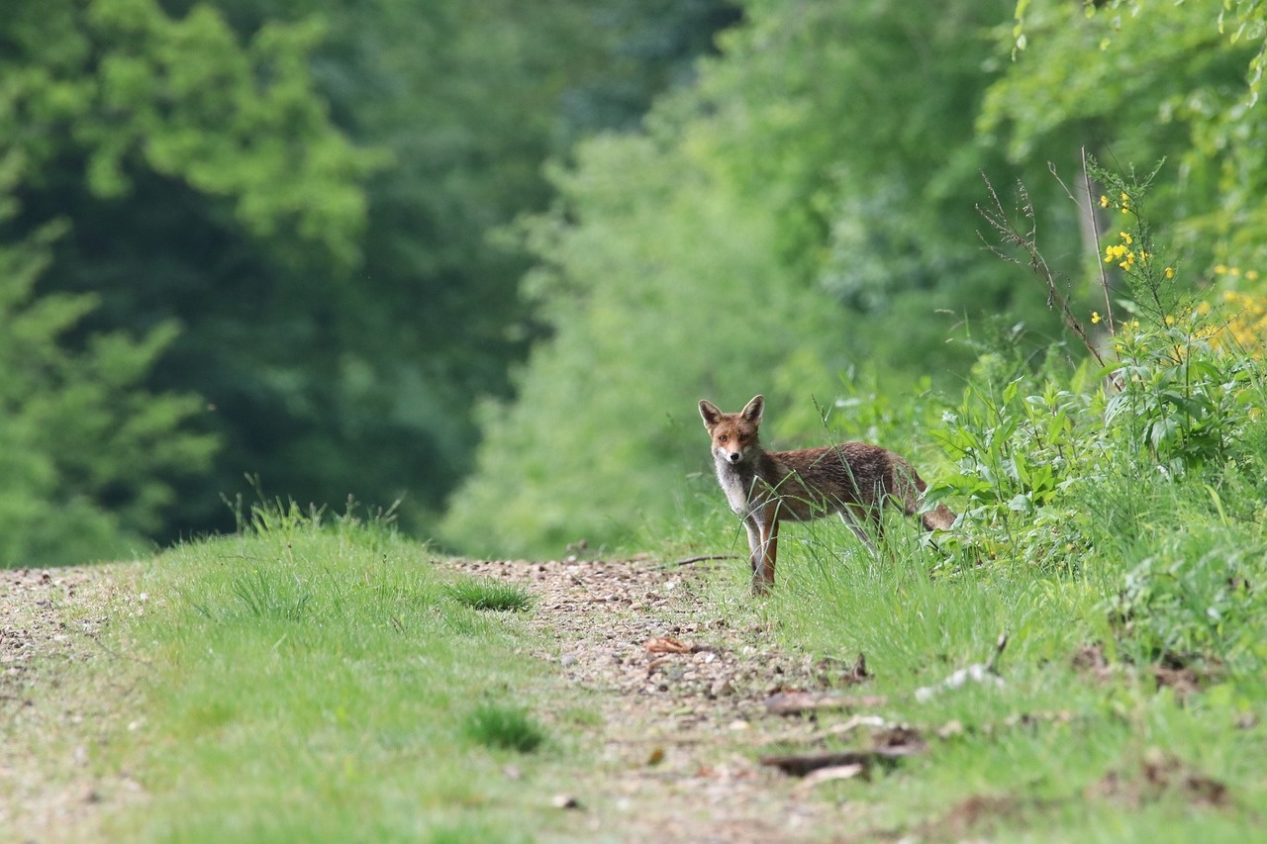
Exploring Science: A Comprehensive Curriculum
Interactions
Systems Interactions
Model Interactions
Interactions in Ecosystems
Systems within living organisms interact to maintain homeostasis.
Examples include the respiratory and circulatory systems working together to deliver oxygen to cells.
Models are used to represent interactions between variables in scientific investigations.
Scientists use models to simulate complex interactions in natural phenomena.
Interactions between organisms in an ecosystem determine the balance of the ecosystem.
Predation, competition, and symbiosis are examples of interactions in ecosystems.

Slide 25

Exploring Science: A Comprehensive Curriculum
Introduction to Scientific Methodology
Curriculum Model
International Baccalaureate Middle Years Programme (IB MYP)
Grade Level
MYP Year 1
Disciplinary Focus
Integrated Science Approach

Slide 26
Exploring Science: A Comprehensive Curriculum
How do scientists investigate the natural world?
Observation
Hypothesis Formation
Experimentation
Data Collection
Analysis and Interpretation
Scientists carefully observe natural phenomena to gather information and identify patterns.
Based on observations, scientists formulate educated guesses or hypotheses to explain the observed phenomena.
Scientists design experiments to test their hypotheses and gather empirical evidence.
During experiments, scientists collect data through measurements and observations to analyze and draw conclusions.
Scientists critically analyze the collected data to draw meaningful conclusions and interpret the results.

Slide 27
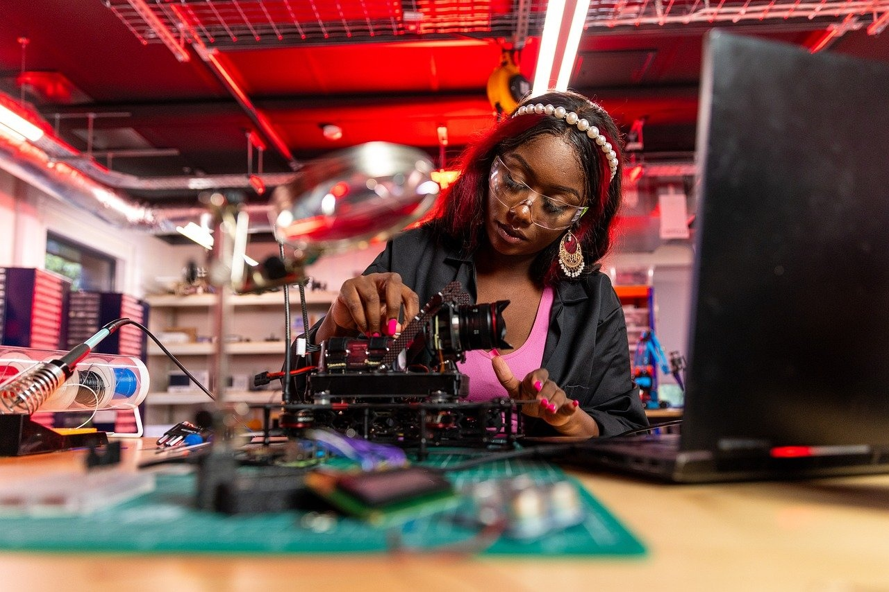
Exploring Science: A Comprehensive Curriculum
What makes a valid scientific investigation
Clear Research Question
A valid scientific investigation starts with a well-defined research question that can be tested through experimentation.
Controlled Variables
Ensuring that all variables, except the one being tested, are kept constant to accurately measure the impact of the independent variable.
Reproducibility
The ability for other scientists to replicate the experiment and achieve similar results, indicating the reliability of the investigation.
Data Collection Methods
Using appropriate methods to collect data, such as quantitative measurements or qualitative observations, to support the conclusions drawn.
Peer Review
Subjecting the investigation to scrutiny by other experts in the field to validate the methodology and findings.

Slide 28
Exploring Science: A Comprehensive Curriculum
Develop basic laboratory skills
Introduction to Laboratory Equipment
Safety Protocols
Measurement Techniques
Experimental Design
Data Collection and Analysis
Familiarize students with common laboratory tools such as microscopes, beakers, test tubes, and pipettes.
Teach students proper safety procedures including handling chemicals, using protective gear, and emergency protocols.
Train students on accurate measurement techniques using graduated cylinders, balances, and rulers.
Guide students in designing experiments, identifying variables, and developing hypotheses.
Instruct students on recording observations, organizing data, and analyzing results to draw conclusions.

Slide 29
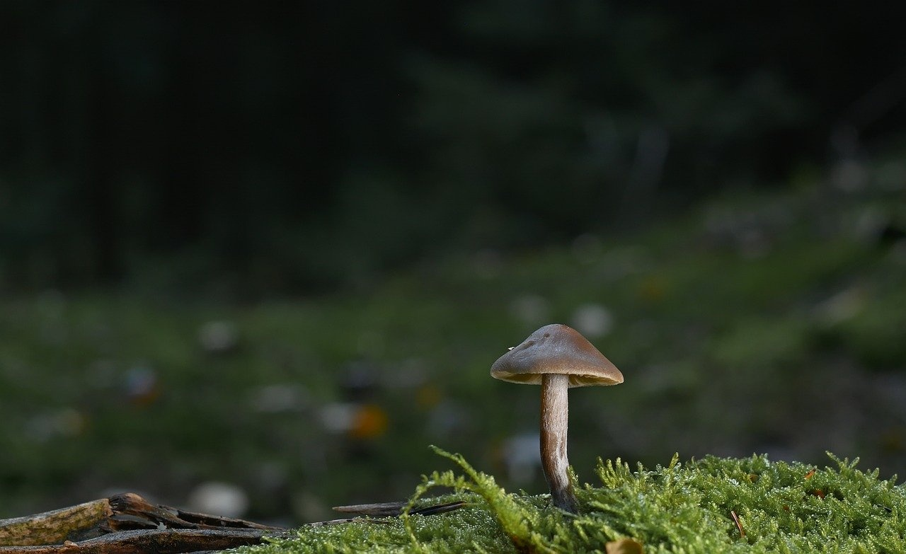
Exploring Science: A Comprehensive Curriculum
Understand scientific method
Definition
The systematic approach used by scientists to investigate natural phenomena and acquire knowledge.
Key Steps
Observation: Noticing and describing a phenomenon.
Question: Formulating a question based on the observation.
Hypothesis: Proposing a testable explanation for the phenomenon.
Experiment: Designing and conducting experiments to test the hypothesis.
Analysis: Collecting and analyzing data to draw conclusions.
Conclusion: Reflecting on the results and communicating findings.
Importance
Ensures systematic and reliable results.
Fosters critical thinking and problem-solving skills.
Forms the basis for scientific discoveries and advancements.
Application
Used across various scientific disciplines, from biology to physics.
Guides research in fields such as medicine, environmental science, and technology.
Remember
Understanding the scientific method is essential for conducting valid and impactful scientific investigations.

Slide 30

Exploring Science: A Comprehensive Curriculum
Create and interpret scientific models
Developing Models
Utilize scientific data to construct accurate models.
Incorporate key concepts of systems, models, and interactions into model creation.
Interpreting Models
Analyze and interpret scientific models to draw conclusions.
Evaluate the effectiveness of models in representing real-world phenomena.
Application in Unit 1
In Unit 1: Introduction to Scientific Methodology
Students will create models to visualize scientific concepts.
Models will aid in understanding the scientific method and experimental design.
Enhancing Understanding
Models serve as tools for simplifying complex scientific ideas.
Encourage students to refine and improve models based on new information.
Key Takeaway
Developing and interpreting scientific models is essential for understanding and explaining natural phenomena effectively.

