Slide 1


Understanding Human Development Across the Lifespan
Insights and Applications of Developmental Psychology in Personal and Professional Growth

Slide 2
Table of Contents
Introduction to Developmental Psychology
Key Stages of Human Development
Applications of Developmental Psychology
Career Development and Developmental Psychology
Resources from the American Psychological Asso…
Real-World Example: Grit and Perseverance
Multiple Choice Questions
Engaging Activity 1: Case Study Analysis
Engaging Activity 2: Career Development Worksh…
Engaging Activity 3: Group Discussion
Conclusion
References
Next Steps
03
04
05
06
07
08
09
10
11
12
13
14
15

Slide 3

Introduction to Developmental Psychology
Scope of Developmental Psychology
Importance of Understanding Development
Lifespan Perspective
Developmental psychology is the study of human development across the lifespan.
It examines the cognitive, social, and emotional changes that occur from infancy to old age.
Understanding developmental psychology is essential for making informed decisions about personal and professional relationships.
It also aids in career choices and strategies for personal growth and development.
Developmental psychology provides insights into changes that occur throughout a person's life.
This perspective helps in understanding the interconnectedness of various life stages.
3
Understanding Human Development Across the Lifespan

Slide 4
Key Stages of Human Development
Infancy: Building Trust
Childhood: Learning and Socializing
Adolescence: Shaping Identity
Adulthood: Finding Purpose
Infancy (0-1 year): basic trust and attachment to caregivers.
This stage lays the foundation for emotional security and relationships.
Childhood (1-12 years): language and social skills development.
This period is crucial for cognitive growth and forming friendships.
Adolescence (12-18 years): identity formation and independence.
Teenagers explore their individuality and establish personal values.
Adulthood (18+ years): development of a sense of purpose and meaning.
This stage involves contributing to society and achieving personal goals.
4
Understanding Human Development Across the Lifespan

Slide 5

Applications of Developmental Psychology
Education
Healthcare
Business
Informing teaching methods and curriculum design.
Enhancing learning experiences tailored to developmental stages.
Developing interventions and treatments for individuals at different stages of development.
Promoting mental and physical well-being across the lifespan.
Informing human resource management and organizational development.
Optimizing workplace dynamics through understanding developmental needs.
5
Understanding Human Development Across the Lifespan

Slide 6

Career Development and Developmental Psychology
Developmental Psychology Insights
Career development is the process of choosing and pursuing a career.
It involves making decisions and setting goals to achieve professional growth.
Developmental Psychology Insights
Developmental psychology provides a framework for understanding the cognitive, social, and emotional changes that occur across the lifespan.
These insights help individuals navigate personal and professional growth effectively.
Informed Career Choices
By understanding developmental changes, individuals can make informed decisions about their career choices.
This knowledge enables them to develop strategies for achieving their career goals.
6
Understanding Human Development Across the Lifespan

Slide 7

Resources from the American Psychological Association
APA Website Resources
PsycNet Database
The APA website (https://www.apa.org) provides a wealth of resources on developmental psychology, including articles, research papers, and videos.
It serves as a comprehensive platform for accessing information related to various aspects of psychology.
The APA's PsycNet database contains a vast collection of articles, books, and other publications on psychology.
This database is an essential tool for researchers and students seeking in-depth psychological studies and materials.
7
Understanding Human Development Across the Lifespan

Slide 8

Real-World Example: Grit and Perseverance
Real-World Example: Grit and Perseverance
Watch the TED Talk by Dr. Angela Duckworth on "Grit: The power of passion and perseverance"
(https://www.ted.com/talks/angela_lee_duckworth_grit_the_power_of_passion_and_perseverance)
8
Understanding Human Development Across the Lifespan

Slide 9

Multiple Choice Questions
Introduction to Developmental Psychology
Key Question in Developmental Psychology
Multiple Choice Options
Developmental psychology focuses on understanding human growth and changes.
It spans across the entire lifespan, from infancy to old age.
What is the primary focus of developmental psychology?
This question helps in understanding the scope of the field.
The options include studying abnormal behavior, human development, social psychology, and cognitive psychology.
These choices provide a broad perspective on related psychological fields.
Correct Answer Highlighted
Importance of the Question
The correct answer is: b) The study of human development across the lifespan.
This emphasizes the central theme of developmental psychology.
This question tests foundational knowledge in psychology.
It is crucial for students to differentiate developmental psychology from other branches.
9
Understanding Human Development Across the Lifespan

Slide 10

Engaging Activity 1: Case Study Analysis
Case Study Analysis
Analyze a case study of an individual who has applied developmental psychology principles to achieve success in their career.
Identify the key developmental psychology principles that were applied.
Key Principles Identified
Highlight the developmental psychology principles that contributed to the individual's career success.
Discuss how these principles were effectively implemented in their professional journey.
Future Recommendations
Provide recommendations for how the individual could continue to apply developmental psychology principles.
Focus on strategies to ensure sustained success and personal growth.
10
Understanding Human Development Across the Lifespan

Slide 11

Engaging Activity 2: Career Development Workshop
Workshop Overview
Group Activity
Class Presentation
Participate in a workshop on career development, where you will learn about the different stages of career development.
Discover how developmental psychology principles can be applied to each stage.
Work in groups to create a career development plan.
Incorporate developmental psychology principles into your plan.
Present your career development plan to the class.
Receive constructive feedback on your plan.
11
Understanding Human Development Across the Lifespan

Slide 12

Engaging Activity 3: Group Discussion
Exploring Real-World Applications
Significance Across Sectors
Career Opportunities in the Field
Participate in a group discussion on the applications of developmental psychology in real-world scenarios.
Discuss how these applications influence various aspects of daily life.
Discuss the importance of developmental psychology in education, healthcare, and business.
Examine how these sectors benefit from understanding human development.
Identify potential career paths related to the field of developmental psychology.
Explore how these careers contribute to societal growth and individual well-being.
12
Understanding Human Development Across the Lifespan

Slide 13

Conclusion
Understanding Human Behavior
Applying Developmental Principles
Developmental psychology is a crucial aspect of understanding human behavior and development.
By studying developmental psychology, individuals gain insights into the factors that shape human growth and actions.
By applying the principles of developmental psychology, individuals can make informed decisions about their personal and professional lives.
These principles help in developing effective strategies for achieving personal and professional goals.
13
Understanding Human Development Across the Lifespan

Slide 14
References
Developmental Psychology Resource
Grit and Perseverance Talk
American Psychological Association. (n.d.). Developmental Psychology.
Retrieved from https://www.apa.org
Duckworth, A. L. (2013). Grit: The power of passion and perseverance.
Retrieved from https://www.ted.com/talks/angela_lee_duckworth_grit_the_power_of_passion_and_perseverance
14
Understanding Human Development Across the Lifespan

Slide 15
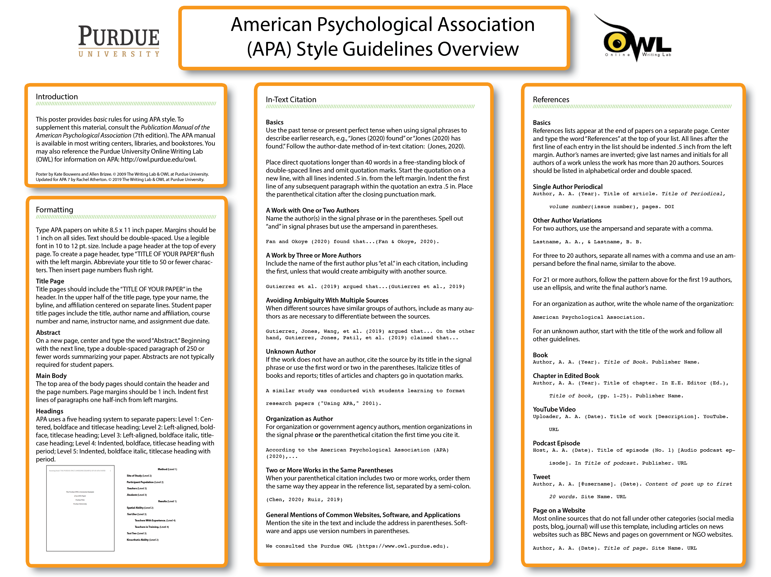
Next Steps
Explore APA Resources
Apply Developmental Psychology Principles
Visit the APA website (https://www.apa.org) to access a wealth of information on developmental psychology.
Discover tools, articles, and research that can enhance your understanding of this field.
Integrate the concepts of developmental psychology into your daily life and workplace practices.
Use these principles to foster personal growth and improve professional interactions.
15
Understanding Human Development Across the Lifespan

