Slide 1












Exploring the Fascinating World of Materials
Unveiling the Secrets and Superpowers of Materials

Slide 2

Table of contents
Lesson Introduction
Materials as Building Blocks
Unlocking the Secret Code
The Incredible World of Materials
Unique Superpowers of Materials
Why Things Bend or Break
Choosing Planet-Friendly Materials
Curious Explorers of the Material World
Understanding Materials Science
Memorizing Names vs. Understanding
01
02
03
04
05
06
07
08
09
10

Slide 3
Table of contents
Soft Cotton vs. Hard Plastic
Favorite T-shirt Material
School Ruler Material
Transforming Young Learners
Materials and Their Superpowers
Exploring the Material World
Curiosity in Materials Science
Material World Exploration
Young Scientists' Journey
Secrets of Materials
11
12
13
14
15
16
17
18
19
20

Slide 4

Lesson Introduction
Unlocking Secrets
Curious Explorers
Materials science isn't just about memorizing names - it's about understanding the properties and behaviors of different materials.
Why do some things bend while others break? How can we choose materials that are kind to our planet? These are the questions that will transform young learners into curious explorers of the material world.
Superpowers of Materials
Engaging Journey
Interactive Learning
Each material has its own unique superpower that makes it special and useful in our daily lives.
Get ready for an engaging journey into the world of materials, where we'll explore, experiment, and discover the wonders of everyday substances.
Through hands-on activities and experiments, we'll learn how materials interact with each other and the world around us.
Exploring the Fascinating World of Materials

Slide 5



Materials as Building Blocks
Introduction to Materials
Types of Materials
Properties of Materials
Material Selection
Material Recycling
Materials are the fundamental building blocks of everything around us.
They come in various forms and serve different purposes, from providing structure to enabling functionality.
There are three main categories of materials - metals, polymers, and ceramics.
Each type has unique properties that make them suitable for specific applications.
Materials possess characteristics such as strength, flexibility, conductivity, and durability.
These properties determine how they behave under different conditions.
Choosing the right material for a specific purpose is crucial.
Factors like cost, availability, and environmental impact play a significant role in the selection process.
Sustainable practices involve recycling materials to reduce waste and conserve resources.
Recycling helps in minimizing the environmental impact of material production.
01
02
03
04
05
Exploring the Fascinating World of Materials

Slide 6

Unlocking the Secret Code
Discovering the Hidden Properties
Unraveling the Mystery
Materials hold secrets within them, waiting to be uncovered.
By studying materials, we decode their behavior and characteristics.
Cracking the Code
Empowering Young Scientists
Unleashing the Potential
Understanding the structure of materials reveals their unique properties.
Knowledge of materials equips young minds to innovate and create.
The secret code of materials unlocks endless possibilities for exploration and discovery.
Exploring the Fascinating World of Materials

Slide 7

The Incredible World of Materials
Lesson Introduction
Exploration Journey
Imagine a world where everything around us tells a fascinating story of how it's made, what it can do, and why it matters!
Materials are the building blocks of our entire universe.
Understanding these magical substances is like unlocking a secret code of how the world works.
Each material has a unique superpower that makes it special.
From the soft cotton of your favorite t-shirt to the hard plastic of your school ruler.
Why do some things bend while others break?
How can we choose materials that are kind to our planet?
Curiosity Sparked
Young Scientists Adventure
Transform young learners into curious explorers of the material world.
Materials science is about understanding, not just memorizing names.
A comprehensive exploration of everyday substances for young scientists.
A 7-year-old materials science adventure awaits!
Exploring the Fascinating World of Materials

Slide 8

Unique Superpowers of Materials
Flexibility
Strength
Some materials like rubber have the superpower to bend and stretch without breaking, making them ideal for creating products like bouncy balls and elastic bands.
Metals such as steel possess incredible strength, allowing them to support heavy loads and withstand high pressures, making them essential for constructing buildings, bridges, and vehicles.
Transparency
Insulation
Conductivity
Glass is a material with the superpower of transparency, allowing light to pass through easily. This property makes it perfect for windows, lenses, and smartphone screens.
Materials like foam have the superpower of insulation, which means they can trap heat or cold, helping to keep our homes warm in winter and cool in summer.
Copper is known for its superpower of conductivity, allowing electricity to flow through it easily. This property makes it essential for wiring and electrical components.
Exploring the Fascinating World of Materials

Slide 9
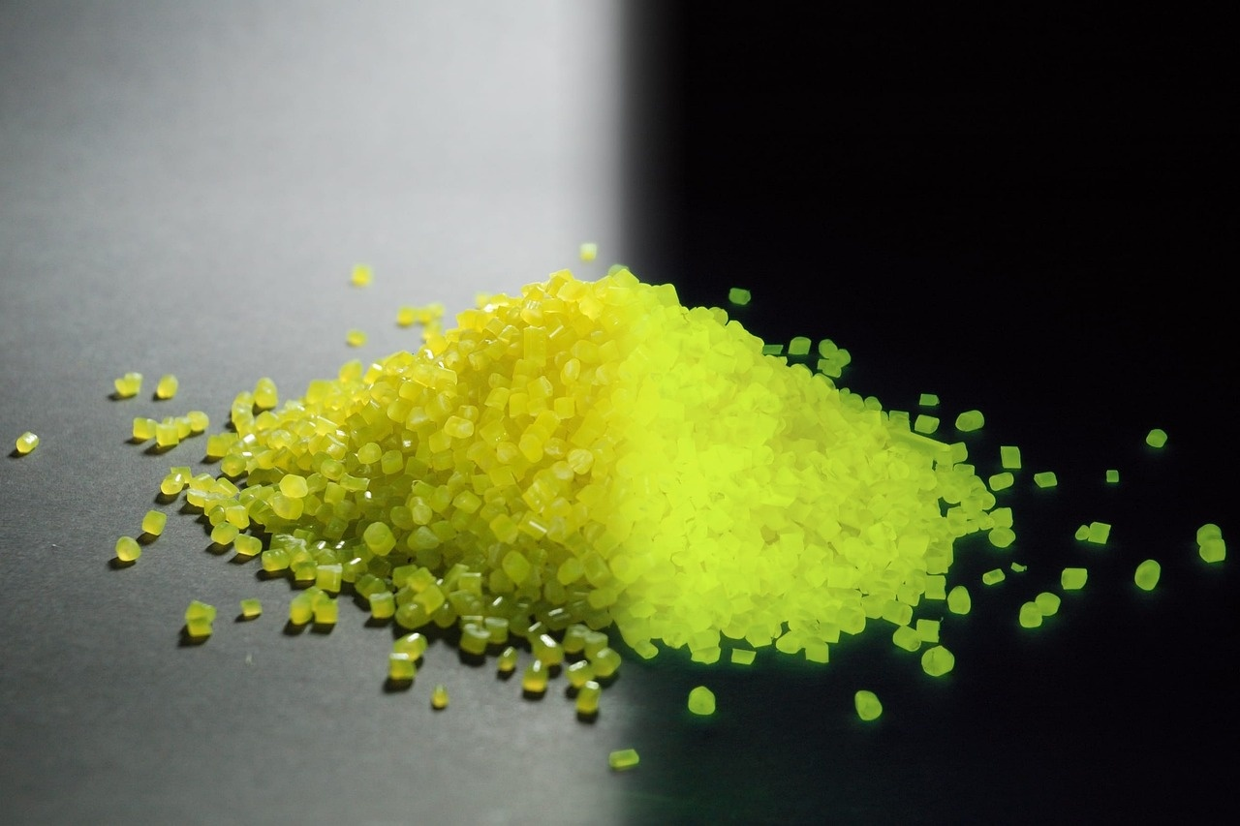
Why Things Bend or Break
Material Properties
Different materials have unique properties that determine how they respond to external forces.
Stress and Strain
When a force is applied to a material, it experiences stress, which can lead to deformation or failure.
Elasticity
Some materials can deform under stress but return to their original shape once the force is removed.
Plasticity
Other materials undergo permanent deformation when stressed beyond their limits.
Fracture Toughness
The ability of a material to resist crack propagation and withstand breaking is crucial in various applications.
Exploring the Fascinating World of Materials

Slide 10

Choosing Planet-Friendly Materials
Recycled Plastic
Organic Cotton
Opt for products made from recycled plastic to reduce the demand for new plastic production.
Choose clothing and textiles made from organic cotton, which is grown without harmful pesticides and chemicals.
Bamboo
Cork
Hemp
Consider bamboo-based products as bamboo is a fast-growing and sustainable material.
Utilize cork-based products as cork is renewable and biodegradable.
Explore items made from hemp, a versatile and eco-friendly material requiring minimal water and pesticides.
Exploring the Fascinating World of Materials

Slide 11
Curious Explorers of the Material World
Observation
Investigation
Classification
Application
Impact
Start by observing the materials around you - from the shiny metal of a spoon to the smooth glass of a window.
Each material has its own unique characteristics waiting to be discovered.
Dive deeper into the properties of materials.
Conduct simple experiments to see how they react to heat, pressure, or water.
This hands-on approach will help you uncover the secrets of different substances.
Learn to classify materials based on their properties.
Are they natural or synthetic?
Are they conductors or insulators?
Understanding these categories will broaden your knowledge of the material world.
Explore how materials are used in everyday life.
From building structures to creating art, materials play a crucial role in shaping our world.
Get creative and think about how you can use materials in innovative ways.
Consider the impact of materials on the environment.
How can we choose sustainable materials that minimize harm to the planet?
As curious explorers, we have the power to make informed choices for a better future.
01
02
03
04
05
Exploring the Fascinating World of Materials

Slide 12

Understanding Materials Science
Introduction to Materials Science
Importance of Materials Science
Materials are the building blocks of our universe.
Each material has unique properties and characteristics.
Understanding materials helps us unlock the secrets of the world around us.
Helps us design stronger and more durable products.
Enables us to create sustainable and eco-friendly materials.
Contributes to technological advancements and innovation.
Applications of Materials Science
Future of Materials Science
Used in aerospace for lightweight and high-strength materials.
Essential in healthcare for biocompatible materials.
Plays a role in energy production through materials for solar panels and batteries.
Continual research and development for new materials.
Focus on recyclable and renewable materials.
Integration of materials science with other fields for interdisciplinary solutions.
Exploring the Fascinating World of Materials

Slide 13
Memorizing Names vs. Understanding
Memorizing Names
Understanding
Importance
Example
Engagement
Simply recalling the names of materials without understanding their properties or uses.
Delving deeper to comprehend why materials behave the way they do and how they impact our daily lives.
Memorization may help in identification, but true understanding empowers us to make informed choices and innovations.
Knowing the name "steel" versus understanding its strength, durability, and versatility in construction.
Encouraging curiosity and exploration leads to a richer understanding of the world of materials.
01
02
03
04
05
Exploring the Fascinating World of Materials

Slide 14

Soft Cotton vs. Hard Plastic
Comfort
Absorbency
Cotton is known for its soft and breathable nature, making it comfortable to wear.
Cotton can absorb moisture, keeping you dry and comfortable.
Biodegradable
Durability
Versatility
Cotton is a natural fiber that is biodegradable, making it eco-friendly.
Plastic is a strong and durable material that can withstand wear and tear.
Plastic can be molded into various shapes and forms for different purposes.
Exploring the Fascinating World of Materials

Slide 15

Favorite T-shirt Material
Soft Cotton
Durable Polyester
Known for its breathability and comfort.
Ideal for everyday wear due to its soft texture.
Offers excellent wrinkle resistance and color retention.
Commonly blended with other materials for added strength.
Sustainable Organic Cotton
Moisture-Wicking Performance Fabrics
Grown without harmful chemicals, promoting eco-friendly fashion.
Supports ethical farming practices and reduces environmental impact.
Designed to keep you dry and cool during physical activities.
Popular choice for sportswear and outdoor enthusiasts.
Exploring the Fascinating World of Materials

Slide 16

School Ruler Material
Plastic
Transparency
Most school rulers are made from durable plastic material, which is lightweight and easy to use for measuring and drawing straight lines.
Some rulers are transparent, allowing for precise measurements and visibility when working on projects or assignments.
Flexibility
Color Variety
Eco-Friendly Options
Plastic rulers are flexible, making them ideal for bending without breaking, ensuring longevity and usability for students.
School rulers come in a variety of colors, adding a fun and personalized touch to school supplies while serving their practical purpose.
There are eco-friendly rulers made from recycled plastic or sustainable materials, promoting environmental consciousness among students.
Exploring the Fascinating World of Materials

Slide 17
Transforming Young Learners
Engaging Lesson Introduction
Unlocking the Secret Code
Dive into the Incredible World of Materials
Thought-Provoking Questions
Curious Explorers
Imagine a world where everything around us tells a fascinating story of how it's made, what it can do, and why it matters!
Materials are the building blocks of our entire universe, and for young scientists like you, understanding these magical substances is like unlocking a secret code of how the world works.
From the soft cotton of your favorite t-shirt to the hard plastic of your school ruler, each material has a unique superpower that makes it special.
Why do some things bend while others break? How can we choose materials that are kind to our planet?
These are the questions that will transform young learners into curious explorers of the material world.
01
02
03
04
05
Exploring the Fascinating World of Materials

Slide 18

Materials and Their Superpowers
Strength: Flexibility
Strength: Strength
Some materials like rubber can bend and stretch without breaking, making them ideal for products like rubber bands and bouncy balls.
Metals such as steel are incredibly strong and can withstand heavy loads, making them perfect for constructing buildings and bridges.
Weakness: Brittleness
Opportunity: Sustainability
Threat: Toxicity
Certain materials like glass are strong but brittle, meaning they can shatter easily under pressure.
Exploring eco-friendly materials like bamboo or recycled plastics can help reduce environmental impact and promote a greener future.
Some materials, like certain chemicals or heavy metals, can be harmful to human health and the environment if not handled properly.
Exploring the Fascinating World of Materials

Slide 19
Exploring the Material World
Material Superpowers
Environmental Impact
Curiosity Unleashed
01
Discover how materials have unique properties that give them superpowers, such as flexibility, strength, or conductivity.
02
Learn about how different materials impact the environment and how we can choose materials that are sustainable and eco-friendly.
03
Materials science isn't just about memorizing names - it's about understanding the secrets behind everyday objects and unleashing your curiosity to explore the material world around you.
Exploring the Fascinating World of Materials

Slide 20
Curiosity in Materials Science
Introduction to Materials Science
Importance of Curiosity
Role of Curiosity in Innovation
Encouraging Curiosity in Young Scientists
Curiosity as a Learning Tool
Materials science is the study of materials and their applications in various fields.
Curiosity drives exploration and discovery in materials science.
Curiosity sparks creativity and leads to breakthroughs in developing new materials.
Inspiring curiosity in young minds fosters a passion for understanding the world of materials.
Asking questions and seeking answers fuels the learning process in materials science.
01
02
03
04
05
Exploring the Fascinating World of Materials

Slide 21

Material World Exploration
Introduction to Materials Science
Diverse Range of Materials
Materials are the foundation of everything around us.
From metals to plastics, each material serves a unique purpose.
Properties of Materials
Environmental Impact
Hands-On Experiments
Understanding why materials behave the way they do is key to unlocking their potential.
Exploring how our material choices can impact the planet.
Engaging in fun experiments to learn more about materials firsthand.
Exploring the Fascinating World of Materials

Slide 22
Young Scientists' Journey
Curiosity Sparked
Exploration Begins
Discovery of Superpowers
Environmental Awareness
Innovative Thinking
Introduce young minds to the wonders of materials science, igniting their curiosity about the world around them.
Encourage hands-on exploration of different materials, from observing their properties to conducting simple experiments.
Unveil the unique characteristics and abilities of various materials, showcasing how they impact our daily lives.
Foster an understanding of sustainable materials and the importance of choosing eco-friendly options for a greener future.
Inspire young scientists to think creatively about how materials can be used to solve real-world problems and improve society.
01
02
03
04
05
Exploring the Fascinating World of Materials

Slide 23

Secrets of Materials
Materials Composition
Structural Arrangement
Materials are made up of atoms and molecules.
The arrangement of atoms and molecules determines the properties of a material.
Material Properties
Material Selection
Material Transformation
Different materials have unique properties like strength, flexibility, conductivity, and more.
Choosing the right material for a specific application is crucial for optimal performance.
Materials can undergo physical or chemical changes to adapt to different uses.
Exploring the Fascinating World of Materials

