Slide 1

Fundamentos de Estructuras de Control y Funciones en C++
Conceptos, Aplicaciones Prácticas y Evaluaciones para el Aprendizaje

Slide 2
Table of Contents
Introduction to Control Structures and Functio…
What are Control Structures?
If-Else Statements
For Loops
Functions
Practical Applications of Control Structures a…
Hands-On Experiment 1: If-Else Statement
Hands-On Experiment 2: For Loop
Hands-On Experiment 3: Function
Homework Assignment 1: If-Else Statement Progr…
Homework Assignment 2: For Loop Program
Homework Assignment 3: Function Program
Quiz: Control Structures and Functions
04
05
06
07
08
09
10
11
12
13
14
15
16

Slide 3
Table of Contents
Conclusion
Next Steps
Reflection Questions
Additional Resources
Parent Engagement
Safety Considerations
17
18
19
20
21
22

Slide 4

Introduction to Control Structures and Functions in C++
Fundamentals of Control Structures and Functions
Overview of Control Structures
Introduction to Functions
Control structures and functions are fundamental concepts in C++ programming.
They enable students to create efficient and organized code.
This lesson will cover the basics of control structures.
Topics include if-else statements and for loops.
Functions are a key component in C++ programming.
They allow for modular and reusable code.
4
Fundamentos de Estructuras de Control y Funciones en C++

Slide 5
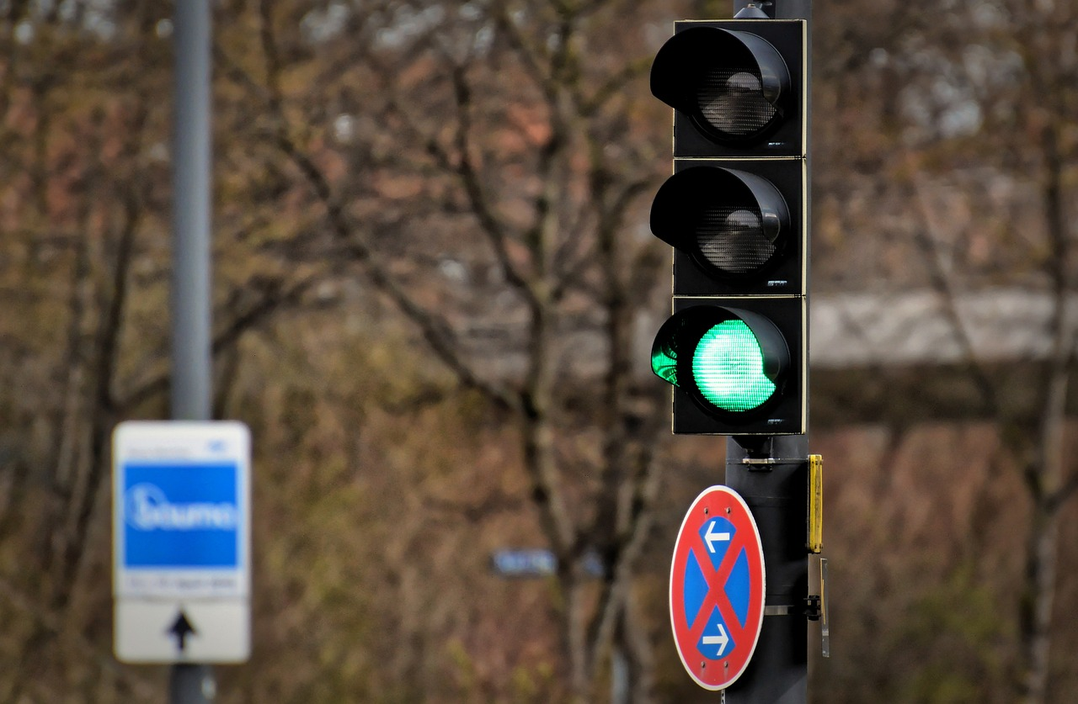
What are Control Structures?
Definition of Control Structures
Purpose of Control Structures
Examples of Control Structures
Control structures determine the flow of a program.
They are fundamental in programming to manage execution paths.
Control structures allow programs to make decisions.
They enable the repetition of tasks based on conditions.
Examples include if-else statements and for loops.
These are commonly used to implement logic and iteration.
5
Fundamentos de Estructuras de Control y Funciones en C++

Slide 6

If-Else Statements
1
Purpose of If-Else Statements
If-else statements are used to make decisions in a program.
They allow the program to execute different code blocks based on a condition.
2
Structure of If-Else Statements
They consist of a condition, an if statement, and an else statement.
This structure enables conditional execution of code.
3
Execution Flow in If-Else Statements
If the condition is true, the code in the if statement is executed.
If the condition is false, the code in the else statement is executed.
6
Fundamentos de Estructuras de Control y Funciones en C++

Slide 7

For Loops
1
Definition of For Loops
For loops are used to repeat tasks in a program.
They consist of a loop variable, a condition, and a loop body.
2
Initialization and Condition Evaluation
The loop variable is initialized, and the condition is evaluated.
If the condition is true, the loop body is executed.
3
Incrementing the Loop Variable
After executing the loop body, the loop variable is incremented.
This process repeats until the condition becomes false.
7
Fundamentos de Estructuras de Control y Funciones en C++

Slide 8

Functions
1
2
3
Definition of Functions
Purpose of Functions
Components of Functions
Functions are used to organize code and reuse functionality.
They consist of a function name, parameters, and a function body.
Functions can be used to perform tasks.
An example is calculating the area of a rectangle.
Functions include a name, parameters, and a body.
These components work together to define the function's behavior.
8
Fundamentos de Estructuras de Control y Funciones en C++

Slide 9

Practical Applications of Control Structures and Functions
Introduction to Control Structures and Functions
Examples of Practical Applications
Learning Outcomes for Students
Control structures and functions are essential tools in programming.
They enable the solution of complex real-world problems effectively.
Control structures and functions can be used for tasks such as calculating sums and checking prime numbers.
They also allow for the simulation of simple games, showcasing their versatility.
Students will gain skills in applying control structures and functions to practical scenarios.
This knowledge prepares them to tackle diverse computational challenges.
9
Fundamentos de Estructuras de Control y Funciones en C++

Slide 10

Hands-On Experiment 1: If-Else Statement
Introduction to If-Else Statements
Program Template and Modifications
Testing and Observing Outputs
Create a C++ program that uses an if-else statement to determine whether a number is even or odd.
This fundamental programming concept helps in decision-making based on conditions.
Use a simple program template and modify it to perform different operations.
This approach allows flexibility and understanding of how templates can be adapted.
Test the program with different inputs and observe the output.
This step ensures the program works correctly and provides expected results.
10
Fundamentos de Estructuras de Control y Funciones en C++

Slide 11

Hands-On Experiment 2: For Loop
Introduction to For Loop in C++
Enhancing the Program
Testing and Observing Outputs
Create a C++ program that uses a for loop to print the numbers from 1 to 10.
This exercise introduces the basic structure and functionality of for loops in programming.
Modify the program to perform different tasks, such as calculating the sum of a series of numbers.
This step demonstrates the versatility of for loops in handling various computational tasks.
Test the program with different inputs and observe the output.
This process helps in understanding the behavior of the program under various conditions.
11
Fundamentos de Estructuras de Control y Funciones en C++

Slide 12
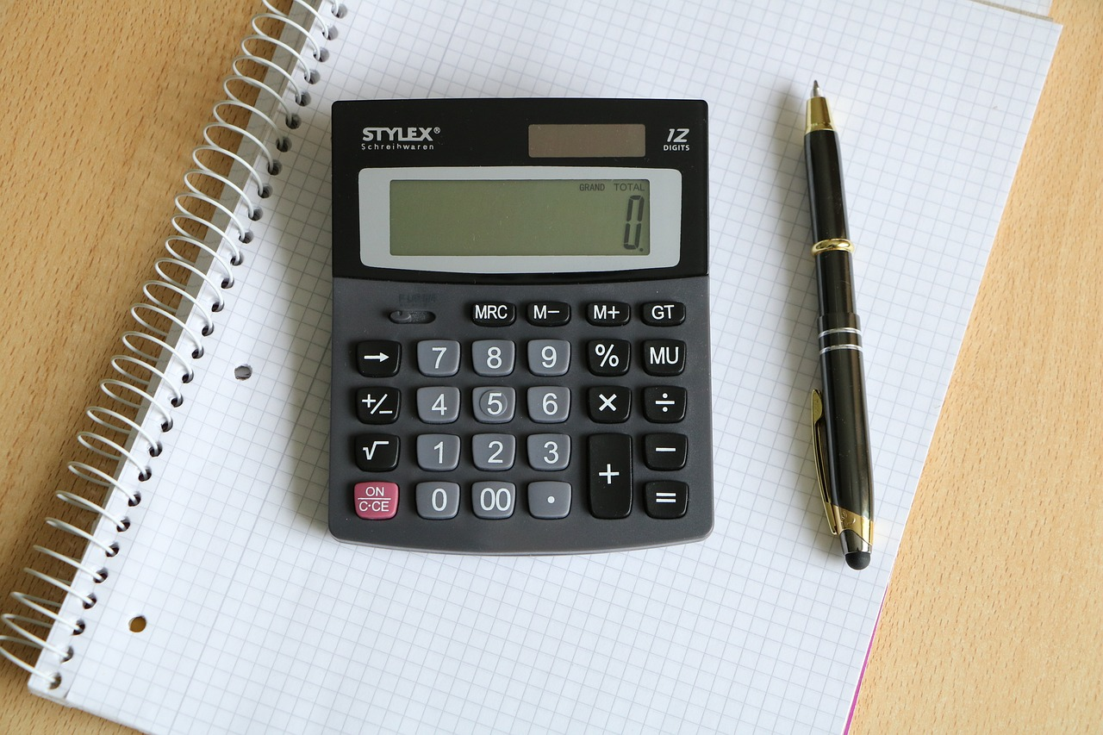
Hands-On Experiment 3: Function
Introduction to Function Usage
Expanding Functionality
Testing and Observing Outputs
Create a C++ program that uses a function to calculate the area of a rectangle.
This demonstrates the application of functions in programming to perform specific tasks.
Modify the program to perform different tasks, such as calculating the perimeter of a rectangle.
This showcases the versatility of functions in handling multiple operations.
Test the program with different inputs and observe the output.
This step ensures the program's correctness and reliability across various scenarios.
12
Fundamentos de Estructuras de Control y Funciones en C++

Slide 13
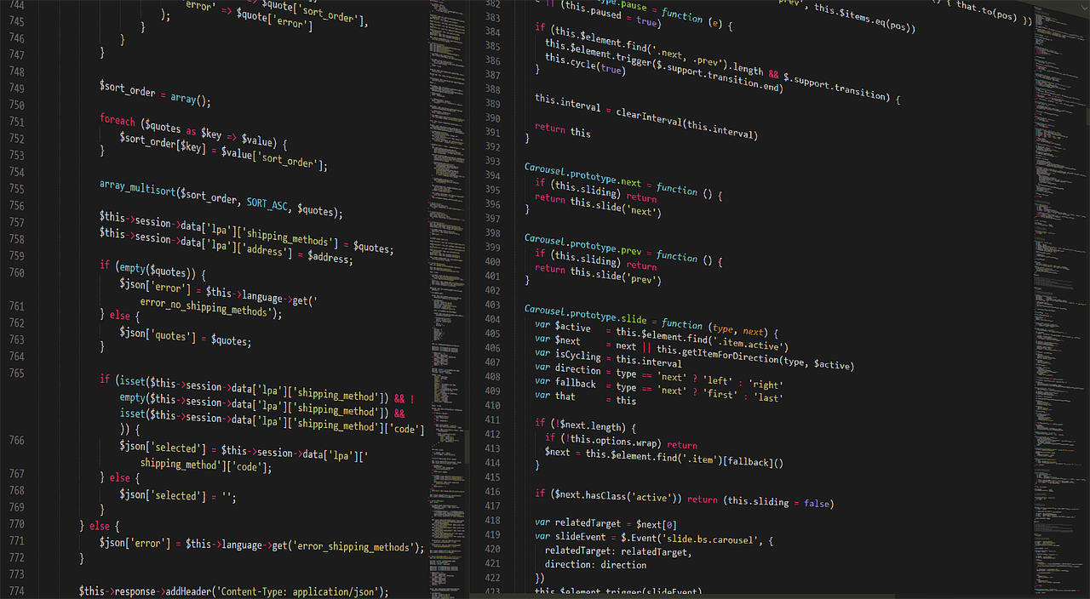
Homework Assignment 1: If-Else Statement Program
Program Objective
Program Template
Testing and Observation
Create a C++ program that uses an if-else statement to determine whether a student has passed or failed a test based on their score.
This program will evaluate the student's score and output the result accordingly.
Use a simple program template and modify it to perform different operations.
This approach ensures a structured and adaptable codebase for various scenarios.
Test the program with different inputs and observe the output.
This step is crucial to validate the program's functionality and correctness.
13
Fundamentos de Estructuras de Control y Funciones en C++

Slide 14

Homework Assignment 2: For Loop Program
Program Objective
Program Enhancement
Testing and Observation
Create a C++ program that uses a for loop to calculate the sum of a series of numbers.
This task involves implementing a loop structure to iterate through a sequence and compute the total.
Modify the program to perform different tasks, such as calculating the average of a set of numbers.
This step requires adapting the existing code to include additional functionalities.
Test the program with different inputs and observe the output.
This process ensures the program's reliability and correctness across various scenarios.
14
Fundamentos de Estructuras de Control y Funciones en C++

Slide 15

Homework Assignment 3: Function Program
Rectangle Calculations
Create a C++ program that uses a function to calculate the area and perimeter of a rectangle.
This task involves implementing mathematical operations within a function to achieve the desired results.
Expanding Functionality
Modify the program to perform different tasks, such as calculating the volume of a cube.
This demonstrates the versatility of functions in handling various computational tasks.
Testing and Observations
Test the program with different inputs and observe the output.
This step ensures the program's accuracy and reliability across diverse scenarios.
15
Fundamentos de Estructuras de Control y Funciones en C++

Slide 16

Quiz: Control Structures and Functions
Understanding the If-Else Statement
Comparing Loop Structures
Role of Functions in C++
The if-else statement in C++ is used to execute different blocks of code based on a condition.
It allows the program to make decisions and perform actions accordingly.
A for loop in C++ is used when the number of iterations is known beforehand.
A while loop is used when the number of iterations depends on a condition being true.
Functions in C++ are used to encapsulate reusable blocks of code.
They help in organizing code and improving readability and maintainability.
16
Fundamentos de Estructuras de Control y Funciones en C++

Slide 17

Conclusion
Fundamental Concepts in C++
Application of Control Structures
Utilization of Functions
Control structures and functions are fundamental concepts in C++ programming.
They form the basis for creating efficient and organized code.
Students have learned how to apply control structures to solve practical problems.
These structures help in managing the flow of the program effectively.
Functions enable modular programming and code reuse.
Students have practiced using functions to enhance program organization and efficiency.
17
Fundamentos de Estructuras de Control y Funciones en C++

Slide 18

Next Steps
Upcoming Lesson: Arrays and Vectors
Exploring Object-Oriented Programming
Understanding File Input/Output and Exception Handling
The next step in our learning journey is Lesson 2, which focuses on Arrays and Vectors.
This lesson will provide a comprehensive understanding of these fundamental data structures.
Lesson 3 will delve into the principles of Object-Oriented Programming.
This topic is essential for designing modular and reusable code.
Lesson 4 will cover File Input/Output and Exception Handling.
These concepts are crucial for managing data and ensuring robust program execution.
18
Fundamentos de Estructuras de Control y Funciones en C++

Slide 19

Reflection Questions
Understanding Control Structures and Functions
Applying Knowledge to Real-World Problems
Challenges in Practical Applications
What did you learn about control structures and functions in this lesson?
How can you apply control structures and functions to solve real-world problems?
How can you apply control structures and functions to solve real-world problems?
What challenges did you face during the hands-on experiments and homework assignments?
What challenges did you face during the hands-on experiments and homework assignments?
What did you learn about control structures and functions in this lesson?
19
Fundamentos de Estructuras de Control y Funciones en C++

Slide 20

Additional Resources
C++ Tutorial Website
Explore comprehensive tutorials on C++ programming.
This resource is ideal for beginners and advanced learners alike.
C++ Programming Book
Dive into detailed explanations and examples in this book.
It serves as a great reference for mastering C++ concepts.
Online Quiz Platform
Test your C++ knowledge with interactive quizzes.
This platform helps reinforce learning through practice.
20
Fundamentos de Estructuras de Control y Funciones en C++

Slide 21

Parent Engagement
Parent-Student Coding Sessions
Progress Updates and Feedback
Coding Competitions and Events
Engage parents and students in collaborative coding activities.
These sessions foster learning and strengthen family bonds through technology.
Provide regular updates on student progress in coding skills.
Offer constructive feedback to guide improvement and celebrate achievements.
Organize coding competitions to challenge and inspire students.
Host events to showcase student projects and encourage community involvement.
21
Fundamentos de Estructuras de Control y Funciones en C++

Slide 22

Safety Considerations
Proper Handling of Equipment
Eye Health Maintenance
Safety Awareness
Handle computers and equipment with care.
Avoid physical damage or electrical shock.
Take regular breaks to avoid eye strain.
Prevent fatigue by managing screen time effectively.
Ensure a safe environment when using electronic devices.
Follow guidelines to minimize risks associated with equipment usage.
22
Fundamentos de Estructuras de Control y Funciones en C++

