Slide 1

Mastering Essential Skills for Career Success
Building Communication, Teamwork, Problem-Solving, and Time Management Competencies for Professional Growth

Slide 2
Table of Contents
Introduction to Essential Skills
Why Essential Skills Matter
Communication Skills
Teamwork and Collaboration
Problem-Solving and Adaptability
Time Management and Organization
Real-World Applications
Overcoming Challenges
Creating a Personalized Career Development Plan
Conclusion
Key Takeaways
Reflection Questions
Next Steps
04
05
06
07
08
09
10
11
12
13
14
15
16

Slide 3
Table of Contents
Additional Resources
Conclusion and Final Thoughts
Final Reflection
Assessment and Evaluation
Career Development and Planning
Final Thoughts and Recommendations
References and Resources
17
18
19
20
21
22
23

Slide 4

Introduction to Essential Skills
Importance of Essential Skills
Key Components of Essential Skills
Benefits of Developing Essential Skills
Essential skills are critical for success in the workplace.
They form the foundation for professional growth and achievement.
Communication, teamwork, problem-solving, and time management are key essential skills.
These skills are vital for navigating challenges and collaborating effectively.
Developing these skills will help you achieve your career goals.
They are crucial for succeeding in your future profession.
4
Mastering Essential Skills for Career Success

Slide 5
Why Essential Skills Matter
Value to Employers
Teamwork and Collaboration
Versatility Across Industries
Competitive Advantage
Essential skills are highly valued by employers.
They demonstrate your ability to contribute effectively to the workplace.
They help you work effectively with others and achieve common goals.
This fosters a productive and harmonious work environment.
Essential skills are transferable across different industries and professions.
This makes them a valuable asset in a dynamic job market.
Developing essential skills will give you a competitive edge in the job market.
They set you apart from other candidates and enhance career opportunities.
5
Mastering Essential Skills for Career Success

Slide 6
Communication Skills
Foundation of Workplace Success
Enhancing Communication Skills
Key Elements of Effective Communication
Communication is the foundation of success in the workplace.
Effective communication involves clear and concise messaging, active listening, and non-verbal cues.
Practice communication skills through role-playing, presentations, and group discussions.
These activities help in building confidence and improving interpersonal interactions.
Clear messaging, active listening, and understanding non-verbal cues are essential.
These elements ensure that ideas are conveyed and understood effectively.
6
Mastering Essential Skills for Career Success

Slide 7

Teamwork and Collaboration
Importance of Teamwork
Valuing Diversity
Skill Development
Teamwork and collaboration are vital in achieving common goals and objectives.
They help in fostering unity and shared responsibility among team members.
Learn to appreciate diverse perspectives, skills, and experiences of team members.
This enriches the team's ability to innovate and solve problems effectively.
Practice teamwork skills through group projects, role-playing, and real-world applications.
These activities enhance communication, coordination, and mutual understanding.
7
Mastering Essential Skills for Career Success

Slide 8

Problem-Solving and Adaptability
Importance of Problem-Solving and Adaptability
Fostering a Growth Mindset
Practical Problem-Solving Techniques
Problem-solving and adaptability are critical in navigating workplace challenges and uncertainties.
These skills enable individuals to effectively address and overcome obstacles in dynamic environments.
Develop a growth mindset and a willingness to take calculated risks.
This approach encourages continuous learning and resilience in the face of challenges.
Practice problem-solving skills through case studies, brainstorming, and real-world applications.
These methods provide hands-on experience and enhance critical thinking abilities.
8
Mastering Essential Skills for Career Success

Slide 9

Time Management and Organization
1
Importance of Time Management
Time management and organization are essential for meeting deadlines and achieving goals.
Prioritize tasks, manage time effectively, and maintain a high level of productivity.
2
Effective Strategies for Productivity
Practice time management skills through scheduling, goal-setting, and self-reflection.
These strategies help in maintaining focus and achieving desired outcomes.
3
Achieving Goals Through Organization
Organized efforts lead to better results and efficient use of time.
Setting clear priorities ensures progress towards personal and professional objectives.
9
Mastering Essential Skills for Career Success

Slide 10

Real-World Applications
Application of Essential Skills
Practical Learning Methods
Real-World Impact
Essential skills are applied in various contexts, from academics to personal relationships.
Learn to recognize and apply essential skills in real-world scenarios.
Practice essential skills through role-playing, case studies, and group projects.
These methods help in understanding and implementing skills effectively.
Essential skills contribute to success in diverse areas of life.
They are crucial for navigating challenges and achieving goals.
10
Mastering Essential Skills for Career Success

Slide 11

Overcoming Challenges
1
Identifying Workplace Challenges
Identify common challenges and obstacles in the workplace.
Understand the impact of these challenges on productivity and morale.
2
Strategies for Overcoming Challenges
Develop strategies for overcoming challenges, such as seeking feedback, asking for help, and learning from mistakes.
Implement these strategies to foster a supportive and solution-oriented environment.
3
Building Resilience and Adaptability
Practice resilience and adaptability through mindfulness, self-reflection, and growth mindset.
Cultivate these qualities to navigate workplace challenges effectively.
11
Mastering Essential Skills for Career Success

Slide 12

Creating a Personalized Career Development Plan
Reflecting on Strengths and Goals
Reflect on your strengths, interests, and career goals.
Understand what drives you and aligns with your aspirations to create a solid foundation for your career development plan.
Developing Essential Skills
Create a personalized plan for developing essential skills required for your chosen career.
Focus on acquiring the competencies that will make you successful in your desired field.
Achieving Career Aspirations
Set goals, seek mentorship, and practice essential skills to achieve your career aspirations.
Take actionable steps to turn your career vision into reality through consistent effort and guidance.
12
Mastering Essential Skills for Career Success

Slide 13

Conclusion
1
2
3
Importance of Essential Skills
Path to Career Success
Practical Application of Skills
Essential skills are critical for success in the workplace.
They form the foundation for achieving career goals and excelling in your profession.
Developing essential skills will help you achieve your career goals.
These skills are key to succeeding in your future profession.
Remember to practice, reflect, and apply essential skills in real-world scenarios.
This approach will help you become a competent and effective employee.
13
Mastering Essential Skills for Career Success

Slide 14
Key Takeaways
Value of Essential Skills
Key Essential Skills
Competitive Edge in Job Market
Ways to Practice Essential Skills
Essential skills are highly valued by employers.
They are crucial for professional success and personal growth.
Communication, teamwork, problem-solving, and time management are key essential skills.
These skills are foundational for thriving in any workplace.
Developing essential skills will give you a competitive edge in the job market.
They help differentiate you from other candidates.
Practice essential skills through real-world applications, role-playing, and self-reflection.
These methods enhance your ability to apply skills effectively.
14
Mastering Essential Skills for Career Success

Slide 15

Reflection Questions
Developing Essential Skills
Applying Skills in Real-World Scenarios
Overcoming Workplace Challenges
What essential skills do you need to develop for your chosen career?
These skills are crucial for achieving success and adapting to industry demands.
How can you apply essential skills in real-world scenarios?
Practical application ensures that theoretical knowledge translates into effective actions.
What strategies can you use to overcome challenges and obstacles in the workplace?
Strategic planning and resilience are key to navigating professional hurdles.
15
Mastering Essential Skills for Career Success

Slide 16
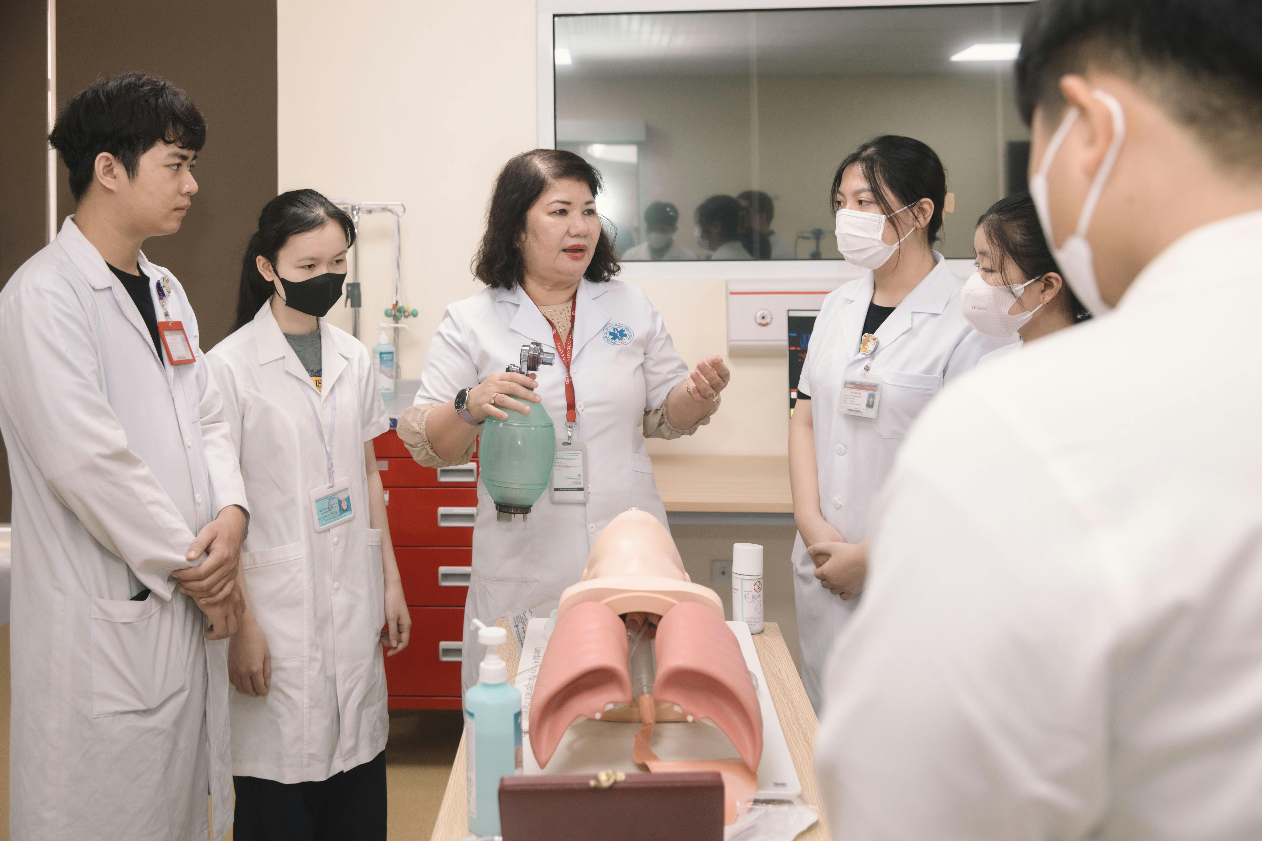
Next Steps
Skill Development
Continue to develop and practice essential skills.
This ensures a strong foundation for future growth.
Mentorship and Feedback
Seek mentorship and feedback from professionals and peers.
This helps in gaining valuable insights and improving your approach.
Real-World Application
Apply essential skills in real-world scenarios and reflect on your experiences.
This bridges the gap between theory and practice.
16
Mastering Essential Skills for Career Success

Slide 17

Additional Resources
Online Resources and Tutorials
Career Counseling and Mentorship
Real-World Applications and Case Studies
Explore a variety of online platforms offering tutorials for essential skills development.
These resources are designed to help individuals enhance their knowledge and expertise in various fields.
Access career counseling services and mentorship programs tailored to individual needs.
These initiatives aim to guide professionals in achieving their career goals effectively.
Dive into practical case studies and real-world applications to practice essential skills.
These examples provide hands-on experience and insights into real-life scenarios.
17
Mastering Essential Skills for Career Success

Slide 18

Conclusion and Final Thoughts
Importance of Essential Skills
Path to Career Success
Continuous Growth and Learning
Essential skills are critical for success in the workplace.
They form the foundation for achieving career goals and excelling in your profession.
Developing essential skills will help you achieve your career goals.
These skills are key to succeeding in your future profession.
Remember to stay curious, keep learning, and continuously develop your essential skills.
This approach will help you stay ahead in the job market.
18
Mastering Essential Skills for Career Success

Slide 19
Final Reflection
Reflecting on Essential Skills
Planning for Growth
Continuous Development
Reflect on what you have learned about essential skills.
Identify areas for improvement and development.
Create a plan to continue practicing and applying essential skills.
Focus on real-world scenarios to enhance your learning.
Identify areas for improvement and development.
Create a plan to continue practicing and applying essential skills in real-world scenarios.
19
Mastering Essential Skills for Career Success

Slide 20

Assessment and Evaluation
Understanding Through Assessment
Progress Evaluation
Feedback and Reflection
Assess your understanding of essential skills through quizzes, tests, and assignments.
These tools help gauge your grasp of the material and pinpoint strengths.
Evaluate your progress and identify areas for improvement.
This step ensures you stay on track and address any gaps in knowledge.
Use feedback and self-reflection to adjust your learning plan.
This approach fosters continuous development of essential skills.
20
Mastering Essential Skills for Career Success

Slide 21

Career Development and Planning
Exploring Career Pathways
Personalized Career Planning
Mentorship and Guidance
Research and explore different career options and pathways.
Understand the opportunities and challenges associated with each career choice.
Create a personalized career development plan and set goals.
Outline actionable steps to achieve your professional objectives.
Seek mentorship and guidance from professionals and peers.
Leverage their experience to navigate your career aspirations effectively.
21
Mastering Essential Skills for Career Success

Slide 22

Final Thoughts and Recommendations
Importance of Essential Skills
Essential skills are critical for success in the workplace.
Developing essential skills will help you achieve your career goals and succeed in your future profession.
Continuous Learning
Stay curious, keep learning, and continuously develop your essential skills.
This approach will help you stay ahead in the job market.
Career Advancement
Essential skills are the foundation for professional growth.
They enable you to adapt and thrive in a competitive environment.
22
Mastering Essential Skills for Career Success

Slide 23

References and Resources
Recommended Reading and Resources
List of recommended books, articles, and online resources for essential skills development.
These materials provide foundational knowledge and advanced insights into skill-building techniques.
Career Guidance Opportunities
Career counseling and mentorship programs.
These initiatives offer personalized advice and support for professional growth.
Practical Skill Application
Real-world applications and case studies for essential skills practice.
These examples demonstrate how theoretical knowledge can be effectively applied in various scenarios.
23
Mastering Essential Skills for Career Success

