Slide 1
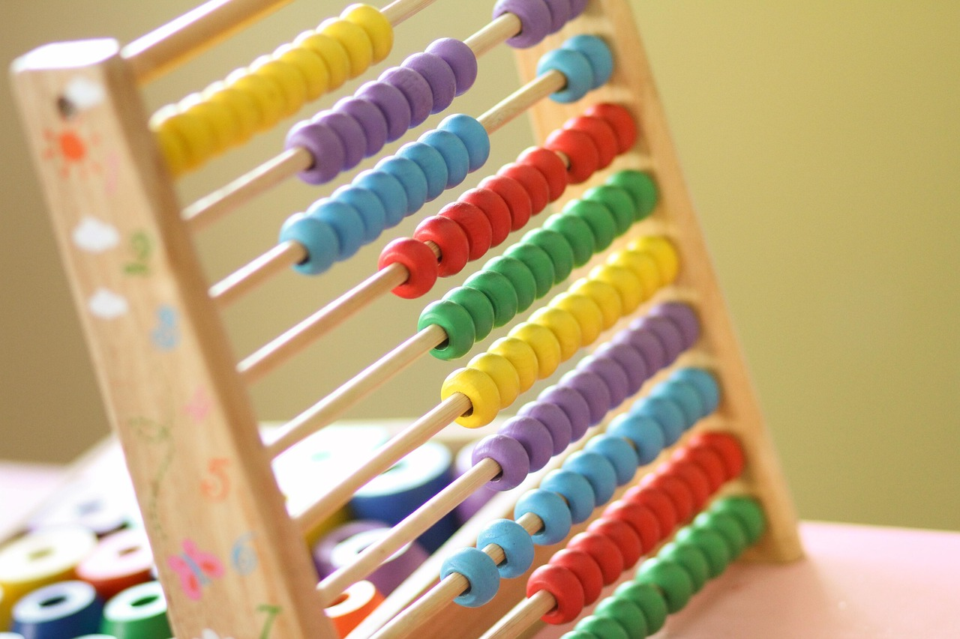
Mastering Addition by Partitioning
A Comprehensive Guide to Understanding, Teaching, and Engaging with Addition Concepts

Slide 2
Table of Contents
Introduction to Addition by Partitioning
What is Addition by Partitioning?
Why is Addition by Partitioning Important?
Differentiated Activities for Mixed-Ability Groups
Lesson Introduction
Teaching Script
Guided Practice Activities
Independent Practice Activities
Subject Knowledge
Common Errors and Misconceptions
Assessment and Evaluation
Conclusion
Teaching Tips and Strategies
01
02
03
04
05
06
07
08
09
10
11
12
13

Slide 3
Table of Contents
Reflection Questions
Next Steps
Parent Engagement
Safety Considerations
Conclusion and Final Thoughts
References and Resources
14
15
16
17
18
19

Slide 4
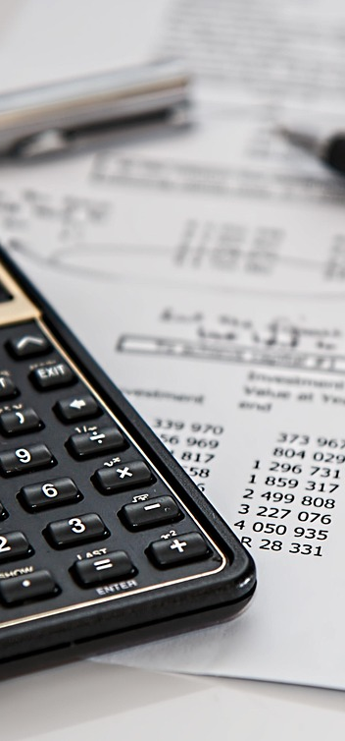
Introduction to Addition by Partitioning
Partitioning Basics
Solving Addition Problems
Building Place Value Skills
Partitioning is the process of dividing a number into smaller, manageable parts.
This method helps young learners add two-digit numbers more effectively.
Students can use partitioning to combine parts of numbers for addition.
This approach simplifies the process and builds confidence in their skills.
Understanding partitioning strengthens students' knowledge of place value.
This foundation is essential for developing effective mental calculation strategies.
1
Mastering Addition by Partitioning

Slide 5
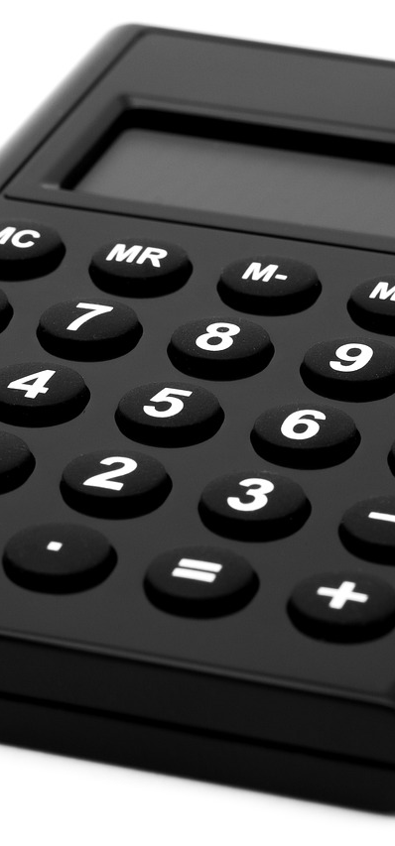
What is Addition by Partitioning?
Number Breakdown
Example Calculation
Skill Development
Addition by partitioning breaks numbers into smaller parts, like tens and ones, simplifying calculations.
To solve 14 + 25, break it down into 10 + 4 + 20 + 5.
Adding these parts step by step gives the final answer of 39.
Addition by partitioning enhances students' mental calculation skills.
This method allows for quicker and more accurate problem-solving.
2
Mastering Addition by Partitioning

Slide 6

Why is Addition by Partitioning Important?
Problem-Solving Skills
Enhances critical thinking and problem-solving abilities, allowing students to tackle challenges systematically.
Understanding Place Value
Facilitates comprehension of place value and number sense, which are essential for understanding advanced concepts.
Foundation for Future Math
A vital skill for future math studies and practical applications, as addition by partitioning lays the groundwork for more complex operations.
3
Mastering Addition by Partitioning

Slide 7
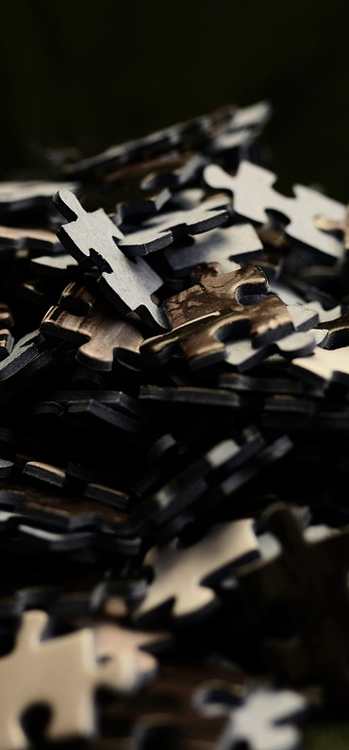
Differentiated Activities for Mixed-Ability Groups
Learning Stations
Learning stations provide tailored challenges for students.
They can choose stations that align with their learning goals.
Tech Activities
Technology-based activities engage students and support skill development.
Interactive tools make learning enjoyable and effective.
Collaborative Learning
Peer-to-peer learning fosters a sense of community among students.
Collaborative tasks enhance critical thinking and communication skills.
4
Mastering Addition by Partitioning

Slide 8
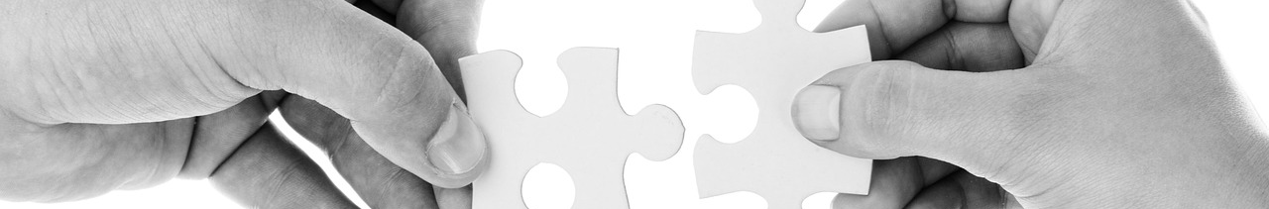
Lesson Introduction
Engaging Experiences
Visual Partitioning
Real-Life Relevance
What specific challenges do you encounter when counting or solving addition problems?
Let's share our experiences to learn from each other.
We will introduce partitioning using visual aids like base-ten blocks and hundreds charts.
These tools will help us visualize and understand numbers more effectively.
Partitioning is essential for sharing items equally in everyday situations.
It also helps us in budgeting by allowing us to allocate resources wisely.
5
Mastering Addition by Partitioning

Slide 9
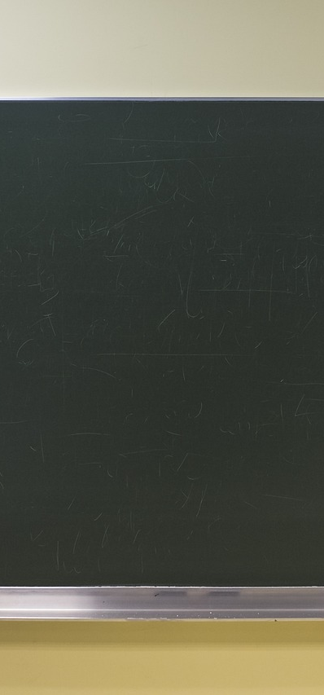
Teaching Script
Concept Overview
Addition Techniques
Collaborative Practice
We will introduce partitioning as a key strategy in addition.
Understanding this concept is vital for tackling two-digit addition.
Students will learn to add two-digit numbers by breaking them into tens and ones.
This approach streamlines the addition process and boosts accuracy.
In pairs, students will practice solving addition problems using partitioning.
This teamwork will deepen their grasp of the concept.
6
Mastering Addition by Partitioning

Slide 10
Guided Practice Activities
Pair Problem Solving
Visualizing Partitioning
Modeling with Base-Ten
Students work in pairs to solve addition problems through partitioning.
This activity promotes teamwork and critical thinking.
Students use a number line to visualize partitioning.
This approach deepens their understanding of how numbers can be divided and combined.
Students utilize base-ten blocks to represent two-digit numbers.
This hands-on activity enhances their comprehension of place value.
7
Mastering Addition by Partitioning

Slide 11

Independent Practice Activities
Addition Worksheet
Word Problems
Challenge Problems
Complete the addition problems on the partitioning worksheet.
Use partitioning strategies to find the answers.
Solve word problems using partitioning techniques.
Carefully read each problem and highlight the key information.
Tackle complex addition problems with partitioning methods.
These problems will challenge your understanding of partitioning.
8
Mastering Addition by Partitioning

Slide 12
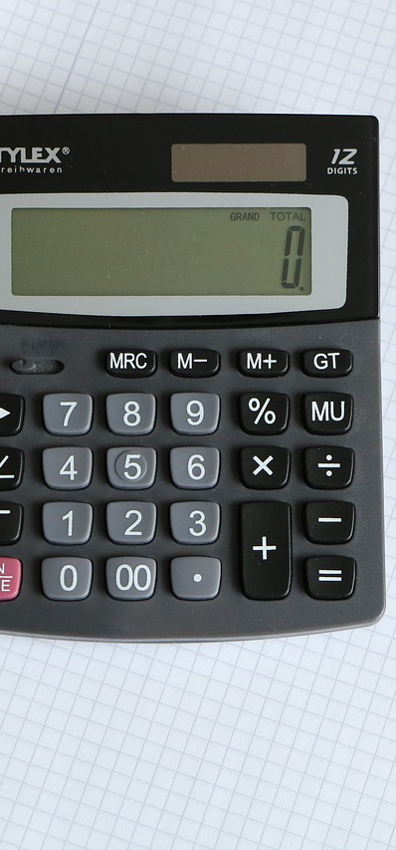
Subject Knowledge
Number Breakdown
Practical Uses
Math Connections
Understanding numbers involves separating them into tens and ones.
Visual aids can significantly improve comprehension.
Numbers play a crucial role in everyday tasks like measuring and budgeting.
Calculating quantities helps in making informed decisions.
This topic relates to fundamental operations such as subtraction and multiplication.
Recognizing these connections enhances overall mathematical understanding.
9
Mastering Addition by Partitioning

Slide 13
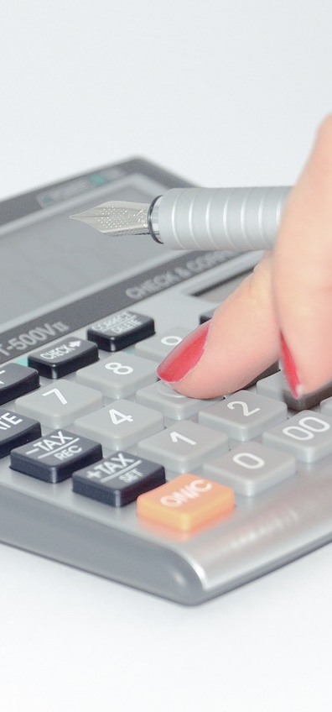
Common Errors and Misconceptions
Incorrect Regrouping
Separate Addition Errors
Place Value Confusion
Students often overlook regrouping when adding numbers.
This can lead to confusion and errors.
Many learners add tens and ones without regrouping.
This often results in incorrect totals.
Students struggle with adding numbers of different place values.
This misunderstanding can cause significant errors.
10
Mastering Addition by Partitioning

Slide 14

Assessment and Evaluation
Formative Tools
Summative Methods
Supportive Feedback
Formative assessments include quizzes, worksheets, and class discussions.
These tools assess how well students grasp the material as they learn.
Summative assessments consist of written tests, practical tasks, and projects.
They measure student learning at the conclusion of an instructional unit.
Providing feedback is essential for encouraging student growth.
Constructive feedback helps students recognize their strengths and areas for improvement.
11
Mastering Addition by Partitioning

Slide 15

Conclusion
Key Takeaways
Practice Importance
Future Lessons
Understanding the concept of partitioning is crucial.
Applying this concept effectively enhances problem-solving skills.
Regular practice is essential for building confidence.
Reinforcement through exercises leads to greater fluency.
Upcoming lessons will cover multi-digit addition and subtraction by partitioning.
We will also tackle word problems to apply these concepts in real-world scenarios.
12
Mastering Addition by Partitioning

Slide 16
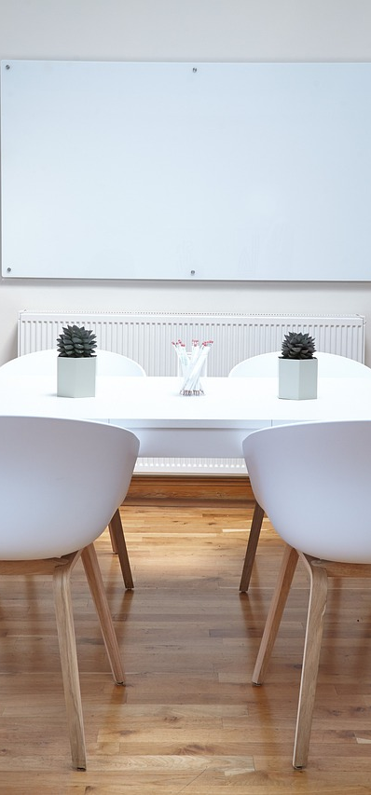
Teaching Tips and Strategies
Visual Aids
Differentiated Activities
Peer Collaboration
Using visual aids can enhance understanding and retention of information.
Real-life examples make learning more relatable and engaging.
Providing differentiated activities caters to the diverse needs of mixed-ability groups.
This approach ensures that all students can participate and learn at their own pace.
Encouraging peer-to-peer learning fosters a sense of community in the classroom.
Collaborative activities allow students to learn from each other and develop social skills.
13
Mastering Addition by Partitioning

Slide 17

Reflection Questions
Concept Introduction
Teaching Adjustments
Lesson Takeaways
How effectively did I introduce the concept of partitioning?
What specific strategies engaged my students?
What changes can I implement to enhance my teaching practice?
Are there particular methods that resonate more with my students?
How can I leverage the insights from this lesson for future planning?
What unique elements can I incorporate into a comprehensive math program?
14
Mastering Addition by Partitioning

Slide 18
Next Steps
Multi-Digit Addition
Subtraction Partitioning
Addition & Subtraction Problems
We will have a follow-up lesson on multi-digit addition to reinforce concepts.
Students will learn to break down numbers for easier subtraction through partitioning.
We will solve real-world problems involving addition and subtraction to help students apply their skills.
15
Mastering Addition by Partitioning

Slide 19
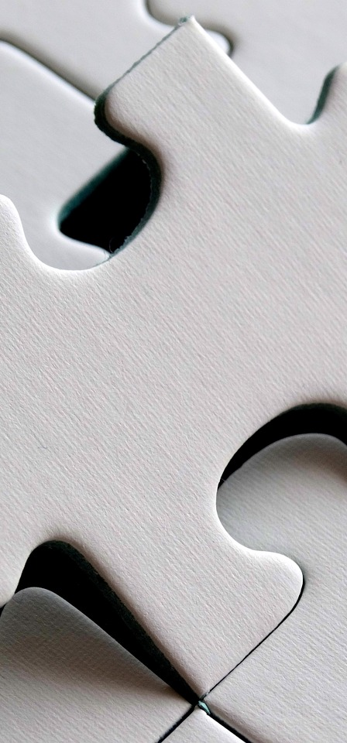
Parent Engagement
Math Night
Family Activities
Progress Updates
We are hosting a Math Night to engage parents in their child's learning.
This event will provide valuable resources and strategies for supporting math skills at home.
We will offer parent-child math activities to strengthen their bond through learning.
These activities are designed to be fun and educational, making math enjoyable for everyone.
Regular progress updates will be provided to keep parents informed about their child's development.
This communication will help parents understand how they can support their child's learning journey.
16
Mastering Addition by Partitioning

Slide 20

Safety Considerations
1
Safe Learning Space
A safe and supportive learning environment is essential for student success.
A positive atmosphere enhances engagement.
2
Student Needs Awareness
Awareness of students' special needs and allergies is crucial.
This knowledge enables appropriate accommodations.
3
Behavior Expectations
Clear behavior expectations promote respect in the classroom.
Students thrive when they understand what is expected of them.
17
Mastering Addition by Partitioning

Slide 21

Conclusion and Final Thoughts
1
Key Takeaways
Addition by partitioning is a crucial concept that simplifies complex problems.
It is essential for developing strong mathematical skills.
2
Practice Encouragement
Regular practice of addition by partitioning builds confidence and skills.
Engage with various problems to reinforce your understanding.
3
Final Reflections
Consider how addition by partitioning can simplify calculations in real-life situations.
Reflect on the strategies learned and how they can be applied moving forward.
18
Mastering Addition by Partitioning

Slide 22

References and Resources
1
2
3
Further Reading
Online Resources
Support Websites
Read specialized publications that provide comprehensive insights.
Explore research articles that highlight recent advancements in the field.
Enroll in online courses that focus on practical applications of the subject.
Utilize interactive websites that offer engaging learning modules.
Join online forums to connect with others and share knowledge.
Access curated resource sites that offer valuable tools and information.
19
Mastering Addition by Partitioning

