Slide 1

Exploring Word Families and Sentence Building Blocks
Enhancing Literacy through Phonological Awareness, Vocabulary Development, and Interactive Learning Activities

Slide 2
Table of Contents
Welcome to Exploring Word Families and Sentenc…
What are Word Families?
Sentence Building Blocks
Phonological Awareness
Vocabulary Development
Word Family Sorting Game
Sentence Building Challenge
Word Family Scavenger Hunt
Language Patterns
Teaching Tips and Strategies
Assessment and Evaluation
Conclusion
Extension Activities
04
05
06
07
08
09
10
11
12
13
14
15
16

Slide 3
Table of Contents
Parent Engagement
Safety Considerations
Reflection and Next Steps
Additional Resources
Final Thoughts
17
18
19
20
21

Slide 4

Welcome to Exploring Word Families and Sentence Building Blocks
Introduction to Word Families
Lesson Plan Overview
Phonological Awareness
Introduction to word families and sentence building blocks.
Importance of phonological awareness and vocabulary development.
Overview of the lesson plan and objectives.
Introduction to the key components of the lesson.
Importance of phonological awareness and vocabulary development.
How these skills contribute to sentence building.
4
Exploring Word Families and Sentence Building Blocks

Slide 5

What are Word Families?
Definition of Word Families
Examples of Word Families
Word families are groups of words that share a common base or pattern.
They help in understanding the structure and meaning of words.
Common word families include -at, -an, and -in.
These patterns are used to form multiple related words like cat, can, and pin.
Importance of Recognizing Word Families
Interactive Activity: Matching Words to Word Families
Recognizing word families enhances reading and writing skills.
It allows learners to decode and spell words more efficiently.
Engage learners by matching words to their respective word families.
This activity reinforces understanding and builds vocabulary.
5
Exploring Word Families and Sentence Building Blocks

Slide 6

Sentence Building Blocks
Introduction to Sentence Structure
Importance of Sentence Building Blocks
Introduction to sentence structure (subject-verb-object)
Examples of simple sentences
Importance of sentence building blocks in communication
Interactive activity: Building simple sentences using word cards
Interactive Learning
Core Components of Sentences
Interactive activity: Building simple sentences using word cards
Examples of simple sentences
Introduction to sentence structure (subject-verb-object)
Importance of sentence building blocks in communication
6
Exploring Word Families and Sentence Building Blocks

Slide 7
Phonological Awareness
Definition of Phonological Awareness
Importance in Reading and Writing
Interactive Activity: Sound Identification
Phonological awareness refers to the ability to recognize and manipulate sounds in spoken language.
It includes skills such as identifying syllables, rhymes, and individual phonemes.
Phonological awareness is crucial for developing strong reading and writing skills.
It helps children decode words and understand the sound structure of language.
Engage in activities like identifying beginning sounds and rhyming words to strengthen phonological awareness.
These exercises make learning fun and improve auditory discrimination skills.
7
Exploring Word Families and Sentence Building Blocks

Slide 8

Vocabulary Development
Significance of Vocabulary in Literacy
Effective Vocabulary Teaching Strategies
Engaging Vocabulary Activities
Vocabulary development is crucial for enhancing reading and writing skills.
A strong vocabulary foundation supports comprehension and effective communication.
Teaching strategies include using word families and context clues to understand meanings.
These methods help students connect new words to familiar concepts.
Interactive activities like matching words to their meanings make learning fun.
Such activities encourage active participation and reinforce understanding.
8
Exploring Word Families and Sentence Building Blocks

Slide 9

Word Family Sorting Game
Interactive Word Sorting
Game Objective
Instructions for the word family sorting game
Interactive activity: Sorting words into their word families
Engage participants in identifying and categorizing words.
Enhance understanding of word families through hands-on activity.
9
Exploring Word Families and Sentence Building Blocks

Slide 10
Sentence Building Challenge
Interactive Activity Overview
Challenge Instructions
Interactive activity: Building simple sentences using word cards.
This challenge encourages creativity and language skills.
Participants will use word cards to construct sentences.
The goal is to create simple and meaningful sentences.
10
Exploring Word Families and Sentence Building Blocks

Slide 11

Word Family Scavenger Hunt
Interactive Activity Overview
How to Participate
Instructions for the word family scavenger hunt.
Interactive activity: Finding objects that match word families.
Follow the instructions to engage in the scavenger hunt.
Identify and collect objects that correspond to specific word families.
11
Exploring Word Families and Sentence Building Blocks

Slide 12

Language Patterns
Introduction to Language Patterns
Interactive Activity
Significance in Literacy
Introduction to language patterns (rhyming, word families).
Importance of recognizing language patterns in reading and writing.
Interactive activity: Identifying language patterns in sentences.
Engage learners in exploring patterns through examples.
Recognizing patterns enhances reading and writing skills.
Patterns provide a foundation for understanding language structure.
12
Exploring Word Families and Sentence Building Blocks

Slide 13
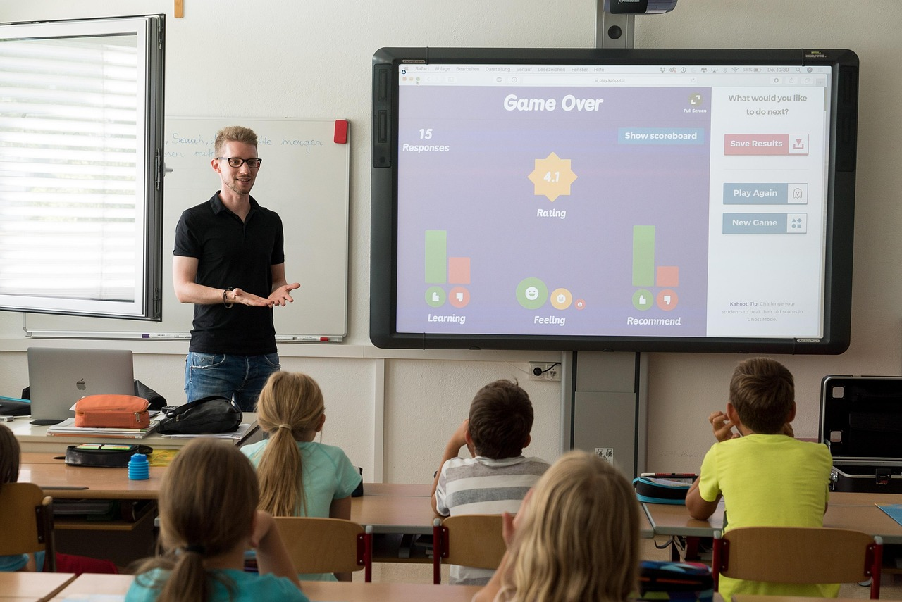
Teaching Tips and Strategies
01
Visual Aids and Real-Life Examples
Using visual aids and real-life examples can make abstract concepts more tangible and relatable.
This approach helps students connect theoretical knowledge to practical applications.
02
Practice and Application Opportunities
Providing opportunities for practice and application reinforces learning and builds confidence.
It allows students to actively engage with the material and develop their skills.
03
Student-Centered Learning
Encouraging student-centered learning fosters independence and critical thinking.
This strategy empowers students to take ownership of their educational journey.
04
Technology in Learning
Using technology to support learning enhances engagement and accessibility.
It provides diverse tools and resources to cater to different learning styles.
13
Exploring Word Families and Sentence Building Blocks

Slide 14

Assessment and Evaluation
Significance in Learning
Importance of assessment and evaluation in learning.
Strategies for assessing phonological awareness and vocabulary development.
Interactive Engagement
Interactive activity: Self-assessment and reflection.
Importance of assessment and evaluation in learning.
Strategic Approaches
Strategies for assessing phonological awareness and vocabulary development.
Interactive activity: Self-assessment and reflection.
14
Exploring Word Families and Sentence Building Blocks

Slide 15

Conclusion
Key Concepts Recap
Encouragement for Growth
Summary of key concepts and learning objectives
Final thoughts and encouragement for continued learning
Final thoughts and encouragement for continued learning
Summary of key concepts and learning objectives
15
Exploring Word Families and Sentence Building Blocks

Slide 16
Extension Activities
Word Family Story Creation
Sentence Building Challenge
Word Family Games and Activities
Word family story creation.
Engage students in crafting stories using specific word families.
Sentence building challenge.
Encourage learners to construct sentences using word family patterns.
Word family games and activities.
Incorporate interactive games to reinforce word family learning.
16
Exploring Word Families and Sentence Building Blocks

Slide 17

Parent Engagement
Significance of Parent Engagement
Importance of parent engagement in learning.
Strategies for involving parents in word family and sentence building activities.
Effective Communication with Parents
Tips for communicating with parents.
Providing feedback to enhance their involvement.
Collaborative Learning Strategies
Encouraging parents to participate in word family activities.
Building sentences together to support learning.
17
Exploring Word Families and Sentence Building Blocks

Slide 18

Safety Considerations
Classroom Safety Importance
Ensuring Student Safety
Importance of safety in the classroom
Strategies for ensuring student safety during activities
Importance of safety in the classroom
Strategies for ensuring student safety during activities
18
Exploring Word Families and Sentence Building Blocks

Slide 19

Reflection and Next Steps
Lesson Reflection
Future Planning
Encouragement for Growth
Reflecting on the lesson and identifying areas for improvement.
This step helps in understanding what worked well and what needs adjustment.
Planning next steps and future lessons.
This involves setting goals and strategies for upcoming learning sessions.
Encouragement for continued learning and growth.
Motivating learners to stay committed to their educational journey.
19
Exploring Word Families and Sentence Building Blocks

Slide 20

Additional Resources
Recommended Books and Resources
Online Learning Platforms
List of recommended books and resources for word families and sentence building.
Explore curated materials to enhance your understanding of language structures.
Online resources and websites for continued learning and support.
Access tools and communities to further your language learning journey.
20
Exploring Word Families and Sentence Building Blocks

Slide 21

Final Thoughts
Final Thoughts
Final thoughts and encouragement for continued learning and growth
21
Exploring Word Families and Sentence Building Blocks

