Slide 1

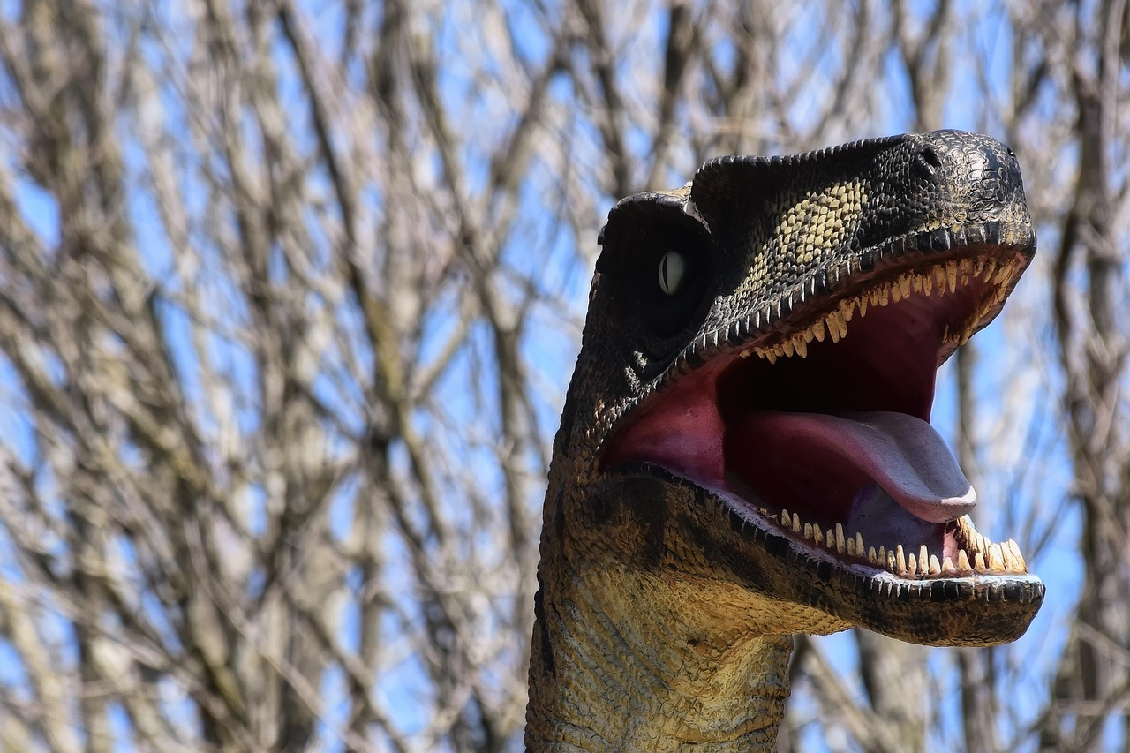
Welcome to the World of Dinosaurs
Exploring the Diversity, Characteristics, and Legacy of Prehistoric Giants

Slide 2
Table of Contents
Welcome to the World of Dinosaurs!
What is a Dinosaur?
Dinosaur Diets
Dinosaur Habitats
Unique Dinosaur Characteristics
Why Study Dinosaurs?
Dinosaur Extinction
Famous Dinosaurs
Dinosaur Facts
Common Misconceptions
Fun Activities
Conclusion
Next Steps
04
05
06
07
08
09
10
11
12
13
14
15
16

Slide 3
Table of Contents
Interactive Quiz
Assessment and Evaluation
Resources and References
Parent Engagement
Teaching Tips and Strategies
Conclusion and Final Thoughts
17
18
19
20
21
22

Slide 4
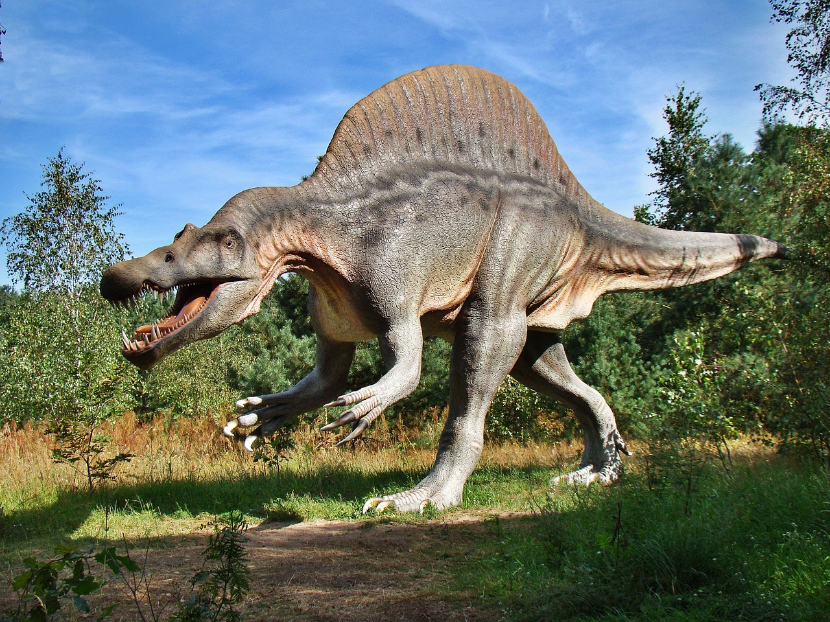
Welcome to the World of Dinosaurs!
Introduction to Dinosaurs
Significance of Dinosaurs
Dinosaur Diversity
Introduction to the fascinating world of dinosaurs.
Overview of the diversity of dinosaurs and their unique characteristics.
Importance of studying dinosaurs for understanding Earth's history.
Exploration of their role in the evolution of life.
Dinosaurs exhibited a wide range of unique characteristics.
Their diversity provides insights into ancient ecosystems.
4
Welcome to the World of Dinosaurs

Slide 5
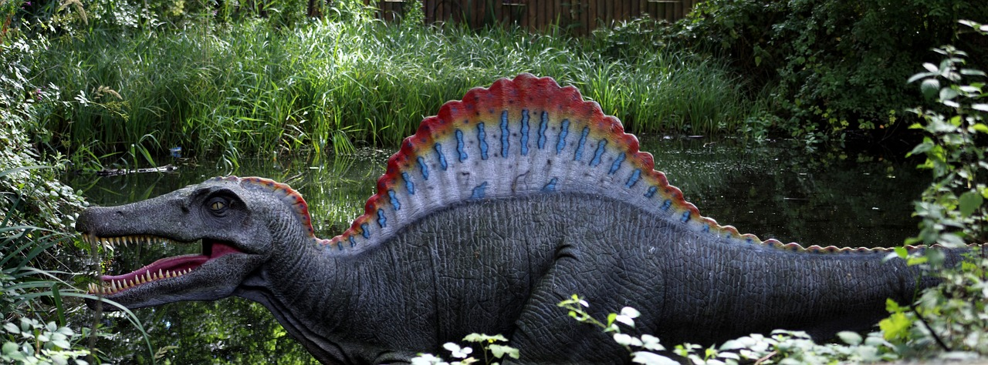
What is a Dinosaur?
Definition of Dinosaurs
Key Characteristics
A type of reptile that lived during the Mesozoic Era.
Dinosaurs are a distinct group of reptiles with unique evolutionary traits.
Dinosaurs laid eggs, were predominantly terrestrial, and varied greatly in size and shape.
These traits helped them adapt to diverse environments during their existence.
Famous Examples
Fun Fact About Dinosaurs
Tyrannosaurus Rex, Stegosaurus, and Diplodocus are some well-known dinosaurs.
Each of these species showcases the diversity within the dinosaur group.
The word 'dinosaur' means 'terrible lizard' in Greek.
This name reflects the awe and mystery surrounding these ancient creatures.
5
Welcome to the World of Dinosaurs

Slide 6
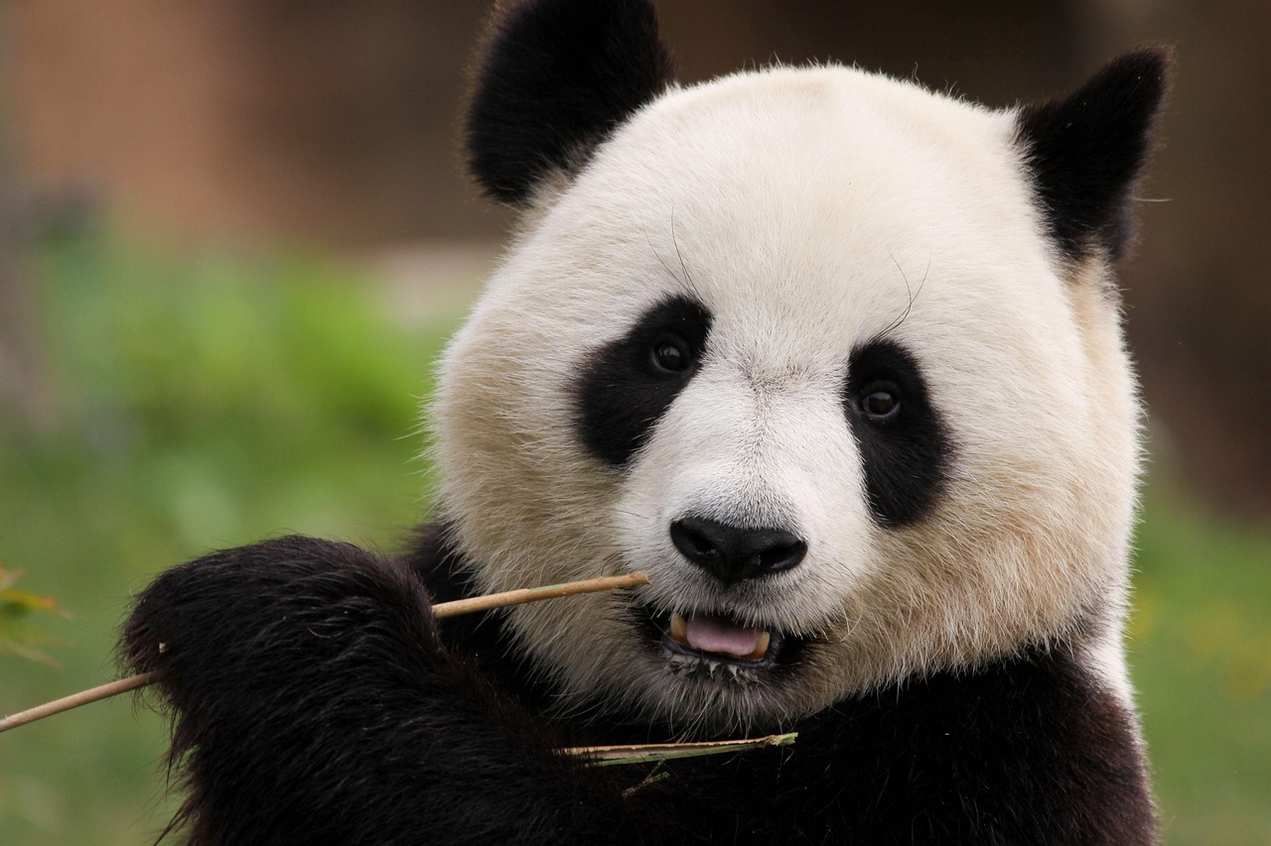
Dinosaur Diets
Herbivores
Carnivores
Omnivores
Plant-eaters, like the Stegosaurus.
They primarily consumed vegetation.
Meat-eaters, like the Tyrannosaurus Rex.
Their diet consisted mainly of other animals.
Ate both plants and animals, like the Oviraptor.
They had a diverse diet including both flora and fauna.
6
Welcome to the World of Dinosaurs

Slide 7
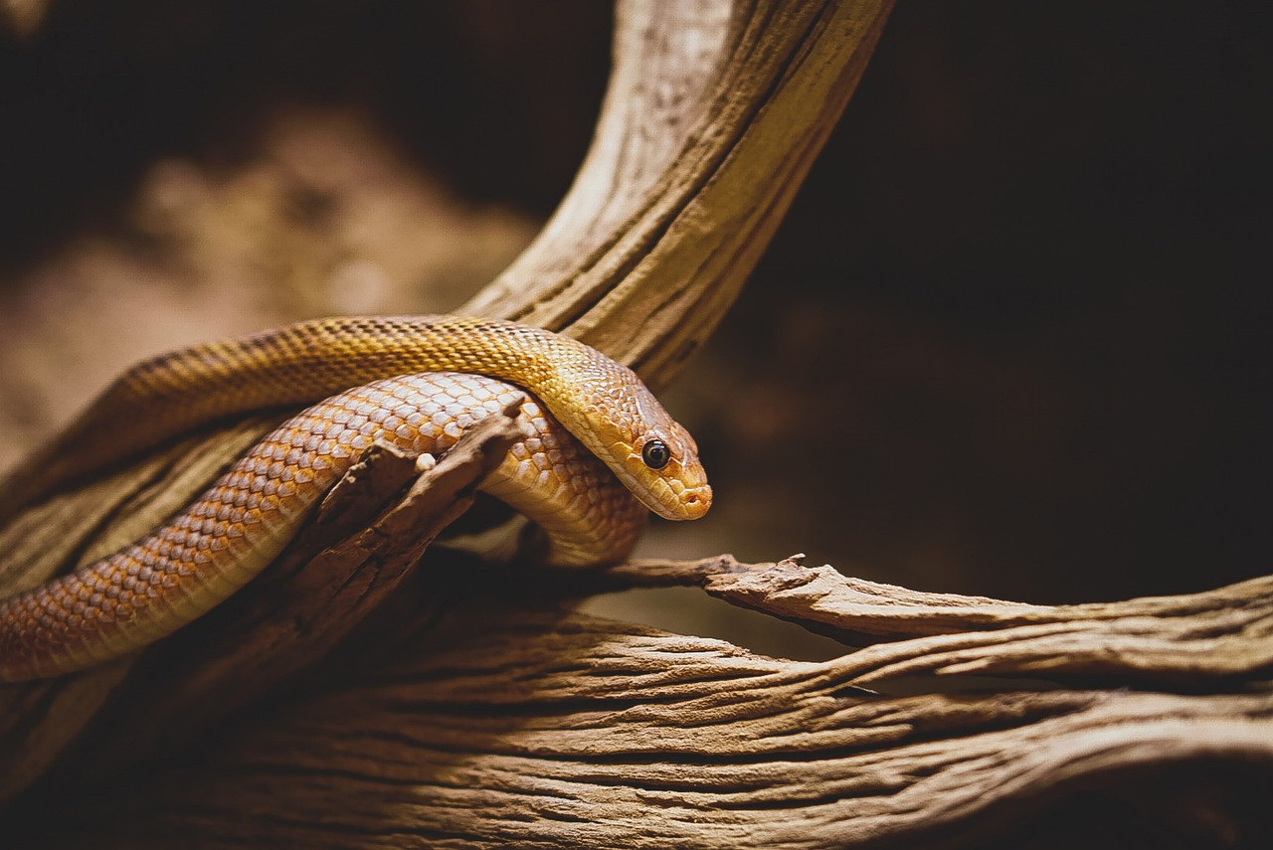
Dinosaur Habitats
Desert Dwellers
Forest Inhabitants
Plains Roamers
Some dinosaurs lived in hot, dry deserts.
These habitats were challenging but supported unique species.
Others lived in lush, green forests.
These environments provided abundant food and shelter.
Many dinosaurs roamed open plains and grasslands.
These vast areas allowed for migration and grazing.
7
Welcome to the World of Dinosaurs

Slide 8

Unique Dinosaur Characteristics
Stegosaurus
Tyrannosaurus Rex
Plates on its back for defense.
These plates may have also been used for display or thermoregulation.
Powerful legs and sharp teeth for hunting.
This made it one of the most fearsome predators of its time.
Diplodocus
Triceratops
Long tail for balance and a small head.
Its tail could also be used as a whip for defense.
Frill on its head and three horns for defense.
These features helped protect it from predators like the Tyrannosaurus Rex.
8
Welcome to the World of Dinosaurs

Slide 9
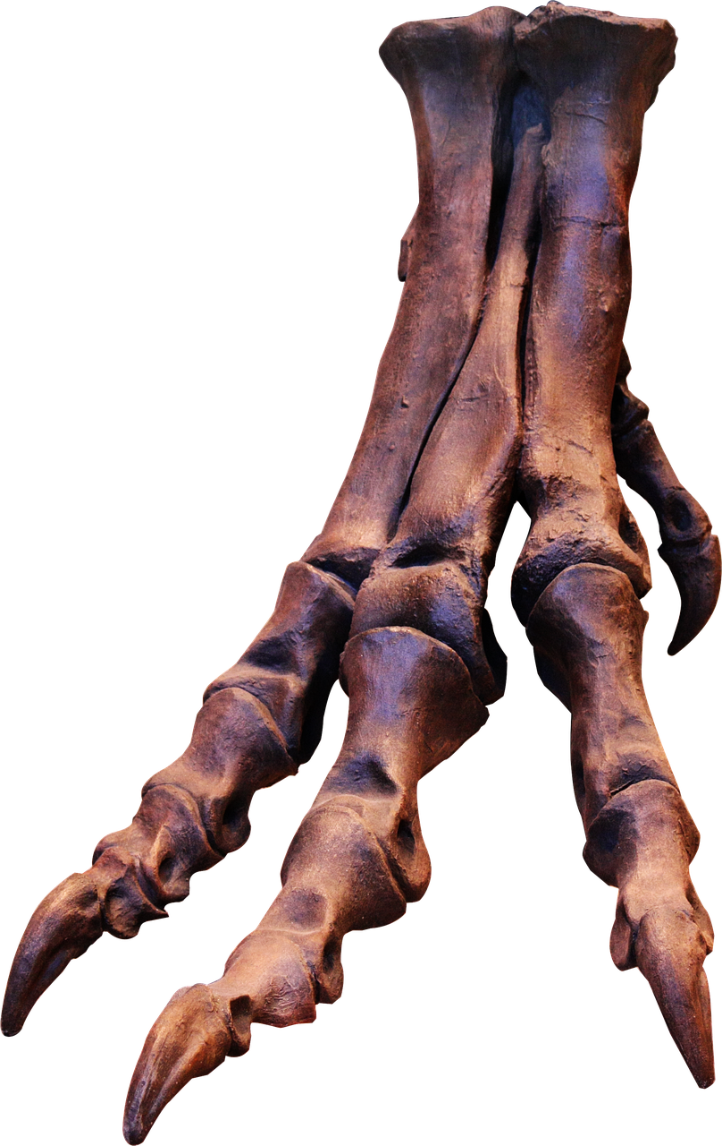
Why Study Dinosaurs?
Understanding Earth's History
Exploring Ecosystems and Habitats
Inspiring Scientific Curiosity
Studying dinosaurs helps us uncover the story of Earth's past.
It reveals how life evolved over millions of years.
Dinosaurs lived in diverse ecosystems and habitats.
Learning about them provides insights into ancient environments.
Dinosaurs spark interest in science and nature.
They encourage exploration and discovery in young minds.
9
Welcome to the World of Dinosaurs

Slide 10
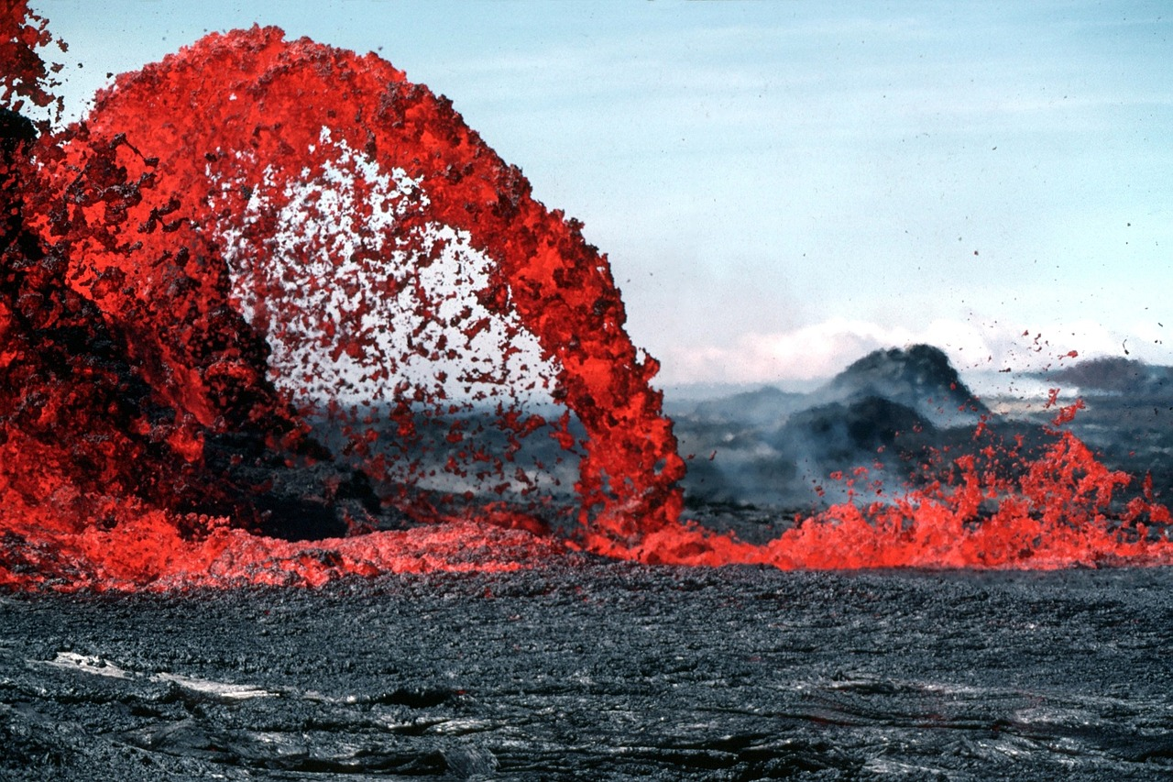
Dinosaur Extinction
1
Mass Extinction Event
Mass extinction event at the end of the Cretaceous period.
Possible causes: Asteroid impact, volcanic eruptions, climate change.
2
Impact on Dinosaurs
Result: Dinosaurs became extinct.
Their legacy lives on.
3
Possible Causes
Asteroid impact, volcanic eruptions, and climate change are considered possible causes.
These events drastically altered the Earth's environment.
10
Welcome to the World of Dinosaurs

Slide 11
Famous Dinosaurs
Tyrannosaurus Rex
Velociraptor
Diplodocus
Spinosaurus
The 'King of the Dinosaurs'.
Known for its massive size and powerful jaws.
Known for its intelligence and pack hunting.
A smaller but highly agile predator.
A long, gentle herbivore.
Famous for its whip-like tail and elongated neck.
A sail-backed carnivore with a unique appearance.
Adapted for both land and water environments.
11
Welcome to the World of Dinosaurs

Slide 12
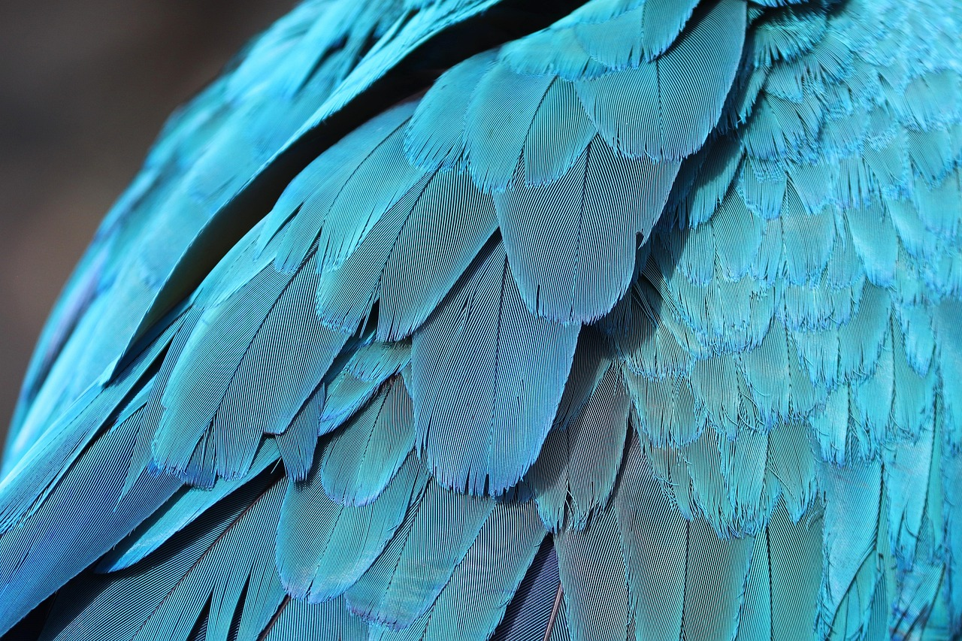
Dinosaur Facts
01
Largest Dinosaur
The largest dinosaur was the Argentinosaurus.
It was a massive herbivore that roamed the Earth millions of years ago.
02
Fastest Dinosaur
The fastest dinosaur was the Ornithomimus.
This dinosaur could run at incredible speeds to escape predators.
03
Feathered Dinosaurs
Some dinosaurs had feathers, like the Sinosauropteryx.
These feathers might have been used for display or insulation.
04
Mesozoic Era
Dinosaurs lived during the Mesozoic Era, over 65 million years ago.
This era is often called the Age of Dinosaurs.
12
Welcome to the World of Dinosaurs

Slide 13
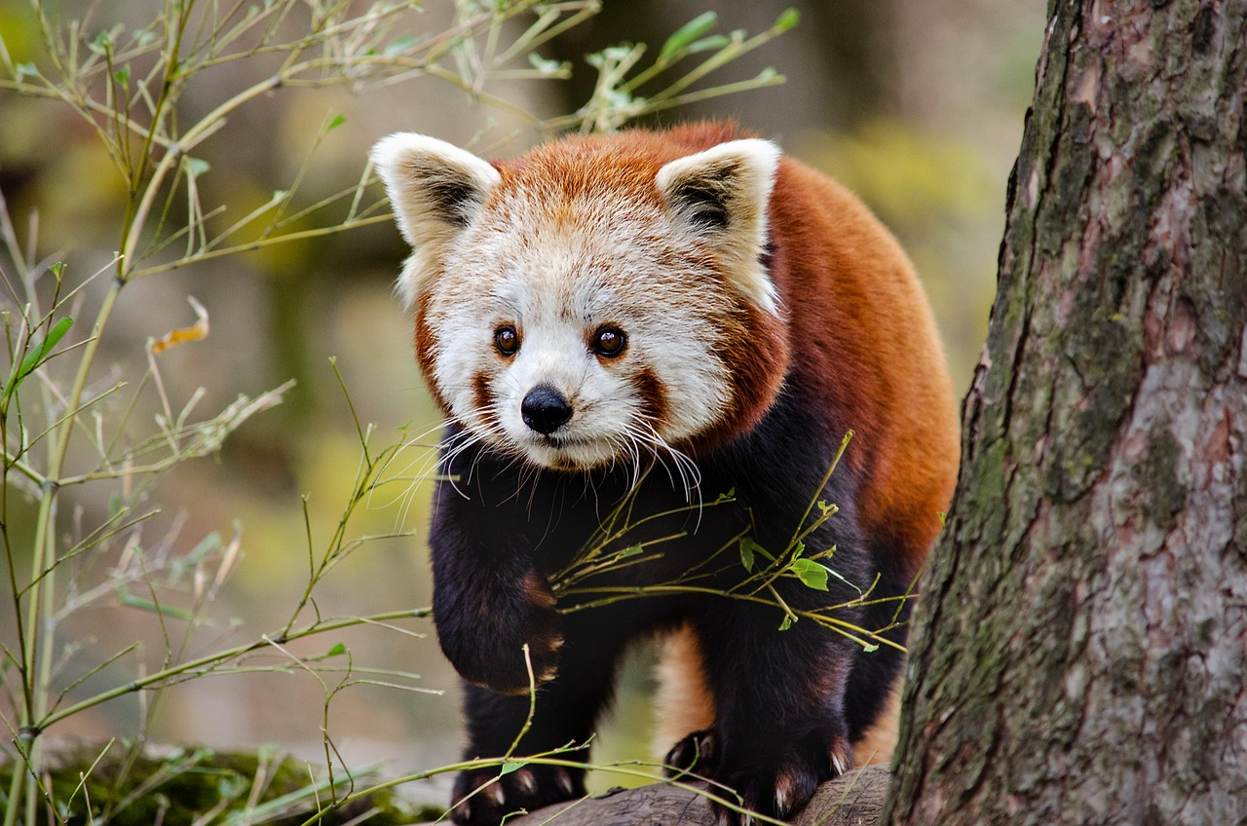
Common Misconceptions
1
Dinosaurs' Size Diversity
Not all dinosaurs were huge.
Some were as small as chickens.
2
Dinosaurs and Humans Timeline
Dinosaurs and humans did not coexist.
Dinosaurs went extinct millions of years before humans appeared.
3
Dietary Habits of Dinosaurs
Not all dinosaurs were meat-eaters.
Many were herbivores, feeding on plants.
13
Welcome to the World of Dinosaurs

Slide 14
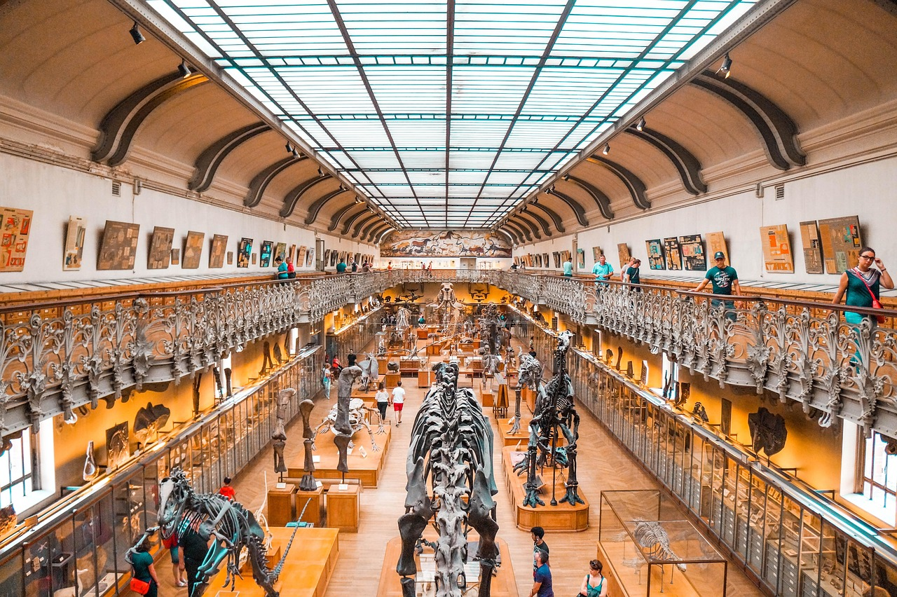
Fun Activities
1
2
3
Dinosaur Model Building
Dino Dig Adventure
Dinosaur Drawing and Coloring
Engage in creating detailed dinosaur models.
This activity is perfect for hands-on learners and dinosaur enthusiasts.
Experience the thrill of excavating plastic dinosaurs from a sandbox.
This activity simulates the work of paleontologists in a fun and interactive way.
Unleash your creativity by drawing and coloring dinosaurs.
This artistic activity is ideal for kids and adults alike.
14
Welcome to the World of Dinosaurs

Slide 15
Conclusion
Key Takeaways
Final Thoughts
Summary of key points learned about dinosaurs
Encouragement to continue exploring and learning about dinosaurs
Summary of key points learned about dinosaurs
Encouragement to continue exploring and learning about dinosaurs
15
Welcome to the World of Dinosaurs

Slide 16
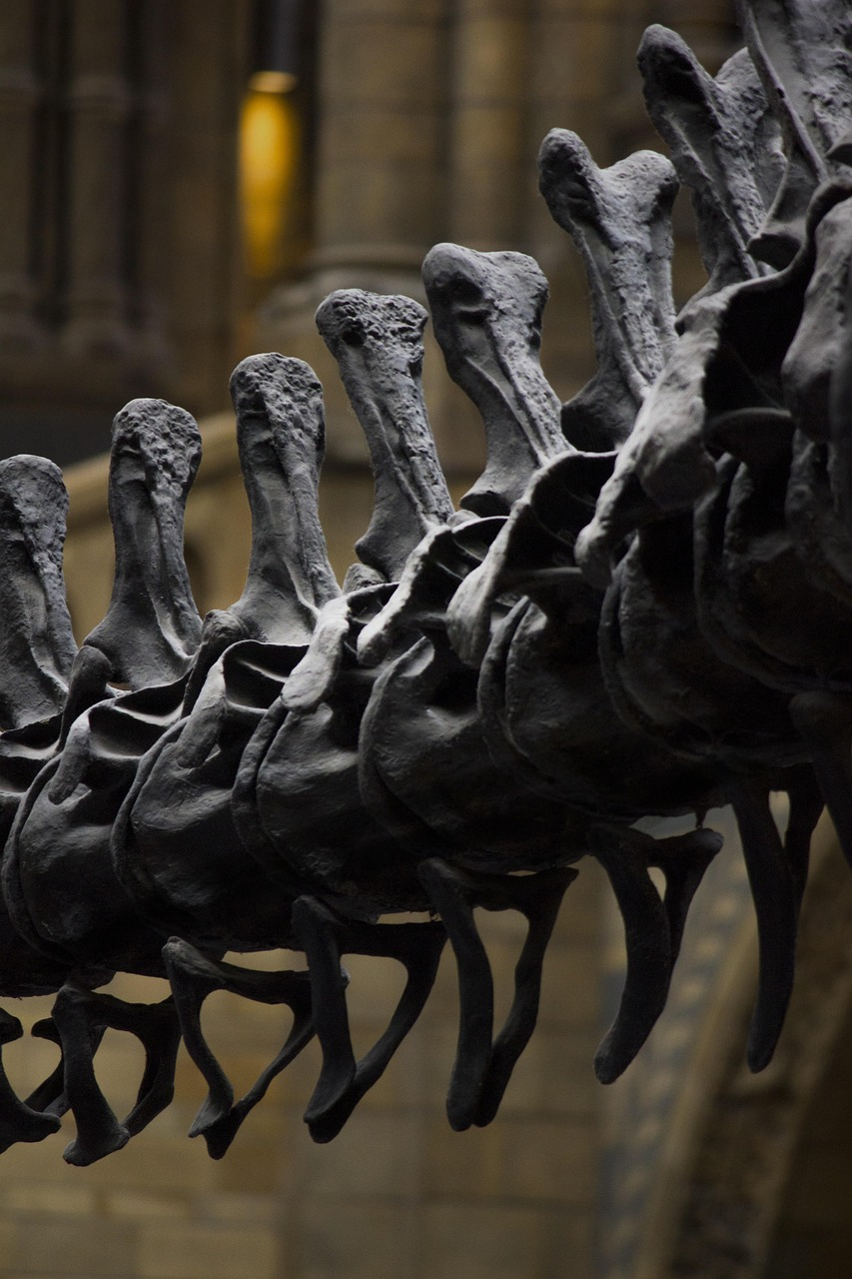
Next Steps
Exploring Dinosaur Knowledge
Further reading and research on dinosaurs.
Visiting natural history museums and dinosaur exhibits.
Engaging with Exhibits
Visiting natural history museums and dinosaur exhibits.
Participating in dinosaur-themed activities and games.
Interactive Learning
Participating in dinosaur-themed activities and games.
Further reading and research on dinosaurs.
16
Welcome to the World of Dinosaurs

Slide 17
Interactive Quiz
Largest Dinosaur
Intelligent Dinosaur
Dinosaur Extinction
Question 1: What was the largest dinosaur?
Explore the fascinating world of prehistoric giants.
Question 2: Which dinosaur was known for its intelligence?
Discover the clever creatures of the past.
Question 3: What was the main reason for dinosaur extinction?
Uncover the mystery behind their disappearance.
17
Welcome to the World of Dinosaurs

Slide 18

Assessment and Evaluation
Participation and Engagement
Students will be assessed on their participation and engagement.
This ensures active involvement in the learning process.
Quizzes and Activities
Evaluation of student understanding through quizzes and activities.
These tools help measure comprehension effectively.
Feedback for Improvement
Feedback and guidance for future improvement.
This supports students in identifying areas for growth.
18
Welcome to the World of Dinosaurs

Slide 19

Resources and References
Recommended Reading
Online Learning
Fun for Kids
List of recommended books and articles on dinosaurs.
Explore a variety of literature to deepen your understanding of these prehistoric creatures.
Online resources and websites for further learning.
Access a wealth of information and interactive content about dinosaurs.
Dinosaur-themed games and activities for kids.
Engage children with entertaining and educational dinosaur-related activities.
19
Welcome to the World of Dinosaurs

Slide 20

Parent Engagement
Engaging Parents in Activities
Supporting Learning at Home
Building a Dinosaur Community
Encouraging parents to participate in dinosaur-themed activities with their kids.
This fosters a fun and interactive learning environment.
Providing resources and tips for parents to support their child's learning.
This ensures parents can effectively contribute to their child's educational journey.
Building a community of parents and kids who share an interest in dinosaurs.
This creates a network for shared experiences and mutual support.
20
Welcome to the World of Dinosaurs

Slide 21

Teaching Tips and Strategies
Engaging Students with Visual Aids
Making Learning Fun
Meeting Diverse Learning Needs
Using visual aids and hands-on activities to engage students.
These methods help in making abstract concepts more tangible and understandable.
Incorporating storytelling and role-playing to make learning fun.
These strategies foster creativity and make lessons more memorable.
Differentiating instruction to meet the needs of all learners.
This approach ensures that every student can access and benefit from the curriculum.
21
Welcome to the World of Dinosaurs

Slide 22

Conclusion and Final Thoughts
Recap of Learning Importance
Encouragement to Explore
Recap of the importance of learning about dinosaurs
Final thoughts and encouragement to continue exploring and learning
Recap of the importance of learning about dinosaurs
Final thoughts and encouragement to continue exploring and learning
22
Welcome to the World of Dinosaurs

