Slide 1

Mastering Comparison and Contrast Essays
A Comprehensive Guide to Structure, Techniques, and Applications

Slide 2
Table of Contents
Introduction to Comparison and Contrast Essays
What are Comparison and Contrast Essays?
Types of Comparative Essays
Structure and Organization
Transitional Words and Phrases
Writing a Comparative Essay
Common Pitfalls to Avoid
Real-Life Applications
Benefits of Comparison and Contrast Essays
Conclusion
Key Takeaways
Reflection Questions
Next Steps
04
05
06
07
08
09
10
11
12
13
14
15
16

Slide 3
Table of Contents
Additional Resources
Conclusion and Final Thoughts
Final Tips and Recommendations
Get Started with Comparison and Contrast Essays
Introduction to Comparison and Contrast Essays…
Objectives
Vocabulary
Resources
Prior Knowledge
17
18
19
20
21
22
23
24
25

Slide 4

Introduction to Comparison and Contrast Essays
Understanding Comparison and Contrast Essays
Learning Objectives of the Lesson
Skill Application in Writing
Welcome to the world of comparison and contrast essays, a fundamental component of academic writing.
In this lesson, we will delve into the purpose, structure, and applications of comparison and contrast essays.
By the end of this lesson, you will be able to identify the purpose of comparison and contrast essays.
You will also be able to explain the differences between comparative and contrasting techniques.
Apply the skills learned to write a basic comparative essay.
This involves understanding and utilizing both comparative and contrasting techniques effectively.
4
Mastering Comparison and Contrast Essays

Slide 5

What are Comparison and Contrast Essays?
Definition of Comparison and Contrast Essays
Purpose of Comparative Essays
Comparison and contrast essays are a type of academic writing that involves analyzing and evaluating two or more concepts, ideas, or texts.
These essays focus on identifying similarities and differences between the subjects under analysis.
The purpose of a comparative essay is to identify similarities and differences, and to provide evidence to support arguments and claims.
This approach helps in constructing well-reasoned and substantiated arguments.
Applications of Comparative Essays
Benefits of Writing Comparative Essays
Comparative essays are commonly used in academic and professional settings, such as in literature, science, and history.
They serve as tools for critical analysis and understanding of complex topics.
By learning how to write effective comparative essays, you will be able to analyze complex information, develop well-supported arguments, and communicate your ideas clearly and persuasively.
This skill enhances your ability to present information in a structured and impactful manner.
5
Mastering Comparison and Contrast Essays

Slide 6
Types of Comparative Essays
Comparative Analysis
Comparative Evaluation
Overview of Comparative Essays
Comparative analysis involves analyzing and comparing two or more concepts or ideas.
It focuses on identifying similarities and differences between the subjects.
Comparative evaluation involves evaluating and comparing two or more concepts or ideas.
This type emphasizes providing evidence to support arguments and claims.
There are several types of comparative essays, including comparative analysis, comparative evaluation, and comparative synthesis.
Each type serves a unique purpose in examining and contrasting subjects.
6
Mastering Comparison and Contrast Essays

Slide 7

Structure and Organization
Introduction of a Comparative Essay
Body Paragraphs in a Comparative Essay
A comparative essay typically begins with an introduction.
This section provides background information, context, and introduces the thesis statement.
The body paragraphs present evidence and analysis.
Transitional words and phrases are used to connect ideas effectively.
Conclusion of a Comparative Essay
Standard Structure of a Comparative Essay
The conclusion summarizes the main points discussed.
It reiterates the thesis statement and provides a final thought or call to action.
A comparative essay follows a standard structure: introduction, body paragraphs, and conclusion.
This organization ensures clarity and coherence in presenting ideas.
7
Mastering Comparison and Contrast Essays

Slide 8

Transitional Words and Phrases
Importance of Transitional Words
Examples of Transitional Words
Function of Transitional Words
Transitional words and phrases are essential in comparative essays, as they connect ideas and provide a clear and logical flow.
They ensure the essay maintains coherence and effectively communicates the relationships between concepts.
Common transitional words and phrases include however, in addition, meanwhile, and nevertheless.
These examples illustrate the variety of ways transitions can be used to enhance writing.
These words and phrases help to signal the reader, indicating the relationships between ideas and providing a clear and concise argument.
They play a crucial role in guiding the reader through the essay's structure and logic.
8
Mastering Comparison and Contrast Essays

Slide 9

Writing a Comparative Essay
Brainstorming and Thesis Development
Supporting Arguments with Evidence
To write a comparative essay, start by brainstorming ideas.
Develop a thesis statement to guide your essay.
Use evidence and examples to support your arguments.
Organize your ideas into a clear and logical structure.
Connecting Ideas and Concluding
Revising and Editing
Use transitional words and phrases to connect your ideas.
Provide a clear and concise conclusion to your essay.
Finally, revise and edit your essay to ensure it is well-written.
Check for errors to make your essay polished and professional.
9
Mastering Comparison and Contrast Essays

Slide 10

Common Pitfalls to Avoid
01
Importance of a Clear Thesis Statement
One common pitfall is the lack of a clear thesis statement.
This can make the essay seem disjointed and unclear.
02
Providing Sufficient Evidence
Another common pitfall is the failure to provide sufficient evidence to support arguments.
This can make the essay seem weak and unconvincing.
03
Ensuring Proper Organization
Poor organization and lack of transitional words and phrases can make the essay seem confusing.
This can make the essay difficult to follow.
04
Addressing Counterarguments
Failure to address counterarguments can weaken the essay.
This can make it seem one-sided.
10
Mastering Comparison and Contrast Essays

Slide 11
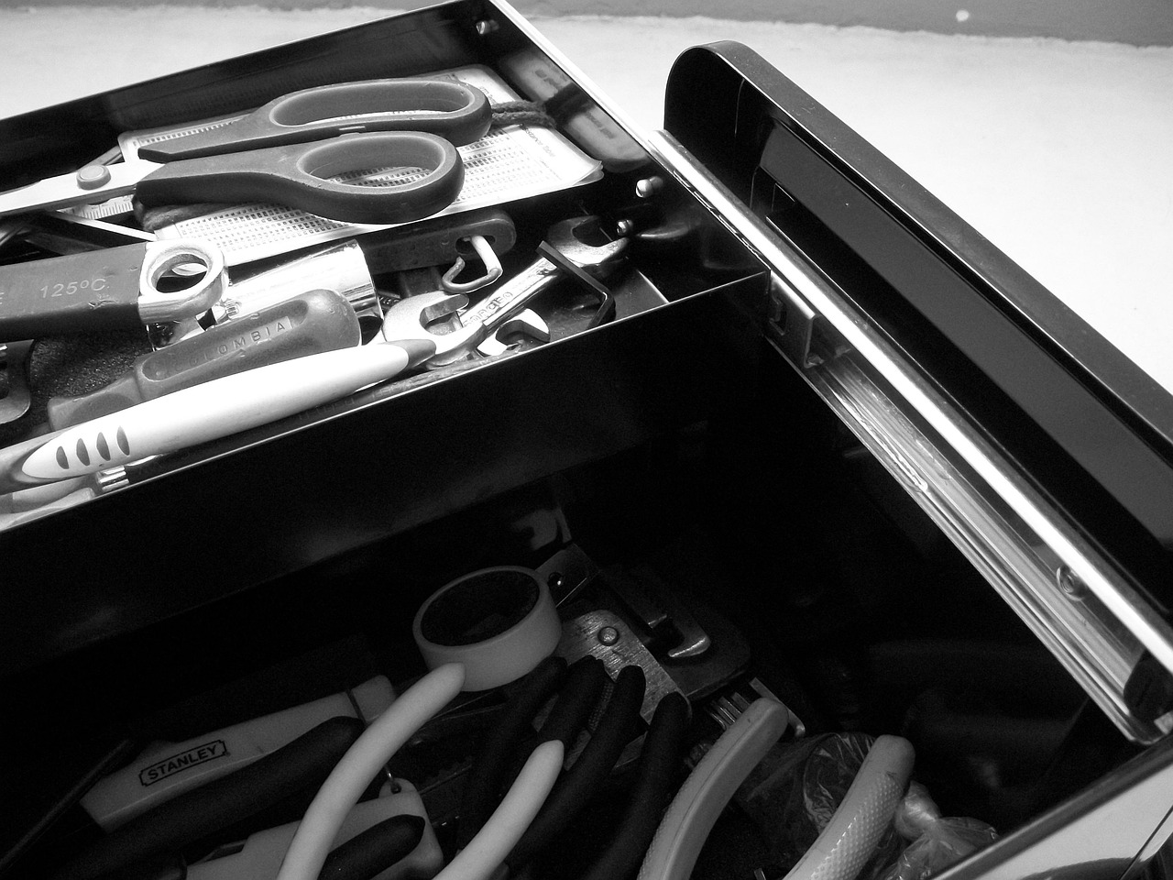
Real-Life Applications
Business Applications
Scientific Applications
Literary Applications
Comparison and contrast essays are utilized in business to evaluate different marketing strategies.
They help in analyzing business models to determine their effectiveness and potential improvements.
In science, comparative essays are used to assess various theories or models.
This approach aids in identifying the strengths and weaknesses of each scientific proposition.
Comparison and contrast essays are valuable in literature for analyzing different works or authors.
They provide insights into thematic and stylistic differences, enriching literary understanding.
11
Mastering Comparison and Contrast Essays

Slide 12

Benefits of Comparison and Contrast Essays
Develop Critical Thinking and Analytical Skills
Enhance Writing Skills
Comparison and contrast essays can help you develop critical thinking and analytical skills.
You learn to evaluate and analyze complex information effectively.
These essays assist in improving your writing skills.
You learn to organize and express your ideas clearly and persuasively.
Improve Research Skills
Strengthen Communication Skills
Comparative essays help in developing your research skills.
You learn to find and evaluate evidence to support your arguments.
Writing comparative essays enhances your communication skills.
You learn to present your ideas and arguments in a clear and concise manner.
12
Mastering Comparison and Contrast Essays

Slide 13

Conclusion
1
Value of Comparative Essays
Comparison and contrast essays are a valuable tool for analyzing and evaluating complex information.
They enable a deeper understanding of the subjects being compared.
2
Skill Development
Writing effective comparative essays helps develop critical thinking, analytical, and writing skills.
These skills are beneficial in both academic and professional settings.
3
Tips for Strong Essays
Using transitional words and phrases, providing sufficient evidence, and addressing counterarguments are essential.
These practices make essays strong and convincing.
13
Mastering Comparison and Contrast Essays

Slide 14

Key Takeaways
01
Purpose of Comparative Essays
The purpose of a comparative essay is to identify similarities and differences.
It provides evidence to support arguments and claims effectively.
02
Structure of Comparative Essays
Comparative essays typically follow a standard structure and organization.
This includes an introduction, body paragraphs, and a conclusion.
03
Role of Transitional Words
Transitional words and phrases are essential in comparative essays.
They connect ideas and provide a clear and logical flow.
04
Applications of Comparison and Contrast Essays
Comparison and contrast essays have many real-life applications.
These include fields such as business, science, and literature.
14
Mastering Comparison and Contrast Essays

Slide 15

Reflection Questions
1
Avoiding Pitfalls in Comparative Essays
What are some common pitfalls to avoid when writing a comparative essay?
Understanding these pitfalls can help improve the quality and effectiveness of your writing.
2
Using Transitional Words Effectively
How can you use transitional words and phrases to connect your ideas and provide a clear and logical flow?
Mastering this skill ensures coherence and enhances the readability of your essay.
3
Applications of Comparison and Contrast Essays
What are some real-life applications of comparison and contrast essays, and how can you use them in your own life and career?
Recognizing these applications can provide valuable insights and practical benefits.
15
Mastering Comparison and Contrast Essays

Slide 16

Next Steps
Introduction to Writing Practice
Enhancing Essay Quality
Steps for Effective Writing
Now that you have learned about comparison and contrast essays, it's time to practice writing your own.
Start by brainstorming ideas and developing a thesis statement, and then use evidence and examples to support your arguments.
Remember to always use transitional words and phrases.
Provide sufficient evidence and address counterarguments to make your essays strong and convincing.
Begin with brainstorming and thesis development.
Support your arguments with evidence and examples while maintaining clarity and coherence.
16
Mastering Comparison and Contrast Essays

Slide 17

Additional Resources
Online Resources and Tutorials
For more information on comparison and contrast essays, check out our online resources and tutorials.
These materials provide comprehensive guidance to enhance your understanding and skills.
Examples and Writing Guidance
You can find examples of comparative essays and guidance on how to write your own on our website.
These examples serve as practical references to improve your essay writing techniques.
Instructor and Tutor Support
Additionally, you can seek help from your instructor or tutor if you have any questions or need further guidance.
Their expertise can provide personalized assistance to address your specific needs.
17
Mastering Comparison and Contrast Essays

Slide 18

Conclusion and Final Thoughts
1
2
3
The Value of Comparative Essays
Skill Development Through Writing
Continuous Improvement in Writing
Comparison and contrast essays are a valuable tool for analyzing and evaluating complex information.
They enable individuals to understand differences and similarities effectively.
Learning to write effective comparative essays helps develop critical thinking, analytical, and writing skills.
These skills are beneficial in both academic and professional settings.
Practicing and seeking feedback are essential for improving writing skills.
This approach helps in becoming a proficient writer of comparative essays.
18
Mastering Comparison and Contrast Essays

Slide 19

Final Tips and Recommendations
Brainstorming and Thesis Development
Always start by brainstorming ideas.
Develop a thesis statement to guide your essay.
Supporting Arguments with Evidence
Use evidence and examples to support your arguments.
Organize your ideas into a clear and logical structure.
Connecting Ideas Effectively
Use transitional words and phrases to connect your ideas.
Provide a clear and concise conclusion to your essay.
Revising and Editing
Revise and edit your essay thoroughly.
Ensure that it is well-written and free of errors.
19
Mastering Comparison and Contrast Essays

Slide 20
Get Started with Comparison and Contrast Essays
Introduction to Writing Comparison and Contrast Essays
Guidelines and Tips for Success
Encouragement and Support
Now that you have learned about comparison and contrast essays, it's time to get started with writing your own.
This is an opportunity to apply the knowledge and techniques discussed in the presentation.
Remember to always follow the guidelines and tips outlined in this presentation.
These will help ensure your essay is structured effectively and communicates your ideas clearly.
Good luck with your writing, and happy learning!
Don't hesitate to seek help if you need it to enhance your essay writing skills.
20
Mastering Comparison and Contrast Essays

Slide 21
Introduction to Comparison and Contrast Essays: A Foundational Guide
1
2
3
Purpose of Comparison and Contrast Essays
Learning Objectives of the Lesson
Focus of the Lesson Plan
This lesson plan introduces 18-year-old students to the fundamental concepts and purposes of comparison and contrast essays.
It aims to provide a foundational understanding of their structure, benefits, and applications in academic and professional contexts.
Students will learn to identify the purpose of comparison and contrast essays and explain the differences between comparative and contrasting techniques.
These skills will enable them to write a basic comparative essay effectively.
The key learning focus is to understand the structure, benefits, and applications of comparison and contrast essays.
This understanding is crucial for their academic and professional development.
21
Mastering Comparison and Contrast Essays

Slide 22

Objectives
01
Understanding Comparative Essays
03
Creating Essay Outlines
Students will be able to analyze the purpose and structure of comparison and contrast essays.
This includes identifying key elements and their roles in the essay format.
Students will be able to create a basic outline for a comparative essay.
This involves using a standard structure and organization for their outlines.
02
Evaluating Essay Effectiveness
04
Writing Comparative Essays
Students will be able to evaluate the effectiveness of comparative essays.
They will use criteria such as clarity, coherence, and use of evidence.
Students will be able to apply comparative analysis skills to write a short comparative essay.
They will use evidence and examples to support their arguments effectively.
22
Mastering Comparison and Contrast Essays

Slide 23

Vocabulary
Understanding Comparative Analysis
Exploring Contrast
Comparative analysis involves evaluating two or more ideas, concepts, or texts.
The goal is to identify both similarities and differences between them.
Contrast focuses on highlighting the differences between ideas, concepts, or texts.
This method emphasizes distinctions to clarify understanding.
The Role of Comparison
Using Transitional Words and Phrases
Comparison is the process of identifying similarities between ideas, concepts, or texts.
It helps in finding common ground and shared characteristics.
Transitional words and phrases connect ideas and paragraphs in a text.
Examples include 'however,' 'in addition,' and 'meanwhile.'
23
Mastering Comparison and Contrast Essays

Slide 24

Resources
Digital Tool: Online Comparative Essay Template
Provides a structured outline for students to organize their ideas.
Helps students write their essays effectively.
Physical Material: Whiteboard and Markers
Used to illustrate key concepts and techniques.
Facilitates teaching comparative analysis and transitional words usage.
Digital Tool: Online Grammar and Mechanics Guide
Offers resources to improve writing skills.
Supports students in enhancing grammar and mechanics.
24
Mastering Comparison and Contrast Essays

Slide 25

Prior Knowledge
Understanding Essay Structure
Analytical Thinking Skills
Students should be familiar with the basic structure of an essay, including introduction, body paragraphs, and conclusion.
This foundational knowledge enables them to organize their ideas effectively in comparison and contrast essays.
Students should have developed analytical thinking skills, which involve breaking down complex information into smaller parts, identifying patterns and relationships, and drawing conclusions.
These skills are crucial for analyzing similarities and differences in comparison and contrast essays.
Critical Thinking Skills
Vocabulary and Terminology
Students should have developed critical thinking skills, which involve evaluating information, identifying biases, and making informed decisions.
Such skills help in assessing the validity of arguments and perspectives in essays.
Students should possess vocabulary and terminology related to comparison and contrast.
This knowledge aids in articulating ideas clearly and effectively in their essays.
25
Mastering Comparison and Contrast Essays

