Slide 1

Navigating Workplace Dynamics
Understanding Culture and Professional Etiquette for Success

Slide 2
Table of Contents
Introduction to Workplace Culture and Professi…
What is Workplace Culture?
Importance of Workplace Culture
What is Professional Etiquette?
Key Elements of Professional Etiquette
Types of Workplace Cultures
Adapting to Different Workplace Cultures
Role-Playing Exercise: Job Interview
Case Study: Workplace Culture and Professional…
Group Discussion: Workplace Culture and Profes…
Reflection and Self-Assessment
Conclusion
Additional Resources
04
05
06
07
08
09
10
11
12
13
14
15
16

Slide 3
Table of Contents
Final Thoughts
Assessment and Evaluation
Extension Activities
Parent Engagement
Safety Considerations
Conclusion and Final Thoughts
Next Steps
Reflection Questions
Final Reflection
17
18
19
20
21
22
23
24
25

Slide 4

Introduction to Workplace Culture and Professional Etiquette
Welcome to Workplace Culture
Exploring Fundamentals
Importance of Application
Welcome to the world of workplace culture and professional etiquette!
Understanding these concepts is crucial for success in any career.
In this presentation, we will explore the fundamentals of workplace culture.
We will also delve into professional etiquette and its application in real-world scenarios.
Applying workplace culture and etiquette effectively can enhance career success.
This presentation aims to provide insights and practical knowledge for implementation.
4
Navigating Workplace Dynamics

Slide 5

What is Workplace Culture?
Definition of Workplace Culture
Impact on Employee Interaction
Types of Workplace Cultures
Workplace culture refers to the shared values, beliefs, and practices within an organization.
It forms the foundation of how the organization operates and interacts internally and externally.
Workplace culture influences how employees interact with each other and their work.
It shapes the dynamics of teamwork, communication, and overall employee engagement.
Examples of workplace cultures include formal, informal, innovative, and traditional.
Each type reflects different approaches to organizational structure and employee behavior.
5
Navigating Workplace Dynamics

Slide 6

Importance of Workplace Culture
Fostering Community and Innovation
Impact on Business Success and Employee Retention
Integration for New Employees
A positive workplace culture can foster a sense of community.
It encourages creativity and innovation among employees.
Workplace culture can drive business success.
It significantly impacts employee satisfaction and retention.
Understanding and adapting to a company's culture is essential for new employees.
This helps them integrate smoothly and contribute effectively.
6
Navigating Workplace Dynamics

Slide 7

What is Professional Etiquette?
Definition of Professional Etiquette
Components of Professional Etiquette
Importance of Professional Etiquette
Professional etiquette refers to the rules of behavior that are considered acceptable in a professional setting.
It encompasses norms and practices that guide interactions and conduct in the workplace.
It includes aspects such as communication, punctuality, dress code, and meeting etiquette.
These elements collectively contribute to a professional and respectful environment.
Mastering professional etiquette is vital for building strong professional relationships.
It plays a crucial role in advancing one's career and achieving professional success.
7
Navigating Workplace Dynamics

Slide 8

Key Elements of Professional Etiquette
1
Effective Communication
Professional etiquette involves mastering both verbal and non-verbal communication cues.
Active listening and clear speech are essential components of effective interpersonal interactions.
2
Importance of Punctuality
Being punctual reflects respect for others' time and commitment to responsibilities.
It includes arriving on time, meeting deadlines, and maintaining a reliable schedule.
3
Appropriate Dress Code
Dressing suitably for the workplace and specific occasions is a key aspect of professional etiquette.
It demonstrates respect for the environment and adherence to organizational standards.
8
Navigating Workplace Dynamics

Slide 9
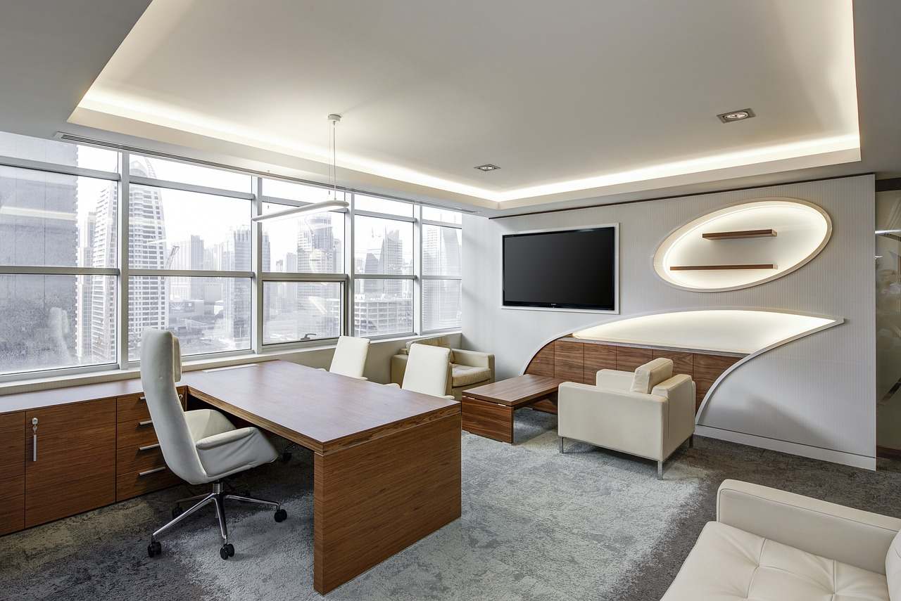
Types of Workplace Cultures
Formal Workplace Culture
Formal culture is characterized by traditional, hierarchical, and rule-based structures.
This type of culture emphasizes order, clear roles, and adherence to established procedures.
Informal Workplace Culture
Informal culture is relaxed, flexible, and open, fostering a casual environment.
It encourages collaboration and adaptability among employees.
Innovative Workplace Culture
Innovative culture promotes experimentation, risk-taking, and creativity.
This culture supports new ideas and dynamic approaches to problem-solving.
9
Navigating Workplace Dynamics

Slide 10

Adapting to Different Workplace Cultures
1
Understanding Workplace Culture
Observe and listen to understand the workplace culture.
This helps in identifying the norms and expectations within the organization.
2
Embracing Flexibility
Be flexible and open to new experiences and challenges.
Adaptability is key to thriving in diverse work environments.
3
Respecting Company Values
Respect and adapt to the company's values and practices.
Aligning with these values fosters a harmonious and productive workplace.
10
Navigating Workplace Dynamics

Slide 11

Role-Playing Exercise: Job Interview
Pair Role Assignment
Divide participants into pairs.
Assign roles of interviewer and interviewee to each pair.
Interview Practice
Conduct a simulated job interview.
Focus on demonstrating professional etiquette and effective communication skills.
Debriefing Session
Discuss the outcomes of the exercise.
Identify strengths and areas for improvement.
11
Navigating Workplace Dynamics

Slide 12

Case Study: Workplace Culture and Professional Etiquette
1
2
3
Exploring Unique Workplace Cultures
Impact on Employees and Organization
Key Takeaways and Lessons Learned
Read and analyze a case study of a company with a unique workplace culture.
Understand the distinctive elements that define the company's approach to workplace dynamics.
Discuss the impact of the culture on employees and the organization.
Evaluate how the workplace culture influences productivity, satisfaction, and overall organizational success.
Identify key takeaways and lessons learned.
Highlight actionable insights that can be applied to other organizational contexts.
12
Navigating Workplace Dynamics

Slide 13

Group Discussion: Workplace Culture and Professional Etiquette
Group Formation and Topic Assignment
Discussion and Sharing
Active Listening and Respectful Communication
Divide participants into small groups.
Assign each group a specific topic related to workplace culture and professional etiquette.
Encourage groups to discuss their assigned topics.
Participants should share their thoughts, experiences, and questions with their group.
Promote active listening among group members.
Ensure communication remains respectful and constructive throughout the discussion.
13
Navigating Workplace Dynamics

Slide 14

Reflection and Self-Assessment
Understanding Workplace Culture
Personal Strengths and Improvements
Setting Development Goals
Reflect on what you have learned about workplace culture and professional etiquette.
Consider how these insights can be applied to enhance your professional interactions.
Assess your own strengths and areas for improvement.
Identify specific skills or behaviors that could benefit from further development.
Set goals for continued learning and development.
Plan actionable steps to achieve these goals and track your progress.
14
Navigating Workplace Dynamics

Slide 15

Conclusion
Importance of Workplace Culture
Applying Learned Concepts
Key Principles for Growth
Understanding workplace culture and professional etiquette is essential for success in any career.
These elements form the foundation for effective collaboration and personal growth.
By applying the concepts learned in this presentation, you can build strong professional relationships.
This approach contributes to fostering a positive and productive workplace environment.
Remember to always be respectful, adaptable, and open to learning and growth.
These principles are vital for continuous improvement and professional success.
15
Navigating Workplace Dynamics

Slide 16

Additional Resources
Recommended Readings
Online Courses
Networking Opportunities
Recommended readings and resources for further learning.
Explore curated materials to deepen your understanding of the subject.
Online courses and workshops for professional development.
Engage in structured learning opportunities to enhance your skills.
Professional networking opportunities and events.
Connect with peers and industry leaders to expand your professional network.
16
Navigating Workplace Dynamics

Slide 17

Final Thoughts
Importance of Workplace Culture
Applying Professional Concepts
Key Principles for Growth
Workplace culture and professional etiquette are essential for success in any career.
They form the foundation for building strong professional relationships and fostering a positive environment.
By understanding and applying workplace culture and etiquette, you can contribute effectively to your organization.
This approach helps in creating a harmonious and productive work atmosphere.
Always be respectful, adaptable, and open to learning and growth.
These qualities are crucial for personal and professional development.
17
Navigating Workplace Dynamics

Slide 18

Assessment and Evaluation
Understanding Workplace Culture
Applying Learned Concepts
Evaluating Personal Growth
Quiz or test to assess understanding of workplace culture and professional etiquette.
This activity helps gauge the comprehension of essential workplace norms and behaviors.
Group project or presentation to apply concepts learned.
Participants collaborate to demonstrate their grasp of the material through practical application.
Reflective journal or self-assessment to evaluate personal growth and development.
This method encourages introspection and recognition of individual progress and achievements.
18
Navigating Workplace Dynamics

Slide 19

Extension Activities
Guest Speaker Engagement
Workplace Observation Tour
Research Project Assignment
Invite a guest speaker to talk about their experiences with workplace culture.
Discuss professional etiquette and its impact on career success.
Conduct a workplace visit or tour to observe different workplace cultures.
Analyze the dynamics and interactions within professional environments.
Assign a research project on a specific aspect of workplace culture.
Explore professional etiquette and its variations across industries.
19
Navigating Workplace Dynamics

Slide 20
Parent Engagement
Discuss Workplace Culture
Attend Workshops
Provide Resources
Encourage parents to discuss workplace culture and professional etiquette with their child.
This helps children understand the expectations and norms in professional environments.
Invite parents to attend a workshop or seminar on the topic.
These events provide valuable insights and strategies for supporting their child's development.
Provide resources and tips for parents to support their child's learning and development.
These materials can guide parents in fostering their child's growth effectively.
20
Navigating Workplace Dynamics

Slide 21

Safety Considerations
Creating a Safe Learning Environment
Navigating Workplace Culture
Promoting Respectful Interactions
Establish a safe and respectful learning environment.
Encourage open communication and respect among students.
Provide guidelines for students to navigate workplace culture.
Offer resources to understand professional etiquette.
Encourage mutual respect among students.
Foster an atmosphere of open communication.
21
Navigating Workplace Dynamics

Slide 22

Conclusion and Final Thoughts
Importance of Workplace Culture
Applying Learned Concepts
Key Principles for Success
Understanding workplace culture and professional etiquette is essential for success in any career.
These elements form the foundation for effective collaboration and personal growth within a professional setting.
By applying the concepts learned in this presentation, you can build strong professional relationships.
This approach fosters a positive workplace culture and enhances team dynamics.
Remember to always be respectful, adaptable, and open to learning and growth.
These principles are crucial for navigating challenges and achieving professional excellence.
22
Navigating Workplace Dynamics

Slide 23

Next Steps
Enhance Your Knowledge
Practical Application
Seek Guidance
Continue learning and developing your understanding of workplace culture and professional etiquette.
This ongoing effort will help you adapt and thrive in diverse professional environments.
Apply the concepts learned in this presentation to real-world scenarios.
This practice will solidify your understanding and improve your professional skills.
Seek feedback and guidance from professionals and mentors.
Their insights can provide valuable perspectives and help refine your approach.
23
Navigating Workplace Dynamics

Slide 24

Reflection Questions
Understanding Workplace Culture
Applying Concepts to Career
Navigating Challenges
What did you learn about workplace culture and professional etiquette?
Reflect on the key aspects of workplace culture and professional etiquette discussed in the presentation.
How can you apply the concepts learned in this presentation to your future career?
Consider how the insights gained can be integrated into your professional development and career planning.
What challenges or obstacles might you face in navigating workplace culture and professional etiquette?
Identify potential difficulties and strategize on how to effectively address them in a professional setting.
24
Navigating Workplace Dynamics

Slide 25

Final Reflection
Reflecting on Learning and Growth
Identifying Areas for Improvement
Setting Future Career Goals
Reflect on your learning and growth throughout this presentation.
Consider how the insights gained have shaped your understanding and skills.
Identify areas for continued development and improvement.
Pinpoint specific skills or knowledge gaps to address moving forward.
Set goals for your future career and professional development.
Outline actionable steps to achieve these objectives effectively.
25
Navigating Workplace Dynamics

