Slide 1
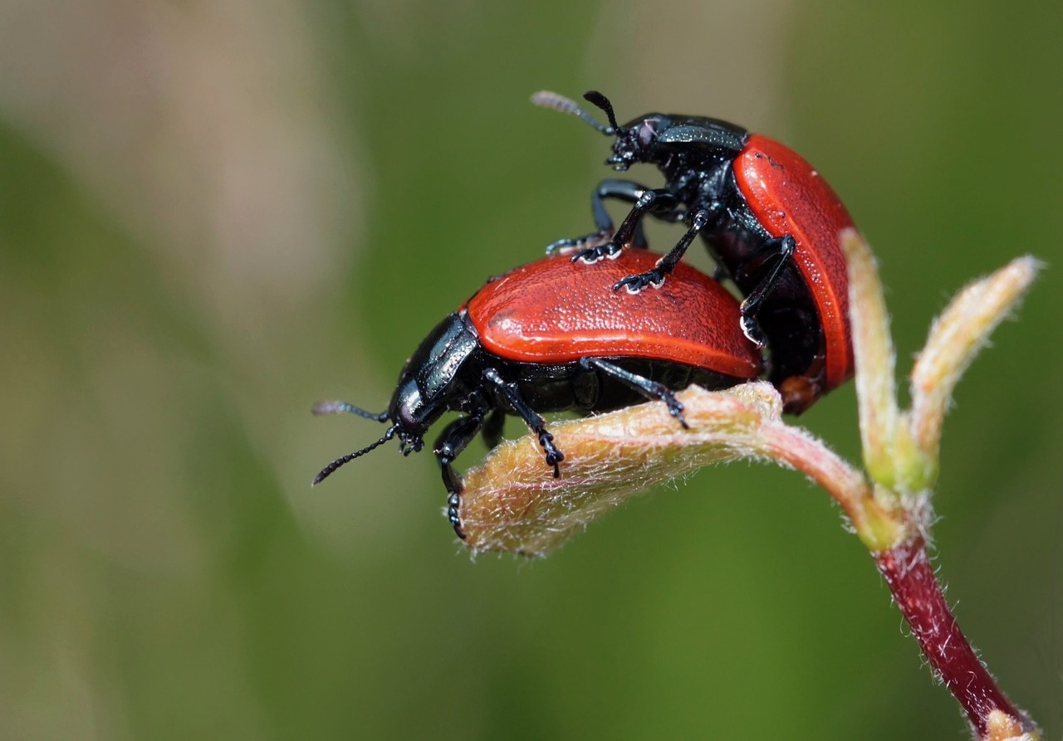
Understanding Reproductive Systems
A Comprehensive Exploration of Human Reproduction and Development

Slide 2
Table of contents
01
02
03
04
05
06
07
08
09
10
11
Lesson Objectives
Introduction to Reproductive Systems
Male Reproductive System Overview
Female Reproductive System Overview
Hormonal Interactions
Cellular Reproduction Mechanisms
Puberty and Developmental Changes
Reproductive Health Considerations
Common Misconceptions
Interactive Learning Strategies
Safety and Respect Guidelines

Slide 3
Table of contents
12
13
14
15
16
Recommended Resources
Conclusion
Q&A and Further Exploration
Design Recommendations
Recommended Visual Elements

Slide 4
1
Lesson Objectives
01
Understand basic reproductive system anatomy
02
Explore biological functions of reproductive organs
03
Learn about hormonal interactions
Identify primary reproductive organs
Describe the structure of male and female reproductive systems
Explain the role of testes and ovaries in gamete production
Discuss the functions of fallopian tubes and uterus in fertilization and pregnancy
Define key hormones involved in the reproductive system
Understand the role of hormones in regulating reproductive processes
04
Develop scientific understanding of human reproduction
05
Promote health literacy and respectful scientific learning
Explain the process of fertilization and embryonic development
Discuss the importance of genetic inheritance in human reproduction
Emphasize the significance of reproductive health education
Encourage respectful communication and understanding in scientific discussions
Understanding Reproductive Systems

Slide 5
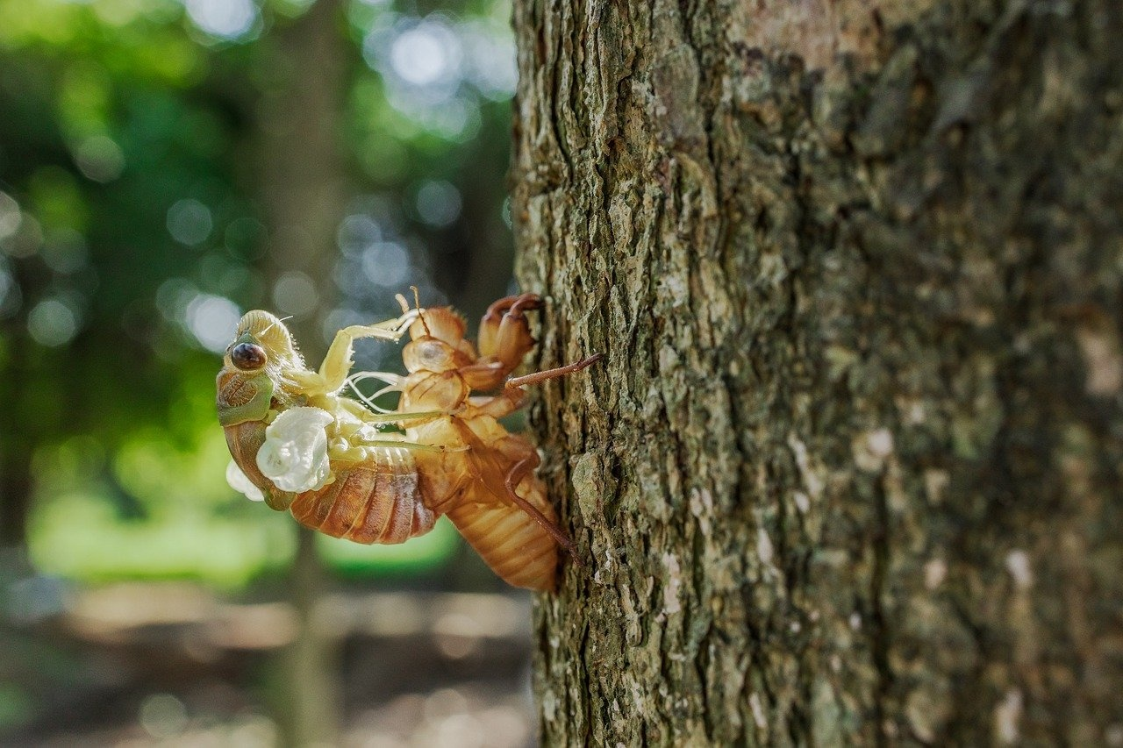
2
Introduction to Reproductive Systems
01
Introduction to Reproductive Systems
02
Supports genetic transmission and biological diversity
Complex biological mechanism
Involves intricate organ systems and hormonal networks
Critical for human development and species continuation
Ensures the continuation of genetic material
Essential for maintaining biological diversity
Understanding Reproductive Systems

Slide 6
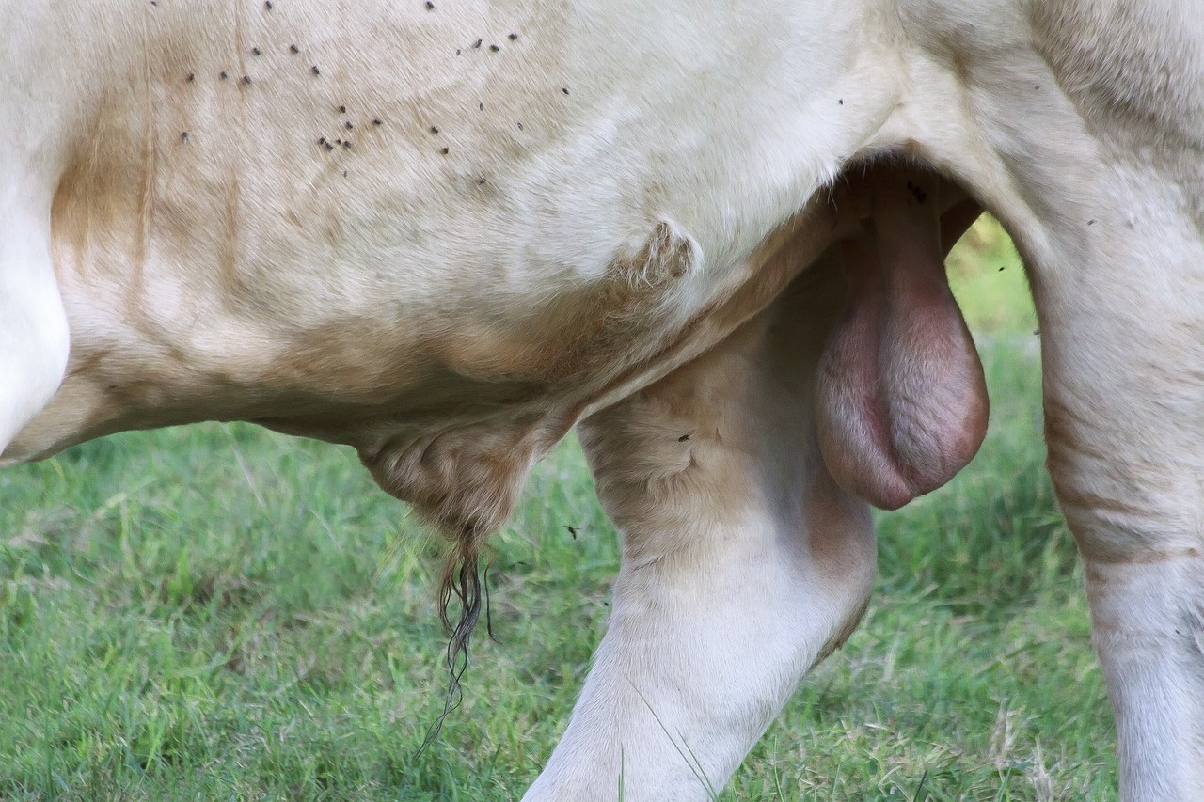
3
Male Reproductive System Overview
01
Male Reproductive System Overview
02
Primary Organs
Testes
Penis
Prostate Gland
03
Key Functions
Sperm production
Hormone generation
Genetic material transmission
Understanding Reproductive Systems

Slide 7

4
Female Reproductive System Overview
01
Primary Organs
02
Key Functions
Ovaries
Fallopian Tubes
Uterus
Egg production
Hormonal regulation
Potential embryo support
Understanding Reproductive Systems

Slide 8
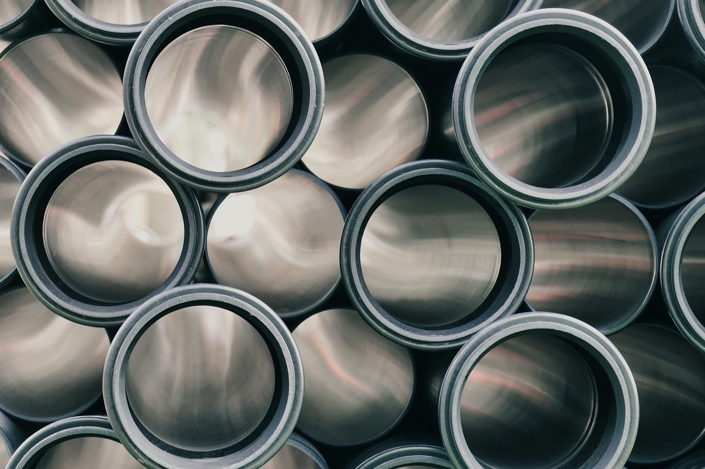
5
Hormonal Interactions
01
Hypothalamic-Pituitary-Gonadal Axis
02
Key Hormones
Regulates reproductive functions
Coordinates hormone release
Testosterone: Male sex hormone, Promotes sperm production
Estrogen: Female sex hormone, Regulates menstrual cycle
Progesterone: Supports pregnancy, Maintains uterine lining
03
Role in
Sexual maturation
Reproductive cycle management
Physical development
Understanding Reproductive Systems

Slide 9

6
Cellular Reproduction Mechanisms
01
Meiosis Process
02
Genetic Diversity Generation
Cell division specific to reproductive cells
Involves two rounds of division: Meiosis I and Meiosis II
Results in four daughter cells with half the genetic material
Crossing over during prophase I increases genetic variation
Independent assortment of chromosomes during metaphase I
Random fertilization contributes to genetic diversity
03
Chromosomal Recombination
04
Unique Genetic Combination Creation
Exchange of genetic material between homologous chromosomes
Increases genetic variability in offspring
Enhances adaptability and survival chances
Fusion of gametes from different individuals
Results in offspring with a unique genetic makeup
Essential for species evolution and diversity
Understanding Reproductive Systems

Slide 10

7
Puberty and Developmental Changes
01
Biological Transformation Period
02
Hormonal Triggers
Adolescence marks the onset of puberty.
Hormonal changes trigger physical and emotional development.
Hypothalamus signals the pituitary gland to release hormones.
Testosterone in males and estrogen in females drive changes.
03
Physical and Emotional Changes
04
Individual Variation in Development
Growth spurts lead to changes in height and body shape.
Emotional fluctuations are common due to hormonal shifts.
Puberty timing varies among individuals.
Factors like genetics and nutrition influence development.
Understanding Reproductive Systems

Slide 11
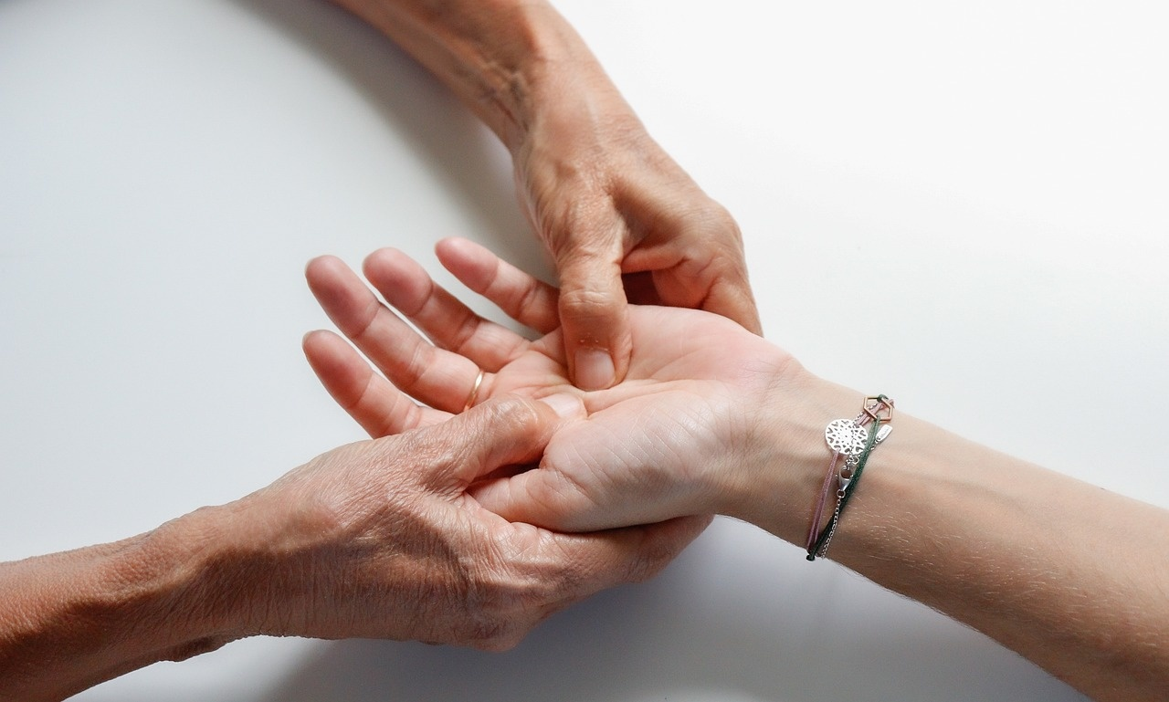
8
Reproductive Health Considerations
01
Holistic Wellness Approach
02
Factors Influencing Reproductive Health
Emphasizes overall well-being
Considers physical, mental, and social aspects
Genetics
Influence on inherited conditions
Family medical history awareness
Nutrition
Balanced diet for reproductive health
Understanding Reproductive Systems

Slide 12

9
Common Misconceptions
01
Reproductive Organs Function Independently (Myth)
02
Reproduction is More Than a Biological Mechanism
The male and female reproductive systems work in tandem to facilitate reproduction, with each organ playing a specific role in the process.
While reproduction is a biological process, it also involves emotional, social, and cultural aspects that contribute to the overall experience.
03
Genetic Inheritance is Complex
04
Reproductive Health is Comprehensive
Genetic inheritance involves a combination of genes from both parents, leading to unique traits and characteristics in offspring.
Reproductive health encompasses physical, emotional, and social well-being related to the reproductive system, emphasizing the importance of holistic care.
Understanding Reproductive Systems

Slide 13

10
Interactive Learning Strategies
01
Anatomical Mapping Exercises
02
Hormonal Pathway Simulations
Engage students in labeling and identifying key reproductive system structures.
Enhance understanding of organ locations and functions through hands-on activities.
Simulate the release and interaction of hormones in the reproductive system.
Illustrate the feedback mechanisms and regulatory processes involved in hormonal control.
03
Comparative Biology Analysis
04
Cellular Reproduction Modeling
Compare the male and female reproductive systems to understand similarities and differences.
Foster critical thinking by exploring evolutionary aspects and adaptations.
Model the process of meiosis to demonstrate genetic recombination and diversity.
Visualize how gametes are formed and the importance of genetic variation in offspring.
Understanding Reproductive Systems

Slide 14

11
Safety and Respect Guidelines
01
Maintain Confidentiality
02
Use Scientific Language
Respect the privacy of others.
Do not share personal information without permission.
Communicate using accurate terminology.
Avoid slang or inappropriate language.
03
Respect Individual Boundaries
04
Create Supportive Learning Environment
Be mindful of personal space.
Listen and respond respectfully to others' opinions.
Encourage open dialogue.
Foster a safe space for questions and discussions.
Understanding Reproductive Systems

Slide 15
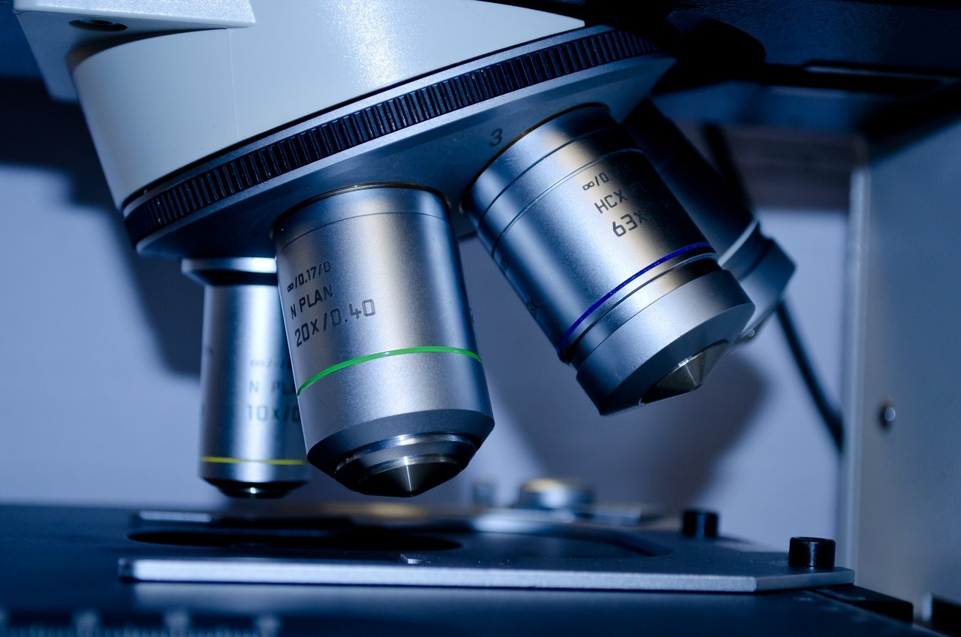
12
Recommended Resources
01
Anatomical Modeling Software
02
Interactive Digital Platforms
Allows for interactive exploration of reproductive system anatomy
Enhances visual understanding of complex biological structures
Engaging tools for learning about hormonal interactions and cellular reproduction
Provides interactive simulations for better comprehension
03
Scientific Textbooks
04
Trusted Medical Websites
Comprehensive resources covering human reproduction in detail
Offers in-depth explanations and illustrations for educational purposes
Reliable sources for accessing up-to-date information on reproductive health
Provides valuable insights and research findings for further exploration
Understanding Reproductive Systems

Slide 16
13
Conclusion
Reproductive Systems are Intricately Complex
Knowledge Enhances Health Literacy
Interplay of organs, hormones, and genetic material
Understanding promotes informed decision-making
Scientific Understanding Mitigates Misconceptions
Continuous Learning is Essential
Dispels myths and fosters accurate knowledge
Stay updated on advancements in reproductive health
Understanding Reproductive Systems

Slide 17

14
Q&A and Further Exploration
01
Encourage Scientific Curiosity
02
Provide Additional Learning Opportunities
Foster a sense of wonder and inquiry
Promote asking questions and seeking answers
Suggest reading materials and resources
Offer hands-on experiments or activities
03
Recommend Trusted Information Sources
04
Open Dialogue Invitation
Direct to reputable websites and scientific journals
Encourage consultation with healthcare professionals
Create a safe space for discussions
Welcome sharing of thoughts and reflections
Understanding Reproductive Systems

Slide 18
15
Design Recommendations
01
Utilize medical-grade anatomical illustrations
02
Maintain professional, age-appropriate color scheme
03
Include clear, legible typography
Enhances visual understanding
Provides accurate representation
Engages early teenage learners
Creates a visually appealing presentation
Facilitates easy reading
Enhances comprehension for young audiences
04
Use minimal text with impactful visuals
05
Ensure scientific accuracy
Avoids overwhelming the audience
Emphasizes key points effectively
Builds credibility and trust
Fosters a learning environment based on facts
Understanding Reproductive Systems

Slide 19

16
Recommended Visual Elements
01
3D Anatomical Diagrams
02
Hormonal Interaction Flowcharts
Detailed illustrations of male and female reproductive systems
Visual representation of the hypothalamic-pituitary-gonadal axis
03
Cellular Reproduction Animations
04
Infographic-style Information Displays
Dynamic visuals explaining the process of meiosis
Clear and concise graphics showcasing key concepts in reproductive health
Understanding Reproductive Systems

