Slide 1



Exploring Transition Metal Chemistry
From Theory to Practice and Beyond

Slide 2
TABLE OF
CONTENTS
Introduction to Transition Metal Chemistry
Importance of Quantifying Transition Metal Ions
Complex Electron Configurations of Transition Metals
Variable Oxidation States of Transition Metals
Formation of Coordination Compounds
Analytical Techniques for Transition Metal Ions
Real-World Applications of Transition Metal Analysis
Environmental Monitoring with Transition Metal Ions
Pharmaceutical Research and Transition Metals
Cutting-Edge Scientific Investigation
Industrial Applications of Transition Metal Analysis
Challenges in Quantifying Transition Metal Ions
Innovative Approaches to Transition Metal Analysis
Advancements in Analytical Chemistry Techniques
Role of Transition Metals in Scientific Research
01
02
03
04
05
06
07
08
09
10
11
12
13
14
15

Slide 3
TABLE OF
CONTENTS
Practical Skills for Analyzing Transition Metal Ions
Integration of Theory and Practice in Transition Metal …
Future Trends in Transition Metal Ion Quantification
Enhancing Accuracy in Transition Metal Analysis
Exploring the Diversity of Transition Metal Compounds
16
17
18
19
20

Slide 4
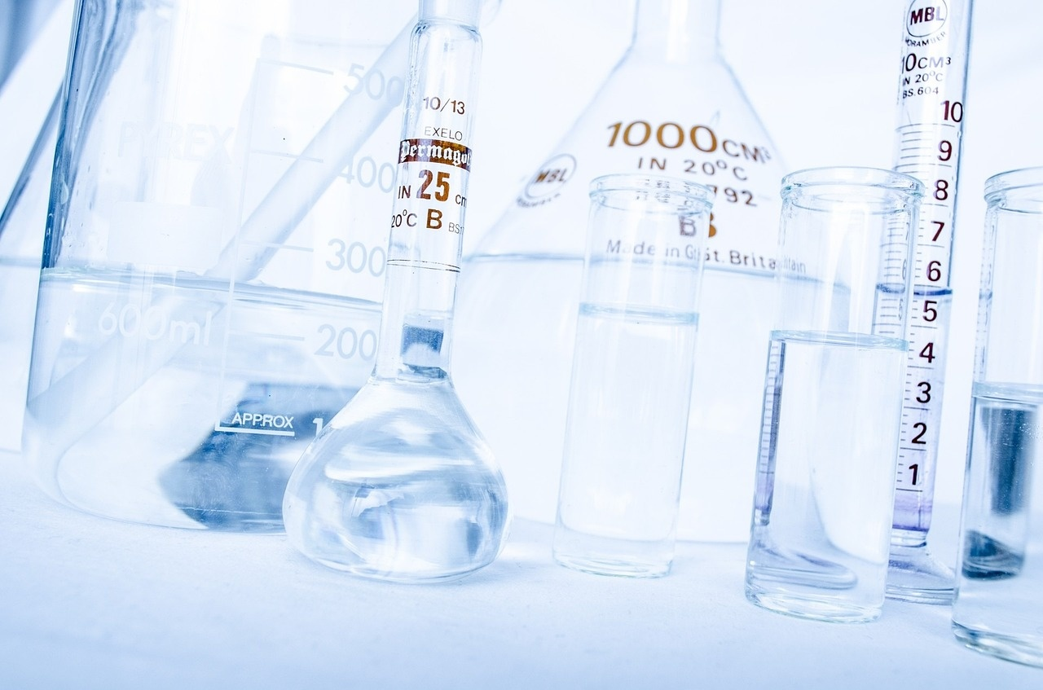
Exploring Transition Metal Chemistry
Introduction to Transition Metal Chemistry
Transition Metal Characteristics
Importance of Transition Metal Chemistry
Analytical Techniques in Transition Metal Chemistry
Transition metals exhibit complex electron configurations.
They have variable oxidation states.
Known for forming intricate coordination compounds.
Essential for understanding catalysis and industrial processes.
Plays a crucial role in biological systems and environmental processes.
Enables the development of new materials and pharmaceuticals.
Spectroscopic methods like UV-Vis and X-ray crystallography.
Electrochemical techniques for studying redox properties.
Chromatographic methods for separation and identification.

Slide 5

Exploring Transition Metal Chemistry
Importance of Quantifying Transition Metal Ions
Introduction to Transition Metal Chemistry
Significance of Quantifying Transition Metal Ions
Transition metals exhibit complex electron configurations and variable oxidation states.
They are known for forming intricate coordination compounds with diverse properties.
Essential for understanding reaction mechanisms and catalytic processes.
Crucial in environmental monitoring for metal pollution detection.
Important in pharmaceutical research for drug development and analysis.
Analytical Techniques for Quantification
Real-World Applications
Spectrophotometry: Measures absorption of light by transition metal ions.
Atomic Absorption Spectroscopy: Determines concentration by measuring absorption of specific wavelengths.
Inductively Coupled Plasma Mass Spectrometry (ICP-MS): Provides high sensitivity and multi-element analysis capabilities.
Monitoring heavy metal contamination in water sources.
Quality control in the manufacturing of electronic devices.
Studying metalloenzymes for biomedical research.

Slide 6

Exploring Transition Metal Chemistry
Complex Electron Configurations of Transition Metals
Variable Oxidation States
Transition metals exhibit multiple oxidation states due to the presence of incompletely filled d-orbitals.
Allows for a range of electron transfer reactions.
Coordination Chemistry
Transition metals can form complex coordination compounds.
Ability to accept and donate electron pairs leads to diverse structures and properties.
Ligand Interactions
Interaction between transition metal ions and ligands influences the stability and reactivity of coordination complexes.
Impacts their behavior in chemical reactions.
Spin States
Transition metal complexes can exhibit different spin states (e.g., high spin, low spin).
Arrangement of electrons in the d-orbitals affects their magnetic properties and reactivity.

Slide 7

Exploring Transition Metal Chemistry
Variable Oxidation States of Transition Metals
Incompletely Filled d Orbitals
Transition metals exhibit variable oxidation states due to the presence of incompletely filled d orbitals.
Wide Range of Reactions
The ability of transition metals to change oxidation states allows them to participate in a wide range of chemical reactions.
Common Oxidation States
Common oxidation states of transition metals include +1, +2, +3, +4, +5, +6, and +7.
Stable Ions
Transition metals can form multiple stable ions with different oxidation states, leading to diverse coordination chemistry.
Colorful Compounds
The variability in oxidation states contributes to the colorful compounds often observed in transition metal complexes.

Slide 8





Exploring Transition Metal Chemistry
Formation of Coordination Compounds
Definition
Coordination Number
Ligands
Chelation
Isomerism
Coordination compounds are complex molecules composed of a central metal atom or ion bonded to surrounding ligands through coordinate covalent bonds.
This refers to the total number of bonds formed between the central metal ion and the ligands.
It determines the geometry of the coordination complex.
These are molecules or ions that donate electron pairs to the central metal ion, forming coordinate bonds.
Common ligands include ammonia (NH3), water (H2O), and chloride ions (Cl-).
Some ligands have the ability to form multiple bonds with a metal ion, creating a ring structure known as a chelate.
This enhances the stability of the coordination complex.
Coordination compounds exhibit different types of isomerism, such as geometric isomerism and optical isomerism.
These arise from the spatial arrangement of ligands around the central metal ion.

Slide 9

Exploring Transition Metal Chemistry
Analytical Techniques for Transition Metal Ions
Introduction to Transition Metal Chemistry
Importance of Quantifying Transition Metal Ions
Transition metals' unique position in the periodic table
Complex electron configurations
Variable oxidation states
Formation of intricate coordination compounds
Bridges classroom learning with real-world applications
Essential for scientific research and industrial applications
Key to environmental monitoring and pharmaceutical research

Slide 10

Exploring Transition Metal Chemistry
Real-World Applications of Transition Metal Analysis
Inductively Coupled Plasma Mass Spectrometry (ICP-MS)
Ultra-sensitive detection of trace transition metal ions
Used in environmental samples
X-ray Absorption Spectroscopy (XAS)
Determines oxidation states
Analyzes coordination environments
Used in catalytic reactions
Atomic Absorption Spectroscopy (AAS)
Quantifies metal ions in biological samples
Aids in medical diagnostics
Supports pharmaceutical research
High-Performance Liquid Chromatography (HPLC)
Separation and quantification of transition metal complexes
Coupled with UV-Vis detection
Used in complex mixtures
Electrochemical Methods
Studies redox properties of transition metal ions
Crucial for designing energy storage devices
Used in electrochemical sensors

Slide 11

Exploring Transition Metal Chemistry
Environmental Monitoring with Transition Metal Ions
Utilizing Transition Metal Ions
Analytical Techniques
Importance of Monitoring
Transition metal ions such as copper, iron, and zinc play a crucial role in environmental monitoring due to their sensitivity to various pollutants.
Advanced analytical techniques like atomic absorption spectroscopy and inductively coupled plasma mass spectrometry are employed to quantify transition metal ions in environmental samples.
Monitoring transition metal ions in water, soil, and air is essential for assessing pollution levels, understanding environmental impact, and ensuring regulatory compliance.

Slide 12

Exploring Transition Metal Chemistry
Pharmaceutical Research and Transition Metals
Utilization of Transition Metal Catalysts
Drug Development
Transition metals such as platinum, palladium, and ruthenium play a crucial role in pharmaceutical research as catalysts for various reactions.
Transition metal complexes are integrated into drug molecules to enhance their efficacy, stability, and targeting capabilities.
Bioinorganic Chemistry Studies
MRI Contrast Agents
Investigating the interactions between transition metal ions and biological systems is essential for understanding drug metabolism and toxicity.
Transition metal complexes are utilized as contrast agents in magnetic resonance imaging (MRI) for enhanced visualization of tissues and organs.

Slide 13
Exploring Transition Metal Chemistry
Cutting-Edge Scientific Investigation
Transition Metals in Chemistry
Importance of Quantification
Lesson Focus
Real-World Applications
Crucial role due to complex electron configurations
Variable oxidation states
Essential for scientific research
Vital for industrial applications
Advanced analytical techniques
Accurate measurement of transition metal ions
Environmental monitoring
Pharmaceutical research

Slide 14
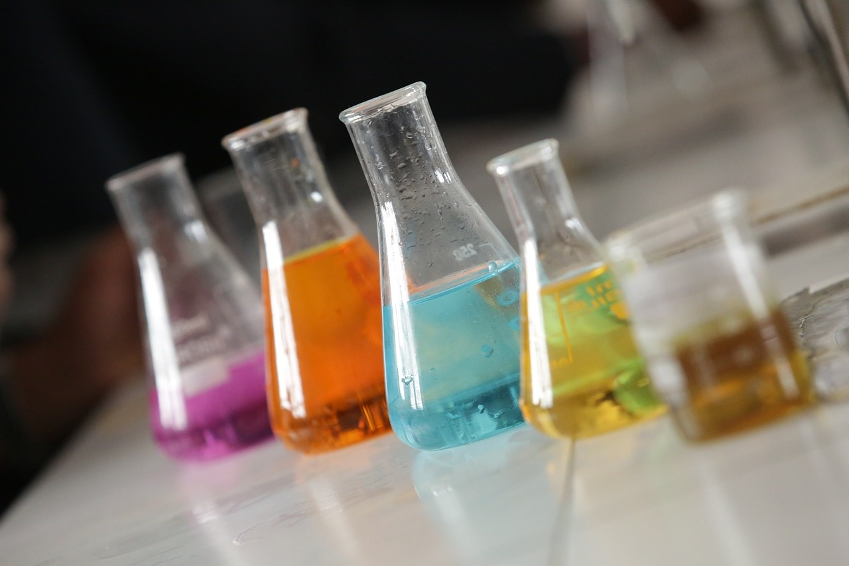
Exploring Transition Metal Chemistry
Industrial Applications of Transition Metal Analysis
Quality Control in Pharmaceutical Industry
Environmental Monitoring
Catalysis in Chemical Industry
Transition metal analysis ensures the purity and quality of pharmaceutical products.
Detecting trace amounts of transition metals helps maintain product efficacy and safety.
Monitoring transition metal levels in water and soil to assess pollution levels.
Analyzing metal ions helps in identifying sources of contamination and implementing remediation strategies.
Transition metals serve as catalysts in various industrial processes.
Understanding metal ion behavior aids in optimizing reaction conditions for improved efficiency.

Slide 15

Exploring Transition Metal Chemistry
Challenges in Quantifying Transition Metal Ions
Complex Coordination Environments
Interference from Other Ions
Transition metal ions often exist in complex coordination environments due to their ability to form coordination compounds with various ligands.
Presence of other ions in the solution can lead to interference during the quantification process, affecting the accuracy of results.
Variable Oxidation States
Sensitivity of Analytical Techniques
Transition metals exhibit variable oxidation states, making it challenging to determine the exact state of the metal ion being quantified.
Quantifying transition metal ions requires highly sensitive analytical techniques to detect and measure low concentrations accurately.

Slide 16
Exploring Transition Metal Chemistry
Innovative Approaches to Transition Metal Analysis
Transition metals in chemistry
Importance of accurate analysis
Lesson focus
Real-world applications
Crucial role due to complex electron configurations
Variable oxidation states
Essential for scientific research
Vital for industrial applications
Advanced analytical techniques
Quantifying transition metal ions in solution
Environmental monitoring
Pharmaceutical research

Slide 17
Exploring Transition Metal Chemistry
Advancements in Analytical Chemistry Techniques
Introduction to Transition Metal Chemistry
Importance of Analytical Techniques
Spectroscopic Techniques
Electrochemical Methods
Mass Spectrometry
Transition metals exhibit complex electron configurations and variable oxidation states.
They are known for forming intricate coordination compounds with diverse properties.
Analyzing transition metal ions accurately is crucial for various scientific and industrial applications.
Advanced analytical methods provide insights into their behavior in solution.
UV-Vis spectroscopy enables the quantification of metal ions based on their absorption spectra.
Atomic absorption spectroscopy offers high sensitivity for trace metal analysis.
Voltammetry techniques, such as cyclic voltammetry, provide information on redox behavior and concentration of metal ions.
Potentiometric titrations offer precise measurements of metal ion concentrations in solution.
Inductively coupled plasma mass spectrometry (ICP-MS) allows for simultaneous detection of multiple metal ions at low concentrations.
Isotope dilution mass spectrometry ensures accurate quantification of transition metal ions.

Slide 18

Exploring Transition Metal Chemistry
Role of Transition Metals in Scientific Research
Catalysts in Chemical Reactions
Biological Functions
Transition metals play a crucial role as catalysts in various chemical reactions, facilitating reaction pathways and increasing reaction rates.
Transition metals are essential for biological processes, such as oxygen transport (iron in hemoglobin) and electron transfer (copper in cytochrome c).
Magnetic Properties
Environmental Remediation
Transition metals exhibit unique magnetic properties, making them valuable in applications such as data storage and magnetic resonance imaging (MRI).
Transition metals are utilized in environmental remediation processes, such as wastewater treatment and air purification, due to their ability to catalyze degradation reactions.

Slide 19

Exploring Transition Metal Chemistry
Practical Skills for Analyzing Transition Metal Ions
Spectrophotometry
Utilize UV-Vis spectrophotometry to determine the concentration of transition metal ions based on their absorption spectra.
Complexometric Titrations
Perform complexometric titrations using EDTA to quantify transition metal ions with high precision and accuracy.
Atomic Absorption Spectroscopy
Employ AAS to measure the concentration of transition metal ions in samples by analyzing the absorption of specific wavelengths of light.
Voltammetry Techniques
Apply cyclic voltammetry or stripping voltammetry to study the electrochemical behavior of transition metal ions in solution.

Slide 20


Exploring Transition Metal Chemistry
Integration of Theory and Practice in Transition Metal Analysis
Theoretical Foundation
Practical Applications
Hands-On Experience
Transition metals exhibit complex electron configurations and variable oxidation states.
Understanding coordination chemistry is crucial for analyzing transition metal ions accurately.
Utilizing spectroscopic techniques like UV-Vis and X-ray crystallography for metal ion quantification.
Conducting titrations and complexometric analysis to determine metal ion concentrations.
Students will engage in laboratory experiments to apply theoretical concepts to real-world scenarios.
Emphasis on precision and accuracy in measuring transition metal ions for practical proficiency.

Slide 21

Exploring Transition Metal Chemistry
Future Trends in Transition Metal Ion Quantification
Inductively Coupled Plasma Mass Spectrometry (ICP-MS)
Ultra-sensitive detection
Quantification of transition metal ions
Applicable to complex matrices
HPLC coupled with ICP-MS
Speciation analysis
Transition metal ions
High-performance liquid chromatography
Electrochemical Methods
Voltammetry
Rapid quantification
Selective quantification
Aqueous solutions
Atomic Absorption Spectroscopy (AAS)
Precise determination
Trace levels
Environmental samples
X-ray Fluorescence (XRF) Spectroscopy
Non-destructive quantification
Transition metal ions
Solid samples

Slide 22
Exploring Transition Metal Chemistry
Enhancing Accuracy in Transition Metal Analysis
Utilizing Inductively Coupled Plasma Mass Spectrometry (ICP-MS)
Calibration Standards and Quality Control Measures
Isotope Dilution Mass Spectrometry (IDMS) for Absolute Quantification
ICP-MS offers exceptional sensitivity and precision in detecting trace levels of transition metal ions.
This technique allows for simultaneous multi-element analysis, enhancing efficiency in sample processing.
Establishing robust calibration curves using certified reference materials ensures accurate quantification.
Regularly monitoring instrument performance through quality control samples maintains data integrity.
IDMS is a powerful method for determining the exact concentration of transition metal ions in complex matrices.
By spiking samples with known isotopic standards, IDMS provides highly accurate results even in challenging sample matrices.

Slide 23

Exploring Transition Metal Chemistry
Exploring the Diversity of Transition Metal Compounds
Varied Coordination Geometries
Diverse Ligand Types
Transition metals exhibit a wide range of coordination geometries, including octahedral, square planar, tetrahedral, and trigonal bipyramidal.
Transition metal compounds can form complexes with various ligands such as monodentate, bidentate, polydentate, and chelating ligands, leading to diverse structures and properties.
Colorful Compounds
Variable Oxidation States
Transition metal compounds are known for their vibrant colors due to d-d electronic transitions within the metal's d-orbitals, showcasing the fascinating interplay of light and electron energies.
Transition metals can exist in multiple oxidation states, allowing for a rich array of chemical reactivity and coordination possibilities in their compounds.

