Slide 1
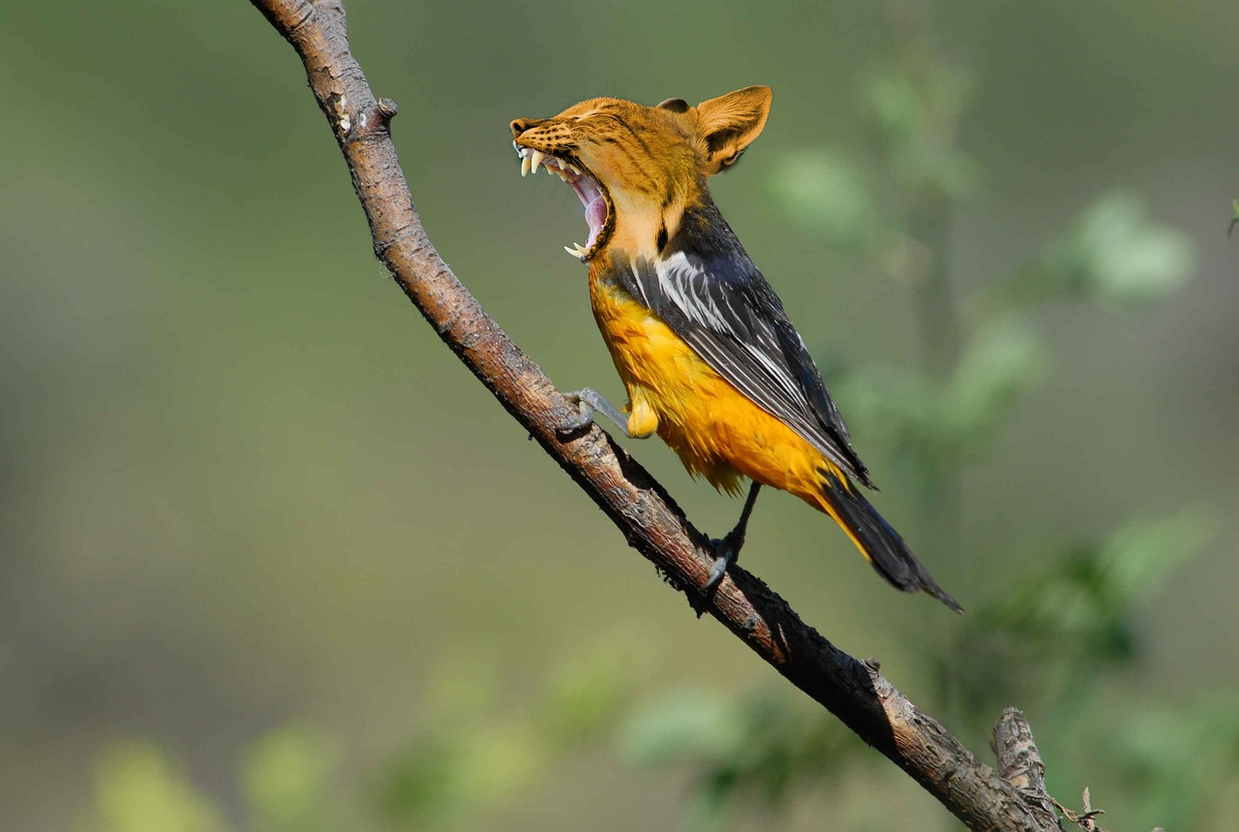
Exploración del simbolismo en "El Tigre" de William Blake y su conexión con Prometeo
Un análisis literario de la creación, la rebelión y la dualidad en la poesía romántica

Slide 2
Table of Contents
Introduction to Uncovering the Symbolism of Wi…
What is Symbolism in Literature?
William Blake and The Tiger
The Myth of Prometheus
Analysis of The Tiger
Symbolism in The Tiger
Connections to Prometheus
Creative Writing Exercise
Discussion Questions
Conclusion
Key Takeaways
Next Steps
Reflection Questions
04
05
06
07
08
09
10
11
12
13
14
15
16

Slide 3
Table of Contents
Additional Resources
Conclusion and Final Thoughts
Final Assessment
Credits and References
Thank You for Participating!
17
18
19
20
21

Slide 4
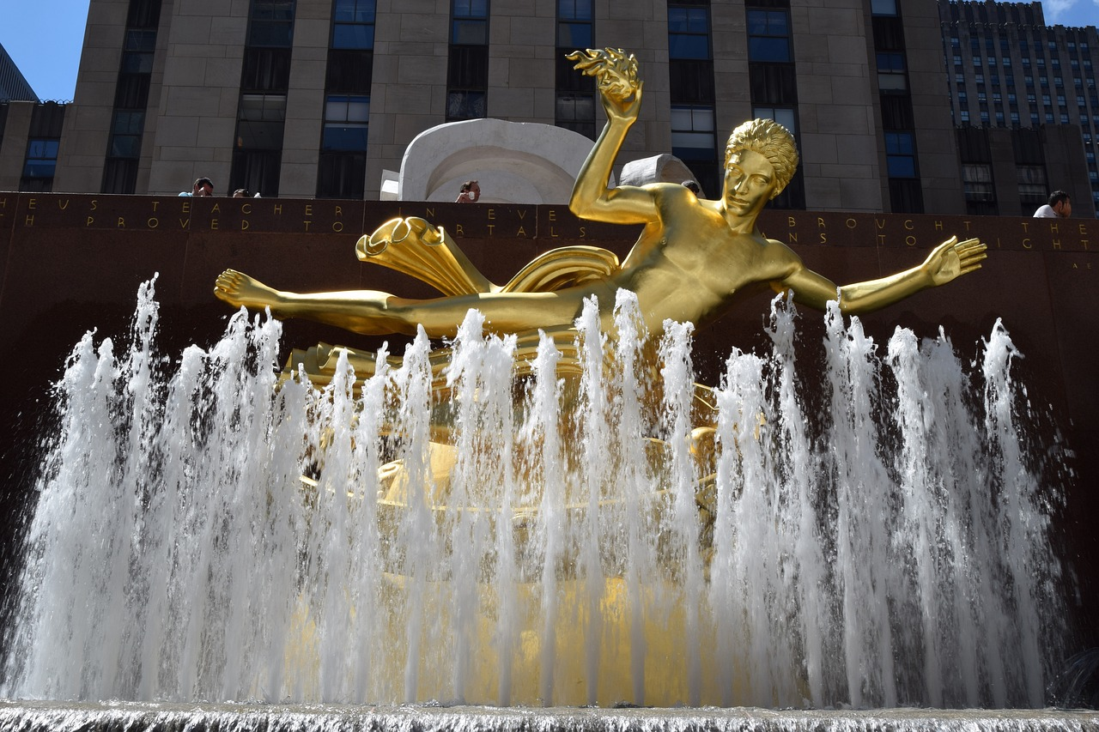
Introduction to Uncovering the Symbolism of William Blake's The Tiger
Exploring Symbolism in Blake's Poetry
Developing Literary Insights
Lesson Objectives
Welcome to our lesson on Uncovering the Symbolism of William Blake's The Tiger and its Connection to Prometheus.
In this lesson, we will explore the rich and complex world of William Blake's poetry, focusing on 'The Tiger' and its connections to the myth of Prometheus.
By the end of this lesson, you will have developed a deeper understanding of literary symbolism.
Improved your critical thinking skills, and cultivated an appreciation for the works of William Blake.
This lesson aims to connect Blake's 'The Tiger' with the mythological figure Prometheus.
It seeks to enhance your ability to analyze and interpret symbolic elements in literature.
4
Exploración del simbolismo en "El Tigre" de William Blake y su conexión con Prometeo

Slide 5

What is Symbolism in Literature?
Definition of Symbolism
Multiplicity of Meanings
Symbolism is the use of objects, colors, or other elements to represent abstract ideas or concepts.
It allows authors to communicate deeper meanings beyond the literal sense.
Symbols can have multiple meanings and interpretations.
This flexibility enriches the reader's experience and understanding of the text.
Purpose of Symbolism in Writing
Examples of Symbolism
Authors use symbolism to convey complex ideas and themes in their writing.
It serves as a tool to add depth and layers to their narratives.
Examples of symbolism include the American flag, the cross, and the tiger in William Blake's poem.
These symbols carry cultural, spiritual, and literary significance.
5
Exploración del simbolismo en "El Tigre" de William Blake y su conexión con Prometeo

Slide 6

William Blake and The Tiger
William Blake's Background
Themes in 'The Tiger'
Symbolism of the Tiger
William Blake was a Romantic poet and artist who wrote 'The Tiger' in the late 18th century.
His work often delves into profound themes and vivid imagery.
The poem explores themes of creation, rebellion, and the nature of God.
It raises questions about the duality of existence and the creator's intentions.
The tiger is a central symbol in the poem, representing power, beauty, and fear.
Its presence evokes awe and contemplation about the mysteries of life.
6
Exploración del simbolismo en "El Tigre" de William Blake y su conexión con Prometeo

Slide 7
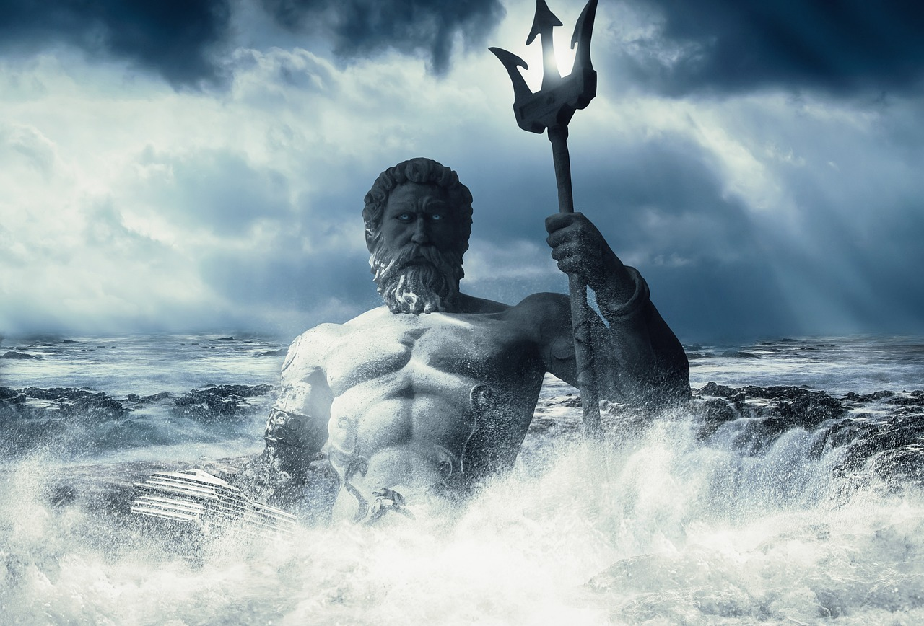
The Myth of Prometheus
Prometheus and the Gift of Fire
Symbolism of Prometheus
Prometheus in Literature
Prometheus was a titan in Greek mythology who stole fire from the gods and gave it to humans.
This act symbolizes the transfer of divine power to humanity, enabling progress and civilization.
The myth of Prometheus represents the spark of creativity and rebellion that drives human progress.
It highlights the human spirit's defiance against limitations and pursuit of knowledge.
The poem 'The Tiger' draws on the myth of Prometheus to explore themes of creation and rebellion.
This connection underscores the enduring influence of Prometheus in art and thought.
7
Exploración del simbolismo en "El Tigre" de William Blake y su conexión con Prometeo

Slide 8

Analysis of The Tiger
Opening Question
Awe of the Tiger
The poem begins with the question 'What immortal hand or eye / Could frame thy fearful symmetry?'
This sets the tone for the speaker's awe and curiosity about the tiger's creation.
The speaker is in awe of the tiger's beauty and power.
They wonder about the creator's intentions behind such a magnificent creature.
Contrast in Creations
Final Stanza Reflection
The poem explores the contrast between the creator's gentle and fierce creations.
This duality raises profound questions about the nature of the creator.
The final stanza asks if the creator of the lamb could also have created the tiger.
This question emphasizes the complexity and mystery of the creator's work.
8
Exploración del simbolismo en "El Tigre" de William Blake y su conexión con Prometeo

Slide 9

Symbolism in The Tiger
The Tiger's Symbolism
The Lamb's Symbolism
The tiger represents power, beauty, and fear.
It embodies a complex mix of awe and terror.
The lamb represents innocence and gentleness.
It serves as a contrast to the tiger's fierce nature.
The Creator's Role
Exploring Creation
The creator represents God or a higher power.
This figure is central to the poem's exploration of creation.
The poem explores the relationship between the creator and the created.
It delves into the duality of beauty and fear in creation.
9
Exploración del simbolismo en "El Tigre" de William Blake y su conexión con Prometeo

Slide 10
Connections to Prometheus
Prometheus and the Themes of Creation and Rebellion
The Tiger as a Symbol of Creativity and Rebellion
Questioning the Divine and the Universe
The poem draws on the myth of Prometheus to explore themes of creation and rebellion.
It delves into the symbolic significance of Prometheus as a figure of defiance and innovation.
The tiger represents the spark of creativity and rebellion that drives human progress.
Its fierce and untamed nature mirrors the human spirit's quest for advancement and change.
The poem asks questions about the nature of God and the universe.
It challenges readers to reflect on the origins and purpose of existence.
10
Exploración del simbolismo en "El Tigre" de William Blake y su conexión con Prometeo

Slide 11

Creative Writing Exercise
Perspective of the Tiger's Creator
Themes to Explore
Imagine you are the creator of the tiger, and write a poem or short story from its perspective.
Explore the themes of creation, rebellion, and the nature of God in your writing.
Creation, rebellion, and the nature of God are central to this exercise.
Delve into these themes to craft a compelling narrative or poem.
11
Exploración del simbolismo en "El Tigre" de William Blake y su conexión con Prometeo

Slide 12
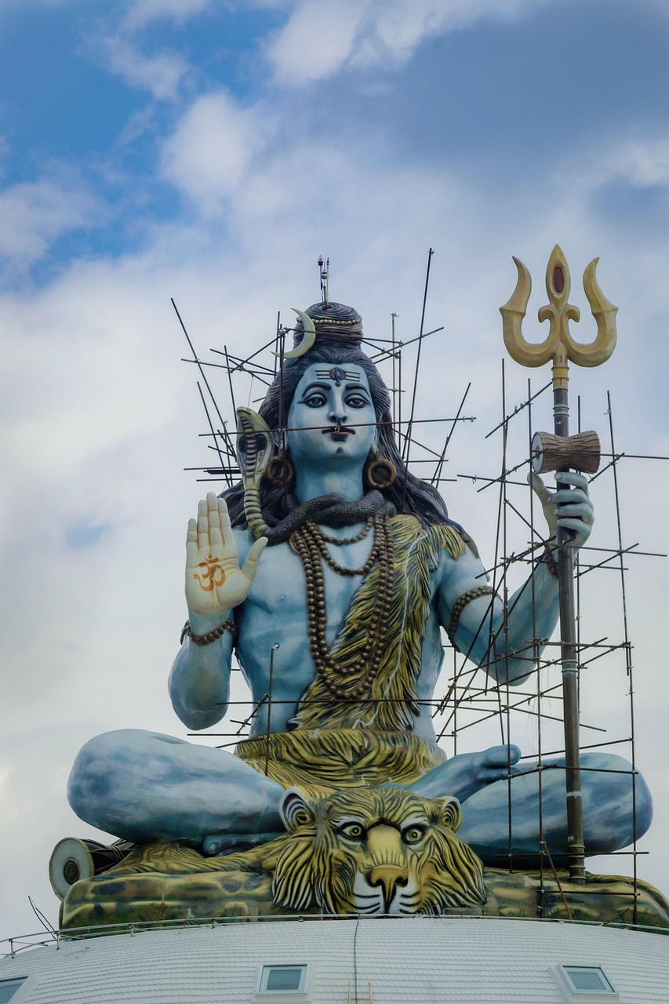
Discussion Questions
01
Symbolism of the Tiger
What do you think the tiger represents in the poem, and how does it relate to the myth of Prometheus?
The tiger's symbolism may connect to themes of rebellion and divine punishment, echoing Prometheus's story.
02
Creator's Duality
How does the poem explore the contrast between the creator's gentle and fierce creations?
The poem delves into the paradox of a creator capable of crafting both beauty and terror.
03
Existential Inquiry
What questions does the poem ask about the nature of God and the universe?
It challenges readers to ponder the complexity and intentions behind divine creation.
04
Personal Connection
How does the poem relate to your own experiences or interests?
The poem invites reflection on personal encounters with themes of creation, power, and morality.
12
Exploración del simbolismo en "El Tigre" de William Blake y su conexión con Prometeo

Slide 13

Conclusion
Themes Explored in 'The Tiger'
Connections to Prometheus Myth
In conclusion, 'The Tiger' is a rich and complex poem that explores themes of creation, rebellion, and the nature of God.
Through our analysis and discussion, we have gained a deeper understanding of literary symbolism.
The poem draws connections between its themes and the myth of Prometheus.
This analysis highlights the interplay between literary works and mythological narratives.
13
Exploración del simbolismo en "El Tigre" de William Blake y su conexión con Prometeo

Slide 14

Key Takeaways
1
Understanding Symbolism
Understanding symbolism in literature is essential for analyzing and interpreting complex texts.
It allows readers to uncover deeper meanings and themes within a work.
2
Themes in 'The Tiger'
The poem 'The Tiger' draws on the myth of Prometheus to explore themes of creation and rebellion.
This connection enriches the poem's exploration of human and divine relationships.
3
Philosophical Questions
The poem asks questions about the nature of God and the universe.
It encourages readers to think critically about these profound themes.
14
Exploración del simbolismo en "El Tigre" de William Blake y su conexión con Prometeo

Slide 15

Next Steps
1
Exploring Romanticism
Explore the Romantic movement and its key authors and works.
Gain insights into the themes and ideas that shaped this literary period.
2
Symbolism in Literature
Analyze symbolism in different texts, such as novels, poems, and plays.
Understand how symbols convey deeper meanings and enhance storytelling.
3
Creating Symbolic Art
Create original symbolic works, such as poems, short stories, or visual artworks.
Express personal ideas and emotions through the use of symbolism.
15
Exploración del simbolismo en "El Tigre" de William Blake y su conexión con Prometeo

Slide 16

Reflection Questions
01
Exploring Symbolism in Literature
What did you learn about symbolism in literature from this lesson?
How does the poem 'The Tiger' relate to your own experiences or interests?
02
Unanswered Questions
What questions do you still have about the poem or the myth of Prometheus?
How can you apply what you learned from this lesson to your own writing or creative projects?
03
Personal Connections to 'The Tiger'
How does the poem 'The Tiger' relate to your own experiences or interests?
What did you learn about symbolism in literature from this lesson?
04
Applying Lessons to Creativity
How can you apply what you learned from this lesson to your own writing or creative projects?
What questions do you still have about the poem or the myth of Prometheus?
16
Exploración del simbolismo en "El Tigre" de William Blake y su conexión con Prometeo

Slide 17

Additional Resources
1
2
3
Romantic Movement Insights
Prometheus in Art and Literature
Literary Analysis Resources
Read more about the Romantic movement and its key authors and works.
Discover the cultural and historical context that shaped this influential literary era.
Explore the myth of Prometheus and its significance in literature and art.
Understand how this enduring myth has inspired countless creative works.
Check out online resources and tutorials on literary analysis and symbolism.
Enhance your understanding of literary techniques and their applications.
17
Exploración del simbolismo en "El Tigre" de William Blake y su conexión con Prometeo

Slide 18
Conclusion and Final Thoughts
Symbolism in 'The Tiger' and Prometheus
Encouragement for Further Exploration
In conclusion, this lesson has provided a comprehensive introduction to the symbolism of William Blake's 'The Tiger'.
It also explored its connection to Prometheus, offering insights into literary analysis.
We hope you have enjoyed this lesson and will continue to explore the world of literary analysis.
Dive deeper into symbolism to uncover the layers of meaning in literature.
18
Exploración del simbolismo en "El Tigre" de William Blake y su conexión con Prometeo

Slide 19

Final Assessment
Purpose of the Final Assessment
Structure of the Assessment
Please complete the final assessment to evaluate your understanding of the lesson.
The assessment will include multiple-choice questions, short-answer questions, and a creative writing exercise.
The assessment will include multiple-choice questions, short-answer questions, and a creative writing exercise.
Please complete the final assessment to evaluate your understanding of the lesson.
19
Exploración del simbolismo en "El Tigre" de William Blake y su conexión con Prometeo

Slide 20
Credits and References
Acknowledgment of Contributors
Sources and References
This lesson was created with the help of various sources, including literary critics and scholars.
Please see the references page for a full list of sources used in this lesson.
This lesson was created with the help of various sources, including literary critics and scholars.
Please see the references page for a full list of sources used in this lesson.
20
Exploración del simbolismo en "El Tigre" de William Blake y su conexión con Prometeo

Slide 21

Thank You for Participating!
Thank You for Participating!
Thank you for participating in this lesson on Uncovering the Symbolism of William Blake's The Tiger.
Its Connection to Prometheus has been explored in depth.
21
Exploración del simbolismo en "El Tigre" de William Blake y su conexión con Prometeo

