Slide 1

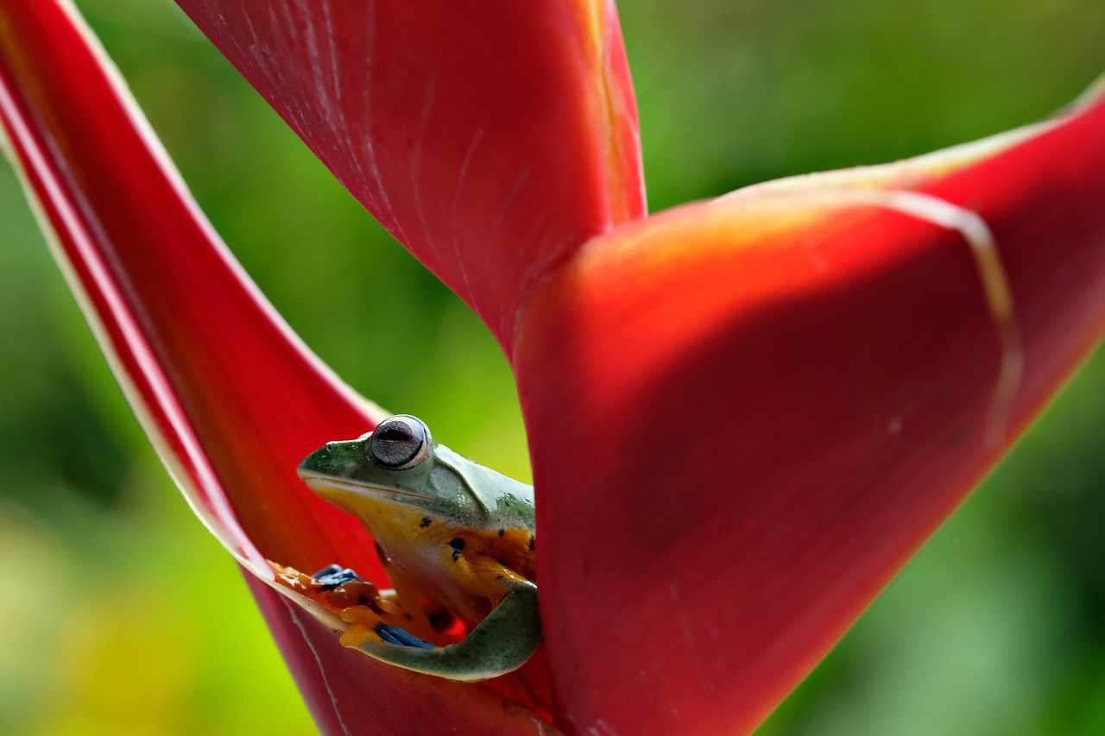
Understanding Food Chains and Ecosystem Dynamics
Exploring the Roles of Producers, Consumers, and Conservation Efforts

Slide 2
Table of Contents
Introduction to Food Chains
What are Producers?
What are Consumers?
Food Chain Structure
Example of a Food Chain
Importance of Food Chains
Human Impact on Food Chains
Activity: Building a Food Chain
Activity: Food Chain Game
Conclusion
Assessment
Extension Activity
Reflection Questions
04
05
06
07
08
09
10
11
12
13
14
15
16

Slide 3
Table of Contents
Next Steps
Additional Resources
Conclusion and Final Thoughts
17
18
19

Slide 4
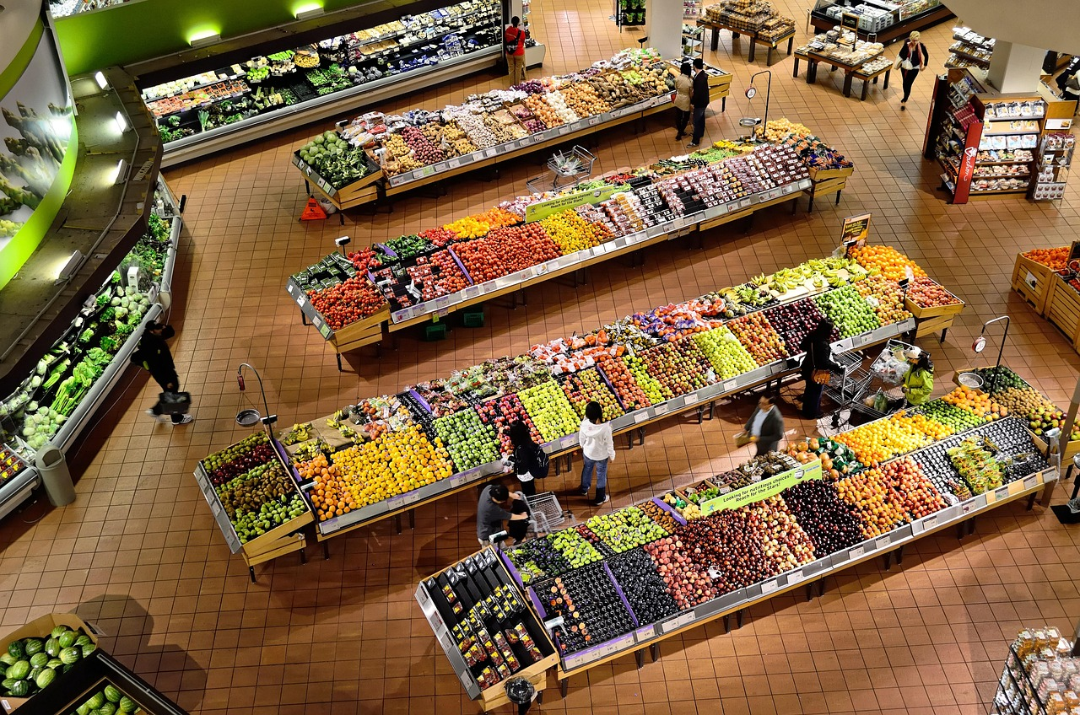
Introduction to Food Chains
Understanding Food Chains
Roles in a Food Chain
Lesson Objectives
Welcome to our lesson on food chains!
In this lesson, we will explore the relationship between producers and consumers in a food chain.
By the end of this lesson, you will be able to identify and explain the different roles in a food chain.
This includes understanding how energy flows from one organism to another.
The goal is to provide a clear understanding of food chain dynamics.
You will learn to distinguish between producers, consumers, and their interactions.
4
Understanding Food Chains and Ecosystem Dynamics

Slide 5

What are Producers?
Definition of Producers
Examples of Producers
Role in the Food Chain
Producers are organisms that make their own food through a process called photosynthesis.
They are essential for sustaining life by converting sunlight into energy.
Examples of producers include plants, algae, and some types of bacteria.
These organisms play a crucial role in ecosystems by generating food for other species.
Producers are the foundation of a food chain and provide energy for other organisms.
Without producers, energy flow in ecosystems would be disrupted.
5
Understanding Food Chains and Ecosystem Dynamics

Slide 6

What are Consumers?
1
Definition of Consumers
Consumers are organisms that cannot make their own food.
They need to eat other organisms to survive.
2
Examples of Consumers
Examples of consumers include animals, such as herbivores, carnivores, and omnivores.
These animals play different roles in the food chain.
3
Dependence on Producers
Consumers rely on producers for energy and nutrients.
This relationship is essential for the balance of ecosystems.
6
Understanding Food Chains and Ecosystem Dynamics

Slide 7

Food Chain Structure
Understanding the Food Chain
Trophic Levels Explained
A food chain is a series of organisms that eat other organisms, with each level representing a different trophic level.
Energy flows from one trophic level to the next, with each level losing some energy.
The trophic levels are: producers, primary consumers, secondary consumers, and decomposers.
Each level plays a unique role in the ecosystem's energy transfer.
Role of Decomposers
Energy Flow in the Food Chain
Decomposers break down dead organisms and recycle nutrients.
This process ensures the sustainability of ecosystems by returning essential elements to the soil.
Energy flows through the food chain but diminishes at each trophic level.
This loss of energy limits the number of trophic levels in a food chain.
7
Understanding Food Chains and Ecosystem Dynamics

Slide 8
Example of a Food Chain
Example of a Food Chain
Energy Flow in the Food Chain
Roles in the Ecosystem
Here is an example of a food chain: grass (producer) → rabbit (primary consumer) → fox (secondary consumer) → hawk (tertiary consumer).
Each organism in the food chain plays a vital role in the ecosystem.
The food chain shows how energy flows from one organism to another.
This energy transfer is essential for maintaining ecological balance.
Organisms in the food chain are categorized as producers, consumers, and decomposers.
These roles ensure the sustainability of life within the ecosystem.
8
Understanding Food Chains and Ecosystem Dynamics

Slide 9
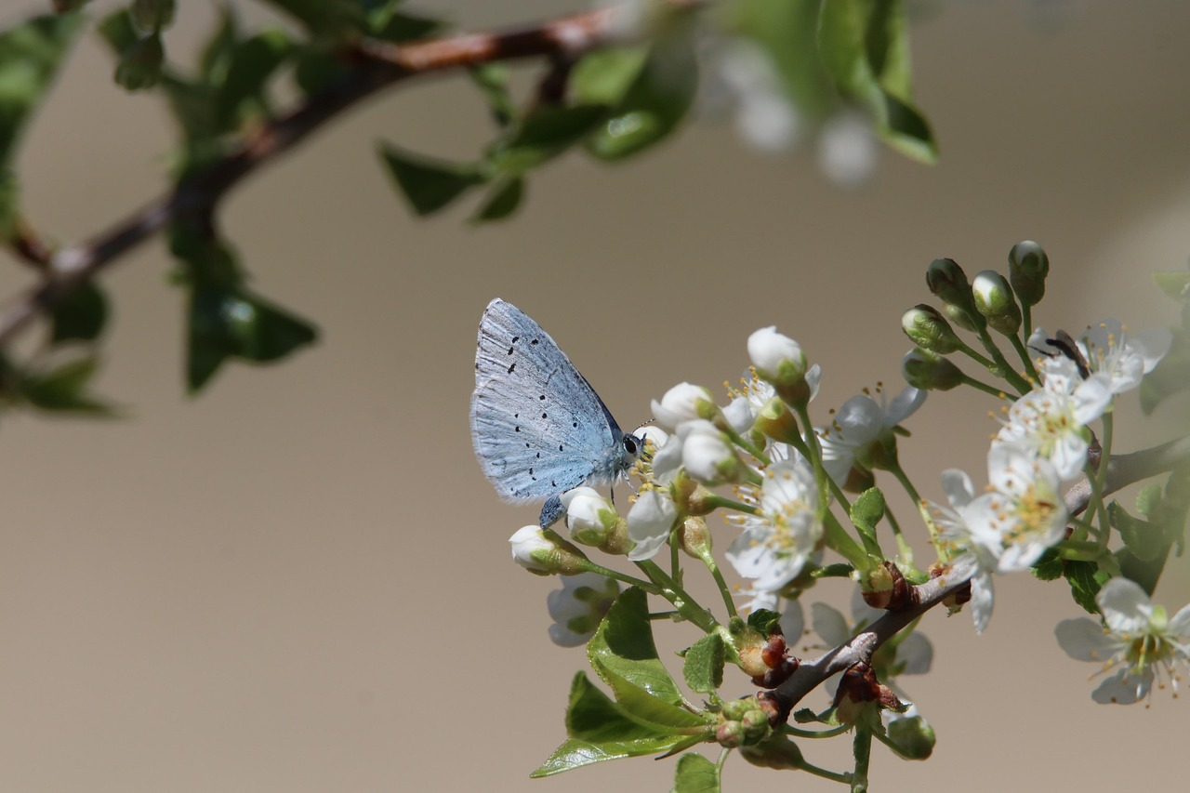
Importance of Food Chains
1
Energy and Nutrient Source
Food chains are essential for the survival of ecosystems.
They provide a source of energy and nutrients for organisms.
2
Balance of Nature
Food chains help maintain the balance of nature.
They support biodiversity within ecosystems.
3
Ecosystem Survival
Food chains are crucial for sustaining ecosystems.
They ensure the flow of energy and nutrients across different organisms.
9
Understanding Food Chains and Ecosystem Dynamics

Slide 10
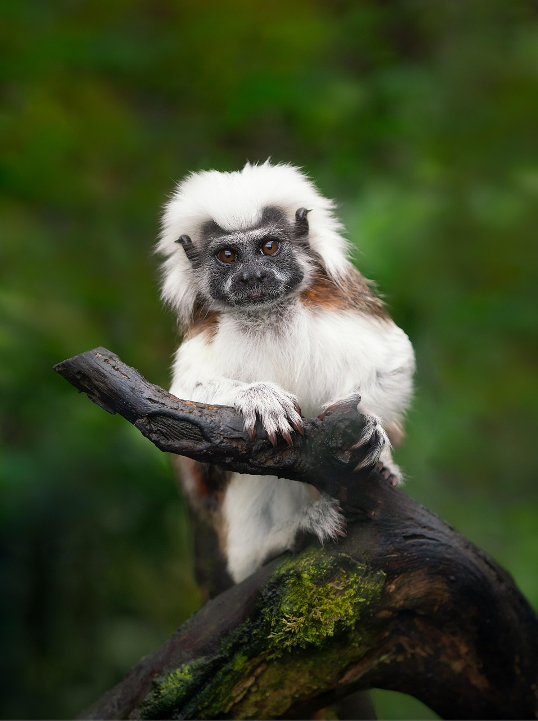
Human Impact on Food Chains
1
2
3
Impact of Human Activities
Effects of Climate Change
Importance of Conservation
Human activities, such as pollution and habitat destruction, can harm food chains.
These disruptions can lead to the decline or extinction of certain species.
Climate change can also affect food chains by altering the distribution and abundance of organisms.
This can result in imbalances within ecosystems.
It is essential to conserve and protect food chains to maintain ecosystem balance.
Efforts to preserve habitats and reduce pollution are crucial for sustainability.
10
Understanding Food Chains and Ecosystem Dynamics

Slide 11
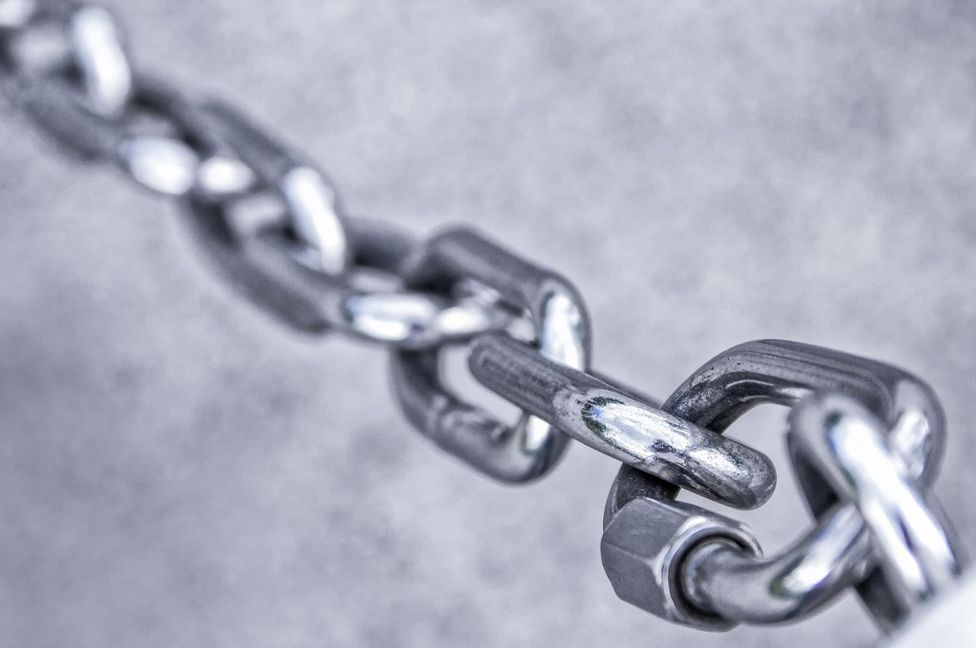
Activity: Building a Food Chain
Introduction to the Food Chain Activity
Encouragement for Creativity
Understanding Trophic Levels
Your task is to build a simple food chain using the following organisms: plants, rabbits, foxes, and hawks.
Use arrows to show the flow of energy between each trophic level.
Be creative and have fun while constructing your food chain.
This activity allows you to explore the relationships between different organisms.
Each organism represents a different trophic level in the food chain.
The flow of energy starts with plants and moves through rabbits, foxes, and hawks.
11
Understanding Food Chains and Ecosystem Dynamics

Slide 12

Activity: Food Chain Game
Introduction to the Game
Objective of the Game
Learning Outcome
We will play a game to simulate a food chain.
Each player will take on the role of a different organism in the food chain.
The goal is to demonstrate how energy flows through the food chain.
This will help us understand the interconnectedness of organisms.
By participating, players will gain insights into ecological relationships.
The game emphasizes the importance of energy transfer in ecosystems.
12
Understanding Food Chains and Ecosystem Dynamics

Slide 13
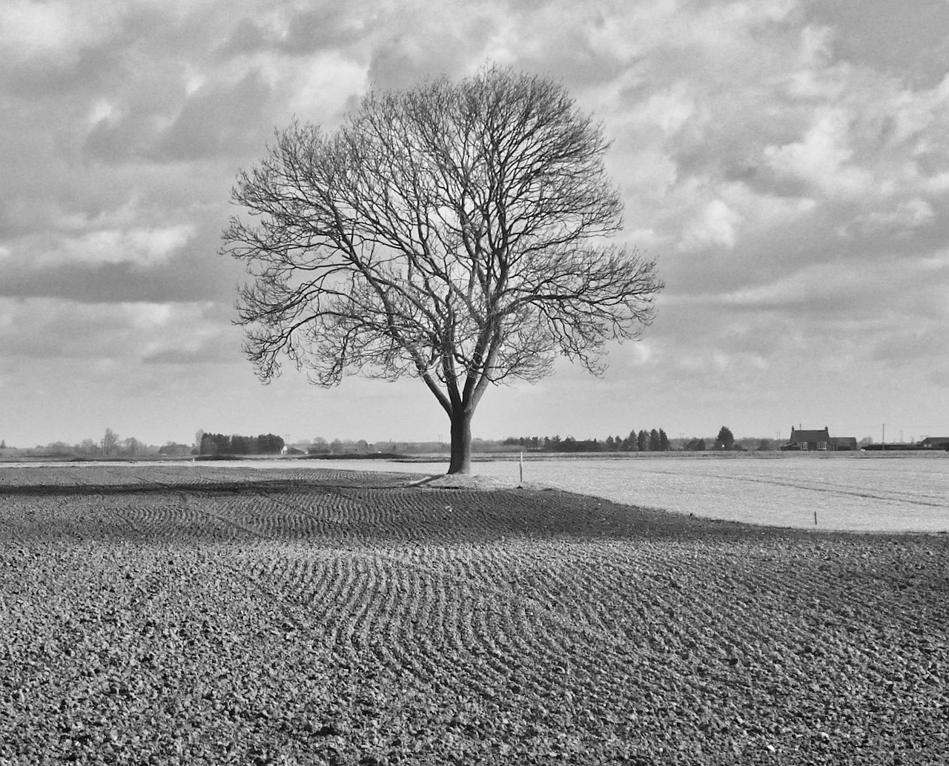
Conclusion
1
Importance of Food Chains
Food chains are essential for the survival of ecosystems.
They ensure the flow of energy and nutrients within the environment.
2
Roles of Producers and Consumers
Producers and consumers play vital roles in food chains.
They contribute to the stability and functionality of ecosystems.
3
Conservation of Food Chains
It is crucial to conserve and protect food chains to maintain ecosystem balance.
Preserving food chains helps sustain biodiversity and ecological health.
13
Understanding Food Chains and Ecosystem Dynamics

Slide 14

Assessment
1
Understanding Food Chains
Now it's time to assess your understanding of food chains.
Please complete the quiz to demonstrate your knowledge.
2
Quiz for Fun
Don't worry, it's just for fun!
Take your time and enjoy the process.
3
Show Your Knowledge
This is your chance to showcase what you've learned.
Good luck and have fun!
14
Understanding Food Chains and Ecosystem Dynamics

Slide 15
Extension Activity
Researching Ecosystems
Creativity in Food Chains
Understanding Trophic Levels
For an extension activity, research a specific ecosystem and create a food chain diagram.
Include at least five organisms and show the flow of energy between each trophic level.
Be creative and have fun while designing your food chain diagram.
This activity encourages exploration and artistic representation of ecosystems.
The food chain diagram should clearly depict energy flow between organisms.
This helps in understanding the roles of producers, consumers, and decomposers.
15
Understanding Food Chains and Ecosystem Dynamics

Slide 16

Reflection Questions
1
2
3
Understanding Food Chains
Interaction of Producers and Consumers
Conservation and Protection
What did you learn about food chains in this lesson?
How do producers and consumers interact in a food chain?
How do producers and consumers interact in a food chain?
What can we do to conserve and protect food chains?
What can we do to conserve and protect food chains?
What did you learn about food chains in this lesson?
16
Understanding Food Chains and Ecosystem Dynamics

Slide 17
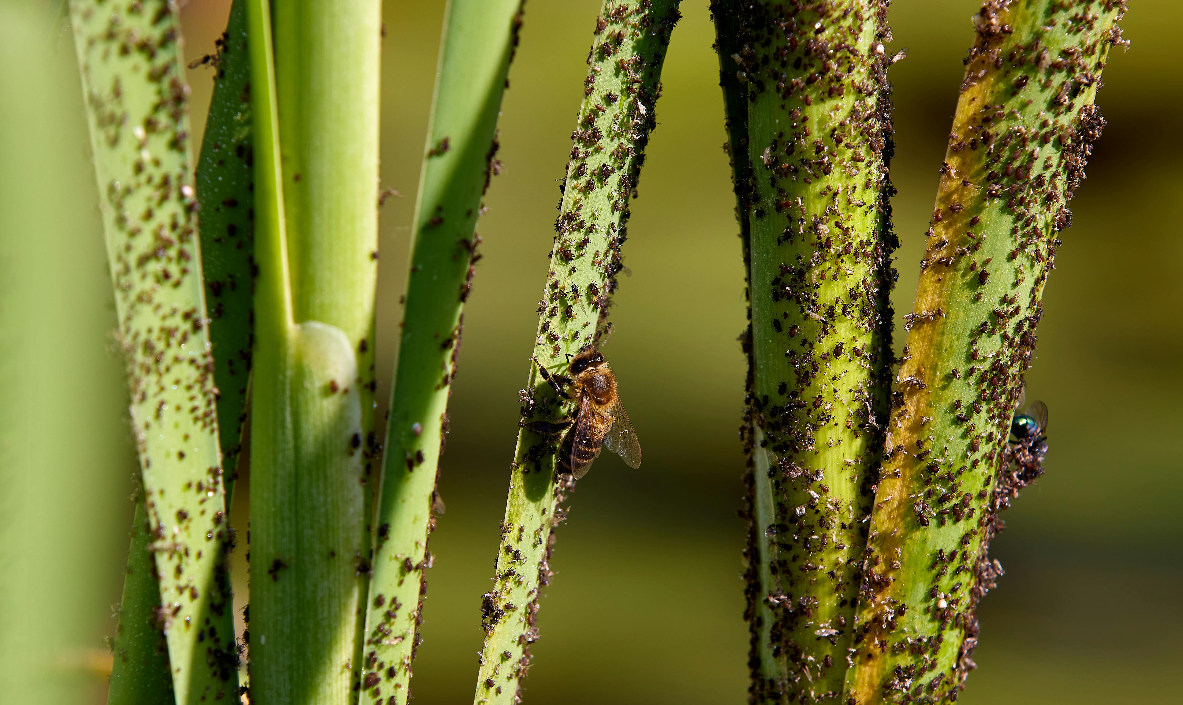
Next Steps
Exploring Food Webs
Conservation and Sustainability
Ecosystems and the Natural World
In our next lesson, we will explore food webs and how they differ from food chains.
This will help us understand the complexity of interactions in ecosystems.
We will also discuss the importance of conservation and sustainability.
These concepts are crucial for maintaining the balance of the natural world.
Get ready to learn more about ecosystems and the natural world!
This will deepen our appreciation for the interconnectedness of life.
17
Understanding Food Chains and Ecosystem Dynamics

Slide 18

Additional Resources
Explore National Geographic
Watch Documentaries
Read Books on Ecology
For more information on food chains, visit the National Geographic website.
It offers a wealth of resources on ecosystems and the natural world.
Watch documentaries on ecosystems and food chains on Netflix or YouTube.
These platforms provide engaging visual content to deepen your understanding.
Read books on ecology and conservation to learn more about the natural world.
Books offer in-depth insights into the complexities of ecosystems.
18
Understanding Food Chains and Ecosystem Dynamics

Slide 19
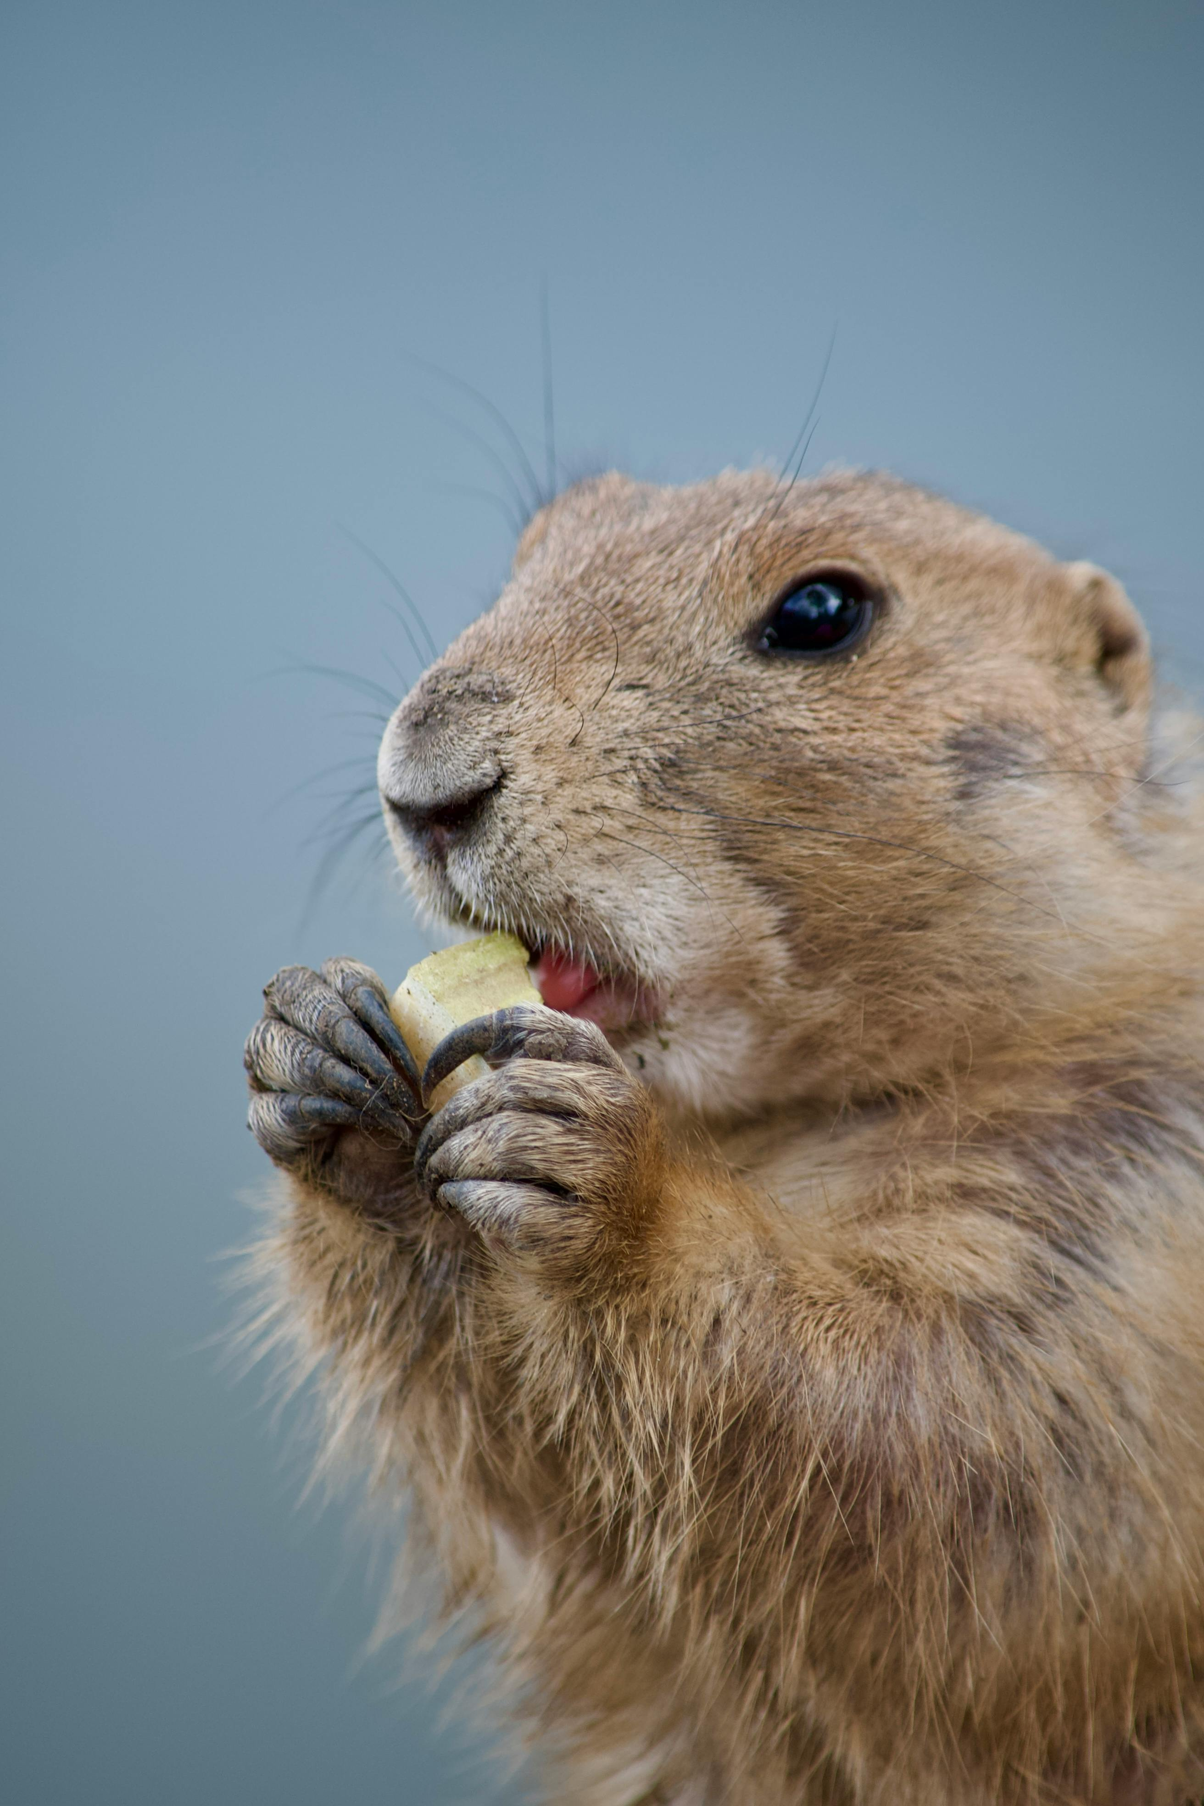
Conclusion and Final Thoughts
1
The Importance of Food Chains
Food chains are fascinating and essential for the survival of ecosystems.
They highlight the interconnectedness of all living organisms.
2
The Role of Organisms
Every organism plays a vital role in the food chain.
Their contributions ensure the balance and sustainability of ecosystems.
3
Call to Action for Conservation
Let's work together to conserve and protect our planet's precious ecosystems.
Our efforts can safeguard biodiversity and maintain ecological harmony.
19
Understanding Food Chains and Ecosystem Dynamics

