Slide 1



Understanding Functions: From Theory to Application
Exploring the Fundamentals and Practical Applications of Functions

Slide 2
TABLE OF
CONTENTS
Title Slide
Vocabulary
What is a Function?
Example Problem 1 - Mapping Diagram
Example Problem 2 - Table of Values
Example Problem 3 - Graphical Representation
Example Problem 4 - Algebraic Representation
Quick Check
Real-World Function Examples
Conclusion
Additional Presentation Notes
01
02
03
04
05
06
07
08
09
10
11

Slide 3

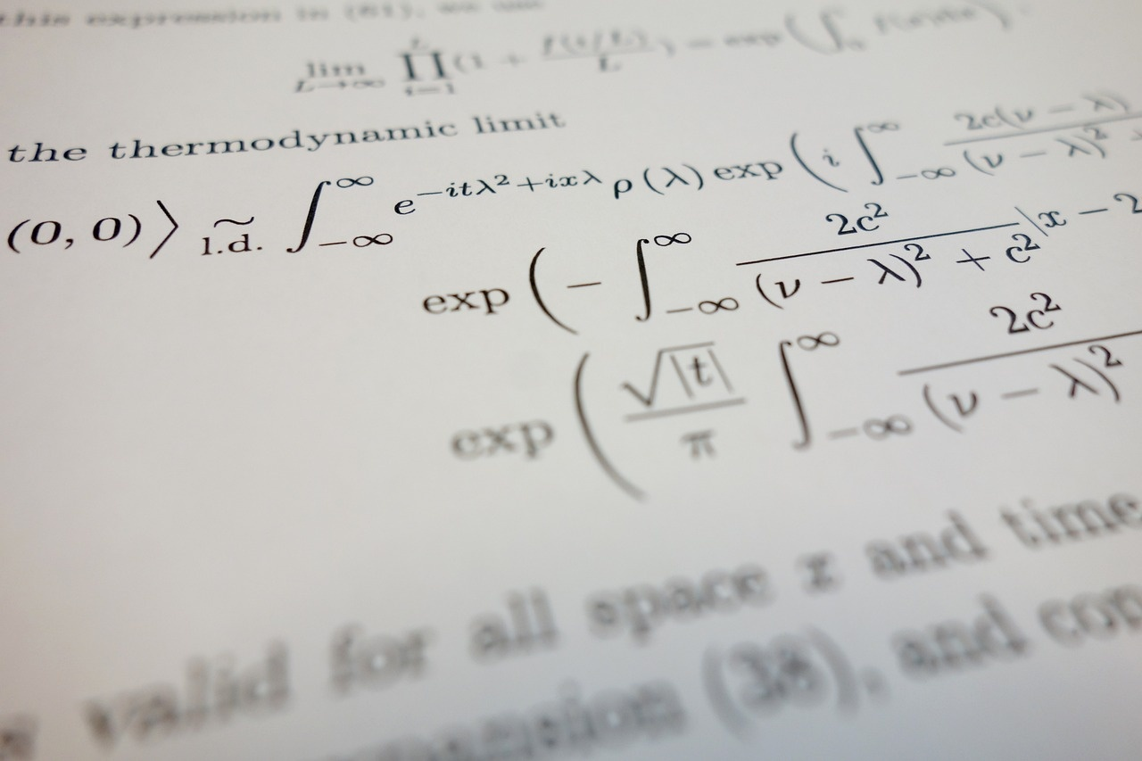
Understanding Functions: From Theory to Application
Title Slide
Relations and Functions: Understanding Mathematical Relationships
9th Grade Mathematics

Slide 4
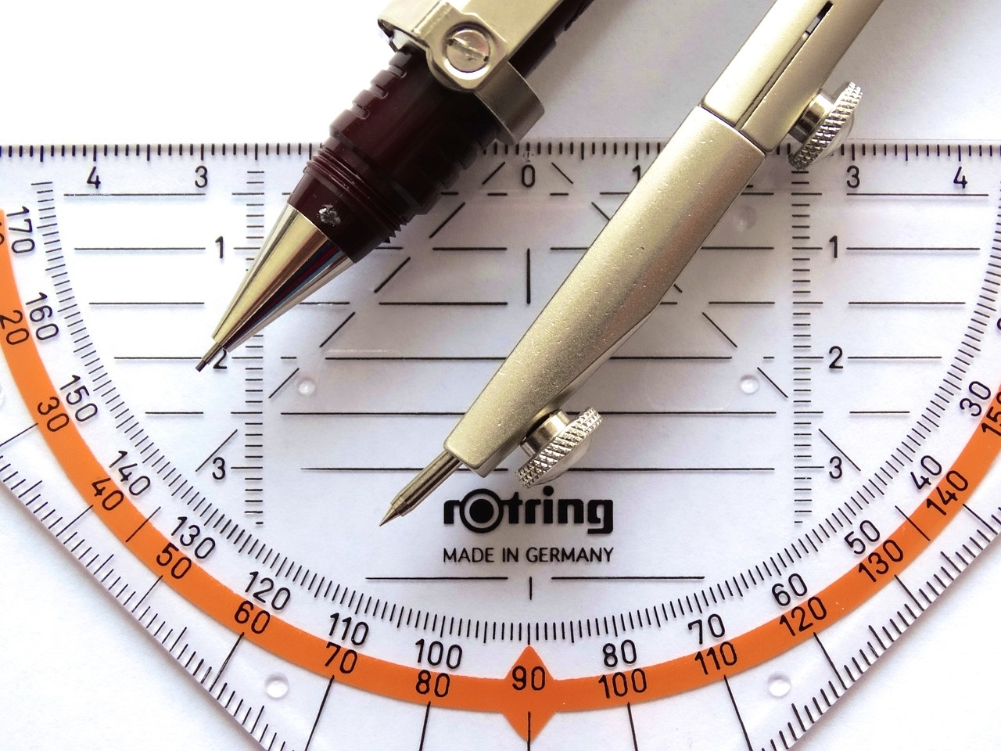
Understanding Functions: From Theory to Application
Vocabulary
Relation
A set of ordered pairs connecting inputs and outputs
Function
A relation where each input has exactly ONE output
Domain
All possible input values
Range
All possible output values
Vertical Line Test
A method to determine if a graph represents a function

Slide 5

Understanding Functions: From Theory to Application
What is a Function?
Function Definition
Every input (x-value) connects to ONLY ONE output (y-value)
Not all relations are functions
Think of a function like a machine: same input always produces the same output

Slide 6

Understanding Functions: From Theory to Application
Example Problem 1 - Mapping Diagram
Example Problem 1 - Mapping Diagram
Mapping Diagram Analysis
Input Set
{1, 2, 3, 4}
Output Set
{A, B, C, D}
Mapping
1 → A
2 → B
3 → C
4 → B
Is this a function? Why/Why not?
Solution: YES (each input has only one output)

Slide 7

Understanding Functions: From Theory to Application
Example Problem 2 - Table of Values
Example Problem 2 - Table of Values
Is this a function? Why?
| x | y |
|---|---|
| 0 | 3 |
| 1 | 5 |
| 2 | 3 |
YES (no repeated x-values with different y-values)

Slide 8





Understanding Functions: From Theory to Application
Example Problem 3 - Graphical Representation
Vertical Line Test
Demonstration
Practice Exercise
Draw a graph with multiple points.
If ANY vertical line crosses the graph MORE THAN ONCE, it is NOT a function.
Sample graph showing function vs. non-function.
Function: Vertical line intersects the graph at most once.
Non-function: Vertical line intersects the graph more than once.
Try applying the Vertical Line Test to different graphs.
Identify whether each graph represents a function or not.

Slide 9

Understanding Functions: From Theory to Application
Example Problem 4 - Algebraic Representation
Example Problem 4 - Algebraic Representation
Function Equation Analysis
Equation
y = x^2
Domain
All real numbers
Range
Non-negative real numbers
Determine if this represents a function

Slide 10

Understanding Functions: From Theory to Application
Quick Check
Scenario 1
Input Set: {2, 4, 6, 8}
Output Set: {A, B, C, D}
Mapping: 2 → A, 4 → B, 6 → C, 8 → B
Is this a function? Why/Why not?
Scenario 2
Input Set: {5, 7, 9, 11}
Output Set: {P, Q, R, S}
Mapping: 5 → P, 7 → Q, 9 → R, 11 → R
Is this a function? Why/Why not?
Scenario 3
Input Set: {1, 3, 5, 7}
Output Set: {X, Y, Z}
Mapping: 1 → X, 3 → Y, 5 → Z, 7 → Y
Is this a function? Why/Why not?
Scenario 4
Input Set: {0, 2, 4, 6}
Output Set: {M, N, O, P}
Mapping: 0 → M, 2 → N, 4 → O, 6 → N
Is this a function? Why/Why not?
Encourage peer discussion and verification

Slide 11

Understanding Functions: From Theory to Application
Real-World Function Examples
Real-World Function Examples
GPS navigation
Vending machines
Temperature conversion
Speed calculations

Slide 12

Understanding Functions: From Theory to Application
Conclusion
Key Takeaways
Functions establish unique input-output relationships.
Utilize various methods to identify functions effectively.
Consistent practice enhances comprehension and proficiency in working with functions.

Slide 13

Understanding Functions: From Theory to Application
Additional Presentation Notes
Utilize color-coded visuals
Incorporate interactive elements
Differentiate between different elements and concepts
Quizzes
Polls to engage students actively
Allocate space for notes
Encourage engagement
Students can jot down key points for better retention
Mathematical reasoning
Critical thinking throughout the lesson

