Slide 1

Exploring the Roots: A Comprehensive Guide to Family Tree Creation
Understanding, Building, and Enriching Your Family Heritage

Slide 2


Table of contents
Introduction to Creating a Family Tree
What is a Family Tree?
Why Create a Family Tree?
Getting Started
Family Relationships
Adding Pictures and Stories
Creating a Family Tree Template
Family Tree Examples
Tips and Variations
Conclusion
Assessment and Evaluation
Extension Activities
Parent Engagement
01
02
03
04
05
06
07
08
09
10
11
12
13

Slide 3
Table of contents
Safety Considerations
Conclusion and Next Steps
14
15

Slide 4

Introduction to Creating a Family Tree
Family Heritage
Immediate Family
Understanding Relationships
Family heritage is a tapestry woven from the stories and experiences of those who came before us.
Exploring your heritage can reveal unique insights into your family's journey.
Your immediate family forms the core of your personal history and identity.
Recognizing each member's role helps in understanding family dynamics.
Family relationships can be intricate, shaped by shared experiences and emotions.
Mapping these connections is vital for a comprehensive family tree.
1
Exploring the Roots: A Comprehensive Guide to Family Tree Creation

Slide 5
What is a Family Tree?
Diagram of Relationships
Multimedia Elements
Interactive Learning
A family tree shows relationships among family members over generations.
Multimedia elements enhance the family tree by including images and narratives about each member.
Creating a family tree is a fun way to explore your heritage and learn about your roots.
2
Exploring the Roots: A Comprehensive Guide to Family Tree Creation

Slide 6
Why Create a Family Tree?
Understand Heritage
Identity Development
Family Connections
A family tree helps appreciate your family's history.
It allows exploration of cultural heritage and its significance.
It fosters a sense of identity and belonging.
Knowing your roots enhances self-awareness.
It helps learn about family members and their relationships.
Understanding these connections strengthens family bonds.
3
Exploring the Roots: A Comprehensive Guide to Family Tree Creation

Slide 7

Getting Started
Materials Needed
Draw Family Members
Add Pictures & Stories
Gather the necessary materials to create your family tree.
You will need items like paper, crayons, and glue.
Begin by drawing your family members on the paper.
Label each drawing with their names and relationships.
Incorporate pictures and personal stories into your family tree.
These elements will add a special touch and make it memorable.
4
Exploring the Roots: A Comprehensive Guide to Family Tree Creation

Slide 8

Family Relationships
Family Connections
Relatives Included
Explaining Relationships
A family tree illustrates how family members are related.
It depicts the connections among relatives.
Include parents, siblings, and grandparents to depict family relationships clearly.
This ensures a comprehensive view of family ties.
Use simple language to clarify complex family dynamics.
Examples can help illustrate how different relatives are connected.
5
Exploring the Roots: A Comprehensive Guide to Family Tree Creation

Slide 9

Adding Pictures and Stories
Bring to Life
Visual Elements
Engaging Captions
Utilize images and narratives to enrich your family tree.
Incorporate visuals of relatives to deepen the storytelling.
Diverse images can significantly enhance your family tree's appeal.
Visuals draw viewers in and create a memorable experience.
Craft captions that narrate the story behind each image.
Well-written captions add depth and intrigue to your family tree.
6
Exploring the Roots: A Comprehensive Guide to Family Tree Creation

Slide 10
Creating a Family Tree Template
Start with a Template
Customize with Creativity
Include Photos and Stories
A family tree template can help you kickstart your creation.
Choose a simple design or craft your own using paper and crayons.
Personalize your family tree with unique designs.
Incorporate elements that showcase your family's heritage.
Add spaces for photographs to enhance visual appeal.
Sharing family stories adds depth and significance to your tree.
7
Exploring the Roots: A Comprehensive Guide to Family Tree Creation

Slide 11
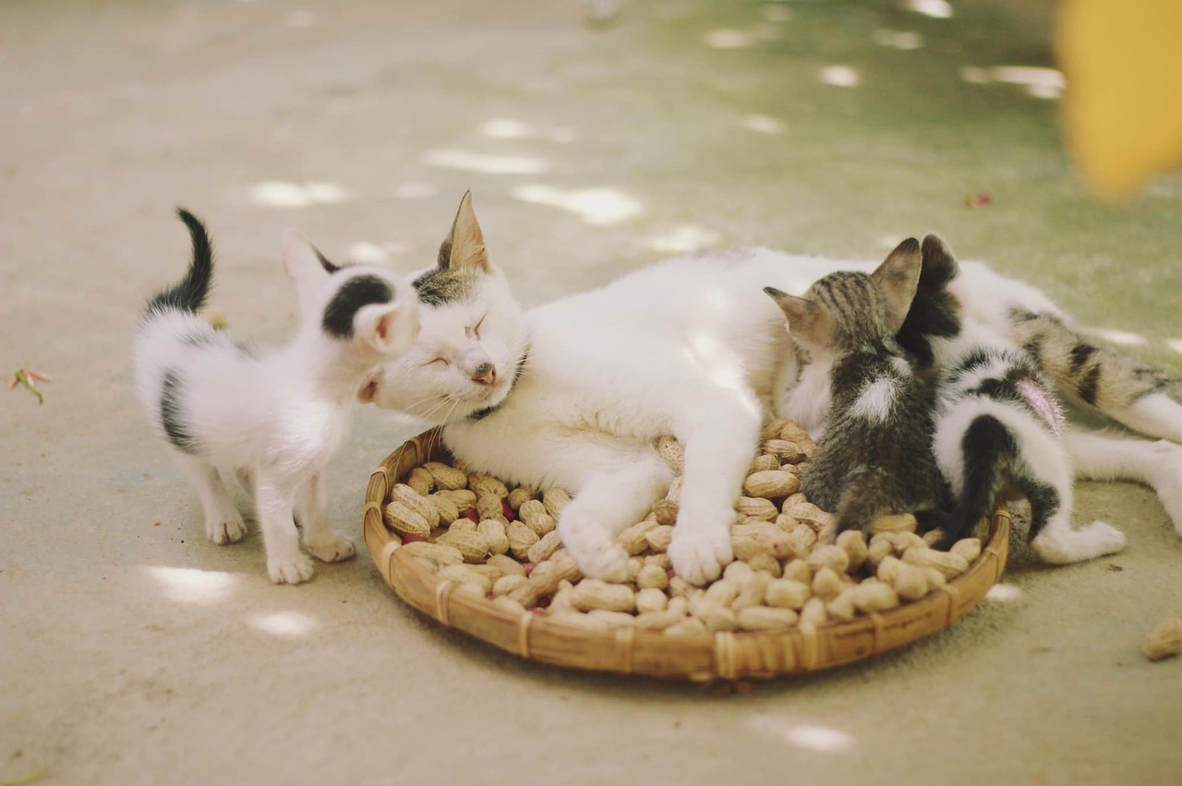
Family Tree Examples
Simple Family Tree
Complex Family Tree
Generational Family Tree
A simple family tree includes only your immediate family members.
It's an ideal starting point for beginners.
A complex family tree can include multiple generations and relatives.
It offers a comprehensive view of family history.
A generational family tree traces lineage through several generations.
It clarifies connections between ancestors and descendants.
8
Exploring the Roots: A Comprehensive Guide to Family Tree Creation

Slide 12

Tips and Variations
Creative Elements
Family Events
Experimentation
Incorporate fun elements like family photos or drawings into your family tree.
Use stickers or colorful markers to enhance its appearance.
Record significant family events, such as weddings and anniversaries, in your family tree.
Highlight birthdays and holidays to celebrate your family's history.
Experiment with different layouts or themes to make your family tree unique and personal.
Feel free to try new ideas that reflect your family's personality.
9
Exploring the Roots: A Comprehensive Guide to Family Tree Creation

Slide 13

Conclusion
Celebrate Completion
Be Creative
Share Your Tree
Congratulations! You have successfully completed the lesson.
Now you can create a family tree with pictures and stories.
Have fun and be creative when making your family tree.
Use colors, stickers, or drawings to make it unique!
Share your family tree with your family and friends.
Celebrate your creativity by showing them your work!
10
Exploring the Roots: A Comprehensive Guide to Family Tree Creation

Slide 14

Assessment and Evaluation
Engaging Quiz Activity
Collaborative Family Tree Sharing
Enjoyable Learning Experience
You will participate in a fun quiz to evaluate your understanding.
This interactive activity will help solidify your knowledge.
You will present your family tree to the class for discussion.
This provides valuable feedback and promotes shared learning.
Experience a delightful journey as you uncover your family's history!
These activities are designed to make learning enjoyable and memorable.
11
Exploring the Roots: A Comprehensive Guide to Family Tree Creation

Slide 15

Extension Activities
Create Family History Book
Interview Family Members
Share Findings
Create a family history book to explore your heritage.
This project helps you connect with your family's past.
Interview family members to gather information about your ancestors.
These discussions can reveal captivating stories and insights.
Share your findings with family and friends.
This encourages others to explore their own family history.
12
Exploring the Roots: A Comprehensive Guide to Family Tree Creation

Slide 16

Parent Engagement
Create Family Tree
Share Family Stories
Encourage Questions
Parents can help their child create a family tree using appropriate materials.
This activity enhances the child's sense of identity.
Sharing family stories and traditions enriches the child's understanding of their heritage.
Encourage parents to ask their child about their family tree.
This interaction fosters curiosity and engagement.
13
Exploring the Roots: A Comprehensive Guide to Family Tree Creation

Slide 17

Safety Considerations
Supervise Children
Clear Workspace
Hand Hygiene
Always supervise children when they are creating their family tree.
This ensures their safety and helps them stay focused.
Make sure the workspace is clear of any obstacles or tripping hazards.
A tidy area promotes a safer and more efficient activity.
Encourage children to wash their hands before and after the activity.
This helps prevent the spread of germs and keeps everyone healthy.
14
Exploring the Roots: A Comprehensive Guide to Family Tree Creation

Slide 18

Conclusion and Next Steps
Celebrate Completion
Be Creative
Share Your Story
Congratulations on completing the lesson on creating a family tree!
Reflect on your hard work and creativity.
Let your imagination soar as you craft your unique family tree.
Explore various designs to make it truly yours.
Share your family tree with loved ones.
Consider creating a family history book or poster to showcase it.
15
Exploring the Roots: A Comprehensive Guide to Family Tree Creation

