Slide 1


Introduction to Creative Writing: Mastering the Art of Short Storytelling
A Comprehensive Guide to Developing Characters, Plot, Setting, and Theme through Interactive Learning and Practice

Slide 2
Table of Contents
Welcome to Writing Your First Short Story
Why Write Short Stories?
Lesson Objectives
Character Development
Plot Structure
Setting and Atmosphere
Theme and Symbolism
Interactive Character Development
Plot Development
Writing Your Short Story
Sharing and Feedback
Common Errors to Avoid
Conclusion
04
05
06
07
08
09
10
11
12
13
14
15
16

Slide 3
Table of Contents
Additional Resources
Assessment and Evaluation
Extension Activities
Reflection and Next Steps
Final Thoughts
17
18
19
20
21

Slide 4

Welcome to Writing Your First Short Story
Introduction to Creative Writing
Interactive Learning
Exploring Imagination
Introduction to the world of creative writing.
Learning the fundamentals of short story writing.
Engaging in interactive prompts.
Participating in games to spark imagination.
Discovering new ways to tell stories.
Unleashing creativity through practice.
4
Introduction to Creative Writing: Mastering the Art of Short Storytelling

Slide 5

Why Write Short Stories?
Fostering Essential Skills
Effective Self-Expression
Develops critical thinking, creativity, and communication skills.
These skills are crucial for personal and professional growth.
Improves ability to express oneself effectively.
This helps in articulating thoughts and emotions clearly.
Enhancing Writing Proficiency
Academic and Beyond
Enhances writing skills and provides a platform for self-expression.
This encourages individuals to explore and refine their writing abilities.
Benefits students across various subjects in school and beyond.
This makes short story writing a versatile and valuable activity.
5
Introduction to Creative Writing: Mastering the Art of Short Storytelling

Slide 6
Lesson Objectives
Understanding Short Story Elements
Interactive Development Techniques
Crafting the Opening Paragraph
Integrating Story Components
Recall the basic elements of a short story.
Explain how characters, plot, and setting interact.
Apply interactive prompts and games to develop a character and plot.
Explore creative methods to enhance storytelling skills.
Create the opening paragraph of a short story.
Focus on engaging the reader from the very beginning.
Combine characters, plot, and setting seamlessly.
Ensure each element contributes to the overall narrative.
6
Introduction to Creative Writing: Mastering the Art of Short Storytelling

Slide 7
Character Development
Believable and Relatable Characters
Interactive Character Development
Character Traits and Motivations
Creating believable and relatable characters.
Understanding character traits, background, and motivations.
Developing characters through interactive games and exercises.
Creating believable and relatable characters.
Understanding character traits, background, and motivations.
Developing characters through interactive games and exercises.
7
Introduction to Creative Writing: Mastering the Art of Short Storytelling

Slide 8
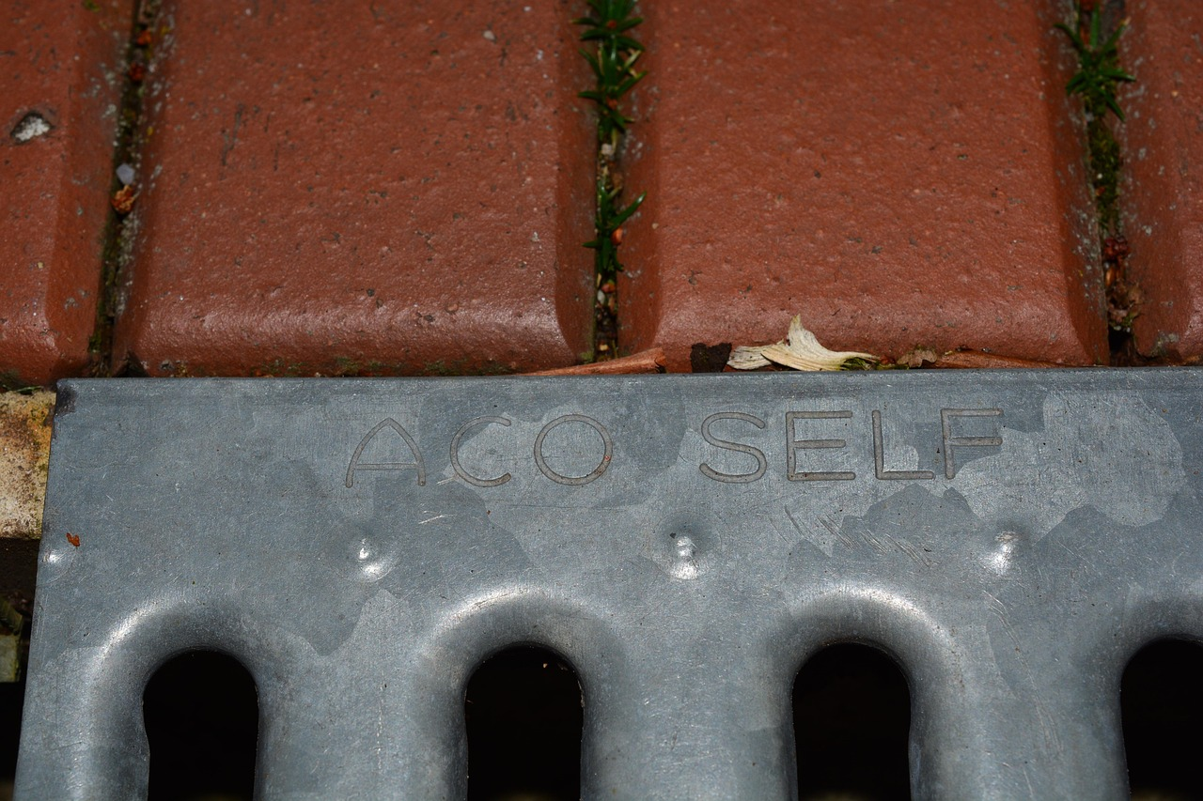
Plot Structure
Sequence of Events
Plot Diagram
Story Elements
Introduction to the sequence of events in a story.
Understanding exposition, rising action, climax, and resolution.
Creating a plot diagram to visualize the story.
Understanding how to structure a story effectively.
Exploring the key components of a story.
Analyzing how each part contributes to the overall narrative.
8
Introduction to Creative Writing: Mastering the Art of Short Storytelling

Slide 9

Setting and Atmosphere
Understanding the Story's Context
Crafting a Vivid Atmosphere
Engaging the Senses
Understanding the time and place of the story.
This helps ground the narrative and provides a framework for the events.
Creating a vivid atmosphere through descriptive language.
This enhances the reader's immersion and emotional connection to the story.
Using sensory details to bring the setting to life.
This makes the environment more tangible and relatable for the audience.
9
Introduction to Creative Writing: Mastering the Art of Short Storytelling

Slide 10

Theme and Symbolism
Understanding the Story's Core
Symbolism in Storytelling
Themes and Their Role
Understanding the underlying message or idea of the story.
Using objects, colors, or elements to represent abstract ideas.
Using objects, colors, or elements to represent abstract ideas.
Incorporating themes and symbolism into the story.
Understanding the underlying message or idea of the story.
Incorporating themes and symbolism into the story.
10
Introduction to Creative Writing: Mastering the Art of Short Storytelling

Slide 11
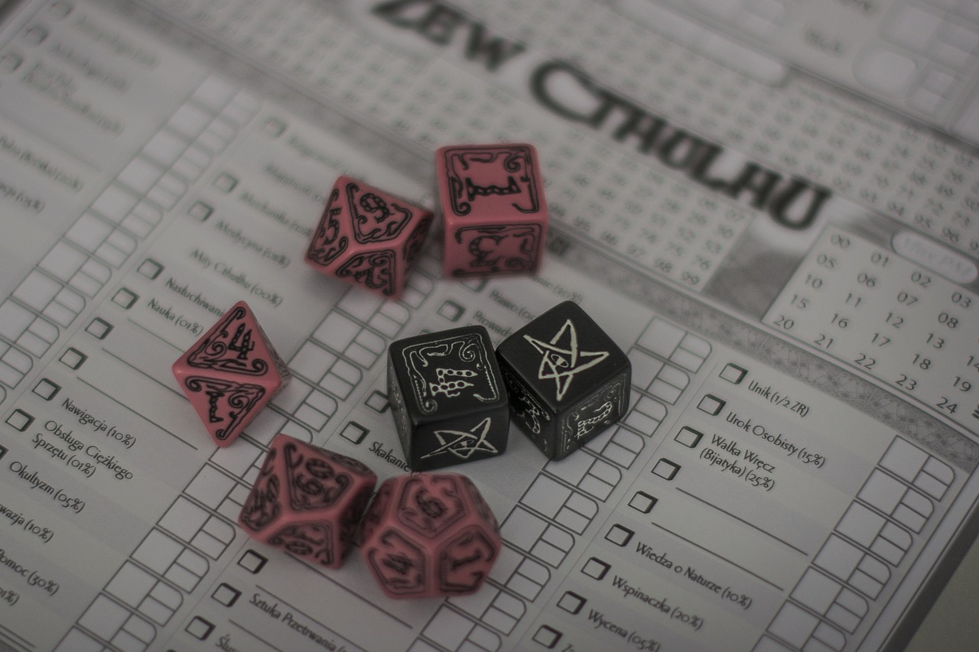
Interactive Character Development
Interactive Games for Character Creation
Creating a character through interactive games and exercises.
These activities help in exploring unique aspects of the character.
Building Character Depth
Developing character traits, background, and motivations.
This process ensures a well-rounded and believable character.
Collaborative Character Sharing
Sharing and discussing character profiles.
This fosters creativity and provides valuable feedback.
11
Introduction to Creative Writing: Mastering the Art of Short Storytelling

Slide 12

Plot Development
1
Visualizing the Story
Creating a plot diagram to visualize the story.
This helps in understanding the flow and structure of the narrative.
2
Key Events and Turning Points
Understanding key events and turning points.
These are crucial for maintaining the reader's interest and driving the story forward.
3
Adding Surprise and Interest
Developing a plot twist to add surprise and interest.
This element keeps the audience engaged and adds depth to the storyline.
12
Introduction to Creative Writing: Mastering the Art of Short Storytelling

Slide 13

Writing Your Short Story
Using Interactive Prompts and Games
Starting to write the short story is the first step in the creative process.
It involves brainstorming and organizing your initial ideas to set the foundation.
Writing a Compelling Opening Paragraph
Interactive prompts and games can help spark creativity and generate unique ideas.
These tools are especially useful for overcoming writer's block and exploring new perspectives.
Writing a Compelling Opening Paragraph
A compelling opening paragraph is crucial to grab the reader's attention.
It sets the tone and introduces the main theme or characters of the story.
13
Introduction to Creative Writing: Mastering the Art of Short Storytelling

Slide 14

Sharing and Feedback
Peer Sharing
Constructive Feedback
Story Revision
Sharing short stories with peers fosters a sense of community and collaboration.
It allows writers to showcase their work and gain diverse perspectives.
Giving and receiving constructive feedback is essential for growth.
It helps identify strengths and areas for improvement in storytelling.
Using feedback to improve and revise the story enhances its quality.
This iterative process ensures the narrative becomes more engaging and polished.
14
Introduction to Creative Writing: Mastering the Art of Short Storytelling

Slide 15
Common Errors to Avoid
01
Insufficient Character Development
Characters lacking depth can make the story unengaging.
Readers may struggle to connect with characters who are not well-developed.
02
Poor Plot Structure
A disorganized plot can confuse readers and weaken the narrative.
Stories with weak structure often fail to maintain interest or deliver impact.
03
Inconsistent Setting and Atmosphere
A setting that changes inconsistently can disrupt the reader's immersion.
Atmosphere plays a crucial role in storytelling and must align with the narrative.
04
Lack of Theme or Symbolism
Themes and symbolism add layers of meaning to a story.
Without them, the narrative may feel superficial or incomplete.
15
Introduction to Creative Writing: Mastering the Art of Short Storytelling

Slide 16
Conclusion
Key Takeaways Recap
Encouragement to Practice
Next Steps for Learning
Recap of key takeaways from the lesson.
Encouragement to continue writing and practicing.
Encouragement to continue writing and practicing.
Final thoughts and next steps for further learning.
Final thoughts and next steps for further learning.
Recap of key takeaways from the lesson.
16
Introduction to Creative Writing: Mastering the Art of Short Storytelling

Slide 17

Additional Resources
Recommended Reading and Writing Resources
Online Tools and Platforms for Writing
Tips for Continued Learning and Improvement
Explore a variety of books and articles that enhance your understanding of storytelling.
These resources provide insights into effective writing techniques and narrative structures.
Discover platforms that allow you to write, edit, and share your stories with a global audience.
These tools offer features like collaborative editing and publishing options to refine your work.
Learn strategies to consistently improve your writing skills and storytelling abilities.
Engage in activities that challenge your creativity and expand your knowledge base.
17
Introduction to Creative Writing: Mastering the Art of Short Storytelling

Slide 18

Assessment and Evaluation
1
Understanding Assessment Criteria
Understanding the assessment criteria is crucial for effective evaluation.
It provides a clear framework for measuring student performance.
2
Evaluating Student Progress
Evaluating student progress and understanding helps identify areas of improvement.
It ensures that students are on track to meet learning objectives.
3
Using Feedback for Instruction
Using feedback to inform future lessons and instruction enhances teaching strategies.
It allows educators to address specific student needs effectively.
18
Introduction to Creative Writing: Mastering the Art of Short Storytelling

Slide 19

Extension Activities
Developing Dialogue and Description
Introduction to Editing and Revision
Publishing and Sharing Student Work
Developing dialogue and description.
This activity focuses on enhancing students' ability to create vivid and engaging narratives.
Introduction to editing and revision.
Students learn the importance of refining their work through structured editing and revision processes.
Publishing and sharing student work.
This step encourages students to present their polished pieces to an audience, fostering confidence and pride in their creations.
19
Introduction to Creative Writing: Mastering the Art of Short Storytelling

Slide 20

Reflection and Next Steps
Reflecting on the Learning Experience
Reflecting on the learning experience allows individuals to assess their achievements and challenges.
This process helps in understanding what worked well and what could be improved for future endeavors.
Identifying Areas for Improvement and Growth
Recognizing areas for improvement is crucial for personal and professional development.
It provides an opportunity to focus on skills and knowledge that need enhancement.
Planning Next Steps for Continued Learning and Development
Planning next steps ensures a structured approach to achieving future goals.
It involves setting clear objectives and strategies for ongoing growth and learning.
20
Introduction to Creative Writing: Mastering the Art of Short Storytelling

Slide 21
Final Thoughts
Lesson Completion
Encouragement to Write
Future Wishes
Congratulations on completing the lesson.
Your dedication and effort are commendable.
Keep exploring your creativity through writing.
Every word you write brings you closer to mastery.
Wishing you success in all your future writing endeavors.
May your creativity continue to flourish.
21
Introduction to Creative Writing: Mastering the Art of Short Storytelling

