Slide 1


Mastering Goal Setting and Learning Routines
Strategies for Effective Time Management, Motivation, and Academic Success

Slide 2
Table of Contents
Introduction to Setting Goals and Creating a S…
Why Set Goals?
What are SMART Goals?
Creating a Personalized Learning Routine
Time Management Strategies
Overcoming Procrastination
Staying Motivated
Common Obstacles and Solutions
Reviewing Progress and Adjusting Goals
Conclusion
Additional Resources
Next Steps
Reflection Questions
04
05
06
07
08
09
10
11
12
13
14
15
16

Slide 3
Table of Contents
Interactive Activity
Conclusion and Final Thoughts
Final Tips and Reminders
Get Started Today!
Additional Support
Conclusion and Final Thoughts
17
18
19
20
21
22

Slide 4

Introduction to Setting Goals and Creating a Successful Learning Routine
Welcome to the Lesson
Lesson Objectives
Importance of Goal-Setting
Welcome to our lesson on setting goals and creating a successful learning routine!
In this lesson, we will explore the importance of goal-setting and learn how to create a personalized learning routine.
By the end of this lesson, you will be able to set realistic goals, prioritize tasks, and create a schedule that suits your needs.
This lesson aims to equip you with the tools to enhance your learning experience effectively.
Setting goals is a crucial step in achieving success in any learning endeavor.
It helps you stay focused, motivated, and organized throughout your journey.
4
Mastering Goal Setting and Learning Routines

Slide 5

Why Set Goals?
Clarify Your Aspirations
Direction and Focus
Setting goals helps you clarify what you want to achieve.
It allows you to define your priorities and focus on what truly matters.
Goals give you direction and focus.
They act as a roadmap guiding you toward your desired outcomes.
Boost Motivation and Confidence
Foster Growth and Resilience
Achieving goals boosts your motivation and self-confidence.
It reinforces your belief in your ability to succeed.
Setting goals helps you develop a growth mindset and overcome obstacles.
It encourages you to embrace challenges and learn from setbacks.
5
Mastering Goal Setting and Learning Routines

Slide 6

What are SMART Goals?
Specific Goals
Measurable Goals
Achievable Goals
Clearly define what you want to achieve.
This ensures clarity and focus in your objectives.
Quantify your goal so you can track progress.
This helps in assessing how far you've come and what remains to be done.
Make sure your goal is realistic and attainable.
Setting practical goals increases the likelihood of success.
Relevant Goals
Time-Bound Goals
Align your goal with your values and priorities.
This ensures that your efforts are meaningful and impactful.
Set a specific deadline or timeframe.
This creates a sense of urgency and helps in planning effectively.
6
Mastering Goal Setting and Learning Routines

Slide 7
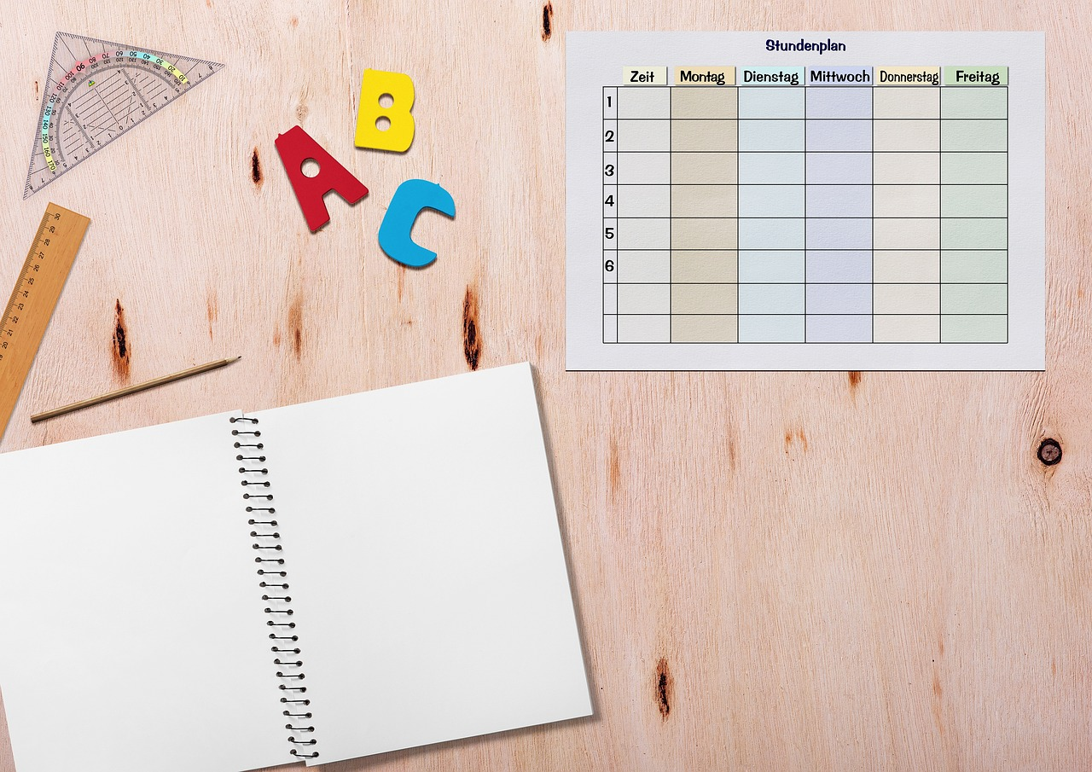
Creating a Personalized Learning Routine
Understanding Yourself
Goal Setting
Identify your strengths, weaknesses, and learning style.
This self-awareness helps in tailoring a routine that works best for you.
Set specific, measurable, and achievable goals.
Clear objectives provide direction and motivation in your learning journey.
Effective Time Management
Staying Organized
Prioritize tasks and allocate time effectively.
This ensures that you focus on what matters most and avoid burnout.
Use a planner, calendar, or app to stay organized.
These tools help you track progress and maintain consistency in your routine.
7
Mastering Goal Setting and Learning Routines

Slide 8

Time Management Strategies
Scheduling Tasks Effectively
Prioritizing Tasks
Breaking Down Large Tasks
Use a planner or calendar to schedule tasks.
This helps in organizing your day and ensuring nothing important is missed.
Prioritize tasks based on importance and urgency.
This ensures that critical tasks are completed first.
Break down large tasks into smaller, manageable chunks.
This makes daunting projects more approachable and easier to complete.
Minimizing Distractions
Taking Regular Breaks
Minimize distractions and stay focused.
This improves productivity and helps in maintaining a steady workflow.
Take regular breaks to avoid burnout.
Short breaks can rejuvenate your mind and enhance overall efficiency.
8
Mastering Goal Setting and Learning Routines

Slide 9

Overcoming Procrastination
Understanding Procrastination
Breaking Down Tasks
Identify the reasons for your procrastination.
This helps in addressing the root causes effectively.
Break down large tasks into smaller, manageable chunks.
This makes them less intimidating and easier to tackle.
Scheduling for Success
Positive Reinforcement
Create a schedule and stick to it.
Consistency is key to overcoming procrastination.
Use positive self-talk and reward yourself for progress.
This builds motivation and reinforces good habits.
9
Mastering Goal Setting and Learning Routines

Slide 10

Staying Motivated
Celebrate Achievements
Find a Study Buddy
Recognize and celebrate your achievements and progress.
This helps to maintain a positive outlook and stay motivated.
Partnering with a study buddy or accountability partner can boost motivation.
It creates a sense of shared responsibility and support.
Positive Self-Talk
Reward Milestones
Using positive self-talk and affirmations can reinforce your confidence.
This practice helps to overcome self-doubt and stay focused.
Rewarding yourself for reaching milestones keeps you motivated.
It provides a tangible incentive to continue working towards your goals.
10
Mastering Goal Setting and Learning Routines

Slide 11
Common Obstacles and Solutions
01
02
03
04
05
Overcoming Procrastination
Boosting Motivation
Managing Distractions
Addressing Perfectionism
Conquering Fear of Failure
Break down tasks into smaller, manageable parts.
Create a schedule to stay organized and on track.
Find a study buddy to keep each other accountable.
Reward yourself for completing tasks to maintain enthusiasm.
Minimize distractions by creating a focused environment.
Use a planner to prioritize and organize your activities effectively.
Set realistic goals to avoid unnecessary stress.
Focus on progress rather than achieving perfection.
Reframe failure as an opportunity to learn and grow.
Embrace challenges as stepping stones to success.
11
Mastering Goal Setting and Learning Routines

Slide 12

Reviewing Progress and Adjusting Goals
01
Regular Progress Reviews
Regularly review your progress and adjust your goals.
This helps in staying on track and achieving desired outcomes.
02
Celebrate Achievements
Celebrate your achievements and identify areas for improvement.
Acknowledging success boosts motivation and highlights areas to work on.
03
Adjusting Schedules
Make adjustments to your schedule and routine as needed.
This ensures your plans remain practical and effective.
04
Flexibility and Adaptation
Stay flexible and adapt to changes.
Being adaptable allows you to overcome unexpected challenges.
12
Mastering Goal Setting and Learning Routines

Slide 13

Conclusion
Importance of Goal Setting
Adaptability and Progress
Achieving Academic Success
Setting goals and creating a successful learning routine is crucial for academic success.
By following the strategies outlined in this lesson, you can achieve your goals and develop a growth mindset.
Remember to stay flexible, adapt to changes, and celebrate your progress.
These practices ensure continuous improvement and resilience in your academic journey.
By implementing the outlined strategies, you pave the way for achieving your academic aspirations.
A growth mindset is key to overcoming challenges and reaching your full potential.
13
Mastering Goal Setting and Learning Routines

Slide 14

Additional Resources
Goal-Setting Tools
Online goal-setting templates and worksheets.
These resources help individuals set clear and achievable objectives.
Time Management Solutions
Time management apps and planners.
These tools assist in organizing daily tasks and optimizing productivity.
Productivity Literature
Study skills and productivity books.
These books provide insights and strategies for effective learning and work habits.
Motivation and Focus Resources
Online resources and tutorials for staying motivated and focused.
These materials offer guidance on maintaining drive and concentration in various activities.
14
Mastering Goal Setting and Learning Routines

Slide 15

Next Steps
Integrating Strategies into Daily Life
Apply the strategies outlined in this lesson to your daily routine.
This will help you build consistency and make progress toward your goals.
Sharing Goals for Accountability
Share your goals and progress with a friend or family member.
This creates a support system and keeps you motivated.
Adapting for Continuous Improvement
Continuously review and adjust your goals and routine to achieve success.
This ensures your approach remains effective and aligned with your aspirations.
15
Mastering Goal Setting and Learning Routines

Slide 16

Reflection Questions
01
Setting Goals
What are your short-term and long-term goals?
Define clear objectives to guide your personal and professional growth.
02
Overcoming Challenges
What strategies will you use to overcome obstacles and stay motivated?
Identify actionable steps to maintain focus and resilience.
03
Effective Time Management
How will you prioritize tasks and manage your time effectively?
Develop a structured plan to optimize productivity and balance responsibilities.
04
Utilizing Resources
What resources will you use to support your learning and goal achievement?
Leverage tools, networks, and materials to enhance your progress.
16
Mastering Goal Setting and Learning Routines

Slide 17

Interactive Activity
Vision Board Creation
Reflective Journal Writing
Sharing Goals and Progress
Create a vision board to represent your goals and aspirations.
This activity helps visualize and clarify your objectives effectively.
Write a reflective journal entry on your progress and challenges.
This practice encourages self-awareness and personal growth.
Share your goals and progress with a partner or in a small group.
Collaborative discussions foster accountability and inspiration.
17
Mastering Goal Setting and Learning Routines

Slide 18

Conclusion and Final Thoughts
The Journey of Goal Setting
Setting goals and creating a successful learning routine is a process that takes time and effort.
Stay committed, persistent, and patient, and you will achieve your goals.
Celebrate Your Achievements
Remember to celebrate your progress.
Reflect on your journey to understand how far you've come.
Patience and Persistence
Achieving goals requires dedication and resilience.
Stay focused and trust the process.
18
Mastering Goal Setting and Learning Routines

Slide 19

Final Tips and Reminders
Stay Organized and Focused
Stay organized and focused to achieve your goals effectively.
Maintaining a clear plan helps in reducing distractions and staying on track.
Effective Time Management
Prioritize tasks and manage your time effectively to maximize productivity.
Allocating time wisely ensures that important tasks are completed efficiently.
Positive Reinforcement
Use positive self-talk and reward yourself for progress to stay motivated.
Celebrating small achievements boosts confidence and encourages continued effort.
Goal Adjustment
Continuously review and adjust your goals and routine to align with your aspirations.
Regular evaluation helps in adapting to changes and improving your strategies.
19
Mastering Goal Setting and Learning Routines

Slide 20

Get Started Today!
Set Your Goals
Achieve Success
Start setting your goals and creating a successful learning routine today.
Remember, every small step counts, and progress is key to achieving success.
Start setting your goals and creating a successful learning routine today.
Remember, every small step counts, and progress is key to achieving success.
20
Mastering Goal Setting and Learning Routines

Slide 21

Additional Support
Guidance from Educators
Online Learning Tools
Collaborative Study
Seek help from teachers, mentors, or tutors when needed.
They can provide personalized support and clarify challenging concepts.
Use online resources and tutorials to support your learning.
These platforms offer diverse materials to enhance understanding.
Join a study group or find a study buddy for accountability and motivation.
Working with peers can make learning more engaging and effective.
21
Mastering Goal Setting and Learning Routines

Slide 22

Conclusion and Final Thoughts
The Journey of Goal Setting
Commitment and Growth
Setting goals and creating a successful learning routine is a journey that requires effort, dedication, and persistence.
Stay committed, and you will achieve your goals and develop a growth mindset.
Setting goals and creating a successful learning routine is a journey that requires effort, dedication, and persistence.
Stay committed, and you will achieve your goals and develop a growth mindset.
22
Mastering Goal Setting and Learning Routines

