Slide 1
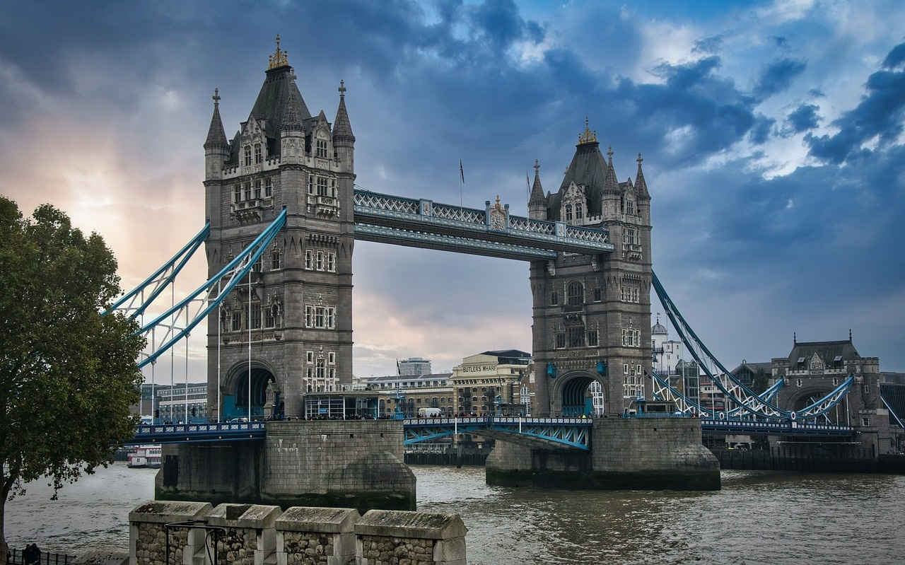



Exploring The Great Fire of London
A Journey Through History, Learning, and Resilience

Slide 2



Table of contents
Title Slide: The Great Fire of London: A Historical…
Dyslexia-Friendly Learning Approach
Historical Context: Map of London in 1666
The Fire Begins: Large, clear timeline
Fire Spread Dynamics: Infographic showing fire prog…
Survival Stories: Personal narrative snippets
Rebuilding London: Before and after architectural c…
Fire Safety Learning: Modern firefighting techniques
Interactive Learning Activities: Hands-on explorati…
Dyslexia Support Techniques: Learning accommodation…
Key Vocabulary: Essential terms
Reflection and Assessment: Inclusive assessment met…
Parent and Educator Guide: Supporting dyslexic lear…
01
02
03
04
05
06
07
08
09
10
11
12
13

Slide 3
Table of contents
Resources and Further Learning: Recommended books
Conclusion: Key takeaways
14
15

Slide 4
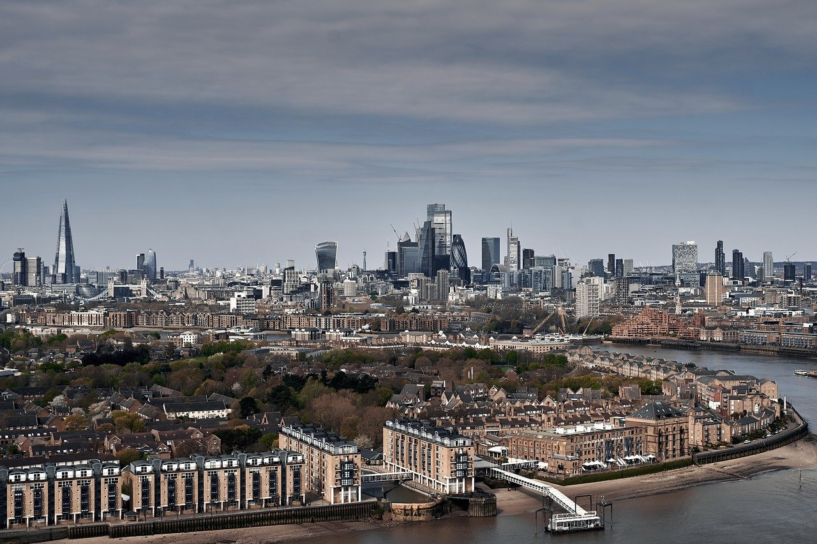
Title Slide: The Great Fire of London: A Historical Adventure
The Great Fire of London: A Historical Adventure
Exploring the 1666 Catastrophe
Exploring The Great Fire of London

Slide 5

Dyslexia-Friendly Learning Approach
01
02
03
04
Multimodal Learning Strategies
Color-coded information
Large, clear typography
Minimal text per slide
Visual representations
Tactile exploration
Audio descriptions
Simplified text
Exploring The Great Fire of London

Slide 6
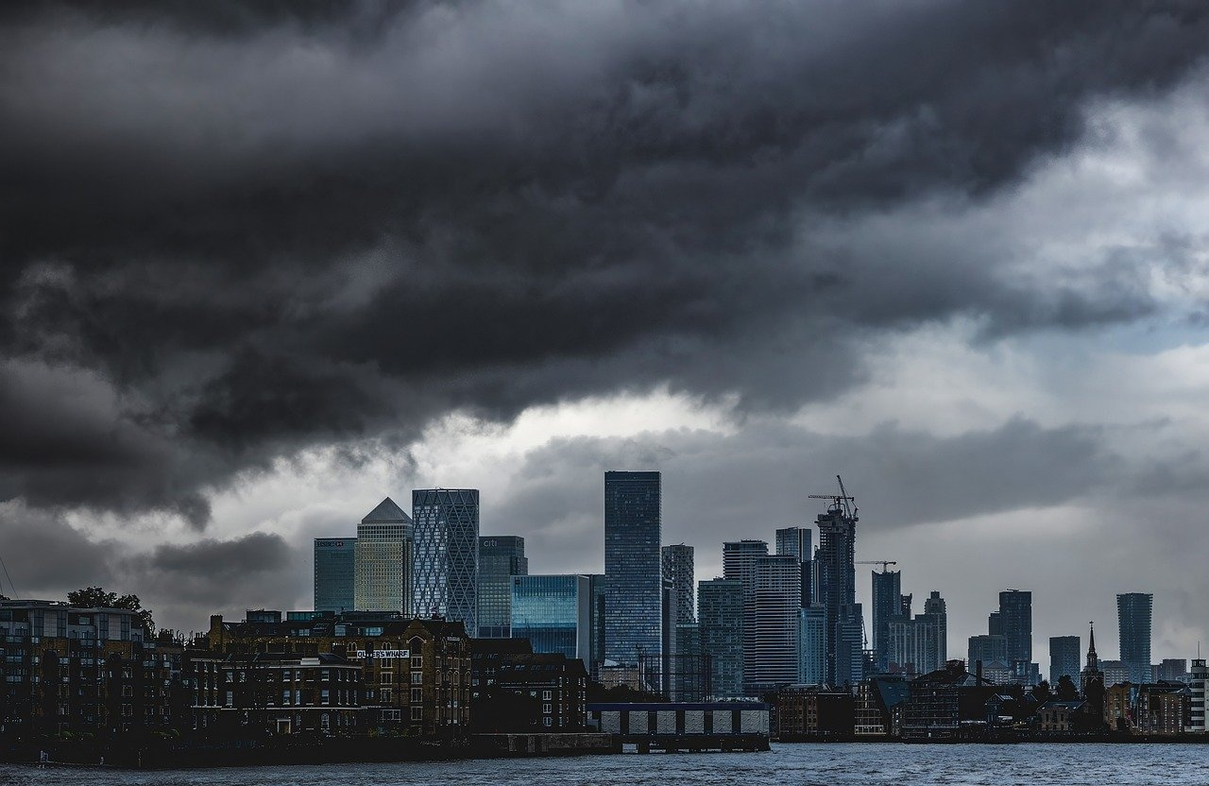
Historical Context: Map of London in 1666
Map of London in 1666
Visual representation of city layout
Wooden buildings
Narrow streets
Tightly packed structures
Exploring The Great Fire of London

Slide 7
The Fire Begins: Large, clear timeline
The Fire Begins
Location
Date
4
Pudding Lane Bakery
September 2, 1666
Timeline Progression
The fire started here
The day the fire began
Exploring The Great Fire of London

Slide 8
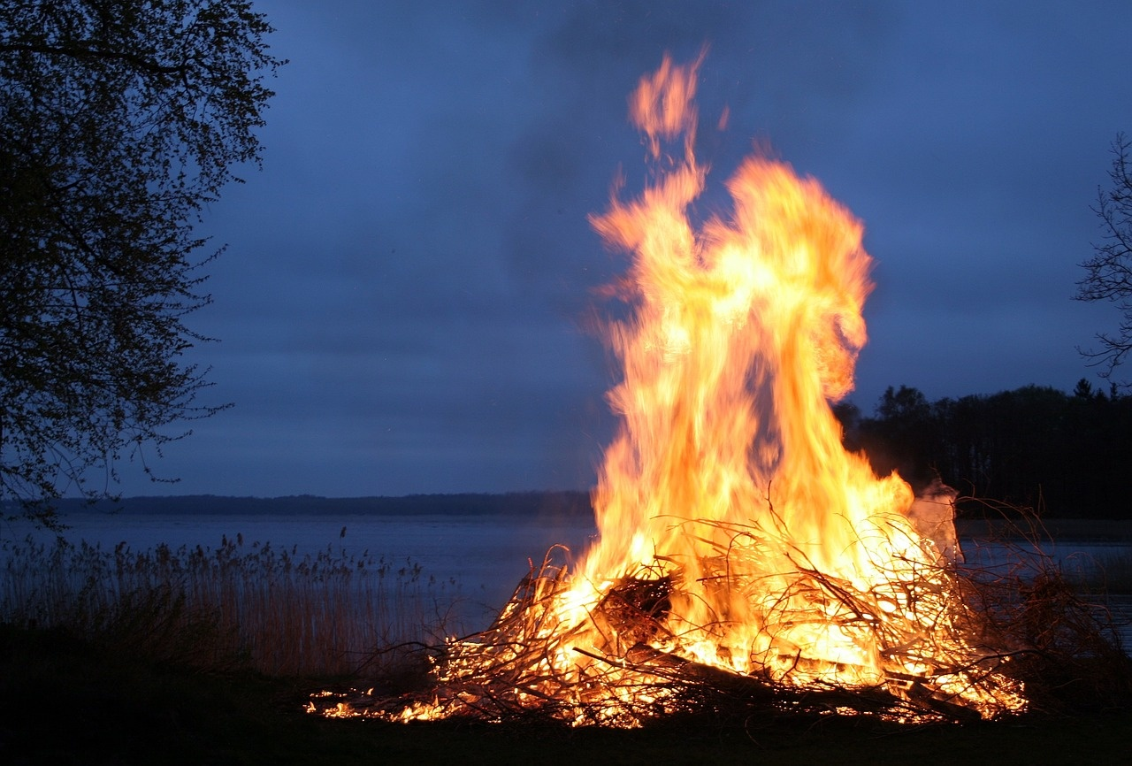
Fire Spread Dynamics: Infographic showing fire progression
Infographic showing fire progression
Visual representation of fire triangle concept
Simplified explanation of combustion process
Use of visual metaphors to illustrate fire dynamics
Exploring The Great Fire of London

Slide 9
Survival Stories: Personal narrative snippets
01
02
03
04
05
Personal narrative snippets
Emotional impact visualization
Survivor quotes
Empathy-building imagery
Large, readable text
Mary Smith: "I woke up to the smell of smoke and the crackling of flames outside my window."
John Brown: "The heat was intense, and I could hear the panicked cries of my neighbors."
Sarah Jenkins: "We huddled together in the street, watching helplessly as our homes burned."
Illustrations depicting fear, resilience, and community support during the fire.
"It felt like the end of the world, but we found strength in each other." - Thomas Harris
"The loss was devastating, but we vowed to rebuild and start anew." - Elizabeth Turner
Images showing families escaping with their belongings, seeking safety amidst chaos.
Font size: 24pt for easy readability by all learners.
Exploring The Great Fire of London

Slide 10
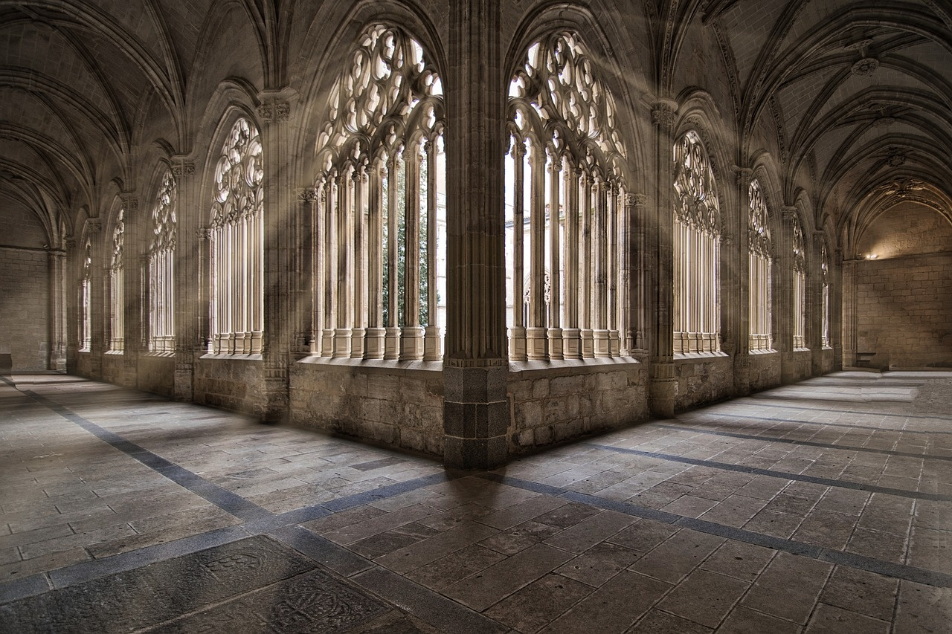
Rebuilding London: Before and after architectural comparison
Before the Great Fire of London (1666)
After the Great Fire of London
Architecture: Tudor-style timber-framed buildings.
Layout: Narrow, winding streets with densely packed structures.
Materials: Primarily wood and thatch roofs.
Icon: Image of Tudor-style buildings.
Architecture: Neo-classical designs by Sir Christopher Wren.
Layout: Wide, grid-like streets with open spaces.
Materials: Stone and brick for fire resistance.
Icon: Image of St. Paul's Cathedral.
Exploring The Great Fire of London

Slide 11
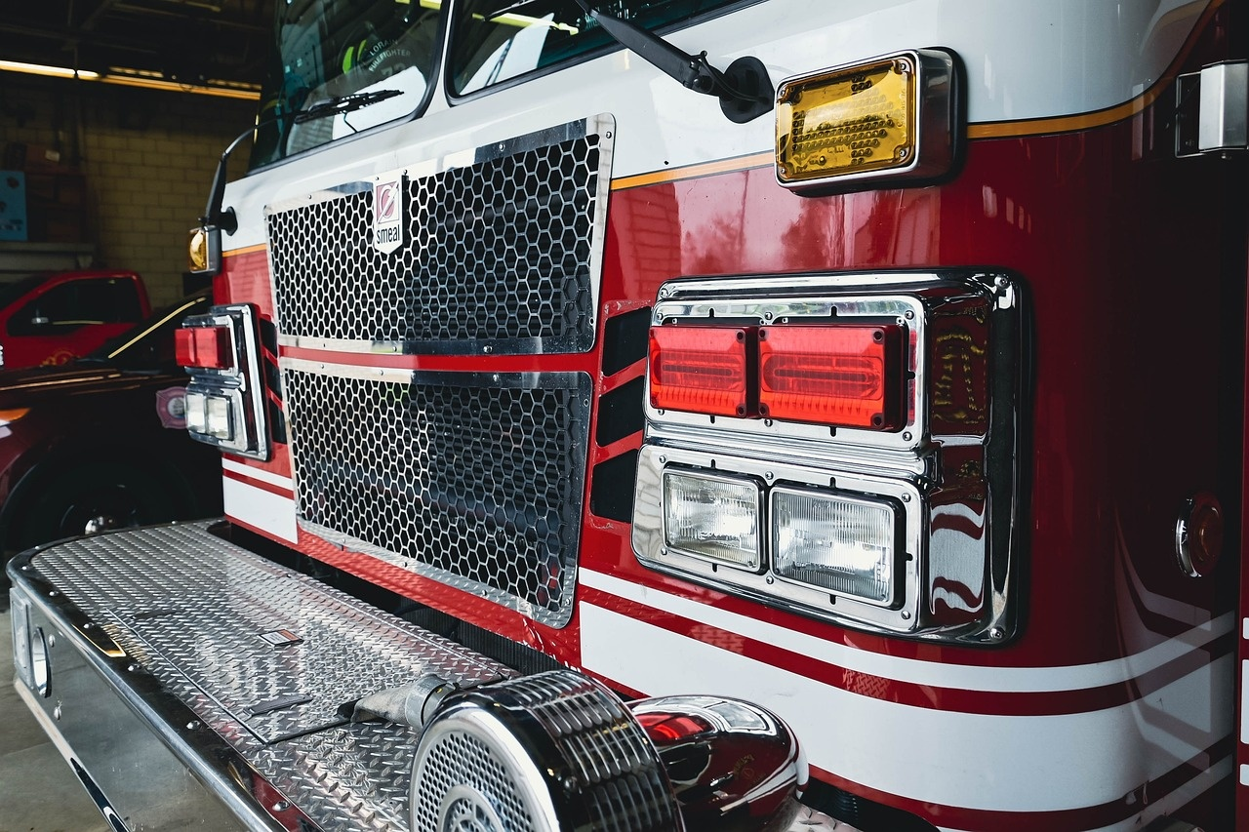
Fire Safety Learning: Modern firefighting techniques
Introduction to modern firefighting methods
Comparison with 1666 firefighting techniques
Advanced equipment and technology
Specialized training for firefighters
Evolution from bucket brigades to fire engines
Improved communication and coordination
Safety tips for fire prevention
Iconographic representations
Importance of smoke alarms
Creating and practicing escape plans
Visual symbols for different firefighting tools
Easy-to-understand graphics for emergency procedures
Exploring The Great Fire of London

Slide 12

Interactive Learning Activities: Hands-on exploration ideas
Role-playing Scenarios
Model Building Suggestions
Encourage students to act out different roles during the Great Fire of London.
Provide materials for students to create miniature replicas of 17th-century London buildings.
Collaborative Learning Strategies
Foster teamwork by assigning group projects related to fire safety or historical reconstruction.
Exploring The Great Fire of London

Slide 13
Dyslexia Support Techniques: Learning accommodation strategies
01
02
03
Step 1: Multisensory Approach
Step 2: Technological Support
Step 3: Personalized Learning Paths
Engage multiple senses in learning
Incorporate visual, auditory, and kinesthetic elements
Enhances memory retention and understanding
Utilize assistive technology tools
Text-to-speech software for reading support
Speech-to-text applications for writing assistance
Tailor learning experiences to individual needs
Identify strengths and weaknesses
Implement customized strategies for success
Exploring The Great Fire of London

Slide 14

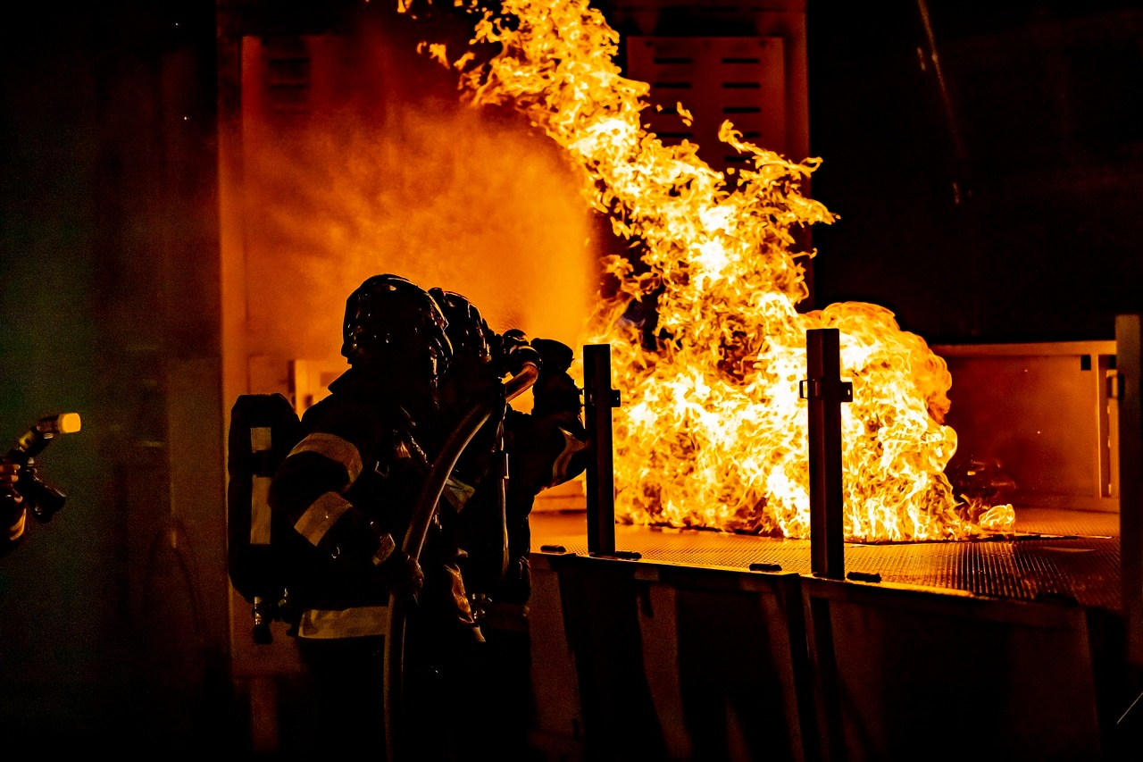
Key Vocabulary: Essential terms
Combustion
The process of burning, producing heat and light.
Inferno
A large, destructive fire that spreads rapidly.
Tinder
Dry, flammable material used to start a fire.
Embers
Small pieces of burning or glowing material.
Blaze
A large and fiercely burning fire.
Exploring The Great Fire of London

Slide 15
Reflection and Assessment: Inclusive assessment methods
01
02
03
04
Multiple Response Formats
Emotional Processing Strategies
Growth Mindset Encouragement
Personalized Learning Paths
Allow for oral presentations, visual projects, and written assignments to cater to diverse learning styles.
Provide opportunities for students to express their feelings about the topic through art, music, or reflective writing.
Offer constructive feedback focusing on progress and effort rather than just final outcomes.
Tailor assessments to individual strengths and interests to promote engagement and success.
Exploring The Great Fire of London

Slide 16
Parent and Educator Guide: Supporting dyslexic learners
01
02
03
04
05
Understanding Dyslexia
Multisensory Learning
Assistive Technology
Positive Reinforcement
Individualized Support
Provide information on what dyslexia is and how it affects learning.
Encourage the use of multiple senses in learning activities to enhance comprehension.
Introduce tools like text-to-speech software and dyslexia-friendly fonts to aid reading and writing.
Emphasize the importance of positive feedback and encouragement for dyslexic learners.
Highlight the benefits of personalized learning plans tailored to each student's needs.
Exploring The Great Fire of London

Slide 17
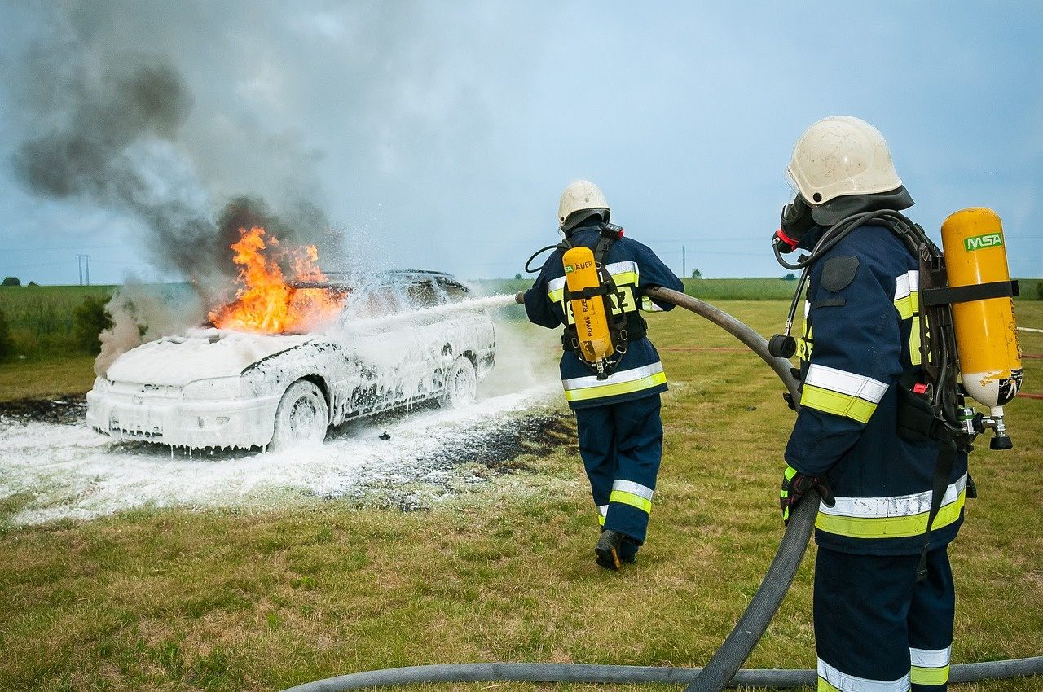
Resources and Further Learning: Recommended books
"The Great Fire of London: The Essential Guide" by Adrian Tinniswood
"The Great Fire of London: In That Apocalyptic Year, 1666" by Neil Hanson
Provides an essential guide to understanding the Great Fire of London.
Offers a detailed account of the events of 1666.
"The Great Fire of London: The Untold Story of the Men Who Fought the Blaze" by Walter George Bell
"The Great Fire of London: The Story of the Destruction and Reconstruction of the City" by Stephen Porter
Reveals the untold stories of the men who battled the fire.
Explores the destruction and subsequent reconstruction of London.
Exploring The Great Fire of London

Slide 18
Conclusion: Key takeaways
01
02
03
04
05
The Great Fire of London
Fire Spread Dynamics
Fire Safety Measures
Survival Stories
Rebuilding London
A catastrophic event in 1666 that reshaped the city's landscape.
Led to significant changes in urban planning and fire safety measures.
Started at Pudding Lane Bakery on September 2, 1666.
Spread quickly due to wooden buildings, narrow streets, and tightly packed structures.
Understanding fire spread dynamics is crucial.
Fire triangle concept and combustion process are key.
Highlight resilience and human spirit.
Individuals impacted by the fire showed remarkable survival stories.
Led by Sir Christopher Wren.
Showcased innovative architectural designs and urban planning strategies.
Exploring The Great Fire of London

