Slide 1
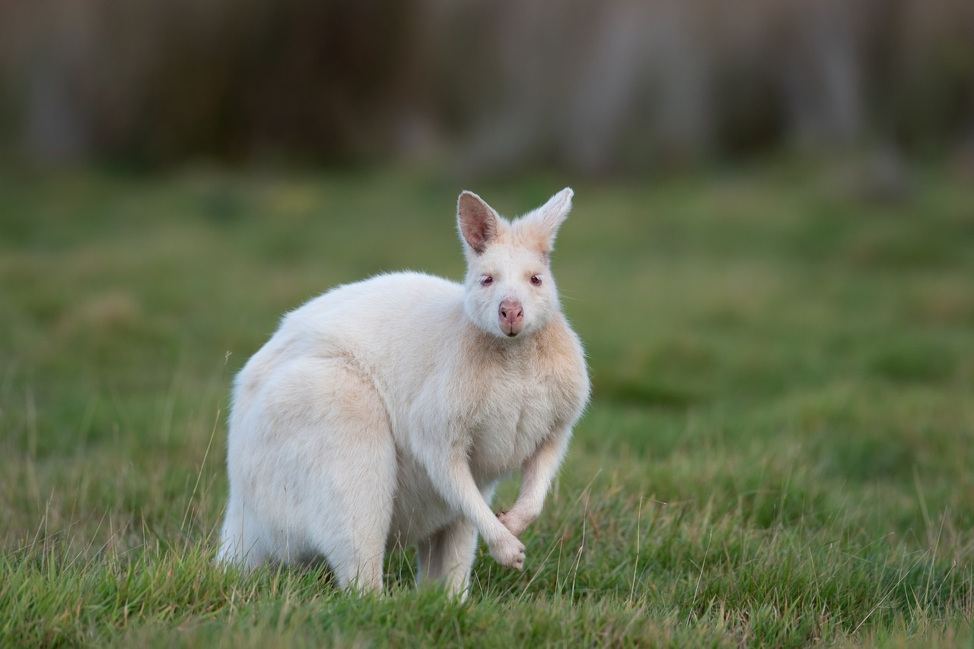
Exploring Genetic Diversity
Unraveling the Secrets of Genetic Variation and Inheritance

Slide 2
Table of contents
01
02
03
04
05
06
07
08
09
10
11
Title Slide: Genetic Diversity Decoded
What is Genetic Variation?
Mechanisms of Genetic Variation
How Genetic Traits Are Inherited
Global Genetic Diversity
Genetic Variation in Action
Personal Genetic Exploration
Ethical Considerations
Future of Genetic Research
Interactive Learning Opportunities
Key Takeaways

Slide 3
Table of contents
12
13
14
15
16
17
18
19
20
21
22
Conclusion
Clean and Modern Design Template
Scientific Graphics and DNA/Chromosome Imagery
Color Palette for Scientific Professionalism
High-Quality Images on Each Slide
Consistent and Readable Typography
Sparingly Used Animations
DNA Double Helix Graphics
Chromosome Diagrams
World Map with Genetic Diversity Indicators
Punnett Square Illustrations

Slide 4
Table of contents
23
24
25
26
27
Microscopic Cellular Imagery
Infographic-Style Information Displays
Engaging and Accessible Tone
Encouraging Curiosity and Wonder
Age-Appropriate for 13-Year-Old Learners

Slide 5
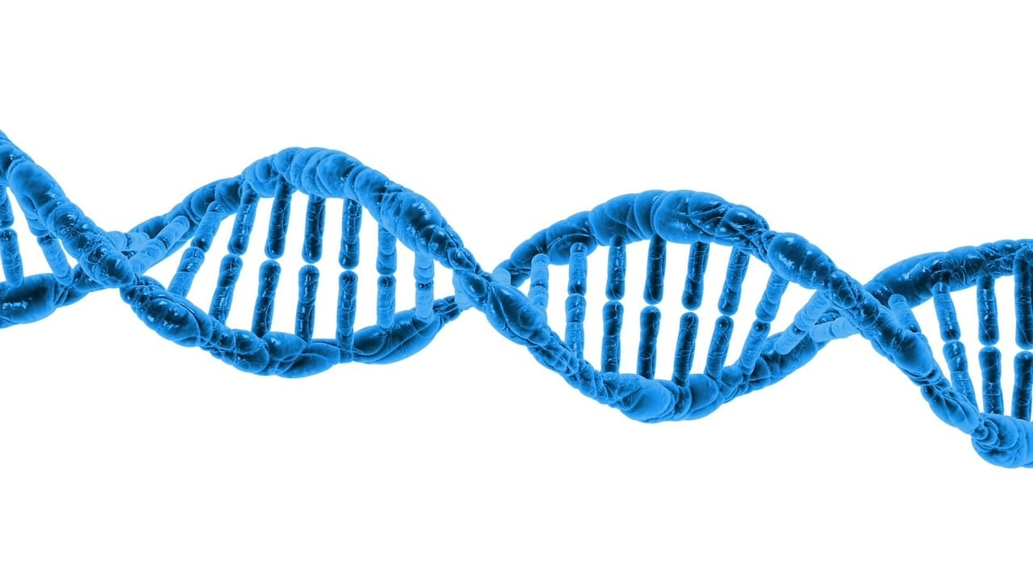
1
Title Slide: Genetic Diversity Decoded
Genetic Diversity Decoded: Understanding Human Genetic Variation
Exploring the Fascinating World of Genetic Differences
Exploring Genetic Diversity

Slide 6
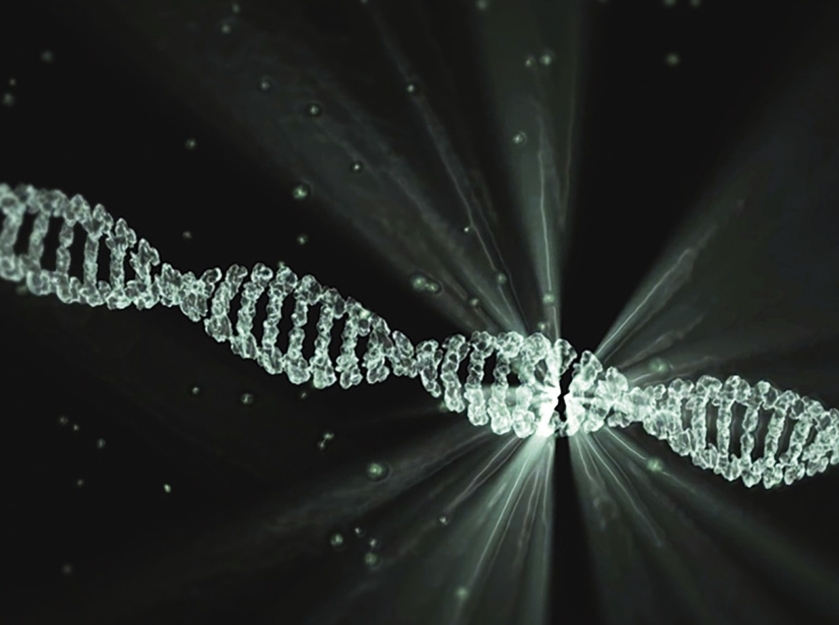
2
What is Genetic Variation?
01
What is Genetic Variation?
02
Key Points
Differences in DNA sequences among individuals
Approximately 3 billion base pairs in human genome
Creates unique biological blueprints
Responsible for individual characteristics
Exploring Genetic Diversity

Slide 7
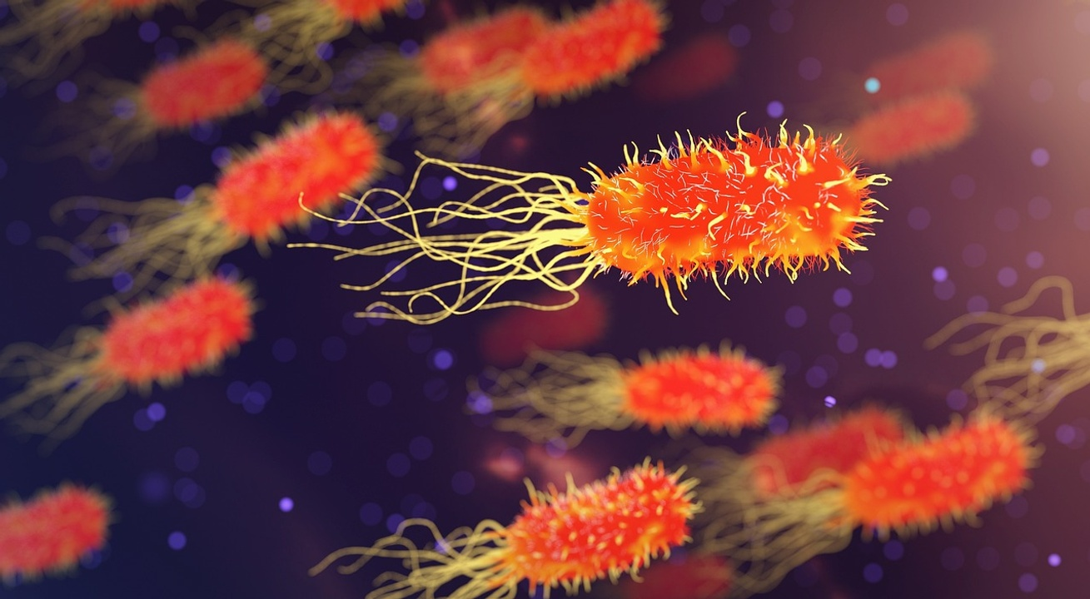
3
Mechanisms of Genetic Variation
01
Mutation
02
Genetic Recombination
Random changes in DNA sequence
Can be spontaneous or induced by external factors
Exchange of genetic material between homologous chromosomes
Increases genetic diversity during meiosis
03
Chromosome Exchange
04
Inheritance Patterns
Crossing over between non-sister chromatids
Leads to new combinations of alleles
Mendelian genetics governs how traits are passed down
Different patterns include dominant, recessive, and co-dominant traits
Exploring Genetic Diversity

Slide 8
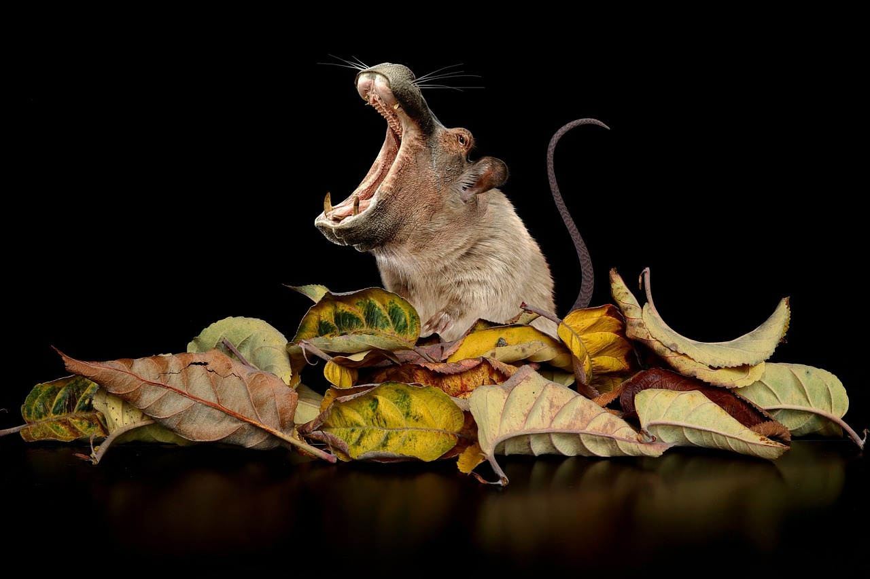
4
How Genetic Traits Are Inherited
01
Dominant vs. Recessive Traits
02
Parental Genetic Contribution
Dominant traits mask recessive traits in offspring.
Recessive traits only appear when both parents carry the gene.
Offspring inherit genetic material from both parents.
Each parent contributes half of the genetic information.
03
Probability of Trait Inheritance
Punnett Squares predict likelihood of trait inheritance.
Probability calculations based on parental genotypes.
Exploring Genetic Diversity

Slide 9
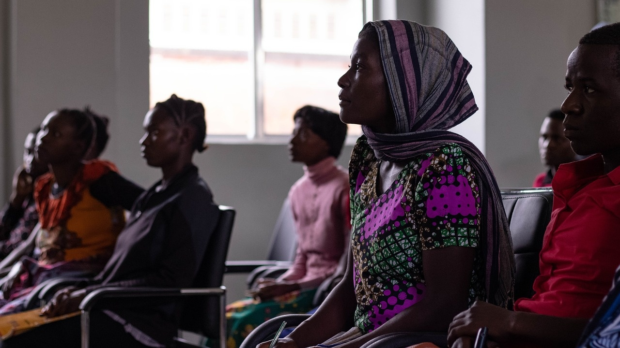
5
Global Genetic Diversity
01
Population Variations
02
Environmental Influences
Different genetic traits across diverse populations
Adaptations to specific environments
Unique genetic characteristics
Impact on genetic traits and variations
Evolutionary responses to environmental pressures
Study of gene-environment interactions
03
Genetic Drift
Changes in gene frequencies over generations
Influence on genetic diversity within populations
Random process affecting allele distribution
Exploring Genetic Diversity

Slide 10

6
Genetic Variation in Action
01
High-Altitude Population Adaptations
02
Genetic Disease Resistance
Examples: Tibetan highlanders, Andean natives
Genetic changes for increased oxygen utilization
Study of unique biological responses to low oxygen levels
Natural immunity to certain diseases
Genetic variations linked to disease susceptibility
Research on genetic factors influencing disease outcomes
03
Unique Population Characteristics
Genetic traits specific to isolated populations
Study of genetic markers for population migration
Understanding the role of genetic diversity in human evolution
Exploring Genetic Diversity

Slide 11
7
Personal Genetic Exploration
01
02
03
Family Trait Mapping
Genetic Characteristic Identification
Understanding Personal Genetic Uniqueness
Identify inherited traits within your family
Trace genetic characteristics through generations
Discover unique genetic markers within your DNA
Understand how genetic traits manifest in individuals
Explore the diversity of your genetic makeup
Appreciate the complexity of your genetic inheritance
Exploring Genetic Diversity

Slide 12

8
Ethical Considerations
01
Genetic Privacy
02
Potential Discrimination Risks
Importance of safeguarding individuals' genetic information
Risks of unauthorized access and misuse of genetic data
Concerns about genetic discrimination in employment and insurance
Ensuring equal opportunities and protection against discrimination
03
Responsible Genetic Research
04
Importance of Genetic Diversity Respect
Ethical guidelines for conducting genetic studies and experiments
Considerations for informed consent and participant welfare
Valuing and preserving diverse genetic backgrounds
Promoting inclusivity and equity in genetic research and healthcare
Exploring Genetic Diversity

Slide 13

9
Future of Genetic Research
01
Advancements in Genetic Testing
02
Revolutionizing Medicine with CRISPR
Enhanced accuracy and accessibility
Personalized health insights
Targeted gene editing for genetic disorders
Potential for curing previously untreatable diseases
03
Ethical Frontiers in Genetic Research
Balancing privacy and data security
Ensuring equitable access to genetic technologies
Exploring Genetic Diversity

Slide 14

10
Interactive Learning Opportunities
01
Genetic Trait Bingo
02
Family History Research
Engage students in a fun game to learn about different genetic traits.
Encourage students to explore their family's genetic background for a hands-on learning experience.
03
Genetic Diversity Infographic Creation
04
Trait Inheritance Simulation
Task students with creating infographics to visually represent the concept of genetic diversity.
Conduct a simulation activity to demonstrate how genetic traits are inherited across generations.
Exploring Genetic Diversity

Slide 15
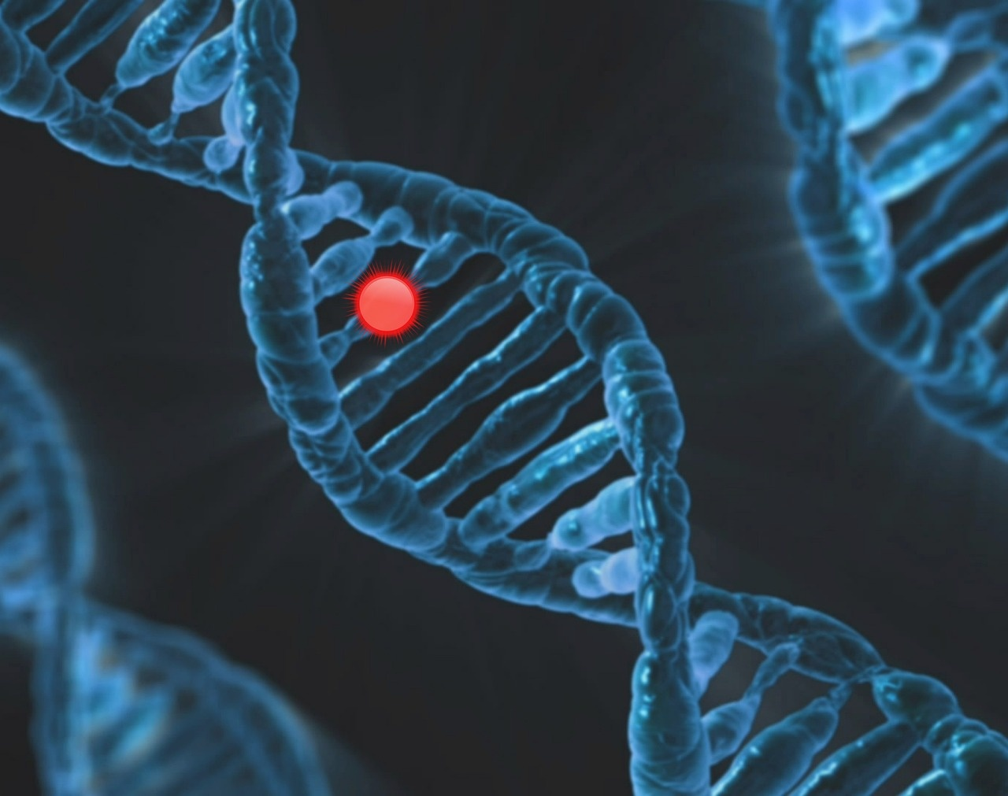
11
Key Takeaways
Genetic Variation
Driven by differences in DNA sequences among individuals.
Approximately 3 billion base pairs in the human genome contribute to this diversity.
These variations create unique biological blueprints and are responsible for individual characteristics.
Exploring Genetic Diversity

Slide 16

12
Conclusion
01
Genetic Diversity
02
Understanding Genetic Variation
Genetic diversity is a fundamental aspect of human biology, shaping individual characteristics and creating unique biological blueprints.
Understanding genetic variation is crucial for appreciating the complexity and beauty of human uniqueness.
03
Embracing Genetic Diversity
Embracing genetic diversity promotes respect for individual differences and fosters a culture of inclusivity and scientific curiosity.
Exploring Genetic Diversity

Slide 17

13
Clean and Modern Design Template
Clean and Modern Design Template
Utilize a sleek and minimalist design
Incorporate high-quality images of DNA double helix and chromosome diagrams
Maintain a color palette suggesting scientific professionalism
Ensure consistent and readable typography
Use animations sparingly to emphasize key points
Exploring Genetic Diversity

Slide 18
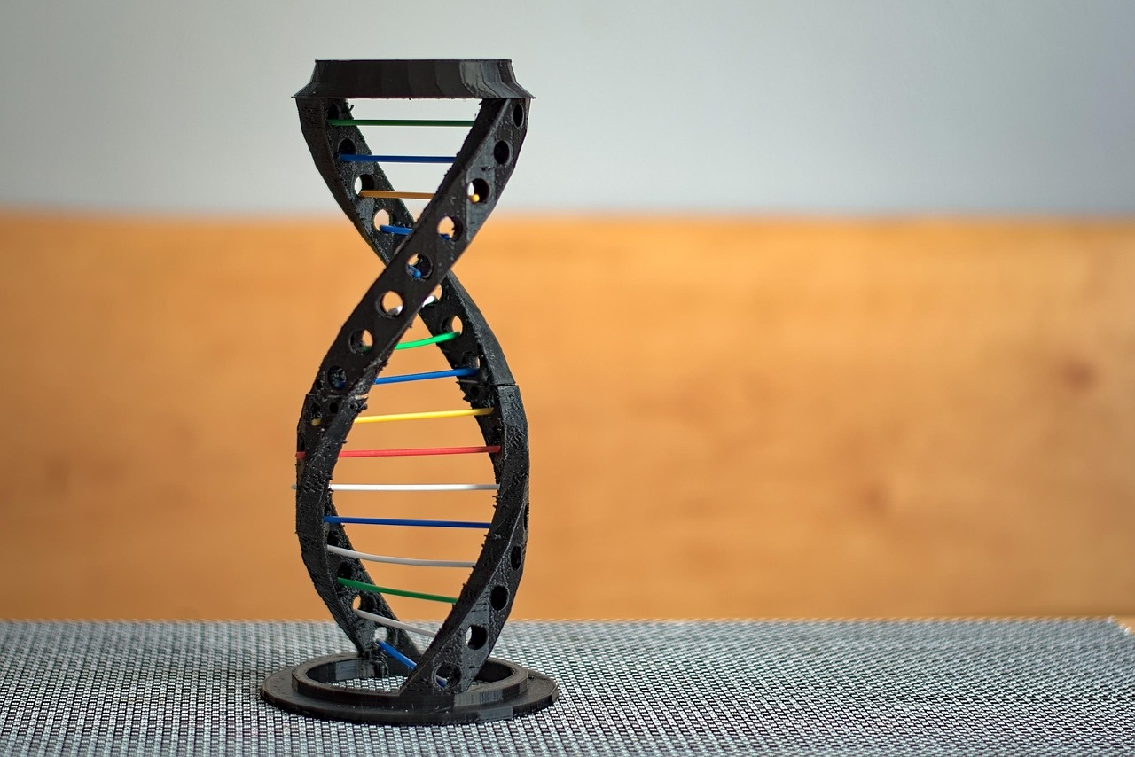
14
Scientific Graphics and DNA/Chromosome Imagery
01
DNA Double Helix Graphics
02
Chromosome Diagrams
Illustrates the fundamental structure of DNA
Visual representation of genetic material organization
03
Microscopic Cellular Imagery
04
Infographic-Style Information Displays
Showcases the intricate details of genetic components
Simplifies complex genetic concepts for easy understanding
Exploring Genetic Diversity

Slide 19
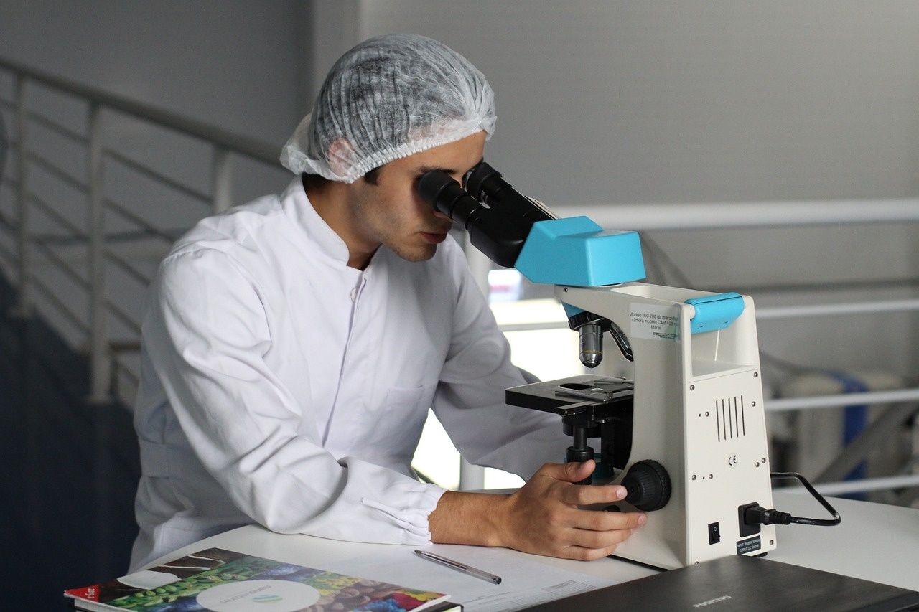
15
Color Palette for Scientific Professionalism
01
Primary Colors
02
Accent Colors
Deep Blue: Represents trust, knowledge, and expertise.
Emerald Green: Symbolizes growth, harmony, and balance.
Steel Gray: Conveys sophistication and professionalism.
Teal: Adds a touch of creativity and innovation.
03
Neutral Shades
Slate Gray: Provides a modern and sleek backdrop.
Ivory: Offers a clean and elegant contrast for text readability.
Exploring Genetic Diversity

Slide 20
16
High-Quality Images on Each Slide
01
DNA Double Helix Graphic
02
Chromosome Diagram
03
World Map with Genetic Diversity Indicators
Illustrates the fundamental structure of genetic material
Represents the intricate complexity of DNA
Visualizes the organization of genetic information within cells
Demonstrates how genes are arranged on chromosomes
Highlights the distribution of genetic variations across populations
Shows the impact of environmental factors on genetic traits
04
Punnett Square Illustration
05
Microscopic Cellular Imagery
Depicts how genetic traits are inherited through generations
Demonstrates the probability of trait inheritance based on parental genetics
Provides a close-up view of cellular components related to genetic variation
Enhances understanding of genetic mechanisms at the cellular level
Exploring Genetic Diversity

Slide 21
17
Consistent and Readable Typography
01
Font Choice
02
Text Alignment
03
Color Contrast
Headings: Arial, 24pt, Bold
Subheadings: Arial, 20pt, Bold
Body Text: Arial, 18pt
Maintain left alignment for all text for easy readability.
Use high contrast between text and background for better visibility.
Avoid using light text on light backgrounds or dark text on dark backgrounds.
04
Spacing
05
Font Size
Ensure adequate spacing between lines and paragraphs for clarity.
Use consistent spacing throughout the slide.
Use larger font sizes for headings to emphasize key points.
Keep font sizes consistent within each level of text hierarchy.
Exploring Genetic Diversity

Slide 22

18
Sparingly Used Animations
01
High-altitude population adaptations
02
Genetic disease resistance
03
Unique population characteristics
Exploring Genetic Diversity

Slide 23
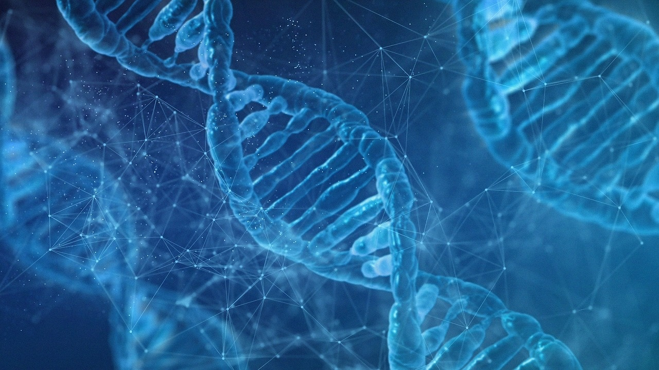
19
DNA Double Helix Graphics
01
Visualization
02
Importance
Detailed representation of DNA double helix structure
Highlighting the complementary base pairing
Fundamental to understanding genetic information storage
Basis for genetic variation and inheritance
Exploring Genetic Diversity

Slide 24
20
Chromosome Diagrams
01
Structure of Chromosomes
02
Types of Chromosomes
03
Chromosome Organization
Chromosomes are thread-like structures made of DNA and proteins.
Humans have 23 pairs of chromosomes, totaling 46 chromosomes.
Autosomes: Chromosomes that contain genes for general body characteristics.
Sex Chromosomes: Determine an individual's sex (X and Y chromosomes).
Each chromosome consists of two sister chromatids connected at the centromere.
Telomeres protect the ends of chromosomes from deterioration.
04
Genetic Diversity in Chromosomes
05
Chromosome Abnormalities
Chromosomes carry genetic information that determines traits and characteristics.
Genetic variations in chromosomes contribute to individual uniqueness.
Changes in chromosome structure or number can lead to genetic disorders.
Examples include Down syndrome (trisomy 21) and Turner syndrome (monosomy X).
Exploring Genetic Diversity

Slide 25

21
World Map with Genetic Diversity Indicators
01
Genetic Variations Across Populations
02
Adaptive Genetic Characteristics
Different populations exhibit unique genetic markers.
Genetic drift and gene flow contribute to variations.
Examples include blood types, lactose tolerance, etc.
Certain genetic traits provide survival advantages.
Examples include sickle cell trait in malaria-endemic regions.
Skin pigmentation variations due to UV exposure.
03
Environmental Influences on Genetic Traits
Climate, diet, and lifestyle impact genetic expressions.
High altitude adaptations in Tibetan populations.
Obesity and diabetes prevalence in different regions.
Exploring Genetic Diversity

Slide 26

22
Punnett Square Illustrations
01
Dominant vs. Recessive Traits
02
Parental Genetic Contribution
Dominant traits mask recessive traits in Punnett squares.
Punnett squares show how genes from parents combine.
03
Probability of Trait Inheritance
Calculating the likelihood of offspring inheriting specific traits.
Exploring Genetic Diversity

Slide 27

23
Microscopic Cellular Imagery
Microscopic Cellular Imagery
Detailed visualization of cellular structures
Highlighting organelles such as mitochondria, nucleus, and endoplasmic reticulum
Cellular processes captured at a microscopic level
Cell division, protein synthesis, and cellular communication
Importance of cellular imagery in understanding genetic variation
Exploring Genetic Diversity

Slide 28
24
Infographic-Style Information Displays
01
DNA Double Helix Structure
02
Chromosome Diagram
03
Genetic Variation Infographic
Illustrates the fundamental building block of genetic material
Comprised of nucleotide base pairs forming a twisted ladder shape
Visual representation of organized DNA within cells
Contains genes responsible for specific traits and characteristics
Depicts the diversity of genetic traits among individuals
Highlights the impact of genetic variation on human uniqueness
04
Population Genetic Diversity
05
Trait Inheritance Simulation
Shows how genetic variations differ across global populations
Demonstrates the influence of environmental factors on genetic traits
Interactive display showcasing how genetic traits are passed down
Emphasizes the role of dominant and recessive genes in inheritance
Exploring Genetic Diversity

Slide 29

25
Engaging and Accessible Tone
01
Interactive Learning
02
Real-World Examples
Engage students with hands-on activities
Encourage questions and discussions
Relate genetic concepts to everyday life
Use relatable analogies for better understanding
03
Visual Aids
04
Encouraging Curiosity
Utilize colorful diagrams and illustrations
Incorporate engaging videos or animations
Foster a sense of wonder and exploration
Inspire a love for scientific discovery
Exploring Genetic Diversity

Slide 30

26
Encouraging Curiosity and Wonder
01
Encouraging Curiosity and Wonder
02
Spark Curiosity through Engaging Activities
Foster a sense of wonder about the intricate world of genetic diversity
Encourage questions and exploration
Emphasize the beauty and complexity of genetic variation
Hands-on experiments to understand inheritance patterns
Interactive case studies showcasing real-world genetic adaptations
03
Cultivate a Sense of Awe for Human Genetic Traits
Explore the impact of genetic diversity on individual characteristics
Encourage students to appreciate the marvels of genetic variation
Exploring Genetic Diversity

Slide 31

27
Age-Appropriate for 13-Year-Old Learners
Interactive Learning Activities
Engaging Classroom Activities
Genetic trait bingo
Family history research
Genetic diversity infographic creation
Trait inheritance simulation
Exploring Genetic Diversity

