Slide 1

Understanding and Preventing Bullying
Exploring the Forms, Effects, and Strategies to Create a Safer and Supportive Community

Slide 2
Table of Contents
Slide 1: Introduction to Bullying
Slide 2: What is Bullying?
Slide 3: Types of Bullying
Slide 4: Effects of Bullying
Slide 5: Role of Bystanders
Slide 6: Being an Upstander
Slide 7: Strategies for Preventing Bullying
Slide 8: Cyberbullying
Slide 9: Online Safety
Slide 10: Creating a Supportive Community
Slide 11: Conclusion
Slide 12: Call to Action
Slide 13: Resources
04
05
06
07
08
09
10
11
12
13
14
15
16

Slide 3
Table of Contents
Slide 14: Reflection Questions
Slide 15: Next Steps
Slide 16: Summary
Slide 17: Key Takeaways
Slide 18: Conclusion and Final Thoughts
Slide 19: Final Call to Action
Slide 20: References
17
18
19
20
21
22
23

Slide 4
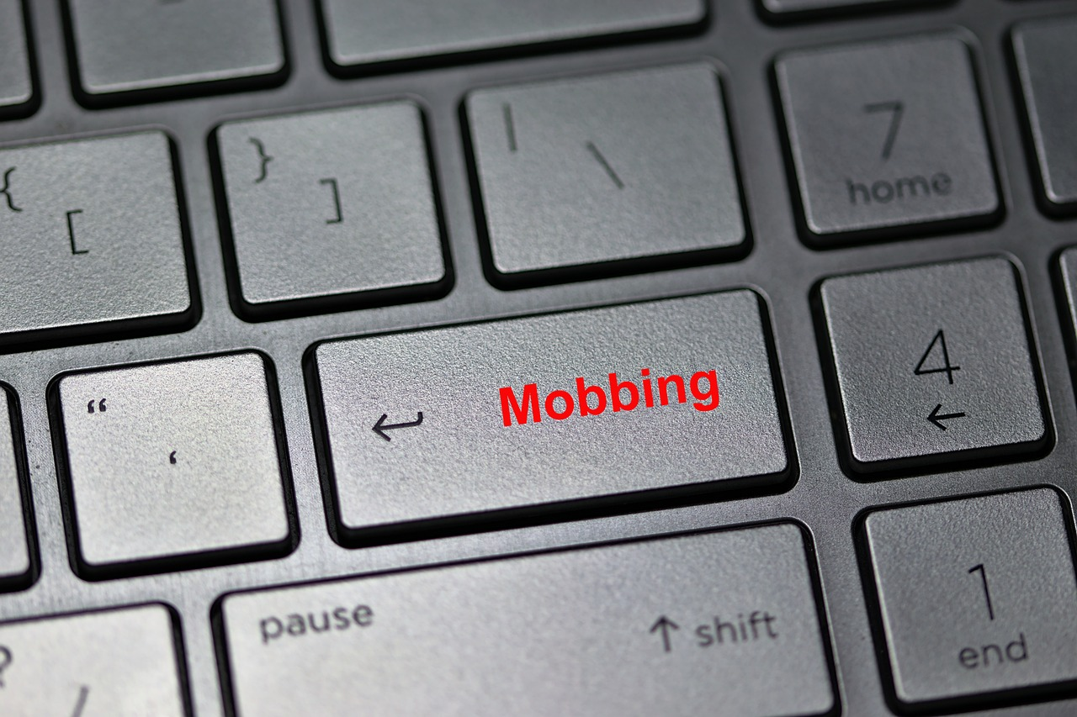
Slide 1: Introduction to Bullying
The Complexity of Bullying
Forms of Bullying
The Importance of Understanding Bullying
Bullying is a complex issue that affects individuals and society.
It can take many forms, including physical, verbal, social, and cyberbullying.
It can take many forms, including physical, verbal, social, and cyberbullying.
Understanding bullying is crucial for creating a safe and supportive environment.
Understanding bullying is crucial for creating a safe and supportive environment.
Bullying is a complex issue that affects individuals and society.
4
Understanding and Preventing Bullying

Slide 5

Slide 2: What is Bullying?
Definition of Bullying
Impact on Mental Health
Bullying is repeated behavior that is intended to hurt or intimidate someone.
It can take various forms, including physical, verbal, social, or cyberbullying.
Bullying can have severe and long-lasting effects on a person's mental health.
It may lead to issues such as anxiety, depression, and low self-esteem.
Effect on Academic and Social Life
Role in Prevention
Bullying negatively affects academic performance and social relationships.
Victims may struggle to focus in school and face difficulties in forming friendships.
Everyone has a role to play in preventing bullying.
By promoting kindness and standing against bullying, we can create a safer environment.
5
Understanding and Preventing Bullying

Slide 6
Slide 3: Types of Bullying
Physical Bullying
Verbal Bullying
Social Bullying
Cyberbullying
Physical bullying involves actions like hitting, pushing, or kicking someone.
These actions are direct and can cause immediate physical harm.
Verbal bullying includes name-calling, insults, or threats.
This type of bullying can deeply affect someone's emotional well-being.
Social bullying involves excluding someone, spreading rumors, or damaging their reputation.
It often aims to isolate the victim and harm their social relationships.
Cyberbullying uses technology to harass, intimidate, or humiliate someone.
This form of bullying can happen on social media, messaging platforms, or other online spaces.
6
Understanding and Preventing Bullying

Slide 7

Slide 4: Effects of Bullying
Academic Consequences of Bullying
Social Impact of Bullying
Bullying can lead to anxiety, depression, and low self-esteem in victims.
These emotional challenges often persist and impact overall mental health.
Victims of bullying often experience decreased grades and absenteeism.
This can result in a lack of motivation and hinder academic progress.
Long-Term Effects of Bullying
Long-Term Effects of Bullying
Bullying can cause social isolation and difficulty in making friends.
It also negatively affects the development of social skills.
Persistent mental health issues and challenges in forming healthy relationships are common.
Victims may also face difficulties in academic or professional settings.
7
Understanding and Preventing Bullying

Slide 8
Slide 5: Role of Bystanders
Bystanders' Role in Prevention
Reporting Bullying Incidents
Impact of Bystander Actions
Bystanders can play a significant role in preventing bullying.
They can intervene safely and effectively to stop the bullying.
Bystanders can report incidents of bullying to authorities.
This ensures that the issue is addressed and resolved appropriately.
The actions of bystanders can influence the outcome of bullying situations.
Their involvement can deter further bullying and support victims.
8
Understanding and Preventing Bullying

Slide 9

Slide 6: Being an Upstander
Definition of an Upstander
Actions of an Upstander
Qualities of an Upstander
An upstander is someone who takes action to stop bullying.
They actively choose to make a difference in situations of injustice.
Upstanders can intervene directly, report incidents, or support the victim.
These actions help to address and prevent bullying effectively.
Being an upstander requires courage, empathy, and a sense of responsibility.
These qualities enable them to stand up for others and promote positive change.
9
Understanding and Preventing Bullying

Slide 10

Slide 7: Strategies for Preventing Bullying
Promoting Kindness and Empathy
Encouraging Reporting of Bullying
Promote kindness and empathy among students.
Encourage a culture of understanding and mutual respect to prevent bullying.
Encourage students to report incidents of bullying.
Create a safe environment where students feel comfortable sharing their experiences.
Supporting Victims of Bullying
Implementing Anti-Bullying Policies
Provide support for victims of bullying.
Offer counseling and resources to help them recover and feel safe.
Develop and implement anti-bullying policies and programs.
Ensure these initiatives are actively enforced and regularly updated.
10
Understanding and Preventing Bullying

Slide 11

Slide 8: Cyberbullying
Understanding Cyberbullying
Methods of Cyberbullying
Impact on Mental Health
Cyberbullying is a form of bullying that occurs online.
It can include harassment, intimidation, or humiliation through social media, text messages, or online forums.
Cyberbullying often takes place on platforms like social media, text messaging, or online forums.
These methods allow bullies to target individuals in a public or private manner.
Cyberbullying can have severe and long-lasting effects on a person's mental health.
It can lead to issues such as anxiety, depression, and a decline in overall well-being.
11
Understanding and Preventing Bullying

Slide 12

Slide 9: Online Safety
1
Importance of Online Safety
Online safety is crucial for preventing cyberbullying.
Students should be aware of online risks and take steps to protect themselves.
2
Role of Parents and Educators
Parents and educators should also be involved in promoting online safety.
They play a key role in preventing cyberbullying.
3
Awareness and Protection
Students need to understand the risks associated with online activities.
Taking proactive steps can help ensure their safety.
12
Understanding and Preventing Bullying

Slide 13
Slide 10: Creating a Supportive Community
Collaborative Effort
Preventing Bullying
Supporting Affected Individuals
Creating a supportive community requires a collective effort.
Students, teachers, and parents should work together to promote kindness, empathy, and inclusivity.
A supportive community can help prevent bullying.
It fosters an environment where harmful behaviors are less likely to thrive.
A supportive community provides assistance to those affected by bullying.
It ensures that individuals feel valued and understood.
13
Understanding and Preventing Bullying

Slide 14
Slide 11: Conclusion
Understanding Bullying
Promoting Kindness and Empathy
Bullying is a complex issue that affects individuals and society.
By understanding bullying, we can create a safer environment for everyone.
Promoting kindness and empathy is essential to address bullying.
Taking action helps build a more supportive environment for everyone.
14
Understanding and Preventing Bullying

Slide 15
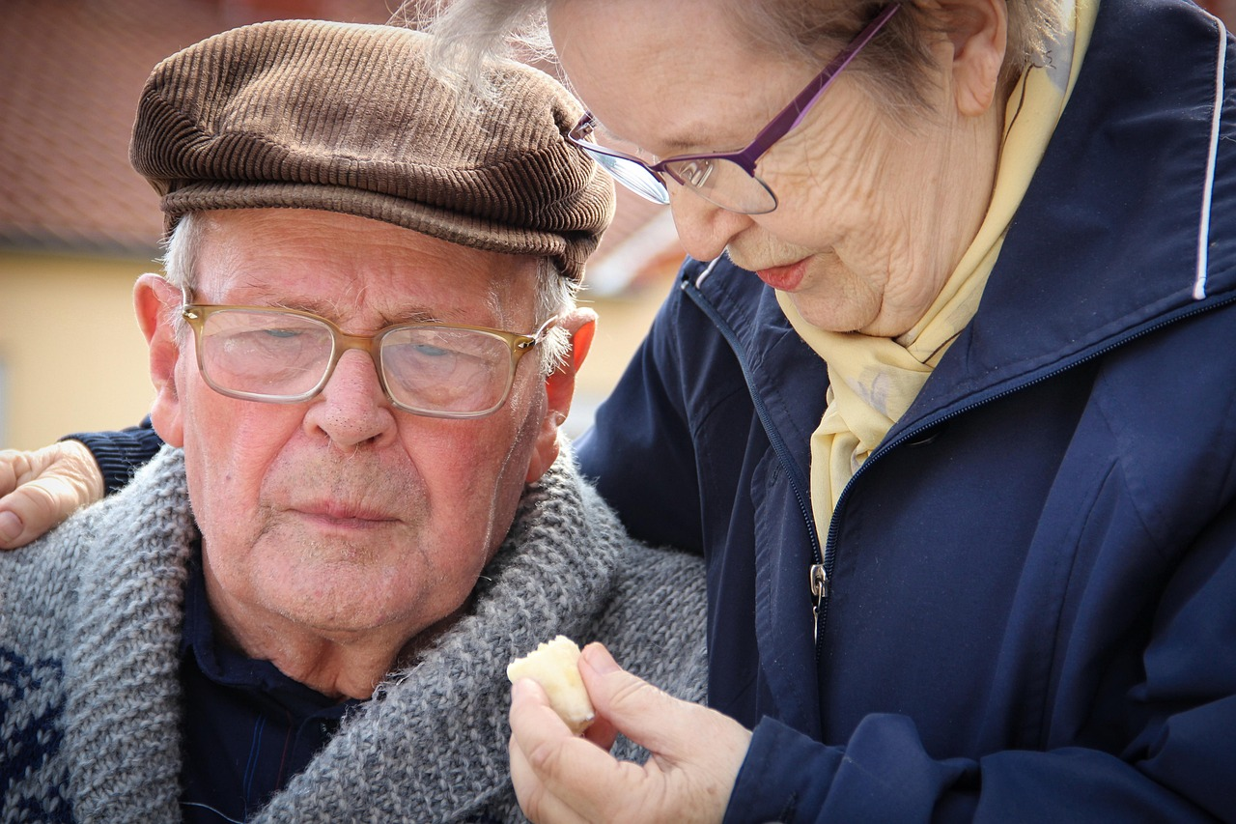
Slide 12: Call to Action
Pledge for Kindness
Support and Report
Take a pledge to be kind, supportive, and proactive in preventing bullying.
Commit to fostering a positive and inclusive environment for everyone.
Report incidents of bullying and support those affected.
Stand up against bullying by being an ally to those in need.
15
Understanding and Preventing Bullying

Slide 16
Slide 13: Resources
National Bullying Prevention Center
StopBullying.gov
Crisis Text Line
National Bullying Prevention Center: www.pacer.org/bullying
This resource provides tools and information to prevent bullying and support those affected.
StopBullying.gov: www.stopbullying.gov
A government resource offering strategies and advice to address bullying in schools and communities.
Crisis Text Line: text 'HOME' to 741741
A confidential support service available 24/7 for individuals in crisis.
16
Understanding and Preventing Bullying

Slide 17
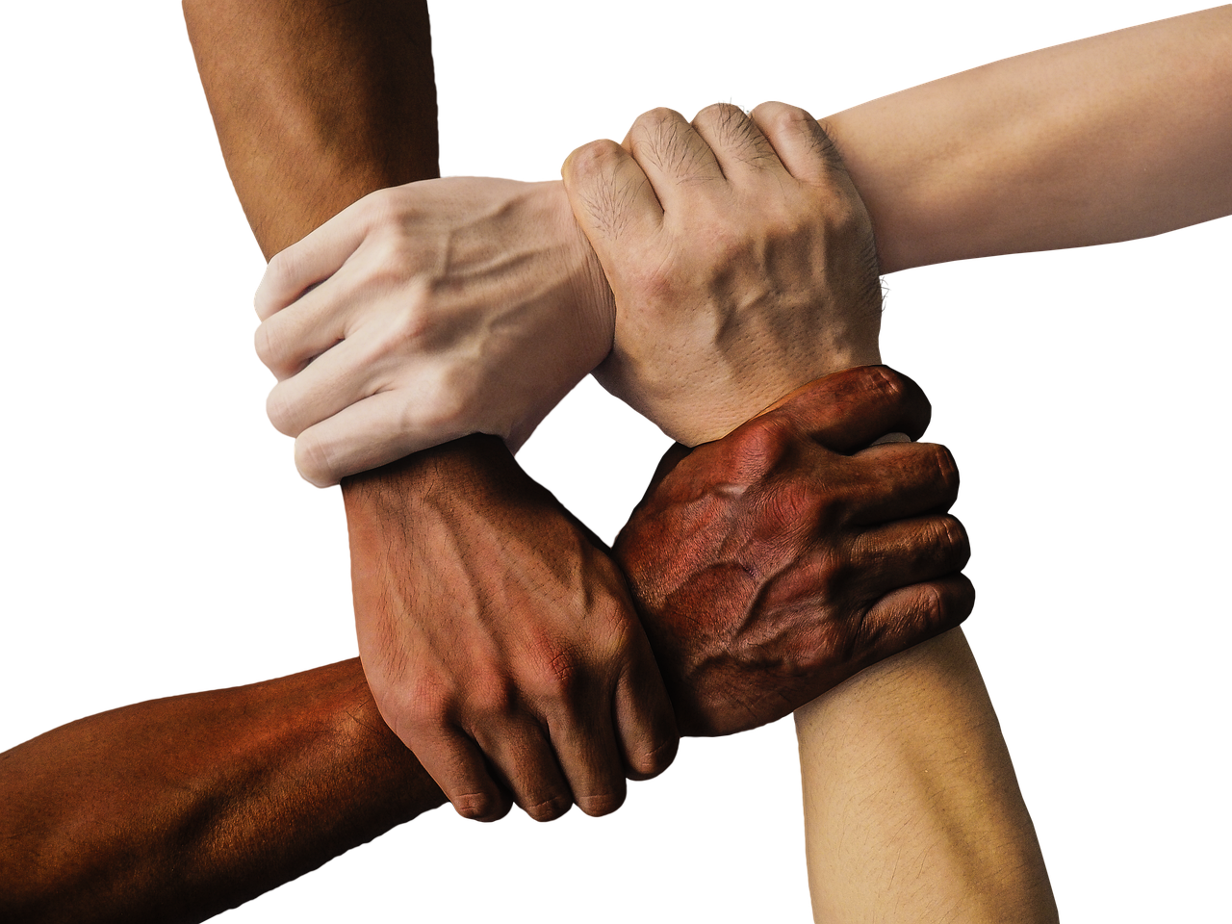
Slide 14: Reflection Questions
1
Understanding Bullying
What did you learn about bullying today?
Reflect on the key takeaways from the discussion on bullying.
2
Personal Application
How can you apply what you learned to your own life?
Think about ways to integrate these lessons into your daily interactions.
3
Building Community Support
What can you do to help create a supportive community?
Consider actions that foster inclusivity and kindness in your environment.
17
Understanding and Preventing Bullying

Slide 18
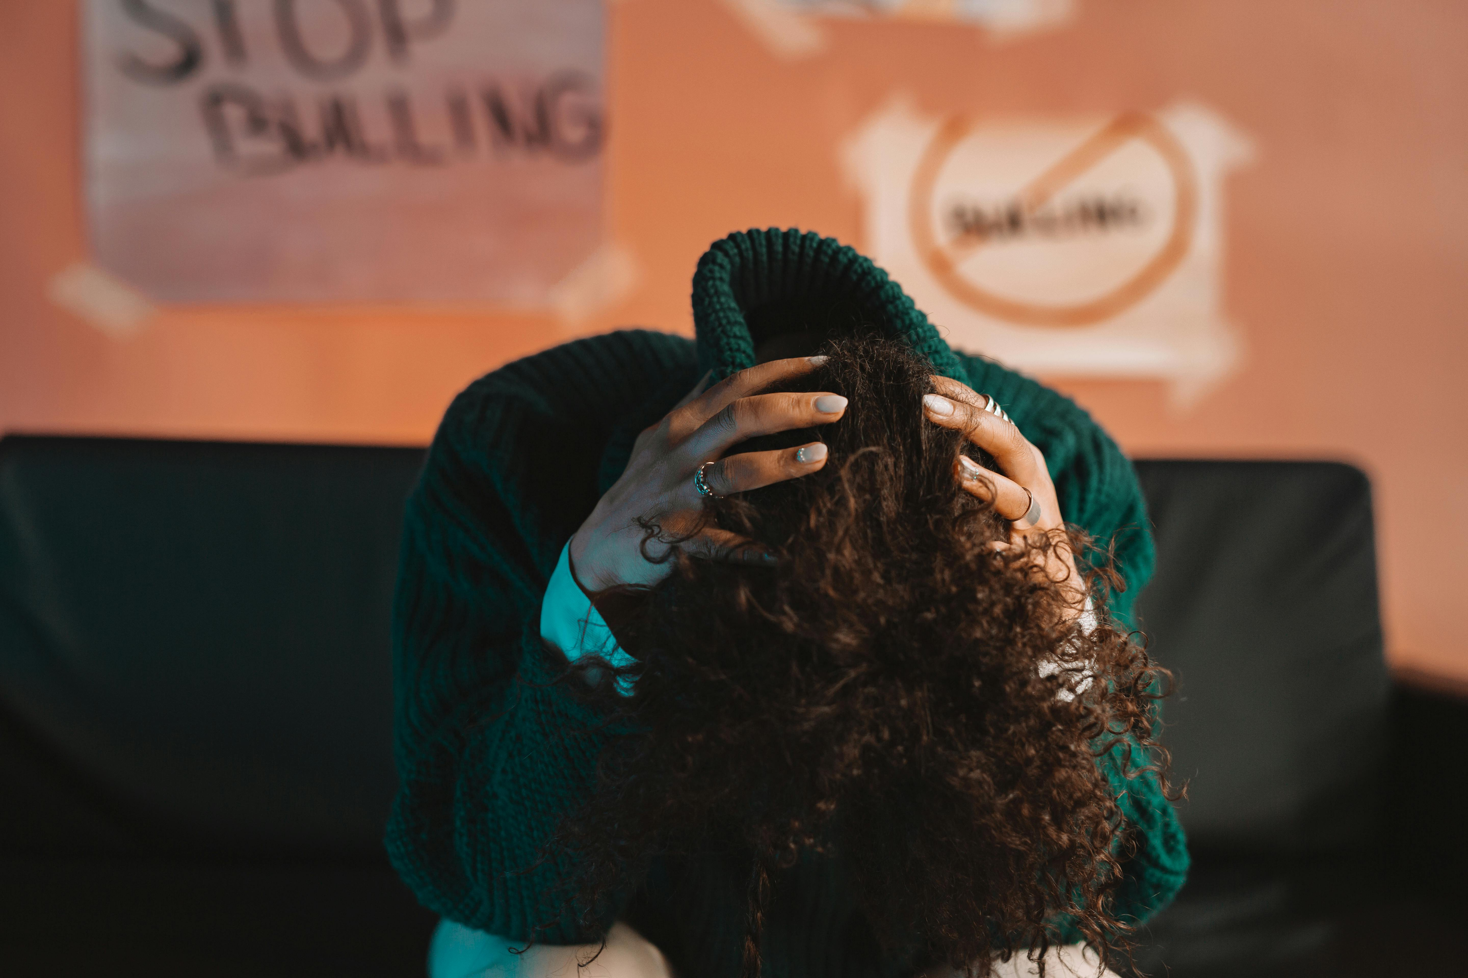
Slide 15: Next Steps
Understanding Bullying
Taking Action
Continue to learn about bullying and its effects.
Educate yourself on the various forms and consequences of bullying.
Take action to prevent bullying and support those affected.
Engage in initiatives and provide help to individuals impacted by bullying.
18
Understanding and Preventing Bullying

Slide 19
Slide 16: Summary
1
2
3
Understanding Bullying
Promoting Kindness and Empathy
Building a Supportive Community
Bullying is a complex issue that affects individuals and society.
Understanding bullying is crucial to addressing its impact effectively.
Promoting kindness and empathy can help prevent bullying.
These values are essential in fostering positive interactions among people.
Creating a supportive community requires a collective effort.
Such communities play a vital role in combating bullying and its effects.
19
Understanding and Preventing Bullying

Slide 20

Slide 17: Key Takeaways
1
2
3
Forms of Bullying
Impact of Bullying
Preventing Bullying
Bullying can take many forms, including physical, verbal, social, and cyberbullying.
These diverse forms highlight the pervasive nature of bullying in various environments.
Bullying can have severe and long-lasting effects on a person's mental health, academic performance, and social relationships.
The consequences often extend beyond the immediate victim, affecting broader communities.
Everyone has a role to play in preventing bullying.
Active participation and awareness are key to creating safer environments for all.
20
Understanding and Preventing Bullying

Slide 21
Slide 18: Conclusion and Final Thoughts
The Complexity of Bullying
Creating a Supportive Environment
Bullying is a complex issue that requires a collective effort to prevent.
It involves understanding the root causes and addressing them effectively.
By working together, we can create a safer and more supportive environment for everyone.
Collaboration among individuals and communities is key to fostering positive change.
21
Understanding and Preventing Bullying

Slide 22

Slide 19: Final Call to Action
Empower Change
Your Role Matters
Take action to prevent bullying and support those affected.
Remember, you have the power to make a positive difference.
Take action to prevent bullying and support those affected.
Remember, you have the power to make a positive difference.
22
Understanding and Preventing Bullying

Slide 23
Slide 20: References
National Bullying Prevention Center
StopBullying.gov
National Bullying Prevention Center is a resource dedicated to preventing bullying and promoting awareness.
It provides tools and support for individuals and communities to address bullying effectively.
StopBullying.gov is a government website offering comprehensive information on bullying prevention.
It includes resources for parents, educators, and youth to combat bullying in various settings.
23
Understanding and Preventing Bullying

