Slide 1


Mastering the Basics of Language: Nouns and Verbs
A Comprehensive Guide to Understanding and Using Nouns and Verbs in Sentence Structure

Slide 2
Mastering the Basics of Language: Nouns and Verbs
2
Table of Contents
Introduction to Nouns and Verbs
What are Nouns?
What are Verbs?
Noun and Verb Functions
Identifying Nouns and Verbs
Using Nouns and Verbs in Sentences
Common Errors
Support for Students with Dyslexia
Real-Life Applications
Conclusion
Key Takeaways
Reflection Questions
Next Steps
04
05
06
07
08
09
10
11
12
13
14
15
16

Slide 3
Mastering the Basics of Language: Nouns and Verbs
3
Table of Contents
Additional Resources
Assessment and Evaluation
Conclusion and Final Thoughts
Final Slide
17
18
19
20

Slide 4
Mastering the Basics of Language: Nouns and Verbs
4
Introduction to Nouns and Verbs
Welcome to the Lesson
Understanding Sentence Structure
Achieving Mastery
Welcome to the lesson on nouns and verbs!
In this lesson, we will explore the definitions, functions, and roles of nouns and verbs in sentence structure.
We will explore how nouns and verbs contribute to sentence structure.
This will help you understand their importance in communication.
By the end of this lesson, you will be able to identify and use nouns and verbs correctly in sentences.
This skill will enhance your writing and speaking abilities.

Slide 5
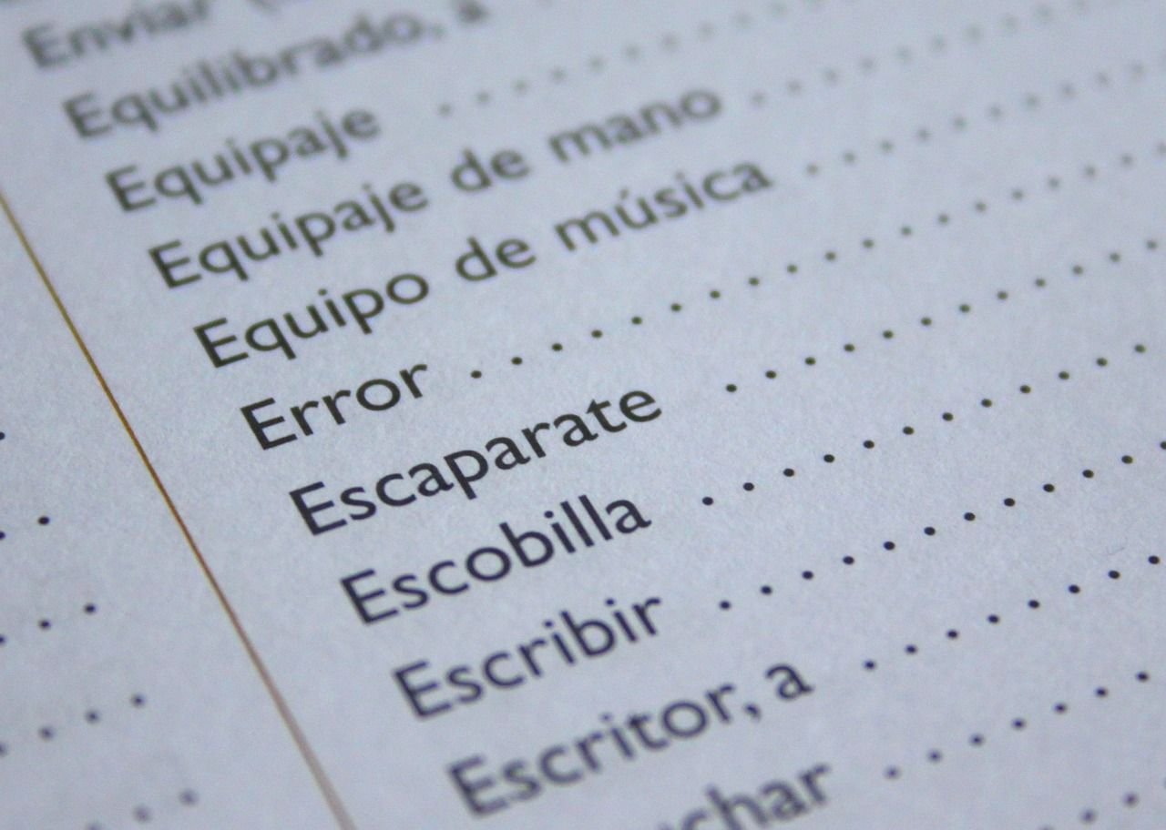
Mastering the Basics of Language: Nouns and Verbs
5
What are Nouns?
Definition of a Noun
Examples of Nouns
A noun is a word that refers to a person, place, thing, or idea.
It serves as a fundamental building block in language.
Examples include book, city, happiness, and teacher.
These examples showcase both tangible and intangible nouns.
Types of Nouns
Importance of Nouns
Nouns can be concrete, referring to tangible objects, or abstract, referring to intangible concepts.
This distinction helps in understanding their usage in language.
Nouns are essential for effective communication in writing, speaking, and reading.
They are used in various contexts to convey meaning clearly.

Slide 6

Mastering the Basics of Language: Nouns and Verbs
6
What are Verbs?
Definition of Verbs
Examples of Verbs
A verb is a word that shows action or a state of being.
It is essential for constructing meaningful sentences.
Examples include run, jump, read, and think.
These words demonstrate actions or mental processes.
Types of Verbs
Importance of Verbs
Verbs can be action verbs, which are physical or mental actions.
They can also be linking verbs, connecting the subject to additional information.
Verbs are crucial for conveying meaning and context in sentences.
They help in expressing actions, states, and relationships.

Slide 7
Mastering the Basics of Language: Nouns and Verbs
7
Noun and Verb Functions
Noun Functions
Verb Functions
Importance of Grammar
Nouns can function as subjects, objects, or modifiers in sentences.
Understanding the functions of nouns is essential for constructing grammatically correct sentences.
Verbs can function as actions, links, or helpers in sentences.
Understanding the functions of verbs is essential for constructing grammatically correct sentences.
Understanding the functions of nouns and verbs is essential for constructing grammatically correct sentences.
This knowledge forms the foundation of effective communication.

Slide 8

Mastering the Basics of Language: Nouns and Verbs
8
Identifying Nouns and Verbs
Understanding Nouns
Recognizing Verbs
Using Context Clues
To identify nouns, look for words that refer to people, places, things, or ideas.
Use context clues, such as surrounding words and sentence structure, to help identify nouns.
To identify verbs, look for words that show action or a state of being.
Use context clues, such as surrounding words and sentence structure, to help identify verbs.
Context clues, such as surrounding words and sentence structure, are essential for identifying nouns.
They are equally important for recognizing verbs in sentences.

Slide 9

Mastering the Basics of Language: Nouns and Verbs
9
Using Nouns and Verbs in Sentences
Role of Nouns in Sentences
Nouns serve as subjects, objects, or modifiers in sentences.
They add context and interest to the overall meaning of the sentence.
Function of Verbs in Sentences
Verbs are used to show action, link ideas, or provide additional information.
They are essential for conveying the dynamics of a sentence.
Collaboration of Nouns and Verbs
Nouns and verbs work together to convey meaning in sentences.
Their interaction creates a complete and engaging sentence structure.

Slide 10

Mastering the Basics of Language: Nouns and Verbs
10
Common Errors
Understanding Common Errors
Improving Sentence Accuracy
Review and Practice
Common errors include confusing nouns and verbs or using them incorrectly in sentences.
To avoid errors, carefully read and review sentences for noun and verb usage.
Practice using nouns and verbs in context to improve your language skills.
Careful practice helps in reducing mistakes and enhancing sentence construction.
Reviewing sentences for correct noun and verb usage is essential.
Consistent practice ensures better understanding and application of language rules.

Slide 11

Mastering the Basics of Language: Nouns and Verbs
11
Support for Students with Dyslexia
Multisensory Approaches
Individualized Support
Assistive Technology
Multisensory approaches, such as visual aids and assistive technology, can help students with dyslexia.
These methods engage multiple senses to enhance learning and comprehension.
Provide extra time for assignments and offer one-on-one support to help students with dyslexia.
This personalized assistance ensures that students can work at their own pace and receive targeted help.
Use assistive technology, such as text-to-speech software, to facilitate reading and writing.
These tools empower students with dyslexia to overcome challenges in literacy tasks.

Slide 12

Mastering the Basics of Language: Nouns and Verbs
12
Real-Life Applications
Effective Communication
Real-Life Contexts
Expressing Ideas Clearly
Understanding nouns and verbs is essential for effective communication in personal and professional settings.
Apply your knowledge of nouns and verbs to create meaningful expressions and convey your ideas clearly.
Nouns and verbs are used in various real-life contexts, such as writing, speaking, and reading.
These elements of language play a crucial role in everyday interactions and tasks.
Mastery of nouns and verbs allows individuals to convey their thoughts effectively.
This skill is vital for creating impactful and understandable messages.

Slide 13

Mastering the Basics of Language: Nouns and Verbs
13
Conclusion
The Role of Nouns and Verbs
Enhancing Communication Skills
In conclusion, nouns and verbs are fundamental language elements that work together to convey meaning in sentences.
By understanding and using nouns and verbs correctly, you can improve your language skills and communicate effectively in various contexts.
By mastering the use of nouns and verbs, individuals can enhance their ability to express ideas clearly.
This understanding is crucial for effective communication in both personal and professional settings.

Slide 14

Mastering the Basics of Language: Nouns and Verbs
14
Key Takeaways
Understanding Nouns
Role of Verbs
Importance of Grammar
Nouns refer to people, places, things, or ideas.
They are fundamental components of sentence construction.
Verbs show action or a state of being.
They are essential for expressing what the subject does or experiences.
Understanding the functions and roles of nouns and verbs is essential for constructing grammatically correct sentences.
This knowledge ensures clarity and precision in communication.

Slide 15
Mastering the Basics of Language: Nouns and Verbs
15
Reflection Questions
01
02
Understanding Nouns and Verbs
Applying Language Skills
What did you learn about nouns and verbs in this lesson?
How can you apply your knowledge of nouns and verbs to improve your language skills?
What did you learn about nouns and verbs in this lesson?
How can you apply your knowledge of nouns and verbs to improve your language skills?

Slide 16
Mastering the Basics of Language: Nouns and Verbs
16
Next Steps
Upcoming Lesson Focus
Practice for Mastery
The next lesson will cover adjectives and adverbs.
This will expand your understanding of descriptive language.
Continue to practice using nouns and verbs in context to reinforce your understanding.
This will help improve your language skills.

Slide 17

Mastering the Basics of Language: Nouns and Verbs
17
Additional Resources
Interactive Exercises and Quizzes
Exploring Nouns and Verbs
For additional practice and review, visit our website for interactive exercises and quizzes.
These resources are designed to enhance your understanding and retention of the material.
Consult your textbook or online resources for further information on nouns and verbs.
These references provide in-depth explanations and examples to solidify your knowledge.

Slide 18
Mastering the Basics of Language: Nouns and Verbs
18
Assessment and Evaluation
Assessment Methods
Your understanding of nouns and verbs will be assessed through quizzes, class discussions, and written assignments.
Use the assessment criteria to evaluate your own learning and identify areas for improvement.
Self-Evaluation
Use the assessment criteria to evaluate your own learning and identify areas for improvement.
Your understanding of nouns and verbs will be assessed through quizzes, class discussions, and written assignments.

Slide 19

Mastering the Basics of Language: Nouns and Verbs
19
Conclusion and Final Thoughts
Conclusion and Final Thoughts
In conclusion, this lesson has provided a comprehensive introduction to nouns and verbs.
It covered their definitions, functions, and roles in sentence structure.

Slide 20

Mastering the Basics of Language: Nouns and Verbs
20
Final Slide
Final Slide
Thank you for participating in this lesson!
We hope you have a better understanding of nouns and verbs and are ready to apply your knowledge in various contexts.

