Slide 1
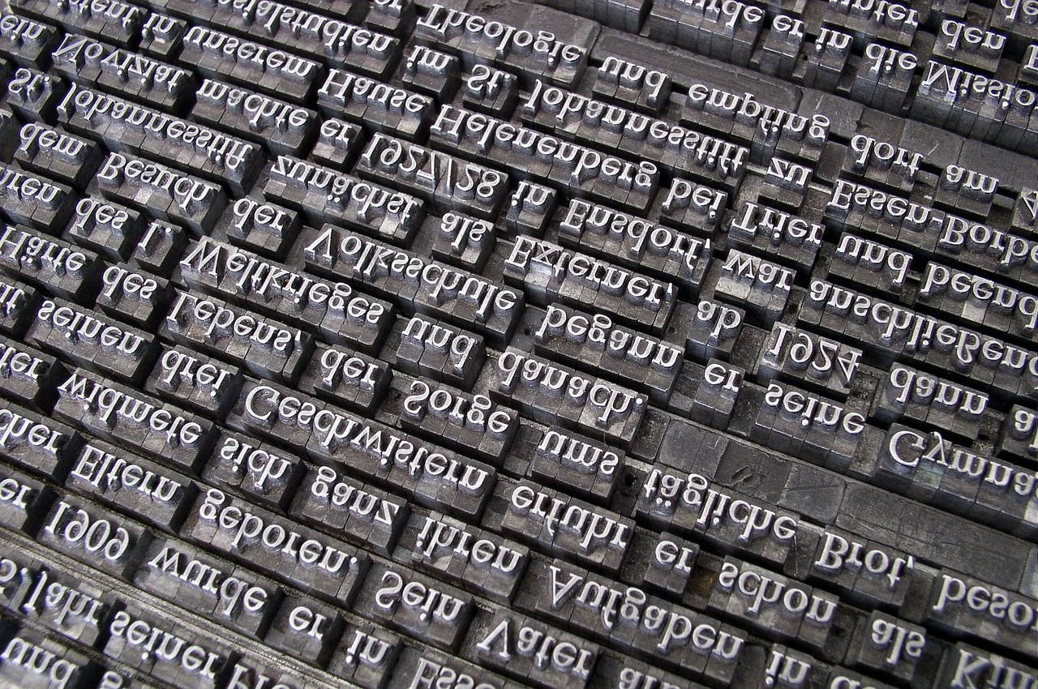
Mastering Determiners: A Comprehensive Guide
Exploring the Role, Types, and Application of Determiners in Language Proficiency and Communication Skills

Slide 2
Table of contents
Lesson Introduction
Subject Knowledge
Determiners Overview
Types of Determiners
Importance of Determiners
Examples of Determiners
Practical Application of Determiners
Enhancing Language Proficiency
Effective Communication Skills
Language Proficiency Improvement
01
02
03
04
05
06
07
08
09
10

Slide 3

Lesson Introduction
In this lesson, we will delve into the world of determiners, a crucial aspect of English grammar.
Determiners are words that precede and modify nouns, providing essential information about the noun's specificity, quantity, or identity.
By the end of this lesson, students will have a deep understanding of the different types of determiners, their functions, and how to use them effectively in their written and spoken communication.
This lesson will equip students with the necessary skills to enhance their language proficiency and improve their overall command of the English language.
Mastering Determiners: A Comprehensive Guide
1

Slide 4

Subject Knowledge
Determiners Definition
Types of Determiners
Determiners are a class of words that provide additional information about a noun, such as its specificity, quantity, or identity.
They help to clarify the meaning and reference of the noun.
The main types of determiners include articles (a, an, the) and demonstratives (this, that).
Functions of Determiners
Importance of Using Determiners
Determiners play a crucial role in specifying nouns and indicating whether they are general or specific.
They also help in expressing quantity, possession, and demonstrating proximity.
Using determiners correctly enhances the clarity and precision of language.
Proper usage of determiners contributes to effective communication and writing skills.
Mastering Determiners: A Comprehensive Guide
2

Slide 5

Determiners Overview
What are Determiners?
Types of Determiners
Function of Determiners
Determiners are words that provide additional information about a noun, such as its specificity, quantity, or identity.
Articles: "a," "an," "the"
Demonstratives: "this," "that"
Clarify the meaning and reference of the noun.
Essential for effective communication in written and spoken English.
Mastering Determiners: A Comprehensive Guide
3

Slide 6
Types of Determiners
Articles
Demonstratives
Possessives
Quantifiers
Numbers
Definite article: "the"
Indefinite articles: "a" and "an"
This
That
These
Those
My
Your
His
Her
Its
Our
Their
Some
Any
Many
Much
Few
Several
One
Two
Three
First
Second
Third
Mastering Determiners: A Comprehensive Guide
4

Slide 7

Importance of Determiners
Enhancing Clarity
Adding Specificity
Determiners help clarify the meaning and reference of nouns in a sentence.
They provide essential information about the specificity, quantity, or identity of the noun.
Improving Communication
Language Proficiency
Effective use of determiners enhances written and spoken communication skills.
Mastering determiners is crucial for improving overall command of the English language.
Mastering Determiners: A Comprehensive Guide
5

Slide 8

Examples of Determiners
Articles
Definite Article: "The" - e.g., "The book"
Indefinite Articles: "A" and "An" - e.g., "A cat", "An apple"
Demonstratives
Near Demonstratives: "This" and "These" - e.g., "This car", "These books"
Far Demonstratives: "That" and "Those" - e.g., "That house", "Those flowers"
Possessives
Possessive Adjectives: "My", "Your", "His", "Her", "Its", "Our", "Their" - e.g., "My car", "Their house"
Possessive Pronouns: "Mine", "Yours", "His", "Hers", "Its", "Ours", "Theirs" - e.g., "The book is mine", "The house is theirs"
Quantifiers
Definite Quantifiers: "All", "Both", "Half", "Each", "Every" - e.g., "All students", "Both options"
Indefinite Quantifiers: "Some", "Any", "Many", "Few", "Several" - e.g., "Some apples", "Many books"
Mastering Determiners: A Comprehensive Guide
6

Slide 9
Practical Application of Determiners
01
02
03
04
05
Enhancing Clarity
Improving Precision
Expressing Quantity
Establishing Identity
Enhancing Descriptions
Utilize determiners to provide specific details about nouns
Helps to avoid ambiguity in communication
Selecting the appropriate determiner can significantly enhance the accuracy and precision of your language
Use determiners to convey the exact quantity or amount of nouns in your writing or speech
Employ determiners to establish the identity of nouns
Makes your sentences more informative and engaging
Incorporate determiners to add depth and detail to your descriptions
Makes your language more vivid and engaging
Mastering Determiners: A Comprehensive Guide
7

Slide 10
Enhancing Language Proficiency
01
02
03
04
Understanding Determiners
Types of Determiners
Function of Determiners
Function of Determiners
Determiners are essential words that provide crucial information about nouns, such as specificity, quantity, or identity.
Articles (a, an, the) and demonstratives (this, that) are among the main types of determiners.
They help clarify the meaning and reference of nouns in sentences.
They help clarify the meaning and reference of nouns in sentences.
Mastering Determiners: A Comprehensive Guide
8

Slide 11
Effective Communication Skills
01
02
03
04
05
Active Listening
Clarity and Conciseness
Empathy and Understanding
Non-Verbal Communication
Feedback and Adaptability
Focus on the speaker without distractions.
Show interest through verbal and non-verbal cues.
Ask clarifying questions to ensure understanding.
Express ideas in a clear and straightforward manner.
Avoid jargon and unnecessary complexity.
Get to the point efficiently to maintain engagement.
Put yourself in the other person's shoes.
Acknowledge emotions and perspectives.
Respond with compassion and respect.
Pay attention to body language and facial expressions.
Maintain eye contact to convey attentiveness.
Use gestures to emphasize points and show engagement.
Seek feedback to improve communication effectiveness.
Be open to adjusting your communication style.
Adapt to the needs and preferences of your audience.
Mastering Determiners: A Comprehensive Guide
9

Slide 12
Language Proficiency Improvement
Enhancing Vocabulary
Grammar Practice
Reading Comprehension
Speaking and Listening Skills
Writing Proficiency
Learn new words daily
Use a variety of vocabulary in writing and speaking
Practice using synonyms and antonyms
Focus on mastering determiners
Understand the correct usage of articles, demonstratives, and quantifiers
Regularly review grammar rules and apply them in sentences
Read a variety of texts, including articles, books, and news
Summarize key points and main ideas
Analyze how determiners are used in different contexts
Engage in conversations with peers and teachers
Practice active listening and respond thoughtfully
Pay attention to determiners used by others and incorporate them in your speech
Write regularly to improve sentence structure and coherence
Pay attention to determiners' placement and impact on the overall meaning
Seek feedback from teachers or peers to enhance writing skills
Mastering Determiners: A Comprehensive Guide
10

