Slide 1



Exploring Human Excretion: A Comprehensive Overview
Understanding the Mechanisms, Functions, and Health Implications of Excretory Processes

Slide 2
Table of contents
Physiological Processes Unveiled: Understanding Hum…
What is Excretion?
Primary Excretory Organs
Kidney Anatomy - Structural Overview
Nephron - The Functional Unit
Blood Filtration Process
Hormonal Regulation in Excretion
Metabolic Waste Characterization
Urine Formation Process
Factors Affecting Kidney Function
01
02
03
04
05
06
07
08
09
10

Slide 3
Table of contents
Common Kidney Disorders
Technological Interventions
Excretion Across Different Organisms
Maintaining Kidney Health
Misconceptions About Excretion
Interactive Learning Challenge
Real-World Health Connections
Future of Excretion Research
Key Takeaways
Conclusion and Further Exploration
11
12
13
14
15
16
17
18
19
20

Slide 4
Physiological Processes Unveiled: Understanding Human Excretion
Physiological Processes Unveiled: Understanding Human Excretion
Definition and Importance
Biological process of removing metabolic waste products
Essential for maintaining homeostasis and preventing toxic accumulation
Key Excretory Organs
Kidneys: Primary organs responsible for filtering blood and producing urine
Exploring Human Excretion: A Comprehensive Overview
1

Slide 5

What is Excretion?
Definition
Key Functions
Visual Aids
Biological process of removing metabolic waste products.
Maintains Homeostasis - Regulates internal balance of fluids and electrolytes.
Prevents Toxic Waste Accumulation - Eliminates harmful substances to protect the body.
Protects Cellular Health - Ensures optimal functioning of cells by removing waste.
Infographic - Illustrates waste removal pathways in the body.
Comparative Diagram - Shows waste elimination across different organ systems.
Exploring Human Excretion: A Comprehensive Overview
2

Slide 6
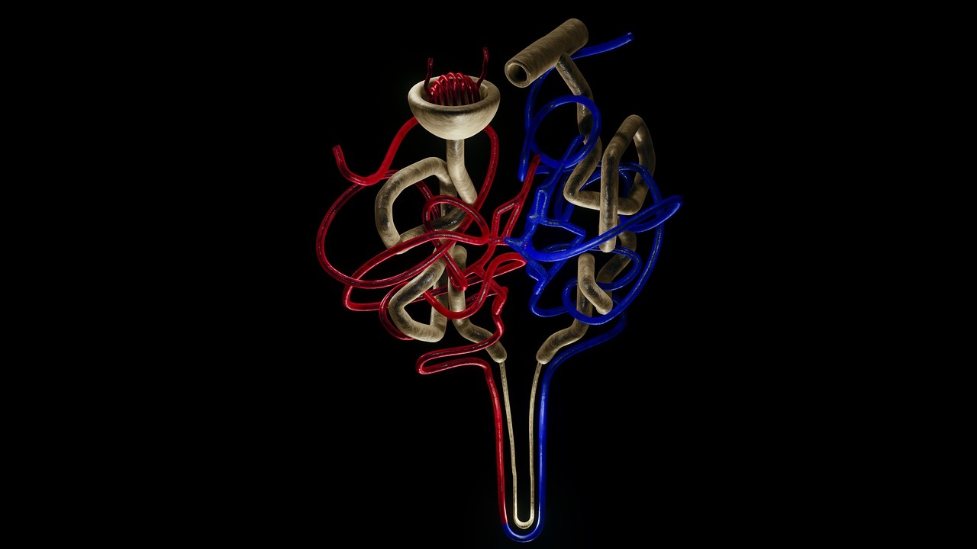
Primary Excretory Organs
Kidneys
Lungs
Primary organs responsible for filtering blood and producing urine.
Remove nitrogenous wastes (urea) and excess salts.
Facilitate the excretion of carbon dioxide through respiration.
Help maintain acid-base balance in the body.
Skin
Liver
Excretes waste products through sweat (e.g., salts, urea).
Plays a role in thermoregulation and hydration.
Processes and detoxifies various metabolites.
Converts ammonia to urea for safe excretion via kidneys.
Exploring Human Excretion: A Comprehensive Overview
3

Slide 7
Kidney Anatomy - Structural Overview
Detailed Kidney Structure Diagram
Key Anatomical Components
3D Cross-Section
Microscopic View of Nephron Complexity
Visual representation highlighting the kidney's anatomy.
Renal Cortex: Outer layer responsible for filtration.
Renal Medulla: Inner region containing renal pyramids.
Renal Pelvis: Funnel-shaped structure collecting urine.
Nephron Structure: Functional unit of the kidney.
Illustrates internal kidney architecture and spatial relationships.
Detailed examination of nephron components and their functions.
Exploring Human Excretion: A Comprehensive Overview
4

Slide 8
Nephron - The Functional Unit
Nephron Structure Overview
Filtration Process Visualization
Molecular-Level Illustration
Components:
Glomerulus: A network of capillaries where blood filtration begins.
Bowman's Capsule: The structure that encases the glomerulus and collects filtrate.
Renal Tubule: The pathway for reabsorption and secretion of substances.
Stages of Filtration:
Initial blood entry into the glomerulus.
Filtrate formation in Bowman's capsule.
Movement through the renal tubule for further processing.
Filtration Mechanisms:
Visualization of how molecules pass through the glomerular membrane.
Interaction of water, ions, and waste products during filtration.
Exploring Human Excretion: A Comprehensive Overview
5

Slide 9
Initial Blood Entry
Blood Filtration Process
Blood enters the kidneys through the renal artery, bringing waste products and excess substances for filtration.
01
Glomerular Filtration
In the glomerulus, blood pressure forces water, ions, and small molecules through the capillary walls into Bowman's capsule, forming the filtrate.
02
Reabsorption
03
As the filtrate moves through the renal tubule, essential substances like glucose, amino acids, and water are reabsorbed back into the bloodstream.
Secretion
04
Additional waste products and excess ions are secreted from the blood into the renal tubule, ensuring that harmful substances are eliminated from the body.
Exploring Human Excretion: A Comprehensive Overview
6

Slide 10
Hormonal Regulation in Excretion
Key Hormones Controlling Excretion
Mechanism of Hormonal Control
Impact on Water Reabsorption
Graphical Representation of Hormonal Interactions
Antidiuretic Hormone (ADH)
Aldosterone
ADH increases water permeability in kidney tubules.
Aldosterone promotes sodium reabsorption and potassium excretion.
ADH enhances water retention, reducing urine volume.
Aldosterone influences electrolyte balance, affecting fluid retention.
Diagram illustrating the feedback loop of ADH and aldosterone.
Visuals showing the effects on kidney function and urine concentration.
Exploring Human Excretion: A Comprehensive Overview
7

Slide 11
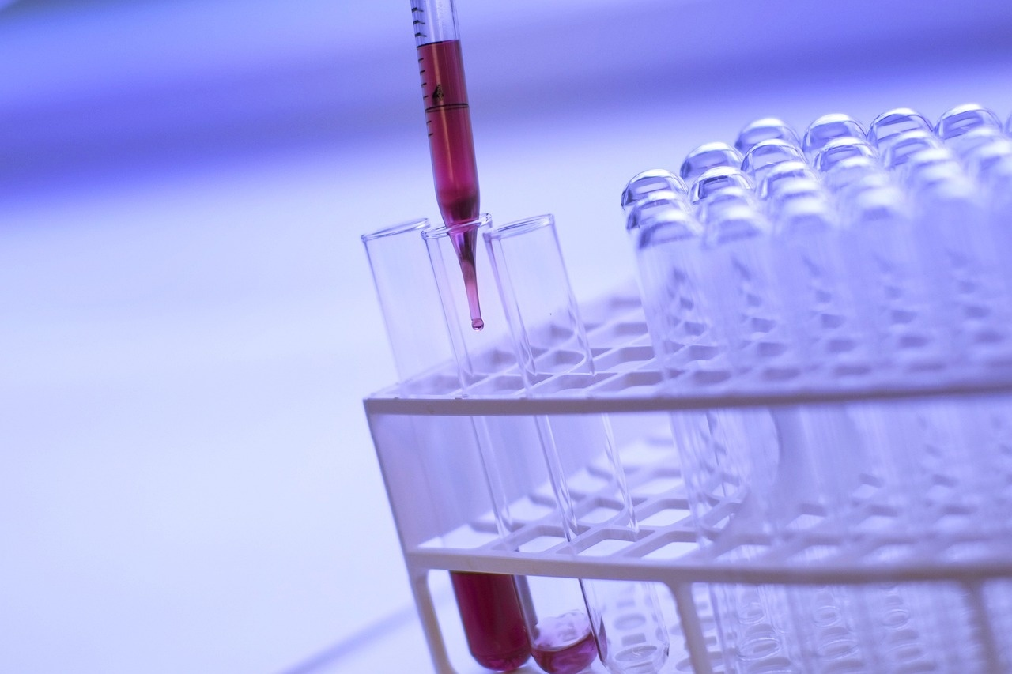
Metabolic Waste Characterization
Types of Metabolic Waste
Chemical Structure Diagrams
Nitrogenous Waste: Urea
Carbon Dioxide
Excess Salts
Visual representations of urea, carbon dioxide, and common salts
Importance of understanding molecular structures
Waste Production Sources
Elimination Pathways Visualization
Breakdown of proteins leading to urea formation
Cellular respiration producing carbon dioxide
Dietary intake contributing to excess salts
Diagrams illustrating pathways for waste removal
Key organs involved: kidneys, lungs, skin
Exploring Human Excretion: A Comprehensive Overview
8

Slide 12
Filtration Stage
Urine Formation Process
The process begins in the glomerulus, where blood is filtered under pressure. This removes waste products, excess salts, and water, forming a filtrate that enters the nephron.
01
Reabsorption Stage
As the filtrate moves through the renal tubule, essential substances such as glucose, amino acids, and a significant amount of water are reabsorbed back into the bloodstream, ensuring that vital nutrients are retained.
02
Secretion Stage
03
Additional waste products and excess ions are secreted into the filtrate from the blood, further refining the composition of urine. This step helps maintain electrolyte balance and pH levels.
Concentration Stage
04
The final filtrate is concentrated in the collecting ducts, where water reabsorption is regulated by hormones like ADH. This results in urine that varies in color and composition based on hydration levels and dietary factors.
Exploring Human Excretion: A Comprehensive Overview
9

Slide 13
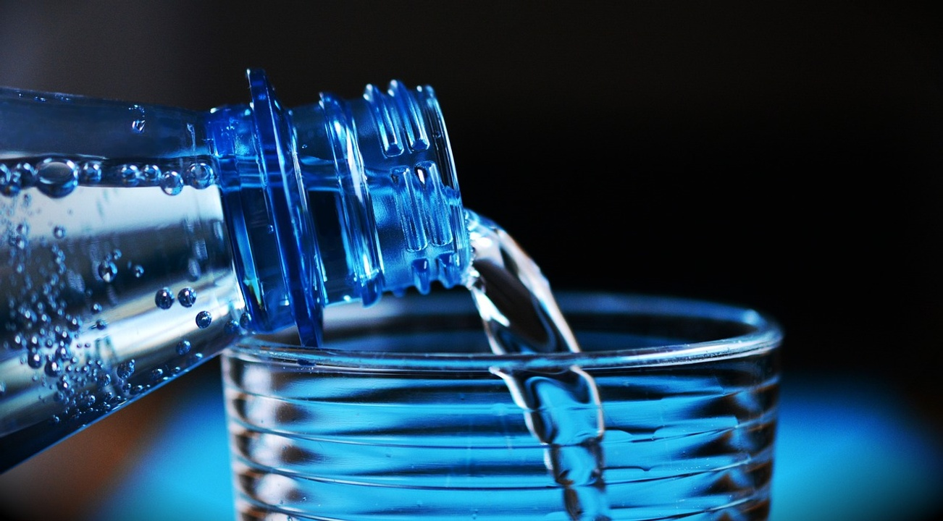
Factors Affecting Kidney Function
Hydration Levels
Dietary Intake
Impact of water intake on kidney filtration efficiency
Dehydration risks and potential kidney damage
Influence of nutrients and minerals on kidney health
Effects of high sodium and protein diets
Physical Activity
Hormonal Balance
Role of exercise in promoting kidney function
Sedentary lifestyle risks for kidney health
Key hormones involved in kidney regulation (e.g., ADH, aldosterone)
Effects of hormonal imbalances on kidney performance
Exploring Human Excretion: A Comprehensive Overview
10

Slide 14
Common Kidney Disorders
Common Kidney Disorders
Diagnostic Indicators
Prevention Strategies
Medical Intervention Overview
Overview of Kidney-Related Health Issues
Kidney Stones: Hard deposits formed from minerals and salts, Symptoms: severe pain, blood in urine, frequent urination
Chronic Kidney Disease (CKD): Gradual loss of kidney function over time, Risk factors: diabetes, hypertension, family history
Renal Failure: Sudden or gradual loss of kidney function, Can be acute (temporary) or chronic (permanent)
Blood tests (e.g., creatinine, blood urea nitrogen)
Urinalysis (presence of protein, blood, or glucose)
Imaging tests (ultrasound, CT scans)
Stay hydrated to prevent kidney stones
Manage blood pressure and blood sugar levels
Maintain a balanced diet low in sodium and processed foods
Medications (e.g., diuretics, phosphate binders)
Dialysis for renal failure management
Kidney transplantation as a long-term solution
Exploring Human Excretion: A Comprehensive Overview
11

Slide 15

Technological Interventions
Modern Medical Technologies
Comparative Diagram of Intervention Methods
Future Research Potential
Hemodialysis: A process that artificially removes waste and excess fluid from the blood when kidneys are unable to perform this function.
Kidney Transplantation: A surgical procedure to replace a diseased kidney with a healthy one from a donor.
Emerging Biotechnological Approaches: Innovative techniques such as gene therapy and bioengineered organs aimed at improving kidney function and overall excretion processes.
Visual representation comparing the effectiveness, risks, and benefits of hemodialysis, kidney transplantation, and emerging biotechnological approaches.
Exploration of advancements in regenerative medicine and personalized treatments to enhance kidney health and excretion efficiency.
Exploring Human Excretion: A Comprehensive Overview
12

Slide 16
Excretion Across Different Organisms
Comparative Excretion Mechanisms
Evolutionary Adaptation Illustrations
Biological Diversity in Waste Elimination
Visual Representation
Mammals: Utilize kidneys for efficient filtration and urine production.
Reptiles: Excrete uric acid, conserving water in arid environments.
Fish: Primarily excrete ammonia directly into water, utilizing gills for gas exchange.
Insects: Use Malpighian tubules to eliminate waste, balancing water retention.
Adaptations: Highlight how different environments shape excretory systems.
Examples: Aquatic vs. terrestrial adaptations in waste management.
Diverse Strategies: Overview of various waste elimination methods across species.
Ecological Impact: Discuss how excretion affects ecosystem nutrient cycles.
Infographics: Include diagrams comparing excretory systems.
Illustrations: Show evolutionary pathways and adaptations in excretion.
Exploring Human Excretion: A Comprehensive Overview
13

Slide 17
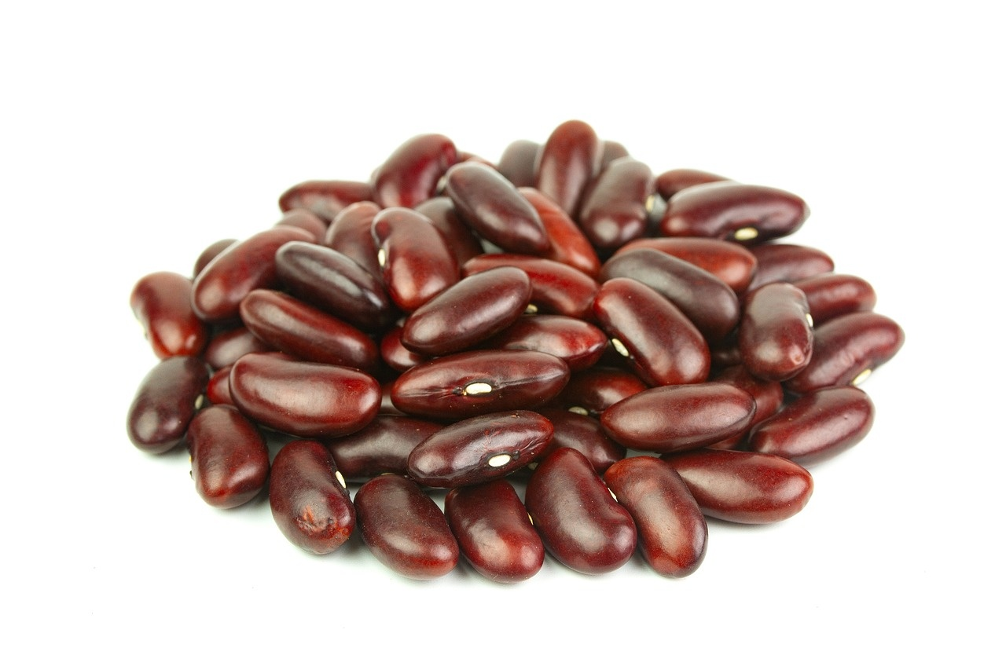
Maintaining Kidney Health
Lifestyle Recommendations
Preventative Health Strategies
Hydration: Drink adequate water daily (about 2-3 liters for adults).
Balanced Diet: Incorporate fruits, vegetables, whole grains, and lean proteins.
Regular Exercise: Aim for at least 150 minutes of moderate exercise weekly.
Avoiding Toxins: Limit exposure to harmful substances (e.g., smoking, excessive alcohol).
Regular Check-ups: Schedule routine kidney function tests.
Blood Pressure Management: Keep blood pressure within a healthy range (below 120/80 mmHg).
Diabetes Control: Maintain blood sugar levels to prevent kidney damage.
Nutritional Guidelines
Maintaining Kidney Health
Limit Sodium Intake: Aim for less than 2,300 mg of sodium per day.
Monitor Protein Consumption: Balance protein intake based on individual health needs.
Stay Informed: Educate yourself on kidney-friendly foods and dietary restrictions.
Exploring Human Excretion: A Comprehensive Overview
14

Slide 18
Misconceptions About Excretion
"Kidneys Only Filter Waste"
"All Waste Exits Through Urine"
"Kidney Function is Constant"
Myth: Many believe that the kidneys' sole function is to filter out waste from the blood.
Fact: Kidneys also play a crucial role in regulating blood pressure, electrolyte balance, and red blood cell production.
Myth: It is commonly thought that urine is the only way the body eliminates waste.
Fact: Waste is also expelled through sweat, exhalation (carbon dioxide), and feces, highlighting the body's multiple excretory pathways.
Myth: Some assume that kidney function remains unchanged throughout life.
Fact: Kidney function can vary based on factors such as hydration, diet, and overall health, adapting to the body's needs.
Exploring Human Excretion: A Comprehensive Overview
15

Slide 19
Interactive Learning Challenge
Engaging Student Activity
Waste Tracking Exercise
Metabolic Process Mapping
Group Investigation Guidelines
Foster collaboration through hands-on learning experiences.
Students monitor and record their daily waste output.
Analyze patterns and discuss implications for health and environment.
Create visual representations of metabolic pathways involved in waste production.
Encourage group discussions on the significance of each pathway.
Outline steps for conducting research on excretory processes.
Provide criteria for evaluating findings and presentations.
Exploring Human Excretion: A Comprehensive Overview
16

Slide 20
Real-World Health Connections
Excretion's Role in Overall Health
Metabolic Disorder Implications
Preventative Healthcare Strategies
Importance of waste removal in maintaining homeostasis
Case studies linking excretion to chronic disease prevention
Impact of kidney function on metabolic health
Examples of disorders like diabetes affecting excretory processes
Lifestyle modifications to enhance kidney health
Importance of regular health screenings and early detection
Exploring Human Excretion: A Comprehensive Overview
17

Slide 21
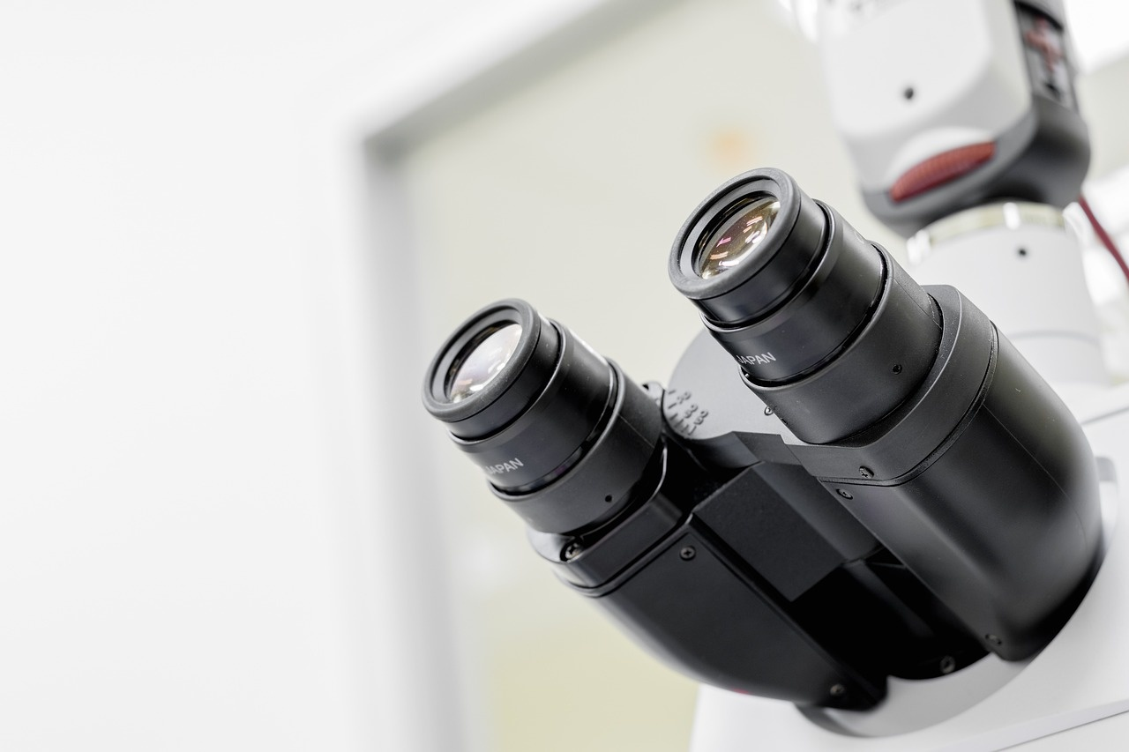
Future of Excretion Research
Emerging Scientific Frontiers
Personalized Medical Approaches
Research Potential Visualization
Regenerative Medicine: Exploring the potential of stem cells to repair or replace damaged kidney tissues.
Biotechnological Innovations: Development of bioengineered organs and advanced dialysis techniques.
Tailored Treatments: Utilizing genetic information to customize therapies for kidney diseases.
Predictive Analytics: Leveraging data to forecast individual responses to treatments.
Cutting-Edge Scientific Developments: Visualizing the integration of AI and machine learning in excretion research.
Future Directions: Mapping out the next steps in excretion research and its implications for health.
Exploring Human Excretion: A Comprehensive Overview
18

Slide 22
Key Takeaways
Comprehensive Summary of Lesson
Critical Learning Points
Interconnected Physiological Processes
This presentation provided an in-depth exploration of human excretion, highlighting its significance in maintaining bodily functions.
Key concepts included the roles of various excretory organs and the processes involved in waste removal.
Understanding excretion involves recognizing how it interacts with other bodily systems to maintain homeostasis.
Importance of Understanding Excretion
Real-World Applications
Knowledge of excretion is crucial for appreciating overall health and the prevention of related disorders.
Insights gained can inform personal health choices and encourage proactive management of kidney health.
Exploring Human Excretion: A Comprehensive Overview
19

Slide 23
Conclusion and Further Exploration
Reflection on Lesson's Significance
Encouragement for Continued Learning
Additional Research Resources
Inspiring Scientific Curiosity
Understanding human excretion is crucial for appreciating bodily functions and maintaining health.
Explore additional topics in biology to deepen your knowledge of human physiology and health.
Recommended websites and books for further reading:
National Institutes of Health (NIH)
"Human Physiology" by Stuart Fox
Consider questions like: How do excretory processes differ among various organisms? What advancements are being made in kidney health?
Exploring Human Excretion: A Comprehensive Overview
20

