Slide 1
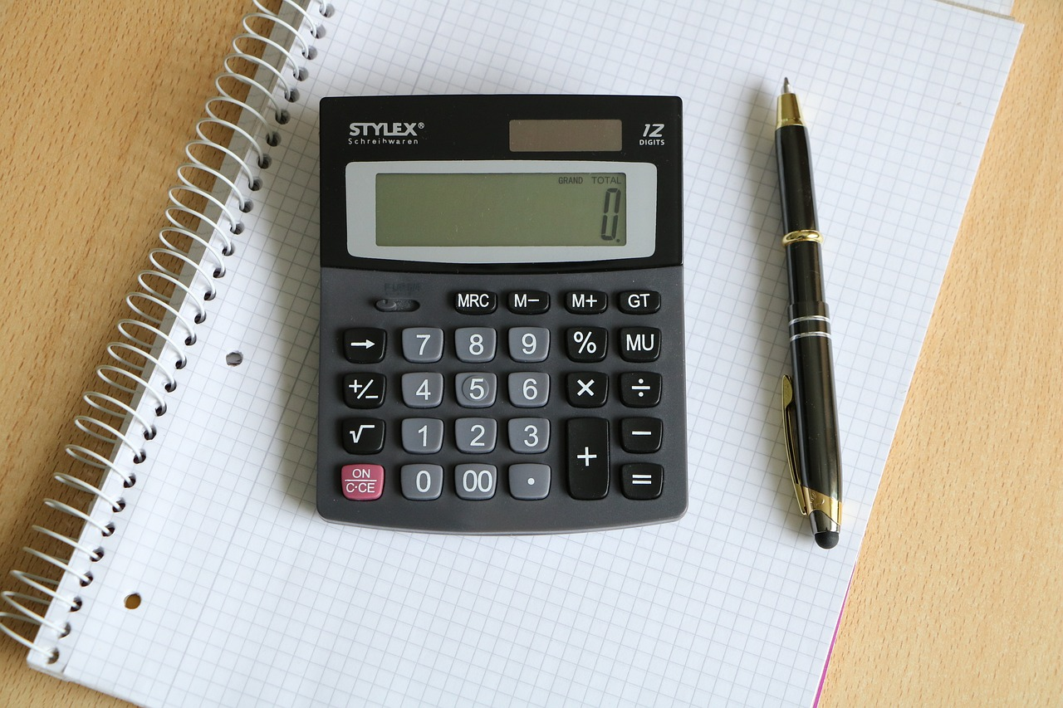
Understanding Fractions and Decimals: A Comprehensive Guide
Exploring Concepts, Applications, and Strategies for Mastery

Slide 2
Table of Contents
Introduction to Fractions and Decimals Basics
Importance of Fractions and Decimals
Lesson Objectives
What are Fractions?
What are Decimals?
Converting Fractions to Decimals
Converting Decimals to Fractions
Real-World Applications
Common Errors and Misconceptions
Assessment and Evaluation
Conclusion
Next Steps
Reflection and Evaluation
01
02
03
04
05
06
07
08
09
10
11
12
13

Slide 3
Table of Contents
Resources and Support
Parent Engagement
Extension Activities
Summary
14
15
16
17

Slide 4

Introduction to Fractions and Decimals Basics
Understanding Fractions
Decimal Concepts
Real-World Applications
Fractions represent parts of a whole and are essential in mathematics.
Understanding fractions lays the groundwork for more complex mathematical concepts.
Decimals are another way to represent fractions, using a base-10 system.
They are crucial for calculations in everyday life, such as money and measurements.
Fractions and decimals are used in various real-world scenarios, including cooking and budgeting.
By mastering these concepts, students can apply them in practical situations.
1
Understanding Fractions and Decimals: A Comprehensive Guide

Slide 5
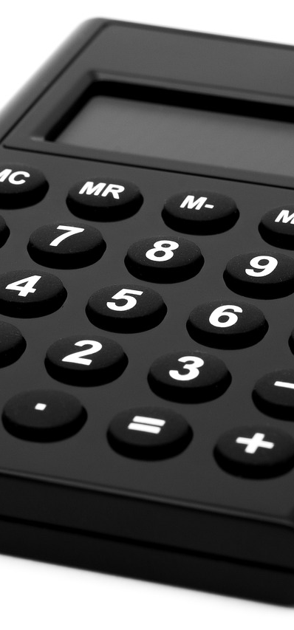
Importance of Fractions and Decimals
Math Proficiency
Real-Life Applications
Fractions and decimals are essential for enhancing mathematical proficiency and problem-solving skills.
They are crucial for success in higher-level math.
Understanding fractions and decimals is vital in real-life scenarios like cooking and finance.
These skills enable informed decision-making.
Interactive Learning
Diverse Learning Styles
This lesson engages students through interactive examples and group discussions.
Practical exercises foster a deeper understanding of the material.
The lesson accommodates various learning styles, including visual and auditory methods.
This approach ensures all students can effectively grasp the concepts.
2
Understanding Fractions and Decimals: A Comprehensive Guide

Slide 6

Lesson Objectives
Fraction Basics
Conversion Techniques
A fraction represents a part of a whole. It consists of a numerator and a denominator.
To convert a fraction to a decimal, divide the numerator by the denominator. This demonstrates their equivalence.
Real-World Applications
Comparison Analysis
In cooking, a recipe may call for 1/2 cup of sugar, illustrating the use of fractions. They are also useful in budgeting, like dividing expenses among friends.
To compare fractions, find a common denominator. This allows for easy identification of equivalent ratios.
3
Understanding Fractions and Decimals: A Comprehensive Guide

Slide 7

What are Fractions?
Numerator Defined
Denominator Explained
Fraction Examples
A fraction represents a part of a whole, expressed as a ratio of two numbers.
The numerator indicates how many equal parts are being considered.
The denominator shows the total number of equal parts in the whole.
It indicates how many parts the whole is divided into.
Common fractions include 1/2, which represents one part of two equal parts.
3/4 represents three parts of four equal parts, and 2/5 represents two parts of five equal parts.
4
Understanding Fractions and Decimals: A Comprehensive Guide

Slide 8

What are Decimals?
Part of a Whole
Written with a Point
Convert to Fractions
A decimal represents a portion of a whole.
For example, 0.75 means 75 out of 100 parts.
Decimals are numbers that include a decimal point, like 0.5 or 0.25.
They are often used in everyday tasks, such as measuring ingredients.
To convert a decimal to a fraction, place the decimal over its place value.
For example, 0.5 becomes 5/10, which simplifies to 1/2.
5
Understanding Fractions and Decimals: A Comprehensive Guide

Slide 9

Converting Fractions to Decimals
Basic Conversions
Complex Fractions
Mixed Numbers
To convert a fraction to a decimal, divide the numerator by the denominator.
For example, 1/2 is 0.5 and 3/4 is 0.75.
Convert fractions like 2/3 and 3/5 to decimals.
This practice builds confidence in handling conversions.
Learn to convert mixed numbers and improper fractions to decimals.
This skill deepens your understanding of fractions.
6
Understanding Fractions and Decimals: A Comprehensive Guide

Slide 10

Converting Decimals to Fractions
Simple Conversions
To convert a decimal to a fraction, write the decimal as a fraction with a denominator of 10, 100, or 1000.
For example, 0.5 can be expressed as 1/2, and 0.25 can be expressed as 1/4.
Complex Decimals
Practice converting decimals like 0.33 and 0.66 into fractions.
These can be expressed as 33/100 and 66/100 respectively.
Recurring Decimals
Learn the method to convert recurring decimals into their fractional forms.
For instance, 0.333... can be represented as 1/3.
7
Understanding Fractions and Decimals: A Comprehensive Guide

Slide 11
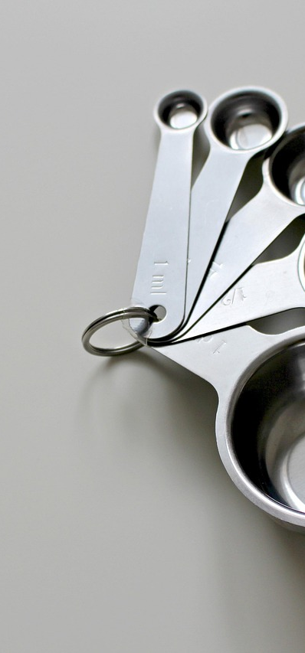
Real-World Applications
Cooking Measurements
Fractions and decimals are essential in cooking, especially when measuring ingredients.
Accurate measurements can make a significant difference in the outcome of a recipe.
Financial Calculations
Fractions and decimals play a crucial role in finance, particularly in calculating interest rates.
Understanding these concepts helps in making informed financial decisions.
Measurement Applications
Fractions and decimals are widely used in various measurement applications, such as lengths and weights.
These measurements are fundamental in fields like construction and manufacturing.
Real-World Research
At the foundation level, students can explore simple scenarios like measuring ingredients for a recipe.
As they progress, they can investigate more complex situations, such as calculating the cost of materials for a DIY project.
8
Understanding Fractions and Decimals: A Comprehensive Guide

Slide 12

Common Errors and Misconceptions
Fraction Confusion
Students often confuse fractions with decimals.
This can lead to mistakes in calculations.
Equivalent Misunderstanding
Equivalent fractions are different fractions that represent the same value.
Many students find it challenging to recognize these fractions.
Decimal Difficulty
Understanding decimal places can be challenging.
A misplaced decimal can change a number's value significantly.
Conversion Errors
Converting between fractions and decimals can be tricky.
Regular practice with visual aids can enhance understanding.
9
Understanding Fractions and Decimals: A Comprehensive Guide

Slide 13

Assessment and Evaluation
Formative Methods
Foundation Focus
Formative assessment includes quizzes and class discussions.
They offer ongoing feedback to improve learning.
The foundation level targets essential skills and concepts.
It establishes a base for future learning.
Summative Tools
Extension Skills
Summative assessment involves tests and projects.
They evaluate performance at the end of a unit.
Extension skills foster critical thinking and creativity.
Students apply their knowledge in various contexts.
10
Understanding Fractions and Decimals: A Comprehensive Guide

Slide 14

Conclusion
Math Fundamentals
Fractions and decimals are fundamental in mathematics.
They are essential for problem-solving and daily applications.
Essential Skills
This lesson establishes a foundation for advanced math studies.
Mastering these skills is crucial for success in various mathematical topics.
Foundation for Learning
A strong grasp of basic math concepts is vital for future learning.
These skills are applicable in many real-world situations.
11
Understanding Fractions and Decimals: A Comprehensive Guide

Slide 15
Next Steps
Adding & Subtracting
Multiplying & Dividing
Real-World Uses
This lesson teaches how to add and subtract fractions by finding a common denominator.
Practice with various examples to reinforce your understanding.
This lesson covers the multiplication and division of fractions, including rules for simplification.
Engage with exercises to master these operations.
This lesson explores how fractions and decimals are used in everyday tasks like cooking and budgeting.
Learn to apply these concepts in practical scenarios.
12
Understanding Fractions and Decimals: A Comprehensive Guide

Slide 16

Reflection and Evaluation
Lesson Effectiveness
Student Progress
Improvement Areas
The lesson was effective in engaging students and facilitating discussion.
Most students demonstrated a clear understanding of the key concepts.
Students showed significant improvement in their ability to apply the concepts learned.
Regular assessments indicate that the majority are on track to meet learning objectives.
There is a need for more differentiated instruction to cater to diverse learning styles.
Future lessons could benefit from incorporating more hands-on activities.
13
Understanding Fractions and Decimals: A Comprehensive Guide

Slide 17

Resources and Support
Whiteboard Tools
Fraction Walls
Whiteboards and markers facilitate interactive learning and enable quick feedback.
Fraction walls visualize relationships between fractions, while decimal charts provide clear comparisons.
Digital Resources
Teacher Support
Online resources offer diverse educational materials, and educational software enhances learning experiences.
Teachers guide students in understanding concepts, and they provide additional support resources.
14
Understanding Fractions and Decimals: A Comprehensive Guide

Slide 18

Parent Engagement
1
Engage in Learning
Encourage parents to engage with their child's learning.
This involvement can significantly enhance their academic success.
2
Participate in Activities
Provide opportunities for parents to participate in lessons and activities.
This fosters a stronger connection between home and school.
3
Support with Math
Offer resources and support for parents to help their child with fractions and decimals at home.
These tools can empower parents to assist their children effectively.
15
Understanding Fractions and Decimals: A Comprehensive Guide

Slide 19

Extension Activities
Fraction Puzzles
Real-World Applications
Competitive Games
Engage students with fraction puzzles that challenge their problem-solving skills.
These activities reinforce key concepts in a fun way.
Incorporate projects that demonstrate how fractions and decimals are used in daily life.
For example, students can explore budgeting for a party or measuring ingredients in cooking.
Organize interactive games like fraction bingo or decimal races to practice skills.
These activities motivate students and enhance understanding through friendly competition.
16
Understanding Fractions and Decimals: A Comprehensive Guide

Slide 20

Summary
Key Concepts
Real-World Relevance
Comprehensive Introduction
Fractions and decimals are essential concepts in mathematics.
Understanding fractions and decimals is crucial for problem-solving and real-world applications.
These concepts are used in everyday situations, such as budgeting and cooking.
Mastering them enhances critical thinking and decision-making skills.
This lesson provides a comprehensive introduction to fractions and decimals.
It caters to mixed ability differentiation, ensuring all learners can engage.
17
Understanding Fractions and Decimals: A Comprehensive Guide

